Slide 1




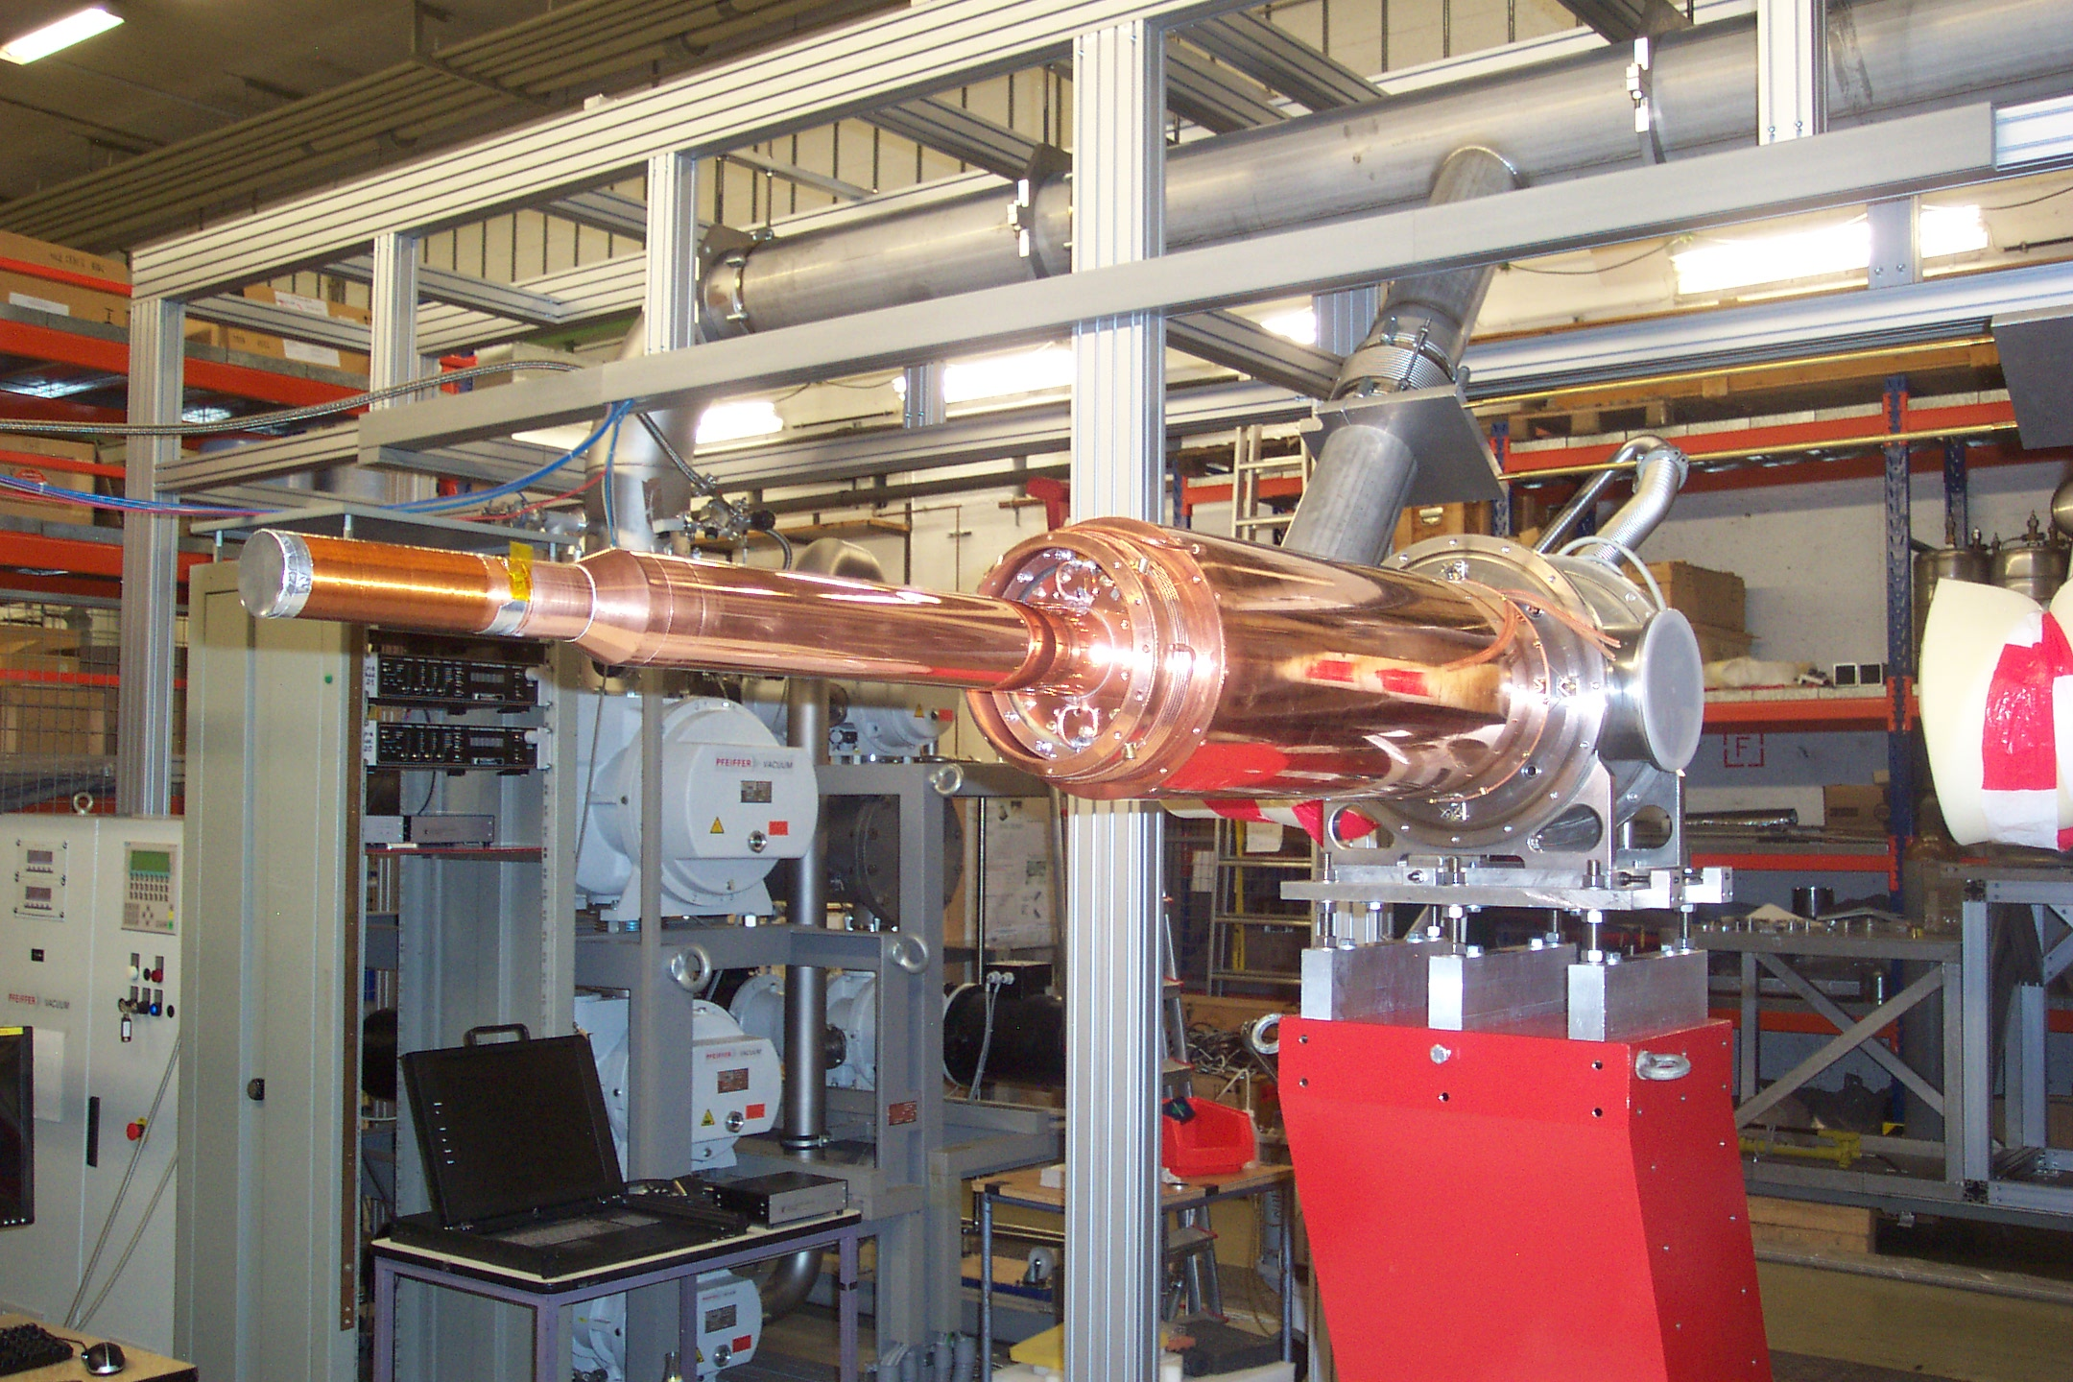
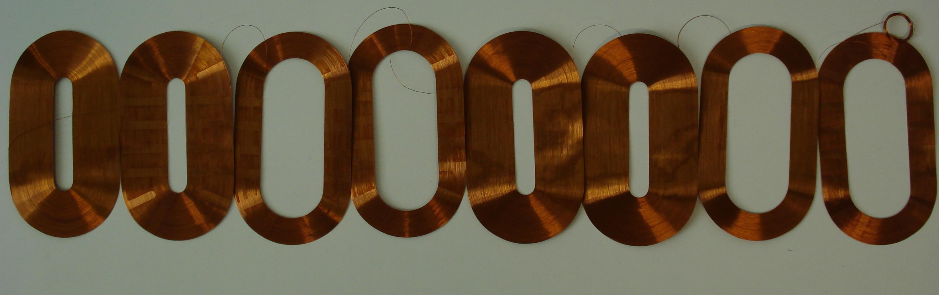
Institut
für Kernphysik
Double Polarized Measurements with Frozen Spin Target at MAMI
1.-Introduction: The Mainz Microtron MAMI
2.-Experimental setup beam +detector: Tagger + Crystal Ball@MAMI
3.- Experimental setup target: The Frozen Spin Target
3.-Double Polarized Experiments : Precision measurements of the Nucleons Excitations, GDH sumrule Determination of Fundamental Properties
PSTP 2013
Charlottesville, September 9th 2013
Andreas Thomas

Slide 2
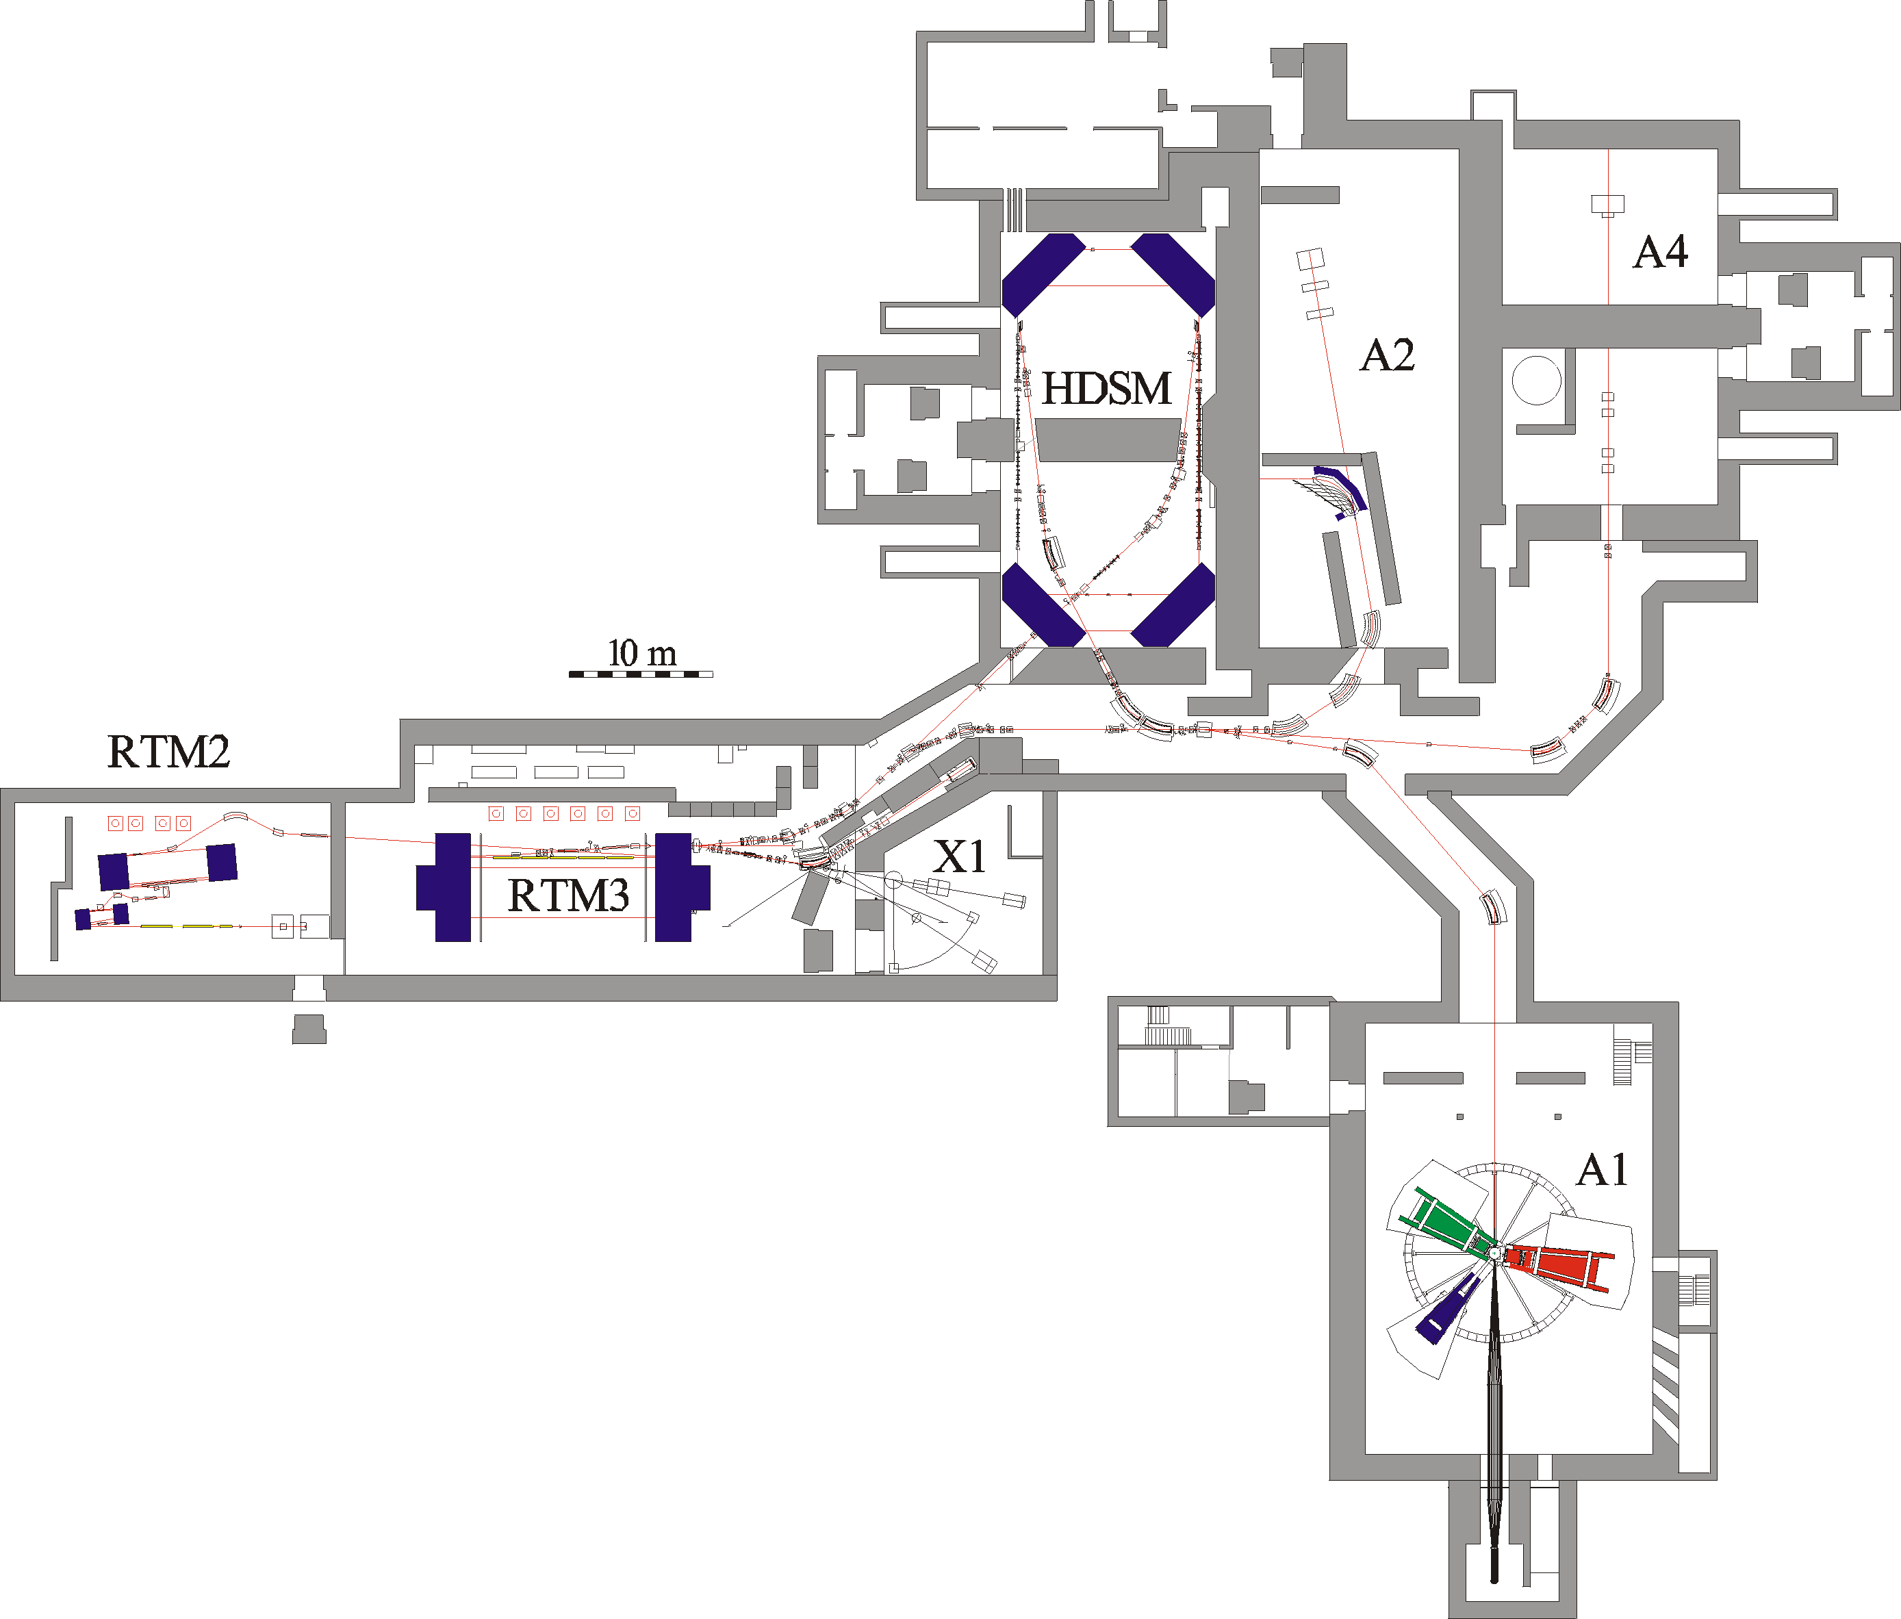
Parameter
1604MeV, σ_{E}=0.100MeV
max. 40μA polarised
ε_{h}=9 nm rad, ε_{v}=0.5 nm rad
~6500h/year as MAMI B !

Slide 4
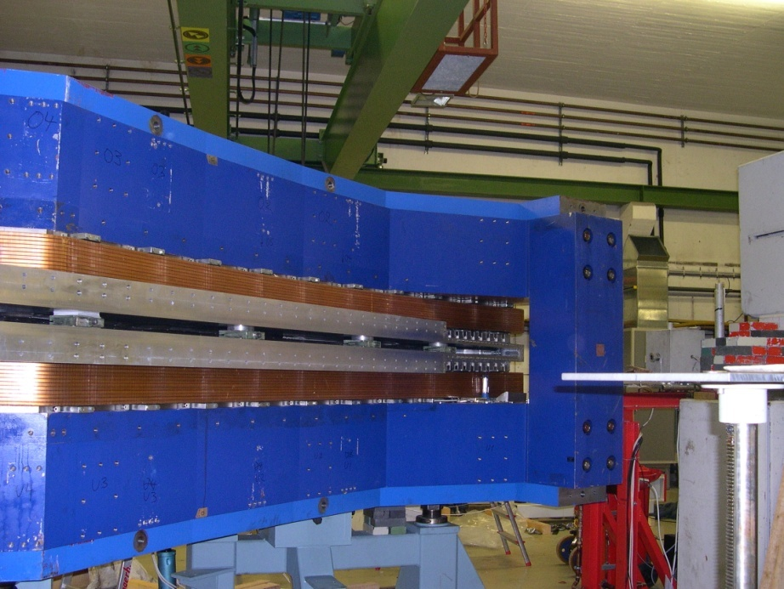
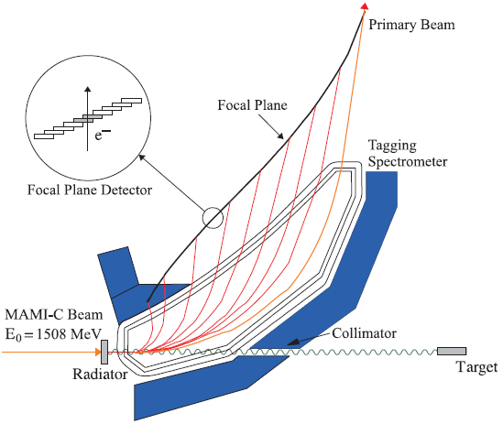
A2 Tagging system (Glasgow, Mainz)
1.
Production and energy measurement of the Bremsstrahlung photons.
Glasgow Tagging Spectrometer
EPJ A 37, 129 (2008)
2.
Determination of the degree of polarization of
the electron beam (Moeller Polarimeter).
Circularly pol. photons.
3.
Coherent production of linearly polarized
photons on a diamond radiator

Slide 5
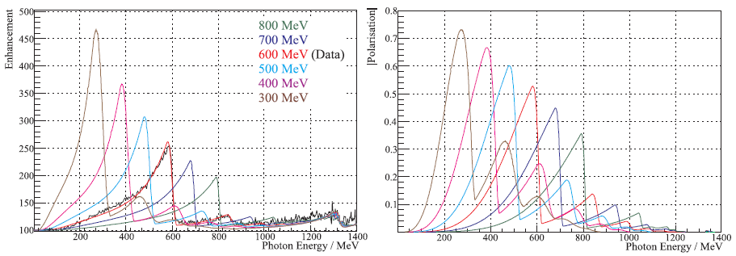
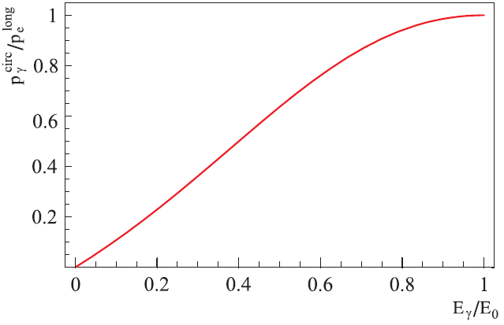
Polarised Photons @ MAMI C
Linear
Polarisation
E_{γ} = 75 ... 1480 MeV
ΔE_{γ} = 4 MeV
N_{γ} = 2 . 10⁵ s⁻¹ MeV⁻¹
Circular
Polarisation
Transfer
High Polarisation
High Photon Flux

Slide 6
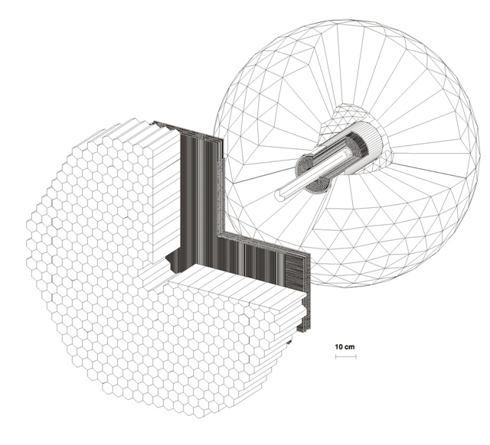
4π photon Spectrometer @ MAMI
TAPS:
366 BaF₂ detectors
72 PbWO₄ detectors
Max. kin. energy:
π⁺⁻ : 180 MeV
K⁺⁻ : 280 MeV
P : 360 MeV
Crystal Ball:
672 NaJ detectors
Max. kin. energy:
μ⁺⁻ : 233MeV
π⁺⁻ : 240 MeV
K⁺⁻ : 341 MeV
P : 425 MeV
Vertex detector:
2 Cylindr. MWPCs
480 wires, 320stripes
PID detector:
24 thin plastic detectors
γp ◊ S11 ◊ pη
π⁰π⁰π⁰
γγγγγγ

Slide 7
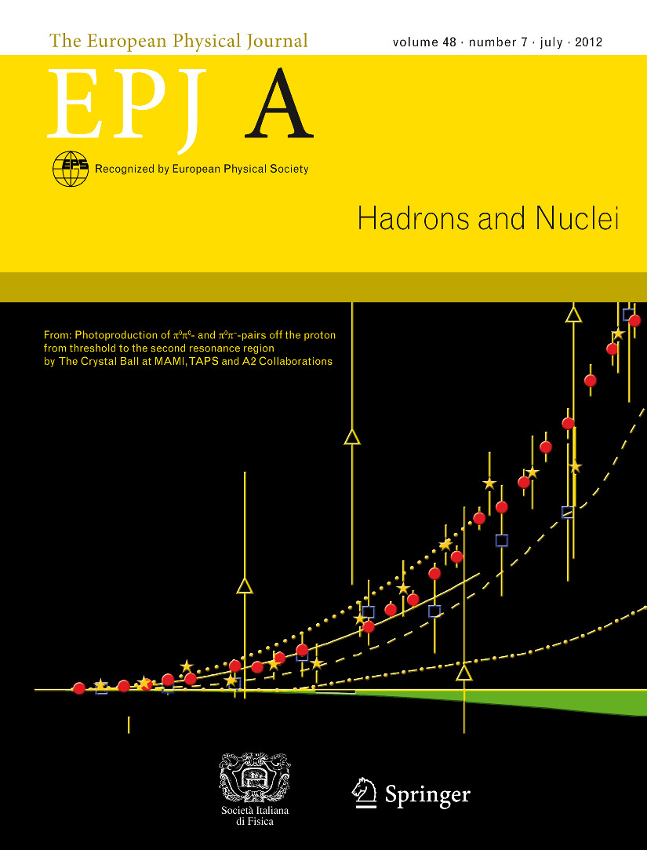
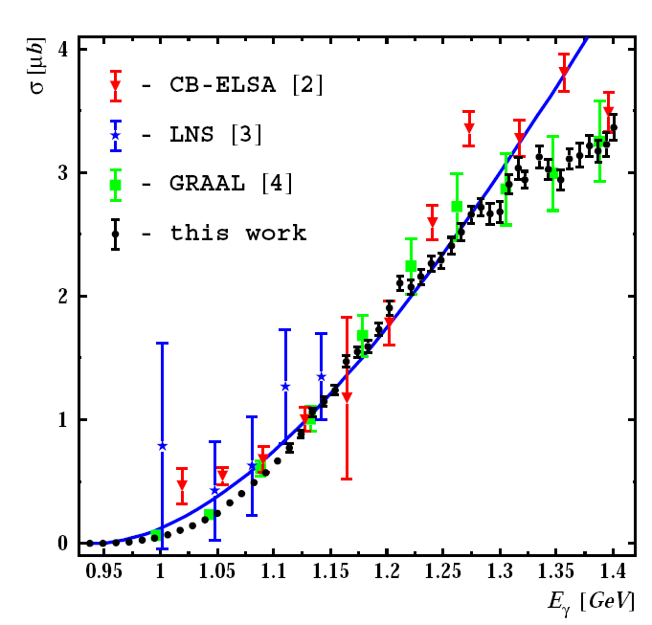
Photoproduction of π⁰π⁰ and π⁰π⁺ pairs off the proton from threshold to the second resonance region
EPJ A vol. 48, issue 7
(DOI 10.1140/epja/i2012-12098-1)
Multiple Meson Photoproduction
γp ◊ pπ⁰η
Data:
V.Kashevarov et al.
EPJ. A 72,141,(2009)
A.Fix, Ostrick, Tiator
EPJ. A36, 61-72, (2008)
Significant dip in forward cross section near W= 1660 MeV
No evidence for any narrow structure
E. F. McNicoll et al., in preparation
Significant dip in forward cross section near W= 1660 MeV
No evidence for any narrow structure
E. F. McNicoll et al., in preparation

Slide 8
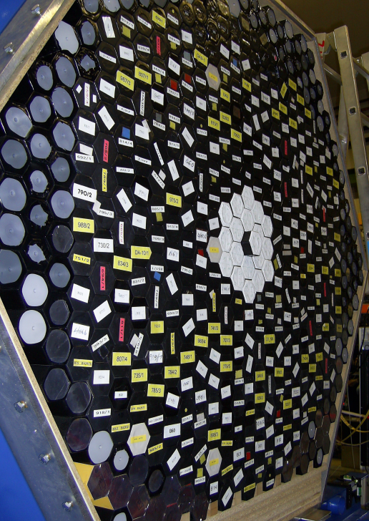
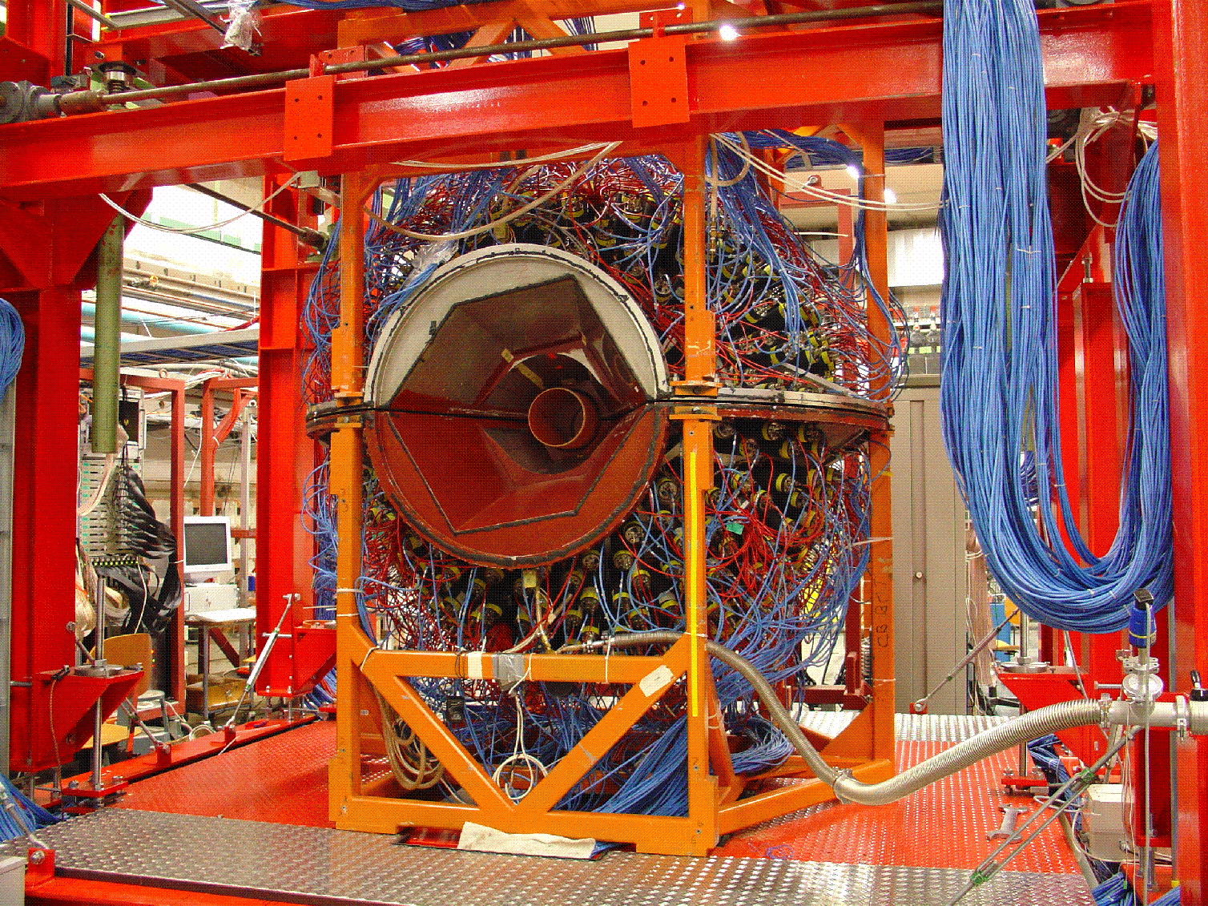
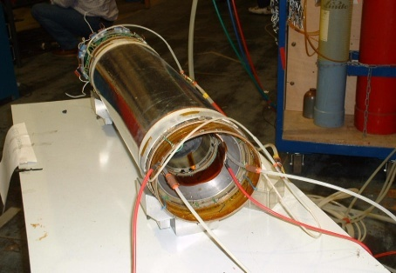
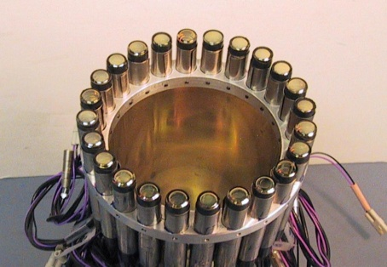
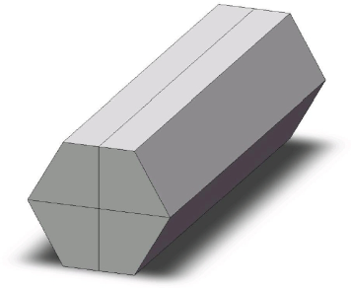
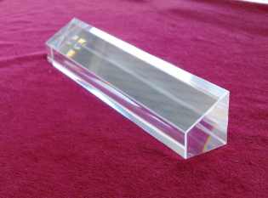
TAPS (Giessen,Basel,Mz):
366 BaF₂ crystals
72 PbWo inner det.
(1-20º )‏
Individual charged
particle vetos
Crystal Ball (UCLA):
672 NaI scintillators
(20-160º)‏
PID and tracking:
Barrel of 24 plastic
scintillators (Edinburgh)‏
MWPC (Pavia)‏
Carbon analyser for
nucleon recoil polarimetry

Slide 9
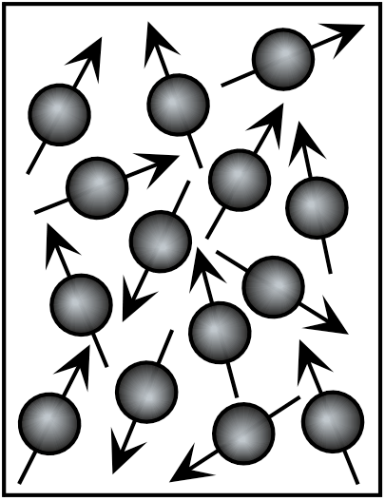
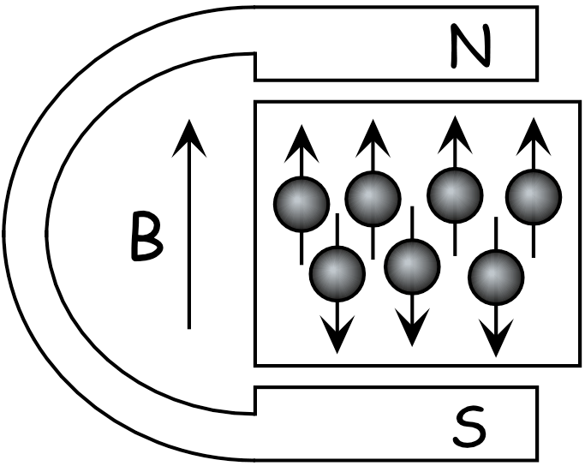
Polarised Solid Target
Polarisation = Orientation of Spins in a magnetic field
Ideally: All spins in field direction
P=100%
Complicated interplay between
Polarising force ~ magnetic field B
and
Depolarising force ~ thermal motion of spin particles
(temperature T – relaxation)

Slide 10
Magnetic moment in magnetic field:
ΔE
B=0T
B=2.5T
B=0T
B=2.5T
electron
proton
Thermal equilibrium
Boltzmann distribution
B [Tesla] | T [mK] | e⁻ [%] | p [%] | d [%]
2,5 | 100 | 99,8 | 0,51 | 0,10
 | 1000 | 93,3 | 0,25 | 0,05
5,0 | 100 | 100,0 | 5,09 | 1,05
 | 1000 | 99,8 | 1,28 | 0,11
Trick: Transfer of the high electron polarization to the nucleon via
μ-wave irradiation (DNP)

Slide 11
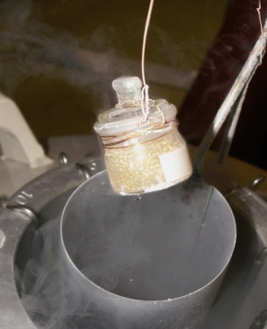
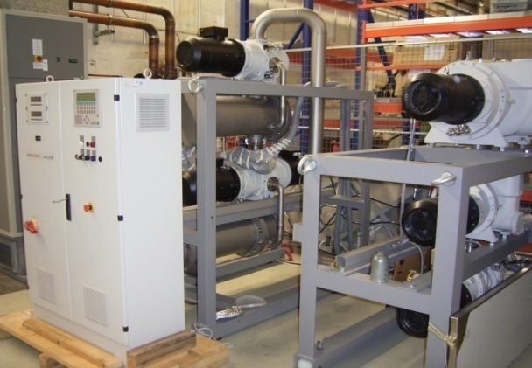
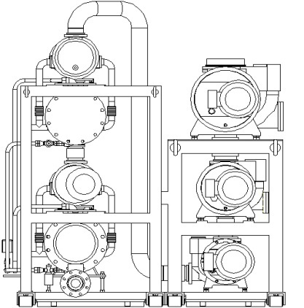
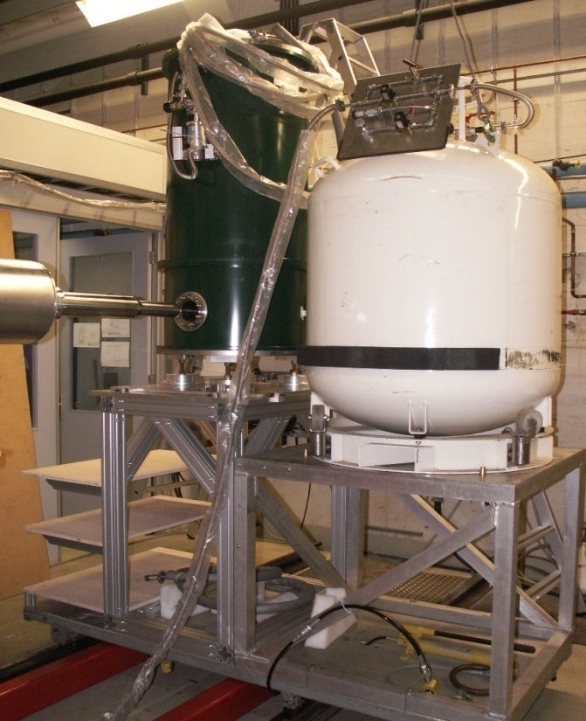
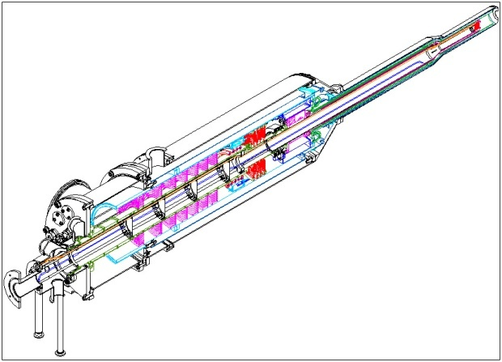
He³/He⁴ Roots
4000m³/h
Vacuum system
Components of the polarized target
for the Crystal Ball detector
Similar to Bonn Target
[C.Bradtke et al., NIM A436, 430 (1999)]
Targetmaterial
H-Butanol
D-Butanol
Mikrowaves
70GHz
Dynamic
Nuclear
Polarization
Horizontal He³/He⁴ Dilutionrefrigerator
(25mKelvin)
with internal
Holding coil
NMR-Apparatus
106MHz
Polarisation meas.
Superconducting
Polarization magnet
5Tesla

Slide 12

Polarized Target for Crystal Ball
Tagged CW photon beam
4π- detector
Frozen spin target (25 mKelvin achieved).
P_{proton} ~ 85%
P_{deuteron}~75%
All directions of polarization.
τ~1000 ….2000 hours
New ³He⁴He-Dilution refrigerator
(in collaboration with JINR Dubna
started 2003)

Slide 13
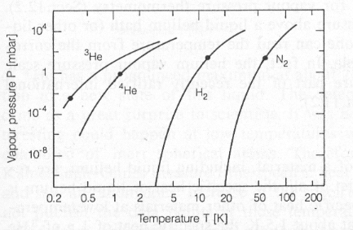
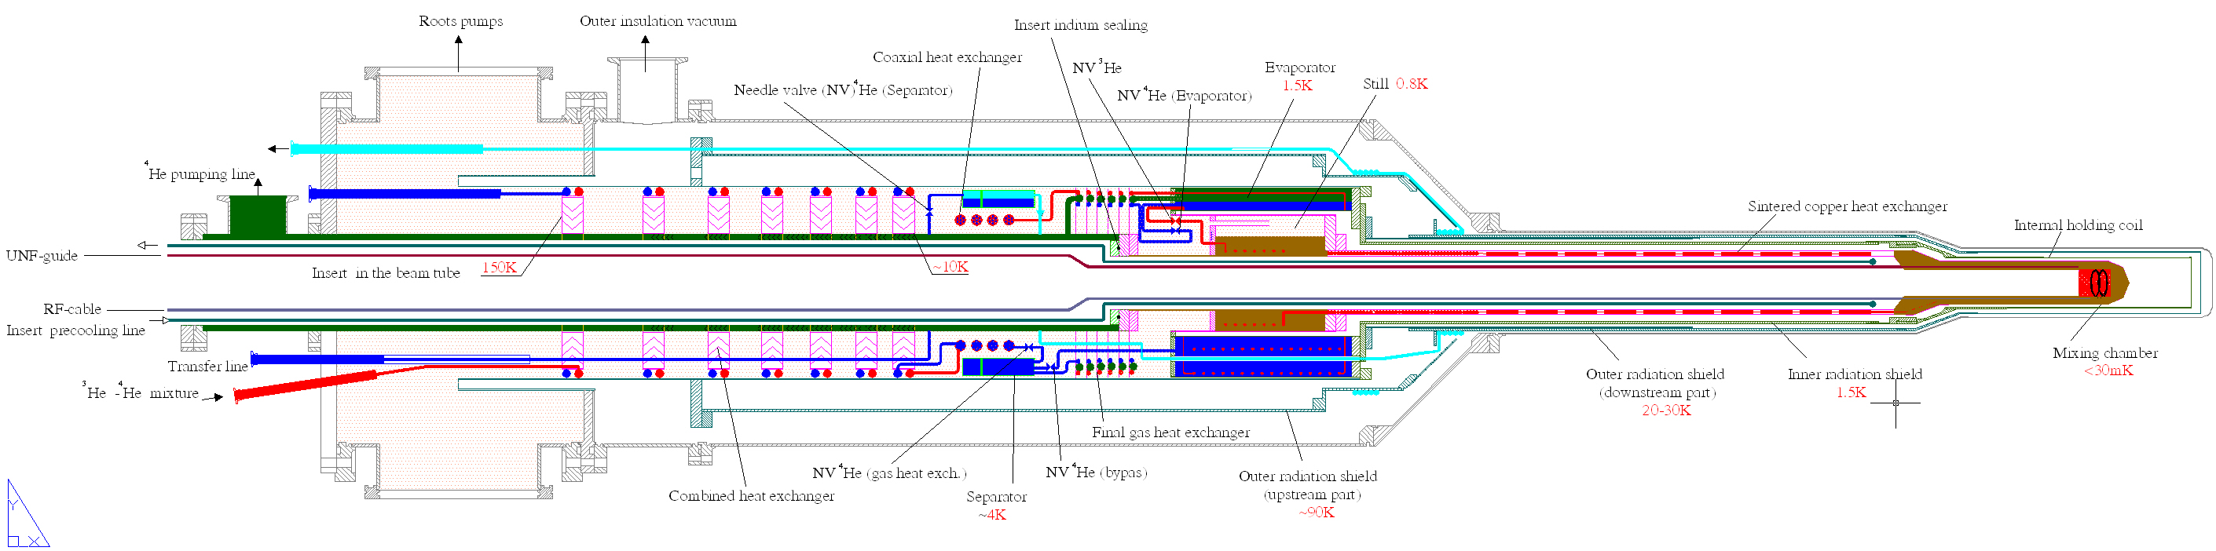
2 Precooling stages:
Evaporator
(1.5Kelvin)
Separator
(4.2Kelvin pot)
Cryogenics
Evaporation cooling
³He⁴He-Dilution refrigerator
Dilution circuit
(0.03Kelvin)

Slide 14
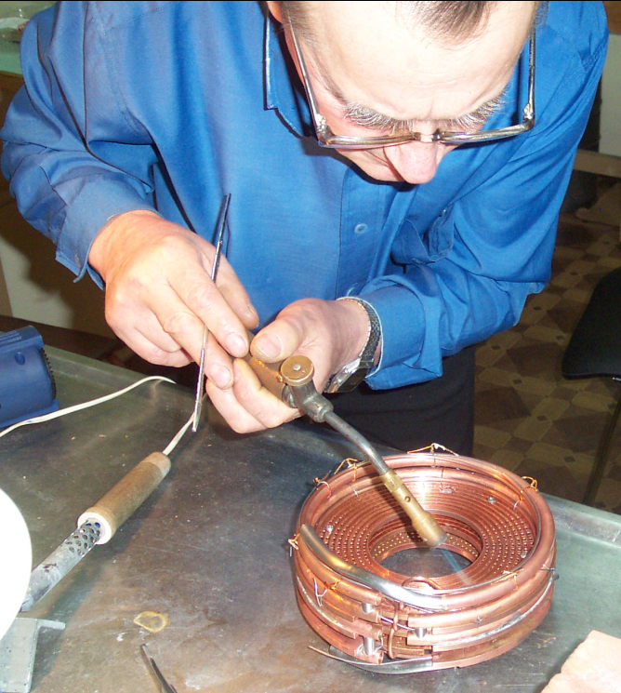
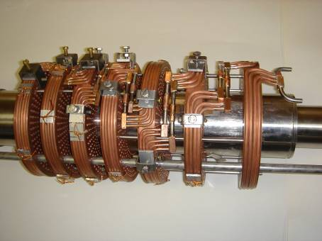
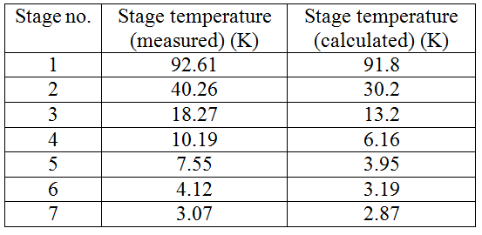
High-temperature heat exchanger
of the ³He pre-cooling stage
3K
300K

Slide 15
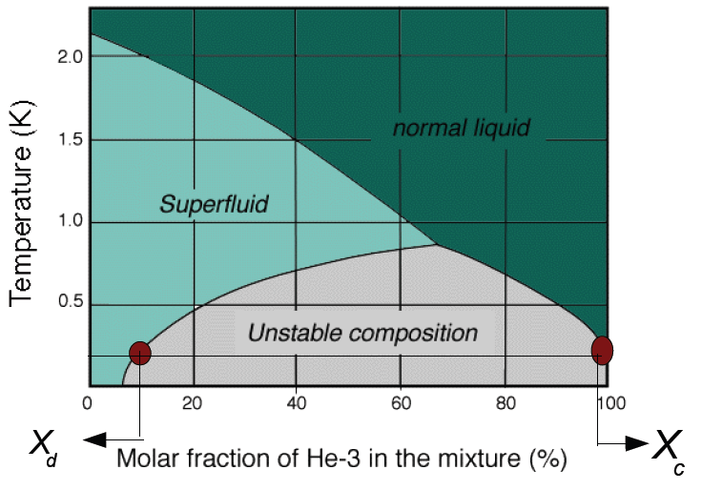
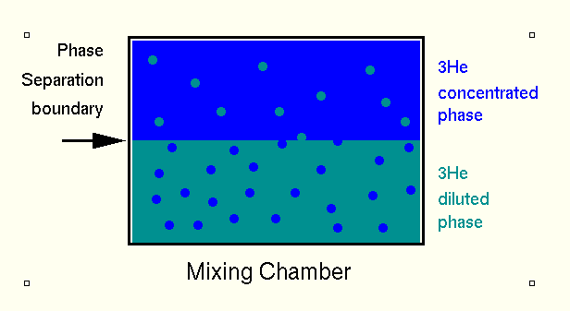
³He-⁴He-Dilution Cooling
³Helium: Spin ½, Fermion
⁴Helium: Spin 0, Boson
Cooling a 25%- gas-mixture
from 300K to 0.6K
Separation of both phases
Further cooling using
„dilution effect“

Slide 16
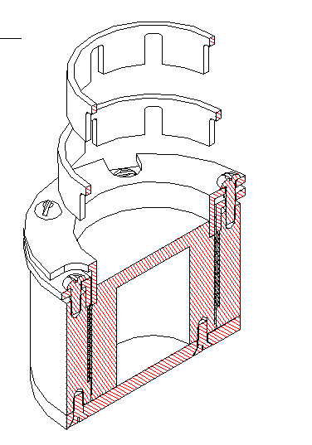
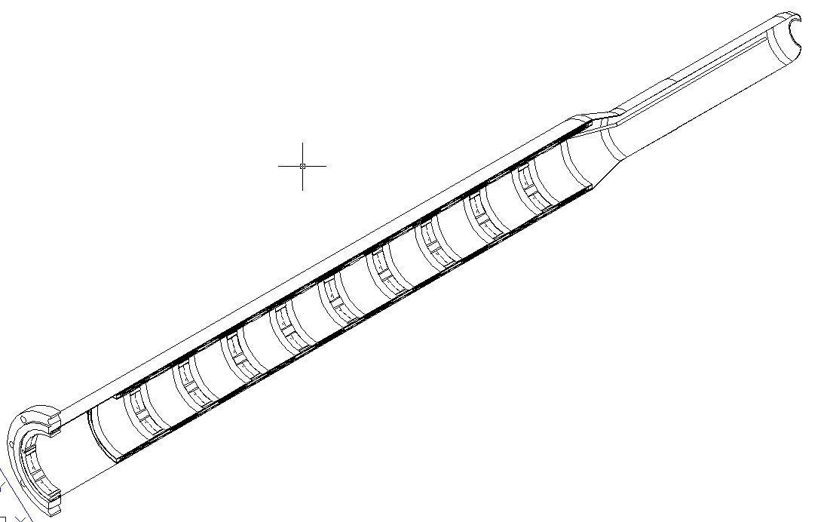
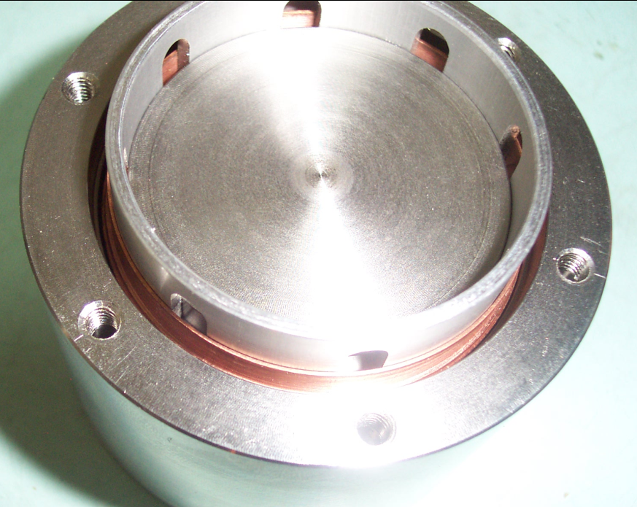
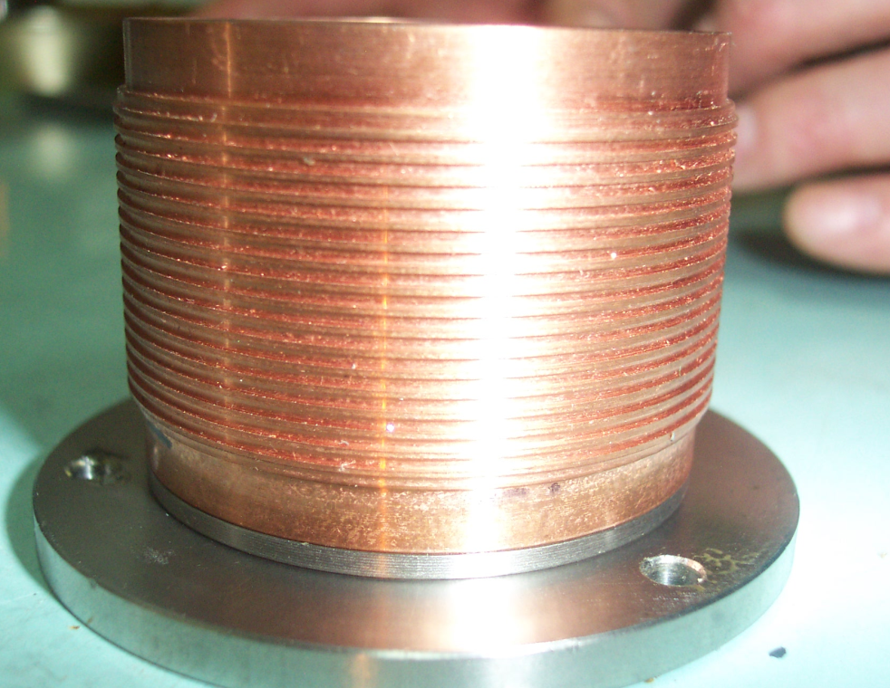
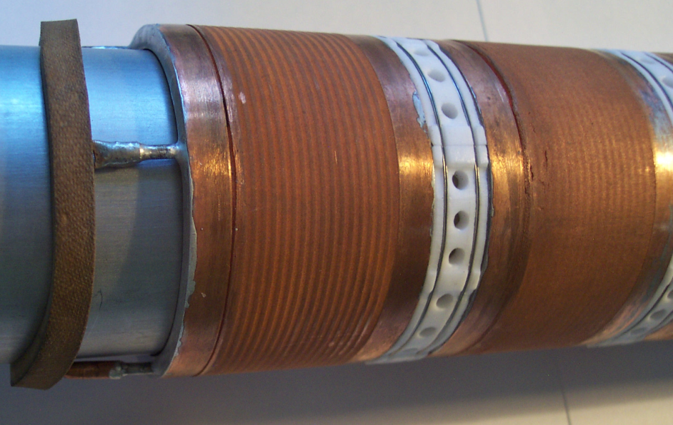
Low-temperature
sintered heat exchanger
0.7K
0.025K

Slide 17
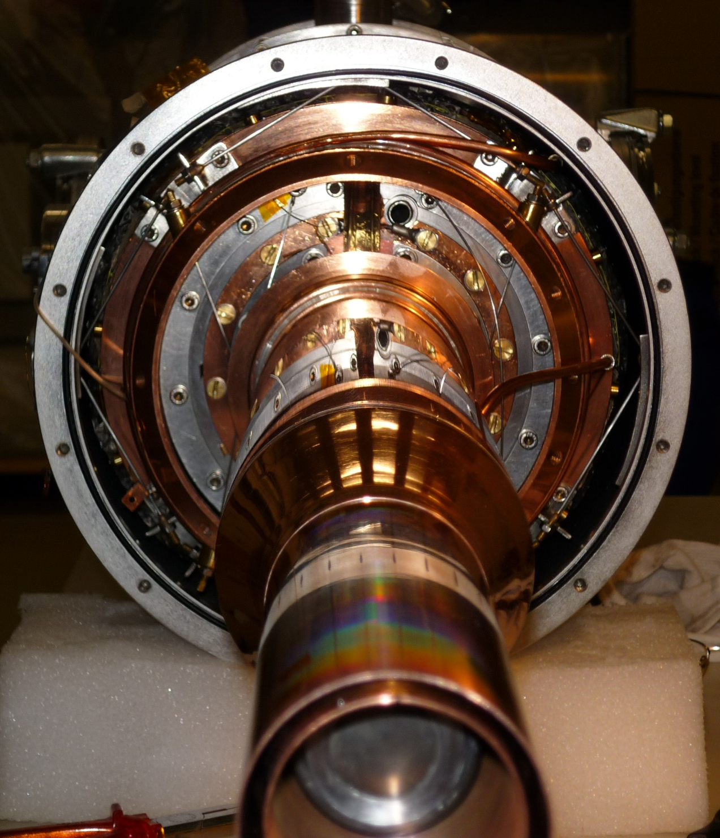
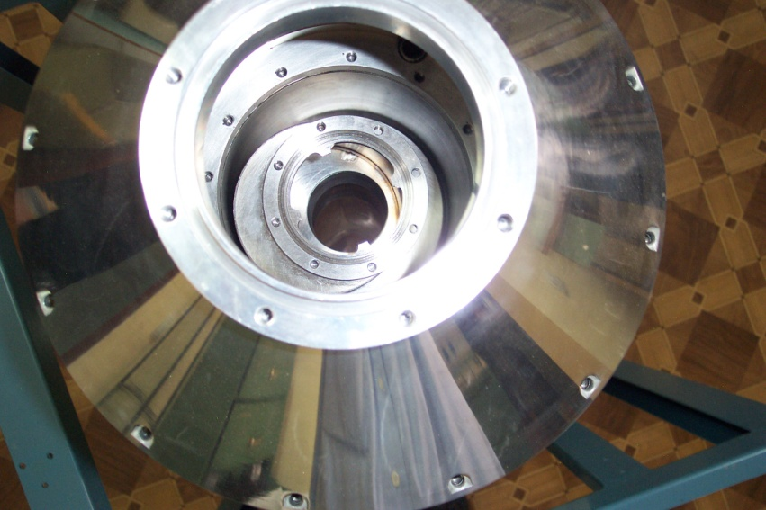
Impressions from
the technical realisation
Alignment thermal radiation shields
Alignment still and evaporator

Slide 18
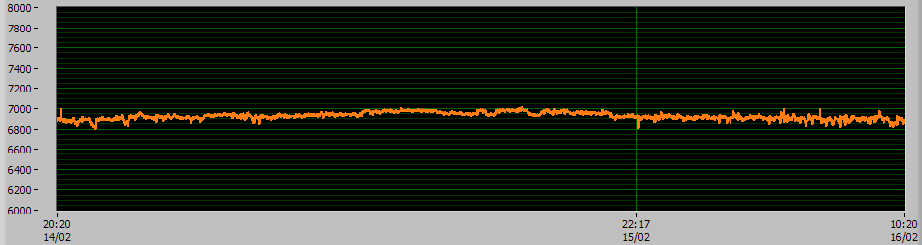
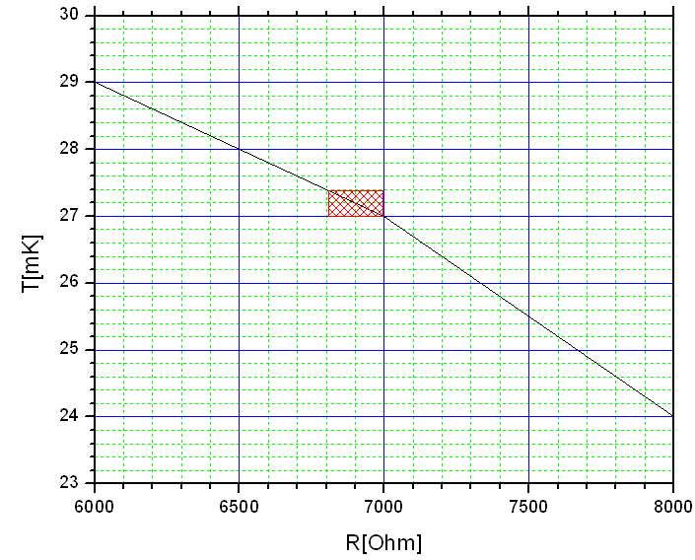
Cryostat Performance
T=24mK
T=27mK
T=29mK
Δt=40h
Temperature stability:
ΔT ~ +- 0.2mKelvin (one day)
(typical one week measurement period).

Slide 19
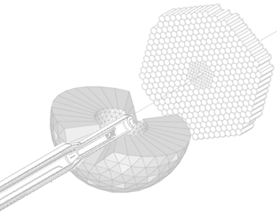
Mainz/Dubna Dilution refrigerator
Mixing chamber(25mK)
Still (0.7K)
Evaporator (1.5Kelvin)
Separator (4.2Kelvin)
Transverse
And
Longitudinal
Internal
Holding coil
1.2 Kelvin
1Tesla at 46A
achieved

Slide 20
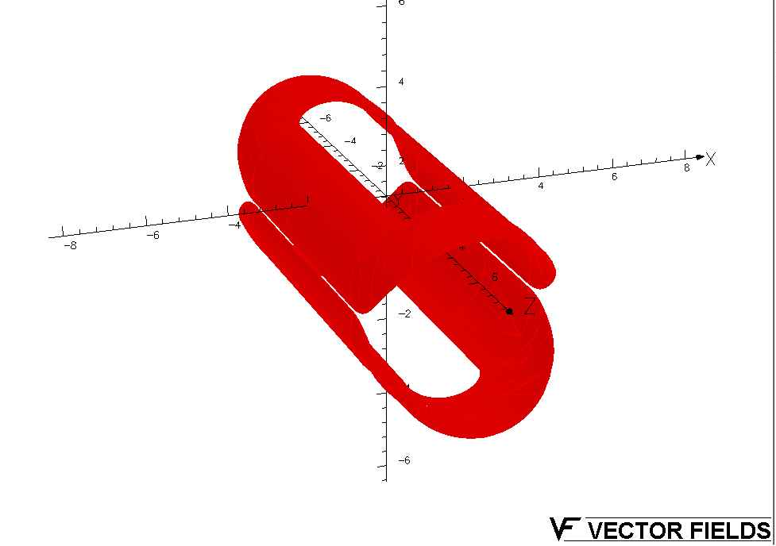
Internal transverse holding coil
Calculations done
with
Opera 3D
Diploma 2009.
Different layers are
used to
optimize the
homogeniety.

Slide 21
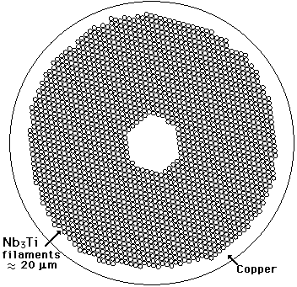
Copper/scandium wire with 54 Nb-Ti filaments embedded in it.
Cu:Sc=1.35:1
Alloy composition: Nb47wt.%Ti
Diameter=0.222mm
It achieves currents up to 50A at 4.2K and 1T.

Slide 22
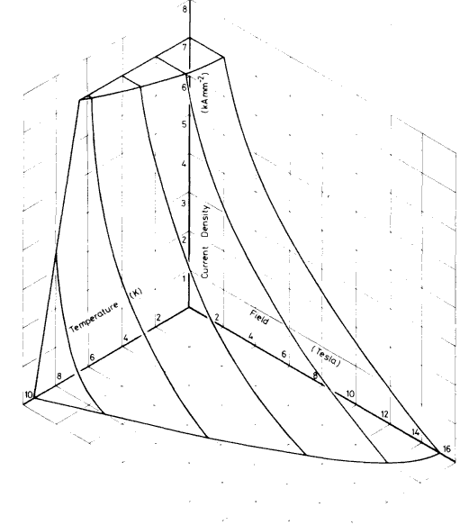

Holding Coil
j_{crit}
Coil has to be as thin as
possible to allow low
energetic particles
to punch through.
Subcooled Superconductor
F54-1.35(0.20)TV
@4.2Kelvin
@1.3Kelvin
T
B

Slide 23
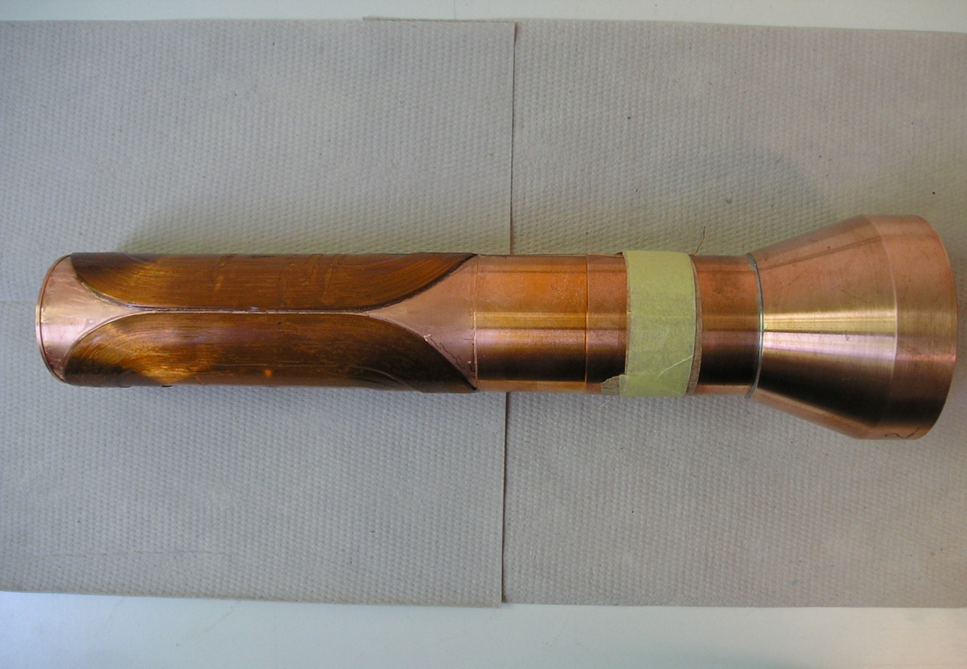
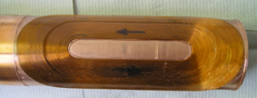
4-layer dipole:
N1=N2=138
N3=N4=78
150mm

Slide 24
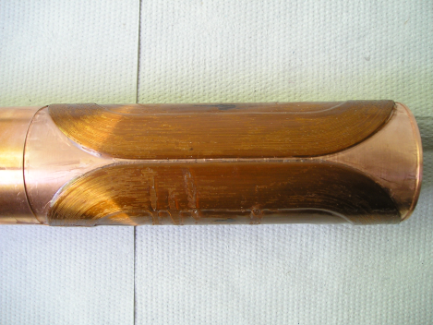
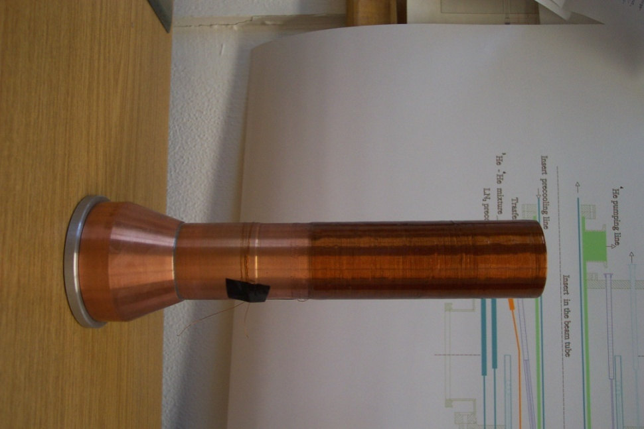
Transverse (Saddle coil)
and
Longitudinal (Solenoid)
Internal
Holding Field (1.2K, 0.6T)
DNP at 200mK and 2.5T with 70GHz microwaves.
Frozen spin target (25mKelvin, 0.6T).
Secondary particles punch through holding coil.
All directions of polarization.

Slide 25
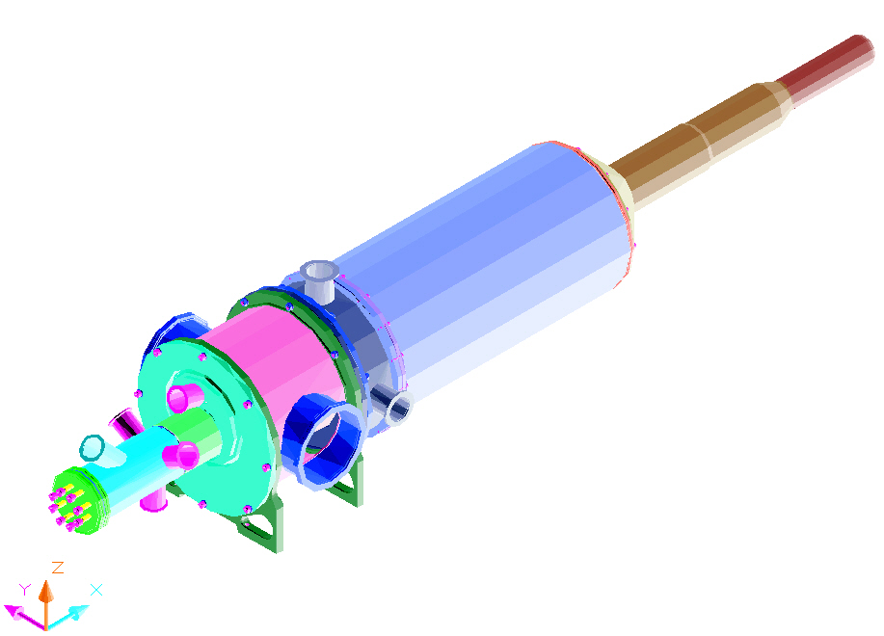
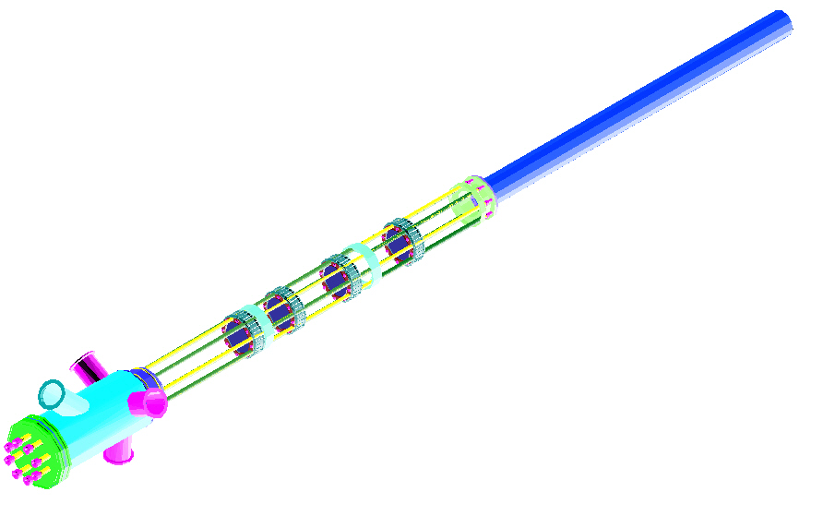
Loading of the target material

Slide 26
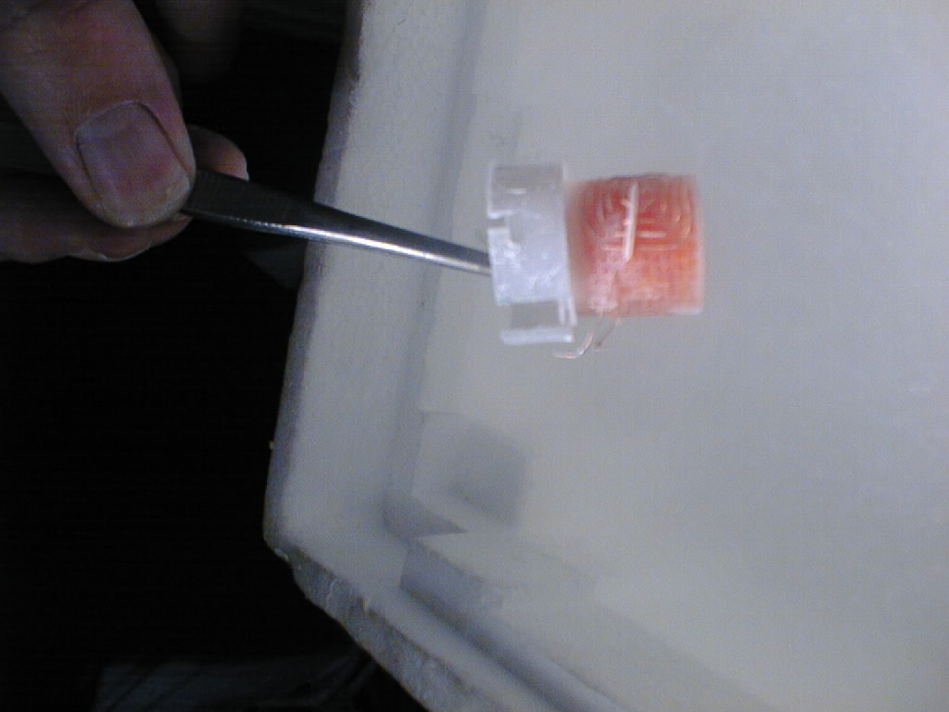

Target material
Butanol
2cm

Slide 27


Slide 28


Slide 29


Slide 30
Frozen Spin Target Waltz
Crystal Ball
Cryostat
Microwaves
Microwaves
Polarizing
magnet
Polarizing
magnet
External magnet 2.5 T
Polarize with microwaves
Internal holding coil 0.7 T
Remove external magnet
Move CB detector in.
Data taking.
Repolarization

Slide 31



Perspectives: Internal Polarising Coil
Problem is the required field homogeniety
of 10-E4. Notched solenoid.
3d finite element calculation, optimisation
and precise production needed.
DNP at 200mK and 2.5T
with 70GHz microwaves.
10Layer coil at 50A.
Secondary particles punch
through holding coil.
Higher momentum threshold.

Slide 32




Perspectives: Internal Polarising Coil
Helium Dewar adapter
Hall probe holder
4-layer coil fixed on the adapter
Test at 4.2K

Slide 33

Polarisation and Temperature measurement
AVS Picowatt Resistance Bridge

Slide 34


Proton NMR Signal
Deuteron NMR Signal
P₊ = +83,6%
P₋ = -81,5%
P₊ = +75,9%
P₋ = -75,2%

Slide 35



Target material D-Butanol
Density and species of the radicals
are very important for:
maximum degree of polarization
polarization build up times
relaxation times
Trityl-Radikal
Highest Deuteron polarisation due to new doping material with narrow ESR from Bochum.
[W.Meyer et al.]

Slide 36
Double Polarised Experiments
Excitation Spectrum
1.- Longitudinal PT: a) Helicity Dependence E of Meson Photoproduction b) Measurement of the G in single pion production
2.- Transverse PT: a) Transverse asymmetries T and F in η−photoproduction in the S₁₁(1535) region
b) Spin observables in πη photoproduction in the D₃₃(1700) region
Fundamental Properties
1.- Long. and trans. PT: Spin Polarisabilities
2.- Transverse PT: Transverse asymmetries T and F in π−photoproduction in the threshold region → m_{u} - m_{d}

Slide 37





Introduction: Excitation Spectrum of the Nucleon
Quark Model (Simple Constituent quark picture)
Classification of Baryons
qqq; only uds
Oktett
Dekuplett

Slide 38


What is the nature of the Nucleon Resonances?
-Excitation inner deg. of freedom
-Molecule
-Quark – Diquark Structure
-Dynamical Generation
- …….?
Unpolarised total photoabsorption cross section
Phys. Rev. Lett. 87, 022003 (2001)
Phys. Rev. Lett. 84, 5950 (2000)
Nucl. Phys. A642, 561 (1998)
Phys. Rev. C 53, 430 (1996); SP01
Nucl. Phys. A645, 145 (1999)
Lifetime

Slide 39


Nature and Properties of nucleon resonances
Polarisation observables used to disentangle broad, overlapping resonances.
Beam
γ
P
lin
P
lin
P
circ
unpol
γ
γ
γ
⎛
π
⎞
⎛
+
π
−
π
⎞
Target
⎜
0
,
⎟
⎜
,
⎟
⎝
2
⎠
⎝
4
4
⎠
⎛
d
σ
⎞
Σ
P
unpol
⎜
⎟
-
-
⎝
d
Ω
⎠
Beam
P
x
-
-
H
F
Target
P
T
P
-
-
y
P
z
-
-
G
E

Slide 40

Helicity Dependence E of Meson Photoproduction on the Proton and Neutron
Experimental test of the GDH
Sumrule
1998
-
2003
Bonn + Mainz
Gerasimov-Drell-Hearn sum rule (GDH)
[S.B.Gerasimov: Sov.J.Nucl.Phys.2(1966)430]
[S.D.Drell, A.C.Hearn: Phys.Rev.Lett.16(1966)908]

Slide 41

F in π−photoproduction
PWA in
Progress:
blue line: MAID-2007
green line: SAID
black line: BG2010-02l
preliminary
γp ◊ pπ⁰
Red Circles – new MAMI Measurement.
Analysis by V. Kashevarov ; independent analysis by P. Hall Barrientos (Edinburgh), S. Schumann (MIT).

Slide 42

T in π−photoproduction
blue line: MAID-2007
green line: SAID
black line: BG2010-02l
preliminary
Red Circles – new MAMI Measurement, black circles Bonn 77 and 98, green circles Tokyo 78.
Analysis by V. Kashevarov ; independent analysis by P. Hall Barrientos (Edinburgh), S. Schumann (MIT).

Slide 43

Pion Production
Eta Production
polarisation observables and different channels essential

Slide 44

F in η−photoproduction
γp ◊ pη
preliminary
black line: η- MAID-2003
blue line: η- MAID-Regge
red line: BG2010-02l
Red Circles – new MAMI Measurement.
Analysis by V. Kashevarov ; independent analysis by P. Hall Barrientos (Edinburgh), S. Schumann (MIT).

Slide 45

T in η−photoproduction
γp ◊ pη
preliminary
black line: η- MAID-2003
blue line: η- MAID-Regge
green line: SAID
red line: BG2010-02l
Red Circles – new MAMI Measurement, black circles Bonn 77 and 98.
Analysis by V. Kashevarov ; independent analysis by P. Hall Barrientos (Edinburgh), S. Schumann (MIT).

Slide 46

Spin observables with focus to P₁₁(1440), S₁₁(1535), and D₃₃(1700) resonance regions.
Löhrig, Metsch, Petry, Eur.Phys.J. A10 (2001) 395-446
The light baryon spectrum in a relativistic quark model

Slide 47



Asymmetries T and F in γp → pπ⁰ at threshold
Study of the dynamic consequences of m_{d} − m_{u} > 0.
m_{π0} =135 MeV
m_{π}+=139.6 MeV
Rescattering diagram responsible for the
unitary cusp observed in E0+(γp → pπ⁰ )
γp → pπ⁰
Θ_{π}=70−140
300hours
simulation
Precission experiment to test the unitary calculations
[Bernstein et al. arXiv:0902.3412 [nucl-th] (Feb. 2009)
and ChPT calculations
[V.Bernard, N.Kaiser, and U.G.Meissner,
Eur. Phys. J. A11, 209 (2001)] of ImE0+.

Slide 48



Dilution Factor and Low Energetic Protons
30mm
C₄H₁₀O – 60%
Vacuum
3He/4He – 6%

Slide 49




Data taken in September 2010 & February 2011
Analysis: S. Schumann (MIT)
E_{γ}=320MeV
Butanol
Carbon
Hydrogen

Slide 50

Perspectives: Active Polarised Target
Vacuum
3He/4He – 6%
[B.van den Brand et al., PSI,
NIM A 446 (2000) 592]

Slide 51



2 Meter

Slide 52



Light Readout: Active Polarised Target
Material
&
Detector challenge !!!
Miskimen (UMass Amherst), Downie (GWU),
Biroth, Thomas (Mainz),
Borisov , Neganov, Usov (JINR).

Slide 53
Polarisabilities
Polarisabilities are fundamental structure constants of the nucleon
Scalar polarisabilities (α, β) describe spin response to static EM field
Scalar polarisabilities measured in real Compton Scattering for the proton [M.Schumacher, Prog.Part. and Nucl.Phys.55, 567 (2005).] :
Real compton scattering with polarized beam and polarized target
α,β,γ₁,γ₂,γ₃,γ₄
Dispersion relation, χPT, lattice QCD..?

Slide 54
Proton electric polarizability
− − − − − − − − − − − − −
π+
π+
π+
Pion
cloud
π+
π+
π+
π+
π+
+ + + + + + + + + + + + +
Electric polarizability: proton between charged parallel plates
[Courtesy of Rory Miskimen]

Slide 55
Proton magnetic polarizability
S S S S S S S S S S S S S
π+
π+
Diamagnetic + Paramagnetic
pion cloud
u
u
π+
d
π+
Paramagnetic
Δ(1232)
N N N N N N N N N N
Magnetic polarizability: proton between poles of a magnetic

Slide 56
Spin Polarizabilities
Spin Vector polarizabilities describe spin response to an incident photon
Four vector pol. (γ_{E1E1} γ_{M1M1} γ_{E1M2} γ_{M1E2}) appear at 3rd order in eff. Hamiltonian
Only two linear combinations of vector polarizabilities measured:
The Forward S.P. γ₀ was determined in GDH-Experiment at ELSA and MAMI (DAPHNE) :
The Backward S.P. γ_{π} was determined from dispersive analysis of backward angle Compton scattering. [B. Pasquini et al., Proton Spin Polarizabilities from Polarized Compton Scattering (2007).]

Slide 57
Conclusions
After more than 40 years polarised solid targets are still an important tool
for Spin physics.
A new Frozen Spin Target produced in collaboration with JINR Dubna allows
high polarisation for p (85%) and d (75%) with Relaxationtimes>1500hours.
Data taking with Cball+TAPS detector system started 2010 at MAMI C.
All directions of polarization possible. First round transverse. Now longitudinal.
Spin observables with focus to P₁₁(1440), S₁₁(1535), and D₃₃(1700) resonance regions. Complete Experiment.
Outlook
New experimental ideas require the developement of new techniques.
Measurement of 4 Vector Spin Polarisabilities in Compton process.
Measurement of T and F in π-threshold region.
R&D for polarised active szintillator target for threshold production.
R&D for an internal polarising coil avoids FST waltz. FoM better.Longitudinal polarisation

Slide 58



Thank you for your attention!
The target team:
+
A2-Collaboration

Slide 59

Theory: Nucleon Vector Spin Polarisibilities
G. Gellas, T. Hemmert, and Ulf-G. Meißner, Phys. Rev. Lett. 85, 14 (2000).
K.B. Vijaya Kumar, J.A. McGovern, M.C. Birse, Phys. Lett. B 479, 167 (2000).
D. Djukanovic, Ph.D. Thesis, University of Mainz, 2008.
R.P. Hildebrant et al., Eur. Phys. J. A 20, 293 (2004).
D. Babusci et al., Phys. Rev. C 58, 1013 (1998).
B. Holstein, D. Drechsel, B. Pasquini, and M. Vanderhaeghen, Phys. Rev. C 61, 034316 (2000).
S. Kondratyuk and O. Scholten, Phys. Rev. C 64, 024005 (2001).
B. Pasquini, D. Drechsel, and M. Vanderhaeghen, Phys. Rev. C 76, 015203 (2007).
J. Ahrens et al., Phys. Rev. Lett. 87, 022003 (2001).
M. Schumacher, Prog. Part. Nucl. Phys. 55, 567 (2005).

Slide 60

η−photoproduction on nuclei
Analysis for d-Butanol not done yet.
Data for h-Butanol published soon.

Slide 61


γp ◊ pη
New high precission unpolarised data published in
E. F. McNicoll et al., Phys.Rev.C82:035208,2010.
Significant dip in forward cross section
near 1680MeV.
No evidence for any narrow structure.

Slide 62


Target material
Saturated electrons of target material not polarized (Pauli principle)
Free electrons
Radicals in material by
chemical or
radiative doping
30mm
Butanol
Ammonia
LiD
N
Dilution factor (e.g. f_{Butanol}=10/74)
determines quality of target material
CH₃
CH₃
Tempo
CH₃
N
CH₃
H
H
O
H

Slide 63


Plans for η’(958) Production
New tagging device (End Point Tagger) is under construction.
Covering energy range from η' threshold to 10 MeV below E_{0.}
Crystal Ball at MAMI C ideal for high η' rates: ~25000 η' /hour @1600MeV.
High precision on Γ(η◊2γ)/Γ(η ' → 2γ) gives η−η ' -mixing angle(s) + gluonium content [B. DiMicco (KLOE-collaboration), Eur. Phys. J. A38, 129 (2008).].

Slide 64
A2-09/09: Spin observables in πη photoproduction in the D₃₃(1700) region
(600 hours parallel with A2-08/09 )
γp ◊ pπ⁰η
A.Fix, Ostrick, Tiator
EPJ. A36, 61-72, (2008)
Data:
V.Kashevarov et al.
EPJ. A 72,141,(2009)

Slide 65



Model A. Fix
Δ₃₃(1700)
dominance

Slide 66

γp ◊ pπ⁰η
Dominated by
single D₃₃ resonance
analog S₁₁ in η prod.
and P₃₃ in π prod.
Systematic analysis of contributions from p-wave amplitudes:
- angular distributions
- polarisation observables (E,T,F)

