Slide 1
High Average Brightness Electron Beam Production at Cornell University
9/13/2013
Jared Maxson
(for the Cornell ERL Team)
PSTP 2013

Slide 2
Outline
The Cornell ERL injector prototype
Milestones in commissioning:
World Record average current
Measurement of low emittance
New Gun and Diagnostic Beamline
Redefining the “ultimate gun” (in brightness terms)
New Gun design features
Processing results, ongoing rebuild
Beamline experiments

Slide 3
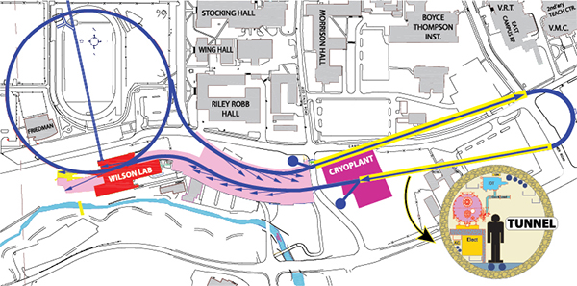
What we want:
CESR
Linac 1
Injector
Linac 2
Sync. Beamlines
Beam parameters: 5GeV, 100mA CW current with energy recovery:
Energy of spent bunch captured entering linac again 180 degrees out of phase.

Slide 4
What we’ve got so far:
Parameter | Value
Frequency | 1.3 GHz
Bunch charge | 77 pC
Average current | 100mA
$$ε_{n,rms}$$ | < 0.5 um
Bunch duration | 2-3 ps RMS
Beam Energy | 4-15 MeV
CESR
Injector

Slide 5
How are we doing?
Parameter | Orig. Requirement | Value
Average Current | 100 mA | 75mA | Close!
Bunch Charge | 77 pC | 77pC | Uses lower d.f, ✔
Energy | 4-15 MeV | 4-14 MeV | Cryo limited, ✔
Laser Power | >20 W | 60 W @ 520 nm | ✔
Gun Voltage | 750 kV (?) | 350 kV | New gun being built
RMS norm. emittance | < 0.5 μm | 0.3 μm in core | ✔
Operational Lifetime | > 1 day | 2.6 days @65 mA | ✔
These are the major milestones I’ll be focusing on.
Many things applicable to polarized sources I can’t cover in the time allotted, please interrupt me with questions if something interests you.
Is a 750kV gun actually required? We don’t think so.
Notes:
Lifetime 2.6 days 1/e at 65 mA

Slide 6
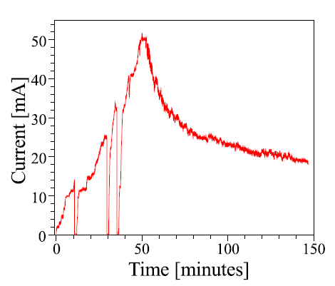
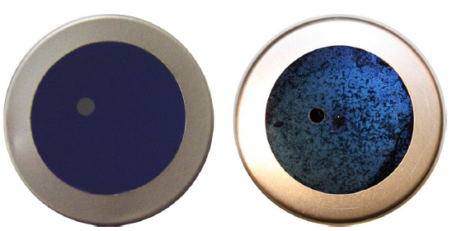
World record photoinjector current!
Dunham et. al. APL 102, 034105 (2013)
Using GaAs: off center active area
Before use
After use
Visible damage due to ion back bombardment at EC.
Overall speckling from heat cleaning.
Each vacuum trip (coupler) corresponds to a damage spot 1 to 1.
Running parameters:
Beam energy: 5 MeV
Beam loss: ~2e-8 (1 nA, based on radiation measurements)
Notes:
Qe was 10% at beginning and QE and peak. 6mm offset. This can be larger than a 10% effect in the emittance.

Slide 7
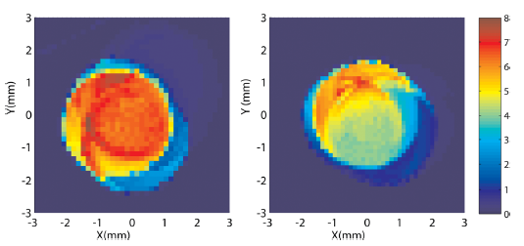
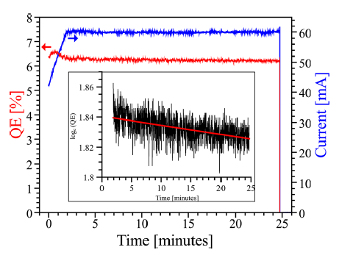
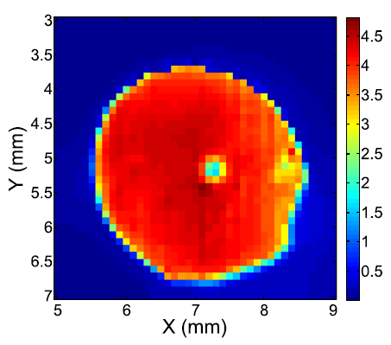
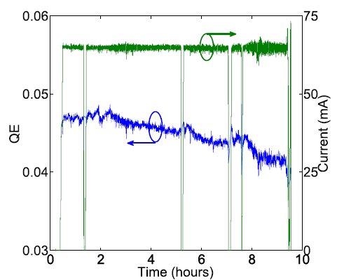
World record photoinjector current!
Dunham et. al. APL 102, 034105 (2013)
Using multialkali off center, a robust bulk emitter:
CsK₂Sb
CsK₂Sb
Before use
After use
60mA run with CsK₂Sb had ~30 h 1/e lifetime
P_{gun}=1.13x10⁻¹¹ torr → 3.0x10⁻¹¹ torr
Likely due to beam scraping
65mA run with NaKSb had ~66 h 1/e lifetime
NaKSb

Slide 8
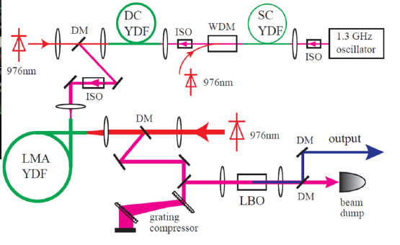
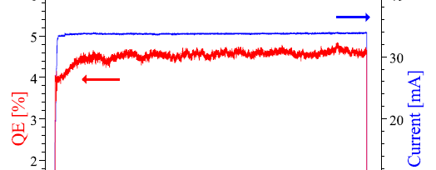
Current Stability
~30 m long
Shaping iris
Transport line
Clipped beam!
Thermal lensing
Beam Clipping from thermal lensing+shaping iris can yield fast beam current fluctuations
Con operate under these conditions successfully, but not ideal.
Solution: use a Pockels cell as a fast feedback shutter to adjust laser intensity to compensate for intensity fluctuation. Hence:
Controlled by feedback
Scaled laser power
4 hours
Notes:
General laser slide, include feedback but we don’t need it

Slide 9
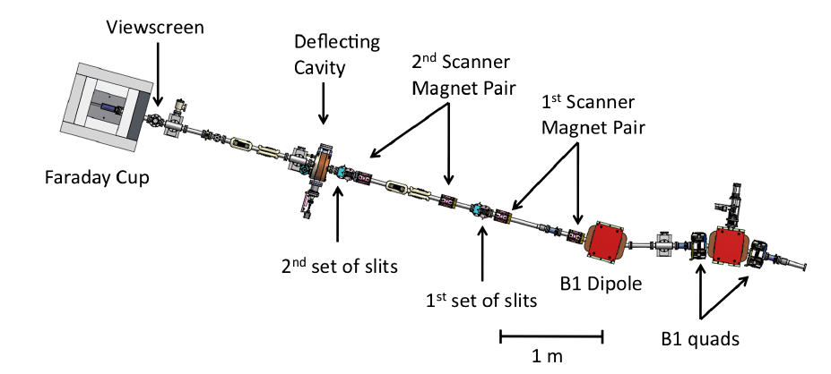
Measurement of Low Emittance
ERL injector equipped with full 6D phase space measurement system:
30 μm slit pairs + fast scanner magnets + deflector cavity+ 15 deg. dipole spectrometer
Measured in the merger section

Slide 10
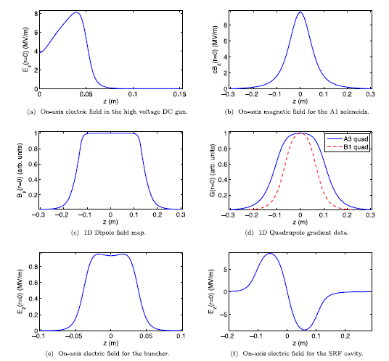
GPT Modeling + Alignment
Simulate using General particle Tracer. Take no shortcuts!
Field map for each element,
either native 3D, or use custom elements to perform off axis expansion.
Gun centering: Center laser beam using ES focusing
Solenoid alignment:
Beam based transfer matrix approach/ mechanical adjustment iterations (~10 um)
3D time dependent maps including asymmetric coupler effects

Slide 11
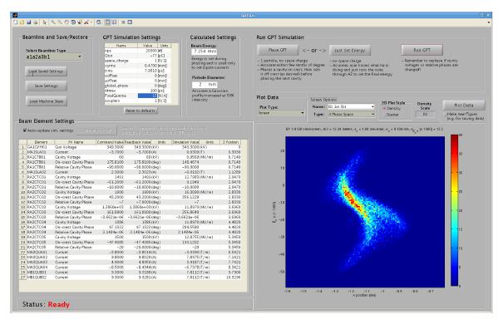
Virtual Accelerator Interface
A GUI for GPT written in MATLAB reads each element setting, and updates the simulation value. Full space charge calculation.
Allows for “real time” (minutes) comparison of simulation and expt.

Slide 12
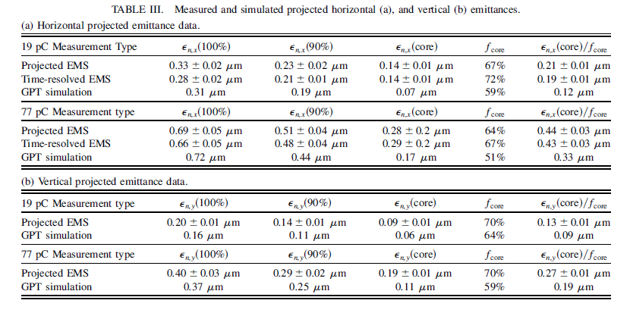
Final Phase space results
$$ε_{th}=0.11±\text{0.01} μm$$
More info: "Demonstration of Low Emittance in the Cornell Energy Recovery Linac Injector Prototype", PRSTAB 16 (2013) 073401
Notes:
Vertical small due to merger-induced asymmetry. Core emittance is where the 0.3 is.

Slide 13
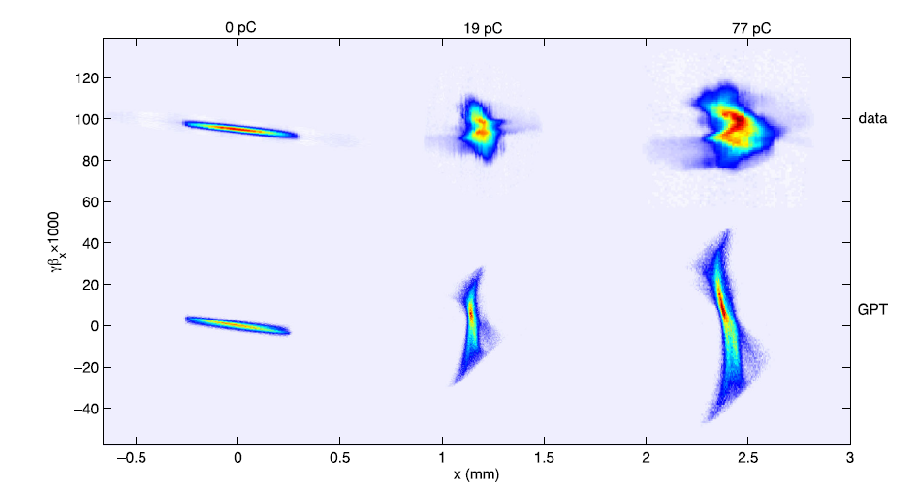
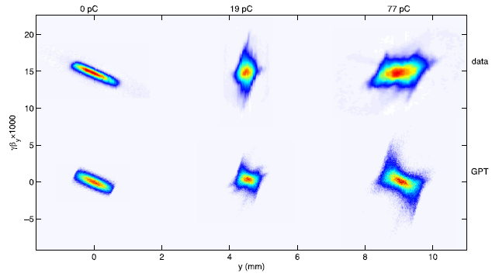
Final Phase space results
Horizontal
Vertical

Slide 14
Ultimate Brightness Gun
For decades, conventional wisdom has dictated that the brightest DC gun is the one with the highest voltage.
Is this true in practice? How high is high enough? 500kV? 1MV? Do we need to go to SRF?
Full simulation and optimization can settle the question.
Consider an injector akin to ERL prototype.
Create field maps for both SRF and DC guns, varying many parameters of their geometry, and beamline setpoints.

Slide 15
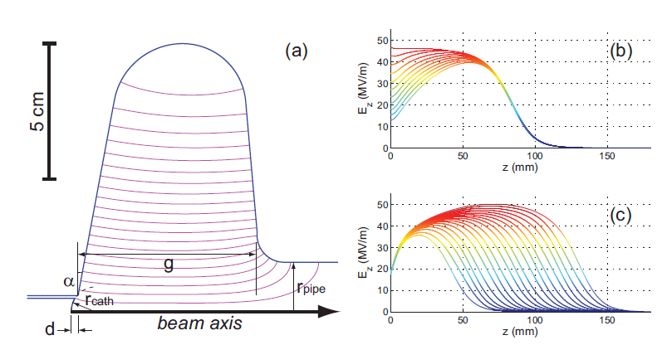
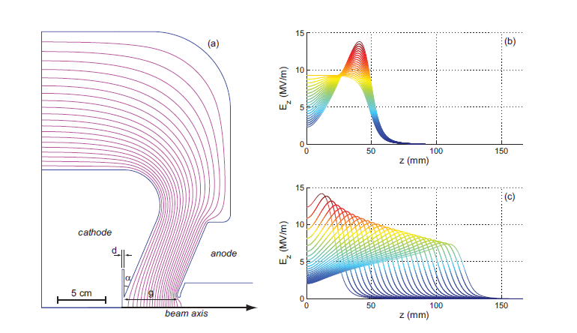
Gun Geometries
SRF parameters:
E_{acc}=25 MV/m
E_{pk/}E_{acc}<2
H_{pk} (mT)/E_{acc} (MV/m)=4.26
DC parameters:
Shortest distance between cathode and anode computed, and voltage constrained to be less than breakdown voltage.

Slide 16
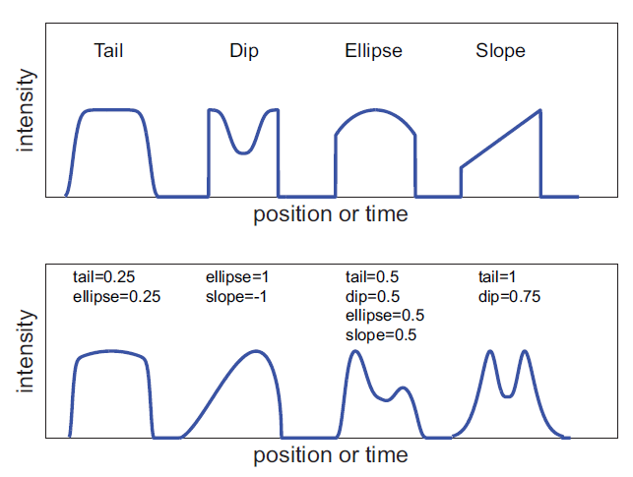
Fields and Laser Dist.
DC fields (w/ buncher)
SRF fields (w/o buncher)
Transverse Laser distribution: assume a Gaussian with variable $σ$ and cutoff radius.
Temporal Laser Distribution

Slide 17
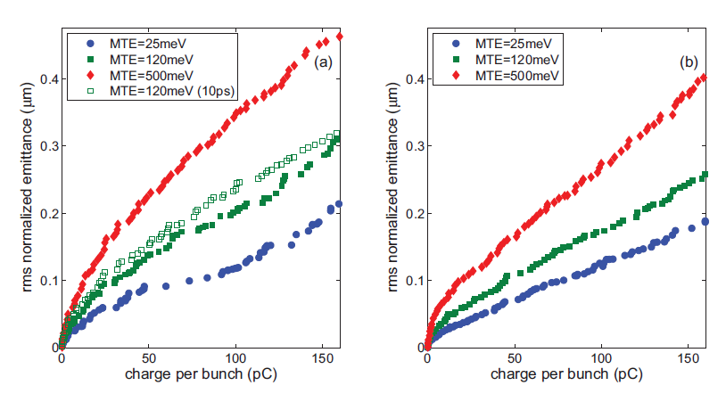
Ultimate Brightness Gun
DC
SRF
Case: 120 meV
V=470kV
E_{cath}=5.1 MV/m
V=1.6 MV

Slide 18
Lessons Learned
DC and SRF emittances were very close (~20%), though the voltages were 3x different!
We owe this to precise emittance compensation.
The small emittances of simulations can be achieved—ERL photinjector is proof.
In DC case:
Chose balance between moderate voltage (470 kV), but and high photocathode field. Some cases have no cathode focusing!
E_{cath} determines maximum achievable brightness!
hv
$$σ_{max}=\frac{E_{cath}}{ε_{0}}$$
$$B_{max,}=\frac{ε_{0}mc^{2}}{2π}\frac{E_{cath}}{MTE}$$
+
$$Δp_{min}∝MTE^{1/2}$$
e⁻
V₀

Slide 19
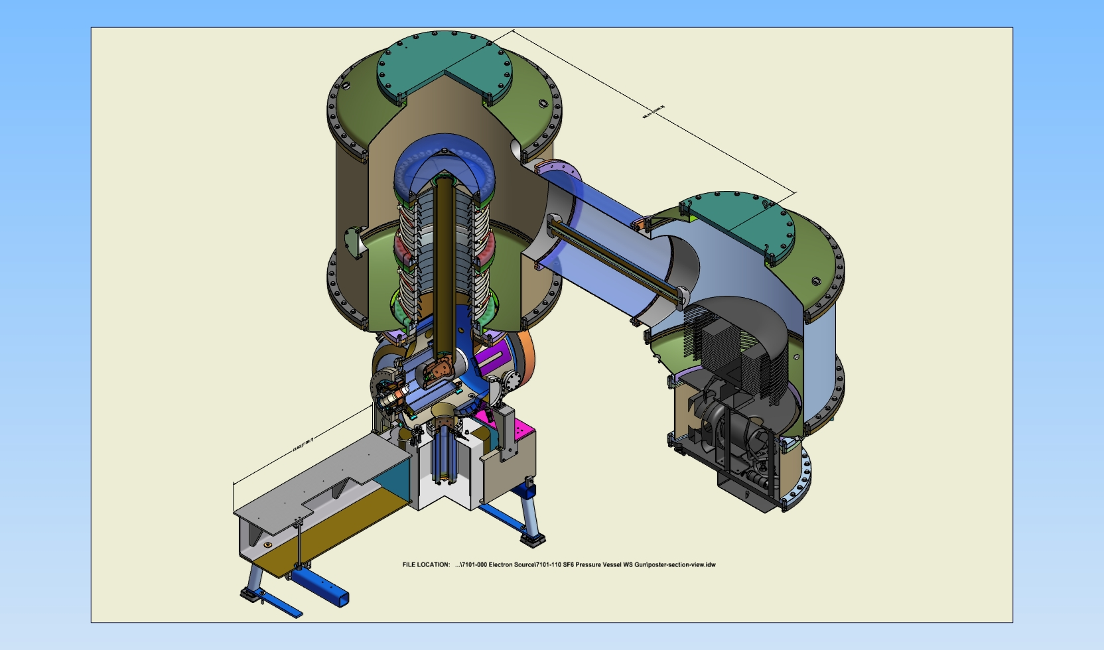
New Gun Overview
Take lessons to heart. Step 1: Want to get to 500kV!
Segmented, shielded insulator
SF6 @ 4 atm
50’’ 316LN stalk
Kaiser 600kV PS
5cm gap, 25deg focusing
100-300 MΩ
Ion pump behind 3500l/s Capacitorr NEG pump (x2)
Notes:
Gun was originally designed for 750—not at all necessary.

Slide 20
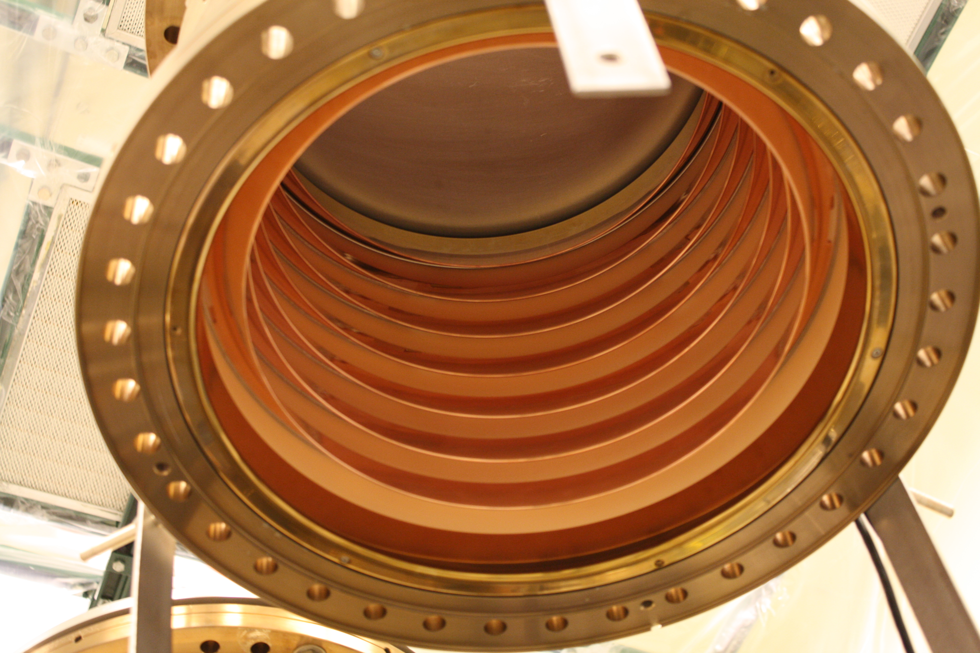
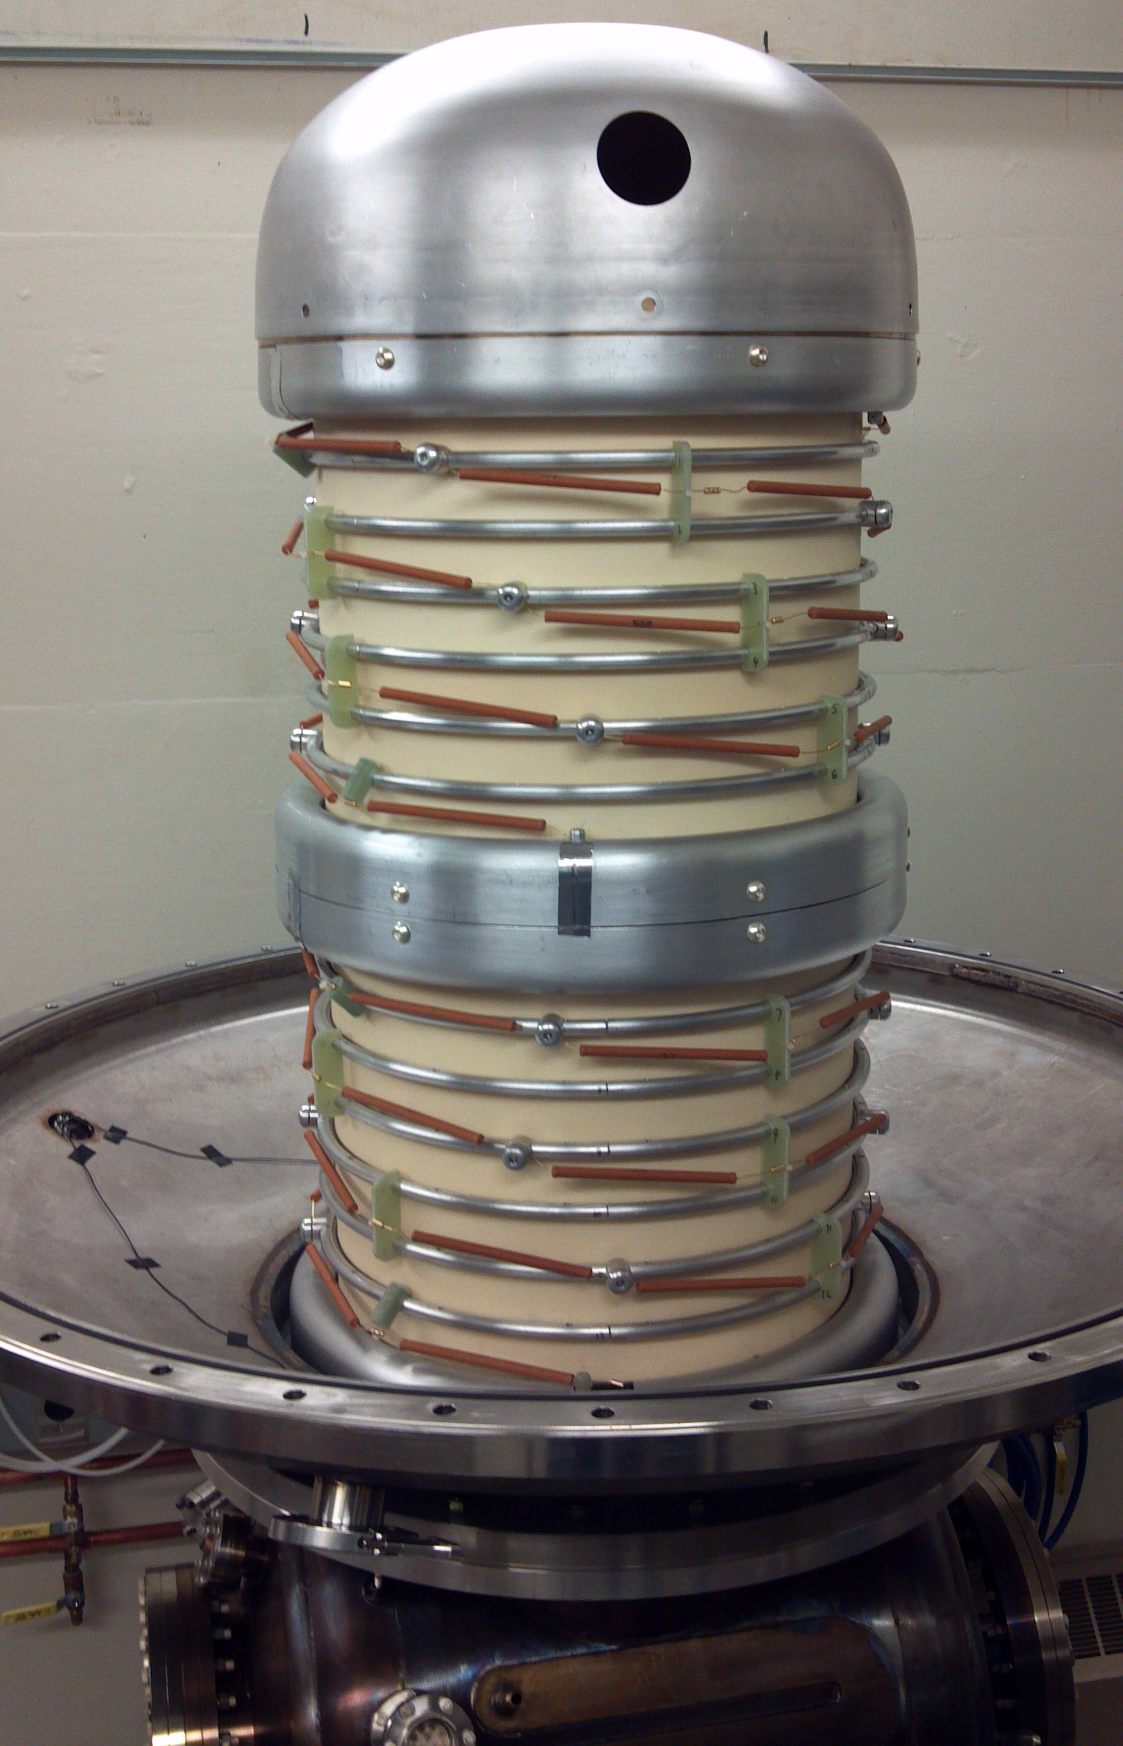
Segmented Insulator
Mitigate punch-through: shield the ceramic!
Brazed Alumina segments with kovar ring in each joint.
Inside: Cu protection rings entirely shield ceramic from field emitted electrons
Outside: Mount 500MΩ resistors between each segment (1GΩ / 2 in parallel)
Allows differentiation between field emission going to ground or going to the rings!
If anode floats, can distinguish between emission from stalk, cathode, and direct to ground.

Slide 21
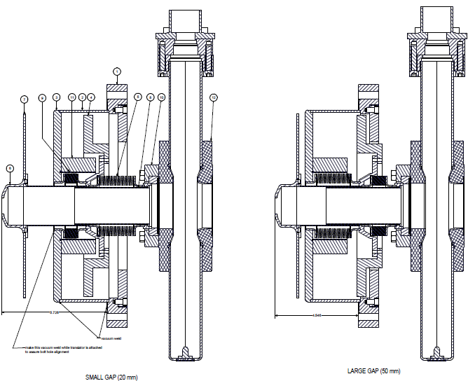
Movable anode
Cathode field is a crucial figure of merit.
Translatable anode allows us to tailor the field.
2 welded bellows
2-5cm adjustable gap
Gate valve
Anode electrode

Slide 22
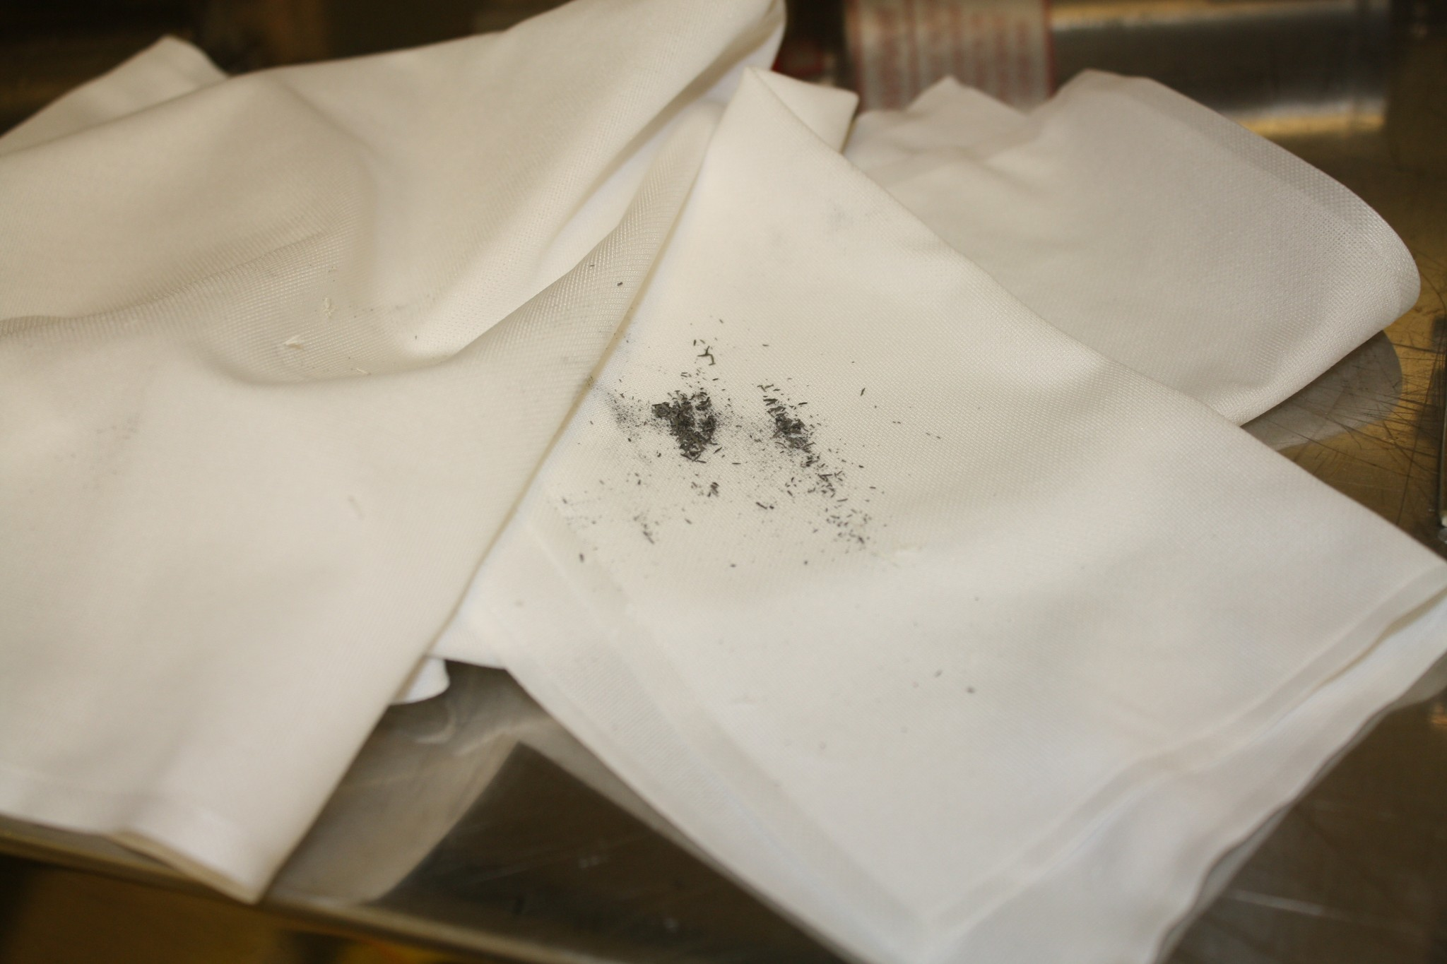
Assembly and Processing
Followed SRF cleaning procedure: Chemistry on all electrodes, HPR all surfaces, and clean room assembly.
During NEG activation, the vacuum window cracked. Large burst of particles from oxygen contamination while hot.
Processing was rocky:
Excess current from power supply (steady state 10s of uA, spikes up to 100uA and beyond),
Excess current on resistors (spikes of ~10uA)
Current on floating anode (<1uA, excess by definition)
Radiation inside lead (up to 10 R/hour)
Vacuum (base 1e-10 torr) spikes of 1e-7…or worse.
Reached 390 kV using gas processing, didn’t translate to vacuum (~350kV).
Decided to open the gun to investigate…
Notes:
Don’t focus on procedure. Get some plots from processing. Stability? Gas or not?

Slide 23
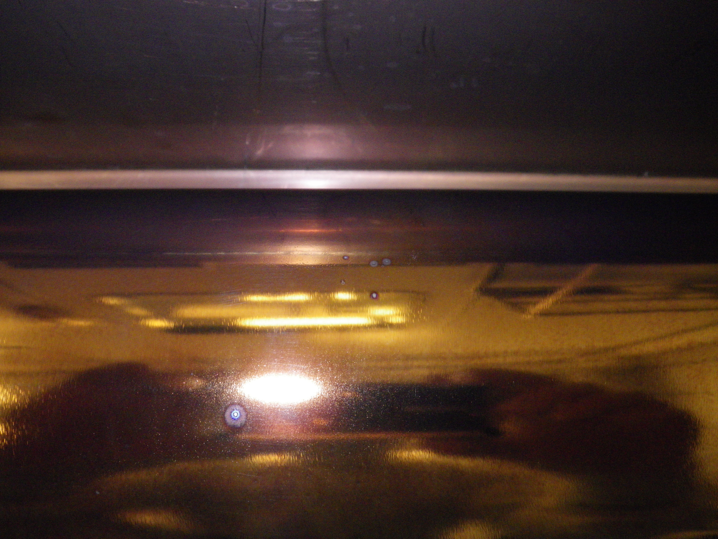
Assembly and Processing
Purged with N2 gas, counted particles 0.3 um and larger. Saw a few bursts of large counts.
Quickly sealed and tried to reprocess without success. Decided to reclean and rebuild.
Began rebuild in SRF cleanroom facility (always class 10).
Stalk showed definite signs of field emission—the rings have thusfar been robust!

Slide 24
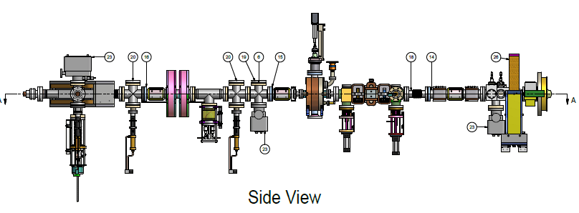
Beamline Overview
Small (~3m) beamline with full 6D phase space measurement capability
Want to demonstrate brightness limit by adjusting electric field of the C-A gap
Want to use real-time optimization teqniques to put emittances to the limit
Also want to directly measure the virtual cathode instability
Has only been indirectly measured by Dowell, Phys. Plasmas 1996
Laser in
Spec.
Dipole
F.cup
Coll.
Slit
Def
Cav
EMS Slits
Corr.
Mag.
Sol
Gun Anode
https://wiki.lepp.cornell.edu/ERL/Private/R128Beamline

Slide 25
Summary
Cornell photoinjector has nearly demonstrated full feasibility of injecting low emittance, high average current electrons for an ERL light source
High current record: 75 mA using multialkali
Emittances < 0.4 um normalized in merger
Constructing new photogun using input from optimization
Push for both photocathode field +voltage, rather than simply voltage.
New gun currently in rebuilding phase, should be back on in a few months!

Slide 26
Summary
Special Thanks to: Ivan Bazarov, Bruce Dunham, Karl Smolenski, Luca Cultrera, Colwyn Gulliford, and Siddharth Karkare

Slide 27
Supplemental Slides

Slide 28
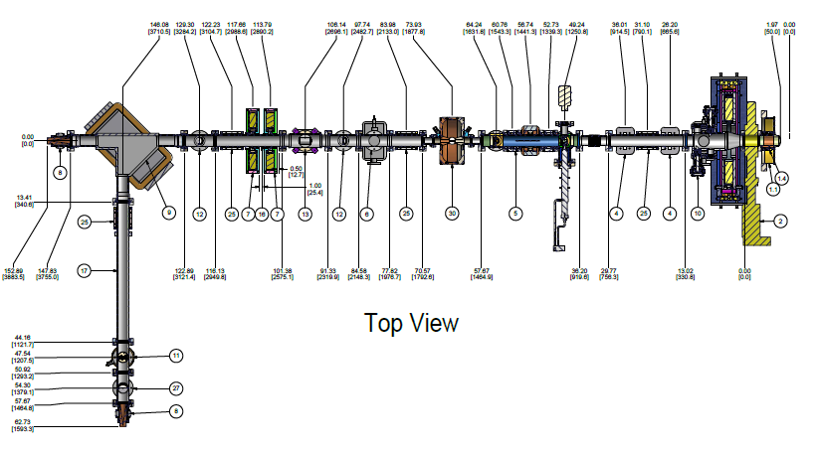
Full Phase Space Measurement
EMS system measures vertical phase space, via two horizontal 30um slits, and box correctors (4 total).
Deflector cavity converts time position to vertical position-> allows measurement of longitudinal profile (bunch length)
Vertical slits make resolution better.
A collimating slit (120 um vertical slit) and dipole magnet measures energy spread

Slide 29
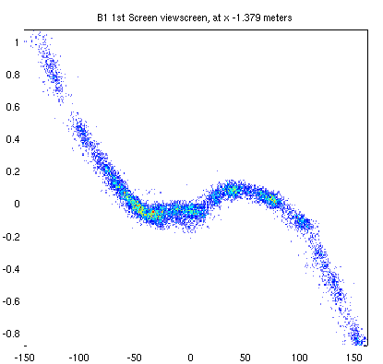
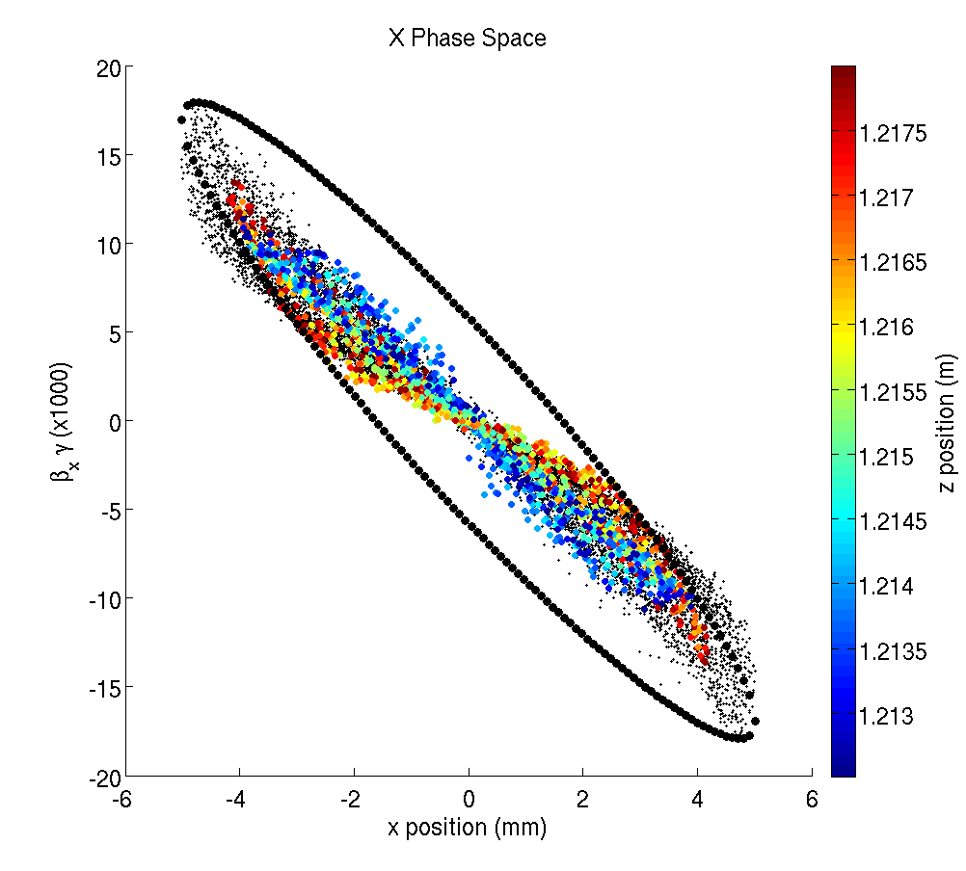
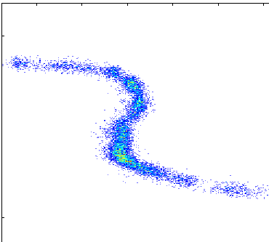
Full Phase Space Measurement
$$β_{y}γ×1000$$
dE/E
EMS Cor. 2
Time (ps)
Y (mm)
EMS Cor. 1
All slits in, deflector on, through dipole,
On final viewscreen:

Slide 30
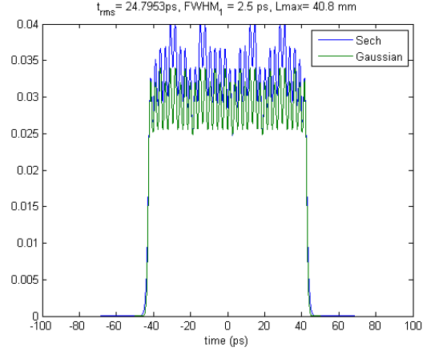
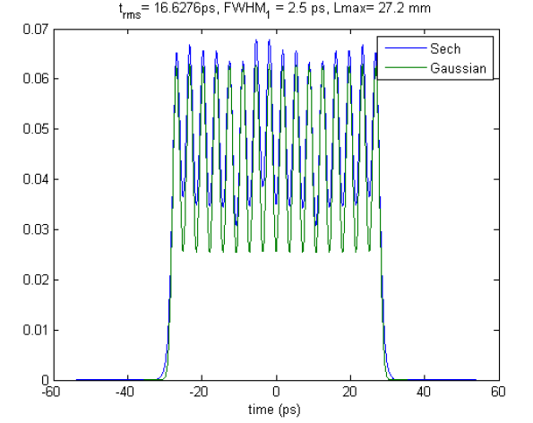
Laser Parameters for Emittance
Have two sets of crystals (5 total) to produce a long pulse:
Can also use subset for shorter pulses.
Careful, careful alignment to reduce spatial distortions.

Slide 31
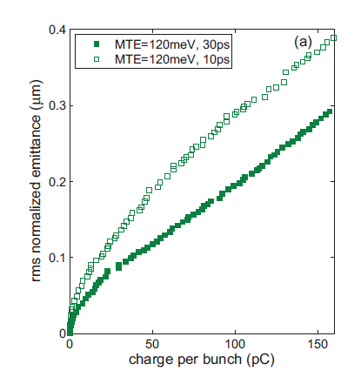
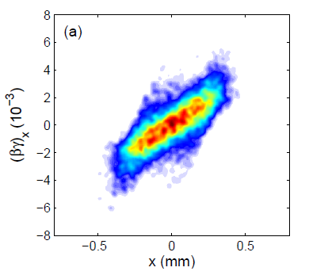
Online optimization
Do charge scan optimization using GA data and in real time.
3D Laser
Solenoid
Sims/GA
_{R}
_{sigma}
_{angles}
Measure @ multiple charges
GA Settings
Real Time GA “tweak”

Slide 32
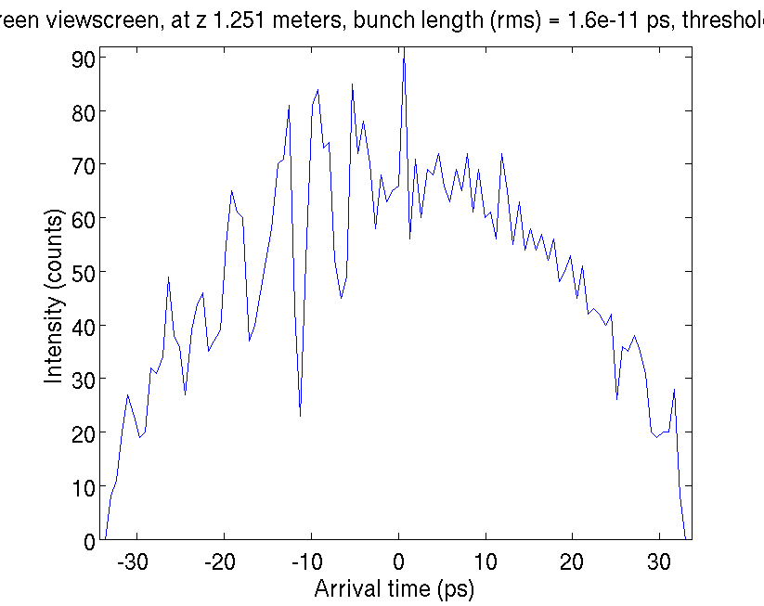
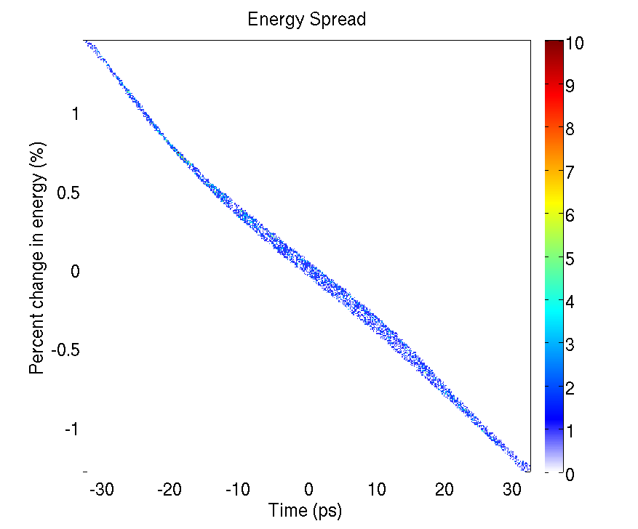
Virtual Cathode Instability:

Slide 33
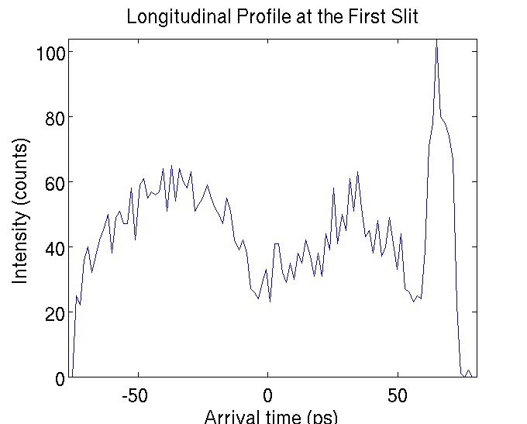
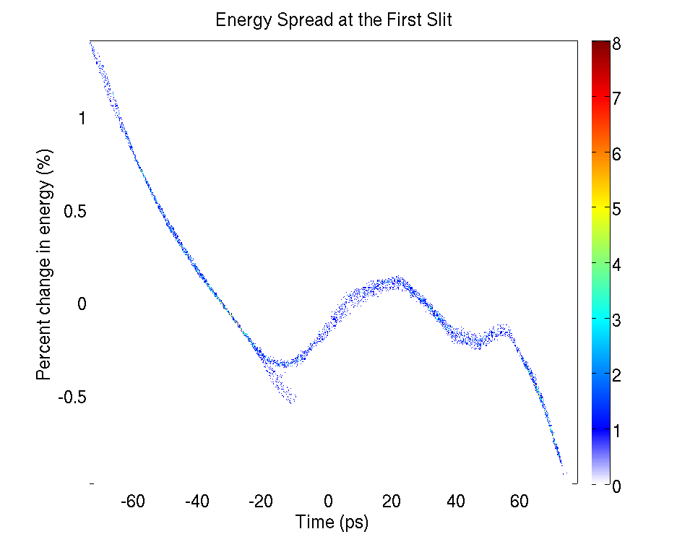
Virtual Cathode Instability
virtual cathode instability
virtual cathode instability
Space charge cancels accelerating force , density oscillation about unstable equilibrium.

Slide 34
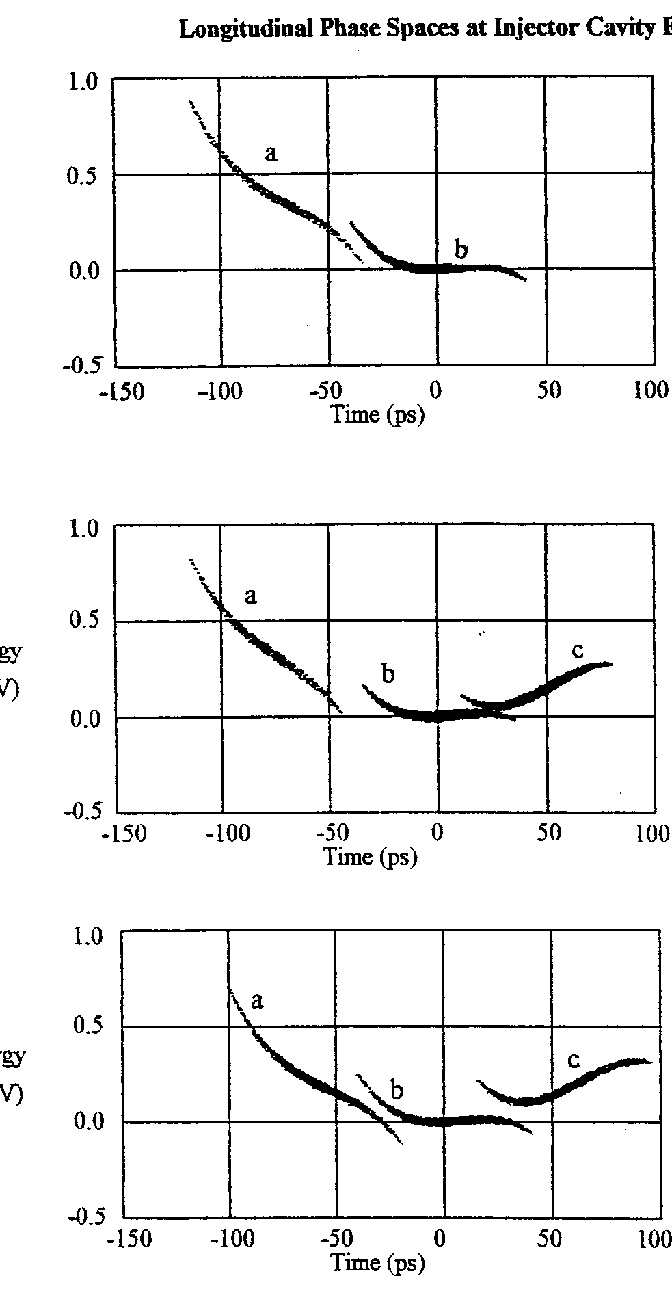
Virtual Cathode Instability
Dowell et al. 1997
Only measured indirectly!

Slide 35
Virtual Cathode Instability
When will this happen? Bazarov et. al 2009 say if the bunch is “pancake like” $A=\frac{σ_{X}}{σ_{z}}≫1$, then:
$$\frac{Q}{πr^{2}}=E_{cath}/ε_{0}$$
Is this true? $σ_{z}=\frac{1}{2} q\frac{E_{cath}}{m}σ_{t}^{2}$
24 ps rms , and $E_{cath}=10 MV/m$, $σ_{z}=0.5$mm
$A\sim 1$!
For slightly longer pulses, we have to modify Child-Langmuir law (1D):
“Effects of pulse-length and emitter area on virtual cathode formation in electron guns”, Valfells et. al 2002.

Slide 36
Virtual Cathode Instability
There are works that extend the CL law to 3D via scaling from simulations.
“Multidimensional short-pulse space-charge-limited flow”, Koh et al. 2006.
“Two-dimensional electromagnetic Child–Langmuir law of a short-pulse electron flow” S. H. Chen et al., Phys. Plasmas 18, 023105 (2011)
They write
Correction factors can be ~2 for beams with A~1!
No one seems to have measured this. Sims are challenging—need exp’t input!
Question of magnetic field role in VC oscillations? Is GPT even doing it remotely correctly?

Slide 37
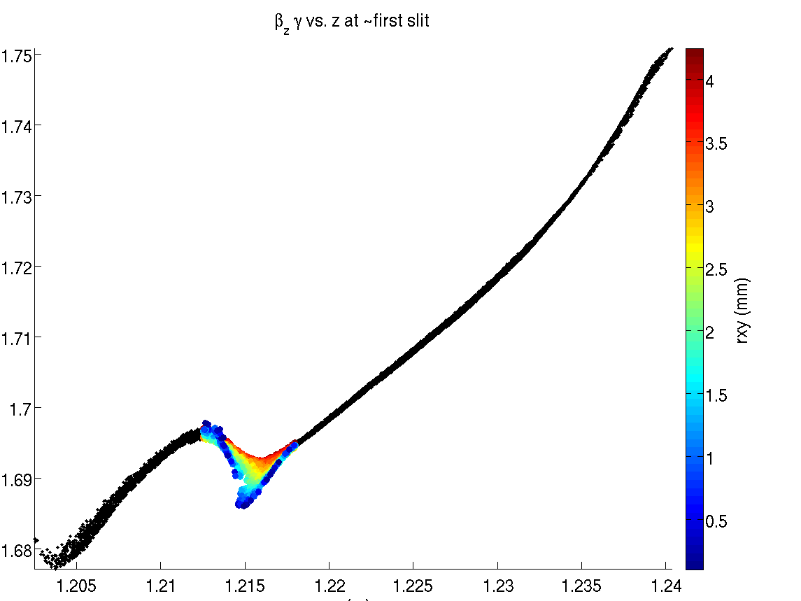
Why Transverse position?
$$β_{z}γ×1000$$
$$β_{y}γ×1000$$
Y (mm)
Z(m)

