Slide 1
COMPASS polarized target for Drell-Yan
Michael Pesek
Charles University in Prague
On behalf of COMPASS PT group
PSPT, Charlottesville, Virginia
9.9.-13.9. 2013

Slide 2
Outline of the talk
COMPASS experiment at CERN
COMPASS Polarized target
Drell-Yan at COMPASS
Needed modifications
Current status and outlook
Conclusion

Slide 3
COMPASS experiment at CERN
Fixed target exp. situated at M2 beam line at NA at CERN SPS accelerator
Using both muon and hadron beams for nucleon spin structure studies and
hadron spectroscopy physics programme
Beam momentum up to 280 GeV/c (190 GeV/c for Drell-Yan)
Two staged spectrometer – LAS and SAS, with PID (RICH in LAS)
Tracking & calorimetry in both stages
Both polarized and unpolarized targets are used

Slide 4
COMPASS Polarized target
Target polarized by DNP
(Probably) Most powerful DR in the world with cooling power of 5mW@75mK
SC Magnet 2.5 T solenoid & 0.6 T dipole allows both transverse and longitudinal polarization
Polarization measurement by cw NMR

Slide 5
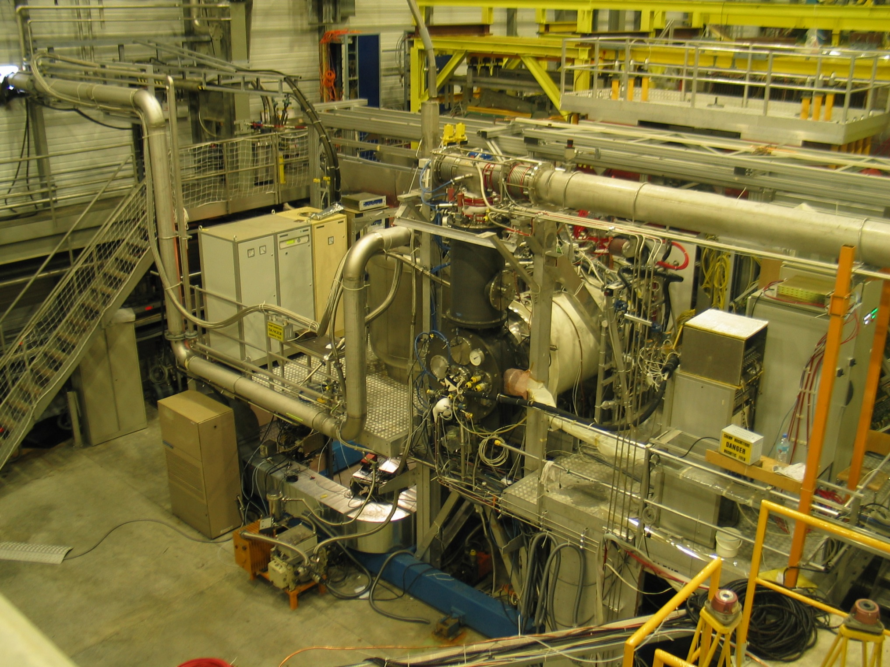
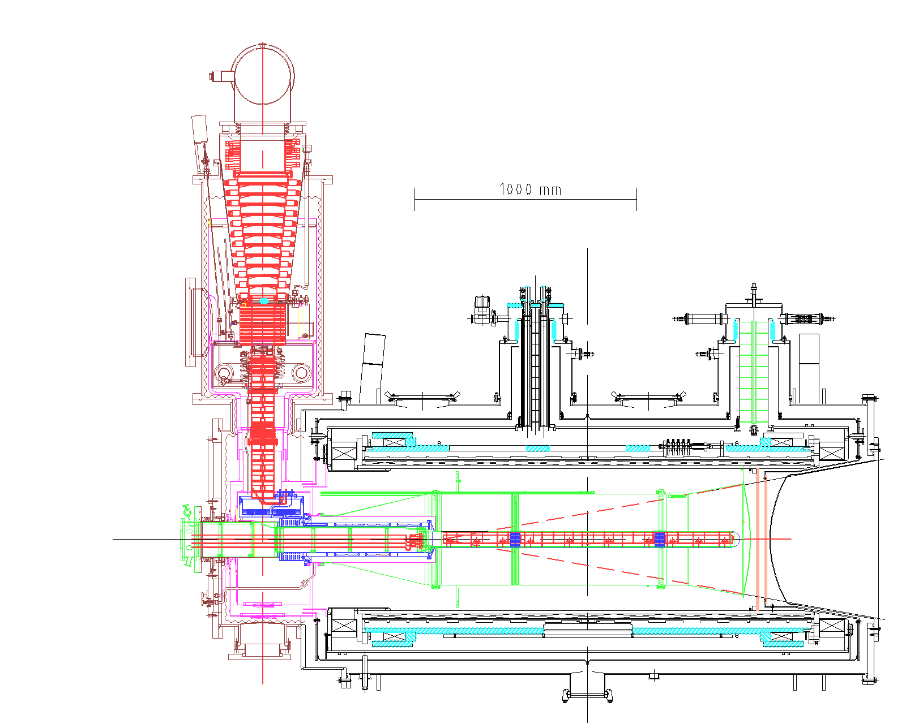
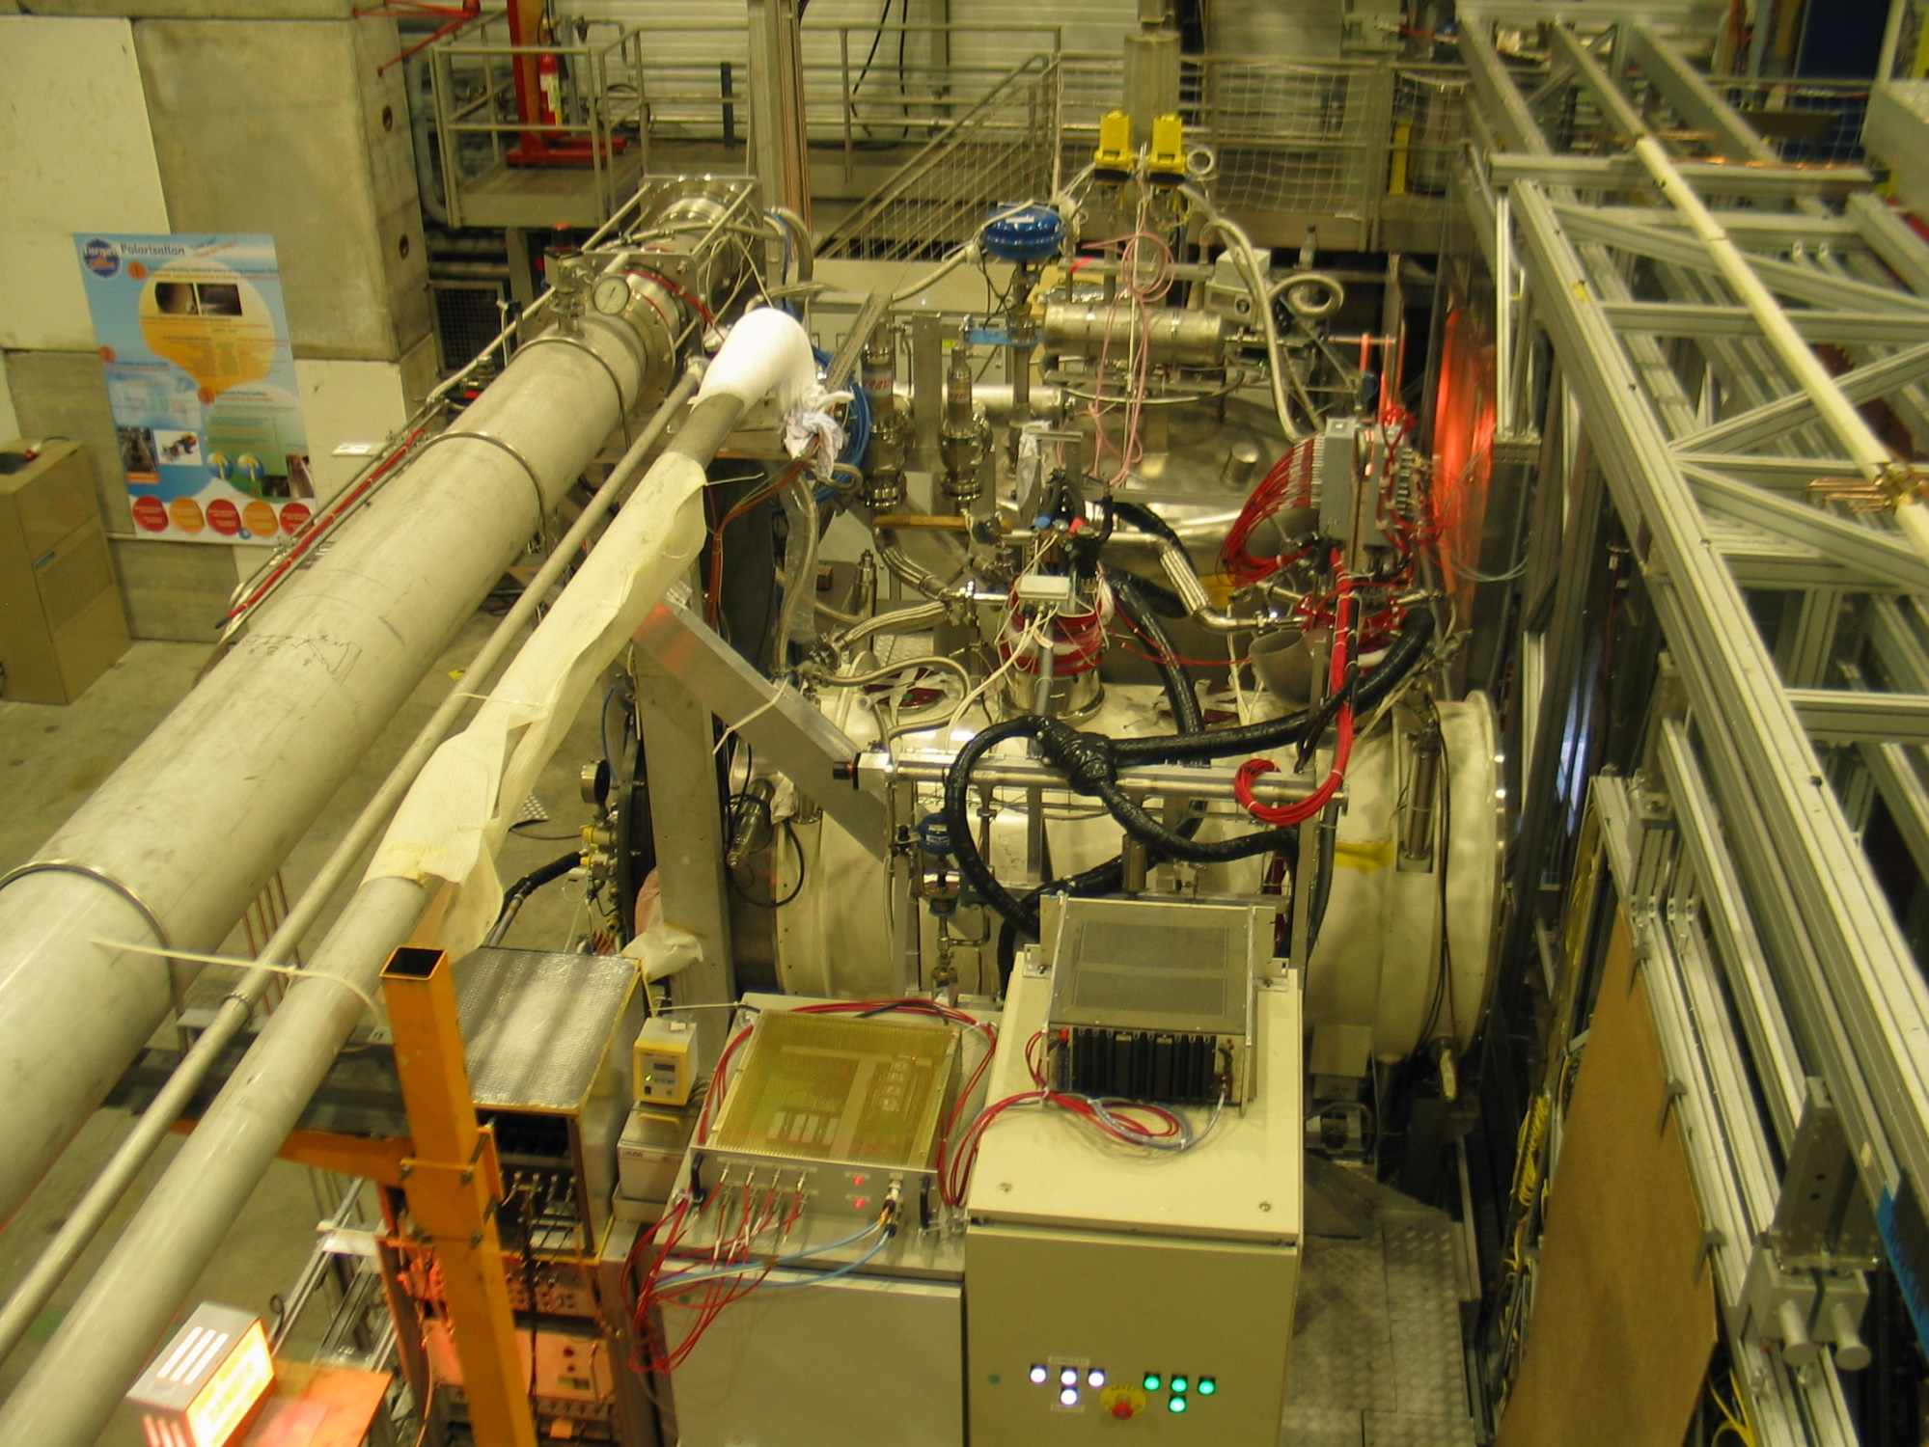
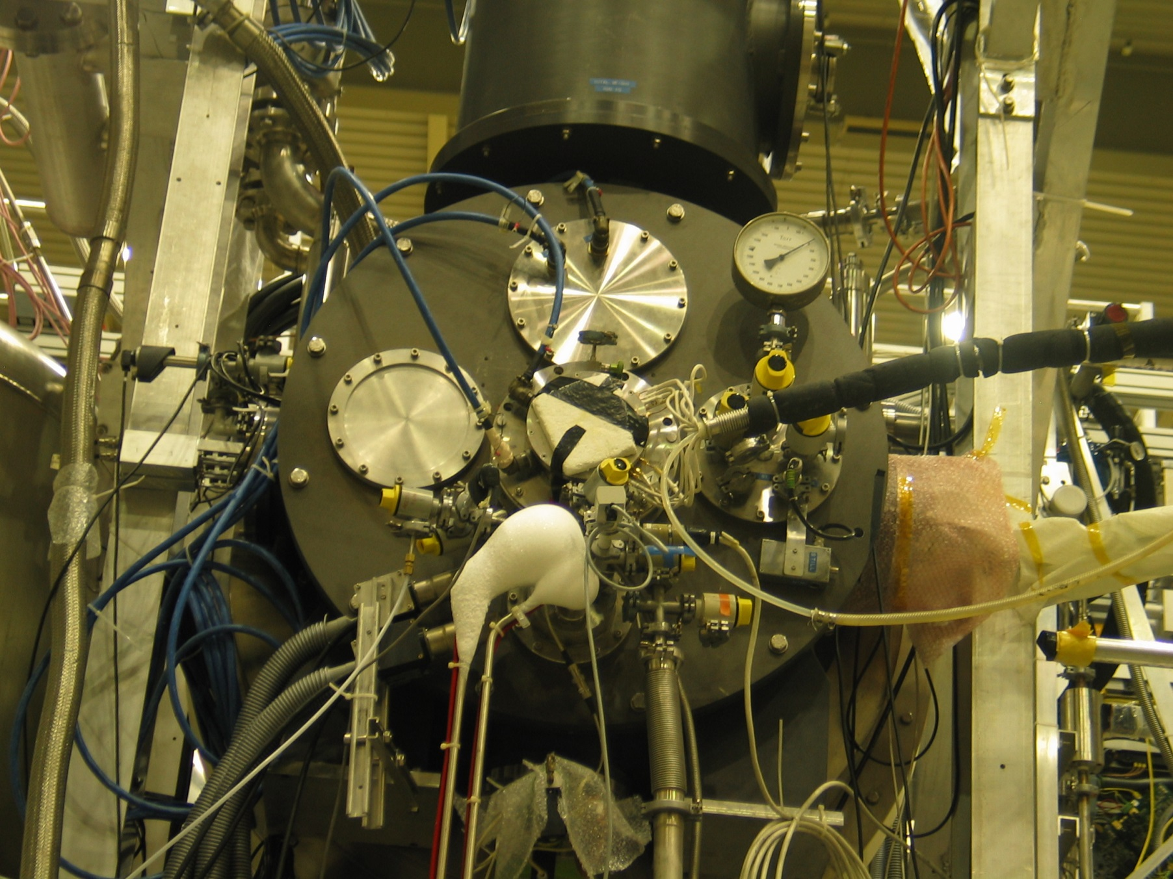
PT during 2010 & 2011
Running with µ beam with intensity 10⁸ µ /s
3 cell design 30-60-30 cm with 4 cm diameter
2 MW stoppers 5 cm long
Solid NH₃ with NH₂ radicals
10 NMR coils
LabView software for NMR data taking and temperature monitoring
Longitudinal and transverse polarization
Average maximum polarization ≈83%

Slide 6
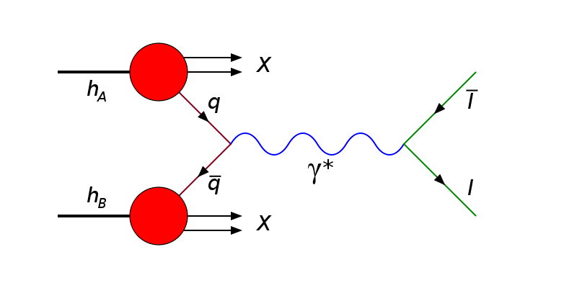
Drell-Yan process
Annihilation of quark anti-quark pair
Detecting two leptons (muons) in final state
Low cross section
High hadronic background needs to be suppressed not to saturate detectors => need for hadron absorber

Slide 7
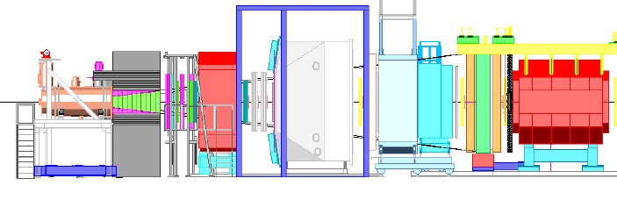
Drell-Yan at COMPASS
Demands on setup: High intensity π⁻ beam
Transversely polarized proton target
Hadron Absorber
Dedicated muon trigger

Slide 8
Needed modifications for PT
High intensity π⁻ beam=> New cell design=>
MW cavity modification
Hadron absorber=> PT platform movement
Higher radiation dose=> New remote control system

Slide 9
New target cell design
High intensity beam=> increased heat load
Defocused beam – larger beam spot
2 cells with 4 cm diameter 55 cm long
20 cm gap – to ensure proper vertex resolution
10 NMR coils with new design (not decided yet)
Kevlar tube with polyamide or torlon mesh target cells (not decided yet)

Slide 10
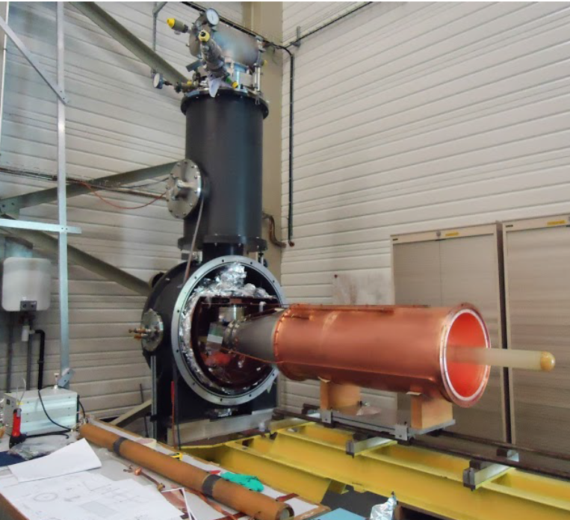
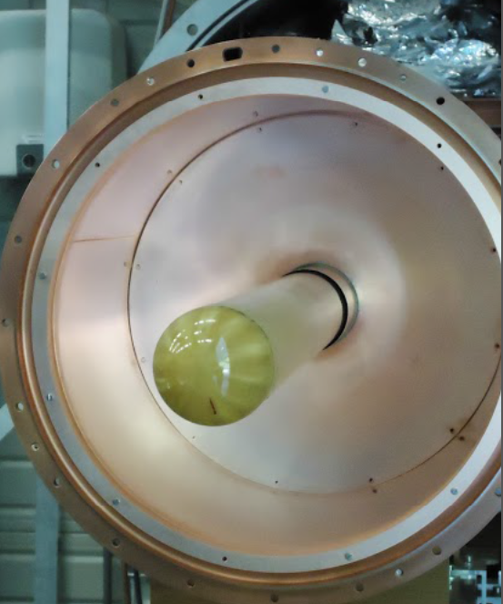
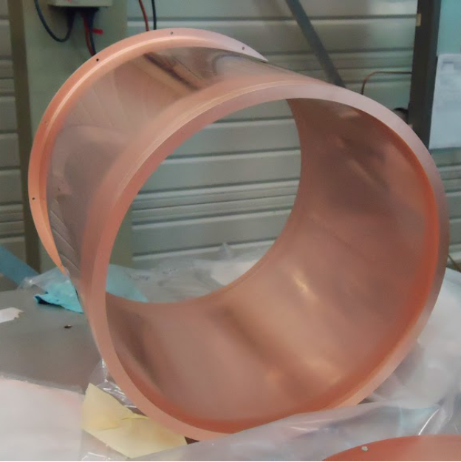
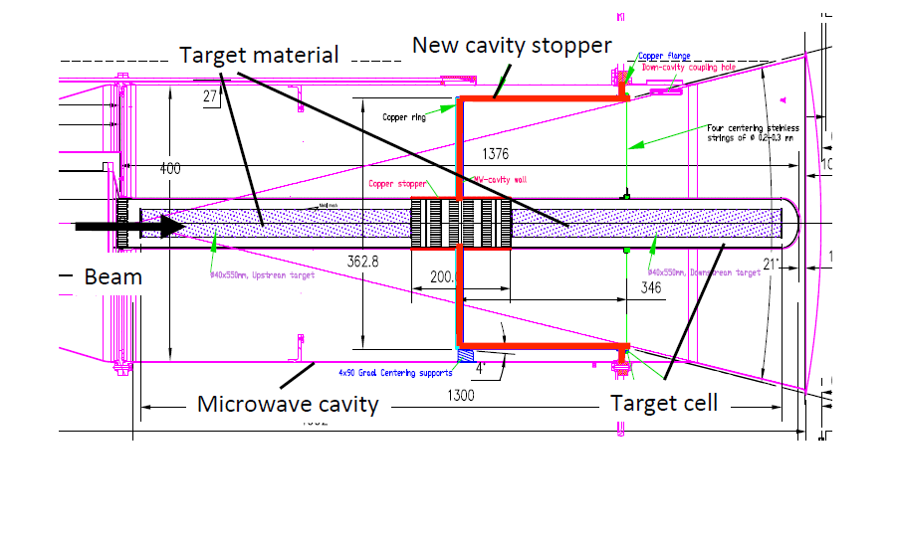
Cavity modification
New 20 cm MW stopper needed

Slide 11
New remote control system
Intense hadron beam (10⁸ π⁻/s) => radiation dose in experimental hall will probably exceed 3 μSv/h limit for permanent workspace area
(3.6 μSv/h according to latest simulations of shielding design)
=> control room will be moved in another building. => Remote control system necessary.
Decision to abandon LabVIEW system for dilution refrigerator

Slide 12
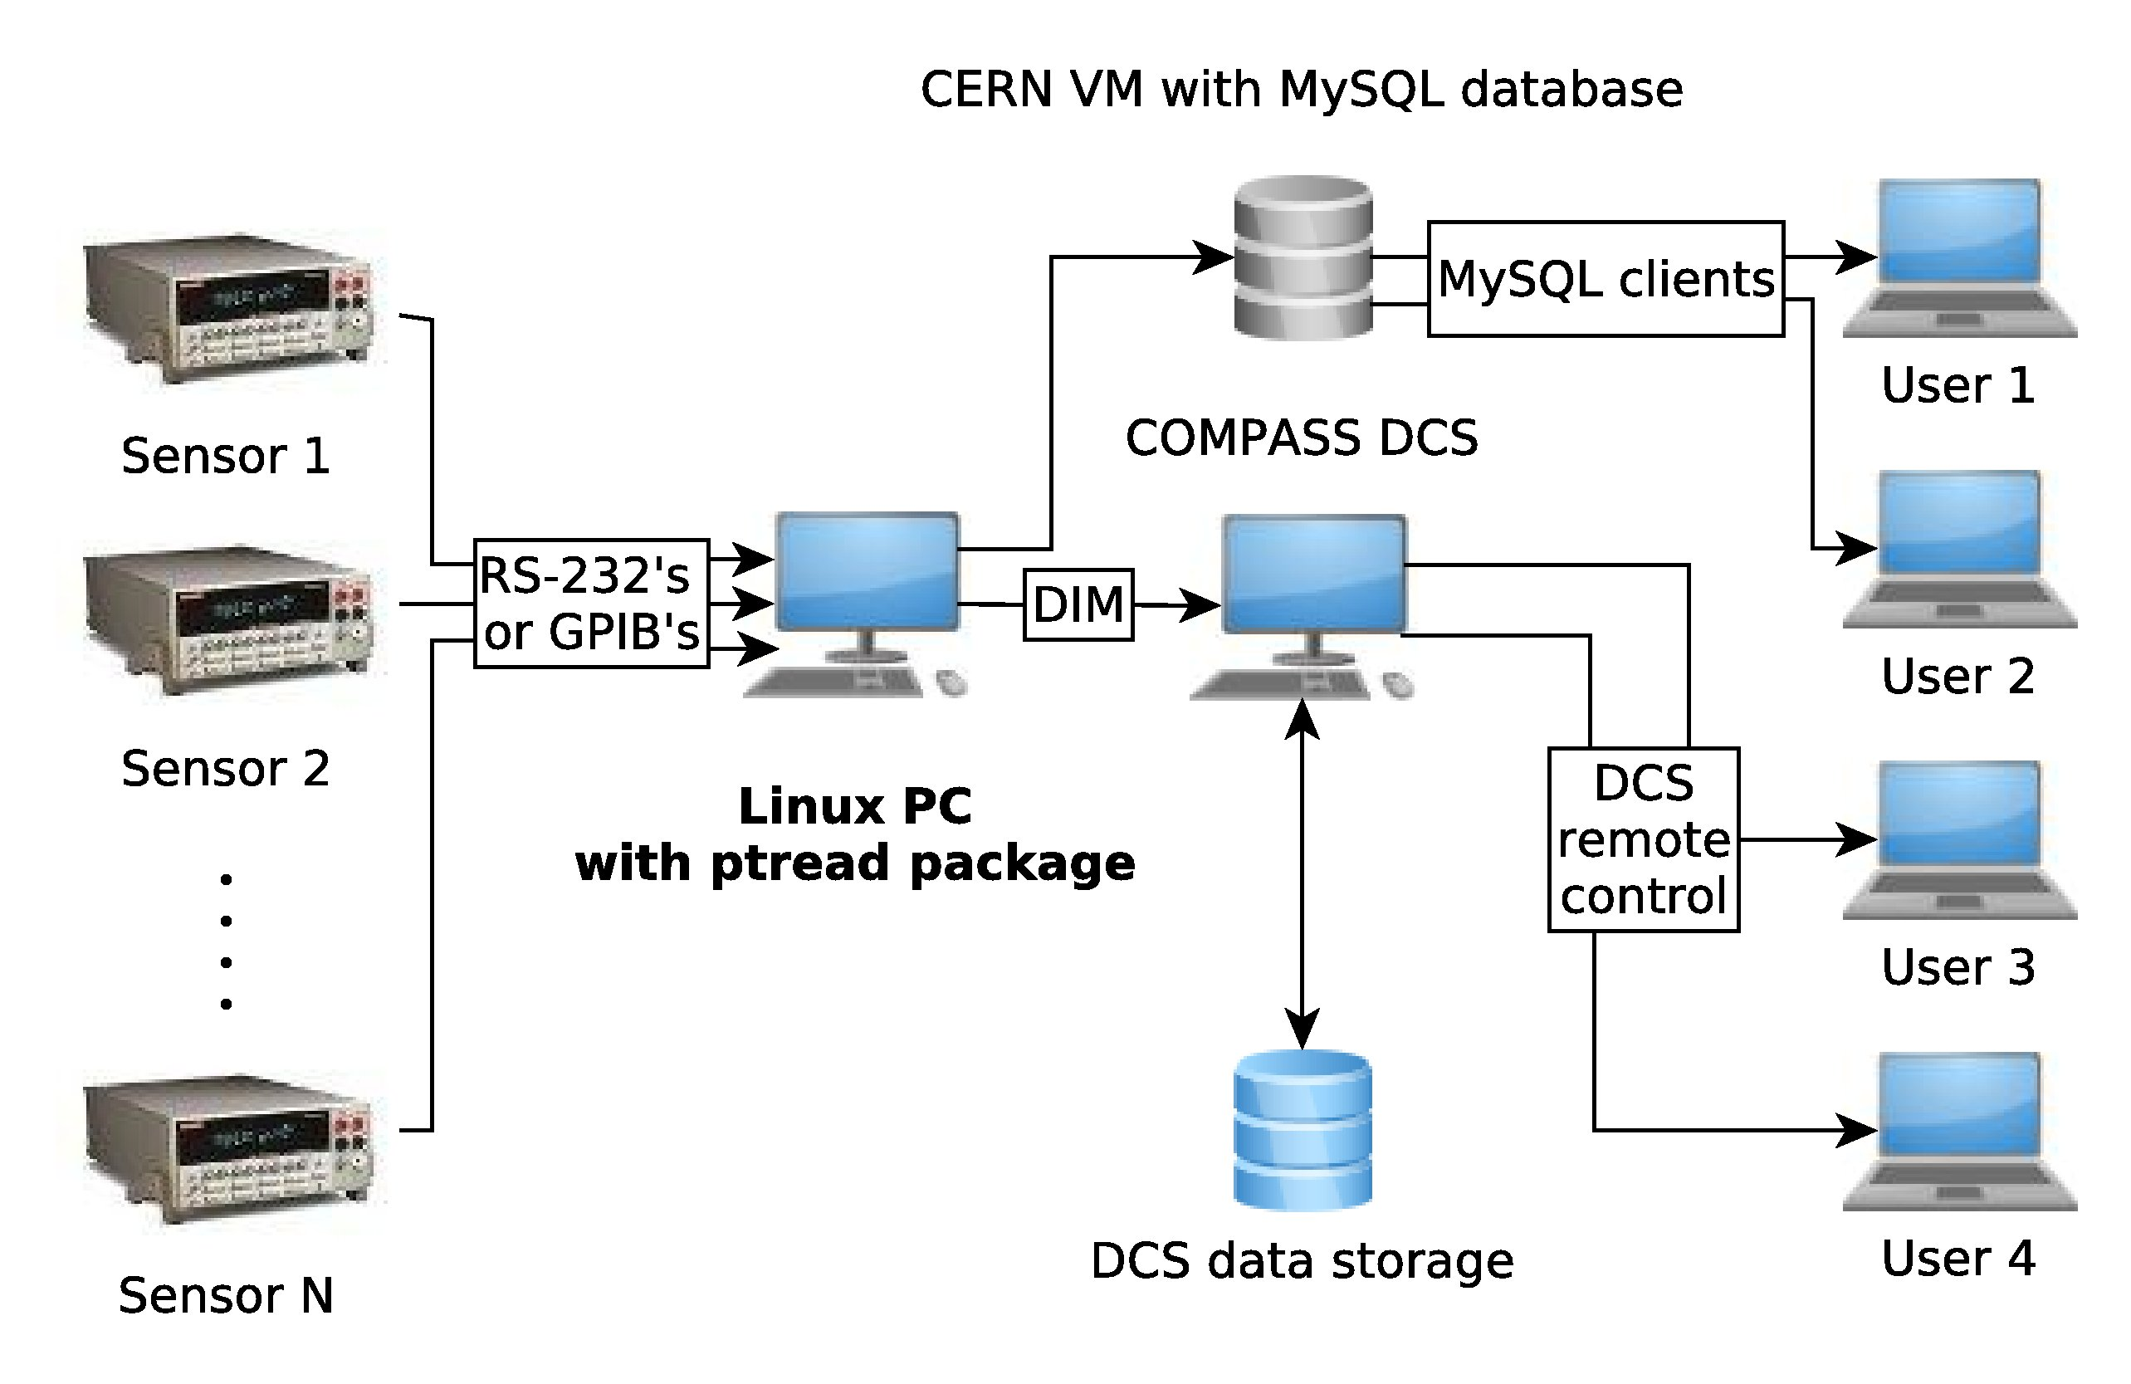
ptread package
Monitors dilution refrigerator (some pressure gauges, flow meters, > 30 thermometers...)
Linux platform, written in Perl, parts in C++, open-source, modular, easy to modify.
Can communicate with COMPASS DCS (centralized Detector Control System)
Output possibilities: MySQL, SQLite, DIM (Distributed Information Management System – for communication in “mixed” environment)

Slide 13
Hadron absorber & PT movement
Dimensions 160x160x230cm
Made of concrete/stainless steel/alumina with tungsten beam plug
Weights 22.5 tons (supplemented by other 140 t of concrete shielding)
=>need to move PT platform 230 cm upstream from current (SIDIS) position
=>shorter loading platform

Slide 14
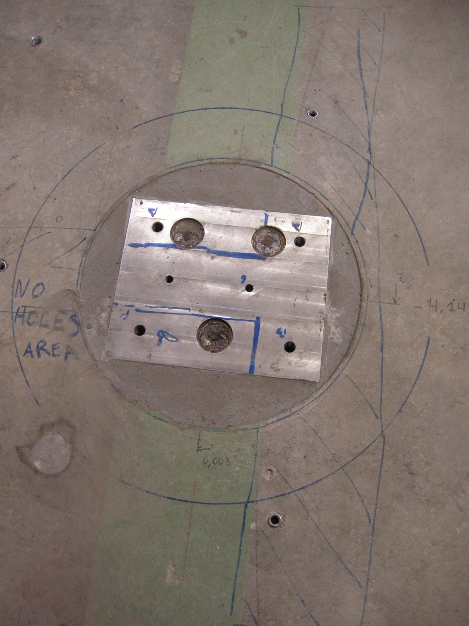
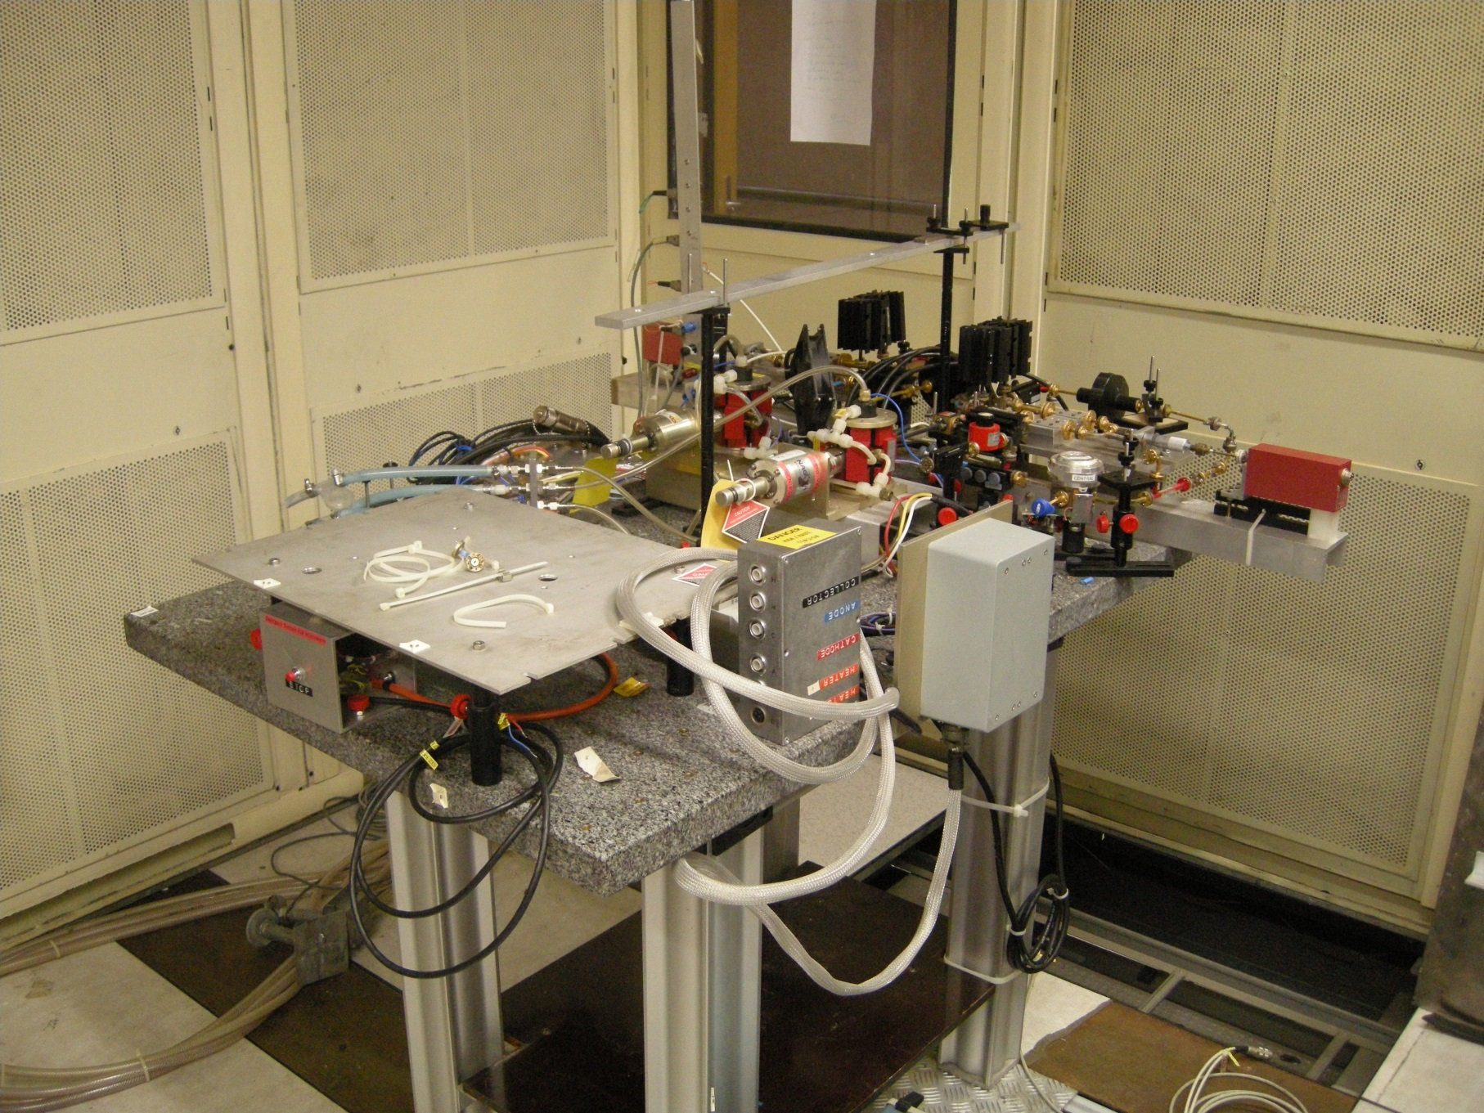
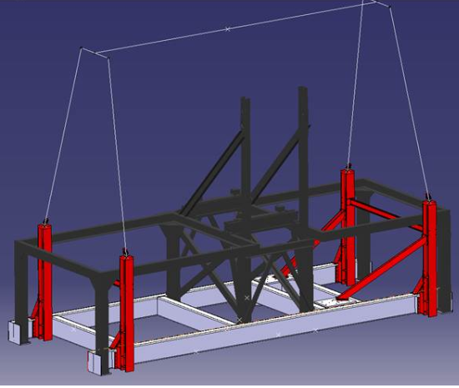
PT platform movement
New holes drilled in the floor
Special device for crane is being prepared
Also new holes in shielding for MW waveguides
Movement of the MW system

Slide 15
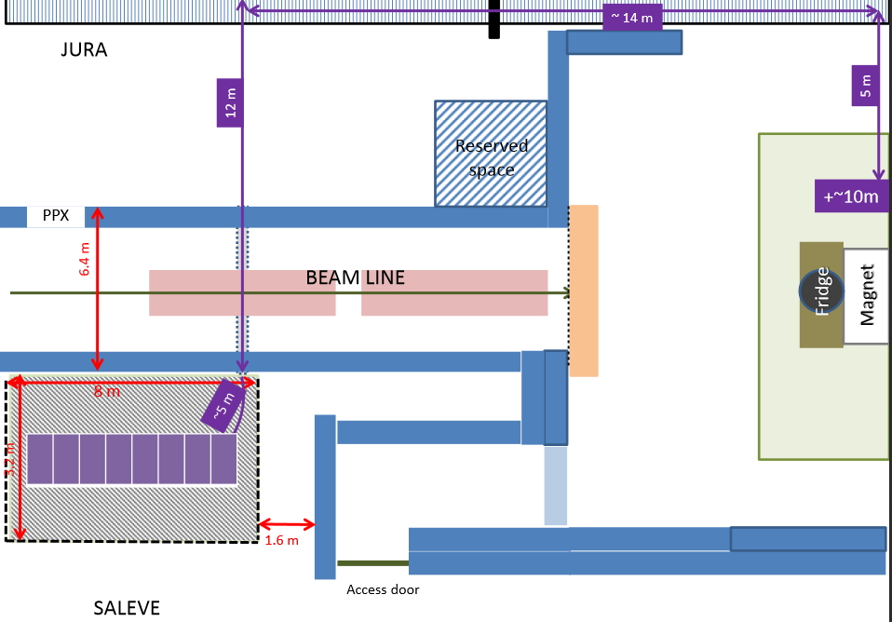
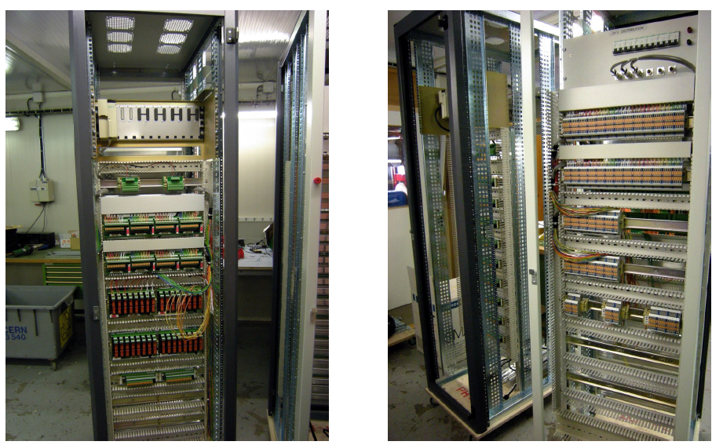
New magnet control system
New control and safety system being made by CERN magnet group
Target magnet refurbishment ongoing

Slide 16
Current status & Plans
Cavity – new MW stopper installed, cavity tested
Helium leak test of DR at room temperature – no leaks found
Target holder is being prepared
New magnet control system and magnet refurbishment should be finished by end of November
PT platform movement - new holes drilled - movement probably during October

Slide 17
Conclusion
COMPASS PT preparation for Drell-Yan is progressing well
Will be fully operational for 2014-2015 physics run

Slide 18
Thank you for your attention!

