Slide 1
Search for Electric Dipole Moments with Polarized Beams in Storage Rings
Paolo Lenisa
Università di Ferrara and INFN - Italy
PSTP 2013 – Charlottesville, Virginia, Sept. 9th-13th

Slide 2
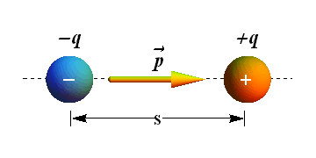
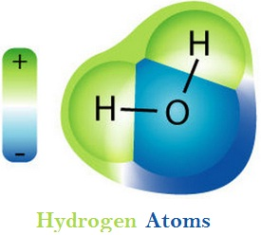
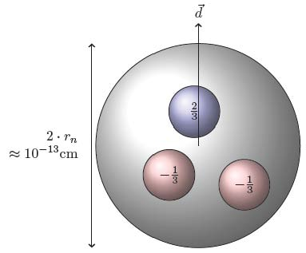
Electric Dipoles
Definition
$$\vec{p}=q∙\vec{s}$$
Charge separation creates an electric dipole
Orders of magnitude
 | Atomic physics | Hadron physics
Charges | e | e
|r₁-r₂| | 10⁻⁸ cm | 10⁻¹³ cm
EDM (naive) exp. | 10⁻⁸ e cm | 10⁻¹³ e cm
observed | H₂O molecule 4∙10⁻⁹ e cm | Neutron < 3∙10⁻²⁶ e cm
H₂O molecule:
permanent EDM
(degenerate GS
w/ different Parity)
EDM 3∙10⁻²⁶ e cm → charge separation < 5∙10⁻²⁶ cm between u and d quarks

Slide 3
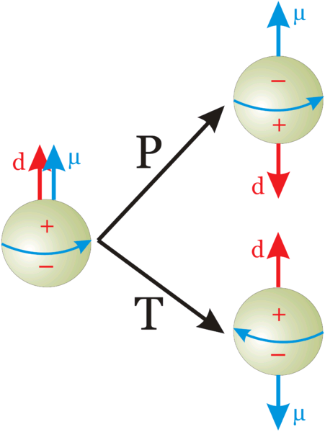
EDM of fundamental particles
Molecules have large EDM because of degenerated ground states with different parity
Elementary particles (including hadrons) have a definite partiy and cannot have EDM
Unless P and T reversal are violated
$\vec{μ}$: magnetic dipole moment
$\vec{d}$: electric dipole moment
(both aligned with spin)
Permanent EDMs violate P and T
Assuming CPT to hold, CP violated also

Slide 4
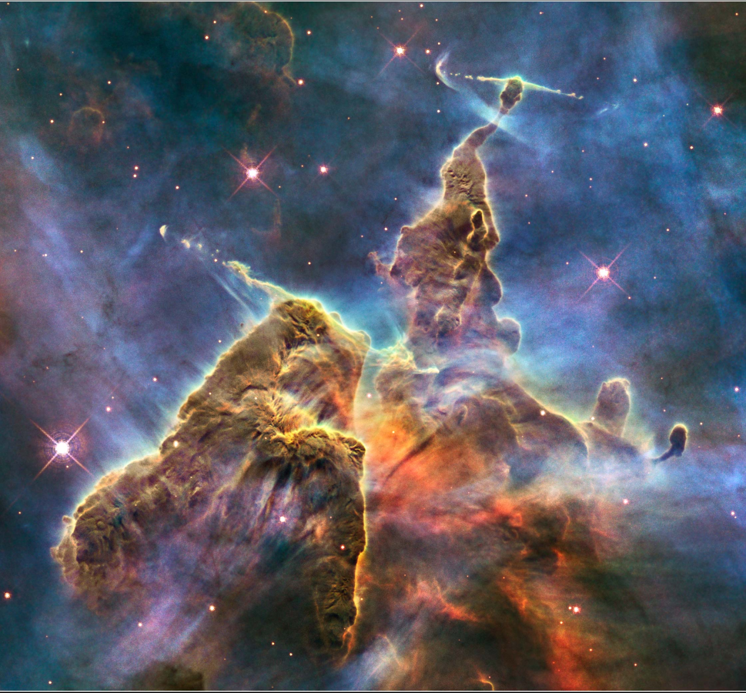
CP violation
.Universe dominated by matter (and not anti-matter).
${(n}_{B}−n_{\overline{B}})/n_{γ}$ = 6x10⁻¹⁰
Equal emounts of matter and antimatter at the Big Bang.
CP violation in SM: 10⁻¹⁸ expected
1967: 3 Sacharov conditions for baryogenesis
Baryon number violation
C and CP violation
Thermal non-equilibrium
New sources of CP violation beyond SM needed
Could manifest in EDM of elementary particles
Carina Nebula (Largest-seen star-birth regions in the galaxy)

Slide 5
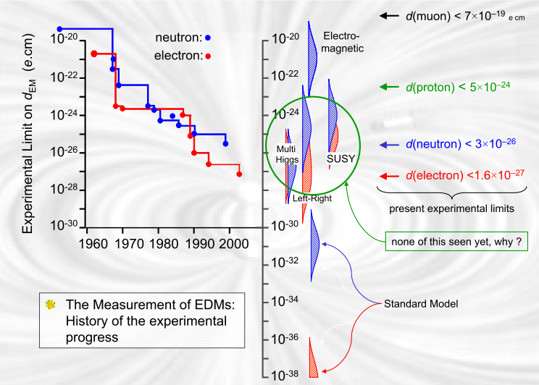
Theoretical predictions
planned
experiments
No Standard Model Background!

Slide 6
Experimental limits
EDM searches: only upper limits yet (in $ecm$)
E-fields accelerate charged part. → search limited to neutral systems
„Traditional“ approach: precession frequency measurement in B and E fields
B
E
B
E
µ d
hf₊ = 2µB + 2dE
hf₋ = 2µB - 2dE

Slide 7
Experimental limits
EDM searches: only upper limits yet
E-fields accelerate charged part. → search limited to neutral systems
„Traditional“ approach: precession frequency measurement in B and E fields
B
E
B
E
µ d
hf₊ = 2µB + 2dE
hf₋ = 2µB - 2dE
Particle/Atom | Current EDM Limit | Future Goal |  𝒅_{𝒏} equivalent
Electron | < 1.6 $$ 10⁻²⁷
Neutron | $$\text{3} ×\text{ 10}\text{−2}\text{6}$$ | ∼10⁻²⁸ | 10⁻²⁸
¹⁹⁹Hg | $$\text{3.1} ×\text{ 10}\text{−2}\text{9}$$ | ∼10⁻²⁹ | 10⁻²⁶
¹²⁹Xe | $$\text{6} ×\text{ 10}\text{−2}\text{7}$$ | ∼10⁻³⁰- 10⁻³³ | ∼10⁻²⁶- 10⁻²⁹
Proton | $$\text{7.9} ×\text{ 10}\text{−2}\text{5}$$ | ∼10⁻²⁹ | 10⁻²⁹
Deuteron | ? | ∼10⁻²⁹ | ∼$\text{3} $10⁻²⁹- $\text{5} $10⁻³¹
(Till now) two kinds of experiments to measure EDMs:
Neutrons
Neutral atoms (paramagnetic/diamagnetic)
No direct measurement of electron or proton EDM yet

Slide 8
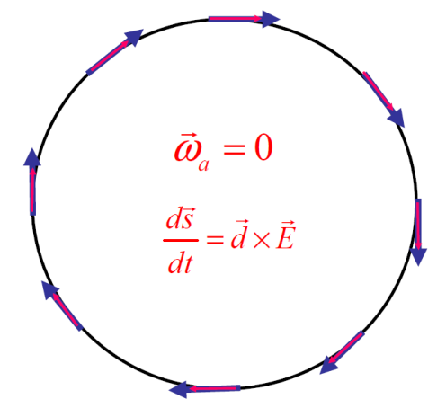
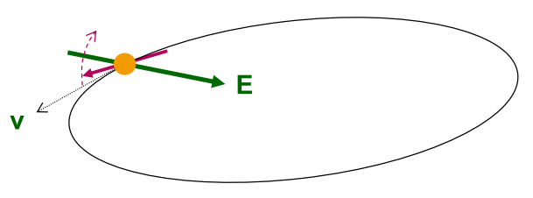
EDM of charged particles: use of storage rings
PROCEDURE
Place particles in a storage ring
Align spin along momentum ( →freeze horizontal spin precession)
Search for time development of vertical polarization
$$\frac{d\vec{s}}{dt}=\vec{d}×\vec{E}$$

Slide 9
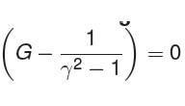
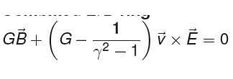
Frozen spin method
Spin motion is governed by Thomas-BMT equation:
d: electric dipole moment μ: magnetic dipole moment
Two options to get rid of terms ∝ G (magic condition):
1. Pure E ring (works only for G>0, e.g proton):
2. Combined E.B ring (works also for G<0, e.g deuteron)

Slide 10
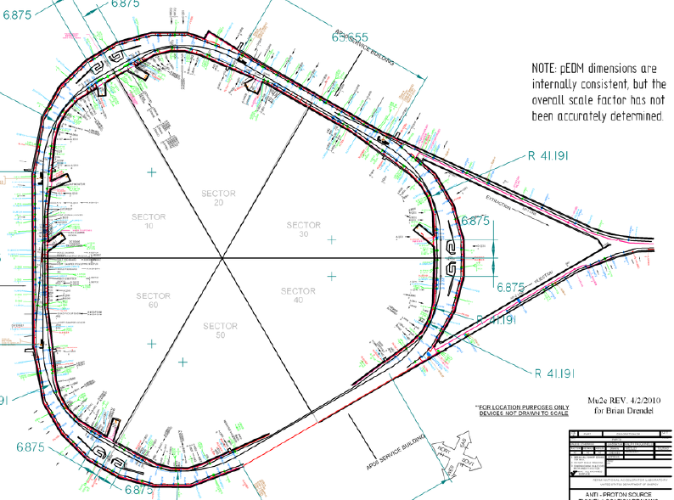
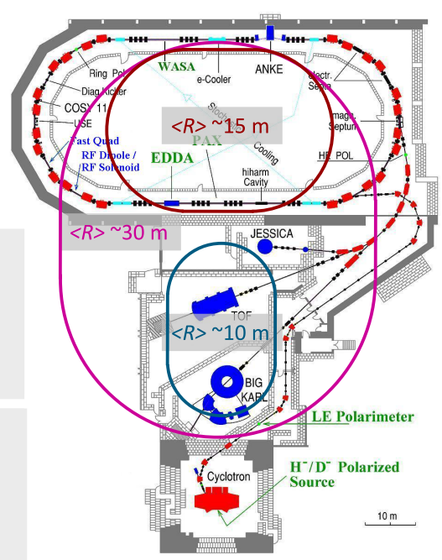
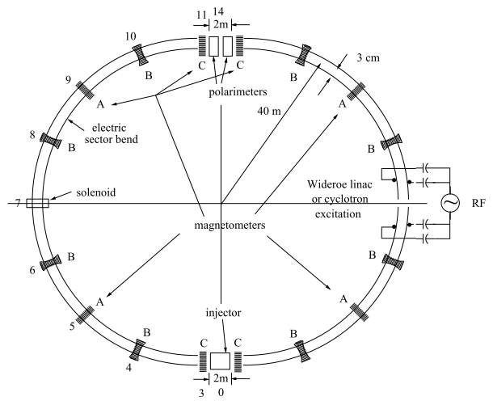
Storage ring projects
pEDM in all electric ring at BNL
Jülich, focus on deuterons, or a combined machine
or at FNAL
(from R. Talman)
CW and CCW propagating beams
(from A. Lehrach)
Two projects: US (BNL or FNAL) and Europe (FZJ)

Slide 11
Feasibility requirements
POLARIMETER
The sensitivity to polarization must by large (0.5).
The efficiency of using the beam must be high (> 1%).
Systematic errors must be managed (< 10^{‒6}).
N.P.M. Brantjes et al. NIMA 664, 49 (2012)
POLARIZED BEAM
Polarization must last a long time (> 1000 s).
Polarization must remain parallel to velocity.
ELECTRIC FIELD, as large as practical (no sparks).
PROTON BEAM POSITION MONITORS (<10 nm)
SYSTEMATIC ERROR PLAN

Slide 12
Systematics
One major source:
Radial B_{r} field mimics EDM effect
Example: d = 10⁻²⁹ e cm with E = 10 MV/m
If μB_{r}≈dE_{r} this corresponds to a magnetic field:
(Earth magnetic field = 5 ∙ 10 ⁻⁵ T)
Solution
Use two beam running clockwise and counterclockwise.
Separation of two beams sensitive to B

Slide 13
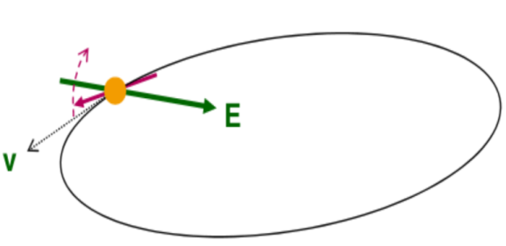
EDM buildup time
Minimal detectable precession
$θ≈{10}^{−6}$ rad
Assuming
$$d≈{10}^{−29}e∙cm$$
$$E=17MV/m$$
$$θ_{EDM}= \frac{2dE}{ℏ}\sim 5\left({10}^{−9}{rad}/s\right)t$$
$$θ_{EDM}\sim \frac{{10}^{−15}rad}{turn}$$
$$1 turn \sim {10}^{−6} s$$
10⁹ turns needed to detect EDM signal
Spin aligned with velocity for t>1000 s (→ spin coherence time next slides)
Feasibility studies @ COSY

Slide 14
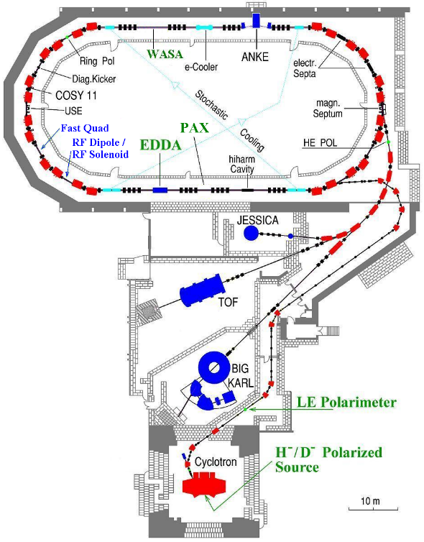
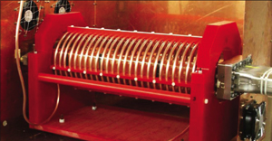
COoler SYnchrotron (FZ-Jülich, GERMANY)
Momentum: <3.7 GeV/c
Circumference: 183 m
Polarized proton and deuteron
Beam polarimeter (EDDA detector )
Instrumentation available for manipulation of
- beam size (electron/stochastic cooling, white noise)
- polarization (RF solenoid)

Slide 15
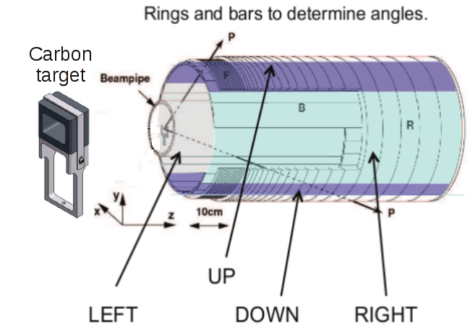
EDDA beam polarimeter
ASYMMETRIES
$$ε_{V}=\frac{L−R}{L+R}∝p_{V}A_{y}$$
beam
VERTICAL polarization
Analyzing power
$$ε_{H}=\frac{U−D}{U+D}∝p_{H}A_{x}$$
HORIZONTAL polarization
Analyzing power
Beam moves toward thick target continuous extraction
Elastic scattering (large cross section for d-C)

Slide 16
Spin coherence time
- Spin coherence along ${\hat{n}}_{co} is not an issue$
Vertical polarization not affected
At injection all
spin vectors aligned (coherent)
After some time, spin vectors get out of phase and fully populate the cone

Slide 17
Spin coherence time
- Spin coherence along ${\hat{n}}_{co} is not an issue$
Vertical polarization not affected
At injection all
spin vectors aligned (coherent)
After some time, spin vectors get out of phase and fully populate the cone
- For $\vec{S}⊥ {\hat{n}}_{co}$ (machines with frozen spin) the situation is different
Longitudinal polarization vanishes!
At injection all spin vectors aligned
Later, spin vectors are out of phase in the horizontal plane
In EDM machine observation time is limited by SCT.

Slide 18
Decoherence: where does it arise?
LONGITUDINAL PHASE SPACE
Problem: beam momentum spread ( )
E.g. Δp/p=1∙10⁻⁴ →Δν_{s}/ν_{s}=2.1x10⁻⁵ →τ_{pol}=63 ms
Solution: use of bunched beam (<Δp/p> = 0)
RF-E
Δp/p ≠ 0 → Δν_{s}/ν_{s} ≠ 0
P. Benati et al. Phys. Rev. ST, 049901 (2013)
TRANSVERSE PHASE SPACE
Problem: beam emittance ≠ 0 → betatron oscillations
Y
Δx (Δy) from reference orbit
X
→ Longer path:
$$\frac{∆L}{L_{0}}=\frac{θ_{x}^{2}+θ_{y}^{2}}{4}$$
Z
→ Higher particle speed → Δν_{s}
E.g. θ = 1∙ mrad → τ_{pol}=9.9 s
Possible solution to this problem investigated at COSY

Slide 19
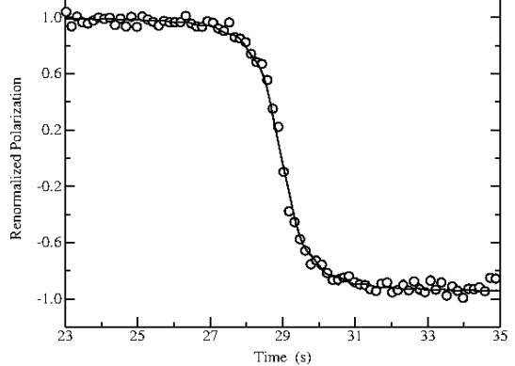
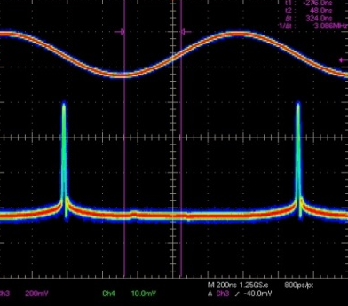
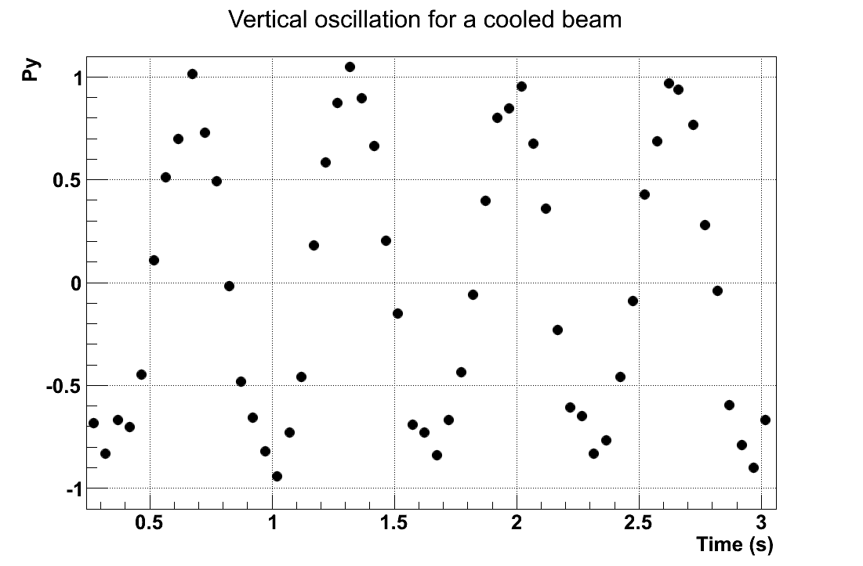
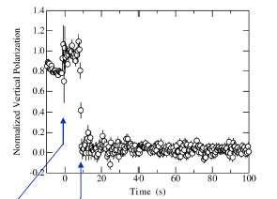
Preparing a longitudinal polarized beam with RF-solenoid
1) Froissart-Stora scan
Identification spin resonance frequency
$$f_{RES}=\left(1−Gγ\right)f_{CYC}≃871434$$
Hz
Vertical polarization
(L-R
asymmetry)
$$Δf=400$$
linear ramping in 40 s
frequency
2) Fixed frequency measurements
On resonance
Vertical polarization
(L-R
asymmetry)
COOLED BEAM
time
3) Solenoid on for half-cycle
Vertical polarization = 0
Polarization is horizontal
(L-R
asymmetry)
time

Slide 20
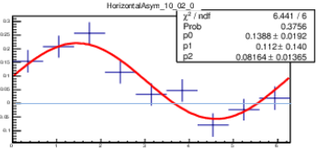
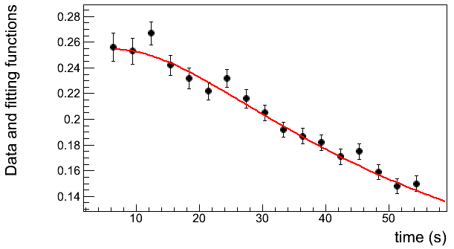
Measurement of the horizonthal SCT
No frozen spin: polarization rotates in the horizonthal plane at 120 kHz
DAQ synchronized with cyclotrhon freqyency -> count turn number N
Compute total spin-precession angle (with spin-tune ν_{s}=Gγ)
Bin by phase around the circle
Compute asymmetry in each bin
x
Phase precession pie
x
(U-D asymmetry)
$$ε_{H}$$
z
$$φ$$
Derivation of horizontal spin coherence time
Amplitude vs time
20
Spin coherence time extracted from numerical fit

Slide 21
Performance
One Store 8x10⁷ turns
Time stamp system
COSY orbit =
183 m
Bunching starts
Cooling starts
Full extraction
starts
Spin-tune and machine stability
Phase over time can be tracked with precision ∼ 10⁻⁸
Stability of the ring magnets < 2x10⁻⁷
from Dennis Eversmann

Slide 22
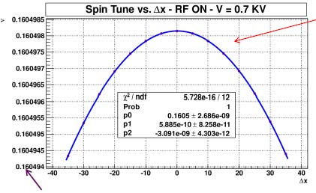
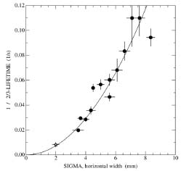
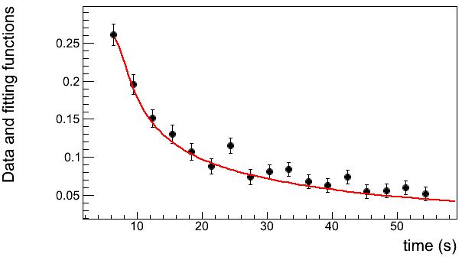
Beam emittance studies
Beam Profile Monitor
Beam preparation
Pol. Bunched deuteron beam at p=0.97 GeV/c
Preparation of beam by electron cooling.
Selective increase of horizontal emittance
Heating through white noise
y
1 fill
x
$$ε_{x}$$
$$ε_{y}$$
Cooling+bunching
Horizonthal heating
Quadratic dependence of spin tune on size of horizonthal betatron oscillation
Investigation of emittance effect on spin-coherence time:
(betatron oscillation → Longer path → different spin tune →spin decoherence)
Narrow profile
Wide profile
$τ_{SCT}=5,0±$0,6 s
$τ_{SCT}=50±2,5$ s
(from A. Pesce)
Simulations (COSY Infinity)
Measurement at COSY
Beam emittance affects spin-coherence time

Slide 23
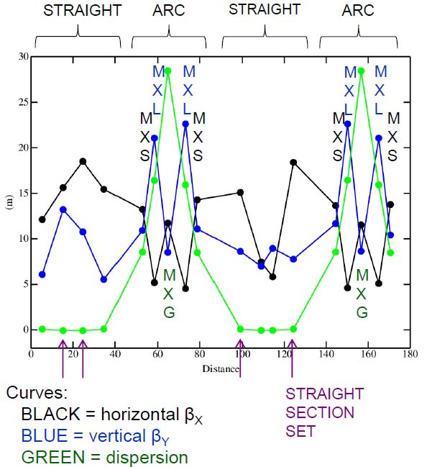
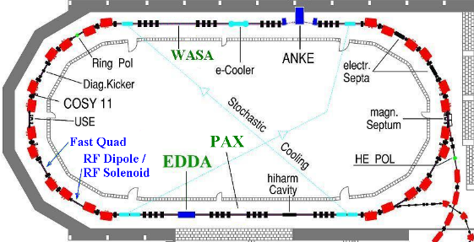
Lengthening the SCT by COSY sextupoles
6-pole field:
$$B=kx^{2}$$
Particle orbit correction
Spin tune spread correction
$$\frac{∆L}{L_{0}}=\frac{θ_{x}^{2}+θ_{y}^{2}}{4}$$
$$∆ν_{s}=GΔγ$$
Use of 6-poles where β_{x} function is maximal
Sextupoles at β_{x} max

Slide 24
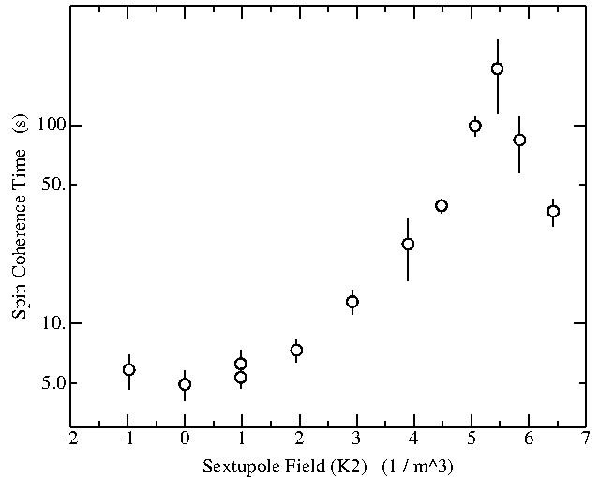
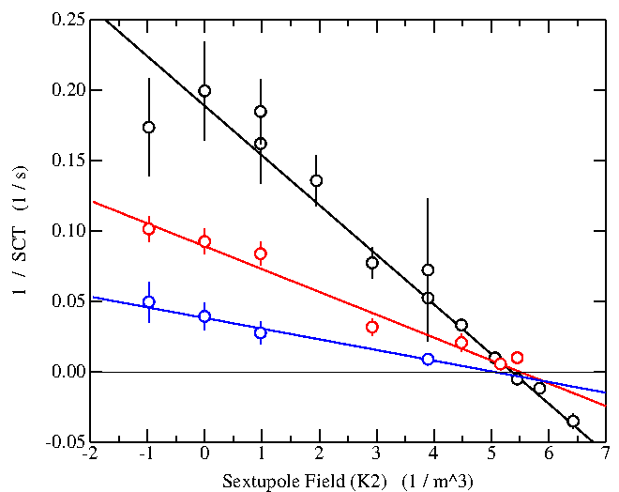
Results
Compensation by means of 6-pole fields:
1/τ_{SCT} = A<θ²_{x}> + a<θ²_{x}> A = original effect
a = sextupole effect
Choose a= -A
SCT $≈200 s$
Wide profile
Medium profile
Different horizontal profile widths
Different slopes
Zero crossing indep. of width
Narrow profile
Same zero crossing!
Sextupole fields can be used to increase $τ_{SCT}!$

Slide 25
Conclusions
Non-zero EDM within the actual experimental limits clear probe of new physics
Polarized beam in Storage Rings might pave the way to first direct measurement of EDM of charged particles.
Technical challenges for the EDM experiment in Storage Ring.
Long Spin Coherence Time.
At the COSY ring dedicated feasibility tests are underway.
SCT studies on a real machine
Emittance affects SCT of the stored beam.
Sextupole field can be effectively used to increase SCT.
.Further developments:
Measurement repetition in y – axis inhibithed by vertical machine acceptance
Compensation of (<ΔP/P>)² with the same principle
Test of spin-tracking codes on the real measurement

Slide 26
Spin coherence time collaboration
Z. Bagdasarian¹, P. Benati², S. Bertelli², D. Chiladze^{1,3}, J. Dietrich³, S. Dimov^{3,4}, D. Eversmann⁵, G. Fanourakis⁶, M. Gaisser³, R. Gabel³, B. Gou³, G. Guidoboni², V. Hejny³, A. Kacharava³,
V. Kamerdzhiev³, P. Kulessa⁷, A. Lehrach³, P. Lenisa², Be. Lorentz³, L. Magallanes⁸, R. Maier³, D. Michedlishvili^{1,3}, W. M. Morse⁹, A. Nass³, D. Öllers^{2,3}, A. Pesce², A. Polyanskiy^{3,10}, D. Prasun³, J. Pretz⁵, F. Rathmnann³, Y. K. Semertzidis⁹, V. Schmakova^{3,4}, E. J. Stephenson¹¹, H. Stockhorst³, H. Ströher³, R. Talman¹², Yu. Valdau^{3,13}, Ch. Weideman^{2,3}, P. Wüstner¹⁴.
¹Tbilisi State University, Georgia
²University and/or INFN of Ferrara, Italy
³IKP Forschungszentrum Jülich, Germany
⁴JINR, Dubna, Russia
⁵III. Physikalisches Institut RWTH Aachen, Germany
⁶Institute of Nuclear Physics NCSR Democritos, Athens, Greece
⁷Jagiellonian University, Krakow, Poland
⁸Bonn University, Germany
⁹Brookhaven National Laboratory, New York, USA
¹⁰Institute of Theoretical and Experimental Physics, Moscow, Russia
¹¹Center for Exploration of Energy and Matter, Indiana University, Bloomington, USA
¹²Cornell University, New York, USA
¹³Petersburg Nuclear Physics Institute, Gatchina, Russia
¹⁴ZEL Forschungszentrum Jülich, Germany

Slide 28
Polarimetry of precessing horizontal polarization
Measurement of horizonal polarization.
No frozen spin: polarization rotates at 120 KHz.
x
(U-D asymmetry)
Polarim.
$$ε_{H}$$
Polarim.
z
$$φ$$
Derivation of horizontal spin coherence time
Amplitude vs time
28
Spin coherence time extracted from numerical fit

Slide 29
Emittance studies on horizonthal SCT
Beam preparation
y
1 fill
x
Injection and acceleration
Cooling
Bunching
$$ε_{x}$$
Selective heating
$$ε_{y}$$
Extraction on target
RF solenoid
SCT measurement
3
27
39
140
Time (s)
Cool & bunch
Horizonthal heating
Investigation of emittance effect on spin-coherence time:
(betatron oscillation → Longer path → different spin tune →spin decoherence)
Narrow profile
Wide profile
$τ_{SCT}=5,0±$0,6 s
$τ_{SCT}=50±2,5$ s
Beam emittance affects spin-coherence time

