Slide 1
POLARIZED ³He SPIN FILTERS for NEUTRON SCIENCE
Tom Gentile
National Institute of Standards and Technology (NIST)

Slide 2
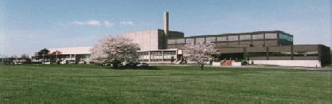
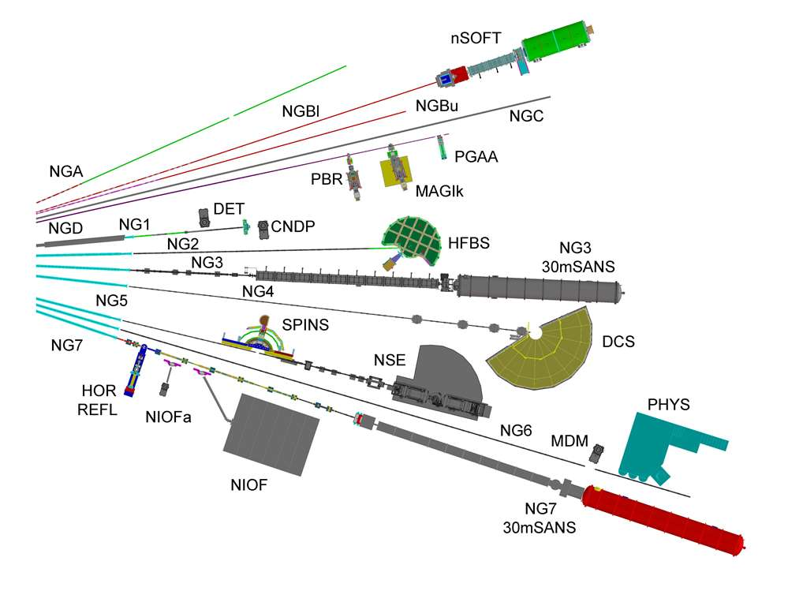
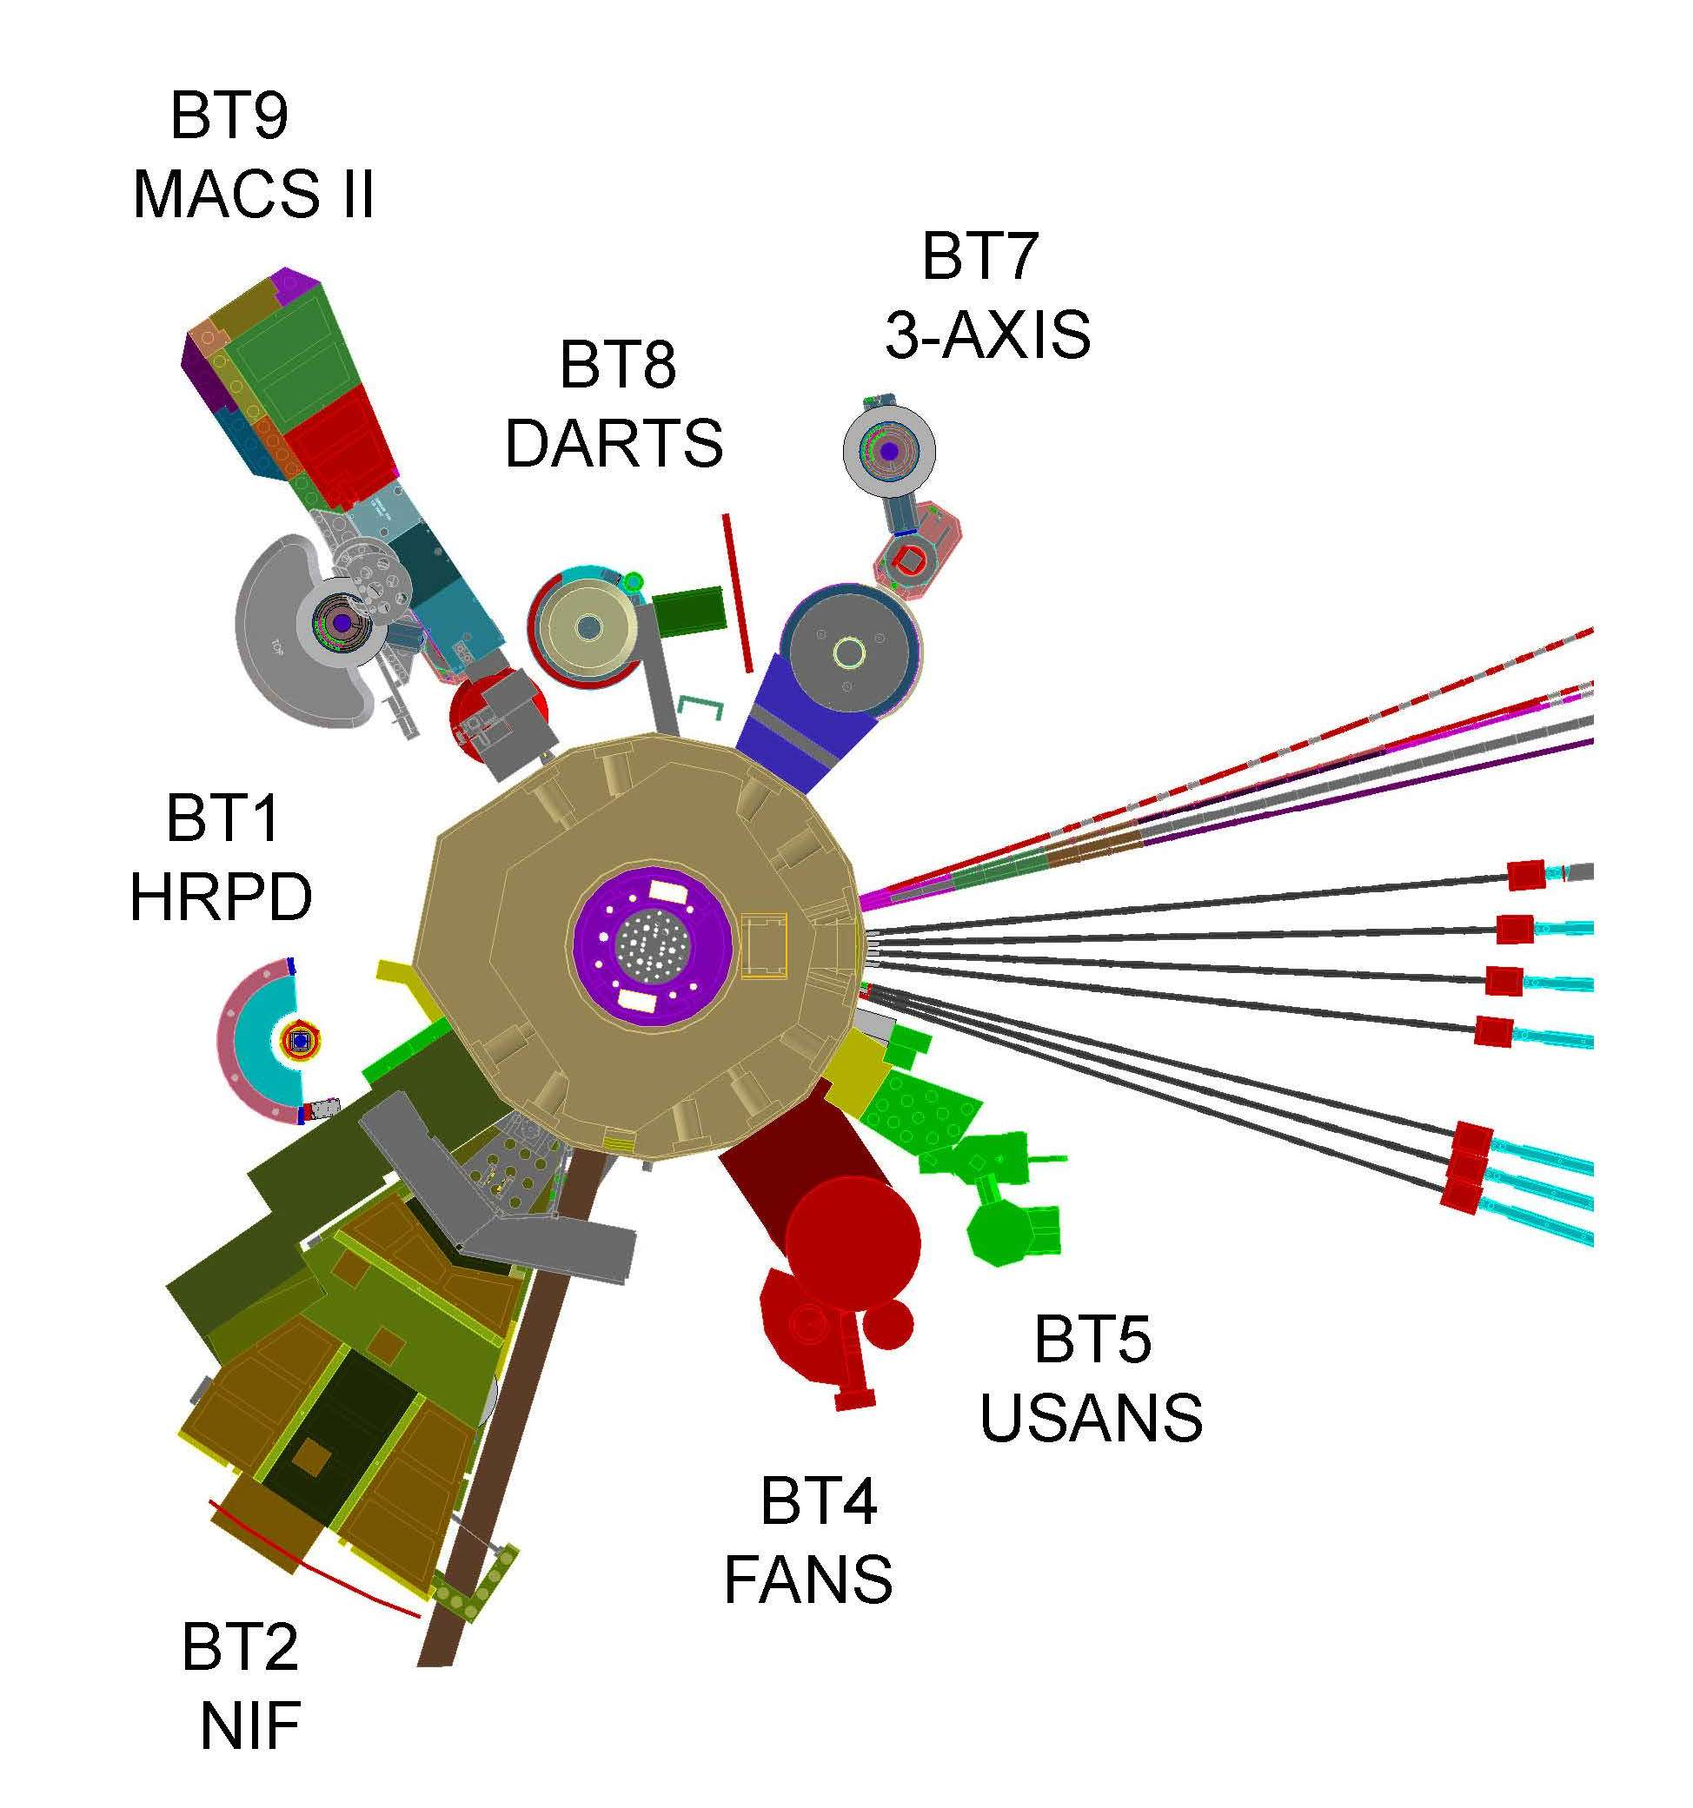
NIST Center for Neutron Research (NCNR), Gaithersburg, Maryland
20 MW research reactor in operation for over four decades
Cold neutron research facility operated since 1990

Slide 3
POLARIZED ³He NEUTRON SPIN FILTERS
strong spin-dependence of the neutron absorption cross section
unpolarized incoming neutrons
polarized ³He
polarized outgoing neutrons
K.P. Coulter et al, Nucl. Instrum. Meth. A 288, 463 (1990)

Slide 6
PRECISION NEUTRON POLARIMETRY with POLARIZED ³He
t = opacity = cross section * ³He density * cell length
P_{n}= neutron polarization
T_{n} = transmission of polarized cell
T₀ = T_{E} exp(-t) = transmission of unpolarized cell
T_{E} = transmission of empty cell
NEUTRON POLARIZATION determined from transmission
cross section proportional to λ − time of flight analysis ideal
PHYSICS ASYMMETRY proportional to P_{n}

Slide 7
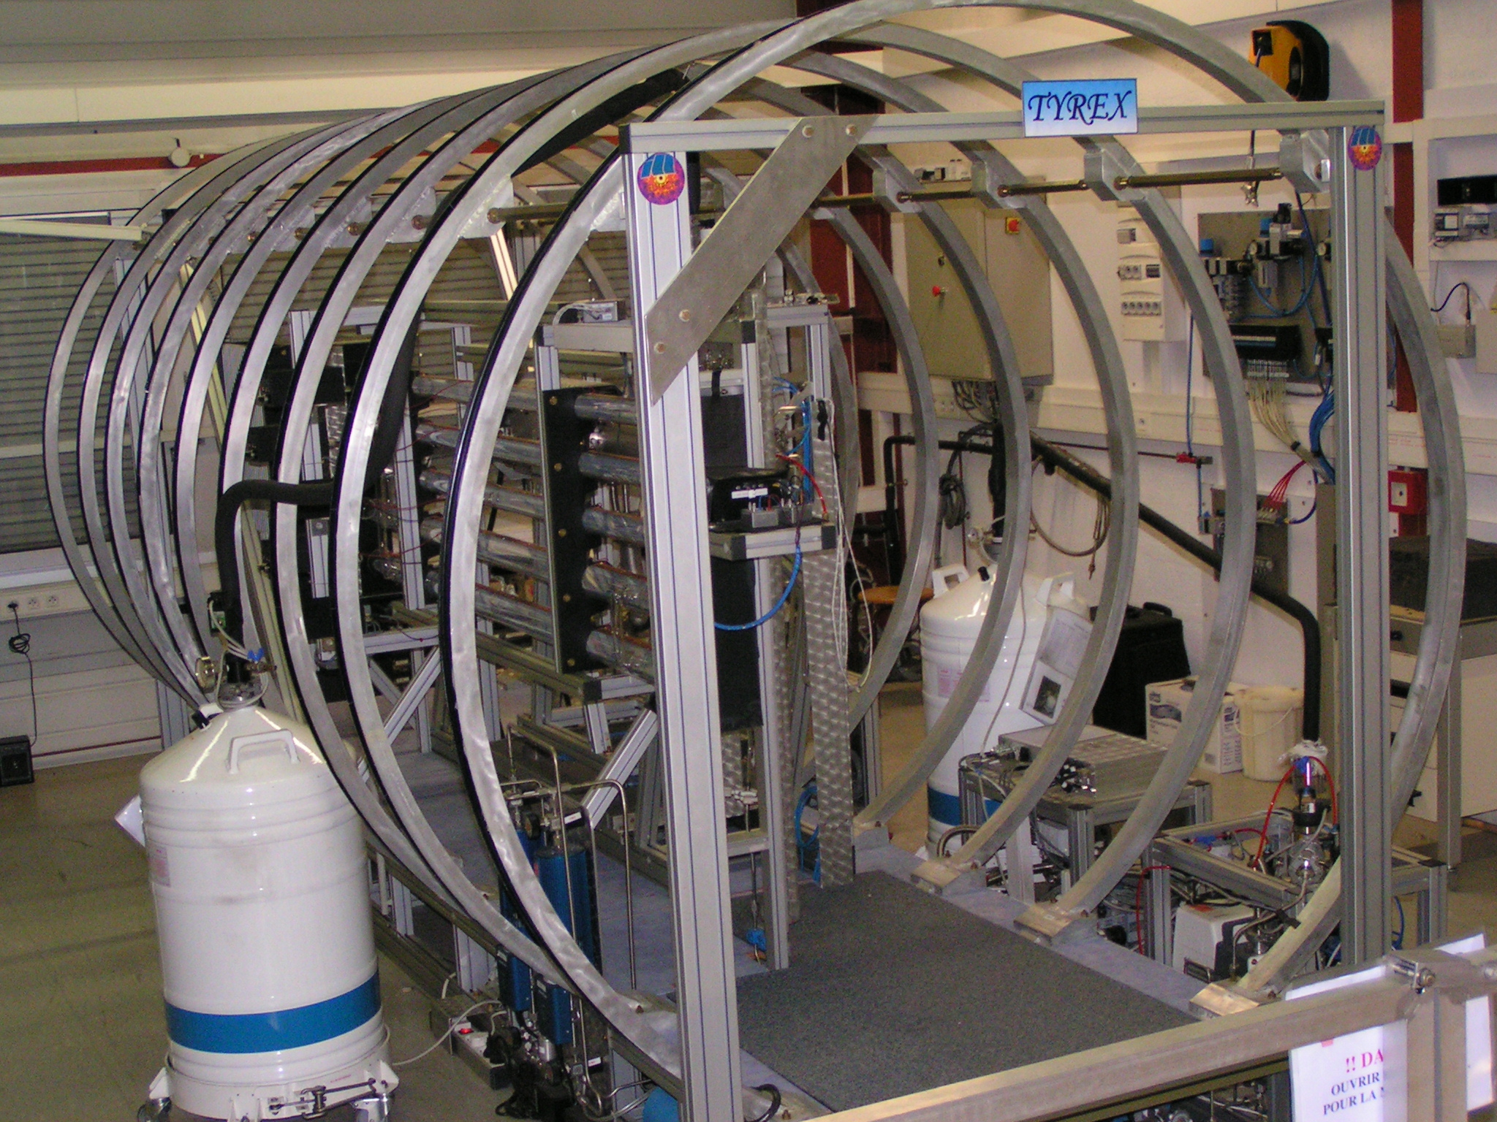
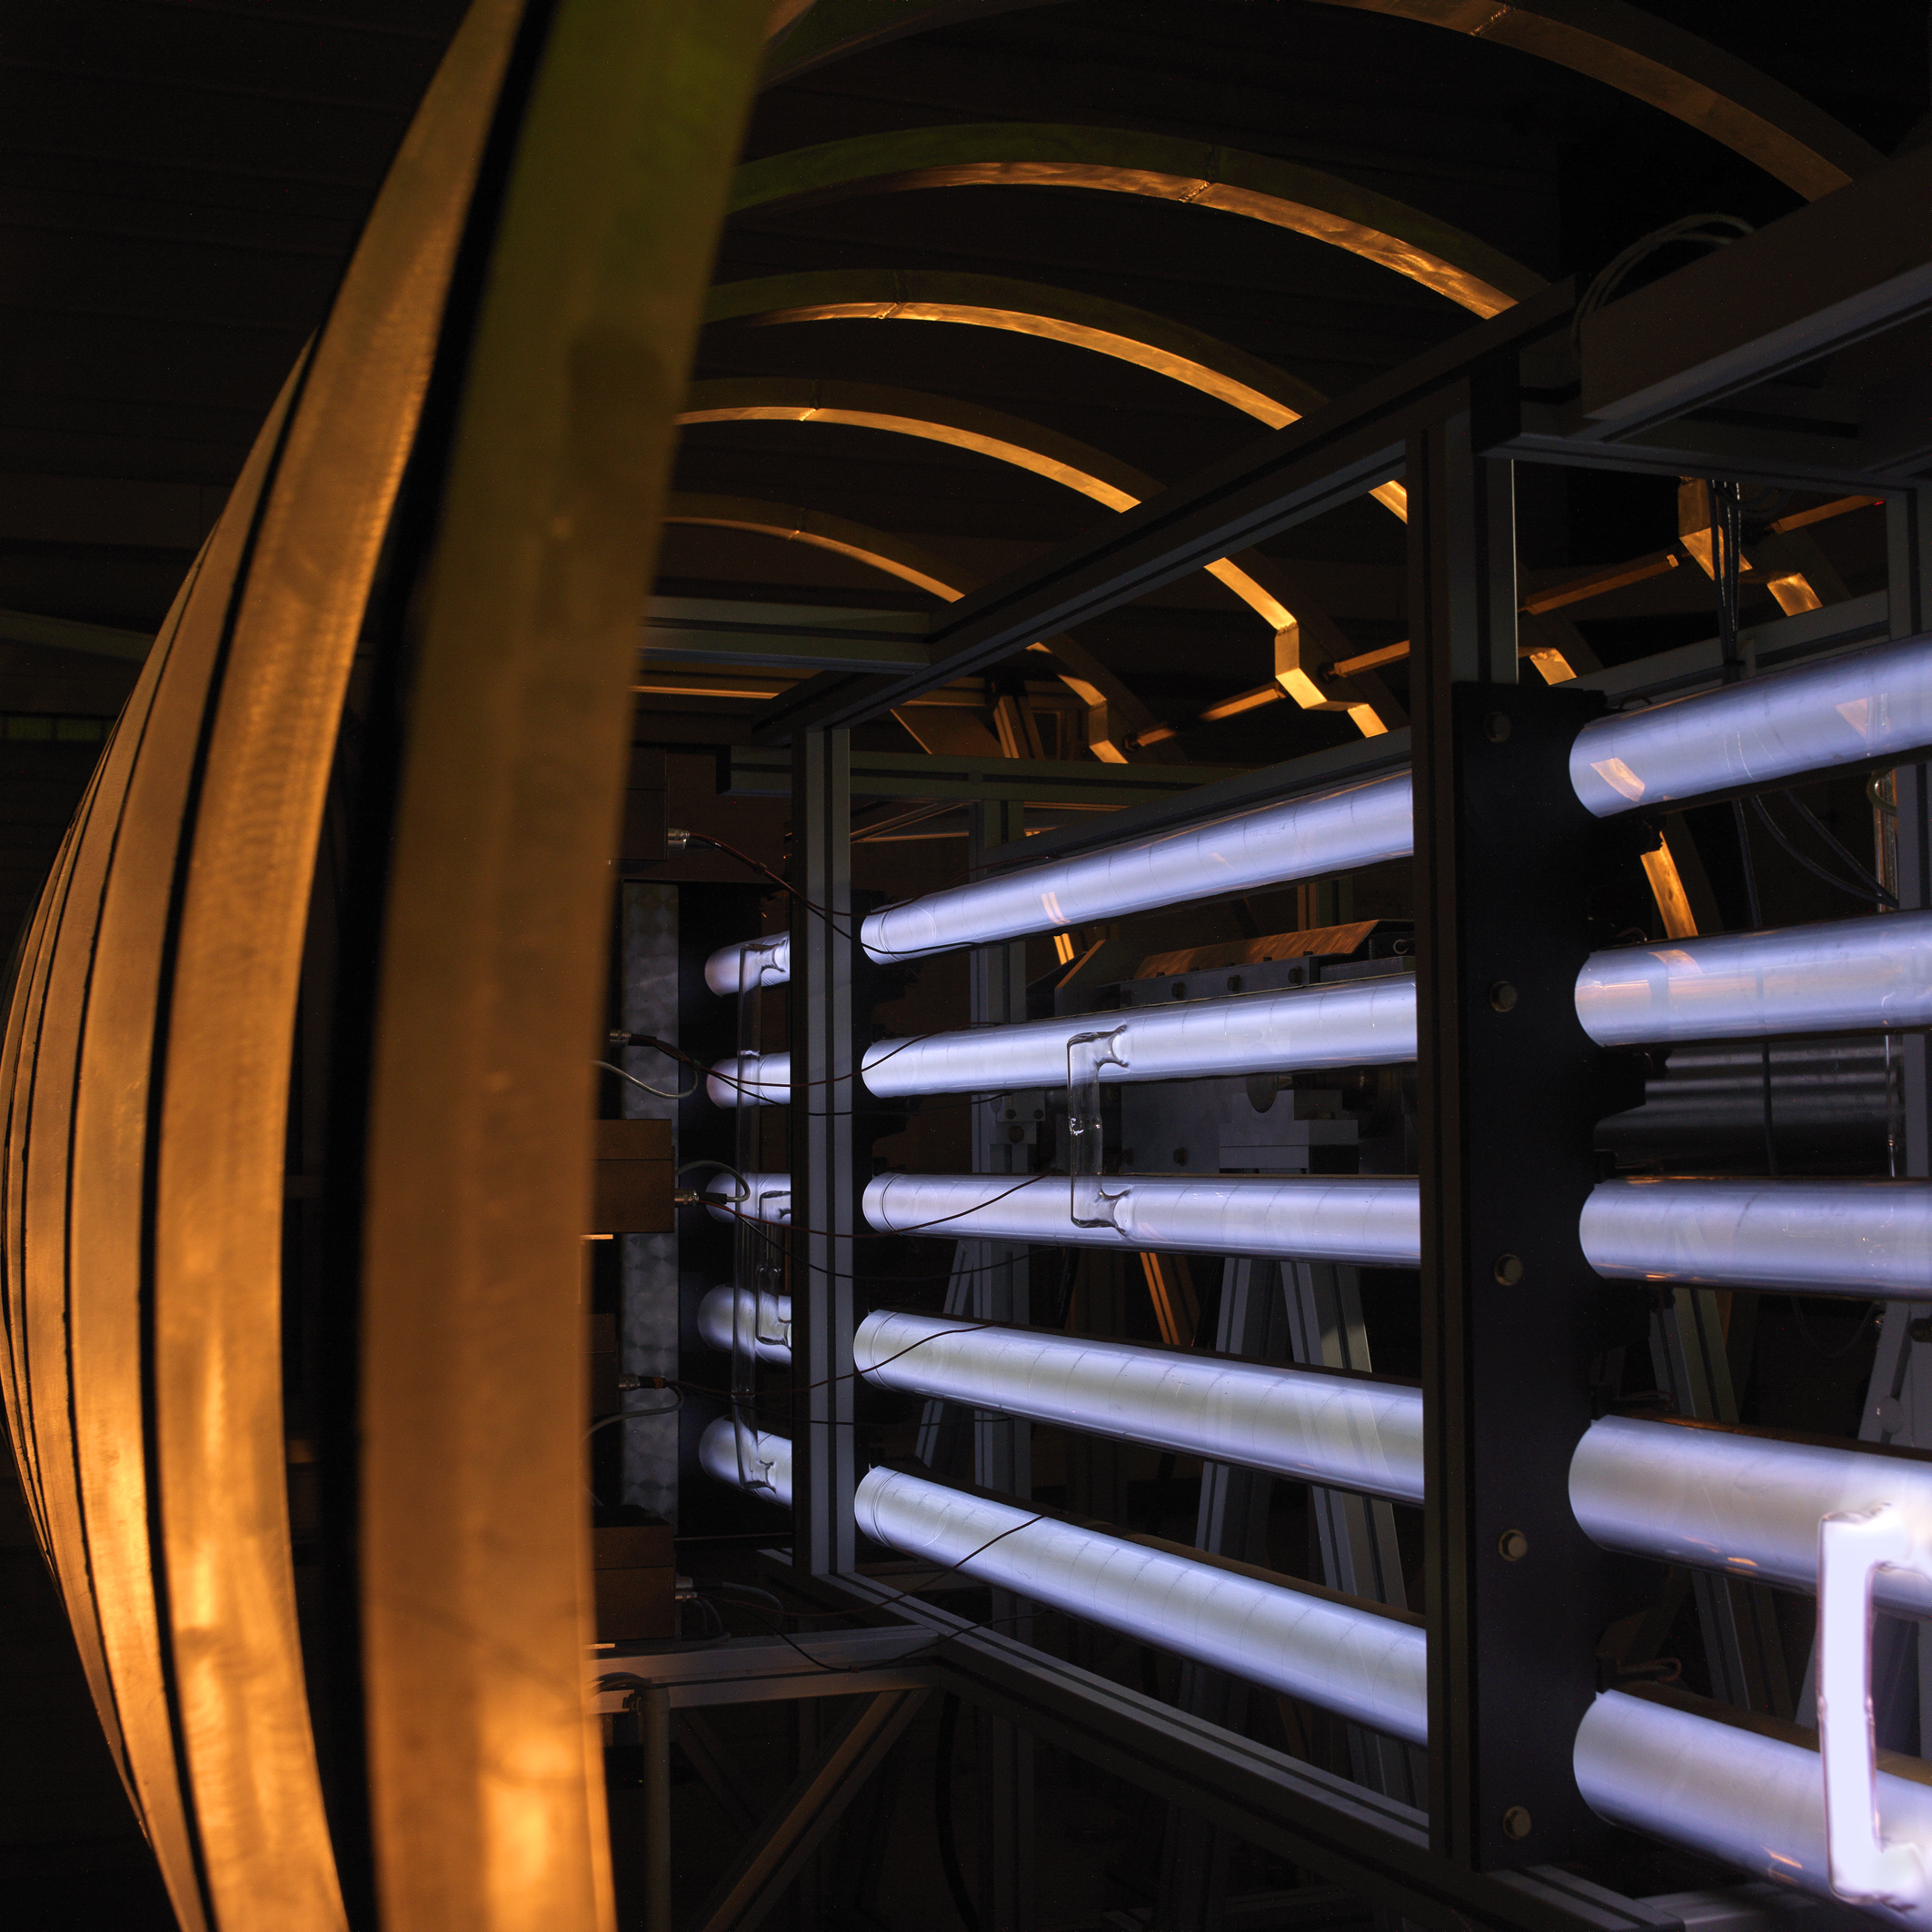
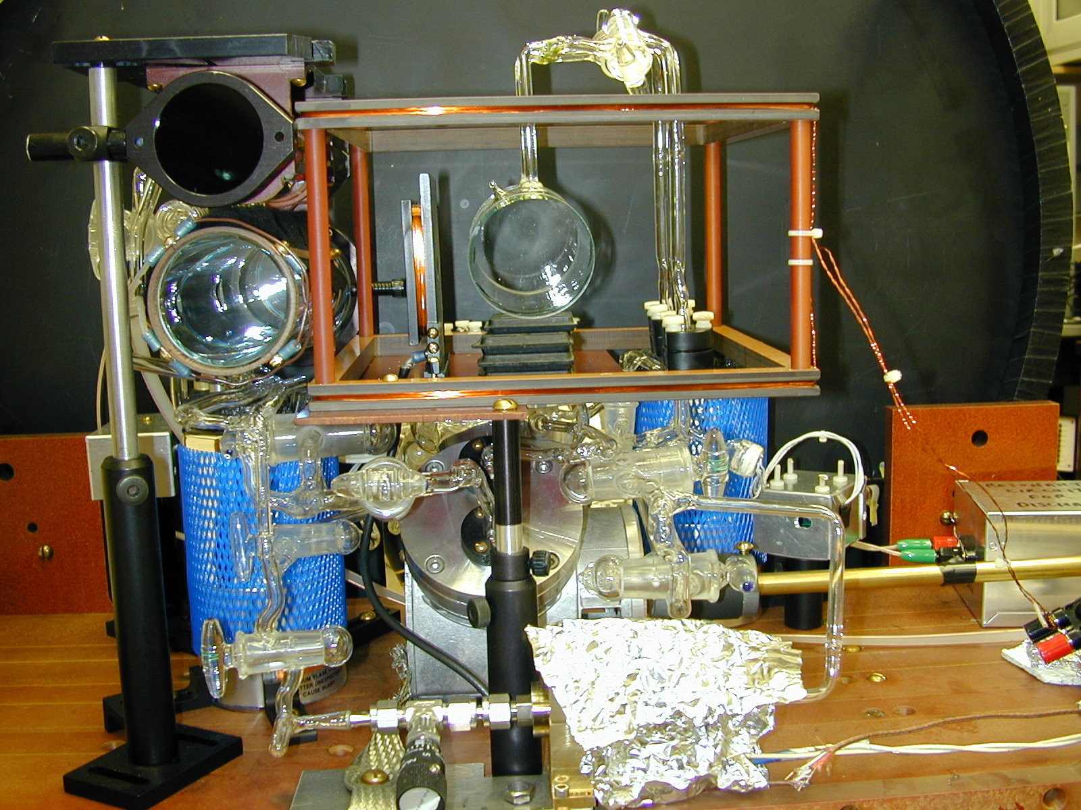
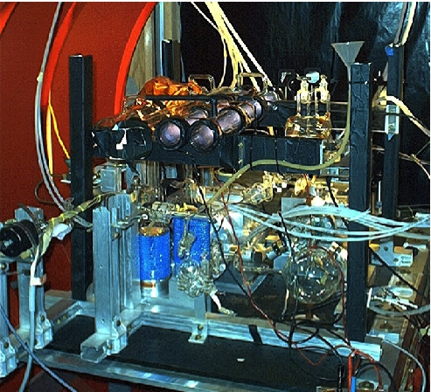
METASTABILITY-EXCHANGE OPTICAL PUMPING COMPRESSION SYSTEMS
“TYREX”
at the ILL
75 - 80%
³He pol.
> 1 bar-L/h
photos from
D. Jullien
NIST
diaphragm
pump
Indiana U
piston
compressor

Slide 8
OPTICAL PUMPING
of RUBIDIUM (Rb)
SPIN-EXCHANGE
FROM Rb TO ³He
Spin exchanged from Rb electron to ³He nucleus slowly through the hyperfine interaction.
795 nm light pumps Rb electron
Rb atom
electron spin
collisional
mixing
5p ²P_{1/2}
collisional
decay
σ⁺
795 nm
³He atom
nuclear spin
5s ²S_{1/2}
m_{s} = -1/2
m_{s}= + 1/2
M.A. Bouchiat, T.R. Carver and C.M Varnum, Phys. Rev. Lett. 5, 373 (1960)
T.E. Chupp et al, Phys. Rev. C 36, 2244 (1987)

Slide 10
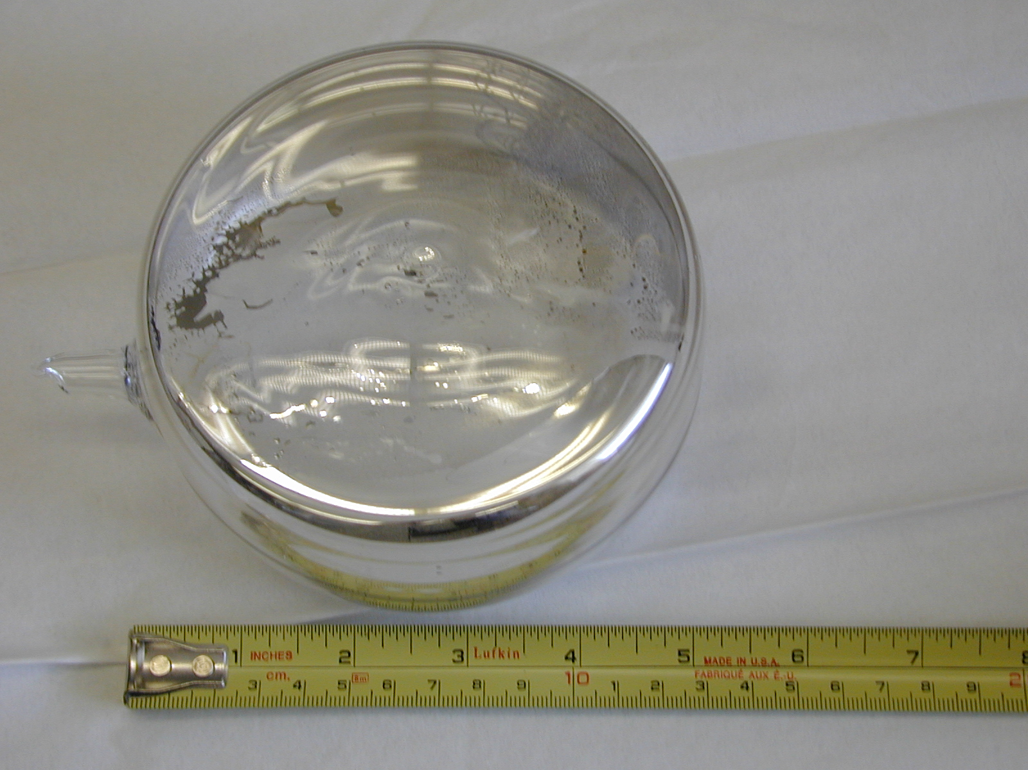
“ASTRO”
Relaxation time
= 730 hours
Yeah !

Slide 12
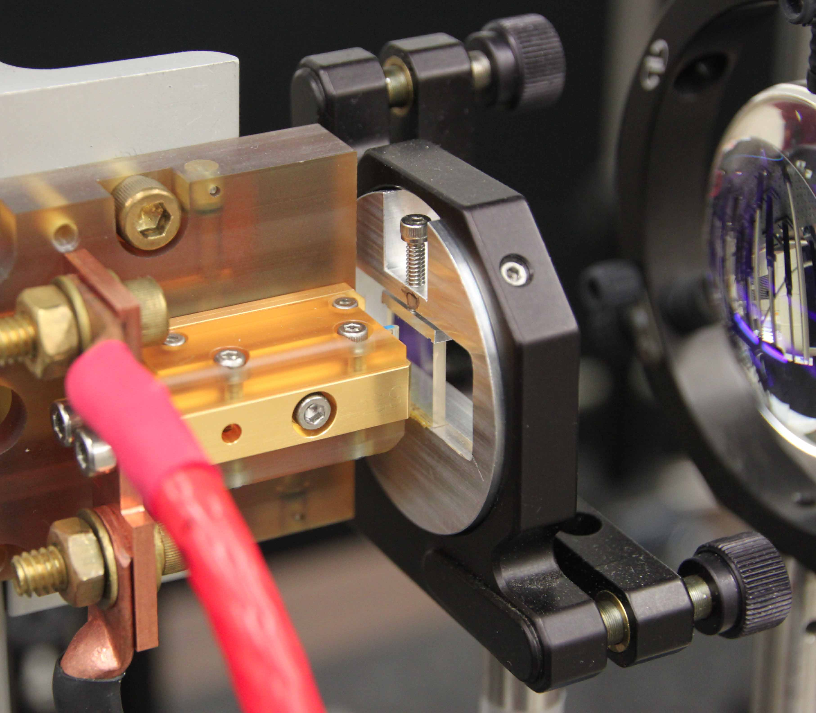
100 W DIODE BAR with CHIRPED VOLUME BRAGG GRATING

Slide 13
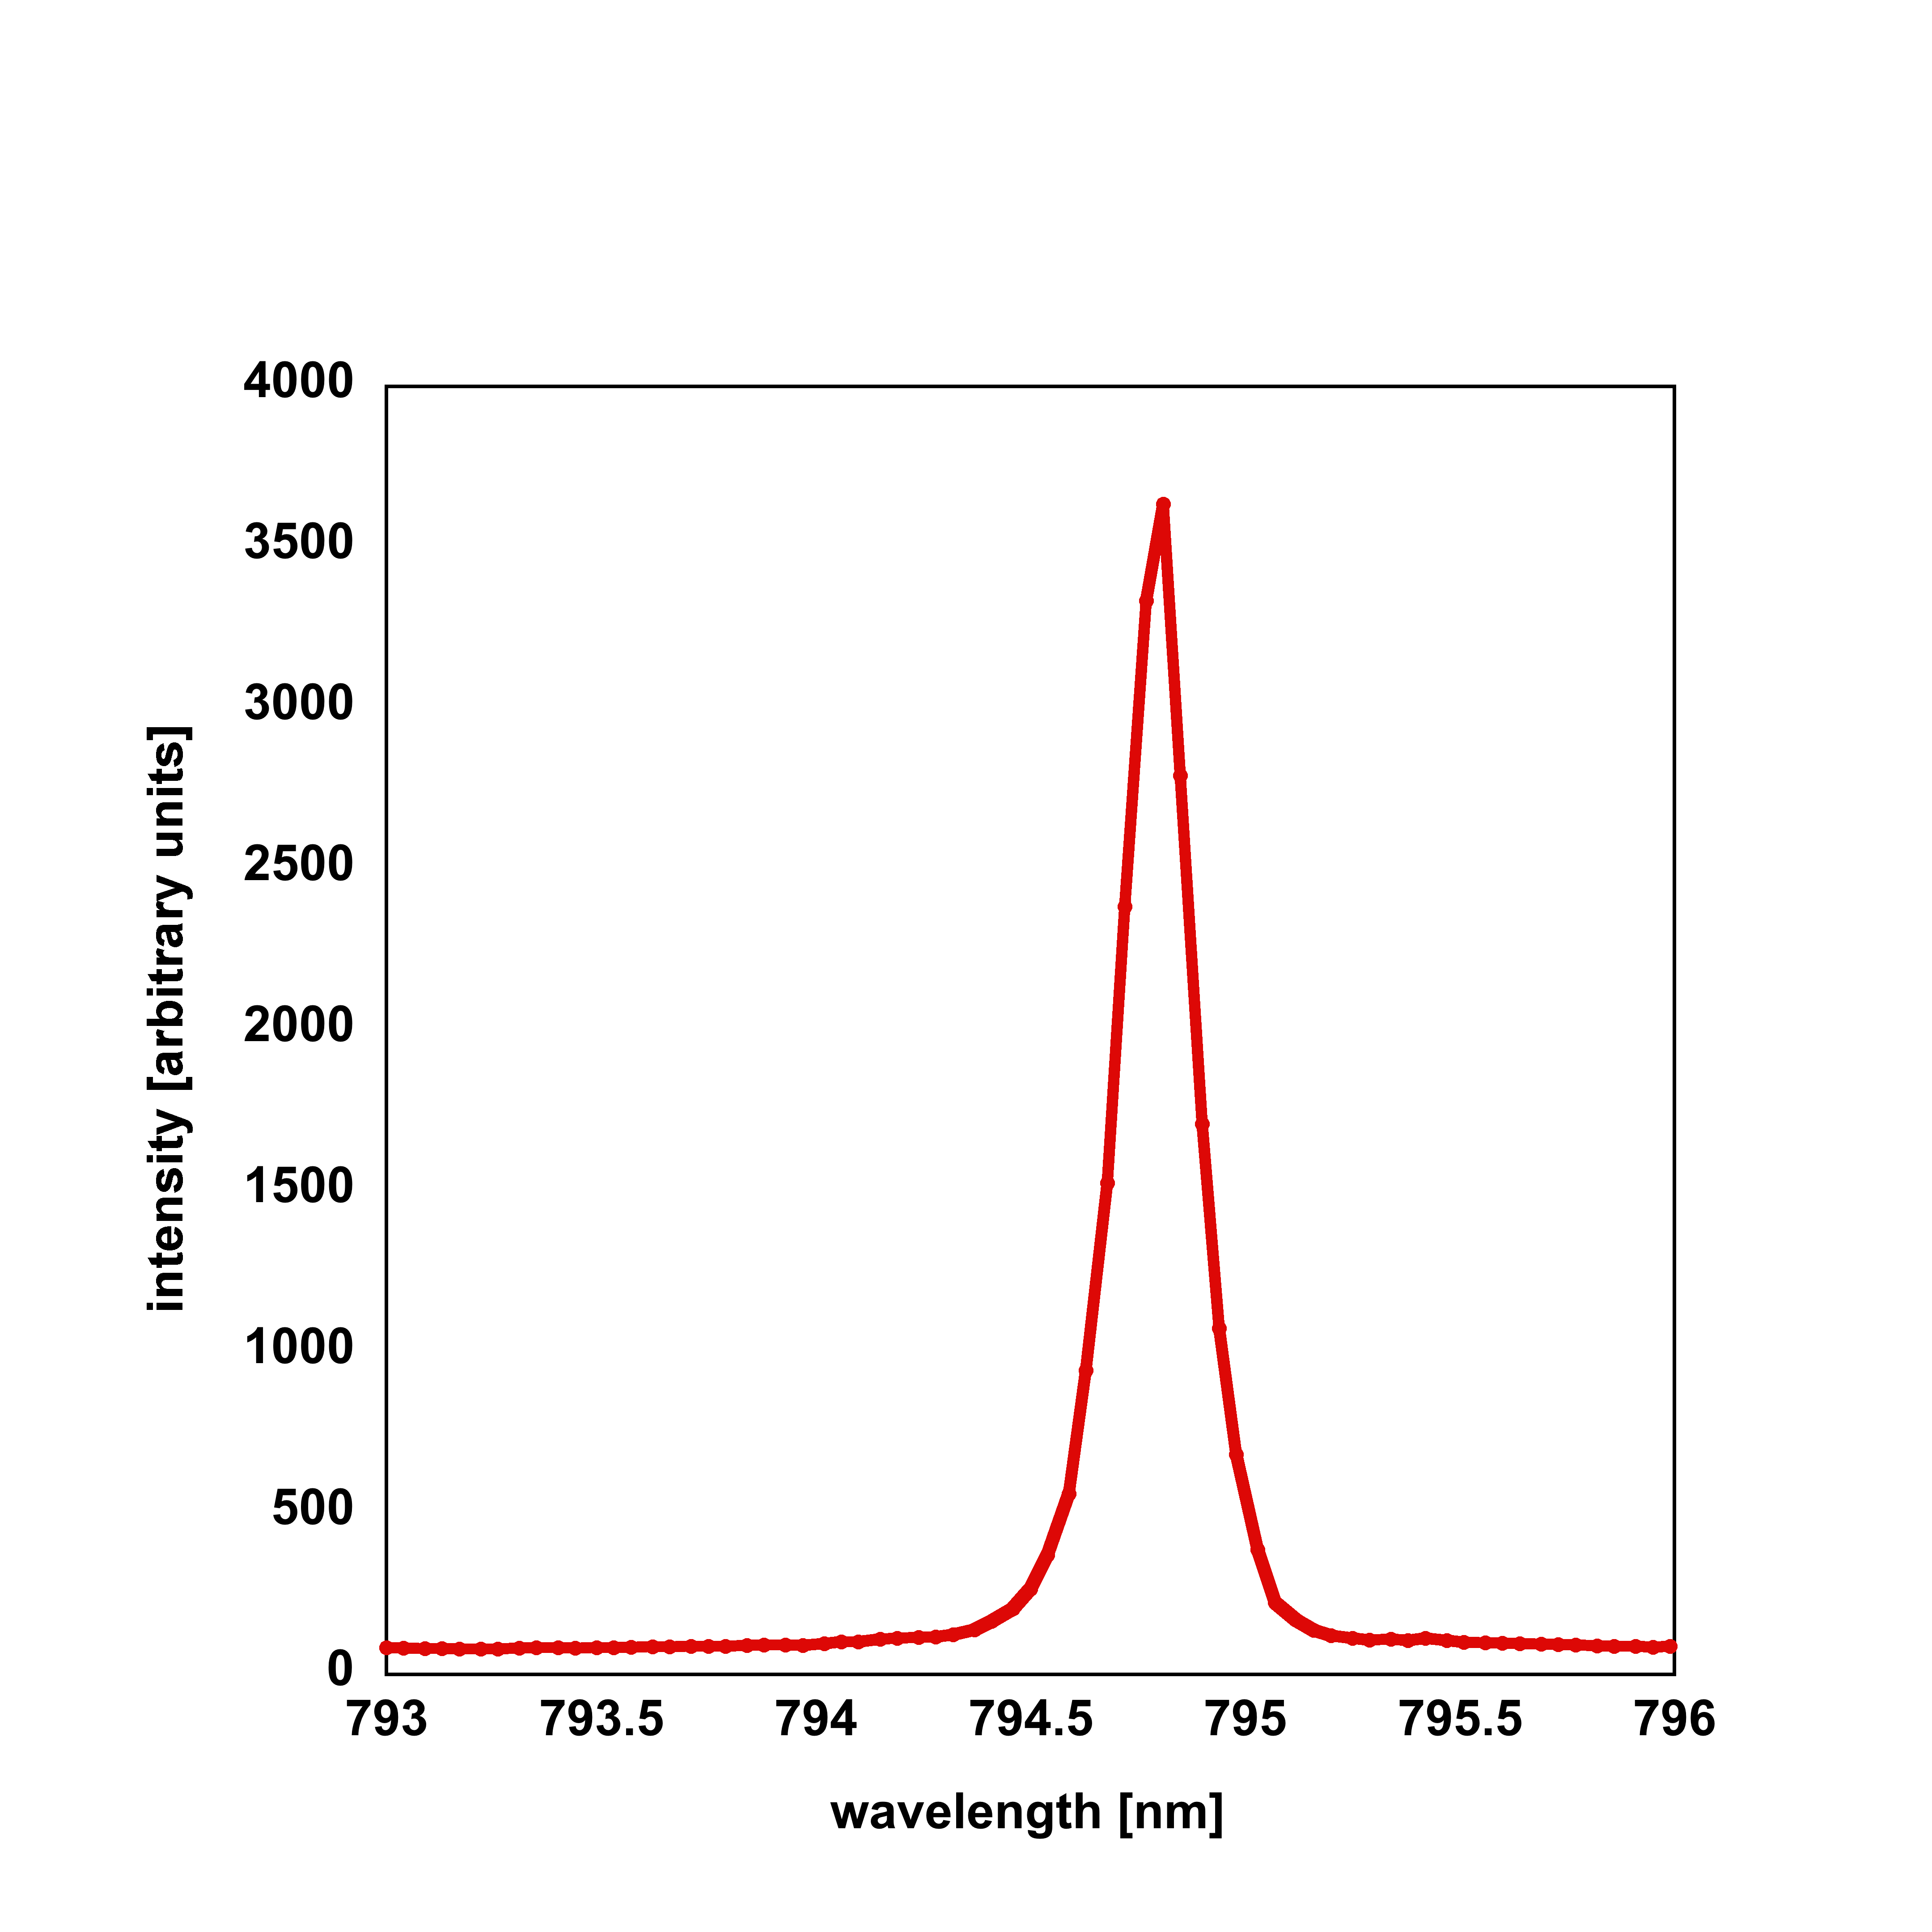
SPECTRUM of 100 W LASER with CHIRPED VBG

Slide 14
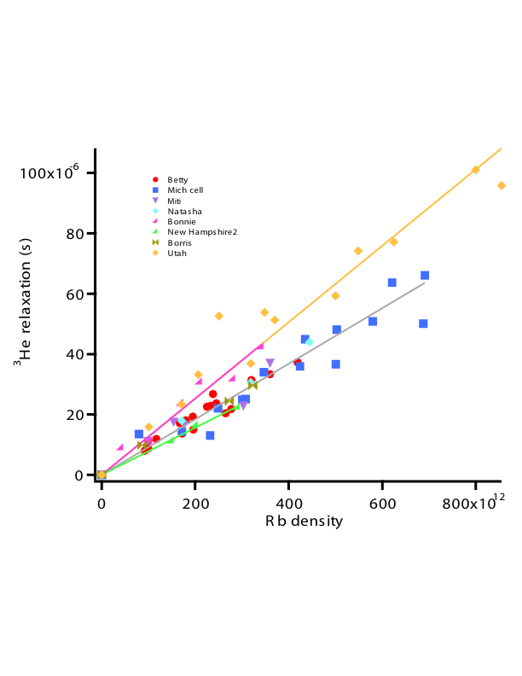
B. Chann et al, J. Appl. Phys. 94, 6908-6914 (2003)
B. Chann et al, Phys. Rev. A 66, 032703 (2002)

Slide 15
X vs. S/V
Univ. of Wisconsin data
(hot relaxation, polarization)
NIST data
(polarization)
E. Babcock et al, Phys. Rev. Lett. 96, 083003 (2006)

Slide 16
STATUS OF ³He POLARIZATION ACHIEVABLE with SEOP
FOR X ~ 0.25 - 3, POLARIZATION LIMITED TO 75 – 80%
- due to observed temperature dependence of wall relaxation
UNTIL late 2010, WHEN WE SWITCHED TO SPECTRAL NARROWING with CHIRPED VBGs :
CELL VOLUME T₁ P_{He} (chirped) P_{He} (diffraction)
Burgundy 895 203 0.85 0.78
Maverick 615 208 0.82 0.77
Syrah 790 450 0.83 0.77
Chablis 945 190 0.77 0.72
Olaf 545 350 0.80 0.72
Chardonnay 400 390 0.84 0.77
Wilma 91 830 0.80 0.76
Betty 81 240 0.79 0.72
CONCLUSION: VOLUME-AVERAGED ALKALI-METAL POLARIZATION WAS NOT 100%

Slide 17
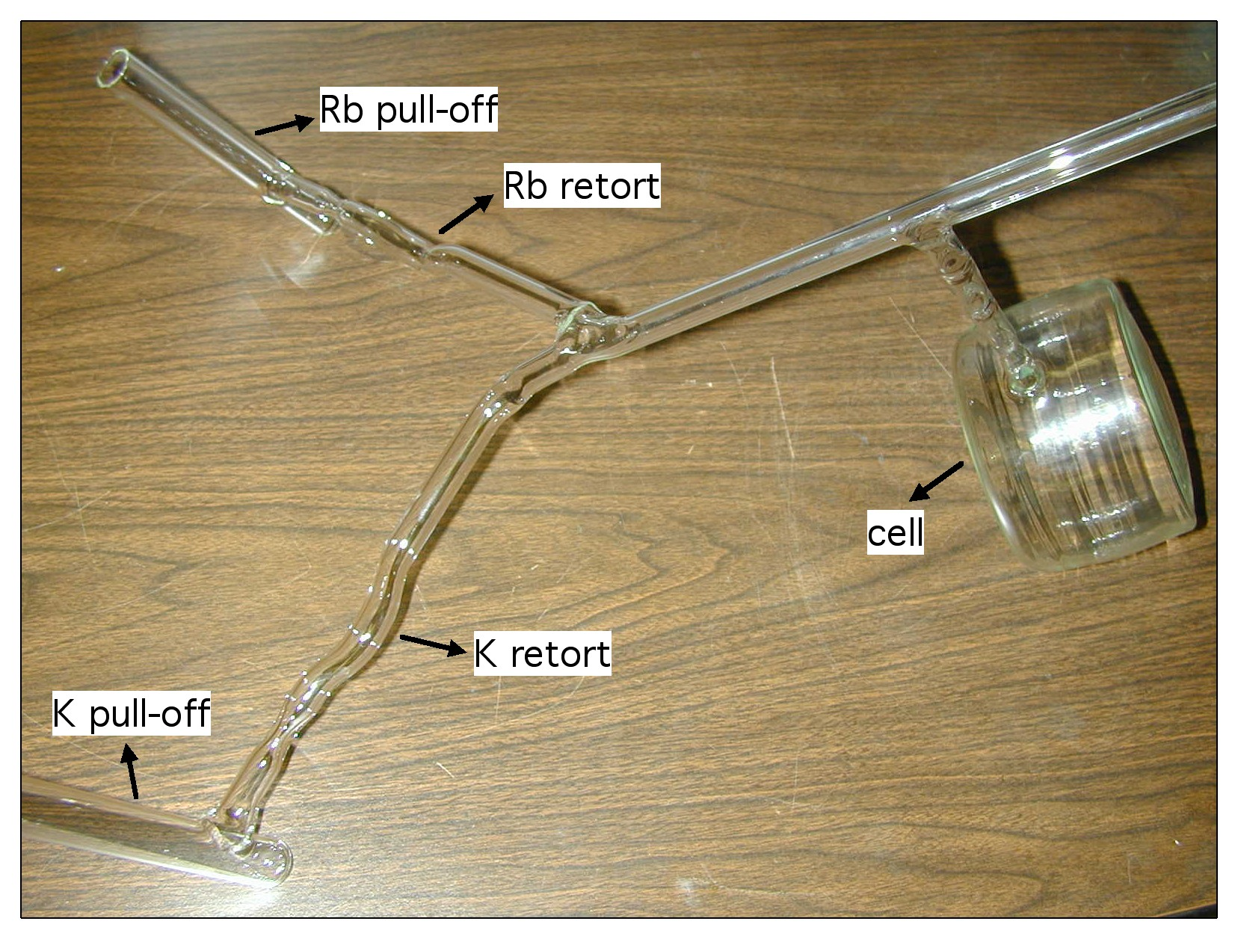
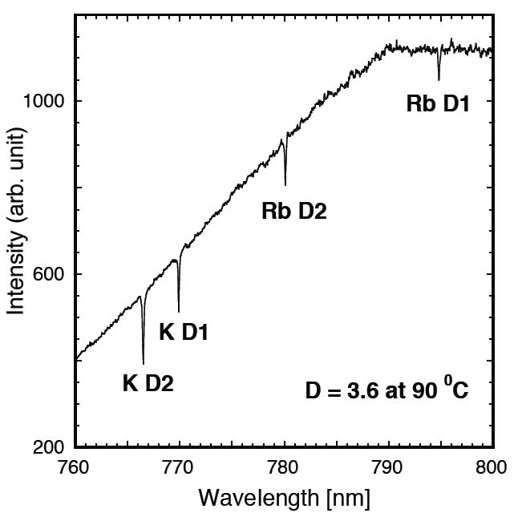
“HYBRID” SEOP:
Rb/K mixtures to decrease alkali spin destruction rate
E. Babcock et al., Phys. Rev. Lett. 91, 123003 (2003)

Slide 18
MAGNETIC FIELD EFFECTS on CELLS
“T₁ hysteresis" - SEOP cells can be magnetized and demagnetized
R.E. Jacob, S.W. Morgan, B. Saam, and J.C. Leawoods, Phys. Rev. Lett. 87, 143004 (2001).
Orientation of cell in a low field can affect relaxation time
R.E. Jacob, J. Teter, B. Saam, W.C. Chen, and T.R. Gentile, Phys. Rev. A 69, 021401(R) (2004)
In general, T₁ can depend on magnetic field direction, strength and history

Slide 19
NEUTRON SCATTERING APPLICATIONS
NIST Center for Neutron Research program
2007 – date
Wangchun Chen
Shannon Watson
Ross Erwin (BT7 triple-axis spectrometer)
Kathryn Krycka (small angle neutron scattering)

Slide 20
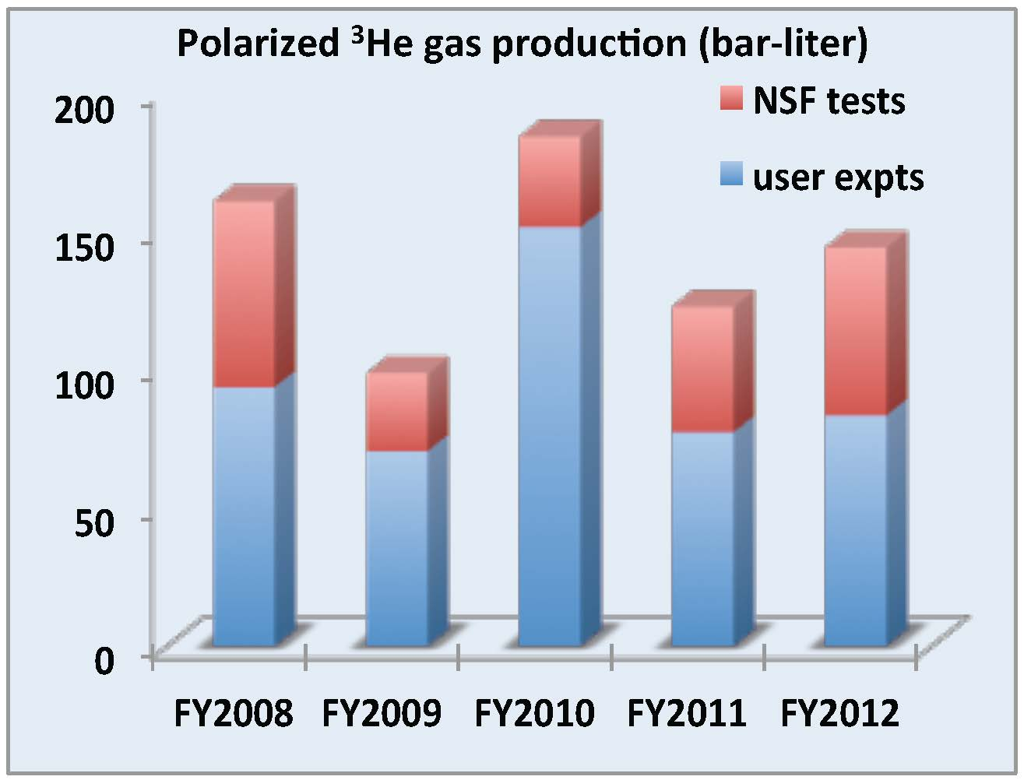
³He neutron spin filter applications at the NCNR
Last 5 years
110 experiments
350 days of beam time
700 bar-liter ³He gas polarized
Over 30 publications (8 PRLs)
³He Neutron Spin Filters
Notes:
20
Here shows a survey from polarized beam experiments during the last 5 years. We have polarized about 700 bar-liter of 3He gas, There are over 30 publications including 8 PRLs. At the very beginning we have spent lots of time for polarized beam development.

Slide 21
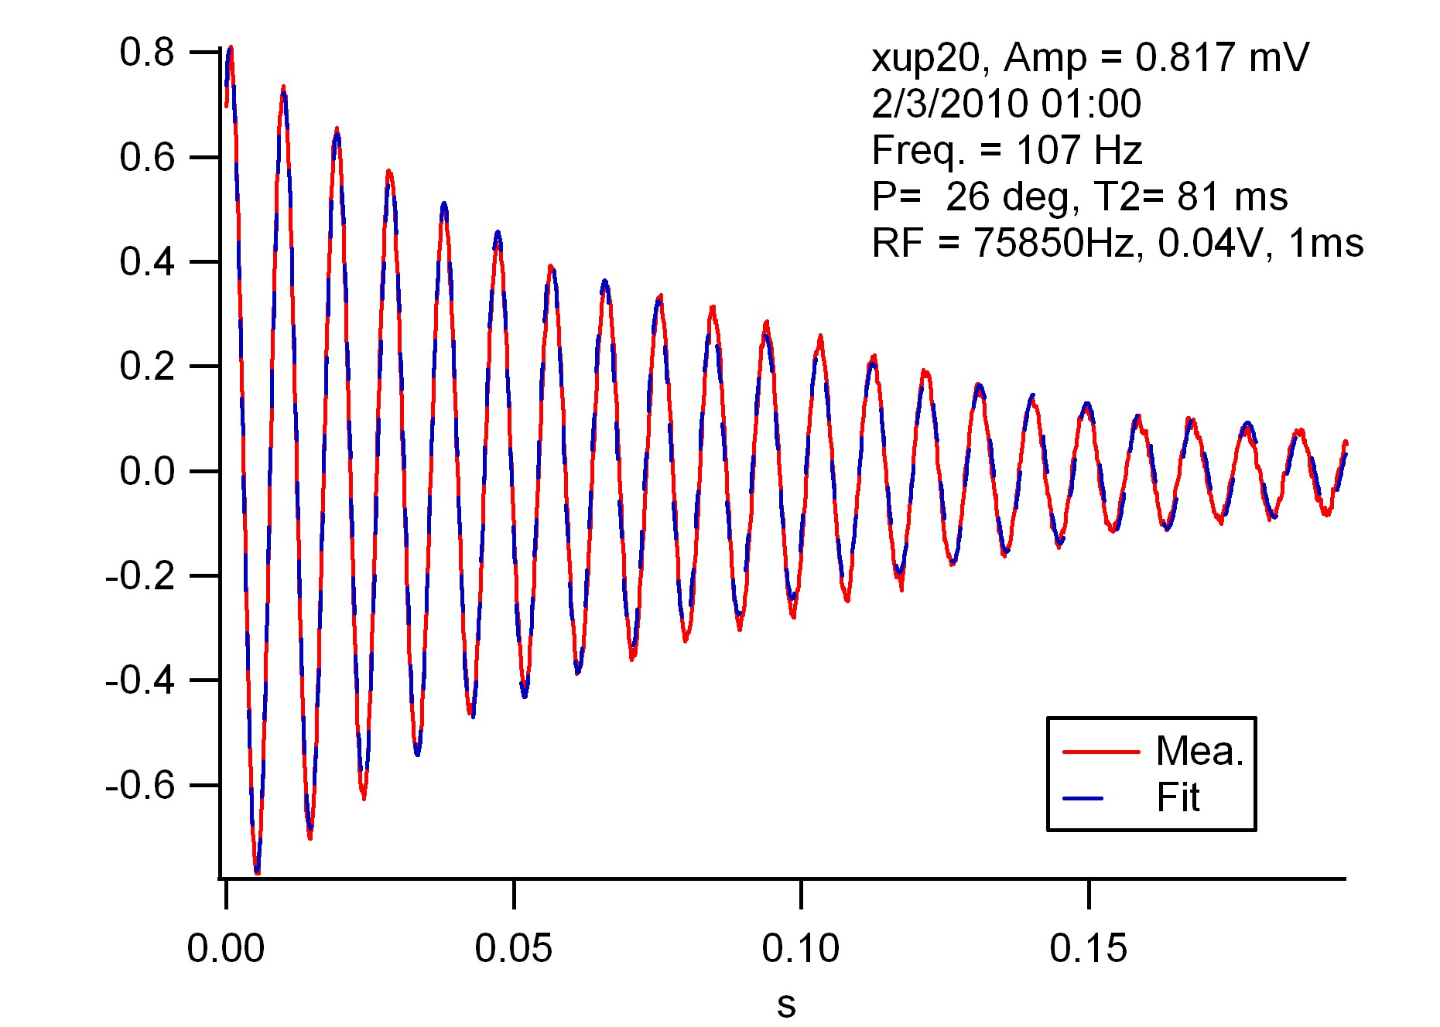
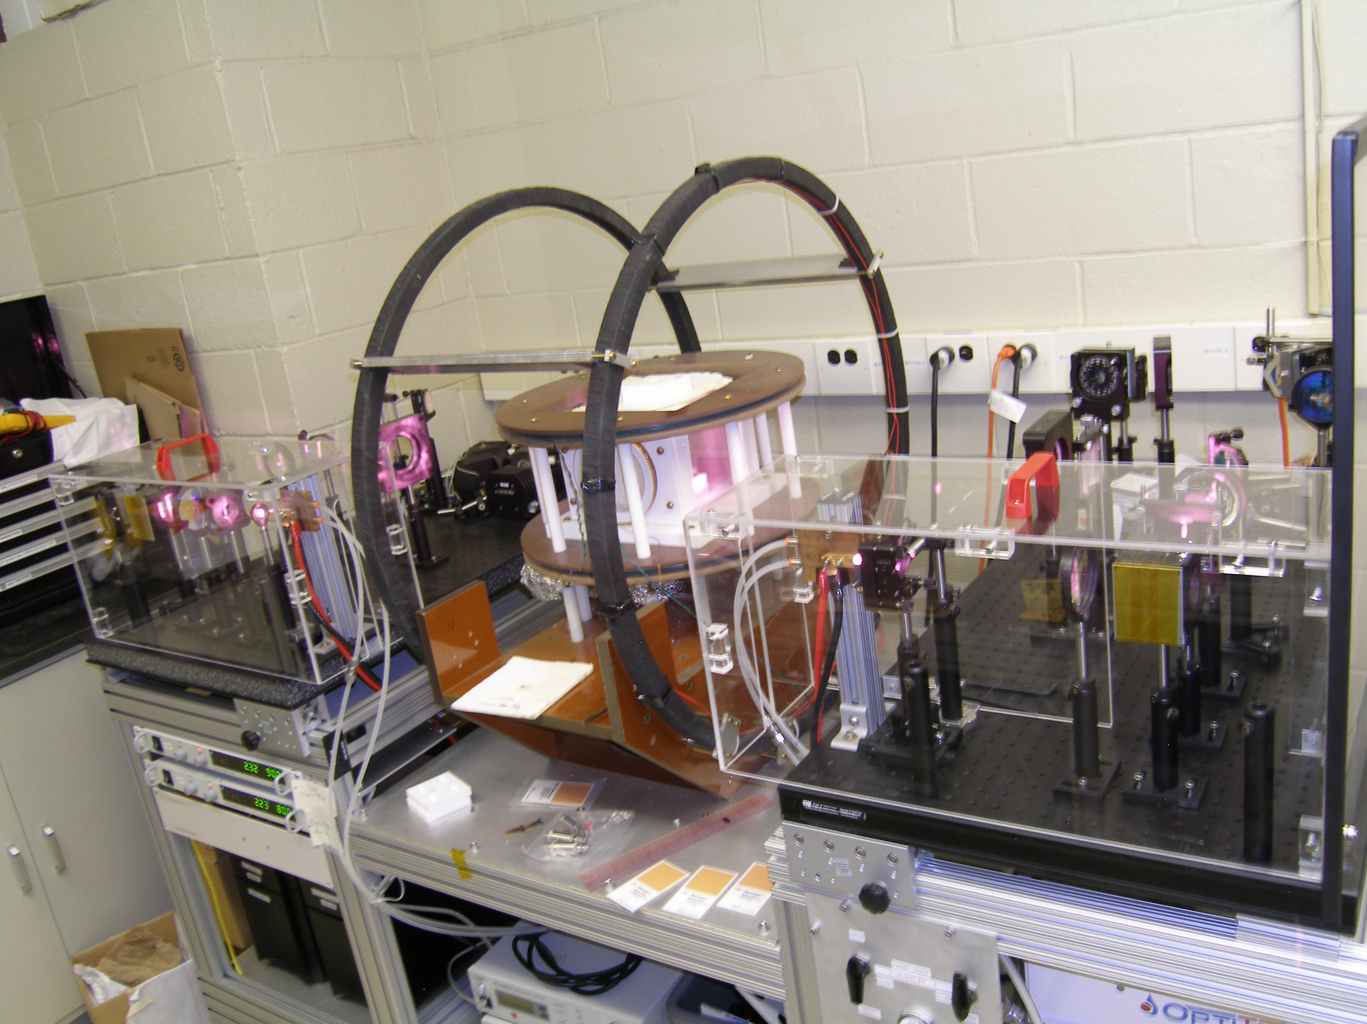
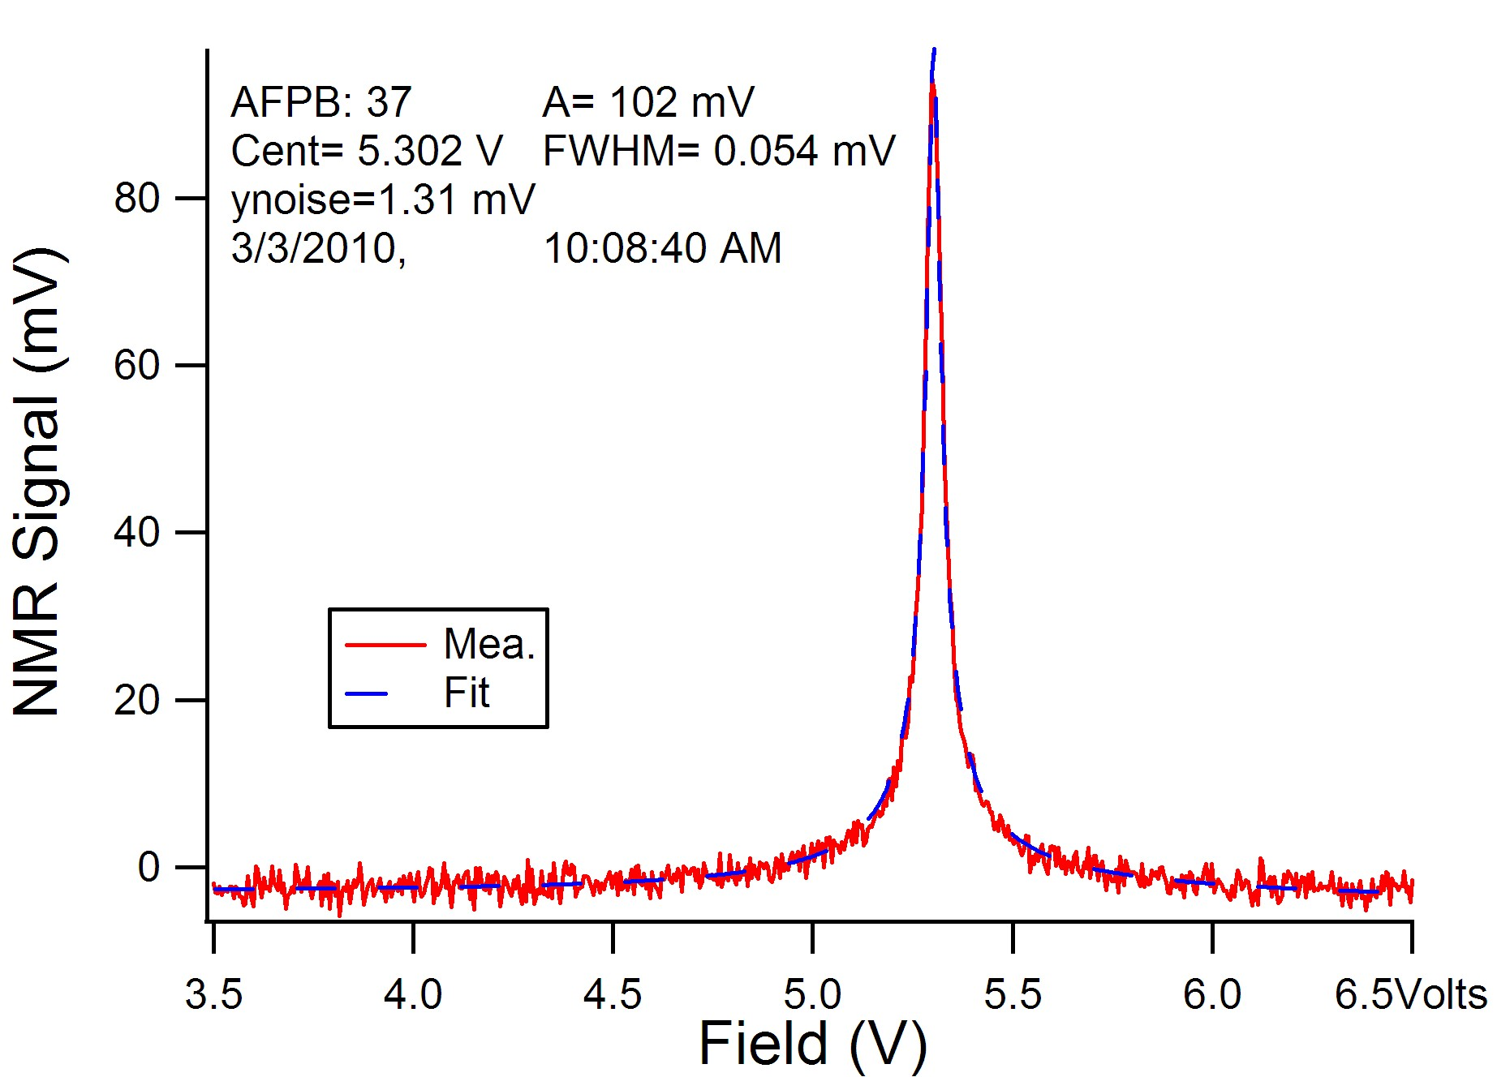
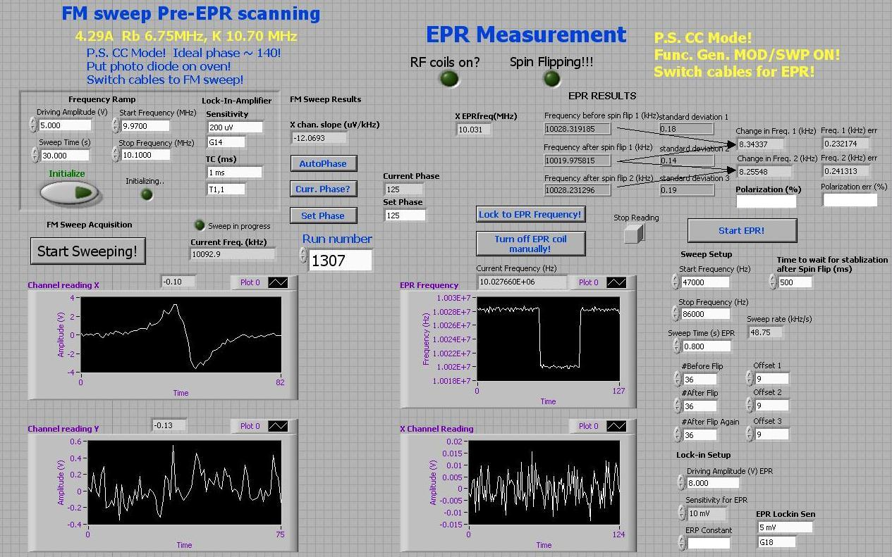
NCNR SEOP system
Notes:
NIST has a long tradition of developing optical pumping technique for polarizing 3He gas. Now we are focusing spin exchange optical pumping technique. As I am speaking now, we have three SEOP systems, two of them dedicated for polarizing neutron scattering. Soon we will have the fourth system available. Each system is equipped with two 100 W lasers, spectrally narrowed with Chirped volume-Bragg grating, illuminating the cell from opposite sides of the cell. Each system has several diagnostic tools, such as FID, AFP NMR, EPR for 3He polarization calibration. We have achieved 3He polarization up to 85% for user experiments.

Slide 22
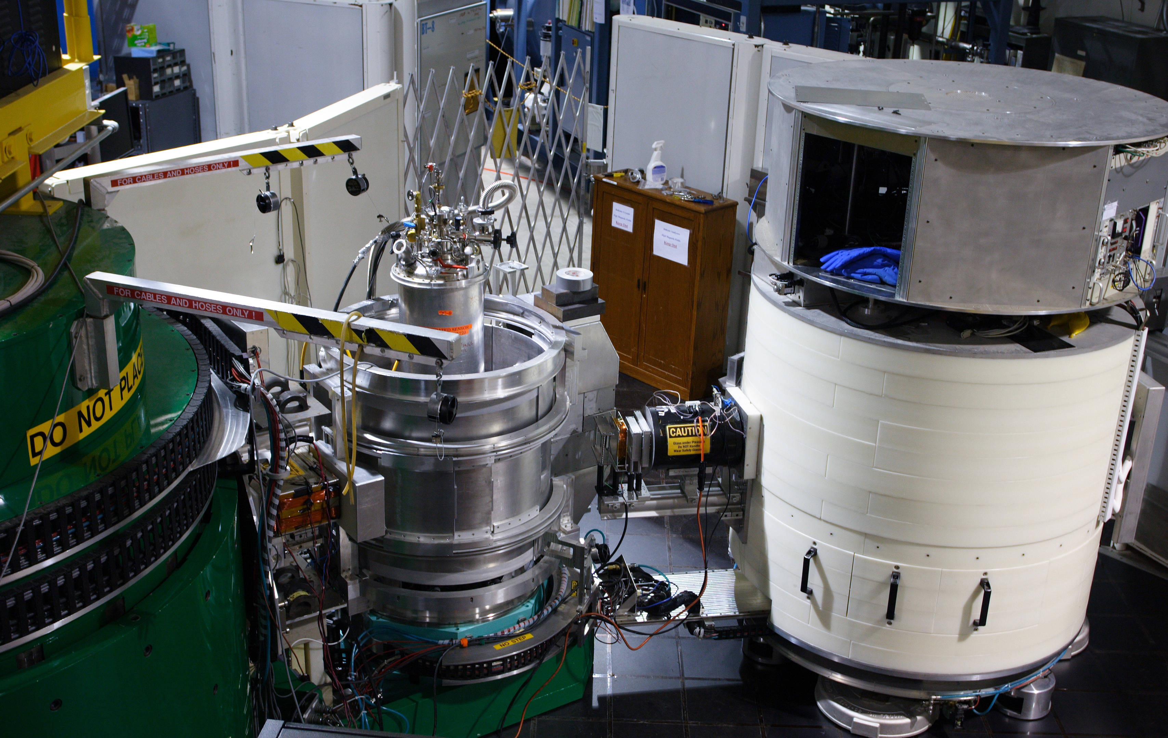
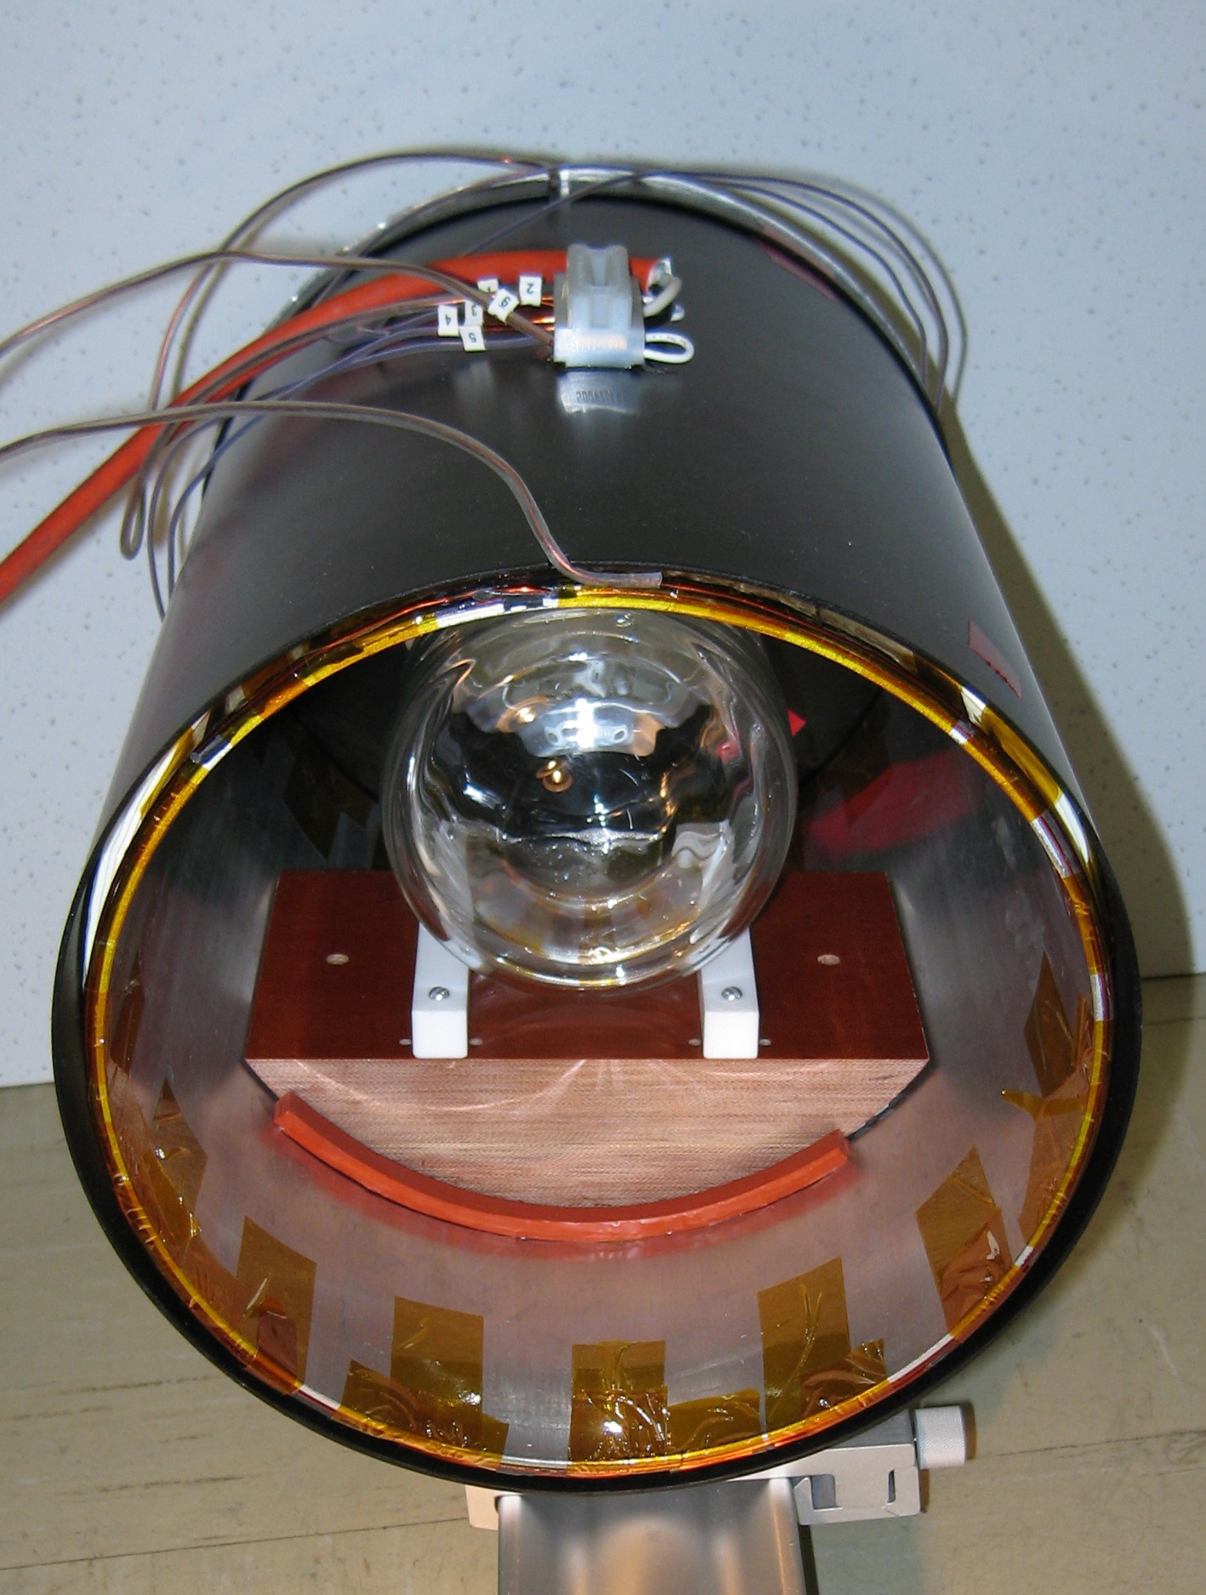
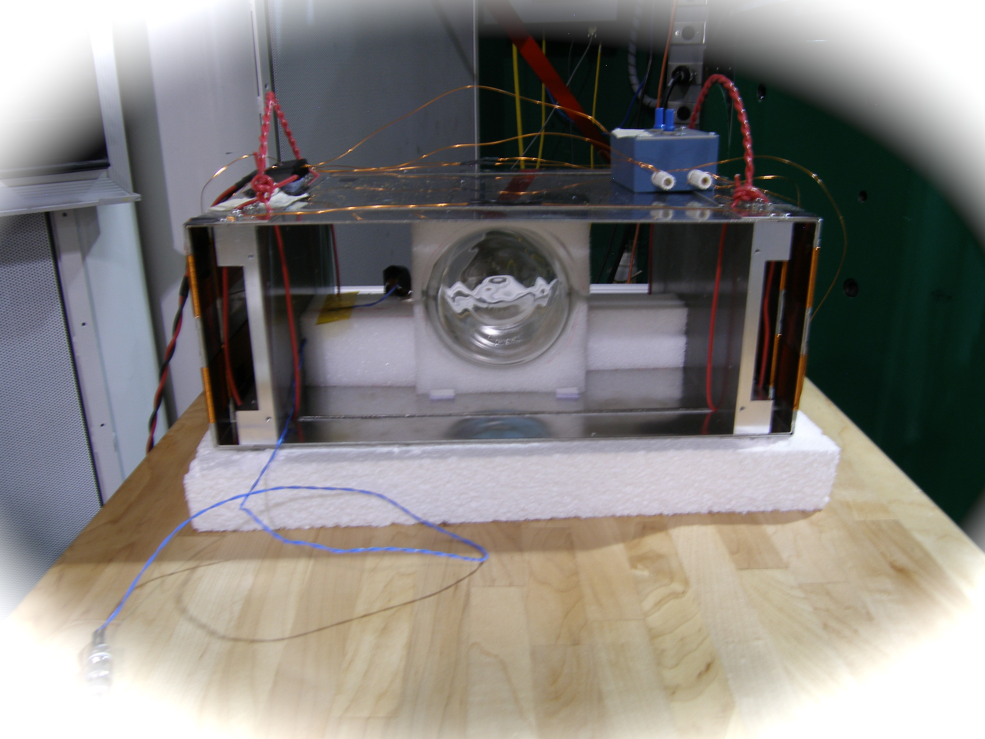
NCNR BT-7 TRIPLE AXIS SPECTROMETER
³He Polarizer
Two < π/2 spin rotations
³He Analyzer
P_{n}
sample
P_{n}
π/2 spin rotation
HF
Two π/2 spin rotations
Notes:
The first one is thermal triple axis spectrometry. Here we use a 3He NSF to polarize a doubly focusing 10 cm by 5 cm beam, and another 3He NSF to analyze the scattered beam. Of course, neutron spin flipping is done by NMR. With 3He NSFs, you can have improved polarized neutronic performance, install one more focusing monochromators than regular TAS, optimize the instrument in both unpolarized and polarized mode simultaneously. Polarized neutron flux is 1.1 x 10^7 n/cm^2/s at 14.7 meV. The typical initial flipping ratio is 50 above for a full open double focusing beam configuration with intensity reduction factor of 10 (measured in the detector). For polarized inelastic scattering, the energy transfer is up to 35 meV. No polarized neutron optics alignment, no tuning is required for polarized experiments. One of the most challenging tasks to implement 3He NSFs is the space constraints and stray fields from the instrument since we have retrofitted 3He NSFs to the instrument. This has made the design of 3He NSF device and spin transport much more difficult. But those issues are gone now.

Slide 23
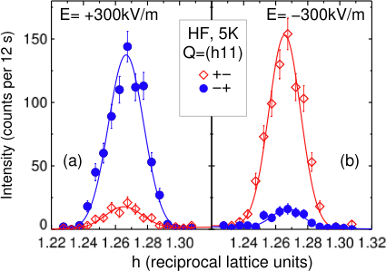
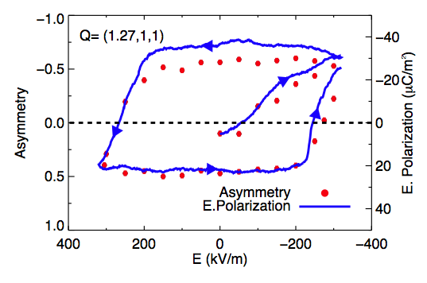
Polarization analysis on Ni₃V₂O₈ PRL 103, 087201, 2009
coupling between magnetic and ferroelectric order
G. Lawes et al, Phys. Rev. Lett. 95, 087205 (2005)
magnetic order and the direction of ferroelectricity are directly linked by the change in the magnetic scattering.
Chirality hysteresis in the ferroelectric state
I. Cabrera et al., PRL 103, 087201, 2009
Notes:
Now I will briefly talk about application of 3he polarizer and analyzer to the thermal triple axis spectrometry. The triple axis spectrometer is very powerful for fundamental studies in high temperature superconductors, colossal magnetoresistive oxides, multiferroics, frustrated magnets, thermoelectrics, ferromagnetic metals. The NIST BT-7 triple axis spectrometer is a new instrument which equips with a double focusing pyrolytic graphite monochromator and provides an intensity an order of magnitude higher than the previously existed BT-2 instrument. However BT-7 does not have a capability of polarizing neutrons efficiently. We have used 3He Spin filters to polarize and analyze neutrons. The preliminary test results showed both 3He polarizer and analyzer worked efficiently. Intensity gained by a factor of 20 in the polarized mode. We also had some spin transport issues which I will not get into.

Slide 24
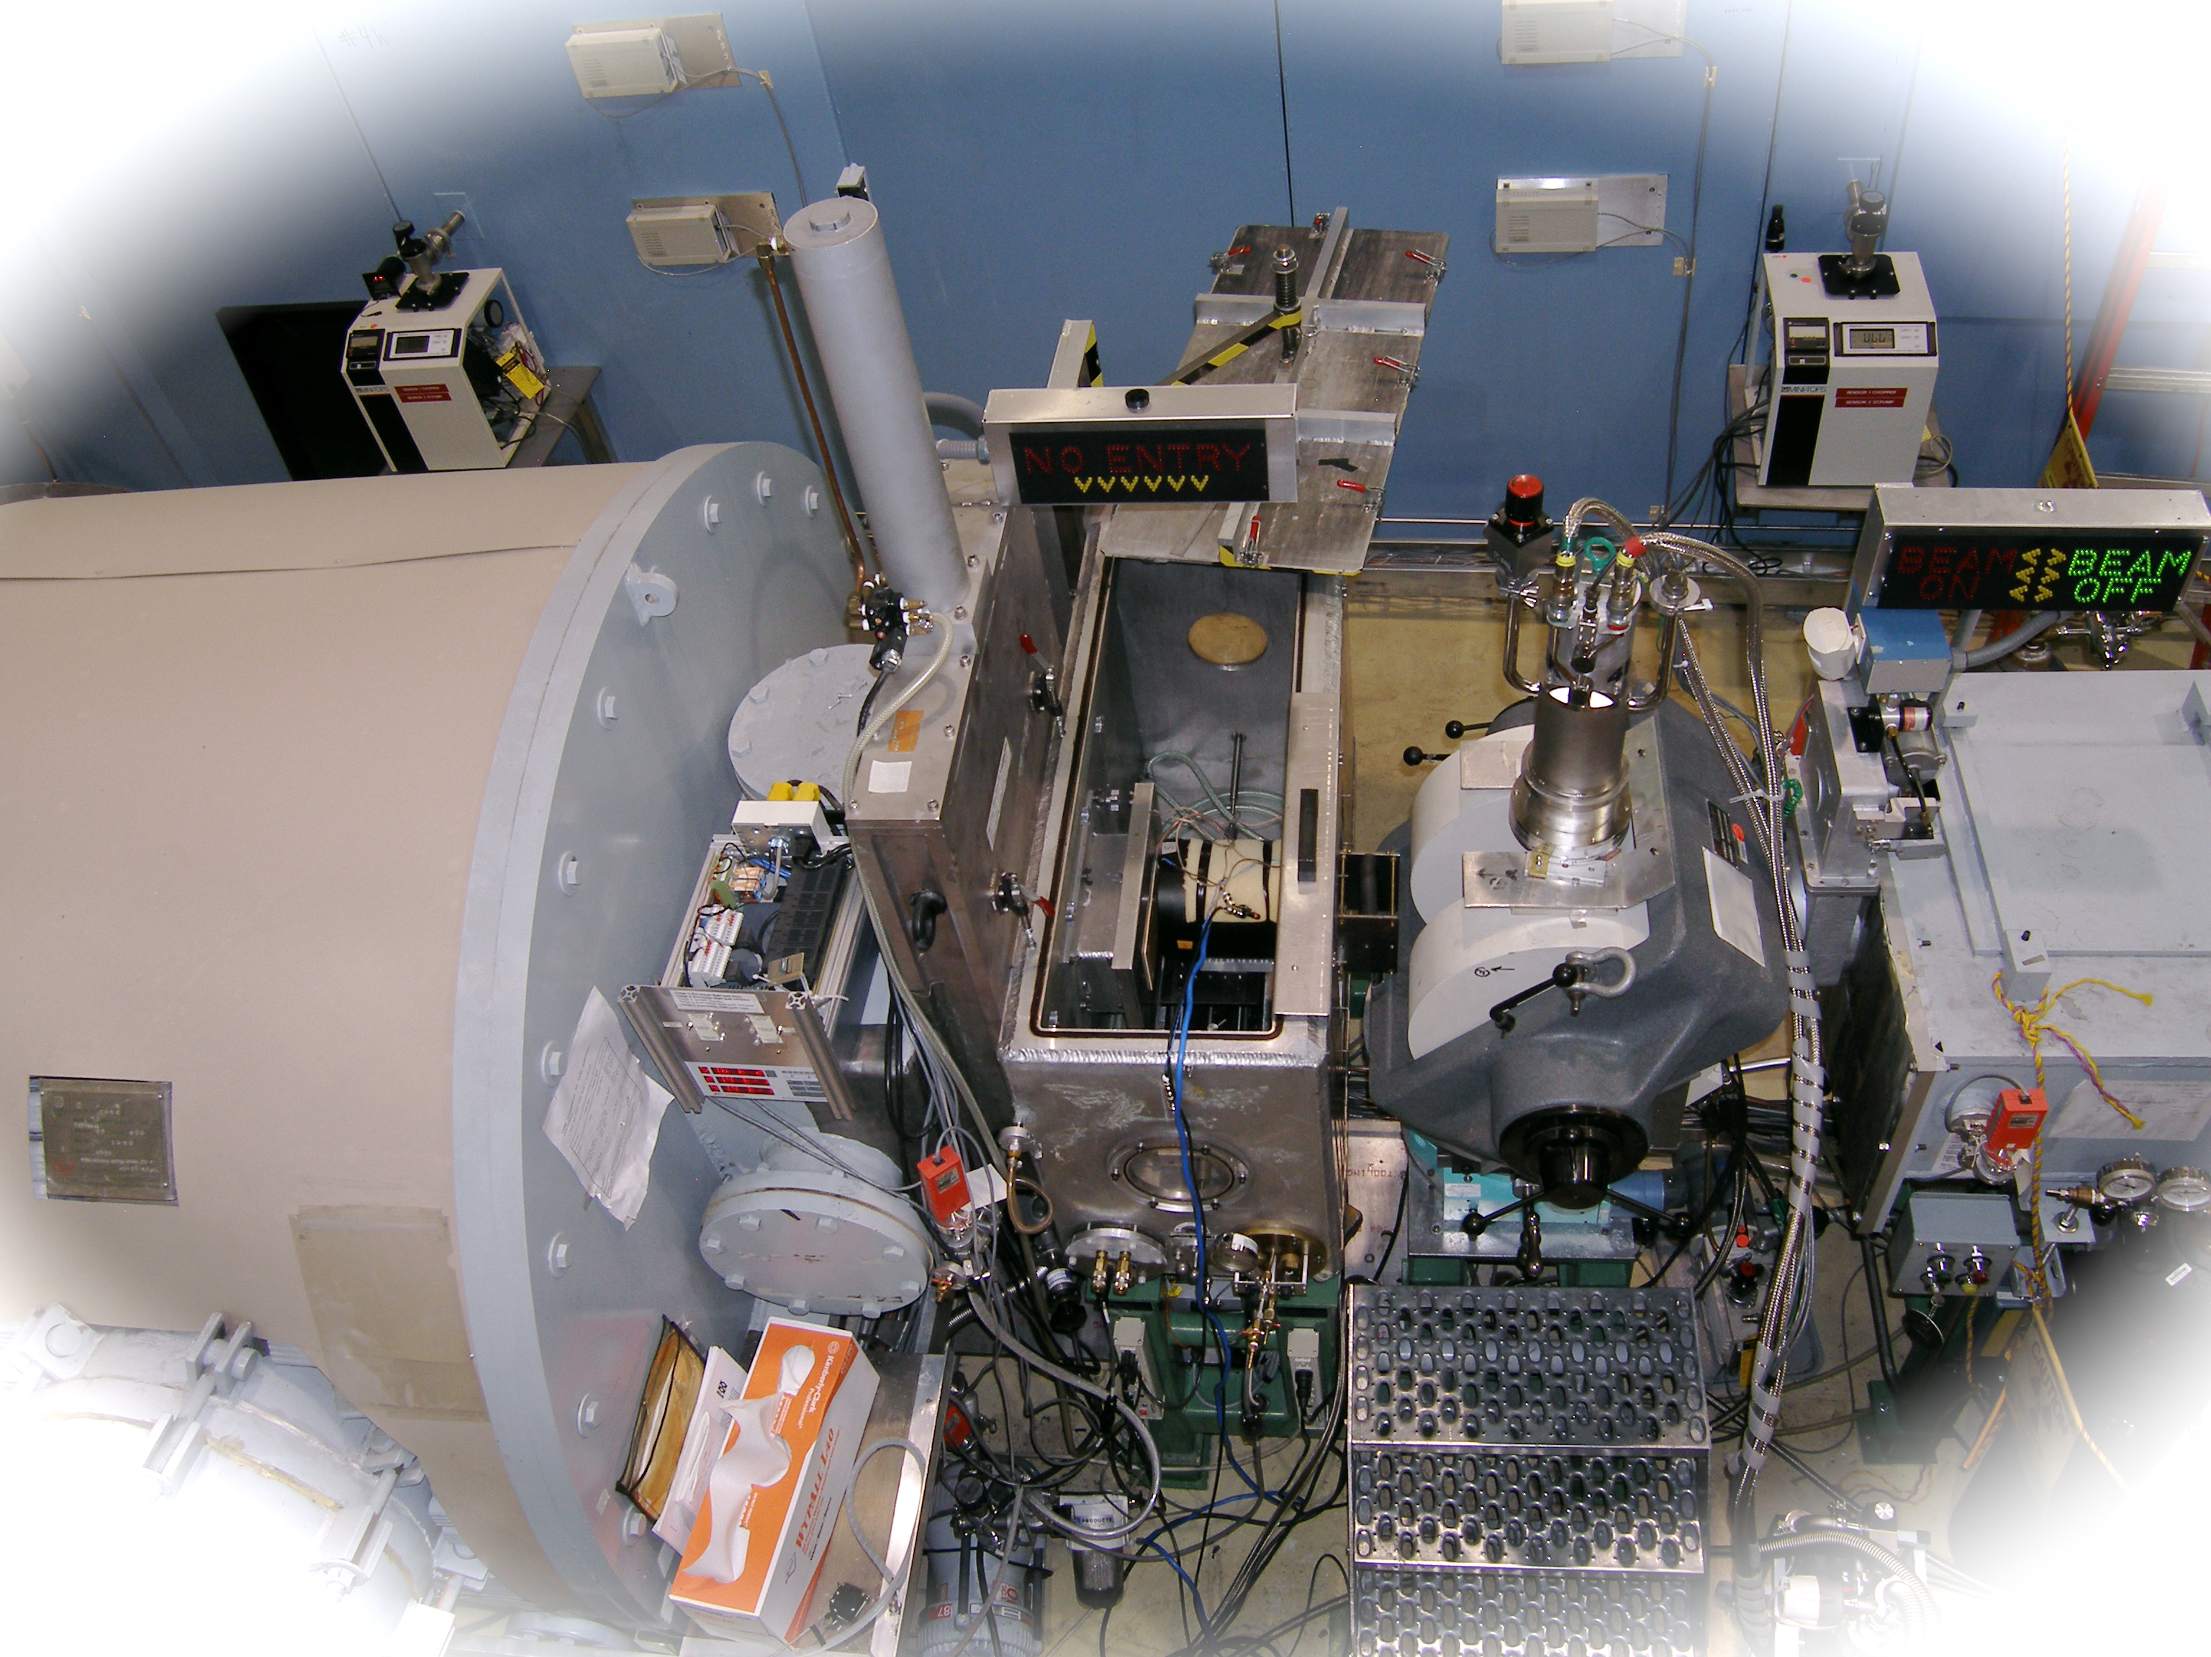
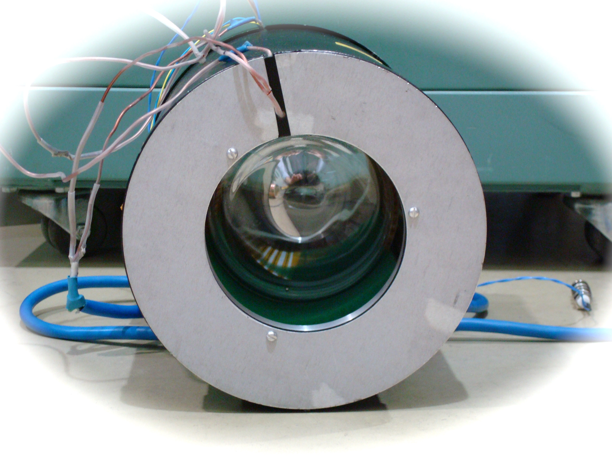
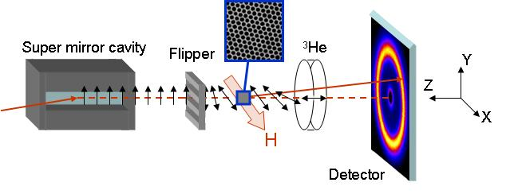
³He NSF based polarization analysis on SANS
Sample
Detector
neutrons
³He analyzer
³He analyzer
Sample
W.C. Chen et al, Physica B 404, 2663 (2009); K.L. Krycka et al, Physica B 404, 2561 (2009)
http://www.ncnr.nist.gov/equipment/he3nsf/index.html
Notes:
Now I will briefly talk about application of 3he polarizer and analyzer to the thermal triple axis spectrometry. The triple axis spectrometer is very powerful for fundamental studies in high temperature superconductors, colossal magnetoresistive oxides, multiferroics, frustrated magnets, thermoelectrics, ferromagnetic metals. The NIST BT-7 triple axis spectrometer is a new instrument which equips with a double focusing pyrolytic graphite monochromator and provides an intensity an order of magnitude higher than the previously existed BT-2 instrument. However BT-7 does not have a capability of polarizing neutrons efficiently. We have used 3He Spin filters to polarize and analyze neutrons. The preliminary test results showed both 3He polarizer and analyzer worked efficiently. Intensity gained by a factor of 20 in the polarized mode. We also had some spin transport issues which I will not get into.

Slide 25

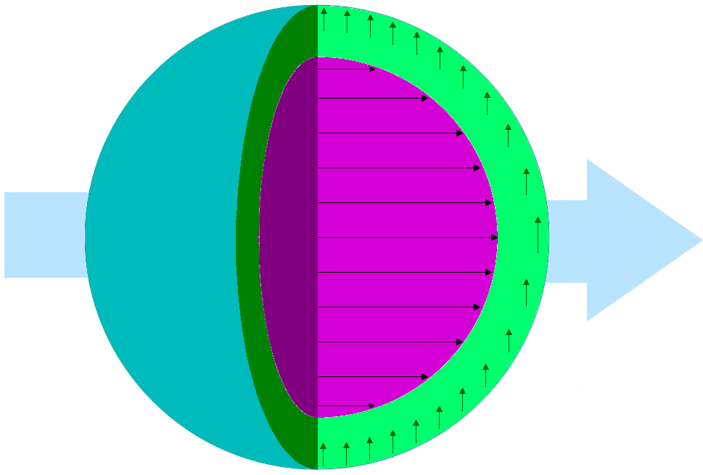
3D magnetism in nanoparticles
K.L. Krycka et al, PRL 104 207203 (2010)
Fe₃O₄ ρ’s
Structural 6.97E-6 Å⁻²
Magnetic 1.46E-6 Å⁻²
^{(513 emu / cc)}
B
+
Modeled Diameters:
Sphere 9.0 nm
Ferrimagnetic core 7 nm
Canted shell 7 to 9 nm (+0.2 nm)
(Q ~ 2π / distance)
Notes:
Now I will briefly talk about application of 3he polarizer and analyzer to the thermal triple axis spectrometry. The triple axis spectrometer is very powerful for fundamental studies in high temperature superconductors, colossal magnetoresistive oxides, multiferroics, frustrated magnets, thermoelectrics, ferromagnetic metals. The NIST BT-7 triple axis spectrometer is a new instrument which equips with a double focusing pyrolytic graphite monochromator and provides an intensity an order of magnitude higher than the previously existed BT-2 instrument. However BT-7 does not have a capability of polarizing neutrons efficiently. We have used 3He Spin filters to polarize and analyze neutrons. The preliminary test results showed both 3He polarizer and analyzer worked efficiently. Intensity gained by a factor of 20 in the polarized mode. We also had some spin transport issues which I will not get into.

Slide 26
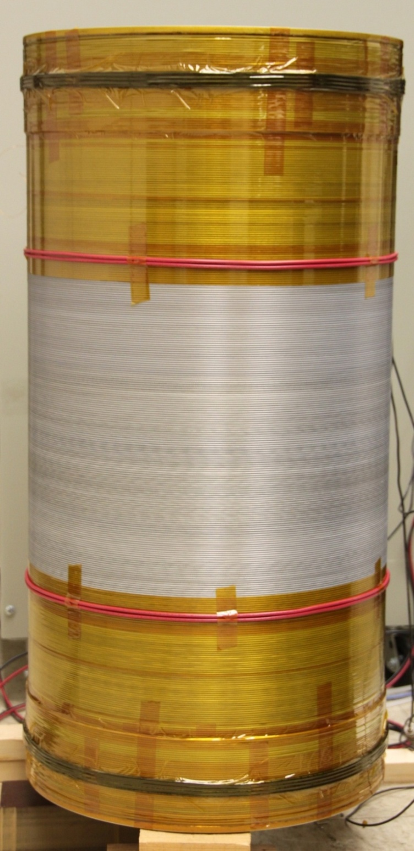
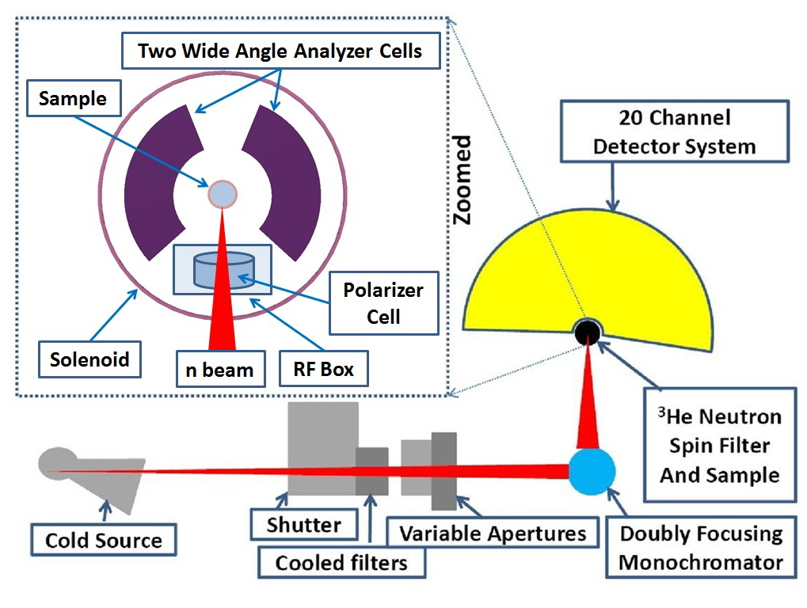
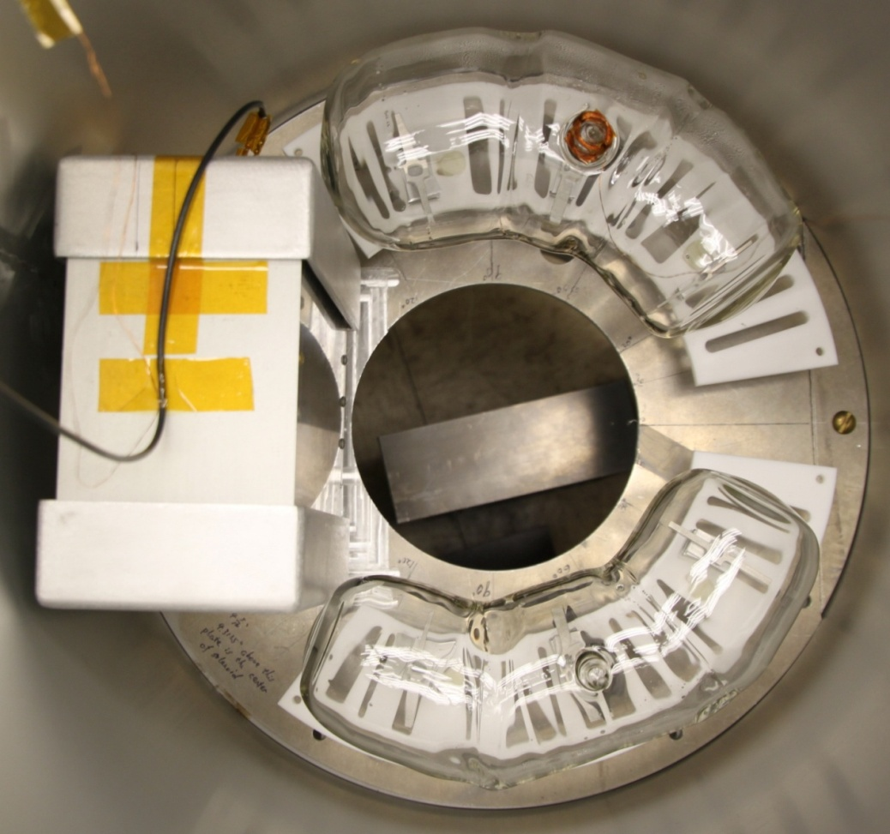
WIDE-ANGLE POLARIZATION ANALYSIS on the Multi-Axis Crystal Spectrometer (MACS)

Slide 27
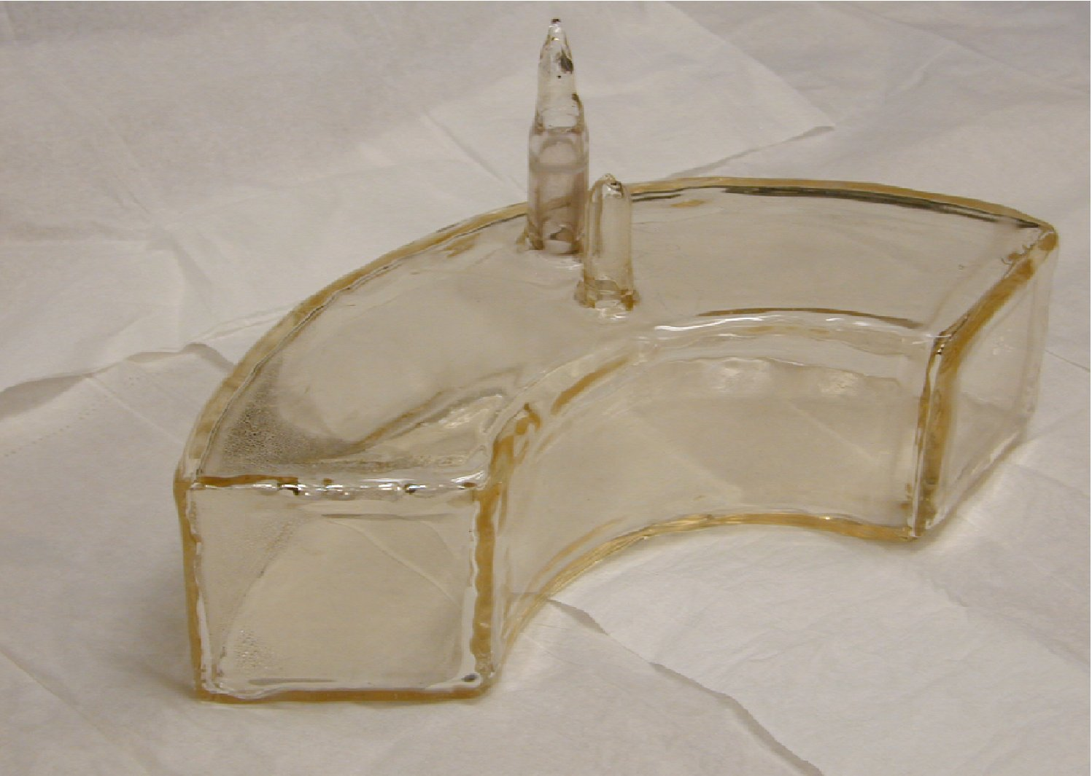
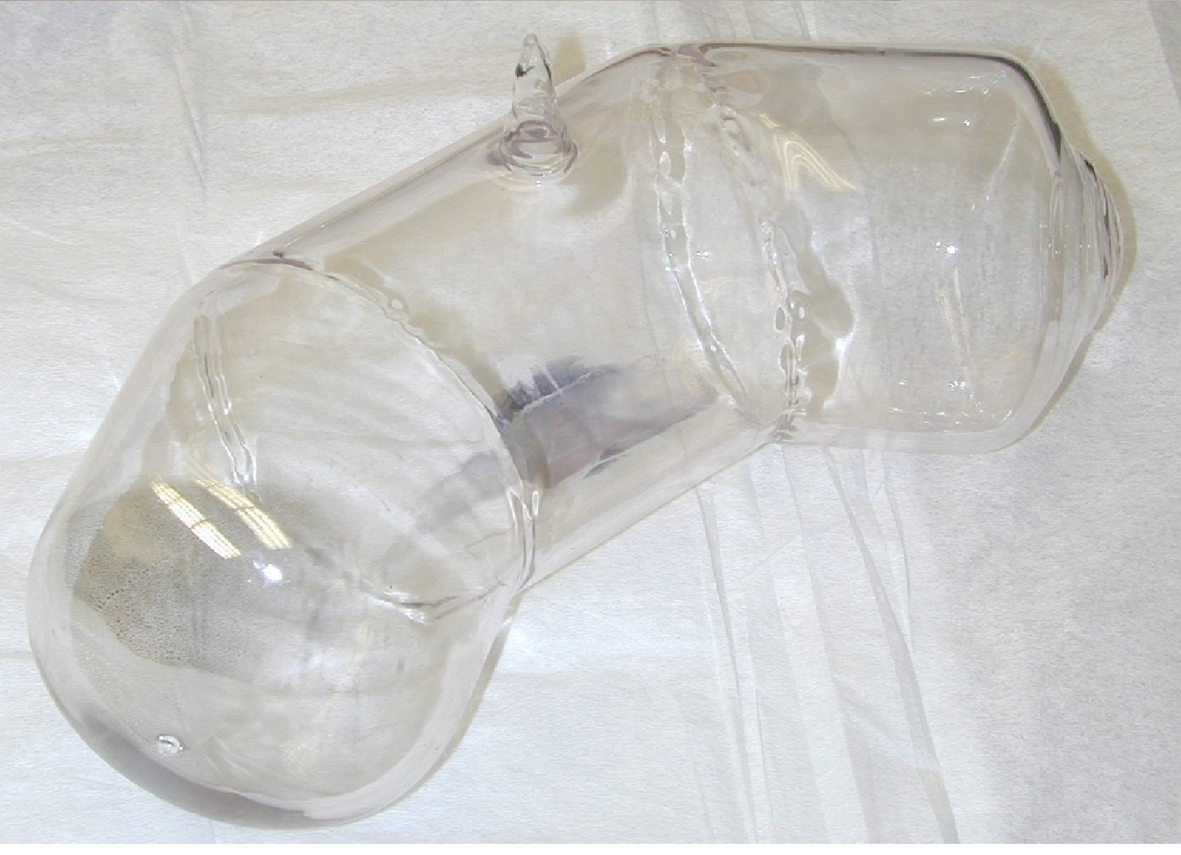
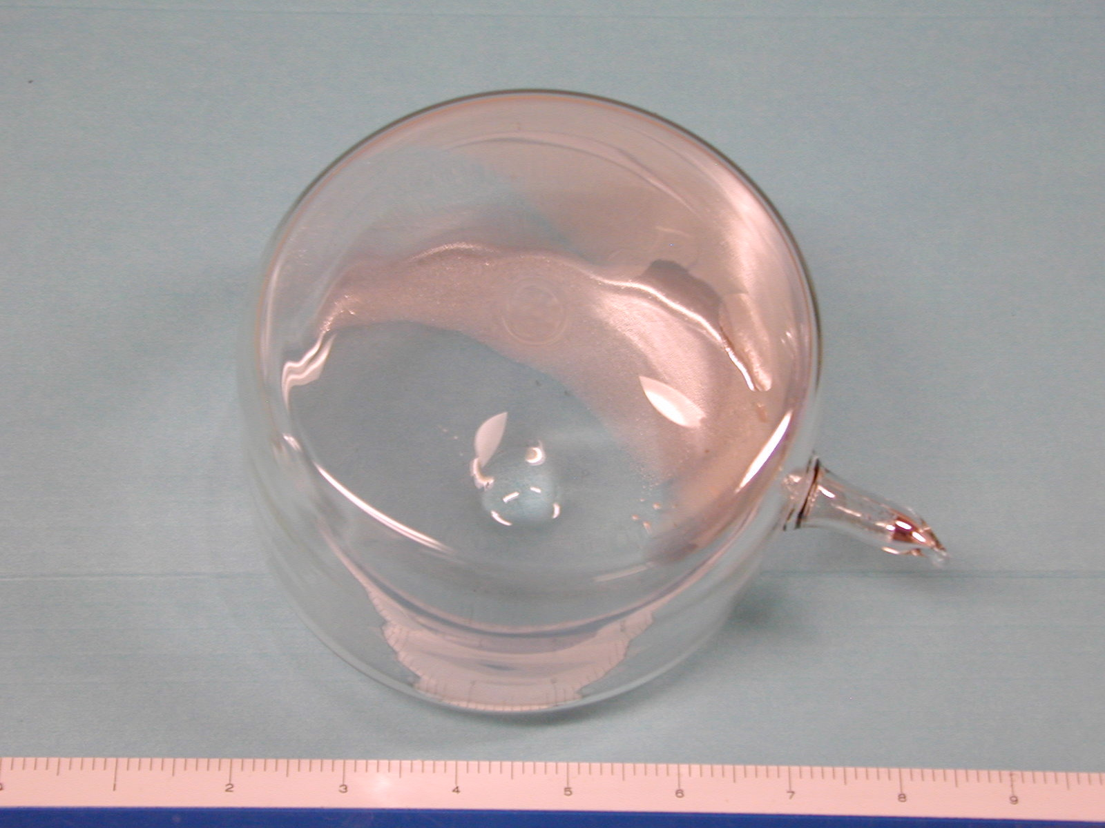
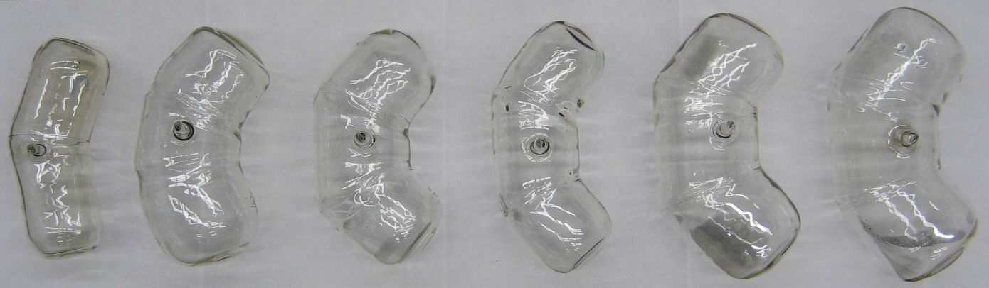
WIDE-ANGLE CELLS for SEOP
“The path is difficult to cross like the sharpened edge of the razor”
Quartz – 20/100 h, P_{He}= 45%
3 sections of blown quartz
200 h, but yet still only 45% !
Temporary for FeSeTe expt:
GE180 cylinder, 200 h, 75%
Veronica Archie Reggie Jughead Reliance Giant
NIST GLASS/OPTICAL SHOP TO THE RESCUE: 3 sections of GE180, 100-400 h, 75%

Slide 28
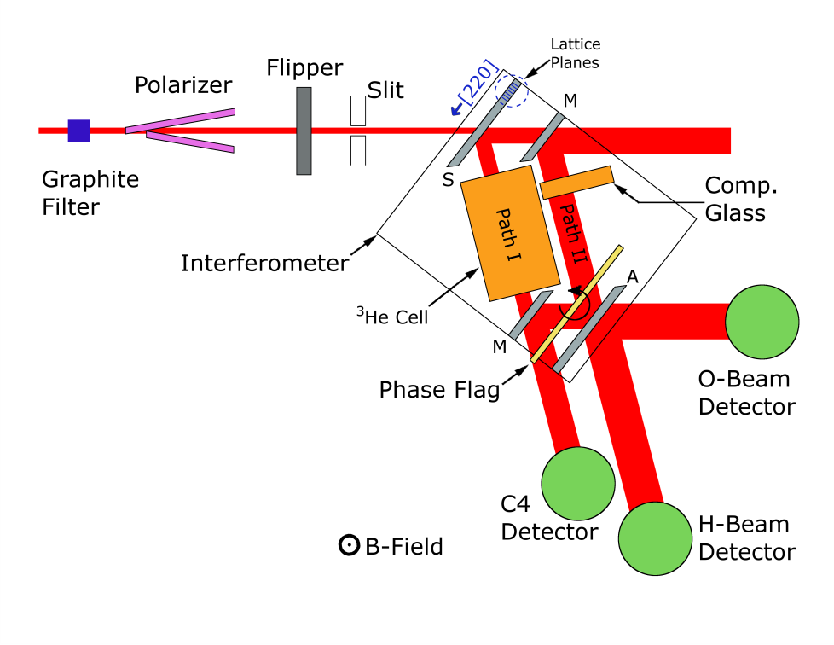
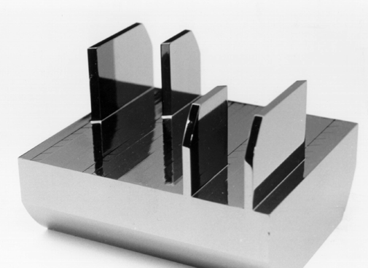
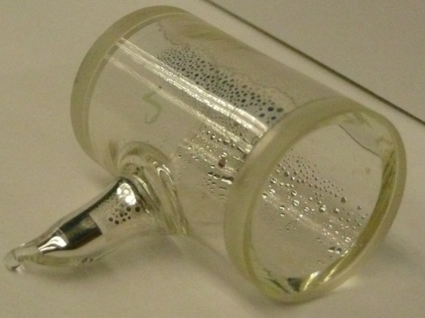
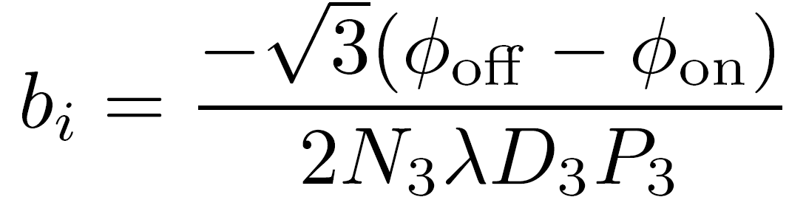
MEASUREMENT of the
n-³He INCOHERENT
SCATTERING LENGTH of ³He
Spin
We measure the n-³He spin-dependent scattering length using polarized ³He gas trapped in a glass cell. The phase shift φ between the two flipper states (off or on) is related to the spin-dependent scattering length (b_{i}) by
M.G. Huber et al, PRL 102, 200401 (2009);
ibid., 103, 179903 (2009).
Notes:
28

Slide 29
PARITY VIOLATION in
NUCLEON-NUCLEON INTERACTIONS
γ
n
+
p
n
p
γ
Parity operator:
PNC asymmetry:
(meson exchange model)

Slide 30
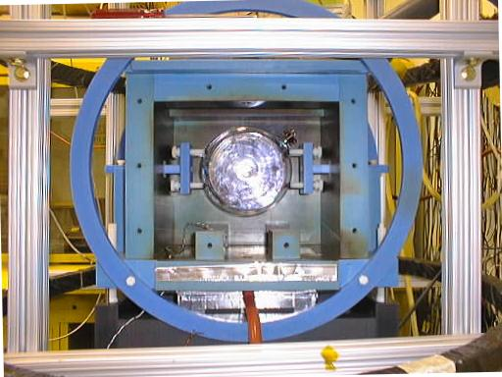
³He polarizer for NPDγ
experiment at LANSCE
one year of nearly continuous use in 2005 for study of solid targets
M.T. Gericke et al, Phys. Rev. C 74, 065503 (2006)
NPDγ result
M. Gericke et al, Phys. Rev. C 83, 015505 (2011)
A_{γ} = -1.2 +/- 2.1 (stat) +/- 0.2 (sys) x 10⁻⁷
Continuous operation in a high flux beam revealed decrease in ³He polarization
short term effect (alkali polarization) and long term effect (opacity to laser light)
Effects studied on PF1b and tomography beam line at the ILL (Babcock et al)
Polarizer: T.E. Chupp et al, Nucl. Instrum. Meth. A 574, 500-509 (2007)
Beam effects: M. Sharma et al , Phys. Rev. Lett. 101, 083002 (2008)
E. Babcock et al, Phys. Rev. A 80, 033414 (2009)

Slide 31
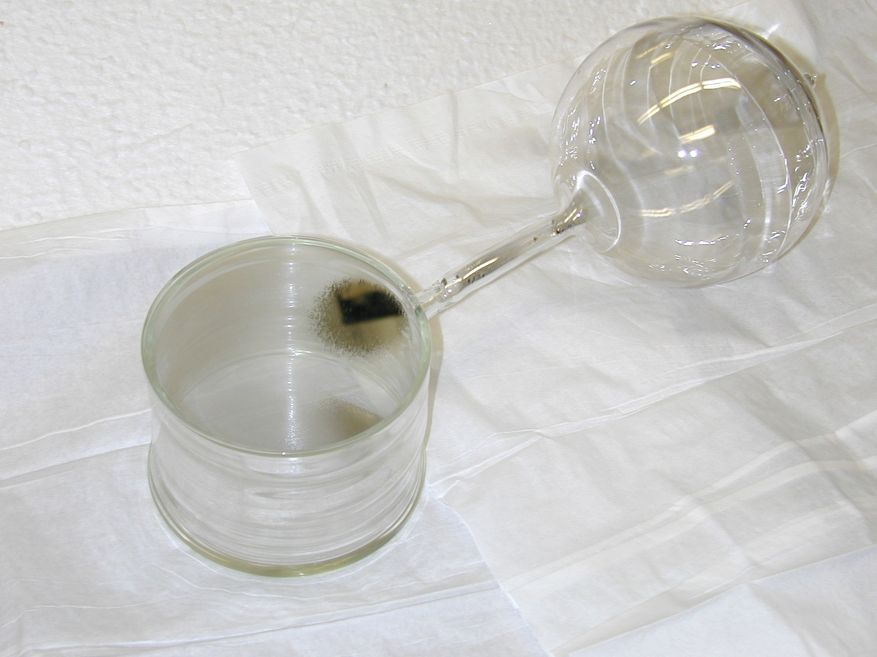
NEUTRON BEAM EFFECTS ON IN-SITU SEOP CELLS
High flux neutron beams induce alkali-metal spin relaxation
Neutron absorption by ³He produces energetic triton and proton
Relaxation rate proportional to square root of neutron flux:
Minor at 10⁸ n/s (LANSCE)
Substantial at 10⁹ n/s (NIST NG6, SNS FNPB)
Dominates at 10¹⁰ n/s (ILL, new NIST NG-C)
Long term effects: reduced transparency of cell, perhaps due to RbH ?
may be decreased for Rb/K mixture cells
Solution: double cells

Slide 32
ACKNOWLEDGEMENTS
Wangchun Chen, Shannon Watson, Ross Erwin, Kathryn Krycka (current NCNR 3He team)
Qiang Ye, Changbo Fu, Wangchun Chen, Dennis Rich, Todd Smith, Gordon Jones (past postdocs)
Alan Thompson, Geoff Greene, Scott Dewey, Fred Wietfeldt (NIST)
Julie Borchers, Kathryn Krycka (SANS)
Jeff Lynn, Ross Erwin (BT7 triple-axis spectrometer)
Collin Broholm, Jose Rodriguez-Rivera, Vivek Thampy (MACS)
Fred Wietfeldt, Mike Huber, Tim Black, Dan Hussey, Muhammad Arif, (interferometer)
Tim Chupp, Kevin Coulter, Gordon Jones (NPDGamma polarizer)
W.M. Snow, Xin Tong, Peter Chang, Haiyang Yan, Dan Hussey, Chris Keith (Indiana University)
G.L. Jones, Brian Collett and students (Hamilton College)
T.G. Walker, Zack DeLand, Brian Lancor, Bob Wyllie, Earl Babcock, Bien Chann (University of Wisconsin)
Earl Babcock (U-Wisconsin, ILL, JCNS-Munich)
Brian Saam, Rick Jacob, Jared Teter, Ben Anger (Univ. of Utah)
Xin Tong, Wai-Tung Lee (SNS)
NIST glass/optical staff: Jeff Anderson, Jack Fuller, and Aaron Kirchhoff
Support from DoE - Basic Energy Sciences

Slide 33
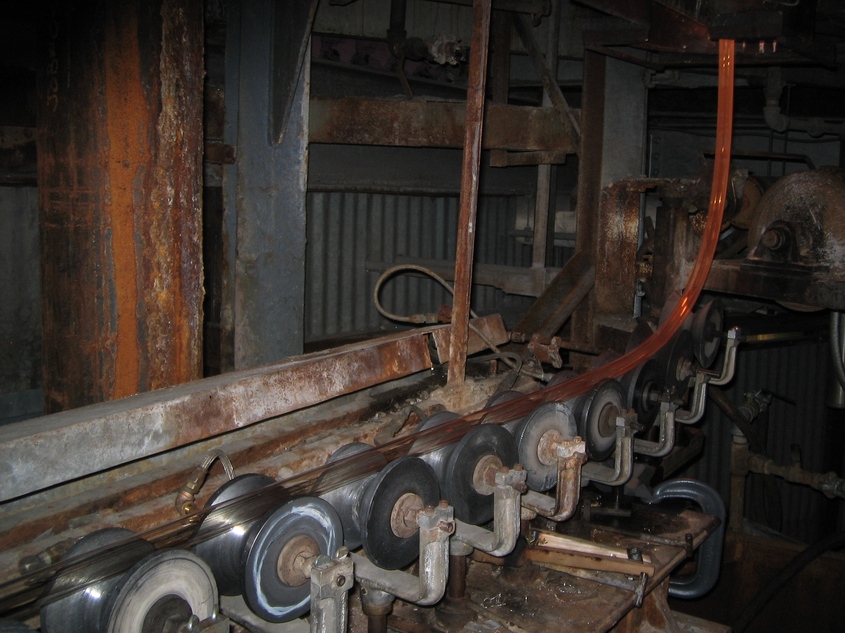
GE Lighting plant, Bridgeville, PA

Slide 34
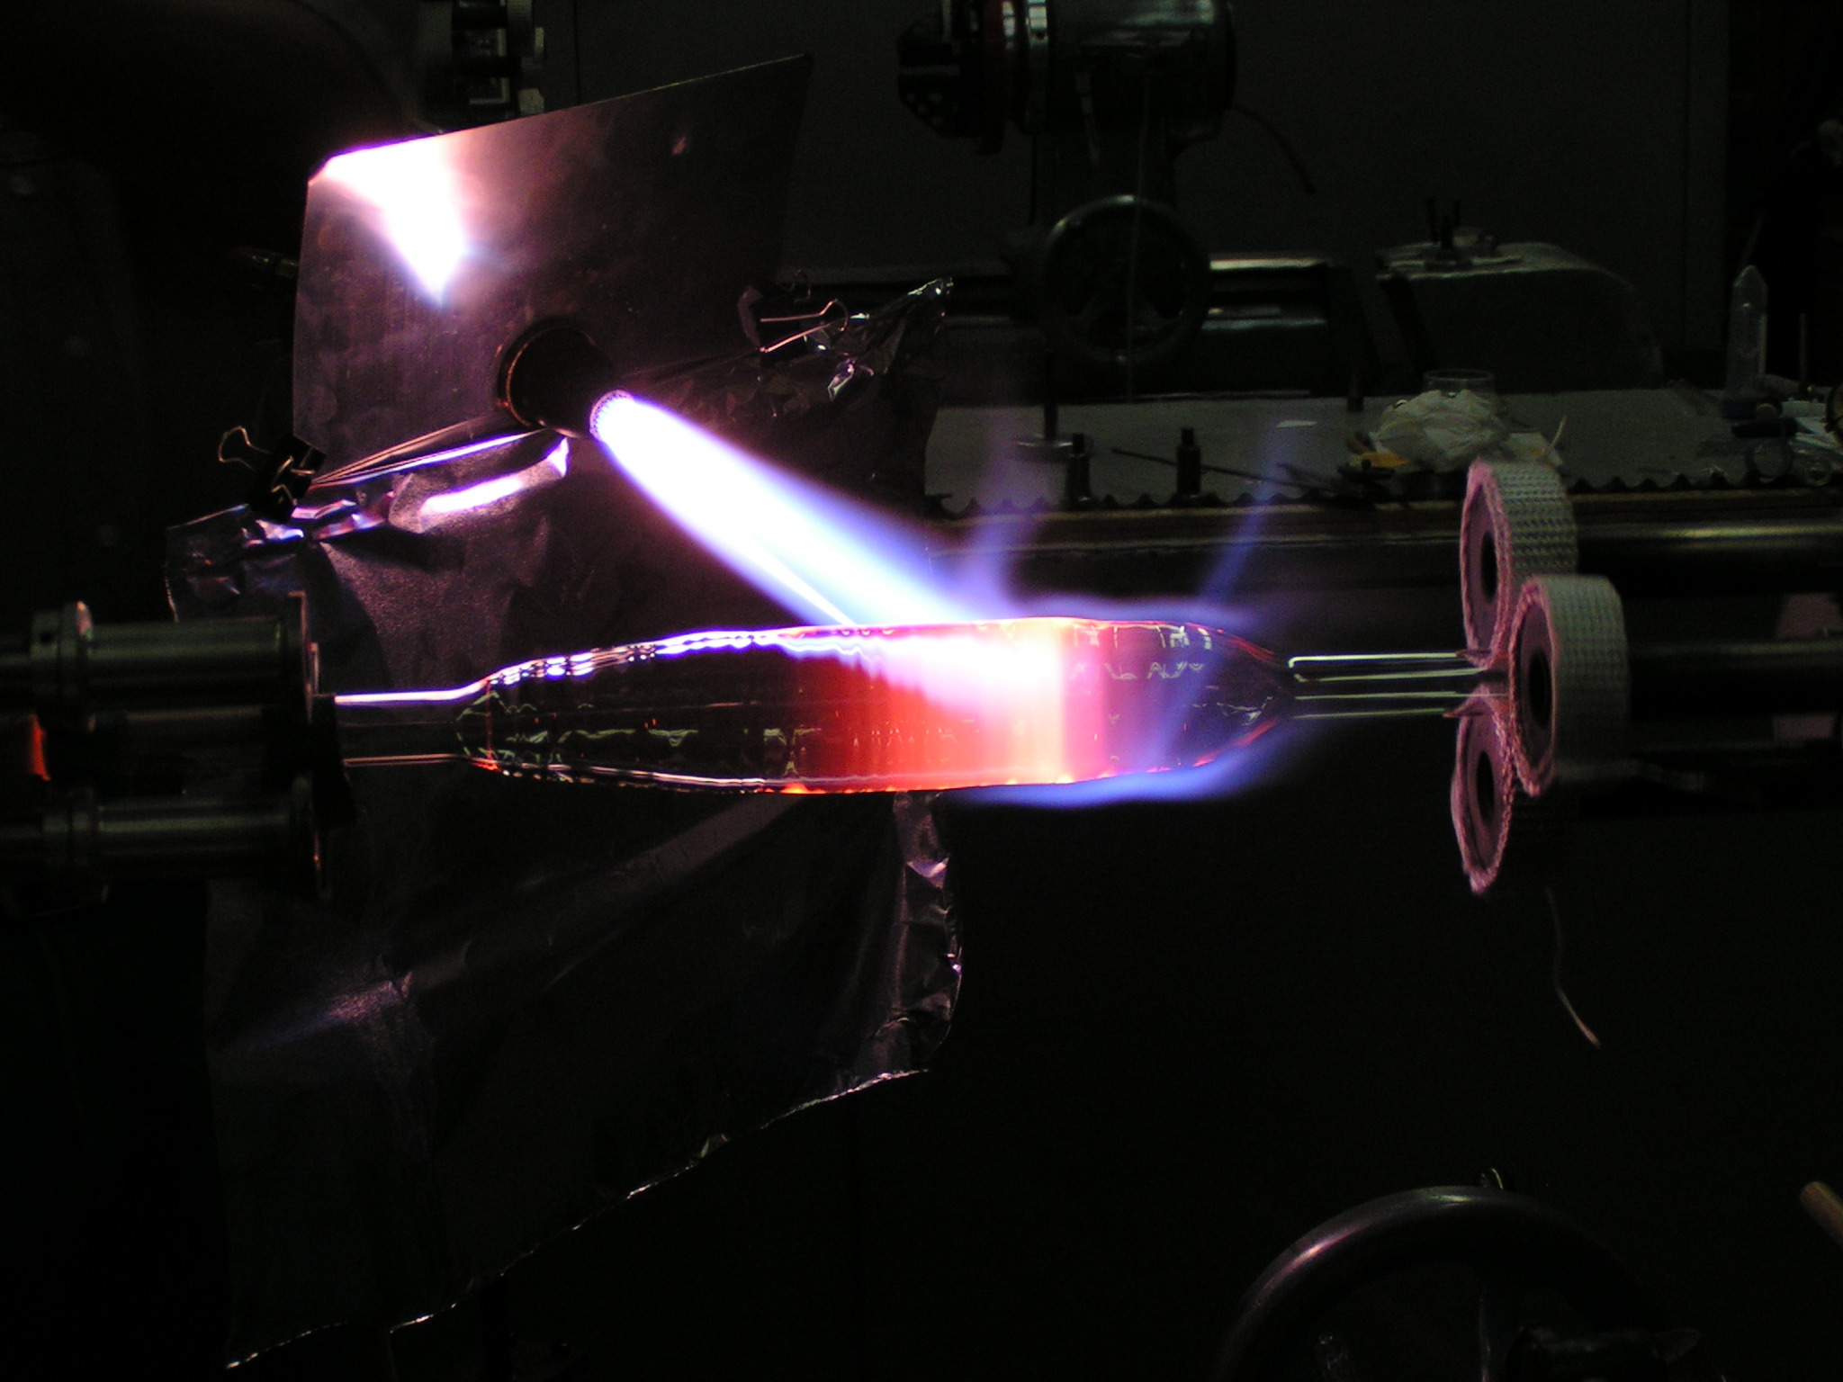
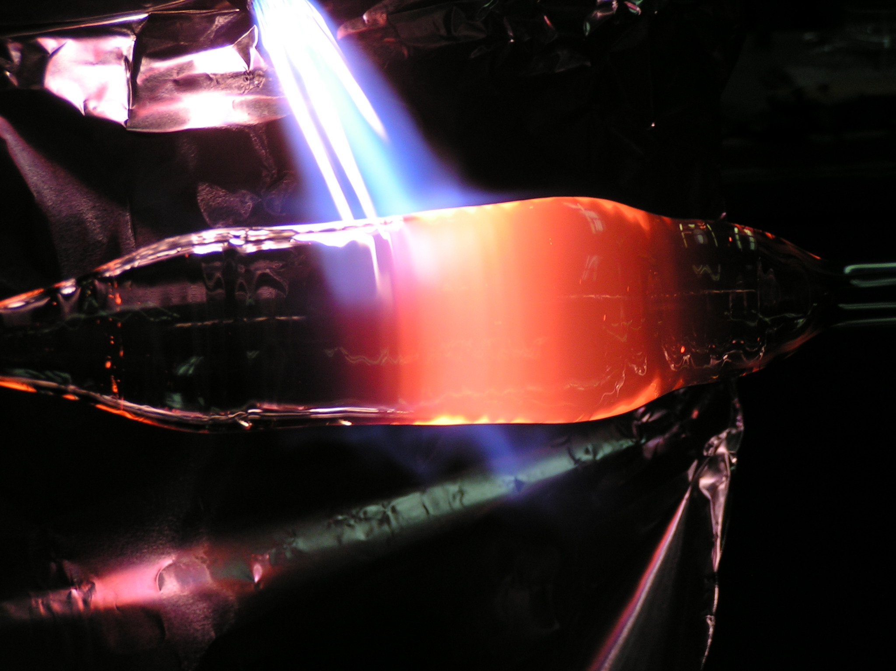
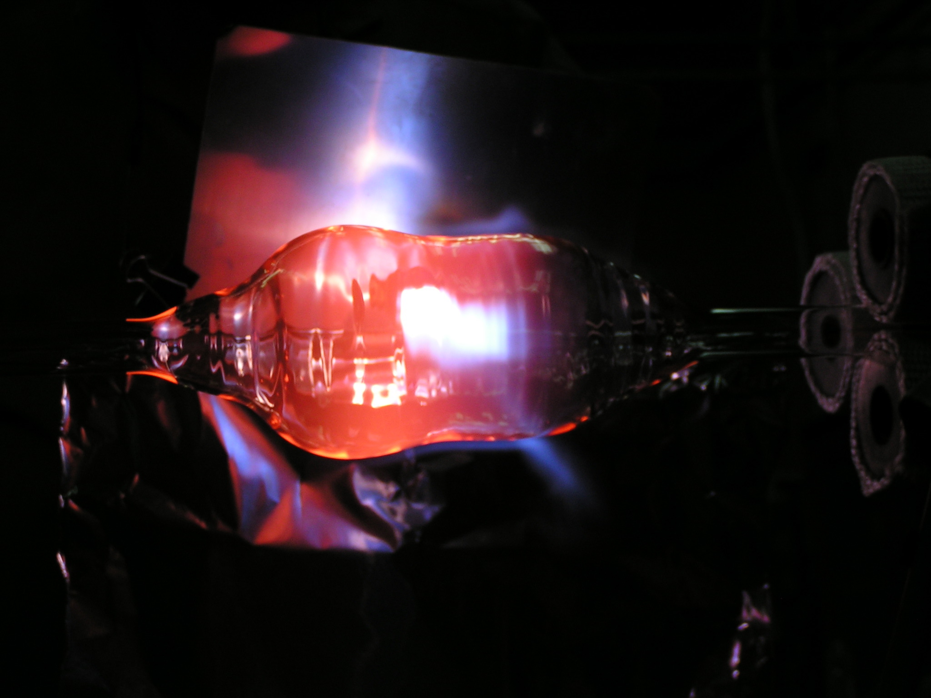
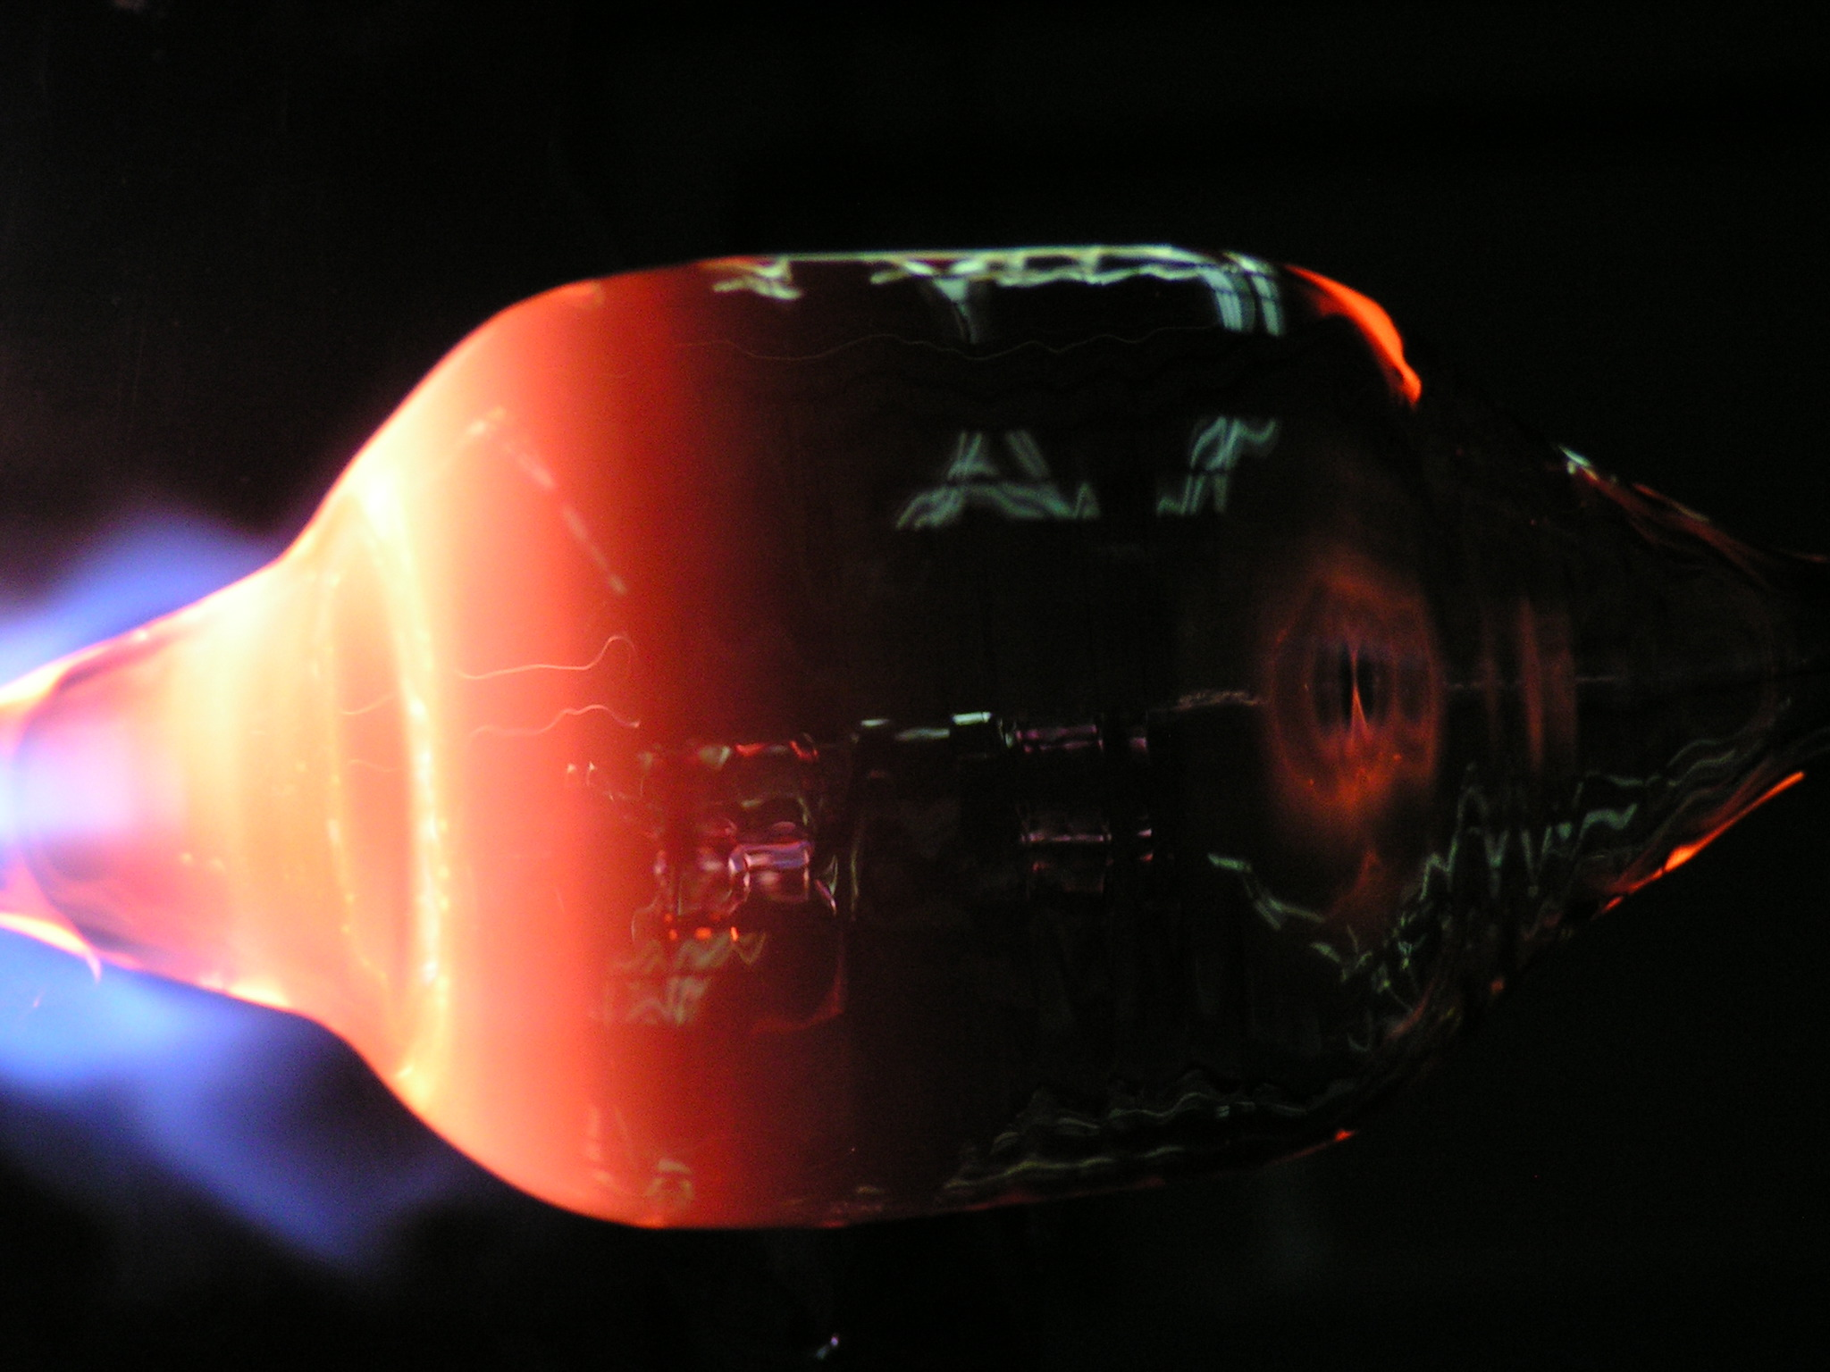
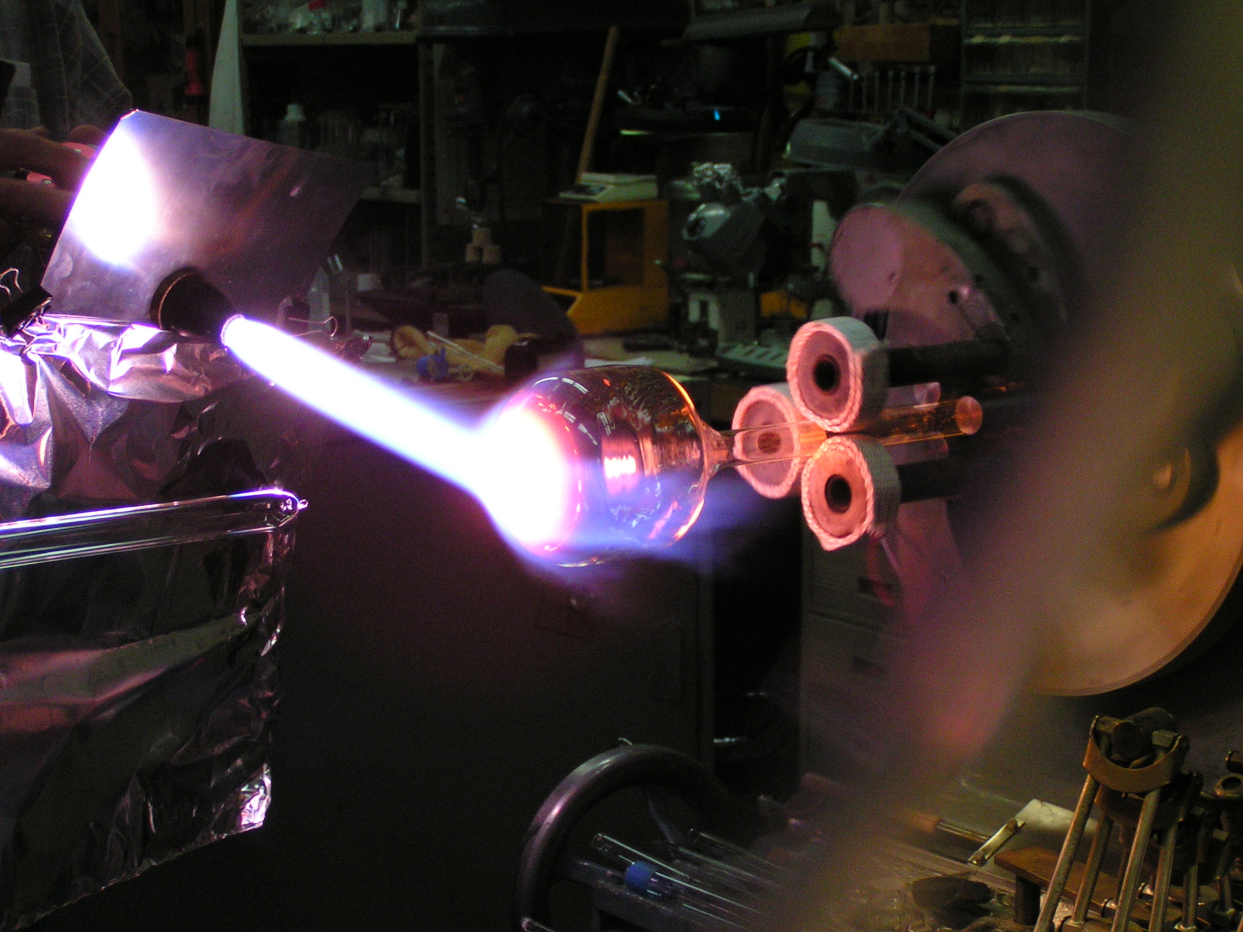
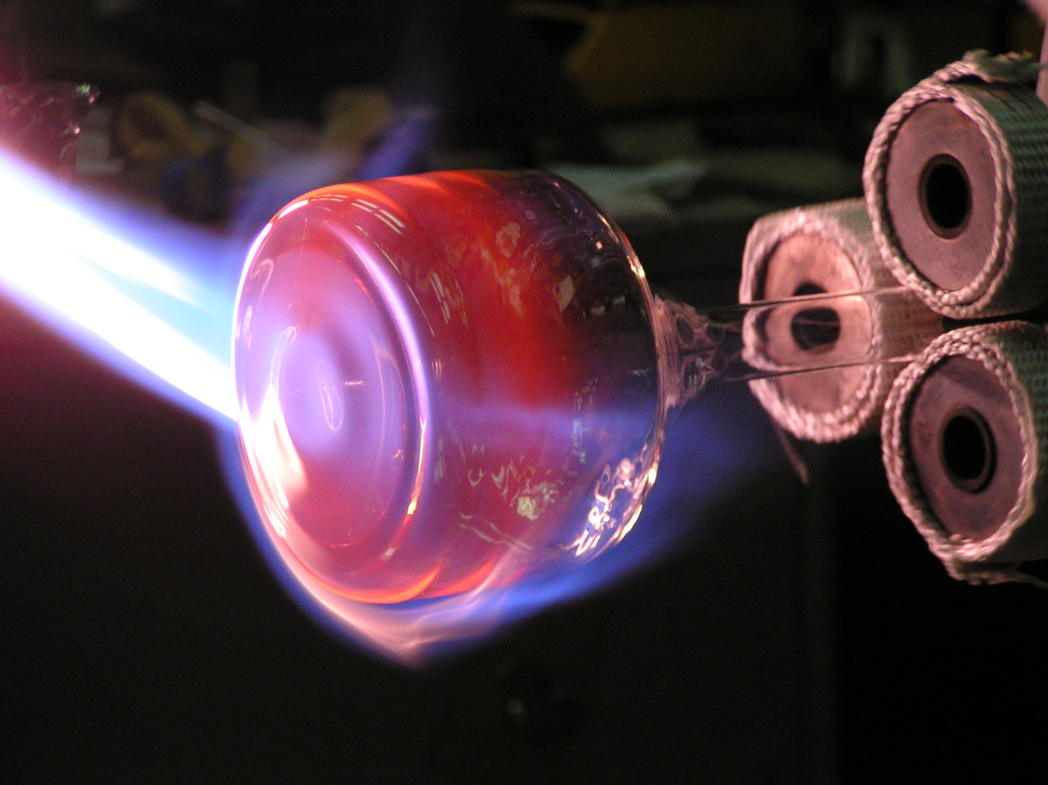
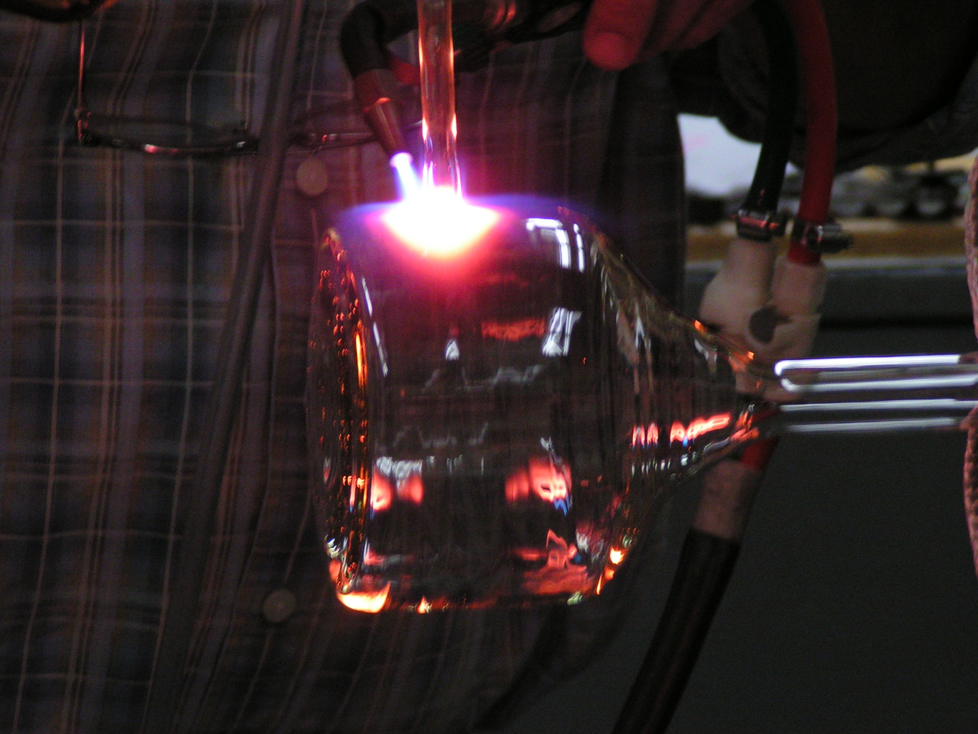
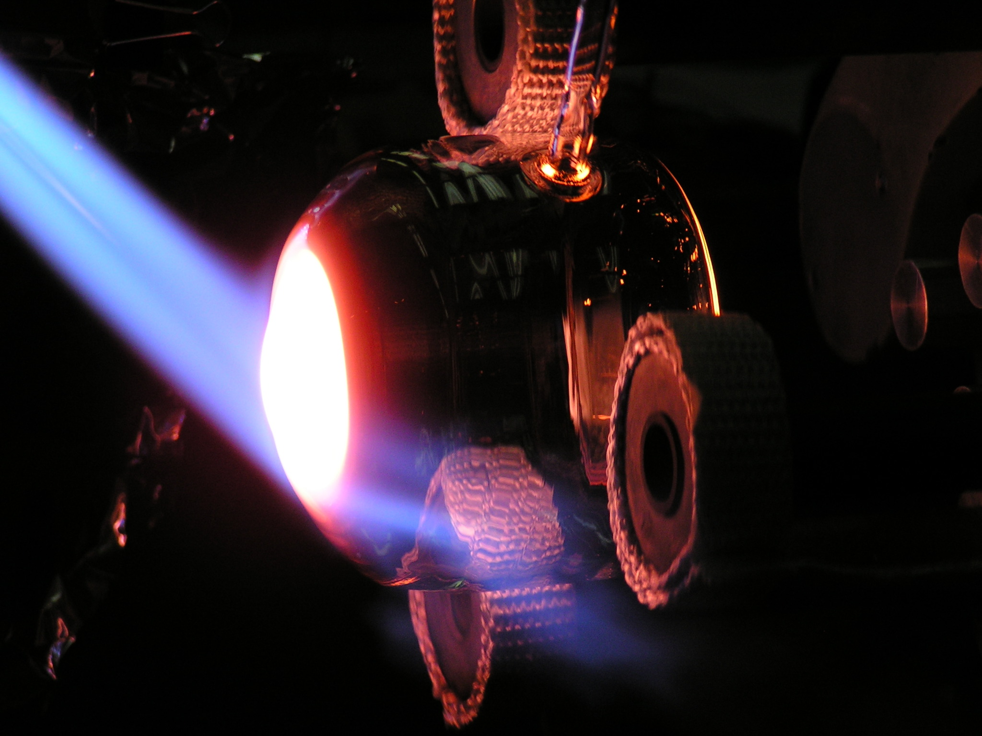
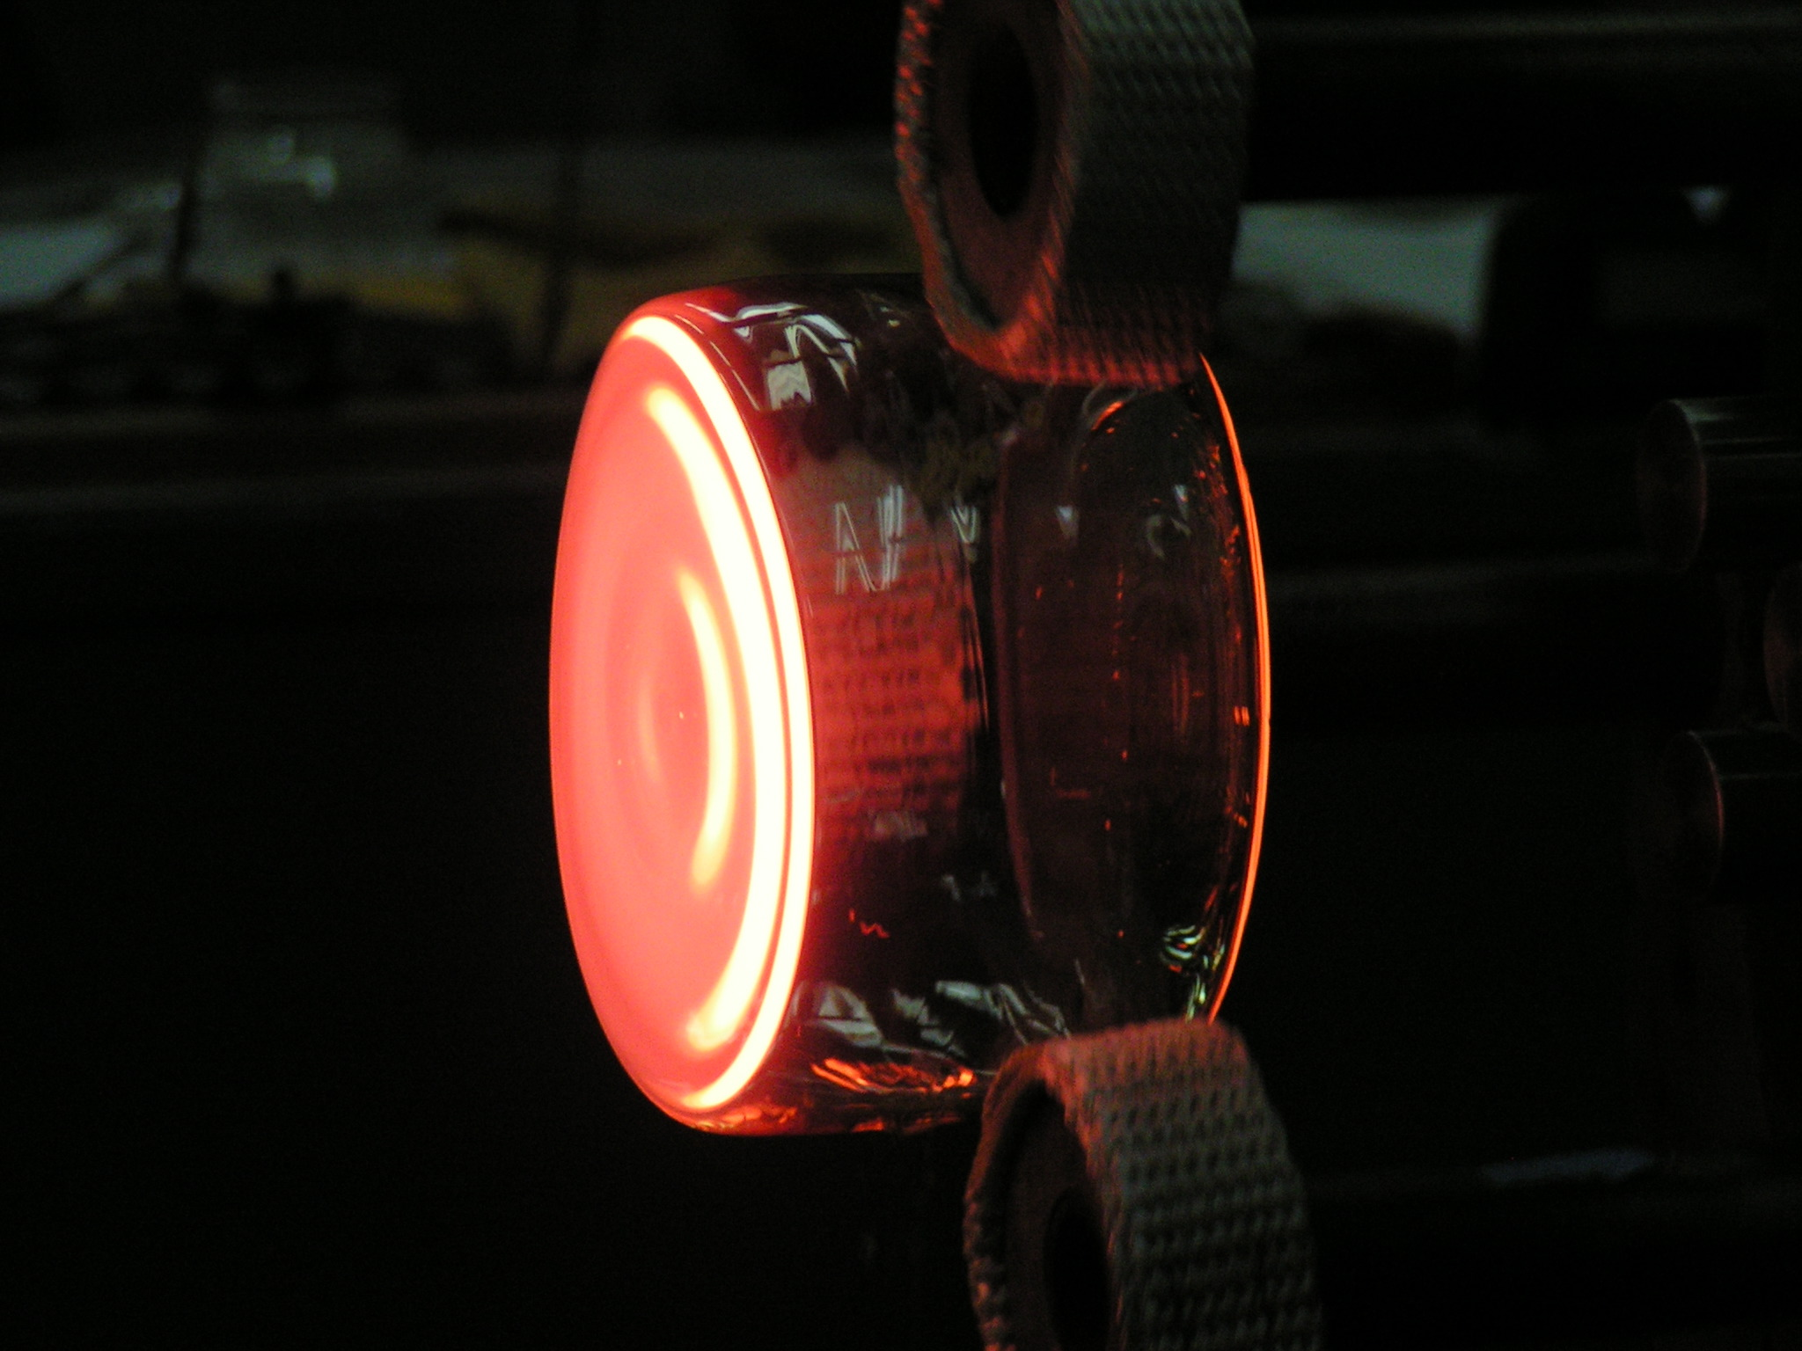

Slide 35

IN-SITU SEOP APPARATUS FOR THE MAGNETISM REFLECTOMETER AT THE
SPALLATION NEUTRON SOURCE at OAK RIDGE NATIONAL LABORATORY
C.Y. Jiang, Physics Procedia 42, 191 (2013).

