Slide 1
Polarimetry Requirements for eRHIC

Slide 2
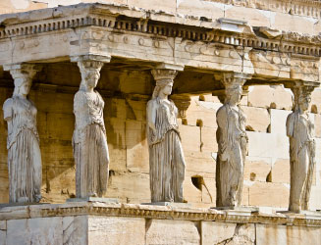
The Pillars of the eRHIC Physics program
Requirements from Physics:
High Luminosity ~ 10³³ cm⁻²s⁻¹ and higher
Flexible center of mass energy
Electrons and protons/light nuclei (p, He³ or D) highly polarised
Wide range of nuclear beams (d to U)
a wide acceptance detector with good PID (e/h and π, K, p)
wide acceptance for protons from elastic reactions and
neutrons from nuclear breakup
Electro Weak
physics of
strong color
fields
spin Physics
2D+1 Imiging
Hadronisation
Wide physics program with high requirements on detector and machine performance

Slide 3
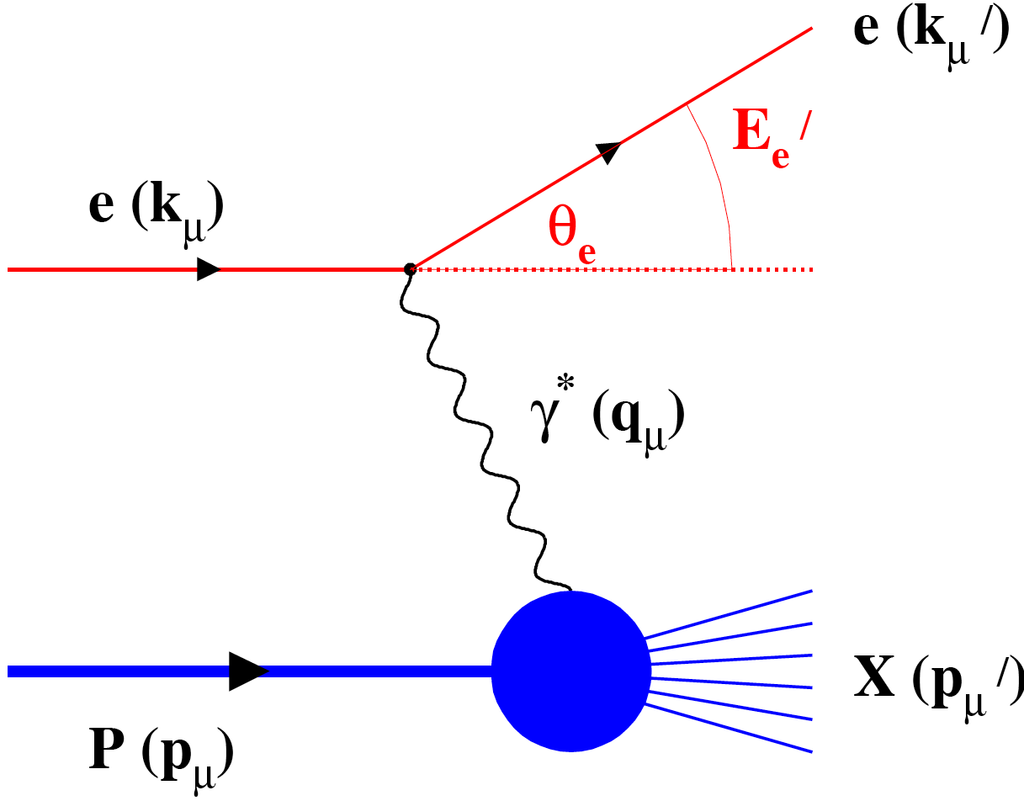
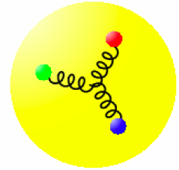
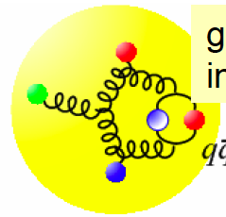
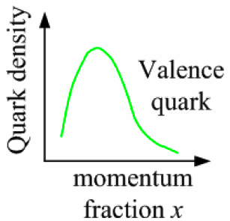
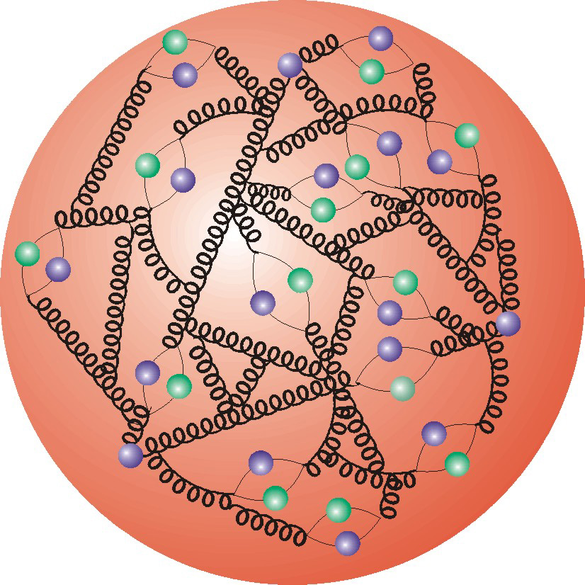
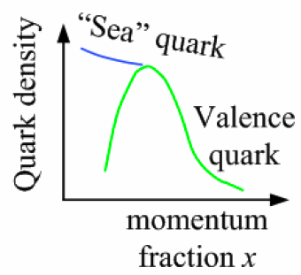
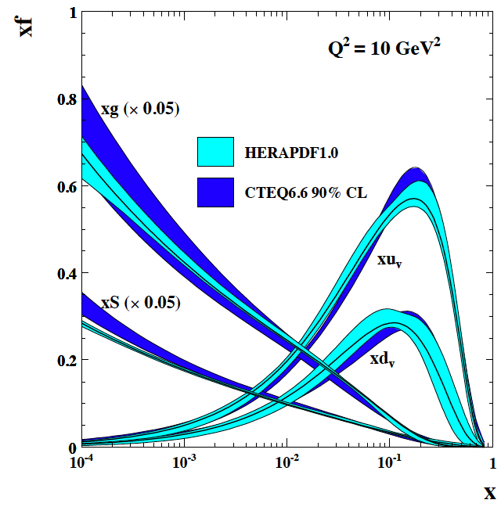
Deep Inelastic Scattering
Kinematics:
Measure of resolution power
Measure of inelasticity
Measure of momentum fraction of struck quark
Gluon splits
into quarks
Quark splits
into gluon
splits
into quarks …
10⁻¹⁶m
10⁻¹⁹m
higher √s
increases resolution

Slide 4
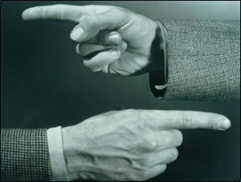
Example: Longitudinal Spin Structure
Contribution to proton spin to date:
Gluon: 20% (RHIC)
Quarks: 30% (DIS)
MISS 50% → low x
Can ΔΣ and ΔG explain it all ?

Slide 5
present vs eRHIC kinematic coverage
RHIC pp data
constraining Δg(x)
in approx. 0.05 < x <0.2
data plotted at x_{T}=2p_{T}/√S
likewise for Q²
5 x 100 GeV eRHIC stage-1
20 x 250 GeV eRHIC
eRHIC extends x coverage
by up to 2 decades
(at Q²=1 GeV²)
lowest x so far 4.6 x10⁻³ COMPASS

Slide 6
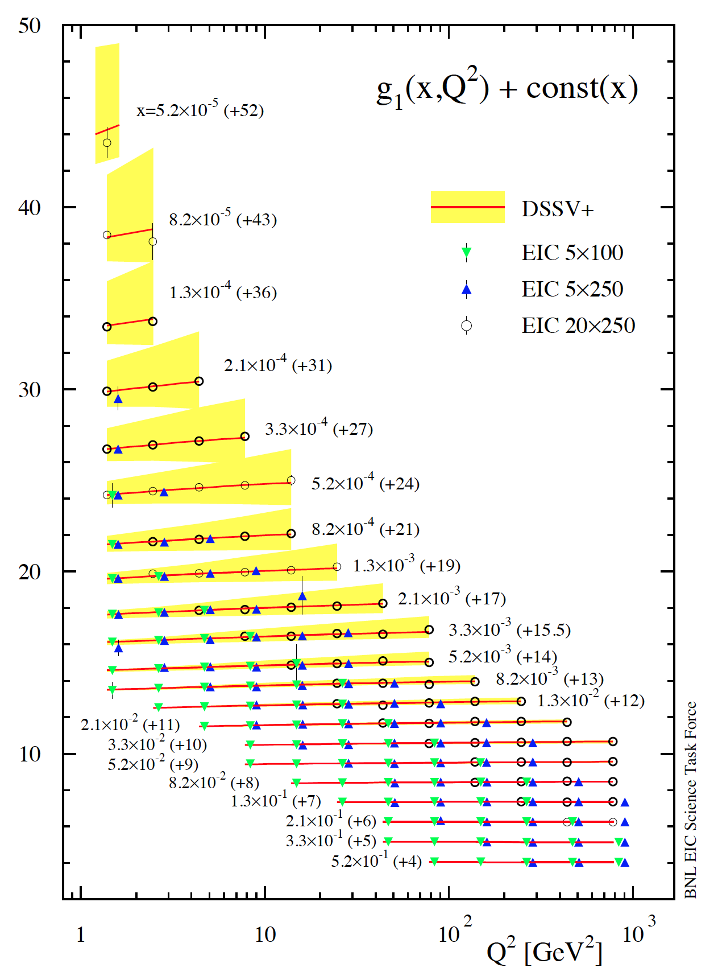
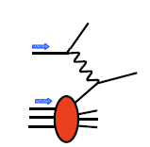
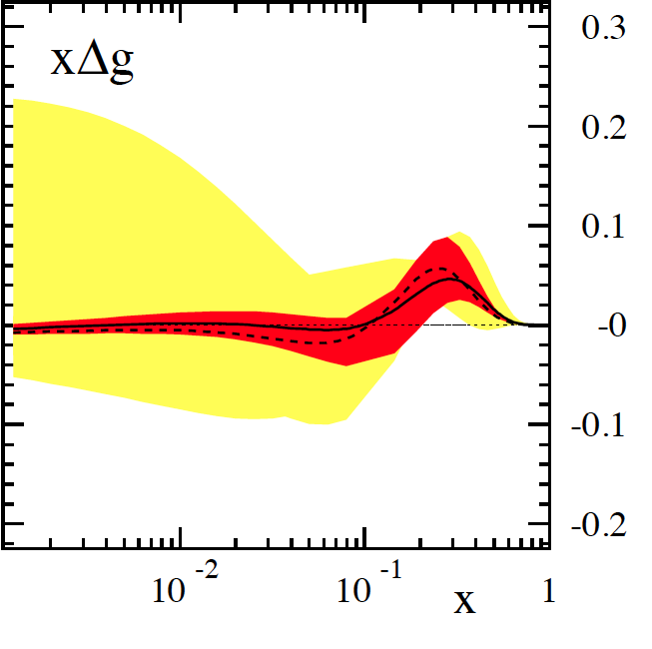
g₁^{p} the way to find the Spin
hep-ph:1206.6014 (M.Stratmann, R. Sassot, ECA)
cross section:
pQCD scaling violations
5 x 250 starts here
5 x 100 starts here
dramatic reduction
of uncertainties:
world data
now
eRHIC 5x100/250 GeV

Slide 7
Can we solve the spin sum rule ?
gluon
spin Δg
✔
total quark
spin ΔΣ
✔
orbital angular
momentum
can be
extracted through
exclusive reactions
current data
for details see
D. Mueller, K. Kumericki
S. Fazio, and ECA
arXiv:1304.0077
w/ eRHIC data
can expect ~5-10%
uncertainties on ΔΣ and Δg
BUT
need to control systematics

Slide 8
Impact on ∫Δg from systematic uncertainties
arXiv: 1206.6014
Dominant systematics:
Luminosity Measurement → Relative Luminosity
needs to be controlled better then A_{LL}
~10⁻⁴ at low x
Absolut polarization measurements:
electron P_{e} and hadron P_{p}
relative
luminosity
Need systematics ≤ 2%

Slide 9
Polarization and Luminosity Coupling
Concept:
Use Bremsstrahlung ep → epγ as reference cross section
  normally only γ is measured
  Hera: reached 1-2% systematic uncertainty
BUT:
coupling between polarization measurement uncertainty and uncertainty achievable for lumi-measurement
no experience no polarized ep collider jet
have started to estimate a with the help of our theory friends → hopefully a is small
Important
need to monitor not only polarisation level but also polarisation bunch current correlation
for both beams

Slide 10
What do we know

Slide 11

Polarisation at eRHIC
RHIC
Existing = $2B
Electron accelerator
to be build
p
Polarized protons
50-250 GeV
polarized leptons
5-20 (30) GeV
e⁻
Polarized light ions He³ 166 GeV/u
70% e⁻ longitudinal beam polarization
currently 55% @ 250 GeV
p-beam polarization
→ will be improved @ eRHIC through more snakes → ~70%
Bunch by Bunch Polarization Direction
each bunch can have a different polarization direction
protons
electrons
minimizes long term systematics due to helicty direction
HERA: one helicity state for all e-bunches for ~3 month

Slide 12
RHIC Hadron Polarimetry
Polarized hydrogen Jet Polarimeter (HJet)
  Source of absolute polarization (normalization of other polarimeters)
  Slow (low rates ⇒ needs looong time to get precise measurements)
Proton-Carbon Polarimeter (pC) @ RHIC and AGS
  Very fast ⇒ main polarization monitoring tool
  Measures polarization profile (polarization is higher in beam center) and lifetime
  Needs to be normalized to HJet
Local Polarimeters (in PHENIX and STAR experiments)
  Defines spin direction in experimental area
  Needs to be normalized to HJet
All of these systems are necessary for the proton beam polarization measurements and monitoring

Slide 13
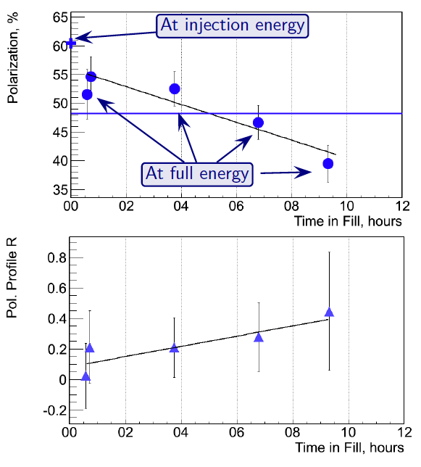
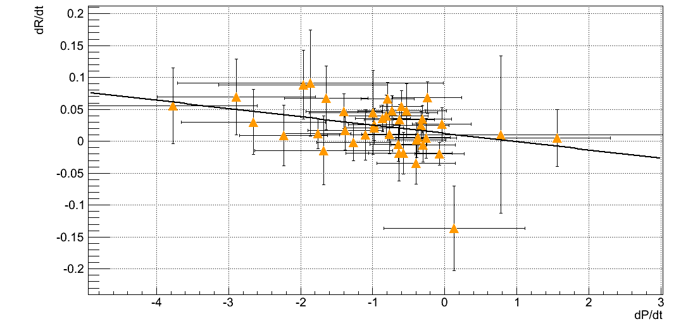
RHIC Hadron Polarisation
Account for
beam polarization decay through fill → P(t)=P₀exp(-t/τ_{p})
growth of beam polarization profile R through fill
pCarbon
polarimeter
Collider
Experiments
x=x₀
Result:
Have achieved 6.5% uncertainty for DSA and 3.4 for SSA
will be very challenging to reduce to 1-2%
correlation of
dP/dt to dR/dt
for all 2012 fills
at 250 GeV
Polarization lifetime has consequences for physics analysis
different physics triggers mix over fill
  → different <P>

Slide 14
RHIC: Polarisation-Bunch Current Correlation
Data from 2012-Run:
Improvements of hadron polarisation measurements:
continuously monitor molecular fraction in the H-Jet
find longer lifetime and more homogenious target material for the pC polarimeters
can we calibrate energy scale of pC closer to E_{kin}(C) in CNI
alternative detector technology for Si-detectors to detect C
Small anti-correlation
between polarisation and
bunch current at injection
which washes out at
collision energies

Slide 15
eRHIC Lepton Beam
  How to generate 50 mA of polarized electron beam? Polarized cathodes
  are notorious for dying fast even at mA beam currents
  One possibility is using the idea of a “Gatling” electron gun with a combiner?
  → 20 cathodes
  → one proton bunch collides always with electrons from one specific cathode
Challenge:
Integrate Compton polarimeter into IR and Detector design
together with Luminosity monitor and low Q²-tagger
longitudinal polarisation → Energy asymmetry
segmented Calorimeter → to measure possible transverse polarisation component → position asymmetry
Important questions:
What is the expected fluctuation in polarisation from cathode to cathode in the gatling gun
from Jlab experience 3-5%
What fluctuation in bunch current for the electron do we expect
limited by Surface Charge, need to see what we obtain from prototype gun
Do we expect that the collision deteriorates the electron polarisation.
A problem discussed for ILC
→ influences where we want to measure polarisation in the ring
How much polarisation loss do we expect from the source to flat top in the ERL.
→ Losses in the arcs have been significant at SLC
Is there the possibility for a polarisation profile for the lepton bunches
→ if then in the longitudinal direction can be circumvented with 352 MHz RF
Notes:
The entire idea of the Gatling gun approach assumes that capabilities of individual cathodes are not affected by the physical presence of other cathodes. This assumption has to be proven experimentally.

Slide 16
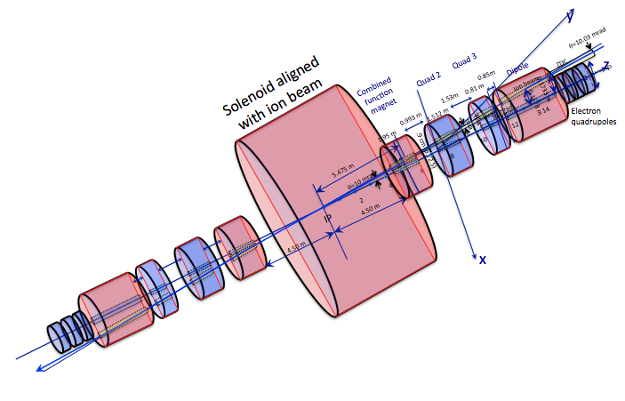
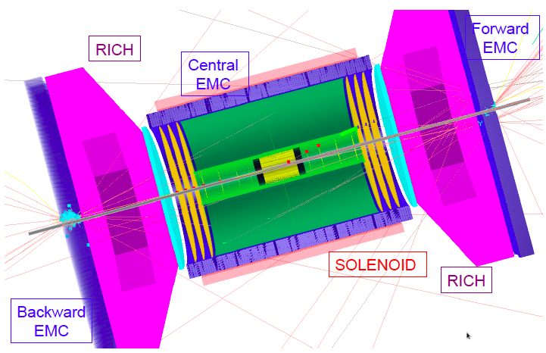
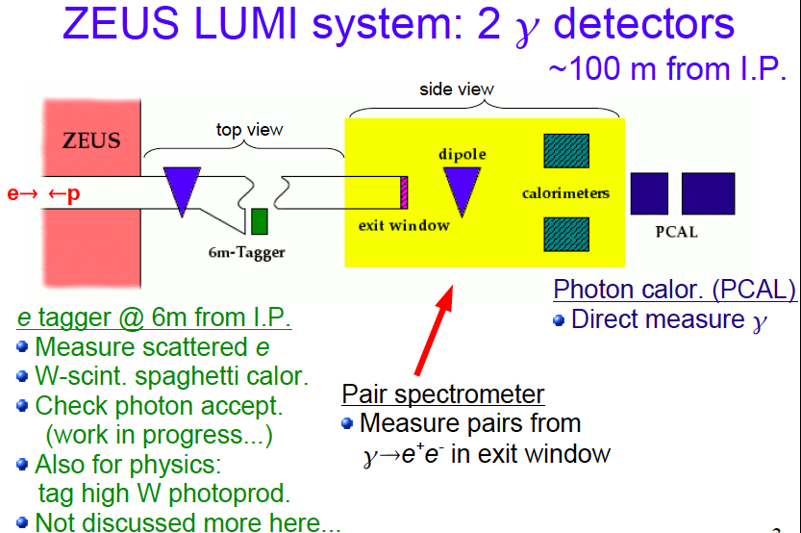
Detector and IR-Design
All optimized for dedicated detector
Have +/-4.5m for main-detector
p: roman pots / ZDC
e: low Q²-tagger
eRHIC-Detector:
collider detector with
-4<h<4 rapidity coverage
and excellent PID
e
p
eRHIC
Detector
100$-question:
Can we combine
low Q²-tagger
lumi-monitor
and compton polarimeter
in one detector system?

Slide 17
A possible layout
pair
spectrometer
Polarimeter
Laser
~
ECAL
small θ
e’-tagger
laser polarisation
needs to be
monitored
p
e
Allows to measure polarisation before and after collision by changing focus
ECal: needs to be radiation hard (sees synchrotron radiation fan)
  possible technology diamante calorimeter → ILC FCal
  will be used to detect compton photons and bremsstrahlungs photons
  challenge to disentangle compton and bremsstrahlungs photons
  → triggering
e’-tagger:
  detect low Q² scattered electrons → quasi-real photoproduction physics
  detect lepton from compton scattering
pair spectrometer: alternative luminosity measurement

Slide 18
Summary
A lot of work was done in the last years on EIC
  arXiv: 1212.1701 & 1108.1713
eRHIC Machine, IR and design very well advanced and many details are studied
  will have a prototype gatling gun available soon
  study systematic effects → impact on polarimeter and lumi-monitor design
Performance Requirements from physics determined
First studies on relative luminosity requirements and polarization measurements have been done
  impact on systematic uncertainties
having large luminosity means there is the need to control the systematic uncertainties to very low levels
  need to understand the limitations in polarisation and luminosity measurements
Many Thanks to my colleagues of the
BNL-EIC-TF and CAD eRHIC group
We welcome everybody to collaborate with us to realize the high precision
electron and hadron polarization
and luminosity measurements

Slide 19
BACKUP

Slide 20
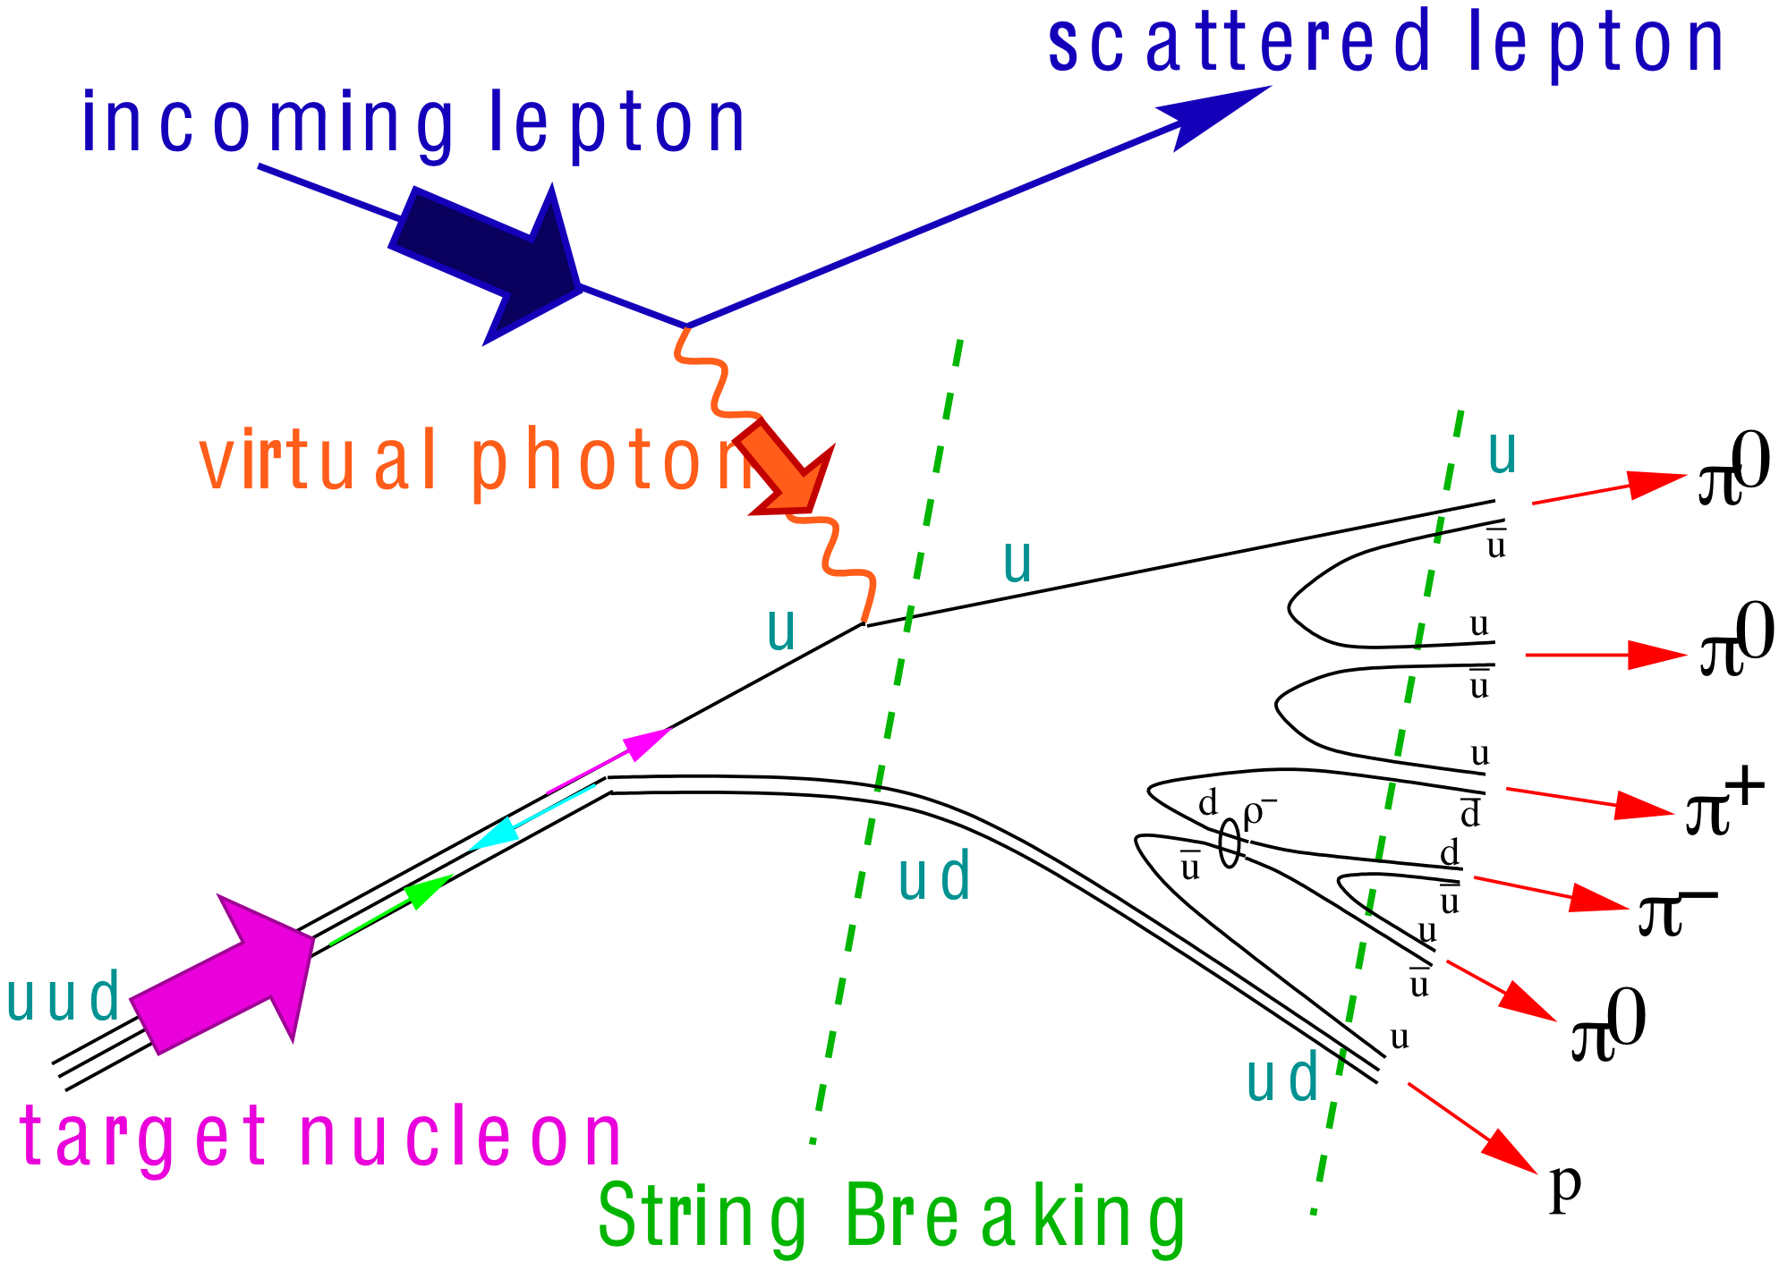
What needs to be covered BY THE DETECTOR
e’
γ, π,J/Ψ
e
γ_{L}*
(Q²)
x+ξ
x-ξ
~
~
H, H, E, E (x,ξ,t)
p
p’
Inclusive Reactions in ep/eA:
Physics: Structure Fcts.: g₁, F₂, F_{L}
Very good electron id → find scattered lepton
Momentum/energy and angular resolution of e’ critical
scattered lepton → kinematics
t
Semi-inclusive Reactions in ep/eA:
Physics: TMDs, Helicity PDFs → flavor separation, dihadron-corr.,…
→ Kaon asymmetries, cross sections
Excellent particle ID: π±,K±,p± separation over a wide range in η
full Φ-coverage around γ*
Excellent vertex resolution → Charm, Bottom identification
Exclusive Reactions in ep/eA:
Physics: GPDs, proton/nucleus imaging, DVCS, excl. VM/PS prod.
Exclusivity → large rapidity coverage → rapidity gap events
↘ reconstruction of all particles in event
high resolution in t → Roman pots

Slide 21
eRHIC-Detector Design Concept
ECAL W-Scintillator
Upstream
low Q²
tagger
ECAL PWO
ECAL WScin
To
Roman Pots
HCAL
RICH
RICH
HCAL
DIRC/proximity RICH
−η
η
PID:
-1<η<1: DIRC or proximity focusing Aerogel-RICH
1<|η|<3: RICH
Lepton-ID:
-3 <η< 3: e/p
1<|η|<3: in addition Hcal response & γ suppression via tracking
|η|>3: ECal+Hcal response & γ suppression via tracking
-5<η<5: Tracking (TPC+GEM+MAPS)

Slide 22
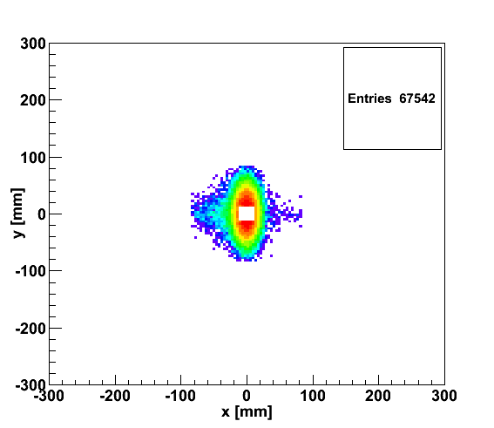
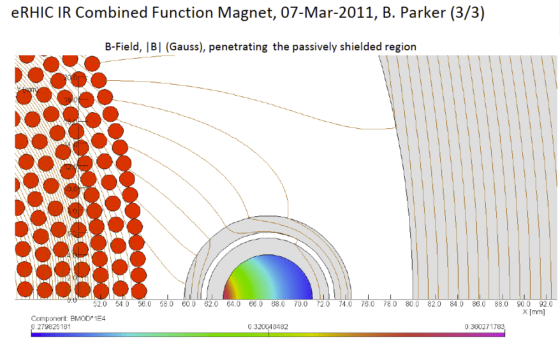
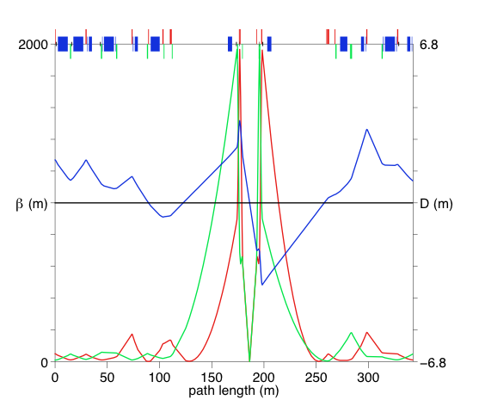
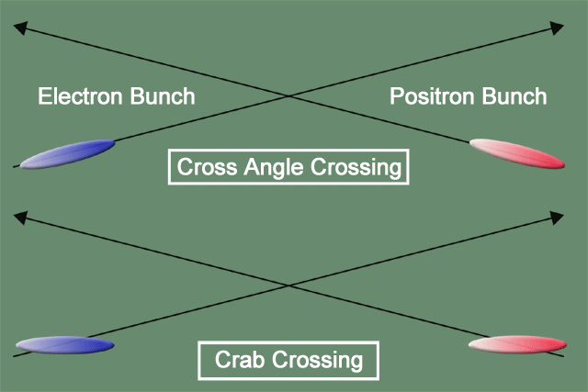
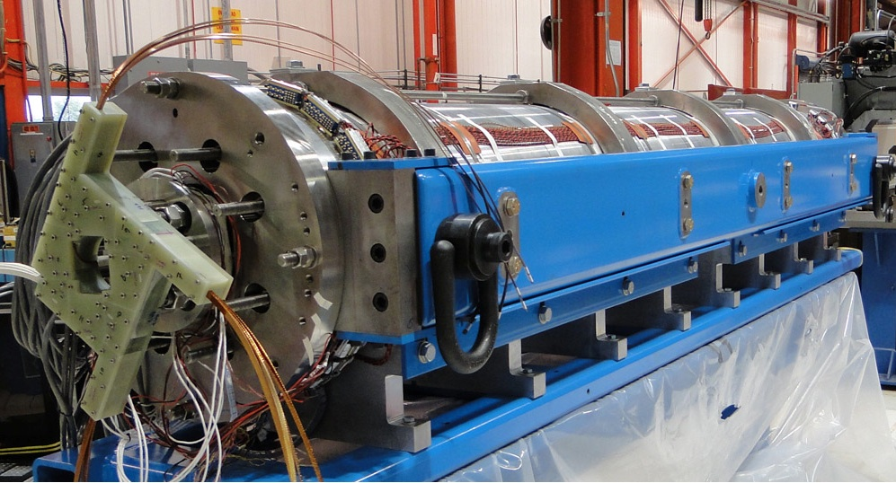
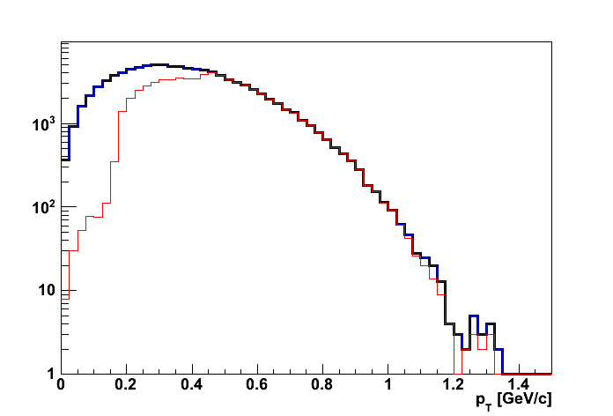
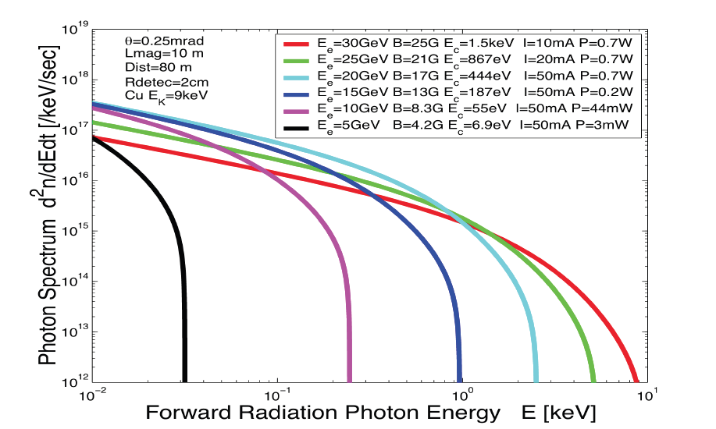
eRHIC: high-luminosity IR
20x250
p
Proton beam lattice
G.Ambrosio et al., IPAC’10
e
Nb₃Sn
20x250
200 T/m
eRHIC - Geometry high-lumi IR with β*=5 cm, l*=4.5 m
and 10 mrad crossing angle → 10³⁴ cm⁻² s⁻¹
Generated
Quad aperture limited
RP (at 20m) accepted
10 mrad crossing angle and crab-crossing
High gradient (200 T/m) large aperture Nb₃Sn focusing magnets
Arranged free-field electron pass through the hadron triplet magnets
Integration with the detector: efficient separation and registration of low angle collision products
Gentle bending of the electrons to avoid SR impact in the detector
© D.Trbojevic, B.Parker, S. Tepikian, J. Beebe-Wang

Slide 23
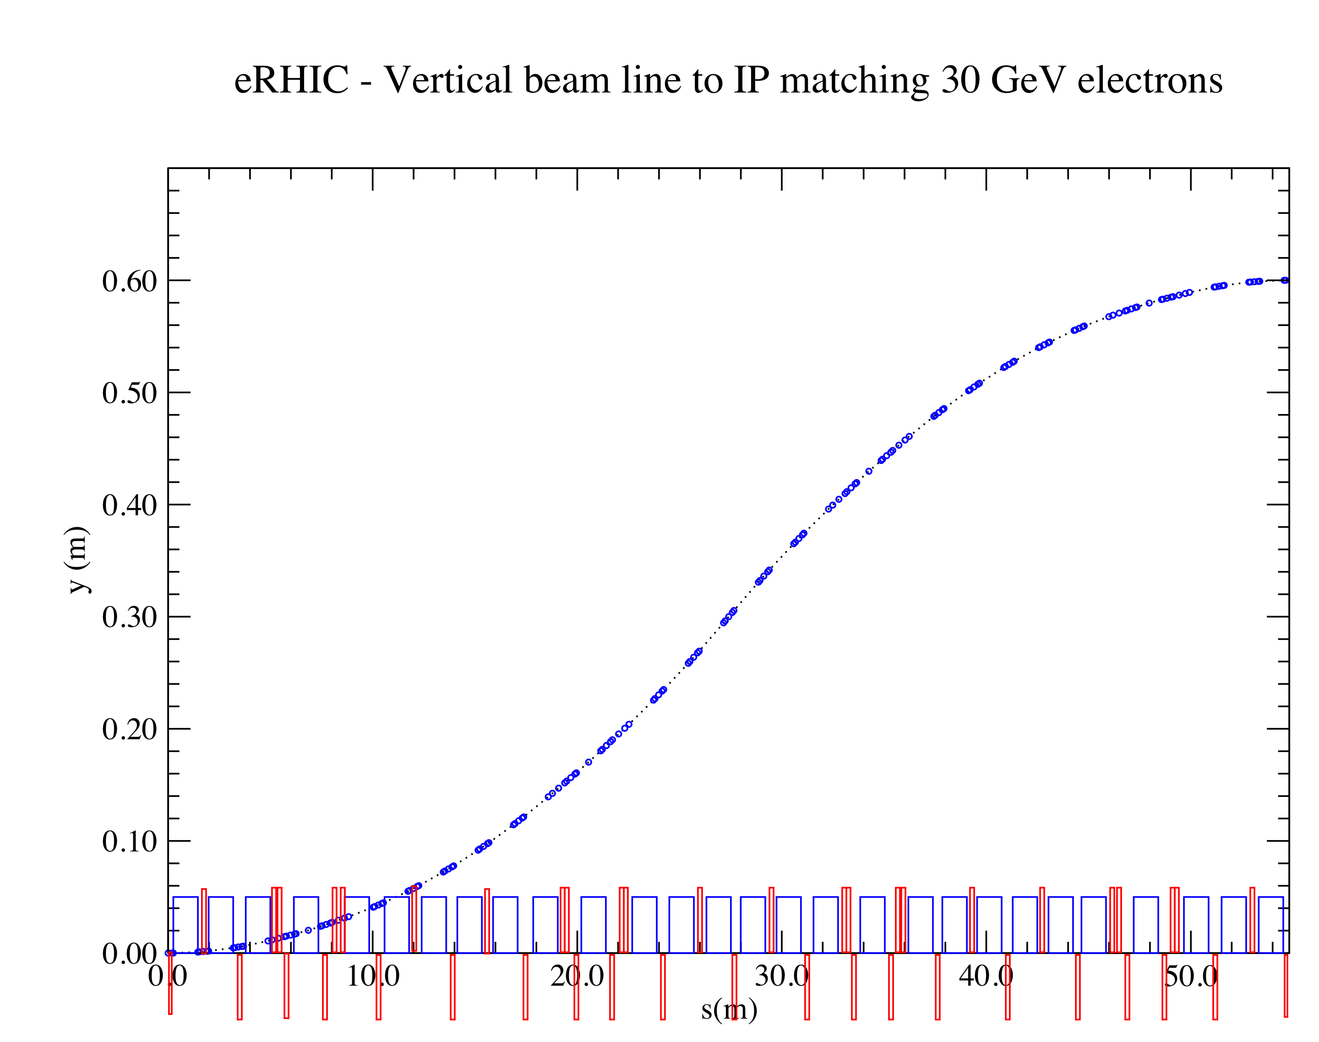
Integration into Machine: IR-Design
Outgoing electron direction currently under detailed design
detect low Q² scattered leptons
want to use the vertical bend to separate very low-Θ e’ from beam-electrons
can make bend faster for outgoing beam → faster separation
for 0.1º<Θ<1º will add calorimetry after the main detector
space for
low-Θ e-tagger

Slide 24
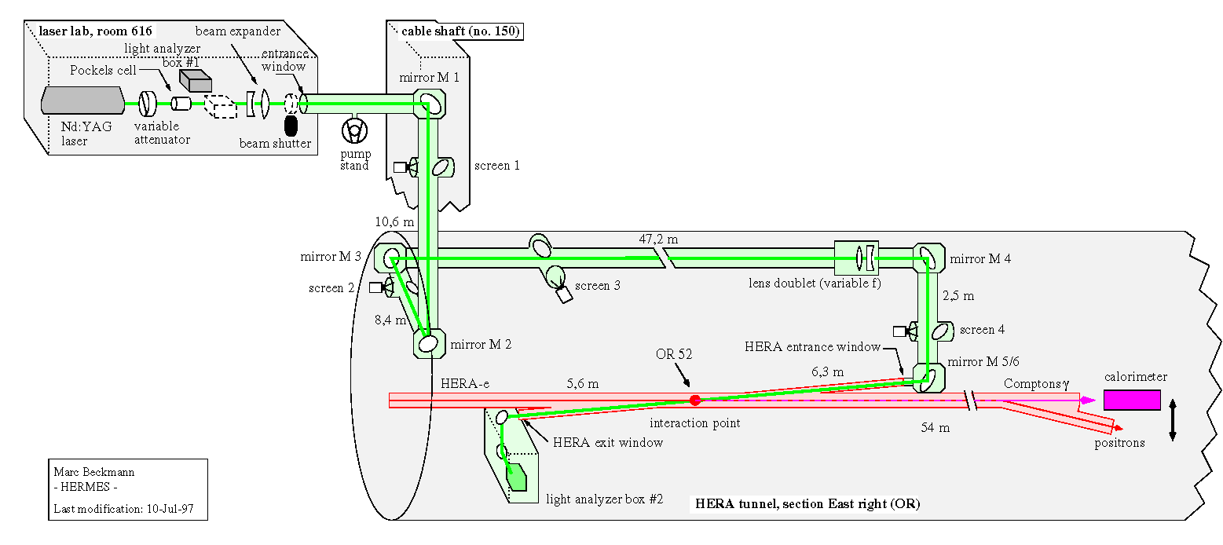
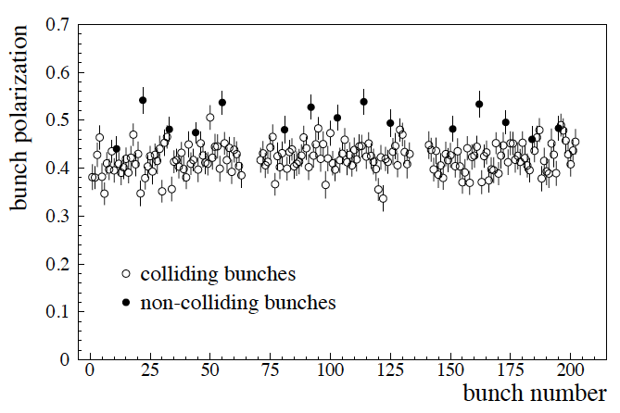
Lepton Polarization
Method: Compton backscattering
Questions, which need still answers
  how much does the polarization vary from bunch to bunch
    yes: need a concept to measure bunch by bunch polarisation in an ERL
    no: measure the mean of all bunches → what is done now at JLab
  is there the possibility for a polarization profile
    yes: how can we measure it ?
    no: makes things much easier
Result:
Have achieved 1.4% uncertainty at HERA
572 nm pulsed laser
laser transport system: ~80m
laser light polarisation measured
continuously in box #2

Slide 25
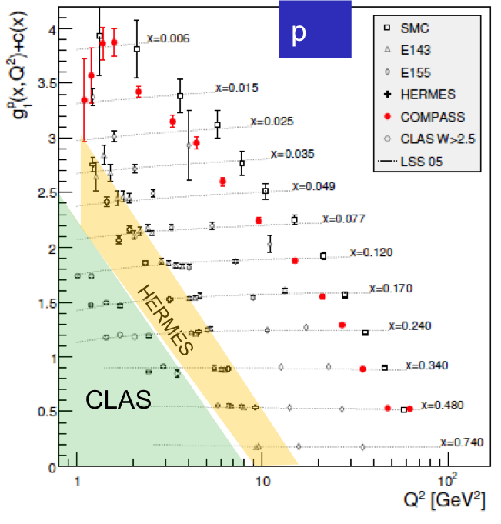
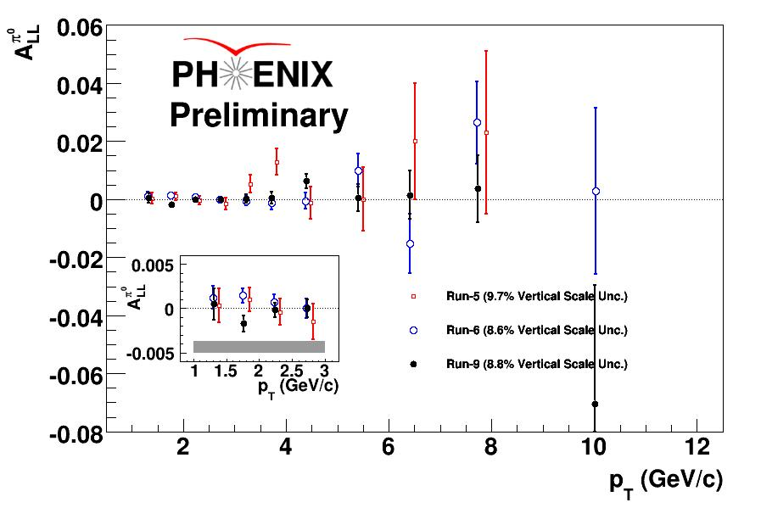
What Do we know now on Δg(x)
Scaling violations of g₁
(Q²-dependence) give indirect access to the gluon distribution via DGLAP evolution.
RHIC polarized pp collisions at midrapidity direct access to gluons (gg,qg)
Rules out large ΔG for 0.05 < x < 0.2
Integral in RHIC x-range:
Contribution to proton spin to date:
Gluon: 20% Quarks: 30%

