Slide 1

Funneling multiple bunches of high-charge polarized electrons
Erdong Wang
On behalf of the Gatling gun group
Brookhaven National Laboratory
Sept.11th 2013

Slide 2
Outline
Motivation
Funneling gun design
  Beam optics design
  Mechanical design
  Vacuum design
  beam diagnostic
  Depressed collector
Proof-of-Principle test
Recent progress

Slide 3
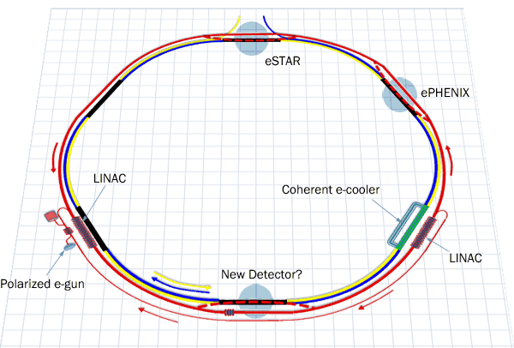
Motivation
ERL based eRHIC: The current proposed design for an EIC integrated with RHIC
eRHIC parameters
 | p | e
Energy, GeV | 325 | 20
Bunch charge, nC | 32 | 3.5
Beam current, mA | 415 | 50
Rms nor. Emittance, µm | 0.18 | 20
Polarization,% | 70 | 80
Luminosity,cm⁻²s⁻¹ | 1.5X10³⁴
With 50mA polarized electron gun, eRHIC luminosity could increase 10 times.

Slide 4
What kind of beam we want?
Polarized electron sources deliver either a high peak current, such as >5A achieved by the SLAC(High peak current, low average current)
A high average current, such as that up to 4mA reached by the Continuous Electron Beam Accelerator Facility. (Low peak current, high average current)
What we want?
High Bunch charge:3.5nC;High average current: 50mA;Long lifetime
Avoid surface charge limit:
Peak current 2.33A from 8mm diameter emission area
Long operation lifetime:
Gatling concept: 20 GaAs cathodes
Careful beam optics design: Reduce Outgassing due to beam loss
Notes:
Space charge limit: dia 8mm,220V, 15A

Slide 5
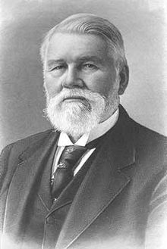
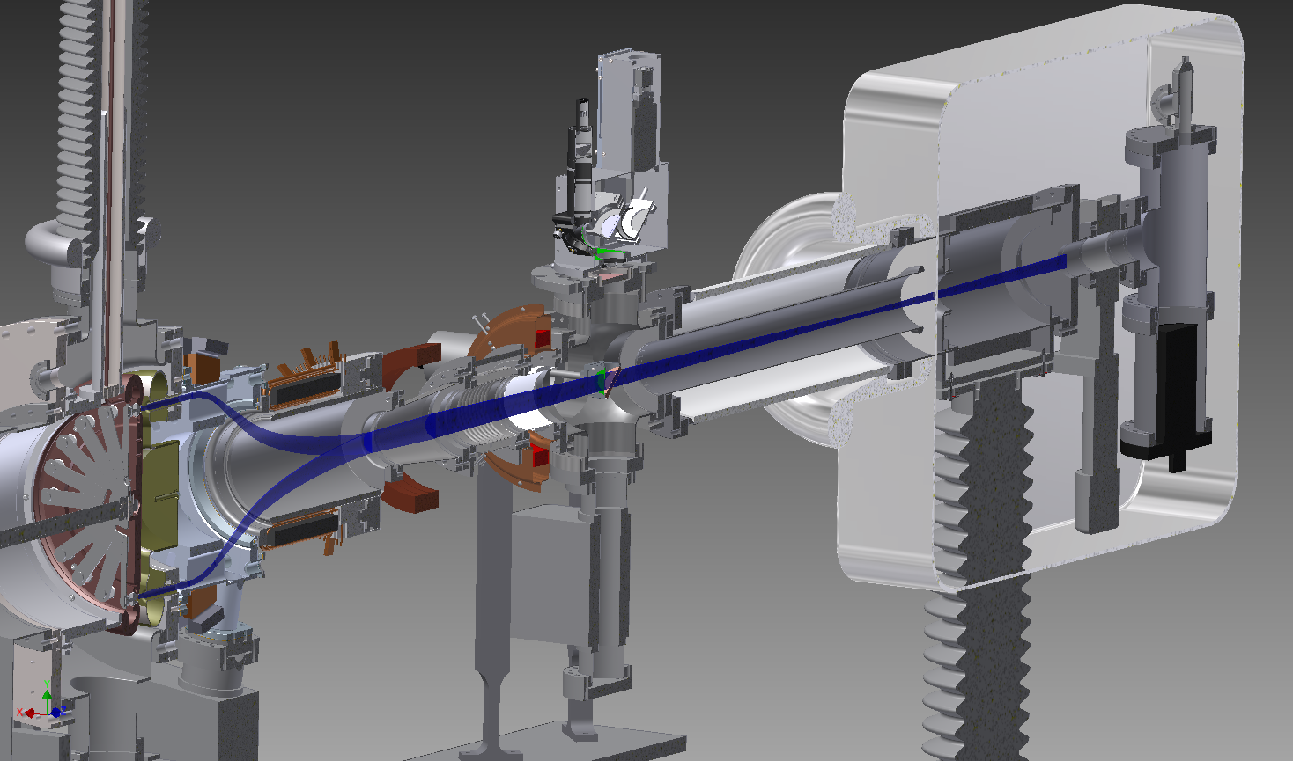
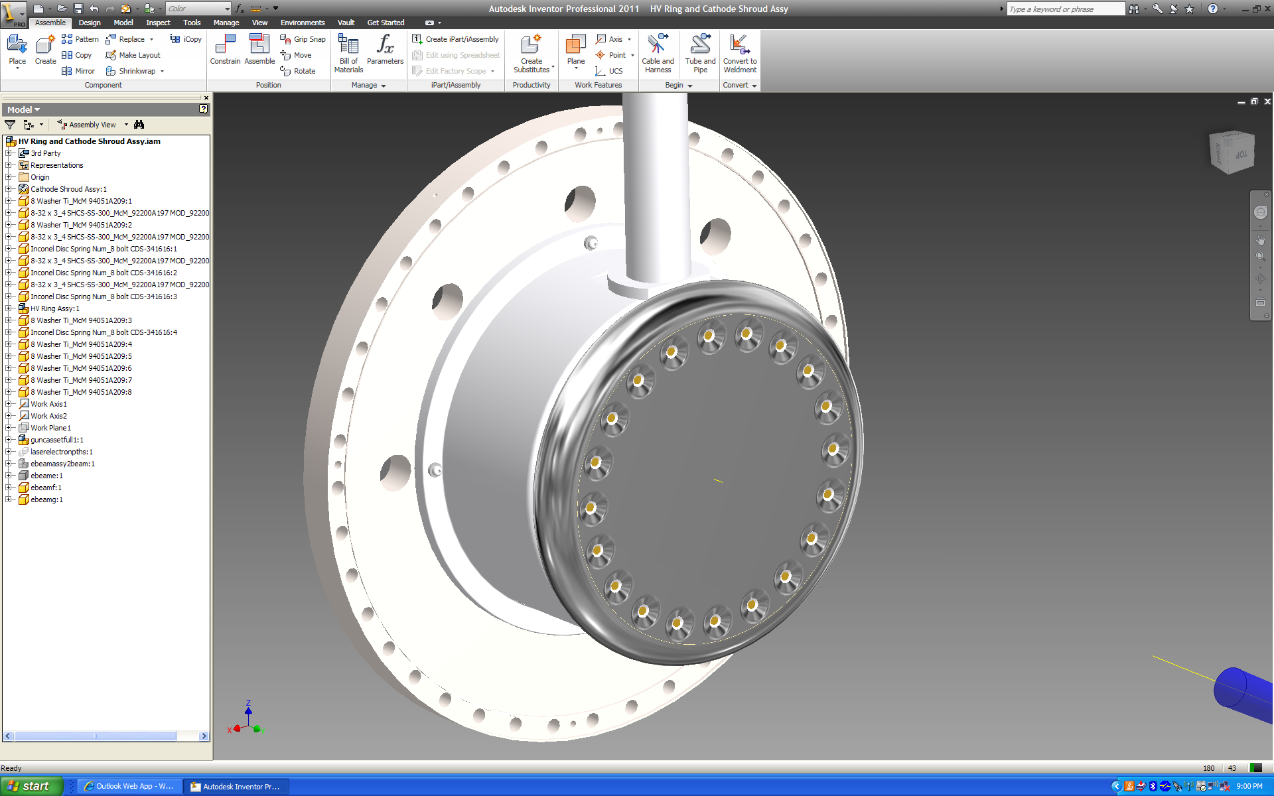
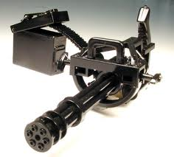
How we figure out?
eRHIC requirement:
Weekly cathode exchange, operation lifetime 85 hours(half week)
Average current :50mA
Charge lifetime: 15,300C!!!
State-of-art single cathode charge lifetime: 1000C @ 2.5mA
Richard Jordan Gatling 1818-1903
15300C/20=765C<1000C
Notes:
Reduce the average current of single cathode, reduce the emission charge from single cathode.

Slide 6
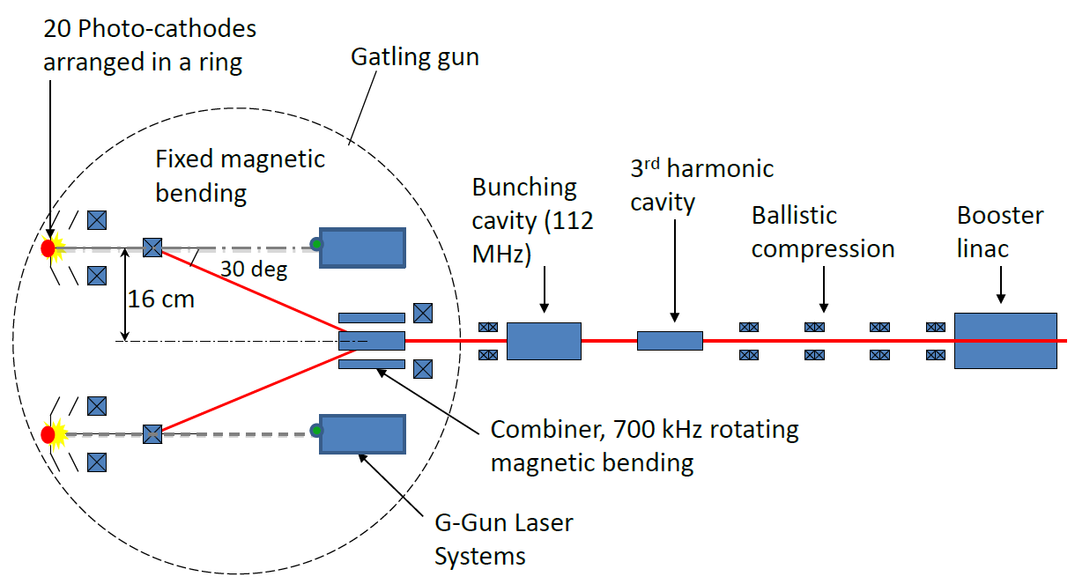
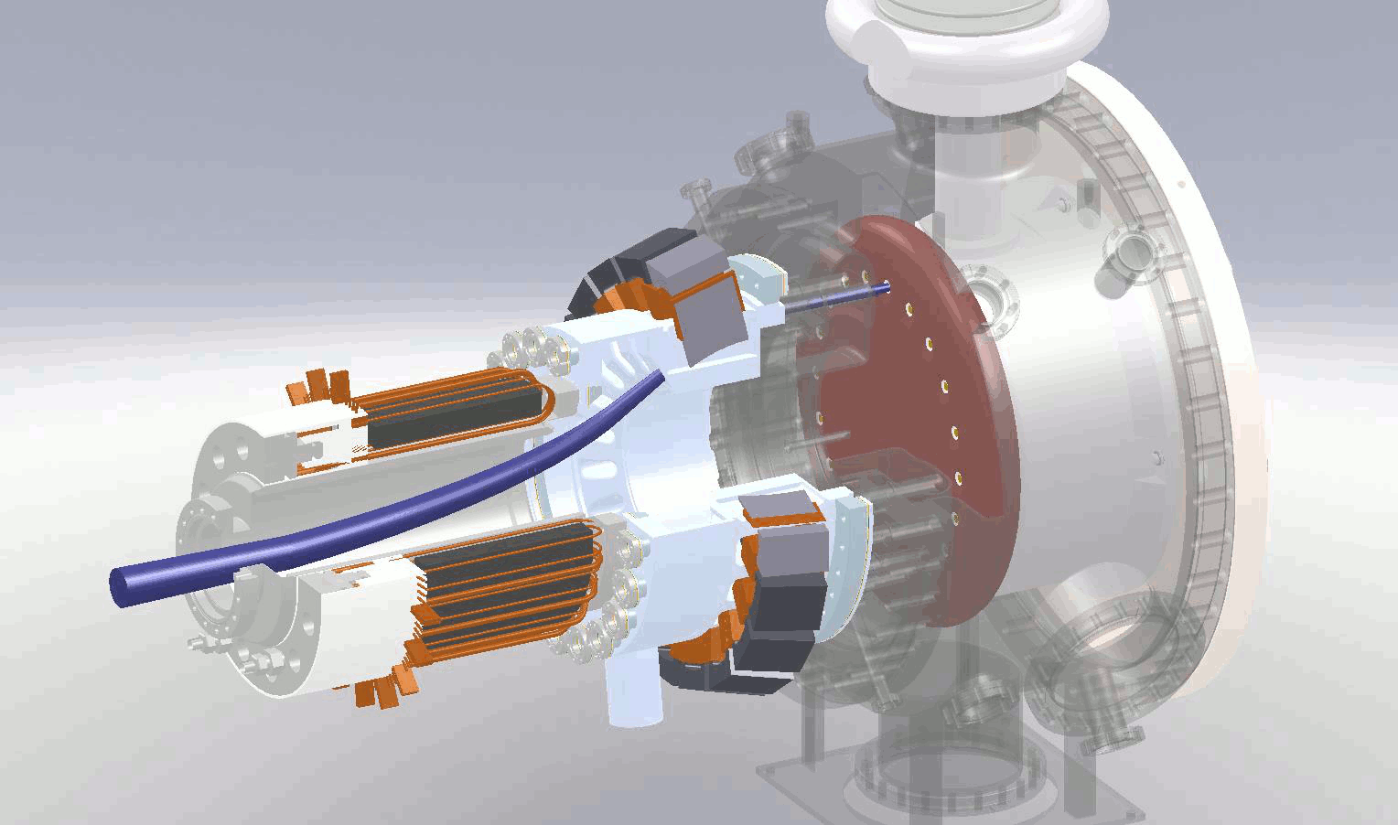
What we want to demonstrate?
10MeV
1.1% Energy spread
1.5 mm bunch length
Single cathode:704 KHz*3.5nC=2.5mA
After funneling:14 MHz*3.5nC=50mA
We want to demonstrate:
The performance of an individual photocathode is not affected by the presence of other cathodes.
The charge lifetime will increase 20 times.

Slide 7
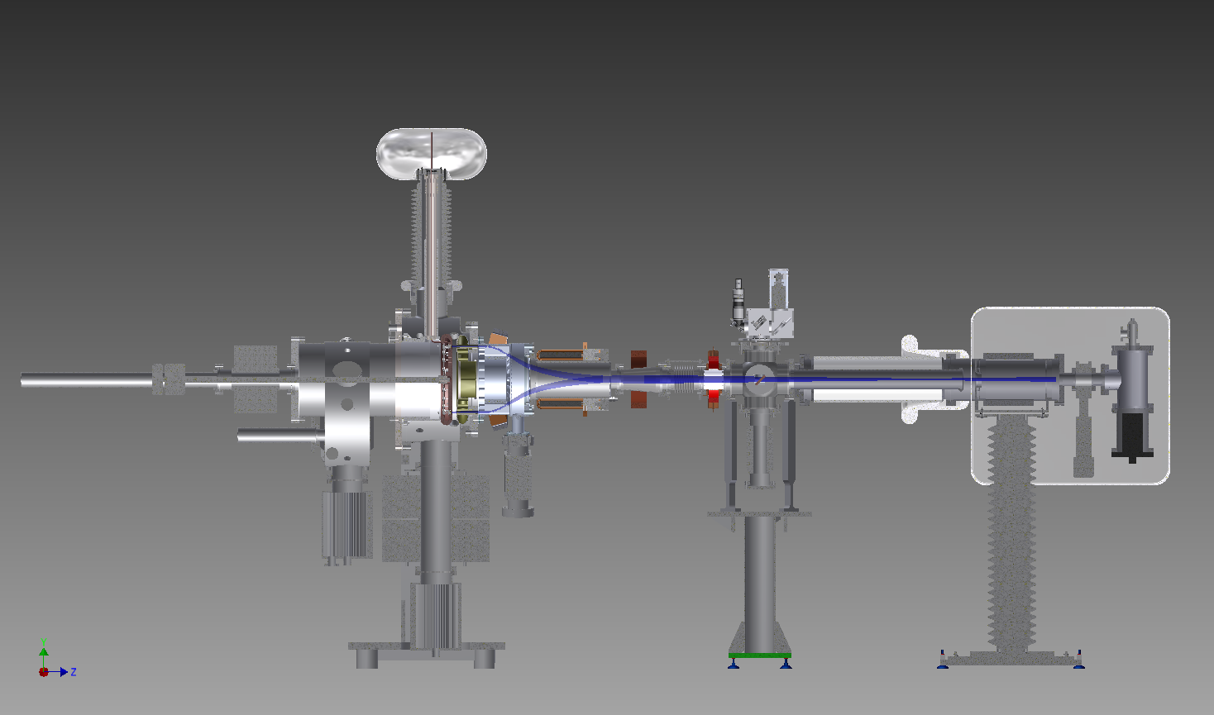
Phase one layout
High voltage feed thru
Beam diagnostics
Depressed collector
Exchange chamber
DC gun
Funneling system
In phase one: The bunching section and energy boosting section will be replaced by a simple depressed collector. The depressed collector reduces the high voltage current, radiation, out-gassing dramatically.

Slide 8
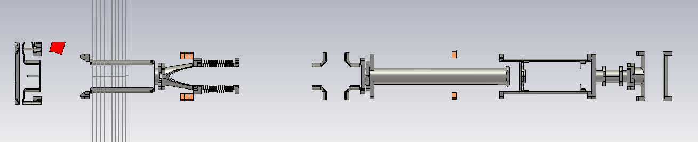
Beam optics design
DC gap
dipole
Combiner
2nd Solenoid
Beam diagnostic
3rd Solenoid
Solenoids
Parameter | Value
Bunch charge at cathode | 3.5nC
Longitudinal charge distribution at cathode | Gaussian distribution(σ=1.5ns)
Transverse charge distribution at cathode | Uniform
Bunch length at cathode | 1.5ns
Bunch radius at cathode | 4mm
Thermal normalized emittance, ε_{n,th} | 0.5 μm/mm(rms); Total thermal emittance=2μm
Single cathode average current | 2.5mA
Repetition rate for one cathode | 704kHz
DC gap voltage | 220kV
CST particle studio 3D beam dynamics study.
Requirements:
Keep the beam far away from the beam pipe
Minimize the beam emittance
Focusing the beam into collection through the hole

Slide 9
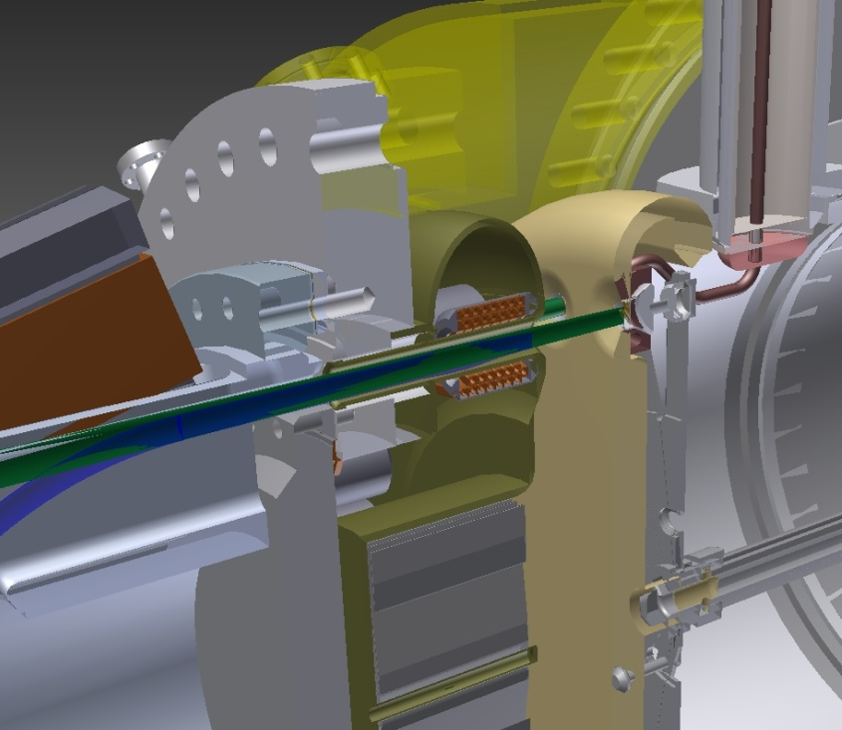
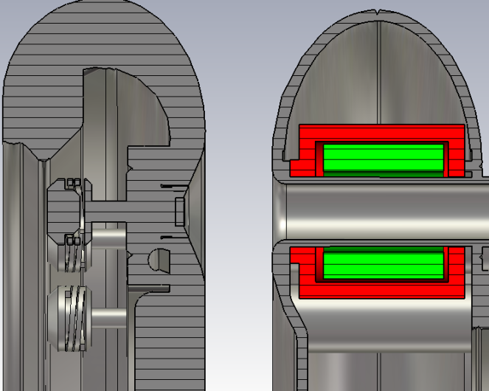
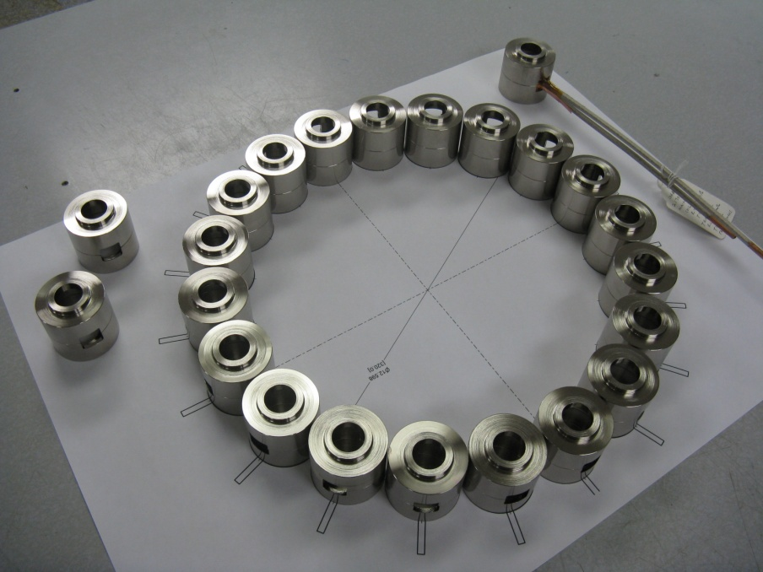
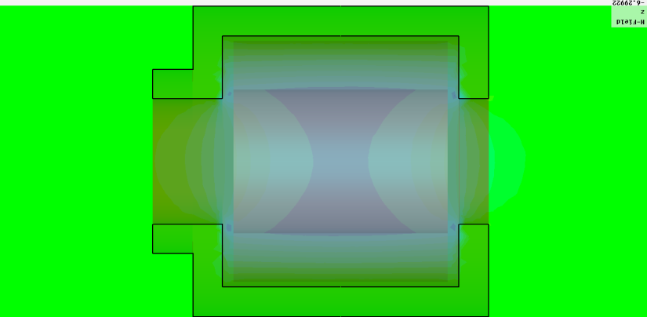
  DC and solenoids
DC gap:2.8cm
Charge to:220kV
SCL:7A
Maximum field:5.3MV/m
Internal tube biased
Solenoid
Cathode
2.8cm
Extra shielding
18°
Max field:660G
Integral : 0.260 T-cm

Slide 10
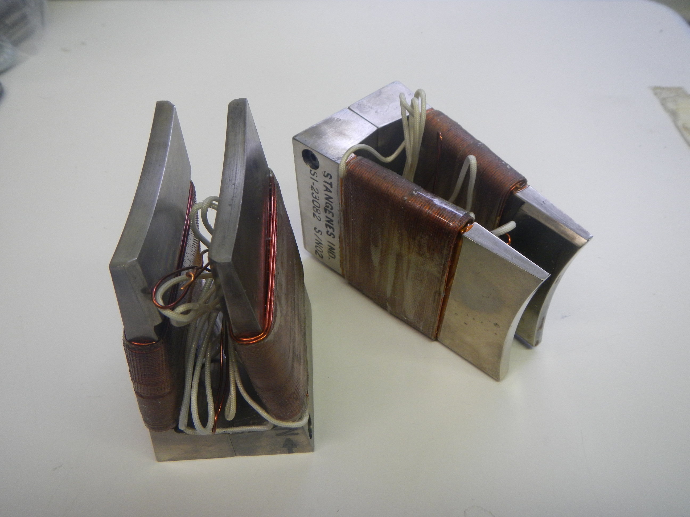
Statics Dipole Magnet
Normalized to 110G
To preserve the longitudinal direction of electron spin polarization, we designed compensated dogleg trajectories in the beam’s funneling system encompassing fixed bending fields generated by 20 dipole magnets, and a rotating bending field generated by the magnetic combiner.

Slide 11

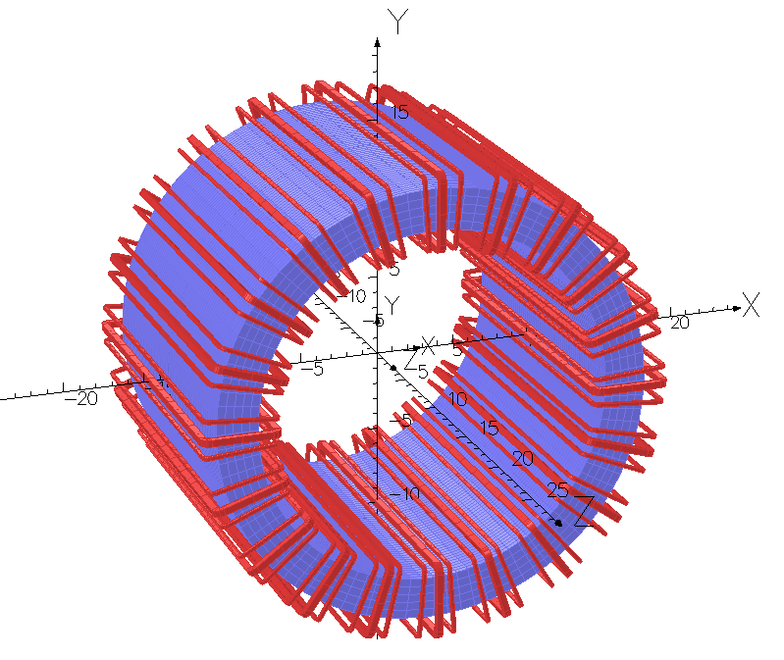
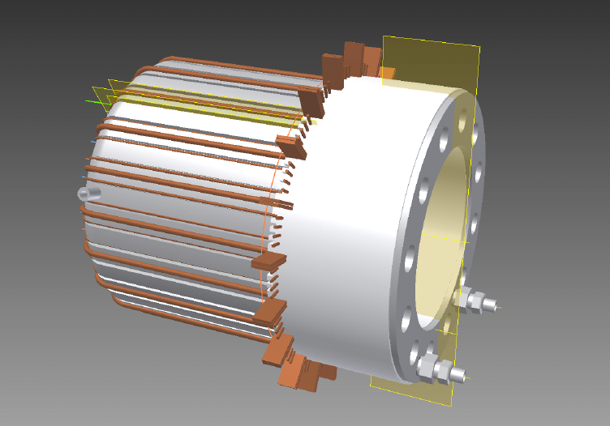
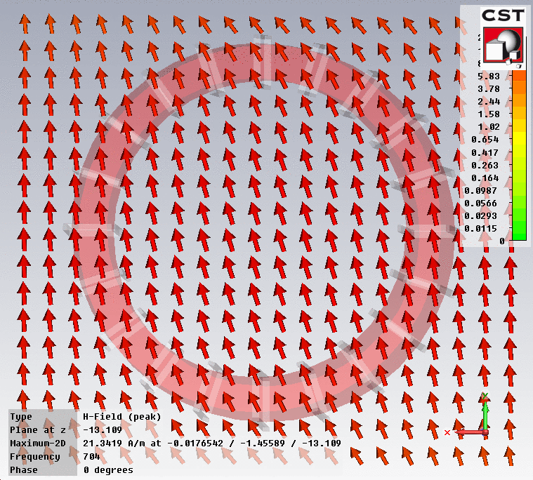
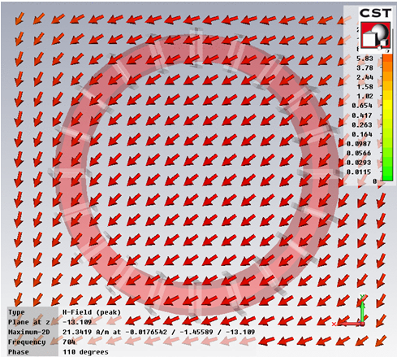
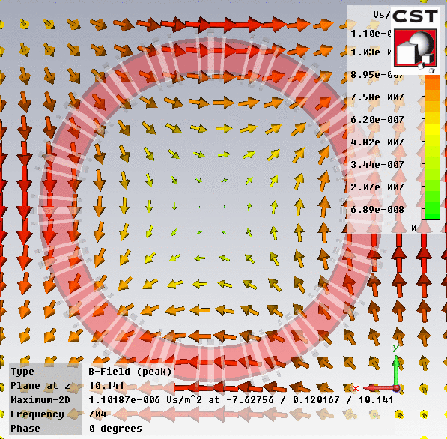
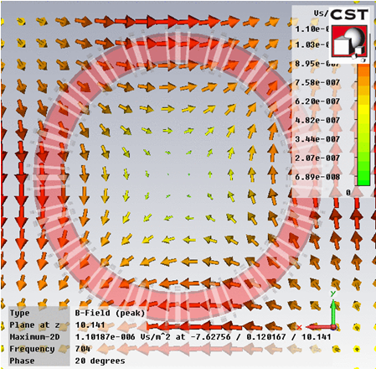
Beam Combiner
Water manifold for ferrite yoke cooling
Water manifold for coil cooling
Power Litz wire
Bending the beam by dipole
Equalize the focusing by quadrupole
Parameters:
I(t)=I_{od}*cos(ωt+φ) where I_{od}=70.7A
I(t)=I_{oq}*cos2(ωt+φ) where I_{oq}=1.54A
B(0,0,0)=25.04G
Freq=704kHz
Bending angle=29 degrees
Power loss=650W

Slide 12
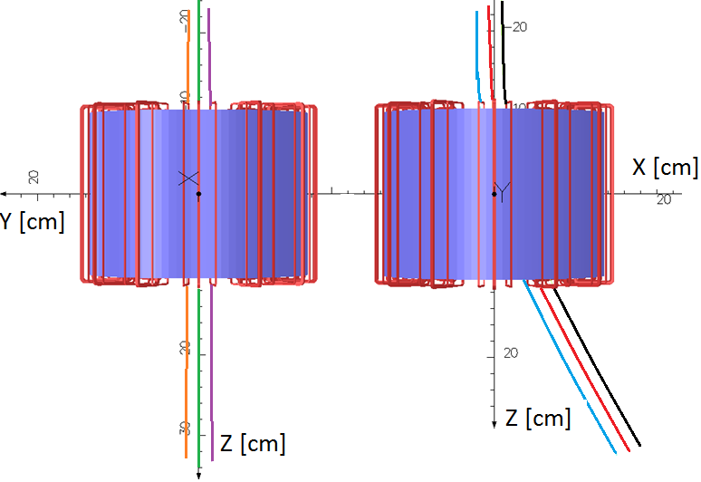
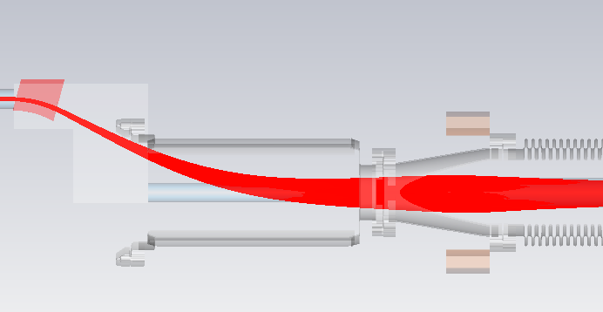
Beam combiner
Single particle tracking shows:
The intergrated field is adjusted to bend the 220keV electrons by 29°
converging angle w/t quadrupole: X’/Y’=2.5mrad/15.7mrad
With quadrupole
X’/Y’=8.7mrad/9.8mrad

Slide 13
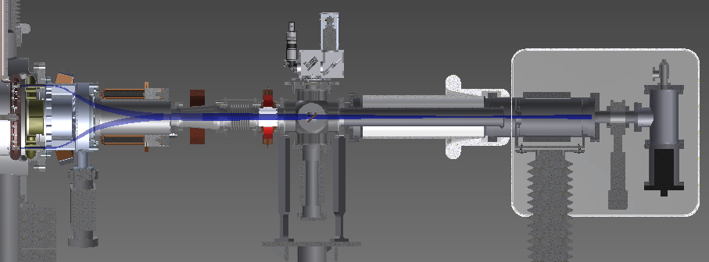
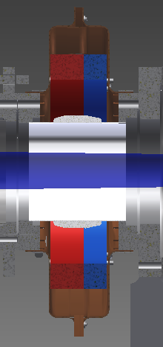
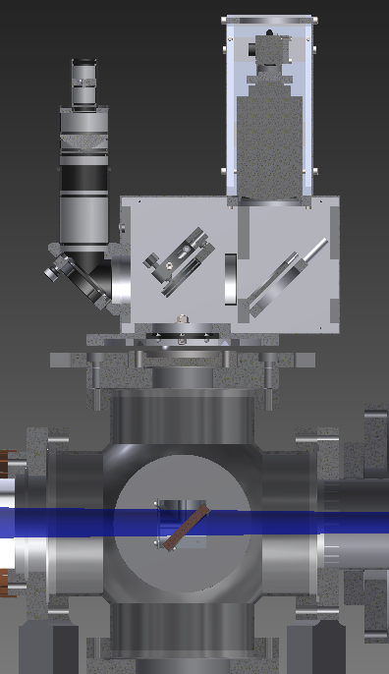
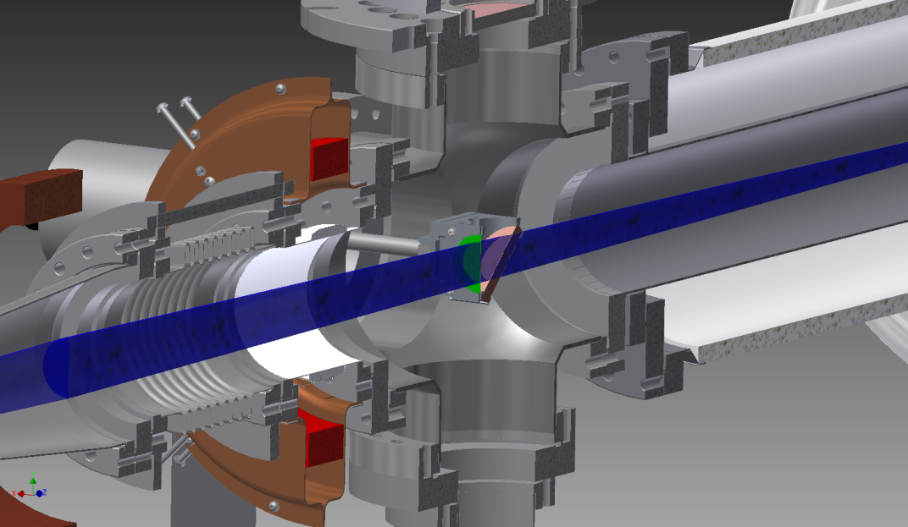
Beam diagnostic
Halo detector
CCD Camera & lens
Virtual Resolution Target
Semitransparent mirror
Fast Current Transformer &
Integrating Current Transformer
Courtesy of D.Gassner

Slide 14
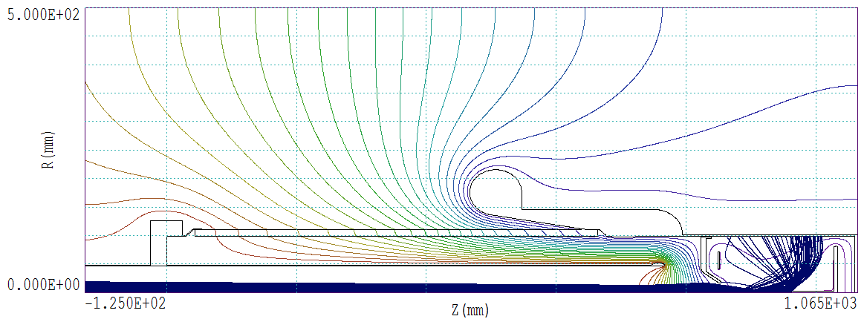
Depressed collector
Courtesy of A. I. Pikin
With collector voltage higher than the primary electron energy spread the returned primary electron current does not exceed 0.1% of the primary electron beam current
The penetration of the secondary and backscattered electrons into the beam pipe is completely eliminated

Slide 15
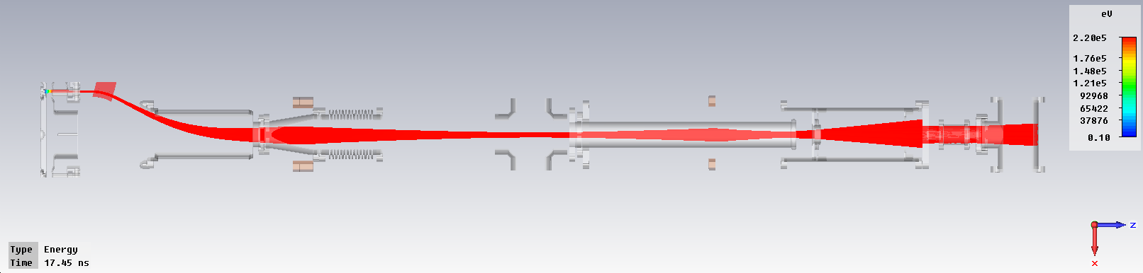
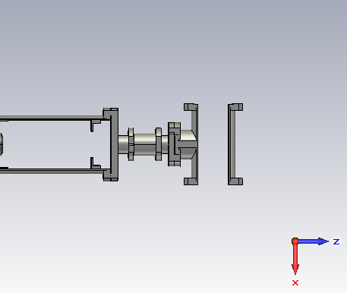
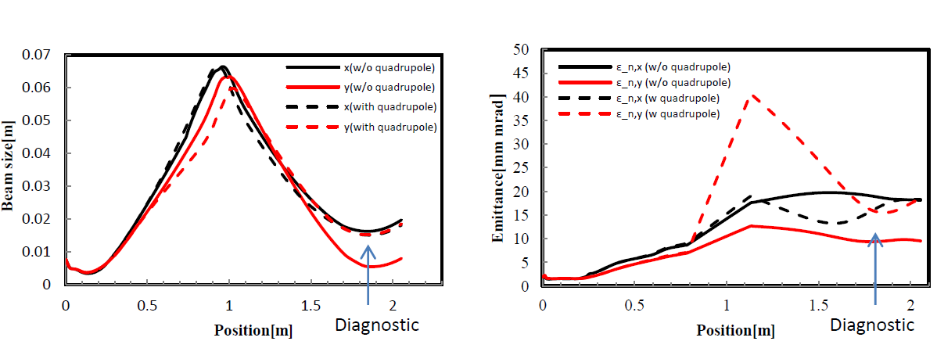
Beam dynamics
Diagnostic
Particles tracking with SC on diagnostic :
Divergence angle: X’/Y’=23.6mrad/25.1mrad
Beam profile: X/Y=15.0mm/15.2mm
ε_{n,x}/ ε_{n,y} =17mm mrad/14.9mm-mrad
Energy spread=8keV(97% particle)
Beam size vs position
Emittance vs position

Slide 16
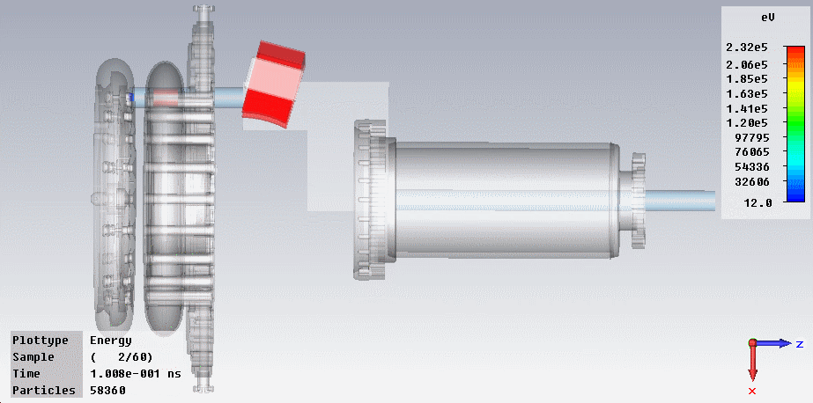
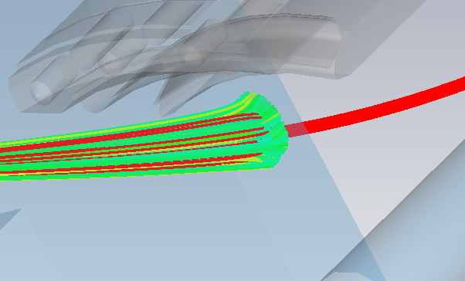
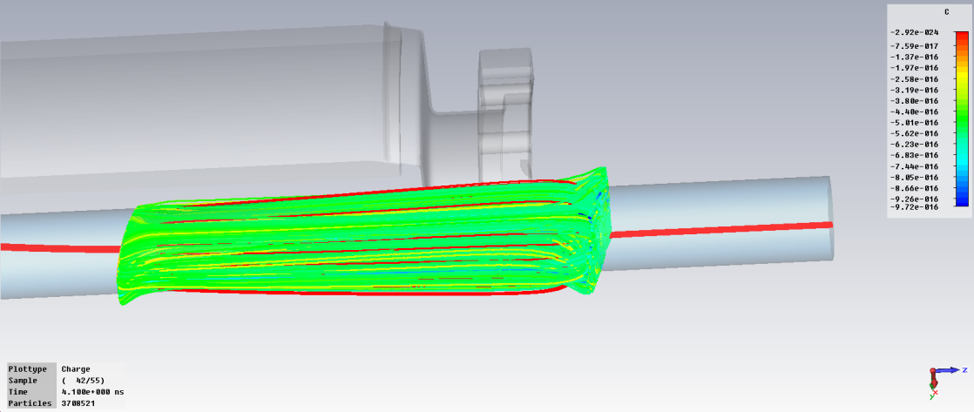
PIC beam tracking
The beam halo cannot form at beginning and end of combiner.
There is no beam loss on the combiner tube base on Particle core model

Slide 17
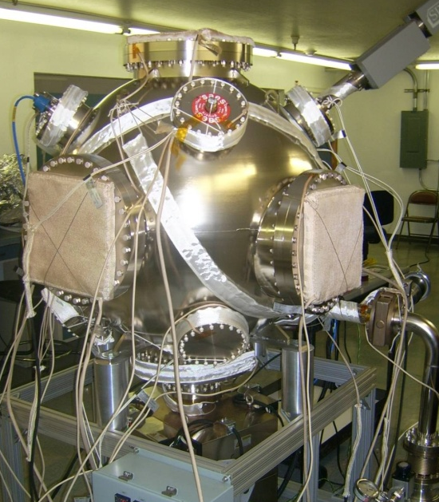
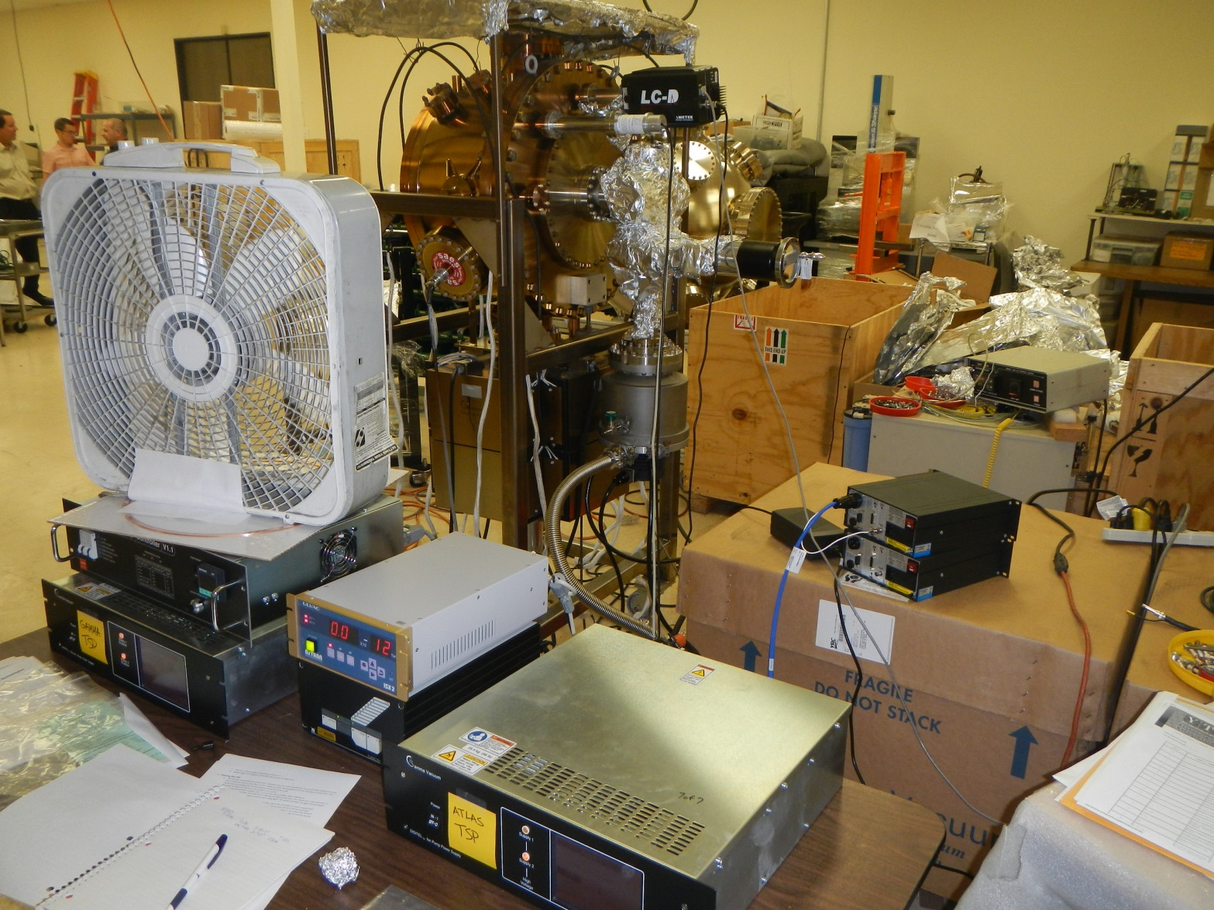
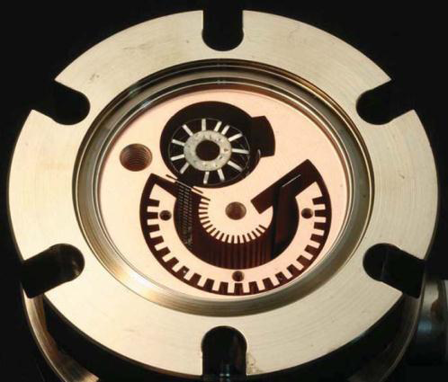
Vacuum design
Compare to other gun:
China IHIP ERL DC gun: 18000L/s NEG
Japan JAEA ERL DC gun:
16000L/s NEG
Transferring chamber: NEG 1500l/s
Design vacuum:10⁻¹² torr scale
Test vacuum now:8*10⁻¹²torr
Gun chamber: 8,000l/s
Design vacuum:6*10⁻¹³ torr
Test vacuum now:<5*10⁻¹²torr
Combiner:6000l/s
Design vacuum:1*10⁻¹¹ torr
Exchange chamber:4000l/s
Design vacuum:1*10⁻¹²torr
Total:20,000L/s
Gun vacuum vessel material:
Vacuum fired SS 316L(2*10⁻¹³ Torr L/cm² s)
Anode material:
Ti(2*10⁻¹⁵ Torr L/cm² s)
Vat Lab 3BG vacuum (super) gauge has <10⁻¹³ Torr resolution

Slide 18
Proof of principle test
Basic goals:
High voltage test in the Funneling gun chamber.
Test one polarized sample in Funneling gun chamber with DC combining field. Average current reach to 2.5mA.
Test two polarized samples in Funneling gun chamber and combine them with switched DC combining field. Average current reach to 5mA.
We will compare the lifetime of single cathode and two cathodes operation to test Gatling principle.
Additional goals:
Combine two beams with rotating combining field.
Current loss measurement.
Emittance measurement.

Slide 19
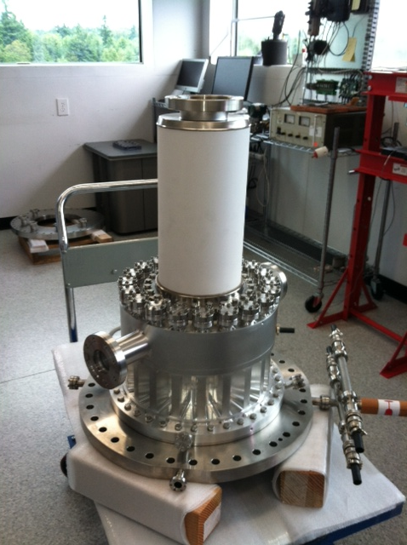
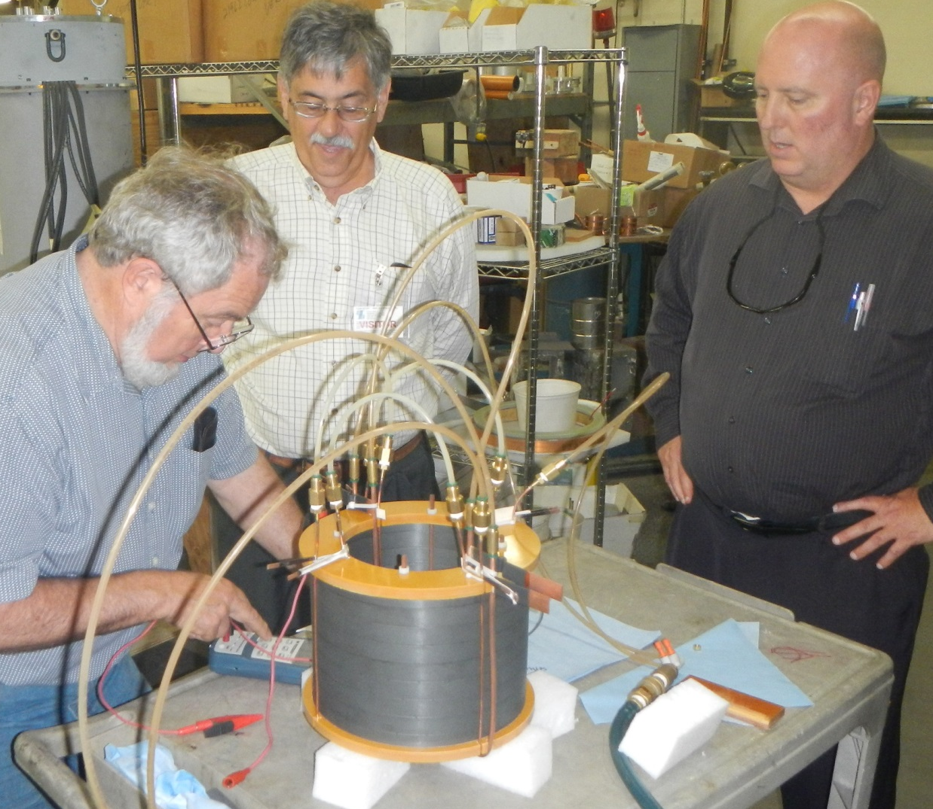
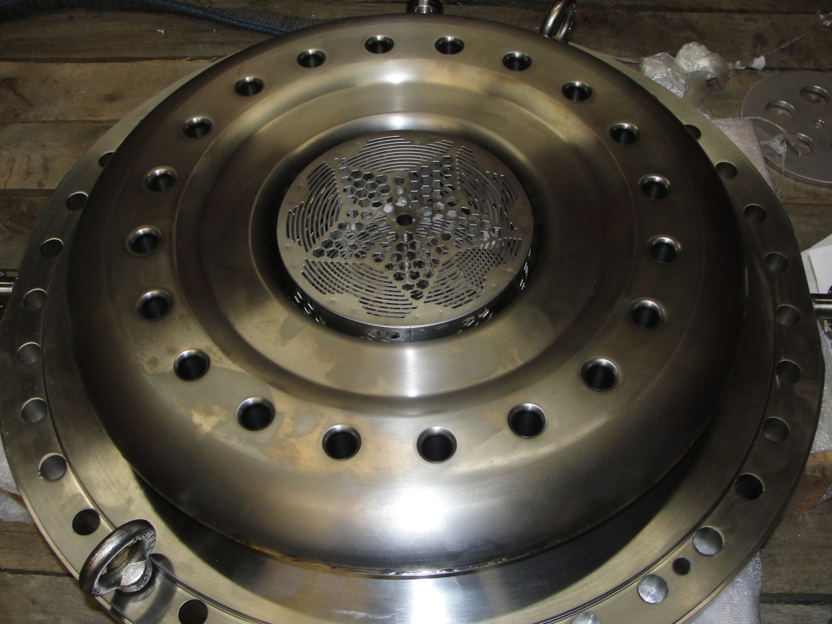
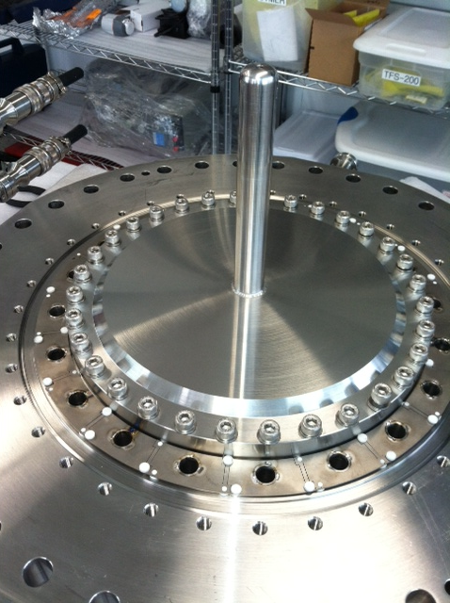
Recent progress
Combiner vessel (Transfer Engineering Corp)
Large flange
DC gun vessel
Combiner ferrite (Stangenes Industries Corp )
Anode(Atlas Technology)

Slide 20
Future plan and schedule
Date | Cathode preparation system | Laser system | Gun and beam optics | Experiments
6/2013 | Cathode prep system setup High QE cathode prepared | 1560nm laser | Vacuum system DC system Part of beam optics
12/2013 | Grand central chamber Cathode lifetime New cathode technical study | 780 laser | Switch Combiner Beam Diagnostics | Low current test Funneling test
6/2014 |  |  | Gun and beam optics assemble Achieve XHV in gun
12/2014 | Multi-cathodes Preparation Multi-cathodes transport Cathode production parameters |  | Depressed collector | Pop test
6/2015 |  |  | Full system in XHV Full system ready Rotatable combiner
12/2015 |  | Multi-lasers |  | 20 cathodes operation

Slide 21
Summary
Gun design includes vacuum, mechanism, beam optics, beam dump, beam instrumentations was done.
3D beam dynamics simulation was done.
Most of the components are under fabrication.
Good QE GaAs photocathode was activated.
Laser system to be shipped to BNL.
Two cathodes funneling and low current test is scheduled on Jan. 2014.
Proof of principle test is scheduled in end of next year.

Slide 22
Acknowledgements
Ilan Ben-Zvi(PI), David M Gassner, Robert Lambiase, Wuzheng Meng, Alexander I. Pikin, Omer Habib Rahman, Triveni Rao, Eric Riehn, John Skaritka, Brian Sheehy, Vladimir Litvinenko, Qiong Wu
MDC Corporation, Transfer Engineering Inc.,
Atlas Technologies, SAES Getters, Thermionics,
Pascal Technologies, Gamma Vacuum, Stangenes Industries
Brookhaven Science associates, LLC under Contracts No.DE-AC02-98CH10886 with the U.S.DOE
BNL, Laboratory Directed Research and Development (LDRD)

Slide 23
Thanks for your attention!

Slide 24
Back up 1 Beam parameters
Parameter | Value
Bunch charge at cathode | 3.5nC
Longitudinal charge distribution at cathode | Gaussian distribution(σ=1.5ns)
Transverse charge distribution at cathode | Uniform
Bunch length at cathode | 1.5ns
Bunch radius at cathode | 4mm
Thermal normalized emittance, ε_{n,th} | 0.5 μm/mm(rms); Total thermal emittance=2μm
Single cathode average current | 2.5mA
Repetition rate for one cathode | 704kHz
DC gap voltage | 220kV
Combiner | Center field=24.5G;Physical length=20cm
First solenoid | Maximum field=560G; Physical length=5.4cm
Second solenoid | Maximum field=184G; Physical length=10.5cm
Third solenoid | Maximum field=366G; Physical length=6.3cm

Slide 25
Gatling Gun Laser System Design Concept
Pulser with Phase-locked loop
Periodically – poled LiNbO₃
Accelerator RF ref
Electro-optic
modulator
4W
780 nm
10 W
1560 nm
4 stage EDFA
CW DFB laser
parameter | unit | spec | comment
wavelength | nm | 780
repetition rate | kHz | 704 | 14.07 MHz / 20 cathodes
pulse energy at photocathode | uJ | 2.8 | QE=0.2% & 3.5 nC bunch chg
average laser power needed at cathode | W | 2 | assuming QE=0.2%
avg laser power output | W | 4
pulse width | nsec | 1.5 | Gaussian FWHM
jitter | psec | 10 | rms
amplitude stability |  | 1.00E-03 | requires noise-eater
contrast |  | 1.00E-06
10 W Erbium doped fiber amplifier (EDFA) system at 1560 nm, frequency doubled in periodically-poled LiNBO₃
Continuous Wave distributed feedback laser (CW DFB) + electro-optic modulation for pulse source
control of pulse shape, low jitter
Frequency double to 780 nm in periodically poled material (40% efficiency)
Design allows flexibility in pulse parameters
Courtesy of B. Sheehy
9/10/2013 5:13:37 PM
PSTP 2013
25

Slide 26
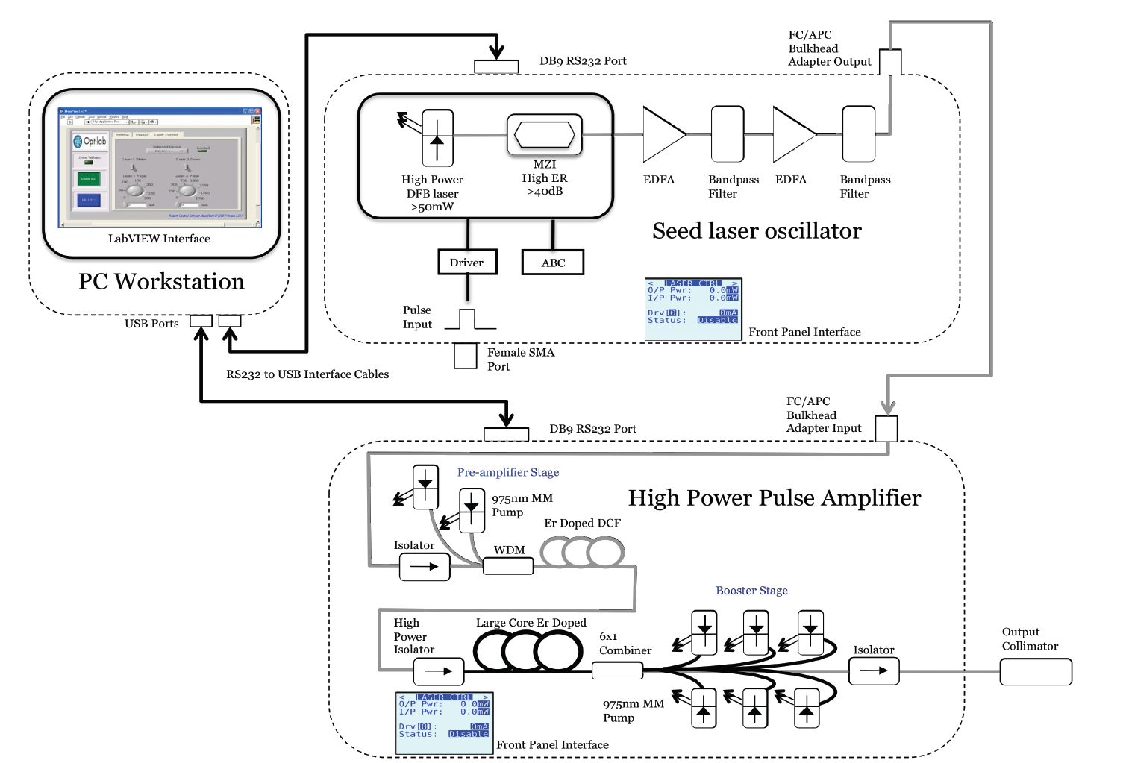
Optilab EDFA laser
Part A
Part B
1560 nm Laser schematic. Abbreviations: MZI, Mach-Zender Interferometer, ER extinction ratio, EDFA erbium-doped fiber amplifier, ABC automatic bias control.

