Slide 1
Charge Exchange injection in BNL AGS
1962-66 Budker, Dimov, Dudnikov, Novosibirsk ;
first achievements of charge exchange method
1972: First suggested for AGS
( by A. Maschke)
1982: Brought into operation in AGS.
D.S. Barton, L. Alhrens, E. Gill, J.W. Glenn, R.K. Reece and R.L. Witkover
(Courtesy of W.Wang)
 | Multiturn H⁺ injection | ChEx H⁻ injection
Injection efficiency | 25% | 95%
Emittance increase | 5 times | minimal
with H⁻ injection
100 times radiation reduction !!
New intensity records in AGS were reached soon after commissioning of the ChEx system

Slide 3
Charge Exchange injection in AGS Booster
New Booster ring (1992) :
overcoming the AGS space charge limit by increasing the AGS injection energy (1.9 GeV->22 GeV)
200 MeV H- from linac ,350 μs pulse
(Booster T_{rev} = 1 μs)
ChEx injection:
-Minimized injection losses
-Achieved highest density allowed by space charge limit

Slide 4
Electron cloud in RHIC
1962-66 Budker, Dimov, Dudnikov, Novosibirsk ; discovery and exploration of e-p instability
As the beam intensity in RHIC has been increasing (in earlier 2000s) beyond the design values
the accumulation of electron cloud and associated effects started to limit RHIC beam intensities
EC showed itself when:
-going to higher bunch repetition rate (9 MHz)
-shortening of the bunches happens: ion transition; proton injection;
re-bucketing to higher frequency RF system at the store
Dynamic pressure rise in warm sections
(including interaction region sections)
Proton emittance growth at the injection energy
(Courtesy of W.Fischer)

Slide 5
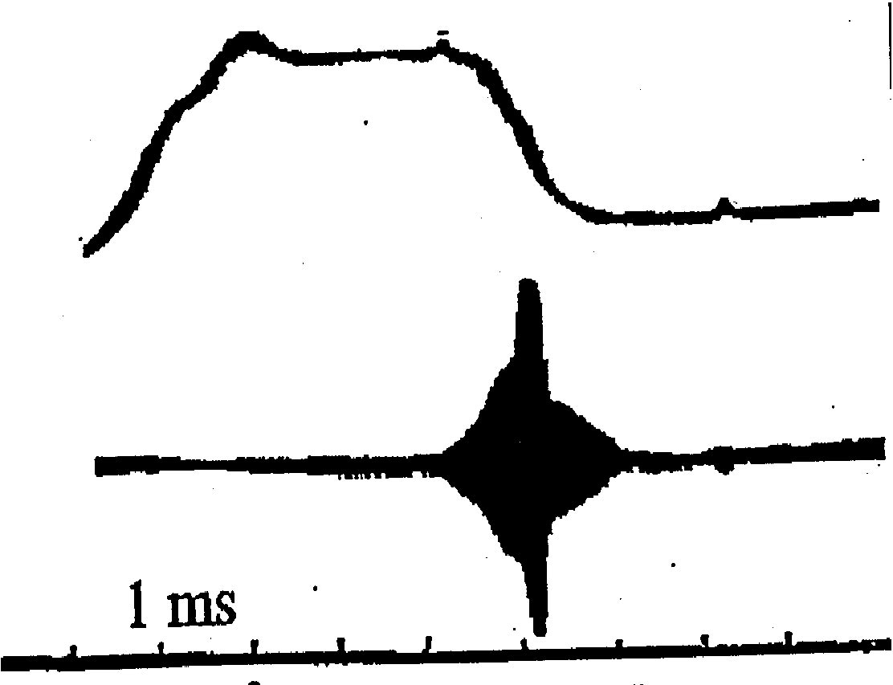
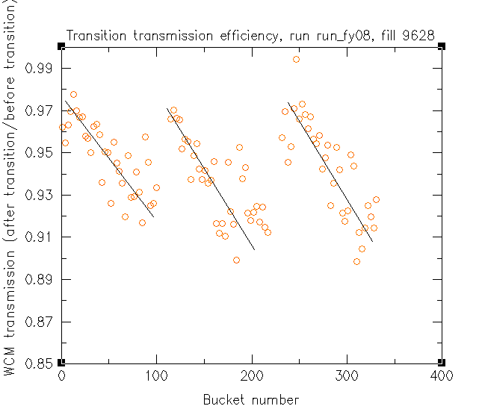
Electron cloud instability in RHIC
1962-66 Budker, Dimov, Dudnikov, Novosibirsk ; discovery and exploration of e-p instability
2005-
Accumulated EC causes the Au ion instability
near transition energy
As the electrons are accumulated along the ion bunch train
later bunches in the train are affected by instability.
One of the limiting factors for the heavy ion beam intensity in RHIC.

