Slide 1


Electron and Ion Spin Dynamics in eRHIC
Workshop on Polarized Sources, Targets and Polarimetry
Charlottesville, VA, 2013
V. Ptitsyn

Slide 2
Talk Outline
eRHIC – proposed electron-ion collider at BNL
Electron beam polarization preservation in eRHIC
Polarized proton and ³He beams for eRHIC

Slide 3
eRHIC: QCD Facility at BNL
p
70% polarized protons
100-250 (325*) GeV
e⁻
Unpolarized and
70% polarized electrons, 5-30 GeV
Light ions (d,Si,Cu)
Heavy ions (Au,U)
50-100 (130*) GeV/u
e⁻
Polarized light ions (He³) 167 (215*) GeV/u
Center of mass energy range: 30-175 GeV
Any polarization direction in lepton-hadrons collisions

Slide 4
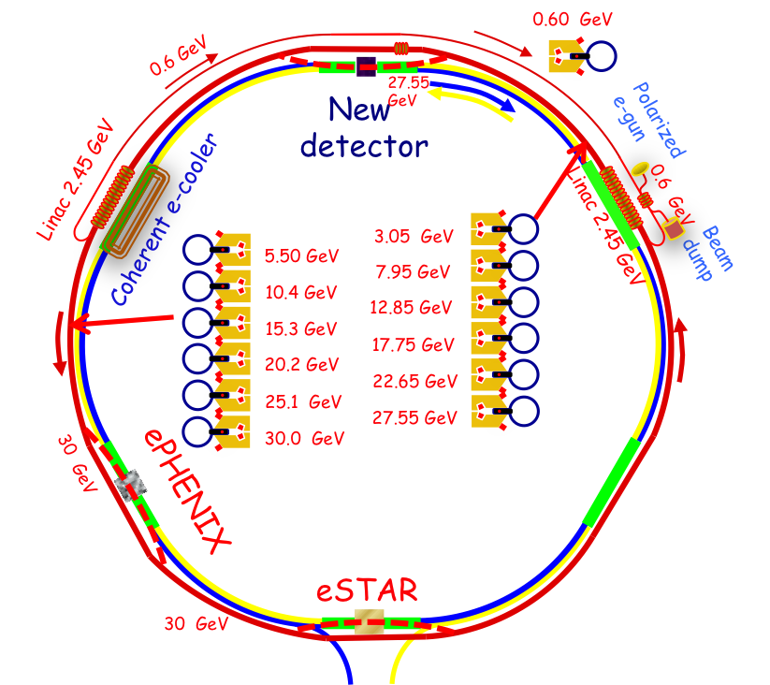
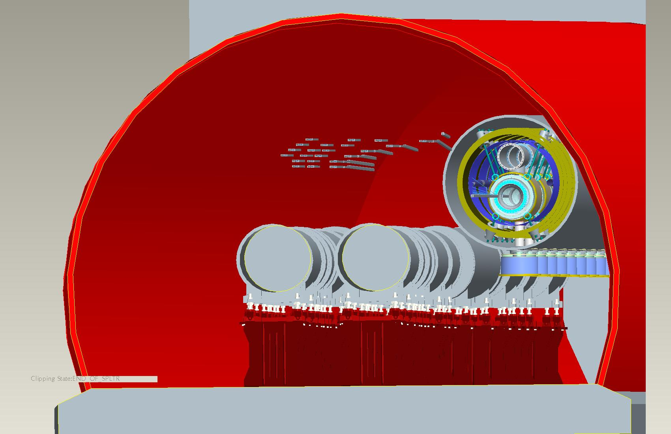
ERL-based eRHIC Design
eRHIC - electron-ion collider on the basis of existing RHIC accelerator:
  Luminosity ~10³⁴cm⁻²s⁻¹
All-in tunnel staging approach uses energy recovery linacs and 6 recirculation passes to accelerate the electron beam.
(recirculation passes on the basis of FFAG lattice are also under consideration)
The electron energy can be gradually increased (stages), from 10 to 30 GeV.

Slide 5
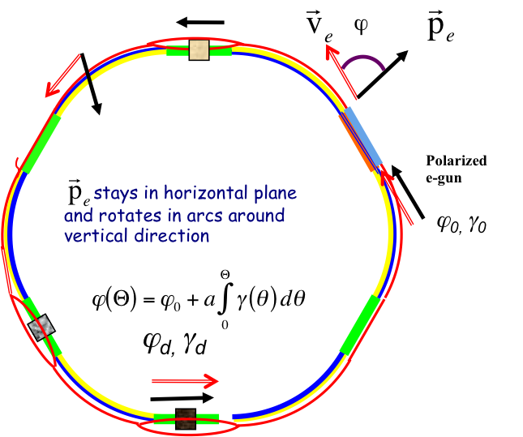
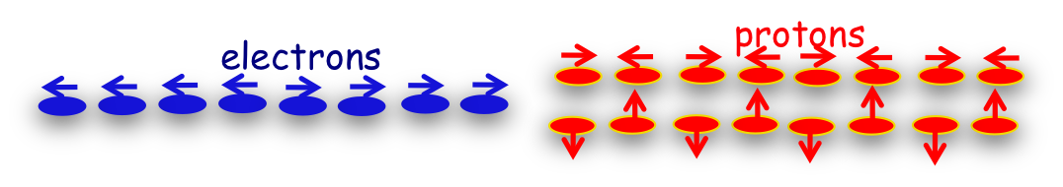
Polarized electrons in eRHIC
High polarized beam current from the electron gun : 50 mA
Direction of polarization can be switched by changing helicity of laser photons making appropriate bunch-by-bunch pattern
Linac accelerator -> No depolarizing resonances!
The experiments are interested only in longitudinal polarization at the collision point(s)

Slide 6
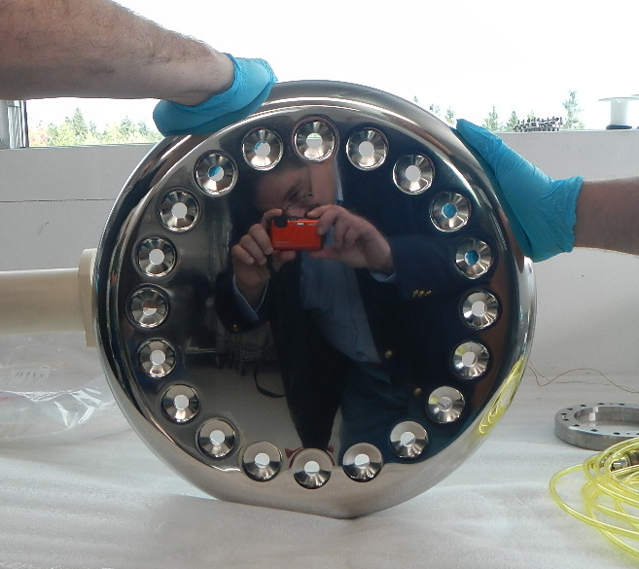
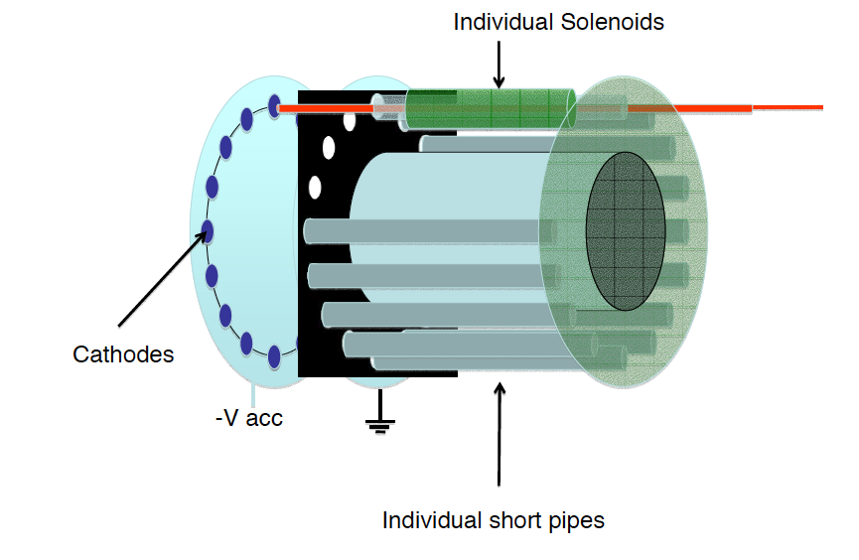
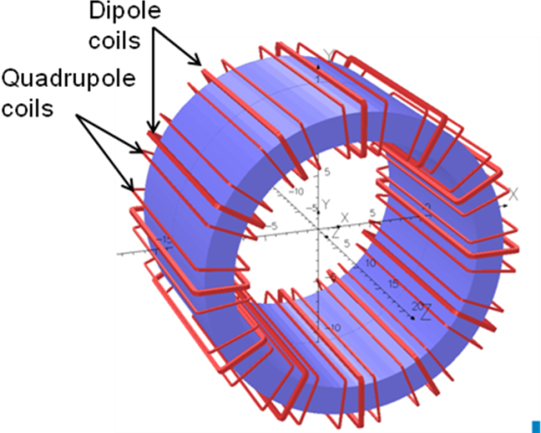
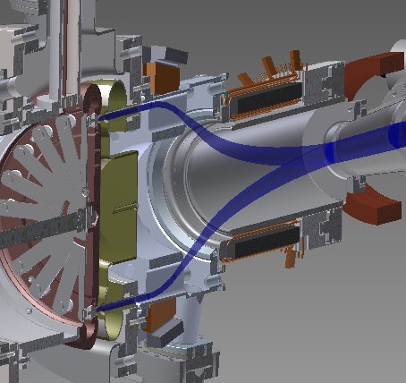
50 mA polarized electron source R&D
BNL Gatling Gun:
the current from multiple cathodes is merged:
20 cathodes, 2.5 mA each
GG prototype is under construction
First gun testing: end of 2014
E.Wang’s talk on Wednesday
Alternative development of high intensity PES by MIT:
(E. Tsentalovich’s talk, Wednesday).

Slide 7
Longitudinal Polarization at IPs
eRHIC avoids lengthy spin rotator insertions
Beam polarization vector rotates in the horizontal plane during the acceleration.
The conditions for the longitudinal polarization orientation in possible experimental points:
  IP8: E_{e} =N*0.0757 GeV
  IP6: E_{e} = N*0.0716 GeV
  Both IP6 and IP8: E_{e} = N*1.321 GeV
1.321 GeV
Plot shows the values of the longitudinal polarization
at IP6 at the energies (green points) corresponding to
the perfect longitudinal polarization at IP8.

Slide 8
Spin decoherence
The spin rotation angle depends on the particle energy.
The energy spread in the beam causes the decoherence and the loss of beam polarization
The beam energy spread is dominated by the effect of the linac accelerator voltage waveform
which introduces the quadratic dependence of the spin angle on the longitudinal coordinate
of a particle
Longitudinal polarization profile as seen at ePHENIX:
E_{g} - the main linac gain
Beam polarization for longitudinal Gaussian distribution:

Slide 9
Polarization loss due to the spin decoherence
After polarized source: coherently oriented electron spins.
During the acceleration: the decoherence due to energy dependent spin rotation rate
The beam energy spread has to be acceptable.
The plots show the decoherence due to the energy spread created by 704 MHz RF system
Longitudinal spin component of electron at the IP8 versus electron position along the bunch for different top energies
Average polarization at IP8 versus the top beam energy, assuming Gaussian longitudinal distribution with rms bunch length 2 and 4 mm

Slide 10
Possible techniques to reduce the spin decoherence
Higher harmonic cavities to flatten the energy spread of the beam
Siberian Snake(s) to change the sign of change rate
Dispersion function slope at the interaction point
Use lower frequency RF system in main linacs (to reduce induced energy spread)
Lonigtudinal spin profile compensated by
using 7th harmonic cavities
Polarization improvement due to
lower frequency main RF system

Slide 11
Synchrotron radiation: polarization diffusion
Well known effect from the electron storage rings:
Quantum nature of the synchrotron radiation leads to depolarization
For eRHIC the mechanism is related with the jumps in the spin precession frequency.
If ϕ is the spin rotation angle (around vertical axis), then:
Emission of SR quantum suddenly changes ΔE and thus (Δϕ)’

Slide 12
Solution of diffusion equations
Diffusion equations for second moments of the energy deviation-spin angle distribution:
Solution of above equations for one pass propagation is:
Doing consecutive pass-by-pass propagation of second order momenta
one can find their values at the interaction point(s)

Slide 13
Synchrotron radiation depolarization in eRHIC
rms spin angle spread
Averaged beam polarization
Evolution of the quantities is shown on 6 turns of accelerating process
Depolarization becomes noticeable only when accelerating to 30 GeV

Slide 14
Spin transparency of eRHIC arc
Shown is the spin deviation from the design spin direction at the end of
the arc produced by the vertical betatron motion
A_{n} =100 mm.mrad
Α_{_n} = 100 mm⋅mrad
Depolarization effect is negligible

Slide 15
eRHIC: polarized protons
RHIC :
- only polarized proton collider in the world
-very successful Run-13: fully completed physics program at 255 GeV
-achieved beam polarization at 255 GeV 57-58% (H-jet polarimeter)
Absolute Polarimeter (H jet)
RHIC pC Polarimeters
Siberian Snakes
PHENIX (p)
Spin flipper
STAR (p)
eRHIC will take favor of
existing hardware in RHIC
and in the injector chain to
accelerate polarized
protons up to 255 GeV.
Spin Rotators
(longitudinal polarization)
Solenoid Partial Siberian Snake
Spin Rotators
(longitudinal polarization)
LINAC
BOOSTER
Pol. H⁻ Source
Helical Partial
Siberian Snake
200 MeV Polarimeter
AGS
AGS Polarimeters
Strong AGS Snake

Slide 16
Towards higher proton polarization for eRHIC
A pathway to 70% proton polarization :
  Using smaller beam transverse emittances.
  Beam scraping in Booster taking advantage of upgraded intensity of the polarized source.
  Higher polarization from the source ( 85% or more)
  Increased number of Siberian Snakes (to 6 per ring)
present Qy

Slide 17

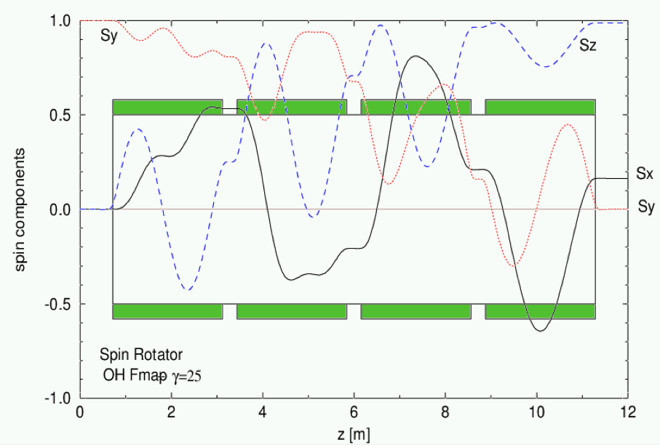
Spin rotators
To create longitudinal polarization at experiments eRHIC will utilize the present spin rotators in RHIC
The spin rotator scheme, consisting of four helical magnet. The sign demonstrates the magnet helicity ("+" is right-handed, "-" is left-handed)
The example of the spin component evolution through the rotator. (Courtesy of W. MacKay)

Slide 18
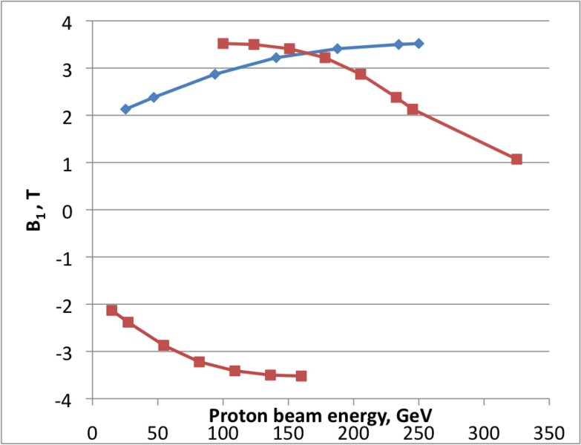
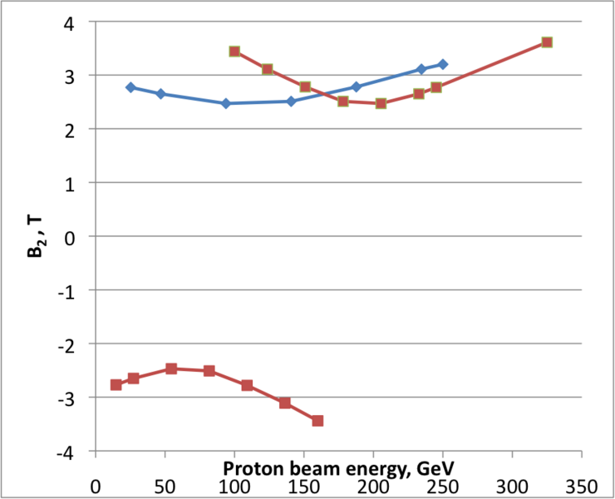
Field of helical magnets required for longitudinal polarization in eRHIC
Red squares – eRHIC
Blue diamonds - RHIC
Red squares – eRHIC
Blue diamonds - RHIC
The magnet field of outer magnets, required for the longitudinal polarization in the IP, versus the beam energy].
The magnet field of inner magnets, required for the longitudinal polarization in the IP, versus the beam energy.
The maximum required field ~3.6 T. In order to operate with the longitudinal polarization below 100 GeV proton energy the sign of the magnet field in all rotator magnets has to be switched.

Slide 19
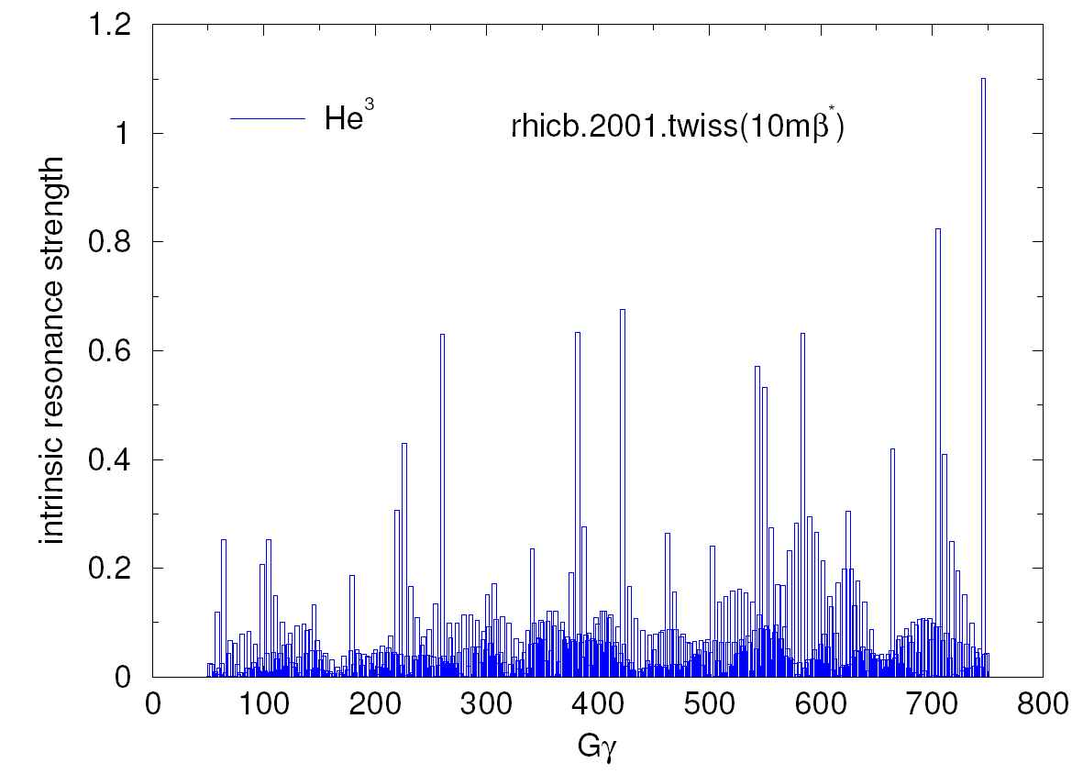
Polarized ³He⁺² for eRHIC
  Polarized ³He Source development (J.Maxwell’s talk on Thursday).
RHIC Siberian snakes and spin rotators can be used for the spin control, with less orbit excursions than with protons.
More spin resonances. Larger resonance strength.
Polarimetry.
 | ³He⁺² | p
m, GeV | 2.808 | 0.938
G | -4.18 | 1.79
E/n, GeV | 16.2-166.7 | 24.3-250
γ | 17.3-177 | 25.9-266
|Gγ | | 72.5-744.9 | 46.5-477.7
Max strength
for protons

Slide 20
Summary points
Polarized beams of electrons, protons and light ions are essential for the physics program of future collider eRHIC
Important R&D for high current polarized electron gun
Electron polarization: methods to reduce spin decoherence (caused by the beam energy spread) have to be accommodated by the accelerator design
For polarized protons: the pathway to 70% polarization is based on higher number of Snakes and smaller beam emittance

