Slide 1
on the LEAP conference
Polarized Fusion
Nuclear Fusion with Polarized Particles
09.09.2013
by Ralf Engels
JCHP / Institut für Kernphysik, FZ Jülich

Slide 2
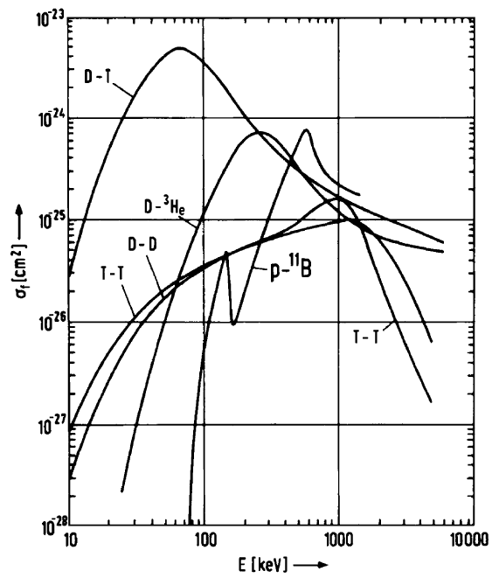
Polarized Fusion
Total cross section (c.m.)
t + d ⁴He + n
³He + d ⁴He + p
d + d ³He + n
d + d t + p
Can the total cross section of the fusion reactions
be increased by using polarized particles ?

Slide 3
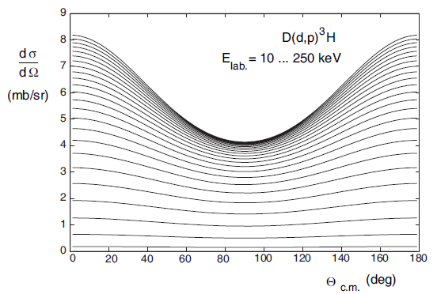
Polarized Fusion
Total cross section
Differential cross section
Can the trajectories of the ejectiles be controlled
by use of polarized particles ?

Slide 4
Polarized Fusion
Can the total cross section of the fusion reactions
be increased by using polarized particles ?
t + d ⁴He + n Factor: ~1.5 at 107 keV
J = 3/2 ⁺ / s-wave dominated
³He + d ⁴He + p Factor: ~1.5 at 430 keV
[Ch. Leemann et al.,
Helv. Phys. Acta. 141 (1971)]

Slide 5
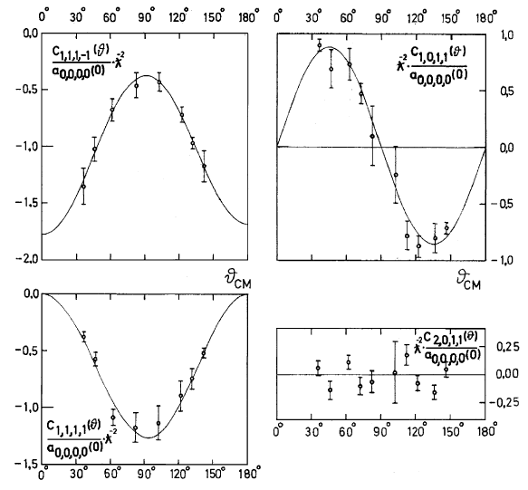
Measurements in Basel 1971
An increased total cross
section is possible !!!
Polarized fuel will increase the diff. cross section for ϑ = 0°/180° and decrease for
ϑ = 90° !!!
H. Paetz gen. Schieck, Eur. Phys. J. A 44, 321-354 (2010)

Slide 6
Polarized Fusion
What is the advantage for fusion reactors ?
1.) Magnetic confinement: not linear !!!
2.) Inertial Fusion (Laser induced fusion)
(Berkeley, Orsay, Darmstadt, …)
Laser
Pellet target (DT or DD pellets)

Slide 7
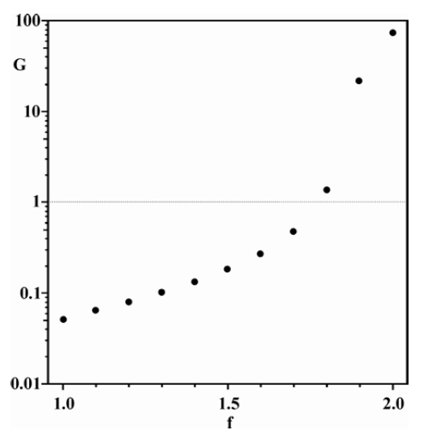
Polarized Fusion
What is the advantage for fusion reactors ?
1.) Calculation by M. Temporal et al.
for the „Megajoule“ Project
No optimization of the laser power:
E_{abs}* =185 kJ

Slide 8
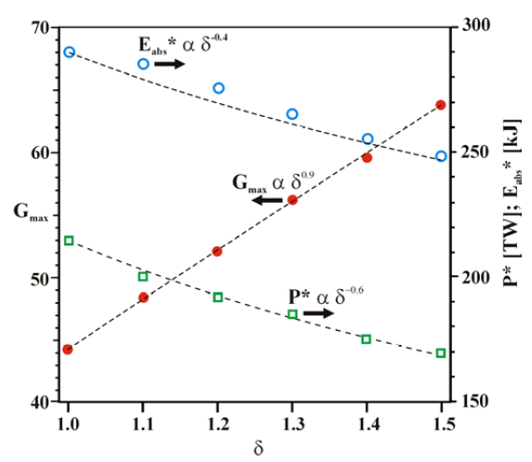
Polarized Fusion
What is the advantage for fusion reactors ?
1.) Calculation by M. Temporal et al.
for the „Megajoule“ Project
dt-Fusion
M. Temporal et al.;
Ignition conditions for inertial
confinement fusion targets with a nuclear spin-polarized,
Nucl. Fusion 52 (2012) 103011

Slide 9
Polarized Fusion
What is the advantage for fusion reactors ?
Laser
Pellet target (DT pellets)
Magnetic field
More gain by use of (more) elliptic targets ?
Trajectories of ejectiles aligned with magnetic holding field => simplified cooling of the reactor

Slide 10
Polarized Fusion
Which questions must be solved ?
1.) Dependence of the total cross section from the
polarization for all fusion reactions.
Can cross sections be increased ?
t + p
Can neutrons be suppressed ?
Can the trajectories of the neutrons
be controlled?
d + d
³He + n

Slide 11
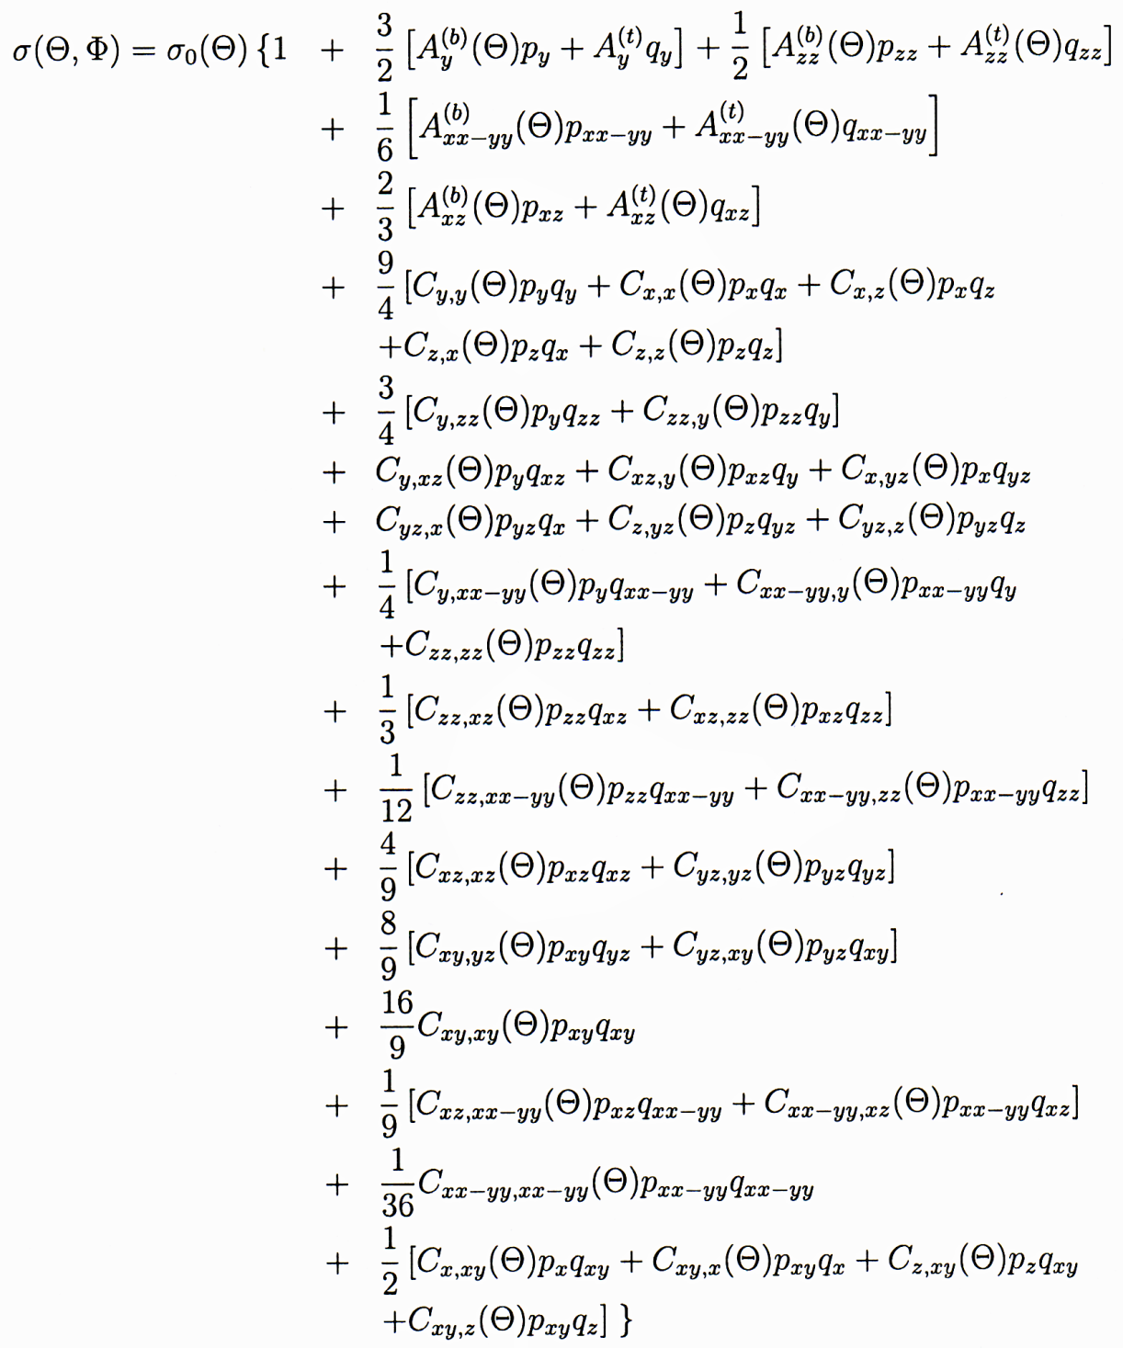
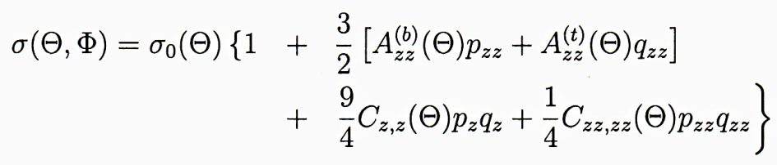
Polarized Fusion
Spins of both deuterons
are aligned:
Only p_{z}(q_{z}) and p_{zz}(q_{zz}) ≠ 0
Only beam is polarized:
(p_{i,j} ≠ 0, q_{i,j} = 0)
σ(ϴ,Φ) = σ₀(ϴ) · {1 + 3/2 A_{y}(ϴ) p_{y}
+ 1/2 A_{xz}(ϴ) p_{xz}
+ 1/6 A_{xx-yy}(ϴ) p_{xx-zz}
+ 2/3 A_{zz}(ϴ) p_{zz} }

Slide 12
Polarized Fusion
Deltuva and Fonseca, Phys. Rev. C 81 (2010)

Slide 13
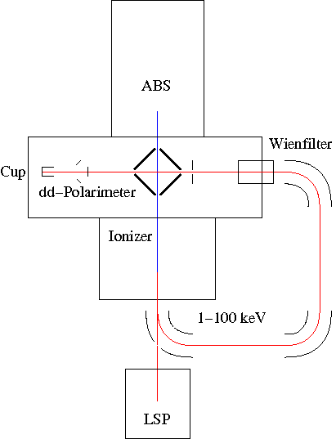
The Experimental Setup in St. Petersburg
1. Setup:
ISTC Project # 3881
DFG Project: EN 902/1-1
ABS and LSP from the
SAPIS Project, Uni. of Cologne
Target Density: ~ 10¹¹ a/cm²
Beam Intensity: > 1.5 μA ~ 10¹³ /s
→ Luminosity: ≤ 10²⁵ /cm² s
E_{d} = 100 keV → σ = 15.5 mbarn
→ count rate: ~ 155 / h
→ 1 month of beam time
E_{d} = 30 keV → σ = 1.2 mbarn
→ count rate: ~ 12 / h
→ 10 month of beam time

Slide 14
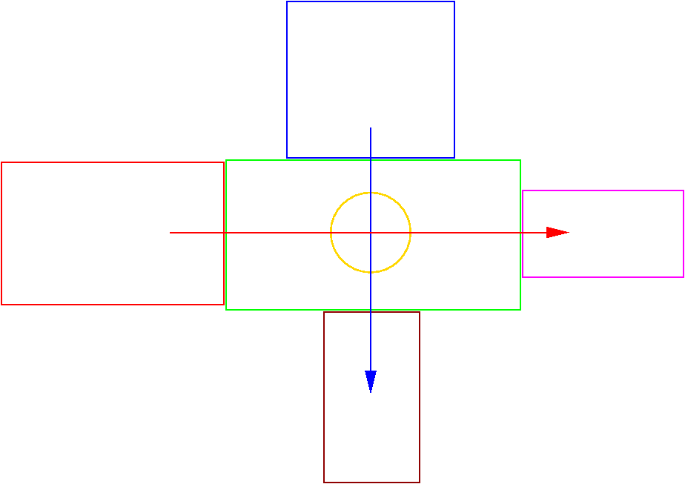
The Experimental Setup in St. Petersburg
ABS from the
SAPIS project:
(after upgrade)
~ 4 ∙ 10¹⁶ a/s
→ ~ 2 ∙ 10¹¹ a/cm²
Detector Setup:
4π covered by
large pos. sens. Detectors
(~300 single PIN diodes ?)
ABS from Ferrara:
~ 6 ∙ 10¹⁶ a/s
→ ~ 3 ∙ 10¹¹ a/cm²
POLIS (KVI, Groningen)
dd-fusion polarimeter
Ion beam: I ≤ 20 μA
→ 1.5 ∙ 10¹⁴ d/s
( E_{beam} ≤ 32 keV )
LSP from POLIS
Luminosity: 4.5 ∙ 10²⁵ /cm² s
→ count rate: ~ 60 /h
→ 1 month of beam time
Luminosity: 3 ∙ 10²⁵ /cm² s
→ count rate: ~ 40 /h
→ 2 month of beam time
LSP from the SAPIS project

Slide 15
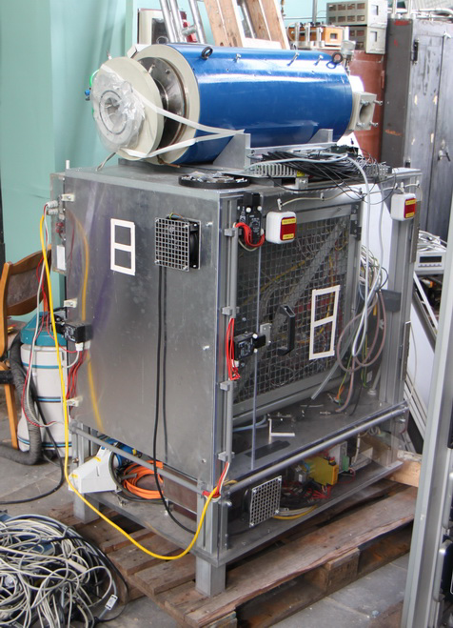
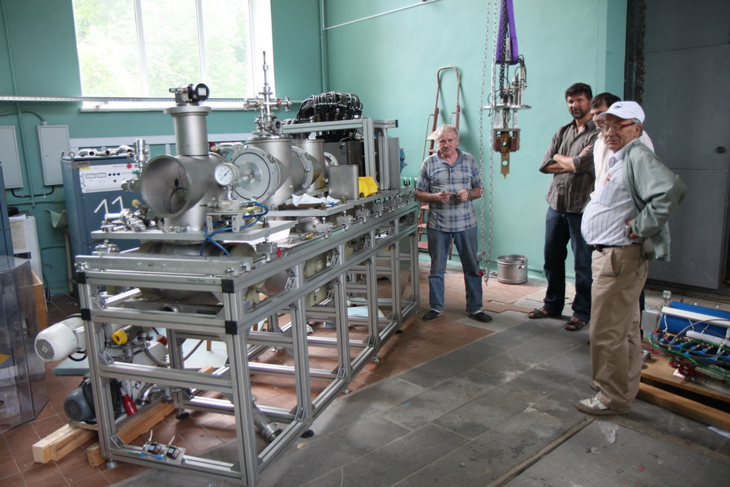
Polis @ PNPI

Slide 16
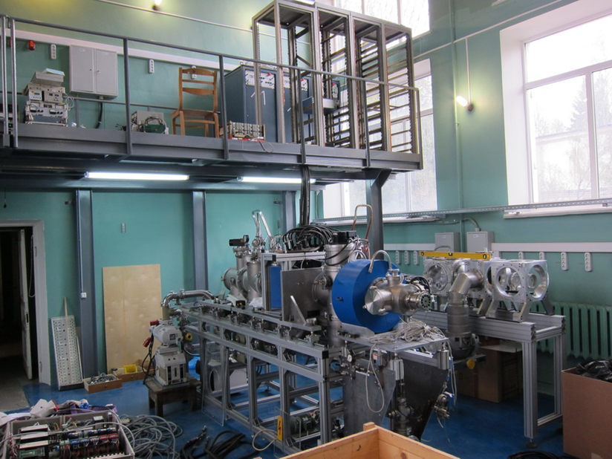
Status in spring 2012

Slide 17
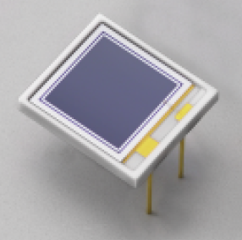
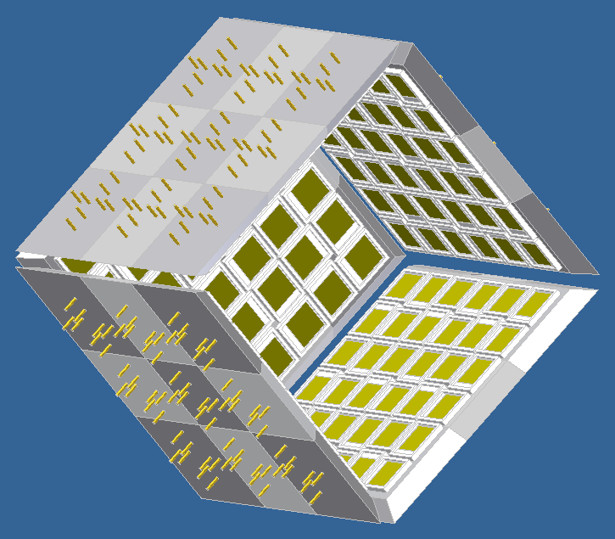

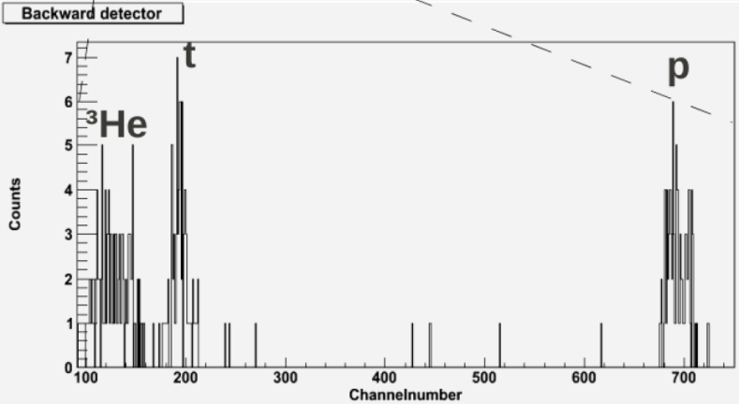
The Detector Setup
4-π detector setup with 60% filling
~300 Hamamatsu Si PIN photodiodes (S3590)
1cm² active area
300um depletion layer
good energy resolution (17keV for 1MeV Carbon ions at RHIC)
Proof of principle:
L. Kroell.
Diploma thesis, 2010.
FZJ – RWTH.
Readout electronics requirements:
320 PIN diodes
≤ 1kHz total count rate
Amplitude analyzer
Common clock for off-line coincidence analysis
Custom CSP (Charge Sensitive Preamplifiers)

Slide 18
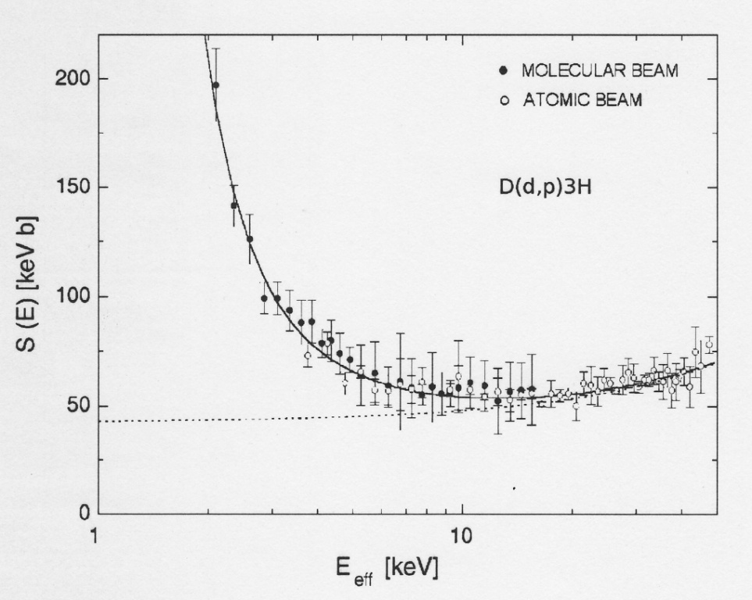

The Electron Screening Effect
Astrophysical S-Factor:
F. Raiola et al.; Eur. Phys. J. A 13, 377 (2002)
Coulomb Potential
Distance
Nuclear Potential

Slide 19
The Electron Screening Effect
?
Coulomb Potential
Distance

Slide 20
Polarized Fusion
Which questions must be solved ?
1.) Dependence of the total cross section from the
polarization for all fusion reactions.
2.) Polarization conservation in the different plasmas ?
a.) Magnetic confinement:
- R.M. Kulsrud et al.; Phys. Rev. Lett. 49, 1248 (1982)
b.) Inertial Fusion:
- J.P. Didelez and C. Deutsch; 2011 Laser and Particle
Beams 29 169.
- M. Büscher (IKP) / Prof. O. Willi (Uni. Düsseldorf)
„Laser Acceleration“

Slide 21
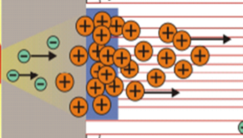

Laser Acceleration
Proton rich dot
20x20x0.5 μm
~ 100 GV/m
~ 100 GV/m
10⁸ protons at 1.5 MeV
10¹¹ protons up to 10 MeV
Laser Acceleration of pol. ³He²⁺ ions from
pol. ³He gas targets

Slide 22
Polarized Fusion
Which questions must be solved ?
1.) Dependence of the total cross section from the
polarization for all fusion reactions.
2.) Polarization conservation in the different plasmas ?
3.) How to produce polarized fuel ?
- inertial fusion: - HD targets are available (10 mK, ~1 T)
(relatively small polarization ~ 40%)
- frozen spin DT targets possible
- magnetic confinement:
a.) pol. ³He is available („Laser-pumping“)
b.) pol. T will be possible with a similar method
c.) pol. D ???

Slide 23
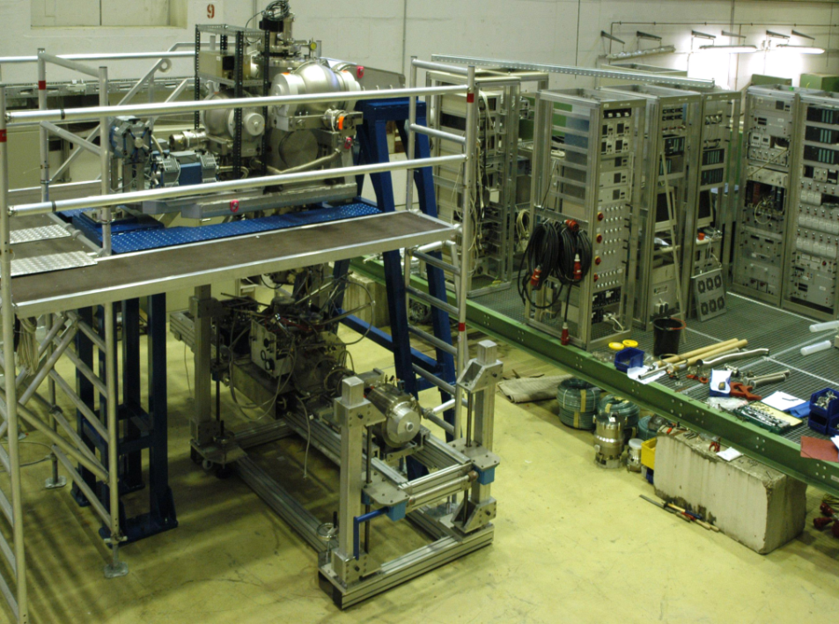
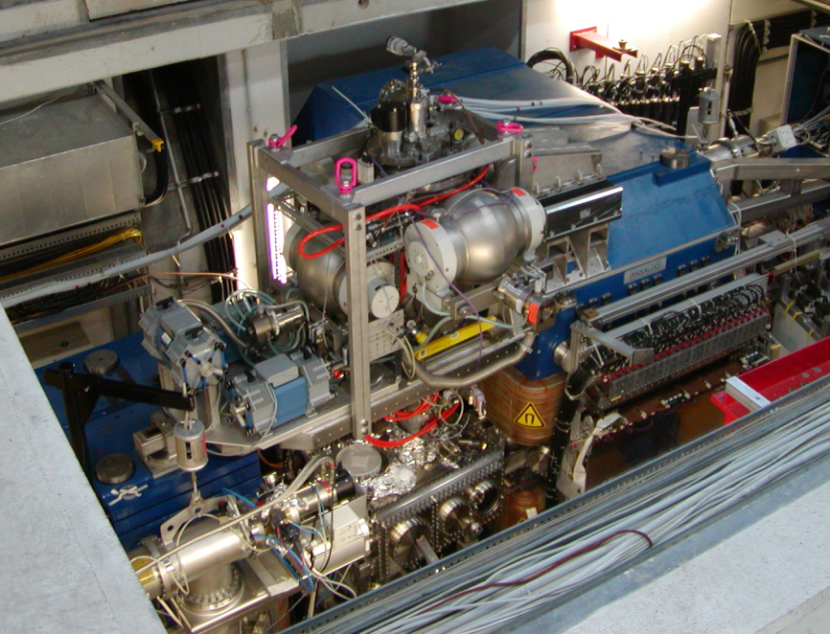
PIT @ ANKE/COSY
Main parts of a PIT:
  Atomic Beam Source
    Target gas
  hydrogen or deuterium
    H/D beam intensity (2 hyperfine states)
    8.2 . 10¹⁶ / 6 . 10¹⁶ atoms/s
    Beam size at the interaction point
    σ = 2.85 ± 0.42 mm
    Polarization for hydrogen/deuterium
    P_{Z} = 0.89 ± 0.01
    P_{Z} = -0.96 ± 0.01
    P_{Z} = + 0.88 ± 0.01 / - 0.91 ± 0.01
    Pzz = - 1.71 ± 0.03 / + 0.90 ± 0.01
  Lamb-Shift Polarimeter
  Storage Cell
See next talk

Slide 24
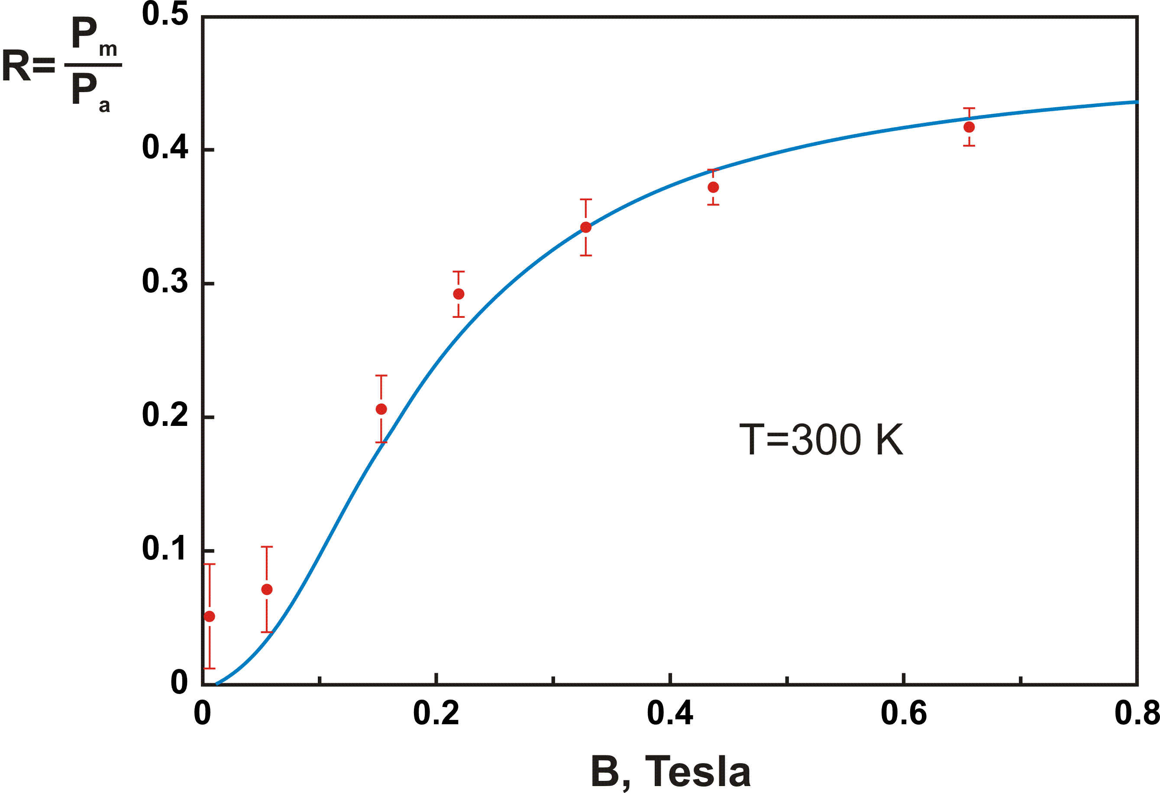
Polarized H₂ (D₂) Molecules
Measurements from NIKHEF, IUCF, HERMES show that recombined molecules retain fraction of initial nuclear polarization of atoms!
Eley-Rideal Mechanism
polarized
P_{m} = 0.5
unpolarized
Is there a way to increase
P_{m} (surface material, T, B etc)?
Nuclear Polarization of Hydrogen Molecules from
Recombination of Polarized Atoms
T.Wise et al., Phys. Rev. Lett. 87, 042701 (2001).
See talk on
Thuesday !!!

Slide 25
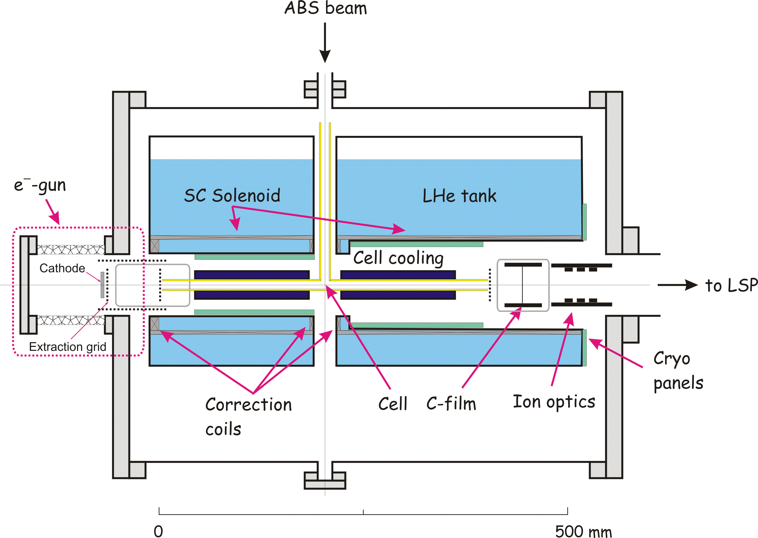
The Setup
ISTC Project # 1861 PNPI, FZJ, Uni. Cologne
DFG Project: 436 RUS 113/977/0-1

Slide 26
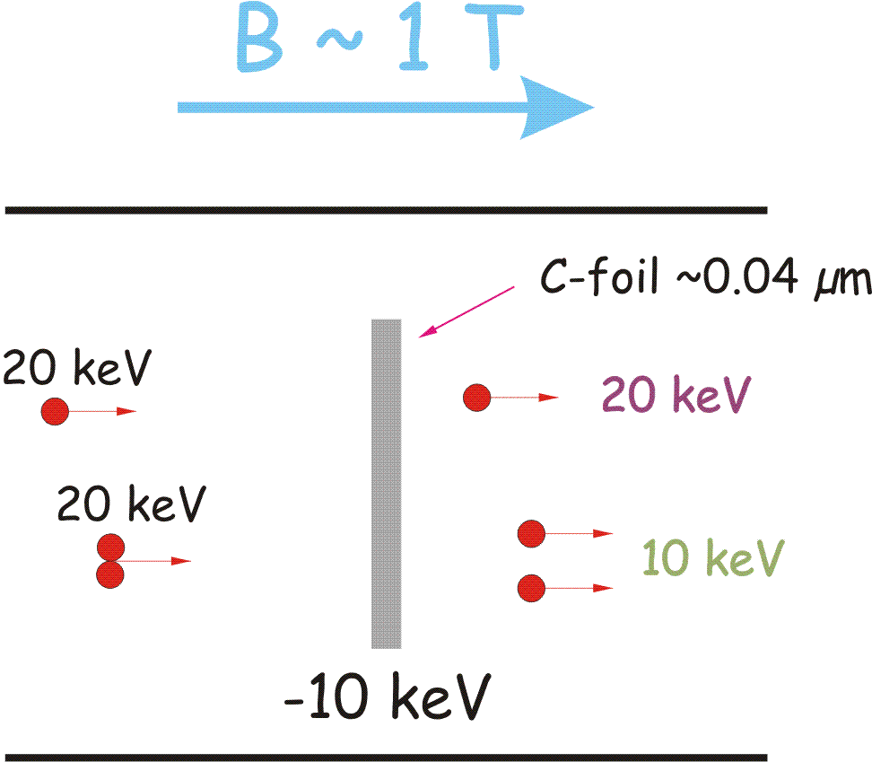
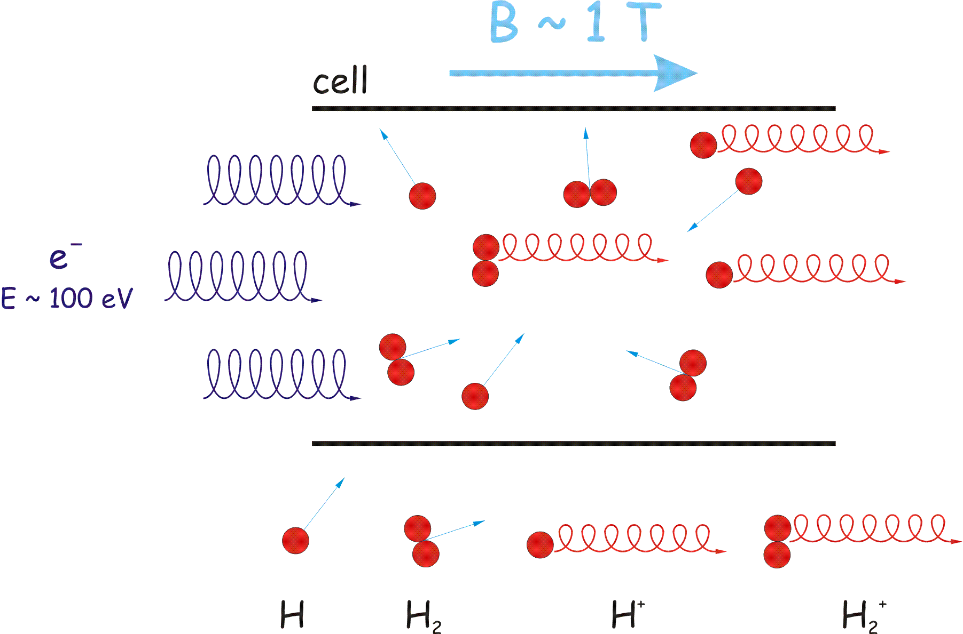
Polarized H₂/D₂ Molecules
Recombination of polarized atoms
into molecules
Conversion of polarized atoms and
molecules into ions
Conversion of H₂⁺ and H⁺ ions into
protons with different energy
(suggested by W.Haeberli)
Separation of protons by energy
Measurement of proton and H₂ -ions
polarization in LSP
B ~ 1T
polarized
+
cell wall

Slide 27
Polarized H₂ Molecules
Measurements on Fomblin Oil (Perfluorpolyether PFPE)
T_{Cell} = 100 K
HFS 3
Protons:
P_{m} = - 0.81 ± 0.02
n = 174 ± 19
c = 0.993 ± 0.005
+
H₂ - Ions:
P_{m} = - 0.84 ± 0.02
n = 277 ± 31

Slide 28
Polarized H₂ Molecules
Measurements on Fomblin Oil (Perfluorpolyether PFPE)
+
B_{cell} = 0.4 T ; H₂ only
HFS 3
HFS 2+3
More Details: Talk on …..

Slide 29
Polarized Fusion
Which questions must be solved ?
1.) Dependence of the total cross section from the
polarization for all fusion reactions.
2.) Polarization conservation in the different plasmas ?
3.) How to produce polarized fuel ?
- inertial fusion: - frozen spin DT targets possible
(relatively small polarization ~ 40%)
- HD targets are available
- magnetic confinement:
a.) pol. ³He is available („Laser-pumping“)
b.) pol. T will be possible with a similar method
c.) pol. D ??? (or pol. D₂ ??)

Slide 30
Outlook
Workshop on
Nuclear fusion with polarized nucleons
at ECT* in Trento at 14./15. of November 2013
http://www.ectstar.eu/node/379

Slide 31
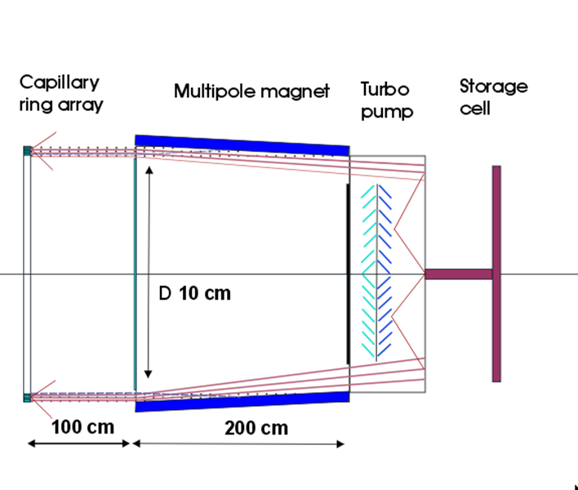
Possible Polarized H₂/D₂ source
Idea of D. Toporkov, Budger Institute, Novosibirsk

