Slide 1
Boosting Deuteron Polarization in HD Targets: Experience of moving spins between H and D with RF methods during the E06-101 experiment at Jefferson Lab
Xiangdong Wei
Thomas Jefferson National Accelerator Facility
The XVth International Workshop on Polarized Sources, Targets and Polarimetry (PTSP 2013)
University of Virginia, Charlottesville, Virginia, USA
September 9-13, 2013
H
D
ice

Slide 2
Collaborators
H
D
ice
Jefferson Lab
X. Wei, C. Bass, A. Deur, G. Dezern, T. Kageya, M.M. Lowry,
A. M. Sandorfi and R. Teachey
Universita di Roma “Tor Vergata” and INFN-Sezione di Roma2
A. D'Angelo
Blaise Pascal University
V. Laine
James Madison University
C.S. Whisnant

Slide 3
Topics
H
D
ice
Target Life-Cycle
Spin Manipulation Methods
Experimental Setup
Target Performance During E06-101 Experiment
Summary

Slide 4
Topics
H
D
ice
Target Life-Cycle
Spin Manipulation Methods
Experimental Setup
Target Performance During E06-101 Experiment
Summary

Slide 5
HD Target Life Cycle
H
D
ice
Gas Handling
HD purification (JMU)
Gas analysis (JMU, Rome2)
See Steve Whisnant’s Talk
Gas recovery
Gas Storage
See Lowry’s Talk
Experiment
Target Production
eHD, γHD
Condensing
(Spin Transferring)
Calibrating
(Spin Flipping)
Polarizing
(Field Rotating)
Aging

Slide 6
Topics
H
D
ice
Target Life-Cycle
Spin Manipulation Methods
Experimental Setup
Target Performance During E06-101 Experiment
Summary

Slide 7
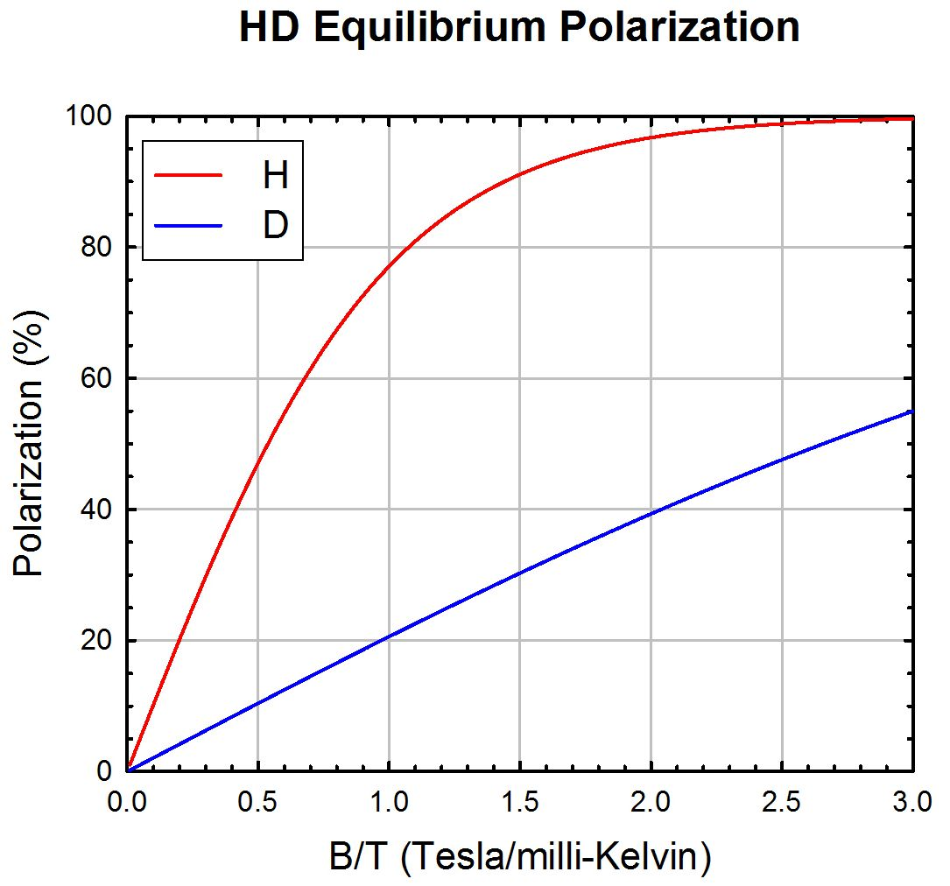
Polarize HD with High Field and Low Temp. (Brute Force)
H
D
ice
Maximum for current setup
(15T and 10 mK)
I=1/2 for H and 1 for D
In reality, typically
60% for H and 15% for D
Can P_{D} be improved?
Yes.

Slide 8
Spin Manipulation Methods
H
D
ice
Adiabatically rotating magnetic field direction
Using both transverse and axial magnets, this operation is straight forward and quick, as long as the field rotation rate is much slower than the Lamar Frequencies of H and D at the lowest field, and the T₁s are much longer than the rotation time.
Typical scales: T₁ ~months;
rotation time ~minutes;
NMR frequency ~300kHz for D and ~2MHz for H
@0.0600T
Polarization amplitudes stay the same <=> H &D rotate together.
+B$⊥$
-B$∥$
+B$∥$

Slide 9
Spin Manipulation Methods
H
D
ice
2. Adiabatically flipping spins of H or D with RF
Nearly 100% efficiency for H and 70% for D so far.
Could be improved: uniformed RF field, stable power supply...
Moderate RF power required (~10mW with non-tuned coils).
Can be used with higher holding field.
Zeeman Levels of HD
m_{D}=-1
m_{D}=0
$$γ_{D}$$
m_{H}=-1/2
Induce “allowed” transitions with RF
m_{D}=+1
$$γ_{D}$$
$$γ_{H}$$
P_{H}
$$γ_{H}$$
$$γ_{H}$$
m_{H}=+1/2
$$γ_{D}$$
$$γ_{D}$$
P_{D}
---flipping H
$γ_{H}$=42.5776MHz/T
---flipping D
$γ_{D}$=6.53359MHz/T

Slide 10
Spin Manipulation Methods
H
D
ice
3. Transferring polarizations between H and D in different molecules
Radiated with RF: P_{H} P_{D} $(Δ{Spin}_{D}=−2Δ{Spin}_{H})$
Zeeman Levels of HD
m_{D}=-1
m_{D}=0
m_{H}=-1/2
Induce “forbidden” transitions with RF
m_{D}=+1
P_{H}
m_{H}=+1/2
P_{D}
$P^{f}\left(H\right)=(1−\frac{3}{4}ε$)$P^{i}\left(H\right)+εP_{V}^{i}\left(D\right)+ …O(P^{3})$
$P_{V}^{f}\left(D\right)=(1−\frac{1}{2}ε$)$P_{V}^{i}\left(D\right)+\frac{2}{3}εP^{i}\left(H\right)+ …O(P^{3})$

Slide 11
Transferring polarizations
H
D
ice
Spin Dipole coupling between H and D in adjacent molecules
A. Abragam, Principles of Nuclear Magnetism, p395, (1983)
A. Honig and H. Mano, Phys. Rev. B 14, V14, vol. 5, 1858 (1976)
$$α=−\frac{3}{4}\frac{γ_{H}ℏ}{r^{3}}\frac{\sin{θ\cos{θe^{±iφ}}}}{H_{0}}$$
H₀: external magnetic field
r: the distance between H and D in different molecules
θ and φ: polar angles defined by H₀.
The RF induced polarization transfer efficiency
$$ε∝ α^{2}H_{1}^{2}$$
H₁ : coil generated RF field
Running at low DC field (H₀) with high power RF (H₁)
Circuit tuning needed to reduce heat load to fridge

Slide 12
FAFP vs. SFP
H
D
ice
FAFP-Flip entire population between levels
ε_{max}=100% (only if everything listed below works)
High power RF (H₁ ~ gauss)
partial flip => low net polarization
Watts of RF heats up fridge. Needs uniform RF field.
Monotonic field sweep (field jitter hurts, reduces ε)..
One chance only (available spins reduced after each operation).
Achieved with 1 cc test target.
NOT EASY for large target with limited cooling power and space.
SFP-Multi FAFP until population on connected levels are equalized
ε=50% is guaranteed (it’s also the maximum)
Fridge cold can handle the “low” RF power.
Field and frequency jitter helps; Jittered field and modulated RF results in multiple transfers per sweep higher ε
keep sweepings until no net spin transfer.
Easy to achieve Used During E06-101 Experiment
but ε_{max}=50%

Slide 13
Topics
H
D
ice
Target Life-Cycle
Spin Manipulation Methods
Experimental Setup
Target Performance During E06-101 Experiment
Summary

Slide 14
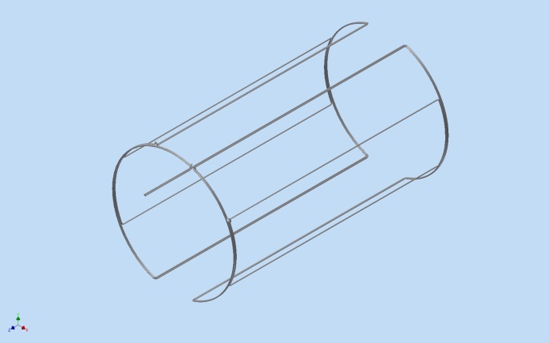
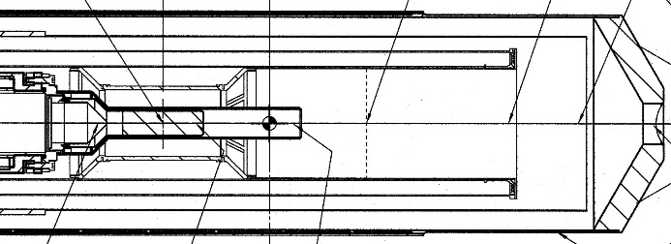
Experimental Setup
H
D
ice
NMR Coils:
A pair of 8-post ”Birdcage” coils was utilized in HDice to improve H1 homogenty to ~10%.
Circuit Tuning:
C_{parallel} was connected to the transmitter outside IBC, and C_{series} was used to isolate the output impedence of RF amplifier.
target heating under control;
system tunned at off-resonance field.
Circuit simulation used as the guide
for fine tuning.
RF Power:
A computer controlled RF switch/attenuation box was built.
An 110W RF amplfier was added
into the NMR spectrometer.
coils
HD
circuit
I_{Cs} I_{Cp} I_{Coil}
I(A) vs. f(MHz) in various components

Slide 15
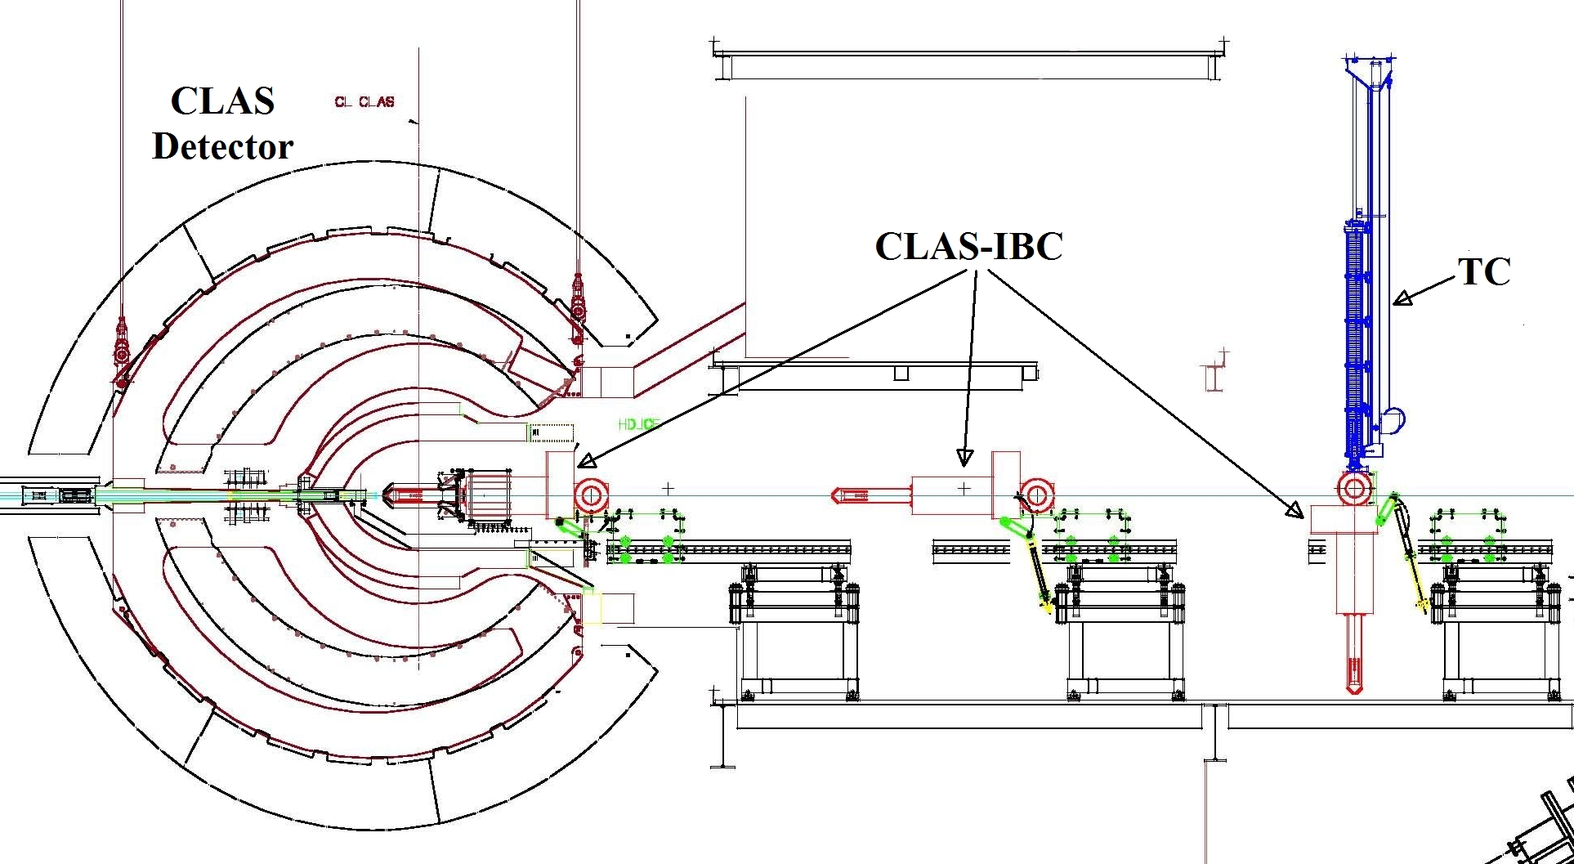
Operation: G-14 Run at Hall-B
H
D
ice

HDIBC in Hall B

Slide 16
Topics
H
D
ice
Target Life-Cycle
Spin Manipulation Methods
Experimental Setup
Target Performance During E06-101 Experiment
Summary

Slide 17
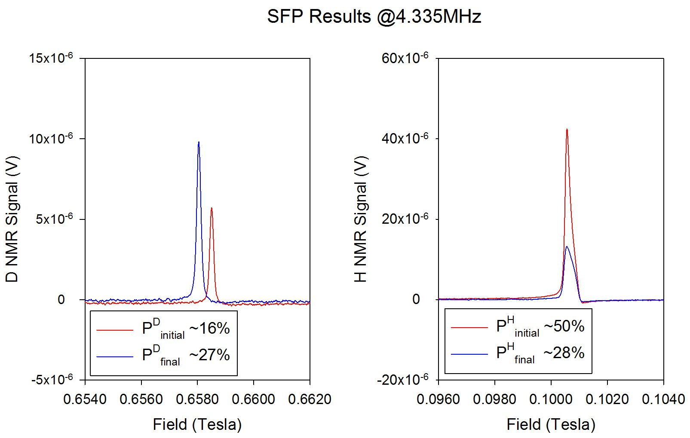
SFP Results during G-14 Run
H
D
ice

Slide 18
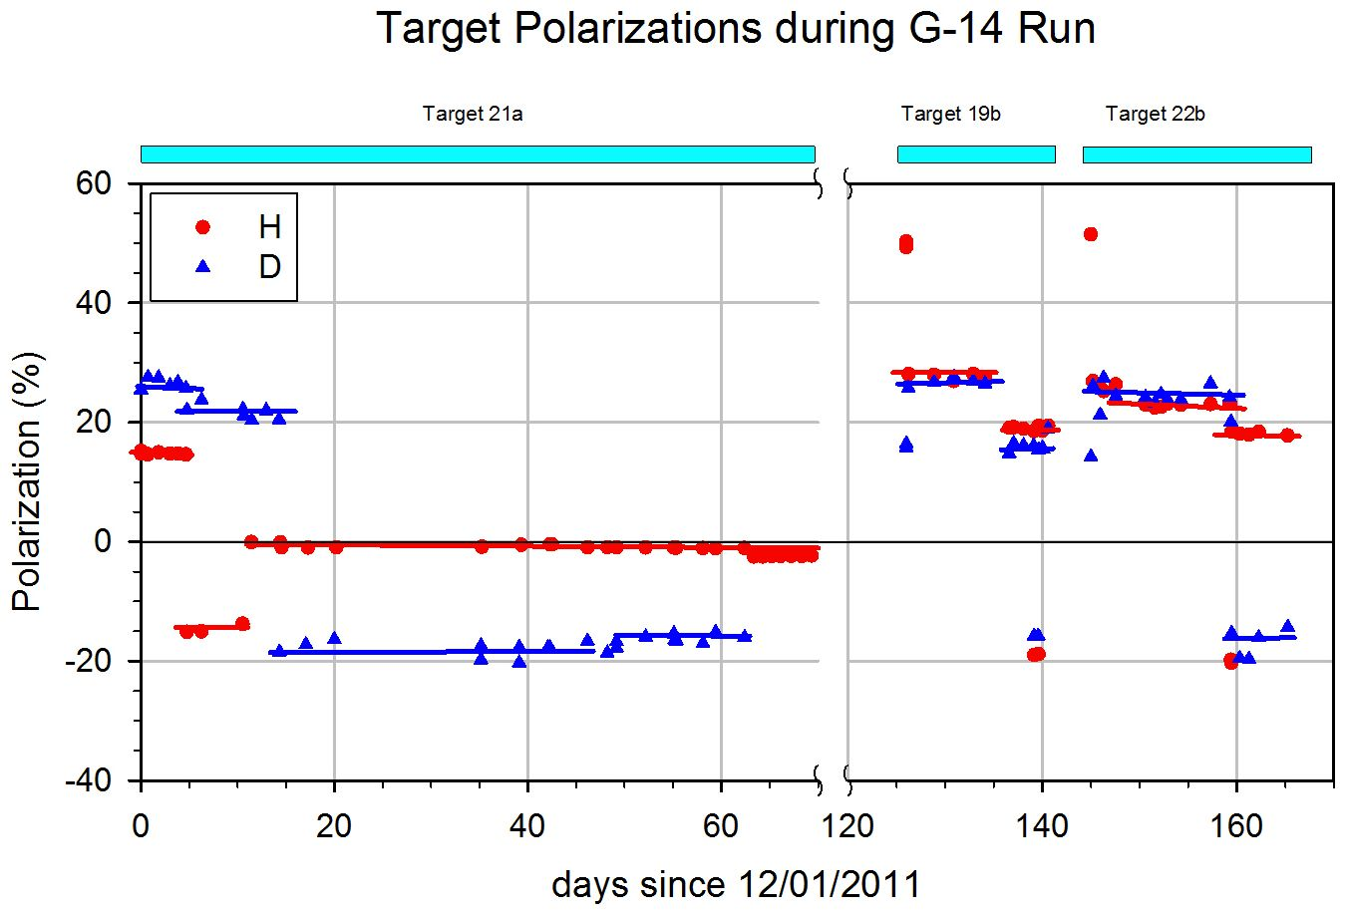
Target Performance during G-14 Run
H
D
ice
FAFP H=>D
FAFP H=>D
H flip caused partial FAFP
Pseudo
quench
Erase H
Quench
RF H flip
RF H flip
Field rotation
Beam steering
Field rotation
Field rotation
HDice targets used in frozen spin mode during E06-101/g14 run. Relaxation times were longer than a year at B=0.9T and T<100mK .

Slide 19
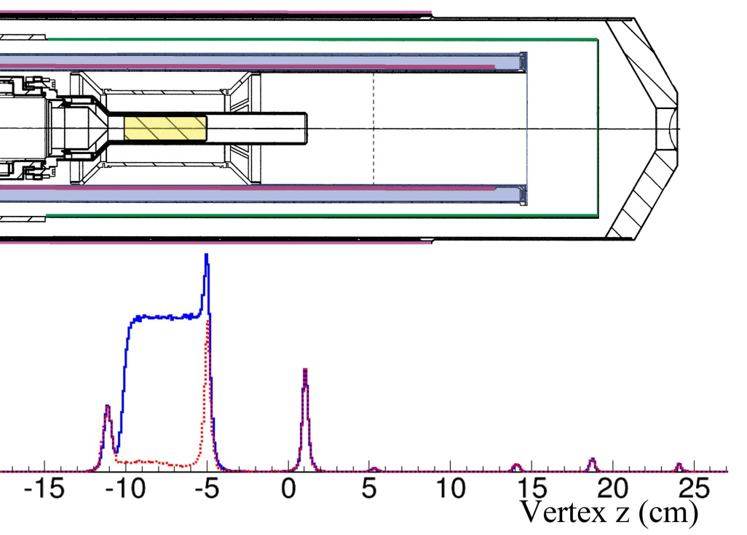
On-going Analysis for G-14 Run
H
D
ice
1st look at data vertex projection
“Empty” (red)
“Full” (blue)

Slide 20
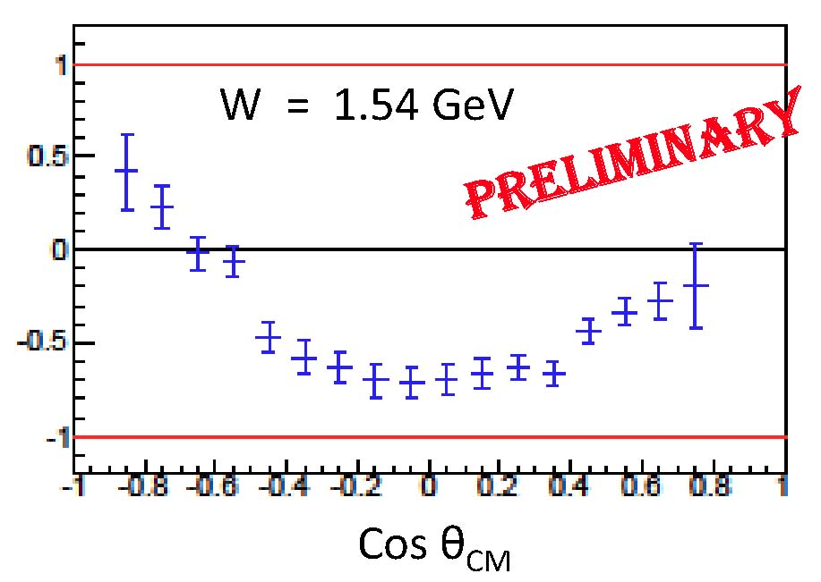
On-going Analysis for G-14 Run
H
D
ice
*
eg: γn => π–p
E
P(D) = 27%
~ 10% of g14 data set
(T.Kageya, NSTAR’13)
1st look at data vertex projection
“Empty” (red)
“Full” (blue)

Slide 21
Summary
H
D
ice
Methods of manipulating spins in HDice targets have been successfully implemented during the E06-101 run in CLAS.
Polarizations of H and D can be transferred back and forth.
More improvements can be done in the future to increase the spin transfer efficiency.
E06-101/g14 data from polarized D, following SFP, now under analysis.
These demonstrate a large potential for solid HD for photon experiments.

