Slide 1


PSTP 2013
Conclusive Remarks
Erhard Steffens
University of Erlangen-Nürnberg
steffens@physik.uni-erlangen.de
Outline
Series of PST(P) Workshops
Tasks of Spin Workshops
Main Topics
Some (of the many) Highlights
Future Trends

Slide 2
Series of PST(P) Workshops
The present workshop is called the 15th of this series.
The first meeting known to me:
Int. Conference on Polarized Targets and Ion Sources
Saclay 1966 – Chairman A. Abragam
Solid proton targets polarized by DNP (Jeffries, Borghini, Saclay group, ...)
Application of solid polarized targets for neutron physics: Spectroscopy, Spin Filtering of neutrons (F.L. Shapiro – Dubna),...
Nice overview ‘Polarized Ion Sources’ by R. Beurty (Saclay): Lamb Shift sources and Classical Sources (ABS) – still worth reading!

Slide 3
Series of PST(P) Workshops
The 2nd conference on (solid) pol. targets took place at Berkeley 1971 (chair: O. Chamberlain)
Work on Spin Tools was discussed at the Polarization Symposia: Karlsruhe 1965 (e.g. 1st ideas on a Colliding Beam Source by W. Haeberli), Madison 1970 (e.g. achromatic focusing by means of a compressor sextupole – H.F. Glavish), Zürich 1975 (e.g. pol. electrons from a GaAs cathode by Müller/IBM) and Santa Fe (e.g. 1st exp. demonstration of the CBS by the Madison group)
Similar work has been presented at the HE Spin Symposia

Slide 4
Series of PST(P) Workshops
Topical workshops – initiated mostly by the HE Spin community:
Ann Arbor 1981 & Vancouver 1883 ‘High intensity pol. proton sources’
Abingdon 1981, BNL 1982, Bad Honnef 1984 ‘Pol. Target Materials and Techniques’
Bodega Bay 1985 ‘Polarized antiprotons’

Slide 5
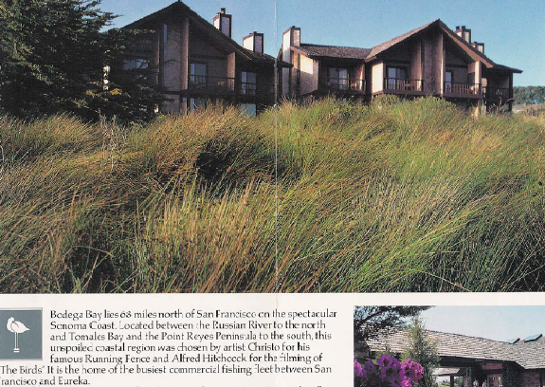
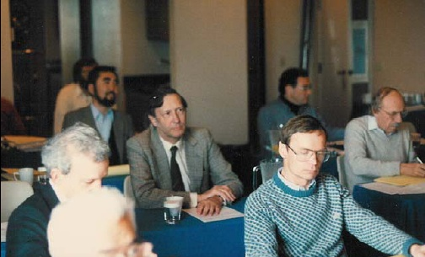
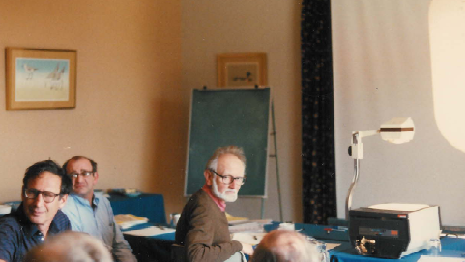
Workshop Bodega Bay 1985
*) Proc. Workshop on Polarized Antiprotons, Bodega Bay, CA, 1985. A.D. Krisch, A.M.T. Lin, O. Chamberlain (Edts.), AIP Conf. Proc. 145 (1986) 207

Slide 6
Series of PST(P) Workshops
Topical workshops – initiated mostly by the HE Spin community:
Ann Arbor 1981, Vancouver 1883 ‘High Intensity Pol. Proton Sources’
Abingdon 1981, BNL 1982, Bad Honnef 1984 ‘Pol. Target Materials and Techniques’
Bodega Bay 1985 ‘Polarized Antiprotons’
Montana 1986 ‘Polarized Sources and Targets’
Minneapolis 1988 and Bonn 1990: several satellite workshops to Spin88 and Spin90
KEK 1990 ‘Pol. Ion Sources and Gas Jets’

Slide 7

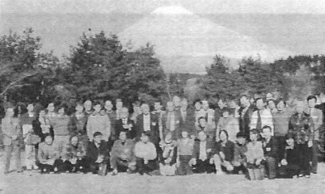
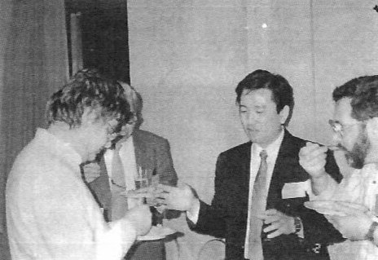
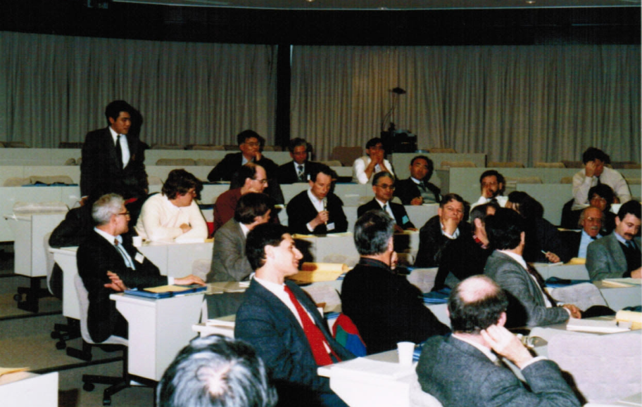
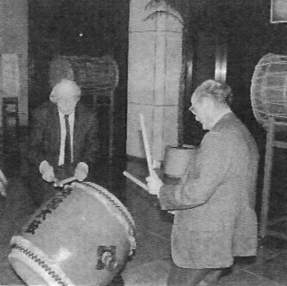

Slide 8
Series of PST(P) Workshops
After 1990: Workshops predominantly in the uneven years between the Spin Symposia!
e.g. ‘Pol. Beams/Sources and Targets’: Heidelberg 1991 (restricted to ‘Pol. Gas Targets’)
followed by Madison 1993, Cologne 1995, Urbana 1997, Erlangen 1999, Nashville 2001, Novosibirsk 2003, Tokyo 2005, Brookhaven 2007, Ferrara 2009 and St. Petersburg 2011.
Now we are attending #15: PSTP 2013 in Virginia!
This would mean that Montana 1986 was the first PST workshop in our series…

Slide 9
Tasks of Spin Workshops
Spin Workshops may be initiated by the ‘Spin Committee’ (ISPC)* on experimental or theoretical subjects which are essential for the success of Spin Physics, i.e. the study of spin effects in Nuclear and Particle Physics;
The workshops should support
(i) development of new methods
(ii) formation of a community
(iii) initiatives for new collaborations and experiments
*) International Spin Physics Committee – Chair: R. Milner (MIT)

Slide 10
Main Topics of PSTP 2013
Polarized Targets about 17 presentations
Polarized Sources “ 24 “
Polarimetry “ 15 “
Facilities “ 7 “
General & New Methods “ 8 -> 72 in total
  JLab and Collaborators “ 36 “
  BNL “ 12 “
  Other US Labs “ 5 “
  Europe “ 8 “
  Russia “ 5 “
  Japan “ 1 “

Slide 11
Main Topics of PSTP 2013
The three main subjects Sources, Targets and Polarimetry are covered nearly equally. Polarimetry has gained in importance because of the need for precision.
New projects or upgrades tend to initiate new developments, in some sense they are driving the progress in our field. This is strongly reflected in the number of talks from the different labs, dominated by JLab and BNL/RHIC. In general in the last decades experimental work on Spin Physics is dominated by US groups, of course with large international contribution.
For a stable future of our field it is important that polarization is implemented at other existing or future projects, like EIC (secured) or FAIR (uncertain). New ideas would help! Are our meetings sufficiently inovative? Or what needs to be done?

Slide 12
Some (of the many) Highlights
Polarized Solid Targets
Polarized Internal Targets
High Pressure Gas Targets (3He)
Polarized Electron Sources
Polarized Ion Sources (H, D, ³He, ..)
Electron and Ion Polarimetry
New Facilities and Methods
Application of Spin
and some special topics

Slide 13
Polarized Solid Targets

Slide 14




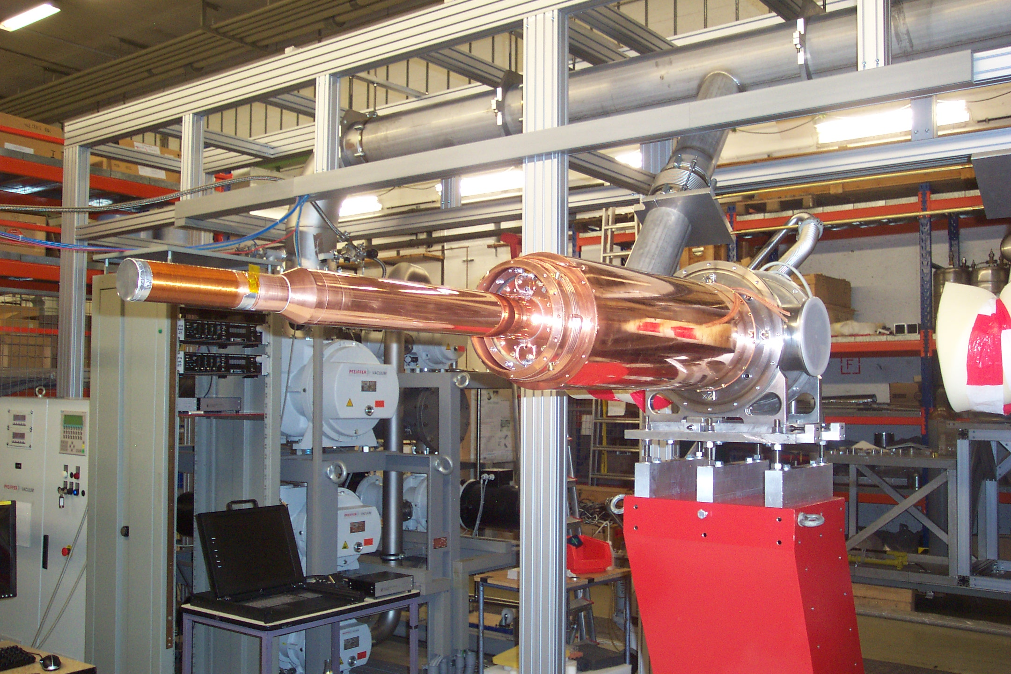
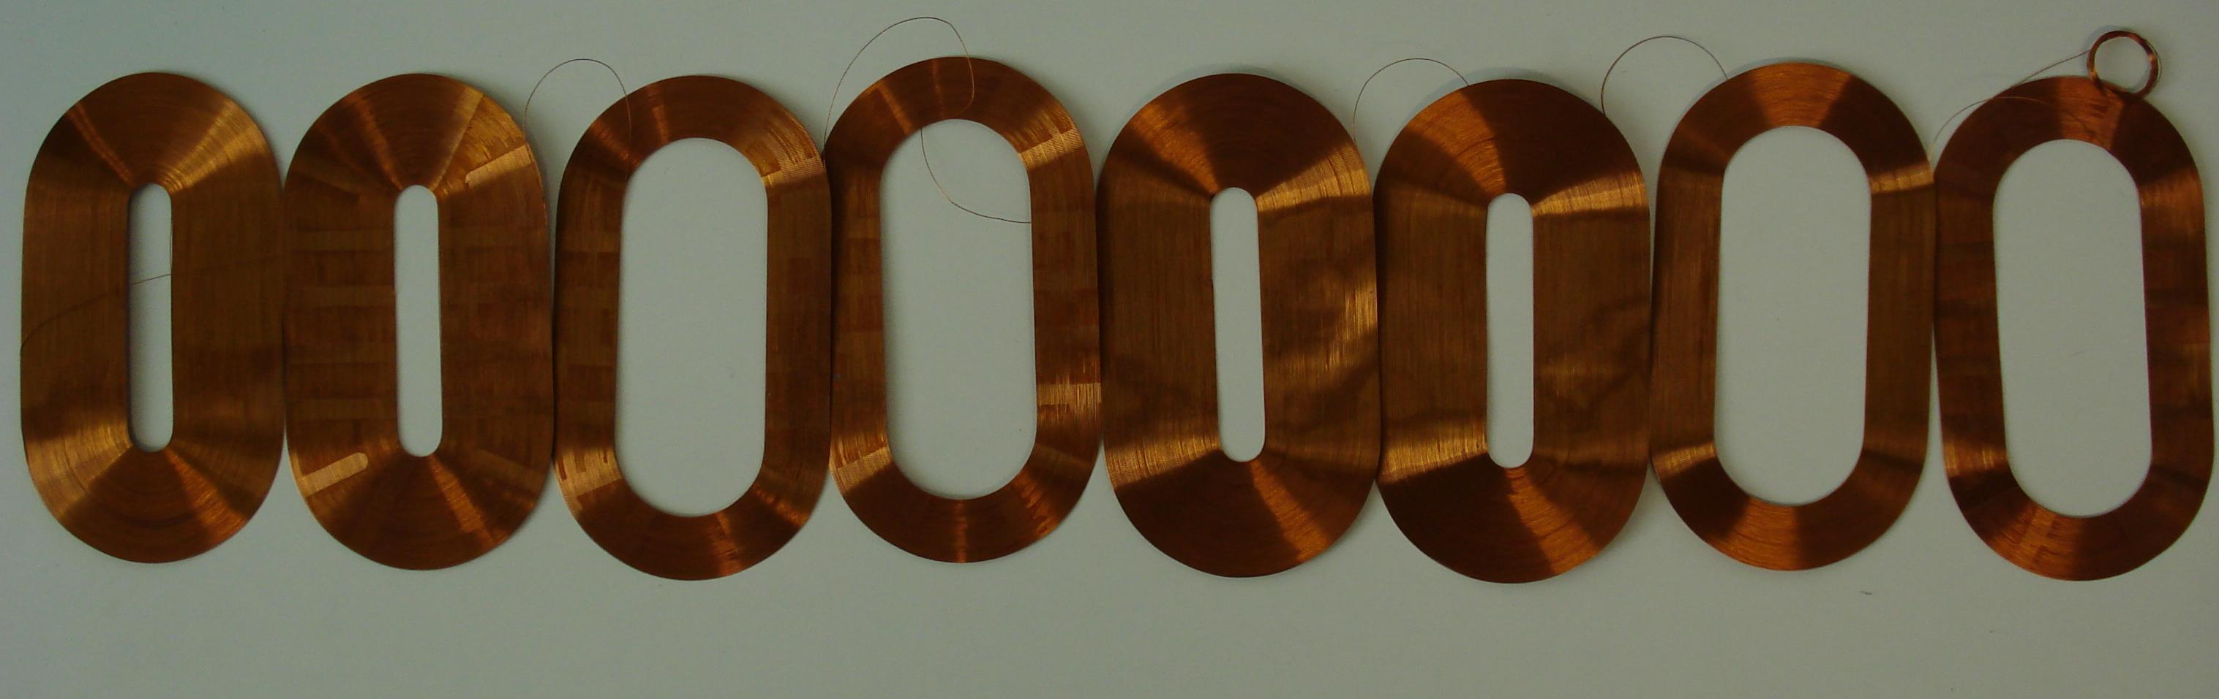
Institut
für Kernphysik
Double Polarized Measurements with Frozen Spin Target at MAMI
1.-Introduction: The Mainz Microtron MAMI
2.-Experimental setup beam +detector: Tagger + Crystal Ball@MAMI
3.- Experimental setup target: The Frozen Spin Target
3.-Double Polarized Experiments : Precision measurements of the Nucleons Excitations, GDH sumrule Determination of Fundamental Properties
PSTP 2013
Charlottesville, September 9th 2013
Andreas Thomas

Slide 15
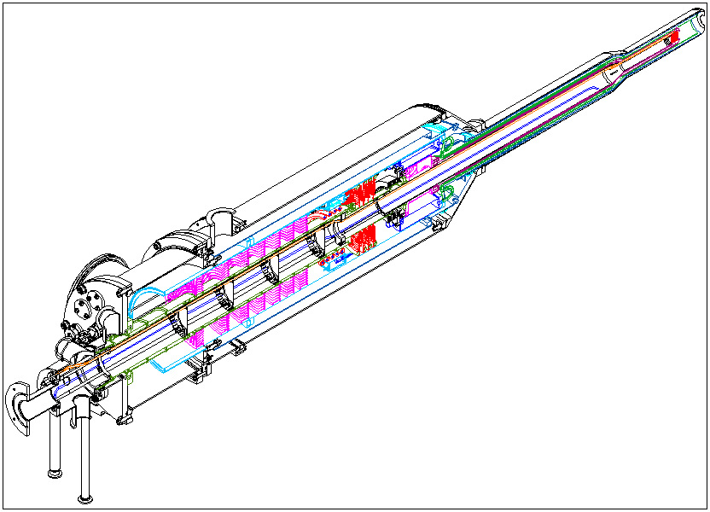
Polarized Target for Crystal Ball
Tagged CW photon beam
4π- detector
Frozen spin target (25 mKelvin achieved).
P_{proton} ~ 85%
P_{deuteron}~75%
All directions of polarization.
τ~1000 ….2000 hours
New ³He⁴He-Dilution refrigerator
(in collaboration with JINR Dubna
started 2003)

Slide 16
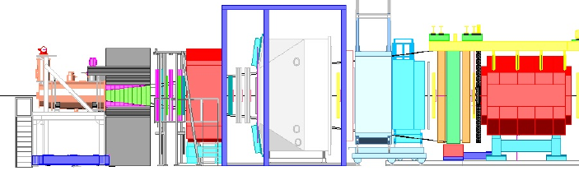
Drell-Yan at COMPASS
Michael Pesek - Prague
Demands on setup: High intensity π⁻ beam
Transversely polarized proton target
Hadron Absorber
Dedicated muon trigger

Slide 17
HD Target Life Cycle
Xiangdong Wei
Thomas Jefferson National Accelerator Facility
H
D
ice
Gas Handling
HD purification (JMU)
Gas analysis (JMU, Rome2)
See Steve Whisnant’s Talk
Gas recovery
Gas Storage
See Lowry’s Talk
Experiment
Target Production
eHD, γHD
Condensing
(Spin Transferring)
Calibrating
(Spin Flipping)
Polarizing
(Field Rotating)
Aging

Slide 18



Spin Manipulation Methods
H
D
ice
Adiabatically rotating magnetic field direction
  Using both transverse and axial magnets, this operation is straight forward and quick, as long as the field rotation rate is much slower than the Lamar Frequencies of H and D at the lowest field, and the T₁s are much longer than the rotation time.
  Typical scales: T₁ ~months;
  rotation time ~minutes;
  NMR frequency ~300kHz for D and ~2MHz for H
  @0.0600T
  Polarization amplitudes stay the same <=> H &D rotate together.
+B$⊥$
-B$∥$
+B$∥$

Slide 19
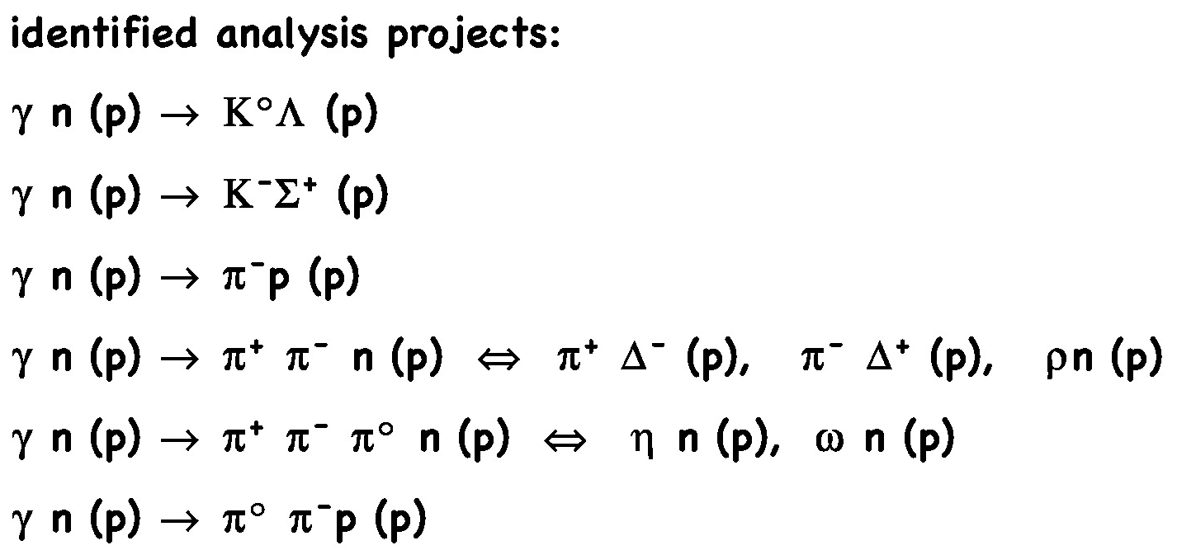
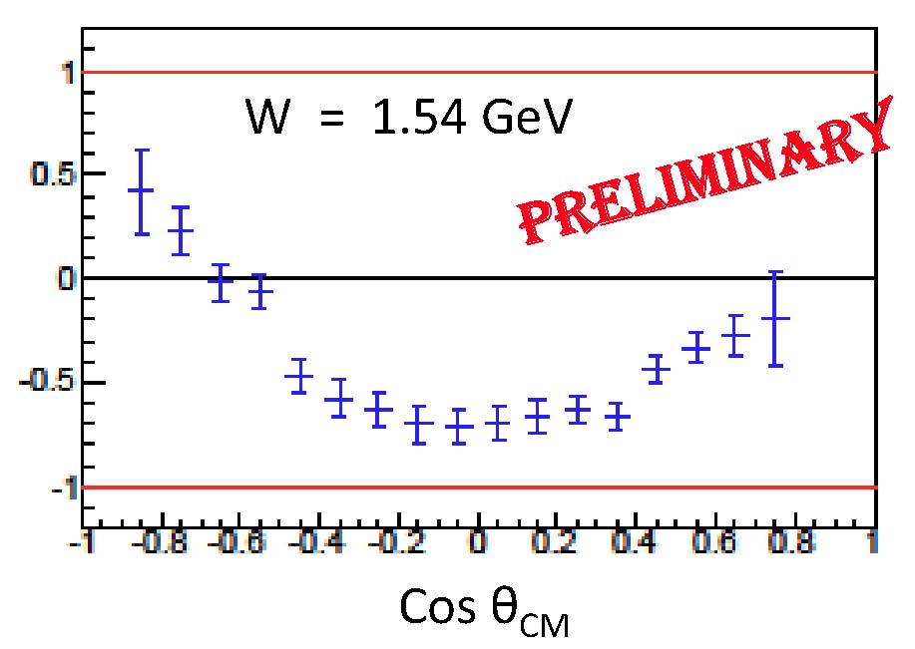
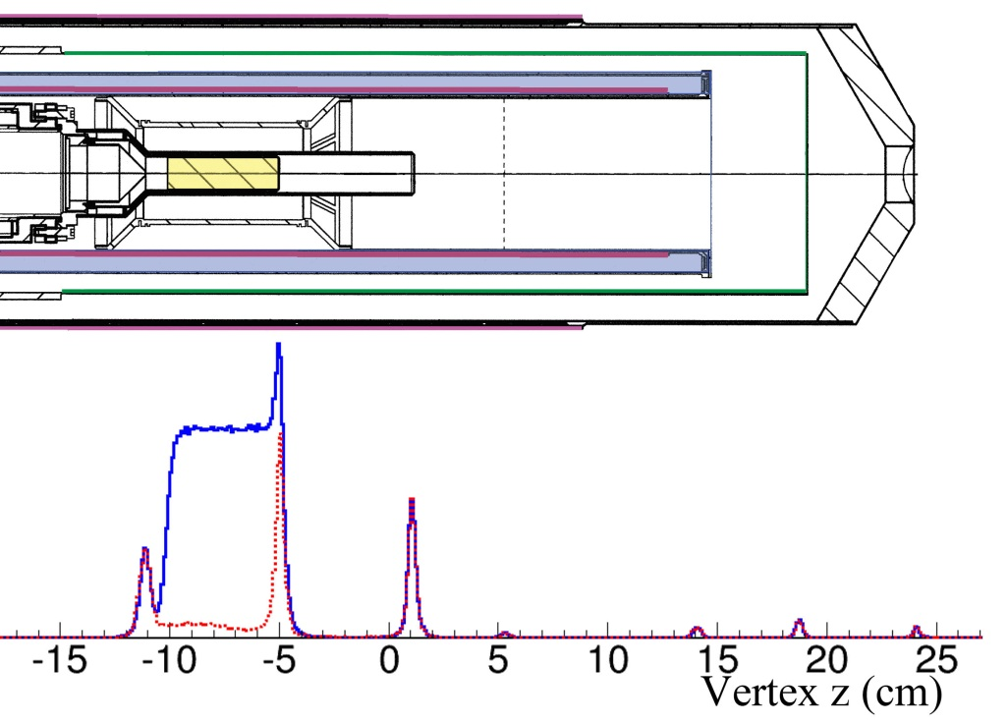
On-going Analysis for G-14 Run
H
D
ice
*
eg: γn => π–p
E
P(D) = 27%
~ 10% of g14 data set
(T.Kageya, NSTAR’13)
1st look at data vertex projection
“Empty” (red)
“Full” (blue)

Slide 20
Internal Target for Spin Filtering Studies at COSY
G. Ciullo – INFN & Univ. Ferrara

Slide 21
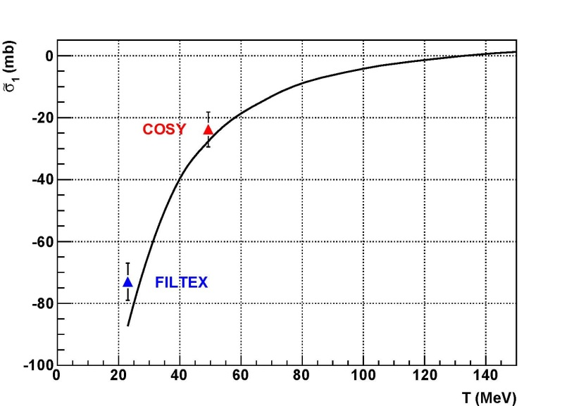
Spin filtering on p well understood
▲
Data 2011
Data 1993
Good agreement confirms that spin-filtering is well described,
contribution from p-p scattering (SAID and Nijmegen databases).
21

Slide 22
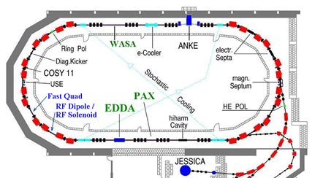
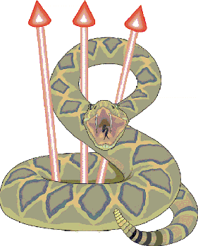
COSY for longitudinal spin filtering
Filter and polarimeter
p beam
H_{II}
22

Slide 23
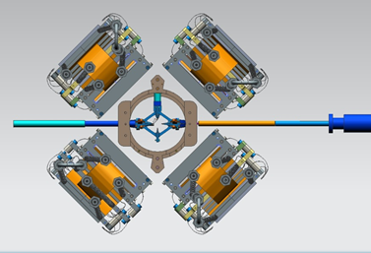
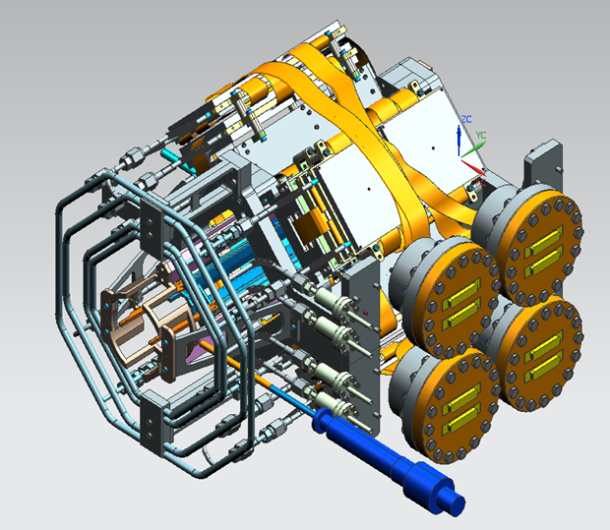
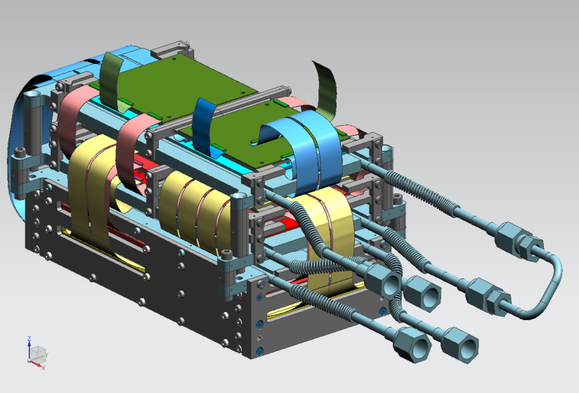
PAX detector designed: in development
23

Slide 24
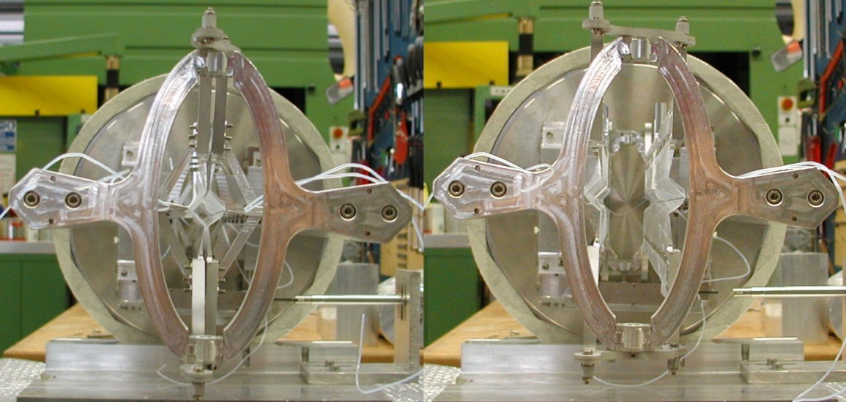
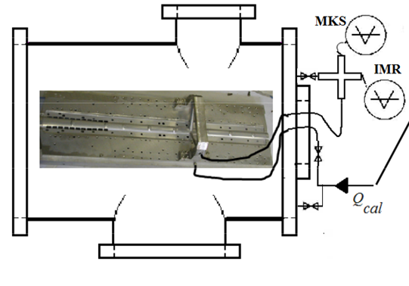
The openable Cell?
High injection at COSY
Constrain for AD
First prototype worked nicely in in the Target commissioning, on COSY
target suffers much stresses.
Construction and test ex situ by He sniffer :
Leaks < 1%.
Absolute monitoring still under study,
BRP already provide a relative monitoring
24

Slide 25
³He Targets as Neutron Spinfilter
T. Gentile - NIST

Slide 26
POLARIZED ³He NEUTRON SPIN FILTERS
strong spin-dependence of the neutron absorption cross section
unpolarized incoming neutrons
polarized ³He
polarized outgoing neutrons
K.P. Coulter et al, Nucl. Instrum. Meth. A 288, 463 (1990)

Slide 27
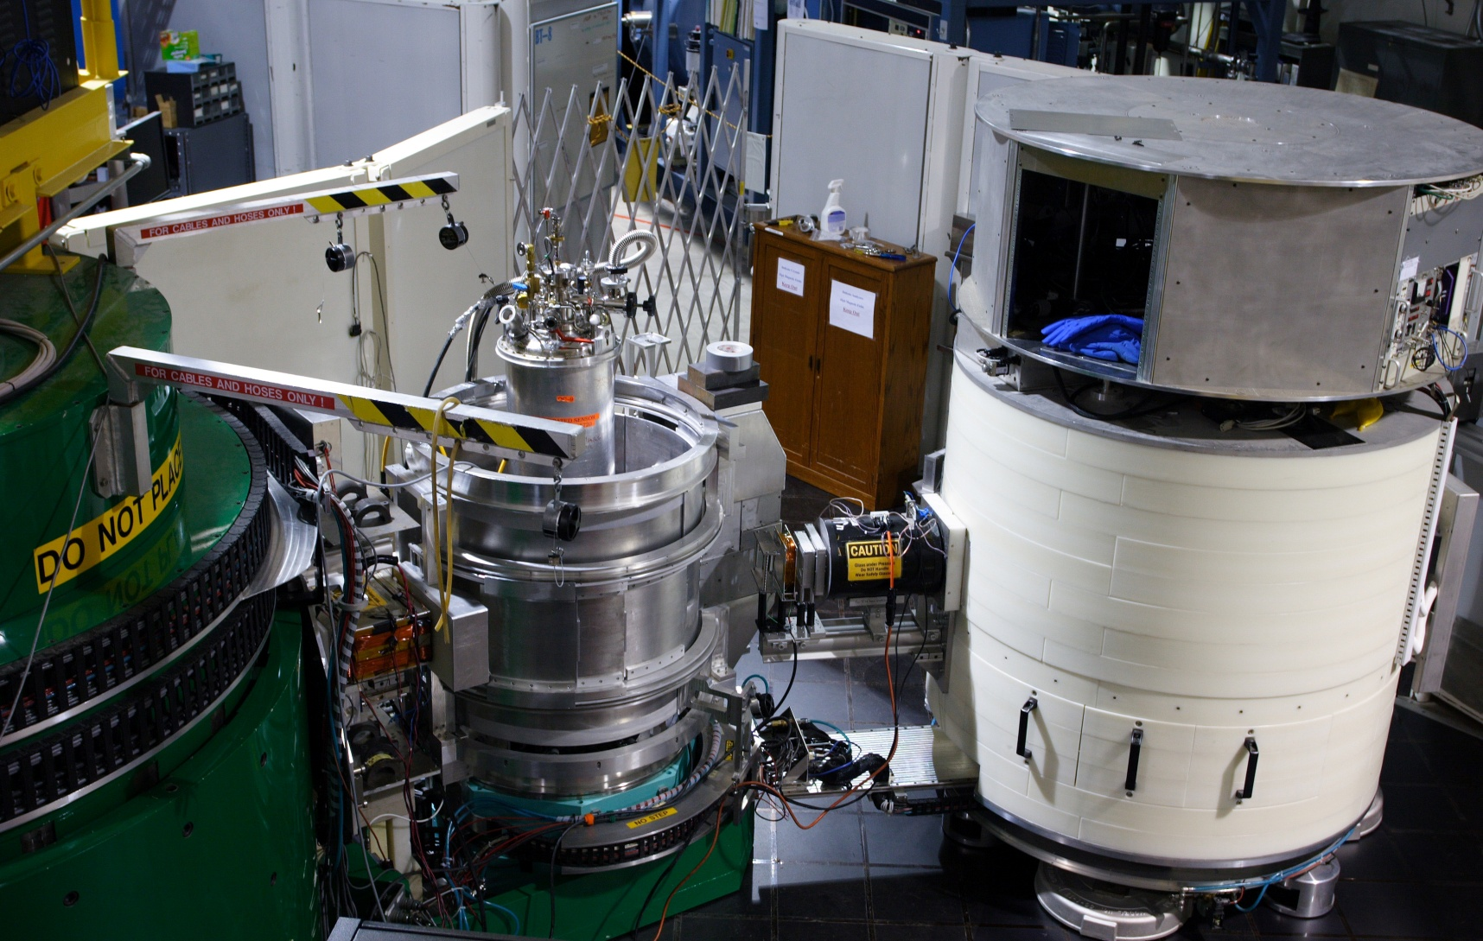
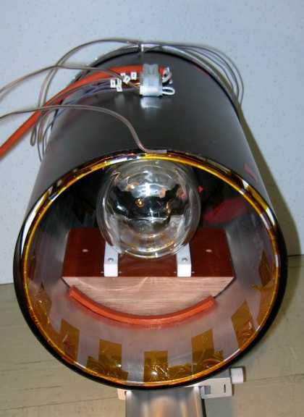
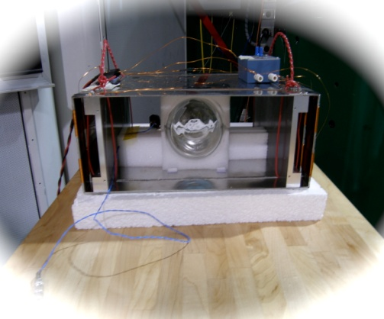
NCNR BT-7 TRIPLE AXIS SPECTROMETER
³He Polarizer
Two < π/2 spin rotations
³He Analyzer
P_{n}
sample
P_{n}
π/2 spin rotation
HF
Two π/2 spin rotations
Notes:
The first one is thermal triple axis spectrometry. Here we use a 3He NSF to polarize a doubly focusing 10 cm by 5 cm beam, and another 3He NSF to analyze the scattered beam. Of course, neutron spin flipping is done by NMR. With 3He NSFs, you can have improved polarized neutronic performance, install one more focusing monochromators than regular TAS, optimize the instrument in both unpolarized and polarized mode simultaneously. Polarized neutron flux is 1.1 x 10^7 n/cm^2/s at 14.7 meV. The typical initial flipping ratio is 50 above for a full open double focusing beam configuration with intensity reduction factor of 10 (measured in the detector). For polarized inelastic scattering, the energy transfer is up to 35 meV. No polarized neutron optics alignment, no tuning is required for polarized experiments. One of the most challenging tasks to implement 3He NSFs is the space constraints and stray fields from the instrument since we have retrofitted 3He NSFs to the instrument. This has made the design of 3He NSF device and spin transport much more difficult. But those issues are gone now.

Slide 28

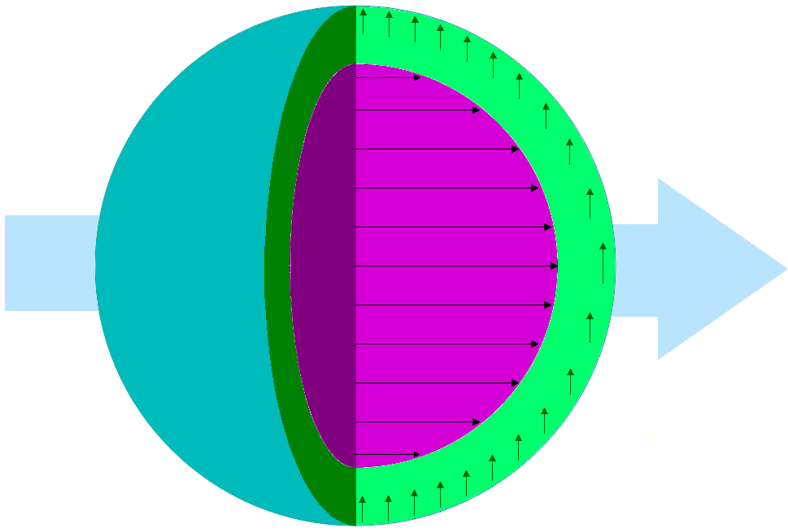
3D magnetism in nanoparticles
K.L. Krycka et al, PRL 104 207203 (2010)
Fe₃O₄ ρ’s
Structural 6.97E-6 Å⁻²
Magnetic 1.46E-6 Å⁻²
^{(513 emu / cc)}
B
+
Modeled Diameters:
Sphere 9.0 nm
Ferrimagnetic core 7 nm
Canted shell 7 to 9 nm (+0.2 nm)
(Q ~ 2π / distance)
Notes:
Now I will briefly talk about application of 3he polarizer and analyzer to the thermal triple axis spectrometry. The triple axis spectrometer is very powerful for fundamental studies in high temperature superconductors, colossal magnetoresistive oxides, multiferroics, frustrated magnets, thermoelectrics, ferromagnetic metals. The NIST BT-7 triple axis spectrometer is a new instrument which equips with a double focusing pyrolytic graphite monochromator and provides an intensity an order of magnitude higher than the previously existed BT-2 instrument. However BT-7 does not have a capability of polarizing neutrons efficiently. We have used 3He Spin filters to polarize and analyze neutrons. The preliminary test results showed both 3He polarizer and analyzer worked efficiently. Intensity gained by a factor of 20 in the polarized mode. We also had some spin transport issues which I will not get into.

Slide 29
Polarized Electron Sources

Slide 30
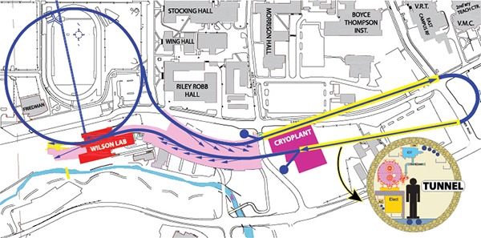
What we want:
J. Maxson – High brightness CW electron beam for ERL /Cornell
CESR
Linac 1
Injector
Linac 2
Sync. Beamlines
Beam parameters: 5GeV, 100mA CW current with energy recovery:
  Energy of spent bunch captured entering linac again 180 degrees out of phase.

Slide 31
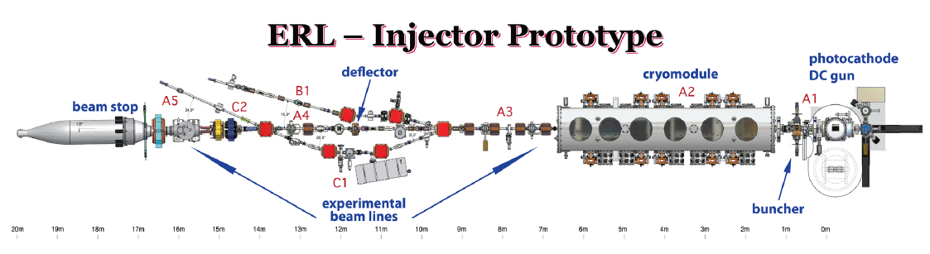
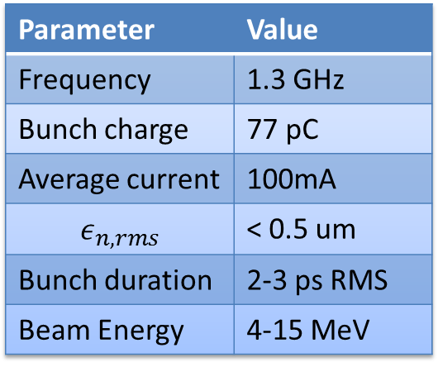
What we’ve got so far:
Parameter | Value
Frequency | 1.3 GHz
Bunch charge | 77 pC
Average current | 100mA
$$ε_{n,rms}$$ | < 0.5 um
Bunch duration | 2-3 ps RMS
Beam Energy | 4-15 MeV
CESR
Injector

Slide 32
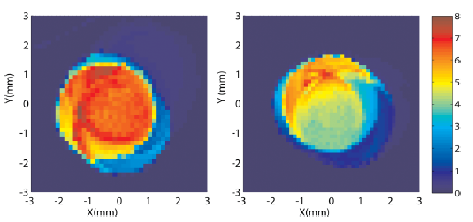
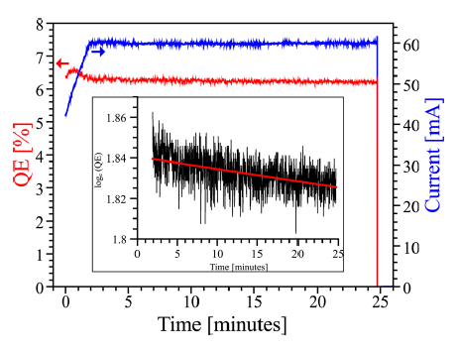
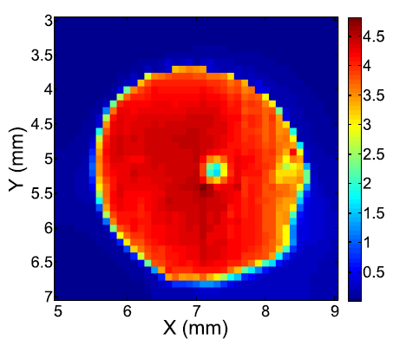
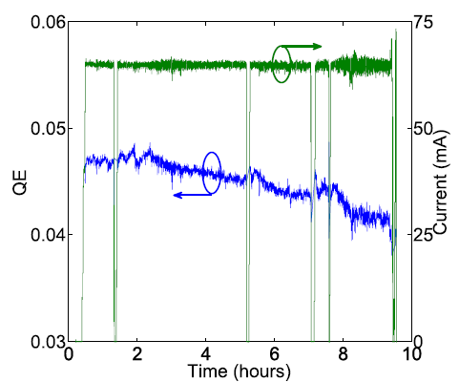
World record photoinjector current!
Dunham et. al. APL 102, 034105 (2013)
Using multialkali off center, a robust bulk emitter:
CsK₂Sb
CsK₂Sb
Before use
After use
60mA run with CsK₂Sb had ~30 h 1/e lifetime
  P_{gun}=1.13x10⁻¹¹ torr → 3.0x10⁻¹¹ torr
  Likely due to beam scraping
65mA run with NaKSb had ~66 h 1/e lifetime
NaKSb

Slide 33
Summary
Cornell photoinjector has nearly demonstrated full feasibility of injecting low emittance, high average current electrons for an ERL light source
  High current record: 75 mA using multialkali
  Emittances < 0.4 um normalized in merger
Constructing new photogun using input from optimization
  Push for both photocathode field +voltage, rather than simply voltage.
New gun currently in rebuilding phase, should be back on in a few months!

Slide 34
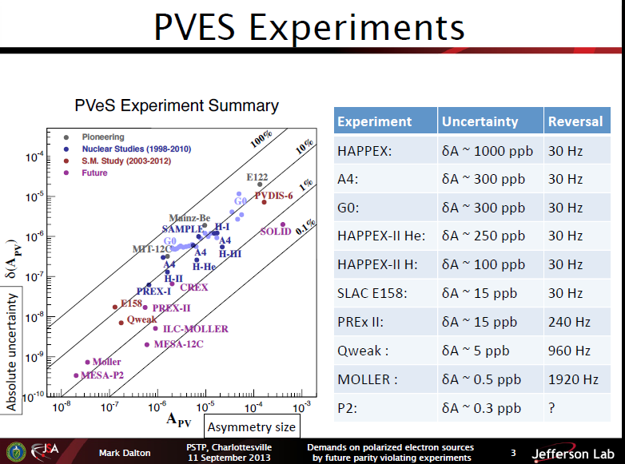
nn
Mark Dalton - JLab

Slide 35
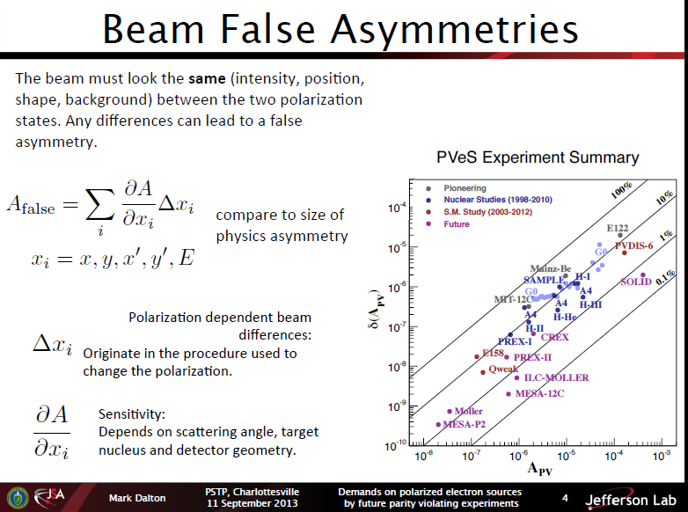

Slide 36
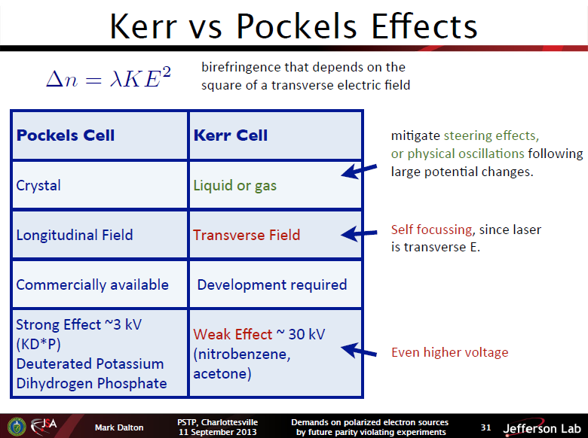

Slide 37
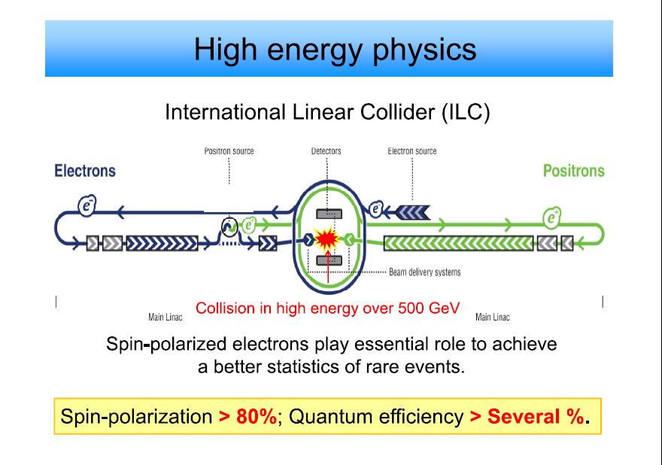
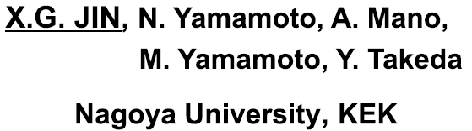

Slide 38
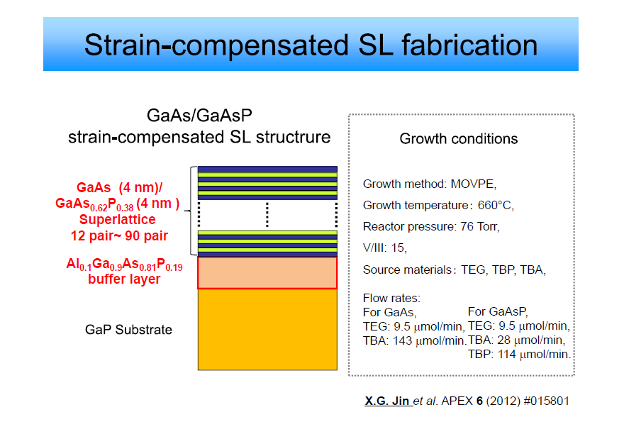

Slide 39
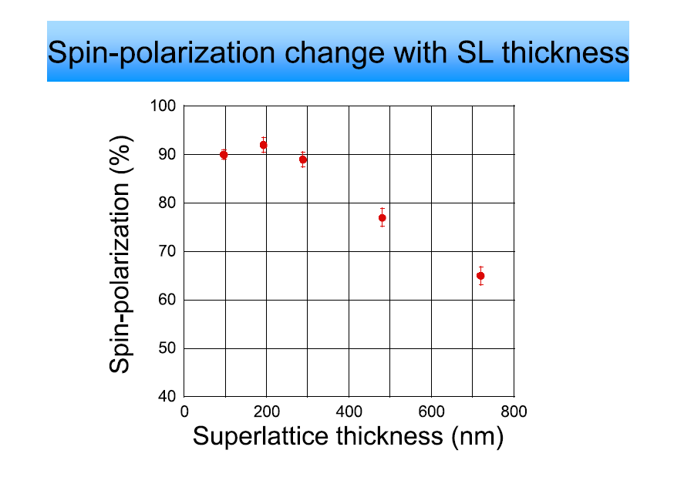

Slide 40
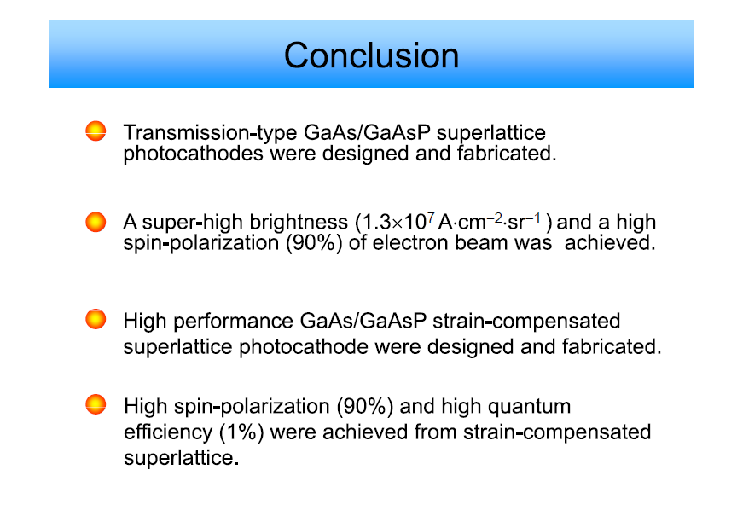

Slide 41
Polarized Ion Sources

Slide 42

RHIC polarized source upgrade.
A.Zelenski, BNL

Slide 43
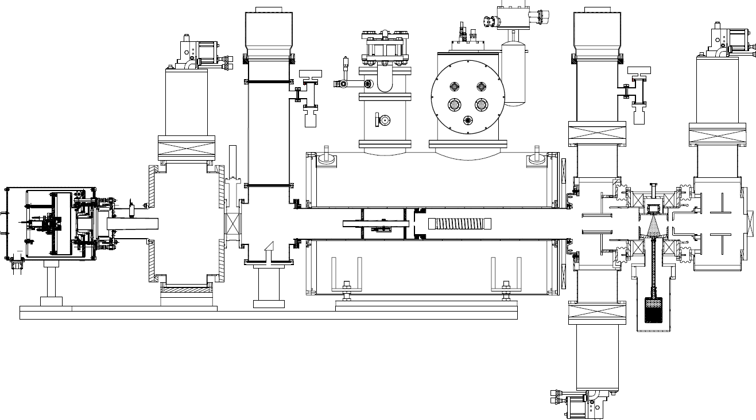
OPPIS with atomic H injector layout.
CP1
TMP1
Neutralizer
cell
Atomic
H injector
He-ionizer
cell
Na-jet
cell
Rb-cell
H2
He
Rb
Na
H⁺
H⁰
H⁺
H⁰
H⁻

Slide 44
Source intensity and polarization.
Reliable long-term ∙operation of the source was demonstrated.
Very high suppression of un-polarized beam component was demonstrated.
Small beam emittance (after collimation for energy separation) and high transmission to 200 MeV.
Rb-cell, Temp., deg. C | 81 | 86 | 91 | 96
Linac Current, μA | 295 | 370 | 430 | 570
Booster Input ×10¹¹ | 4.9 | 6.2 | 7.3 | 9.0
Pol. %, at 200 MeV | 84 | 83 | 80.5 | 78

Slide 45
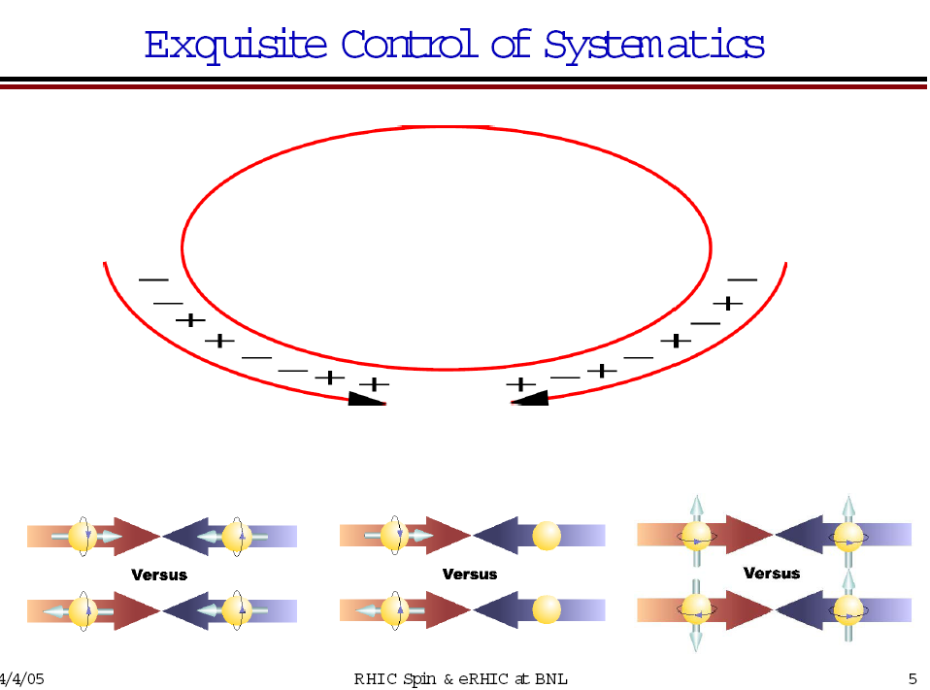
RHIC Polarized beam in Run 2012
OPPIS
0.6mA x 300us→11∙10¹¹ polarized H⁻ /pulse.
LINAC
(6.0-6.5) ∙10¹¹ polarized H⁻ /pulse at 200 MeV
Booster
(2.2-2.4) ∙10¹¹ protons /pulse at 2.3 GeV
(2.0-2.2) ∙10¹¹ p/bunch
AGS
RHIC
~1.8∙10¹¹ p/bunch, P~60-65% at 100 GeV
P ~ 56% at 250 GeV
Notes:
45

Slide 46
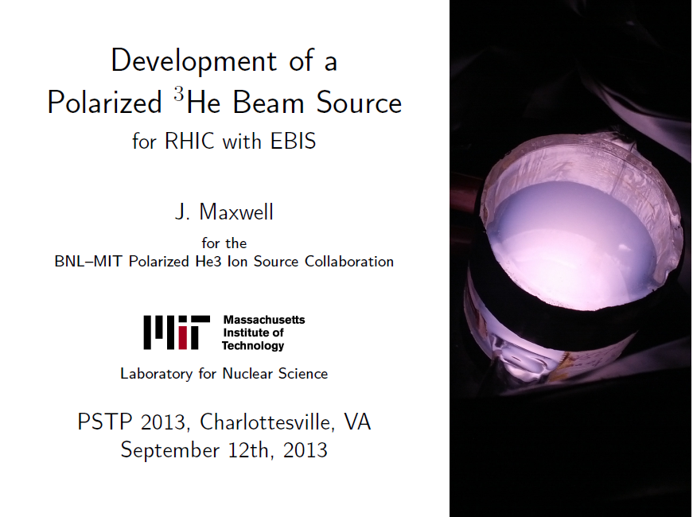

Slide 47
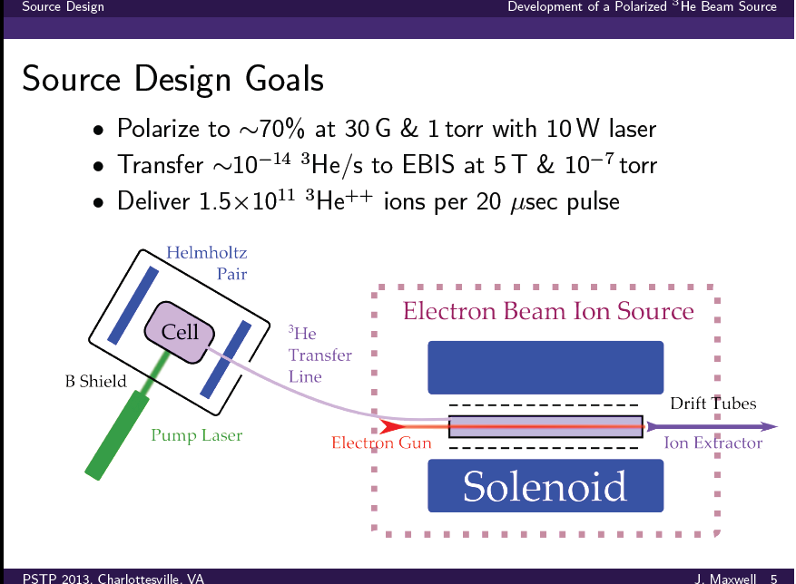

Slide 48
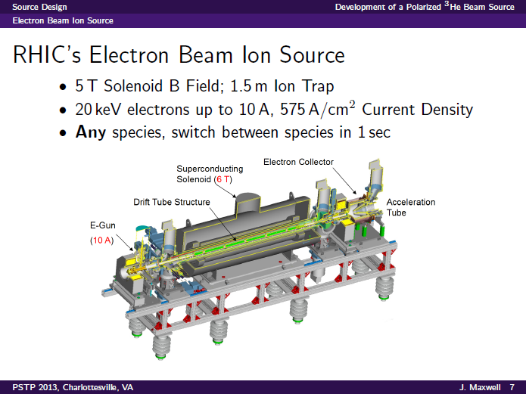

Slide 49
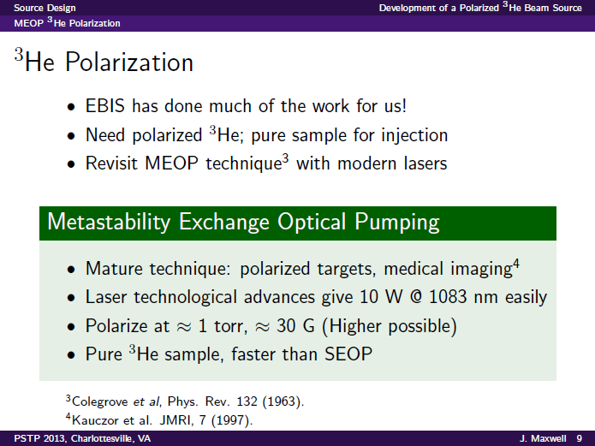

Slide 50
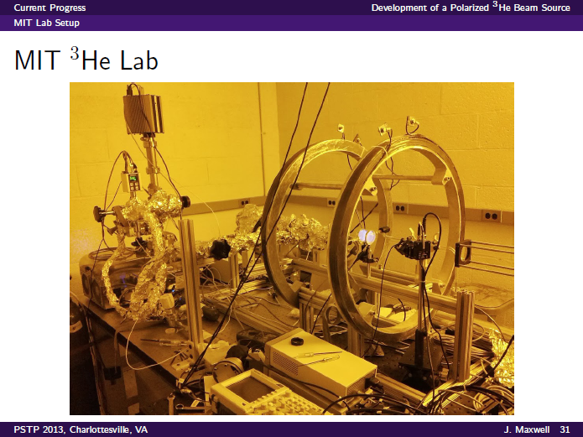

Slide 51
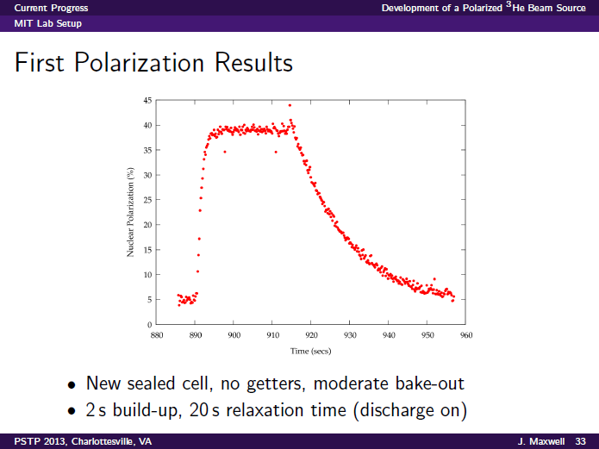

Slide 52
Electron- and Ion Polarimetry

Slide 53
Overview of Electron Polarimetry
Charles Sinclair
Cornell University
Beautiful historical overview !

Slide 54



Møller Polarimetry with Polarized
Atomic Hydrogen at MESA
Patricia Aguar Bartolomé
Institut für Kernphysik, Universität Mainz
PSTP 2013 Workshop, Charlottesville
11th September 2013

Slide 55
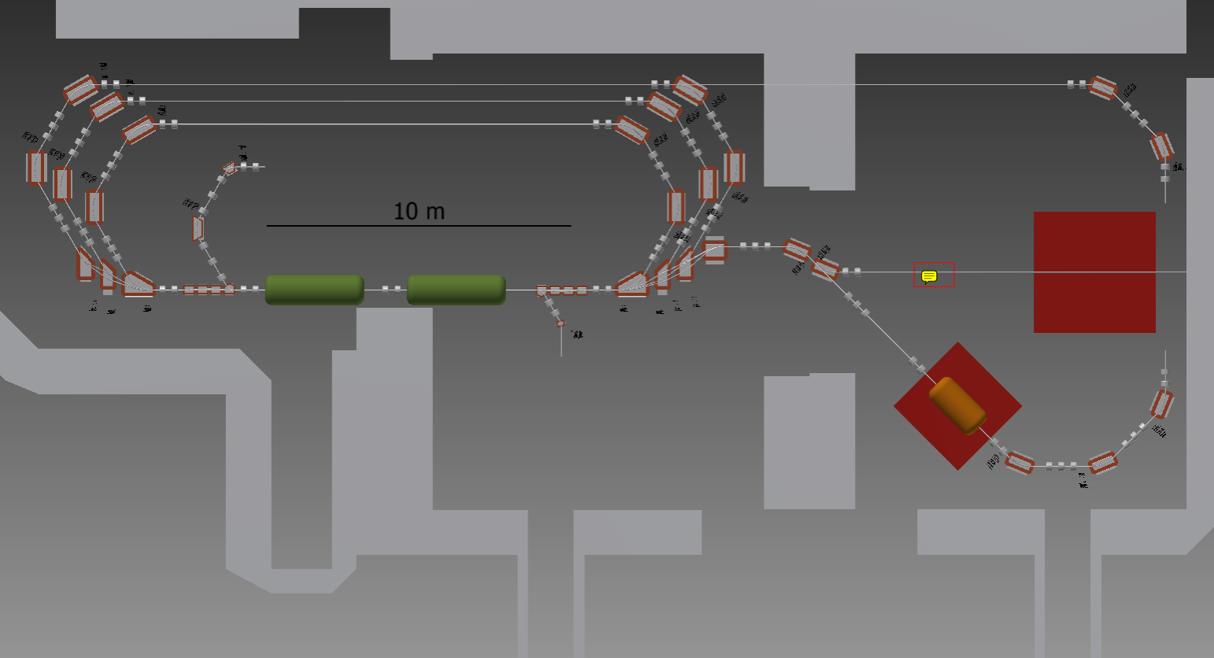
Physics Motivation
200 MeV – energy recovery
Goal: To perform low energy PV electron scattering experiments at MESA with a
systematic accuracy of < 0.5 % for the beam polarization measurements
Hydro-Moller
PV
Detector

Slide 56


Polarized Atomic Hydrogen Target
Storage Cell
In a field gradient a force
Pulls into the strong field
Repels out of the strong field
recombination
(releasing ~ 4.5 eV) higher at low T
H+H H₂
cell walls coated with ~50 nm superfluid ⁴He
.
Gas density: 3 10⁻¹⁵ cm⁻³
100 % polarization of the electrons

Slide 57

Summary/Outlook
PV electron scattering experiments at MESA are planned with systematic
accuracy of < 0.5% for the beam polaization measurements
Atomic Hydrogen gas, stored in a ultra-cold magnetic trap can provide this
accuracy
A solenoid and a dilution refrigerator were shipped from the University of Virginia
to Mainz
Cooling down of the solenoid will be performed in the next weeks
New dilution refrigerator design and production is needed
Production of a new mixing chamber and a atomic hydrogen dissociator is also
planned
Geant4 simulation of the detector system in progress

Slide 58

The polarized hydrogen jet target measurements at RHIC
Andrei Poblaguev
Brookhaven National Laboratory
The RHIC/AGS Polarimetry Group:
I. Alekseev, E. Aschenauer, G. Atoian, A. Bazilevsky, A.Dion, K.O. Eyser, H. Huang, D.Kalinkin,
Y. Makdisi, A.Poblaguev, W. Schmidke, D. Smirnov, D. Svirida, K. Yip, A. Zelenski

Slide 59

The Polarized H-Jet Target
H₂ dissociator
RF cavity
H = p⁺ + e⁻
separation
magnets
(sextupoles)
Atomic Beam Source
focusing
magnets
(sextupoles)
OR
RF transitions
Scattering chamber
Holding field
magnet
P⁺ OR P⁻
record beam intensity
100% eff. RF transitions
focusing high intensity
B-R polarimeter
P_{jet} ~ 0.92
recoil detectors
ToF, E_{REC}; Θ_{REC}
Breit-Rabi Polarimeter
Ion Gage

Slide 60




Running conditions (2013)
255 GeV/c proton beams.
6 detectors (98 channels)
Ran with two beam simultaneously separated vertically
by 3-4 mm dictated by the machine beam-beam
requirements.
Alpha-source runs were taken separately from physics runs.
Full waveform was recorded for every triggered event
Recoil protons were selected within energy range 1 – 5 MeV
Recoil proton asymmetry relative to the beam and jet
polarization was mesured simultaneously
a_{Beam} = A_{N}(t) P_{Beam} & a_{Jet} = A_{N}(t) P_{Jet}
P_{Beam} = (a_{Beam} /a_{Jet} ) × P_{Jet}

Slide 61



Comparison α- and geometry based calibration
If A_{geom} is mean proton amplitude, E_{geom} is energy corresponding to it, and E_{α}(A_{geom}) is energy calculated using α-caliration then the value of
allows us to compare two calibrations directly
No dependence on signal amplitude is observed.
The consistency of the calibrations may be improved if the dead-layer will be treated separetely for each detector.
Energy calibration is controlled at ~ 1% level.

Slide 62
Summary
H-Jet polarimeter provide reliable measurements of the average beam polarizations at RHIC.
Several calibration methods were developed which allow us to monitor energy calibration with a percent accuracy as well as to make a precise alignment of the detectors.
Study of background due to the beam gas is underway
Molecular hydrogen in the Jet gives the largest uncertainty in the polarization measurements.
For future we are considering replacing of the WFD system from the old 8-bit CAMAC based to the recently developed JLab’s 250 MHz VME-based.
We are developing new Si detectors to increase acceptance and energy range.

Slide 63
Polarimetry Requirements for eRHIC

Slide 64
RHIC Hadron Polarimetry
Polarized hydrogen Jet Polarimeter (HJet)
  Source of absolute polarization (normalization of other polarimeters)
  Slow (low rates ⇒ needs looong time to get precise measurements)
Proton-Carbon Polarimeter (pC) @ RHIC and AGS
  Very fast ⇒ main polarization monitoring tool
  Measures polarization profile (polarization is higher in beam center) and lifetime
  Needs to be normalized to HJet
Local Polarimeters (in PHENIX and STAR experiments)
  Defines spin direction in experimental area
  Needs to be normalized to HJet
All of these systems are necessary for the proton beam polarization measurements and monitoring

Slide 65
eRHIC Lepton Beam
  One possibility is using the idea of a “Gatling” electron gun with a combiner?
  → 20 cathodes
  → one proton bunch collides always with electrons from one specific cathode
  How to generate 50 mA of polarized electron beam? Polarized cathodes
  are notorious for dying fast even at mA beam currents
Challenge:
Integrate Compton polarimeter into IR and Detector design
together with Luminosity monitor and low Q²-tagger
longitudinal polarisation → Energy asymmetry
segmented Calorimeter → to measure possible transverse polarisation component → position asymmetry
Important questions:
What is the expected fluctuation in polarisation from cathode to cathode in the gatling gun
from Jlab experience 3-5%
What fluctuation in bunch current for the electron do we expect
limited by Surface Charge, need to see what we obtain from prototype gun
Do we expect that the collision deteriorates the electron polarisation.
A problem discussed for ILC
→ influences where we want to measure polarisation in the ring
How much polarisation loss do we expect from the source to flat top in the ERL.
→ Losses in the arcs have been significant at SLC
Is there the possibility for a polarisation profile for the lepton bunches
→ if then in the longitudinal direction can be circumvented with 352 MHz RF
Notes:
The entire idea of the Gatling gun approach assumes that capabilities of individual cathodes are not affected by the physical presence of other cathodes. This assumption has to be proven experimentally.

Slide 66
Summary
A lot of work was done in the last years on EIC
  arXiv: 1212.1701 & 1108.1713
eRHIC Machine, IR and design very well advanced and many details are studied
  will have a prototype gatling gun available soon
  study systematic effects → impact on polarimeter and lumi-monitor design
Performance Requirements from physics determined
First studies on relative luminosity requirements and polarization measurements have been done
  impact on systematic uncertainties
having large luminosity means there is the need to control the systematic uncertainties to very low levels
  need to understand the limitations in polarisation and luminosity measurements

Slide 67
New Facilities

Slide 68

The 12 GeV Physics Program
at Jefferson Lab
R. D. McKeown
Jefferson Lab
College of William and Mary
PTSP 2013 – Charlottesville, VA
September 9, 2013

Slide 69




12 GeV Scientific Capabilities
Hall D – exploring origin of confinement by studying exotic mesons
Hall B – understanding nucleon structure via generalized parton distributions
Hall C – precision determination of valence quark properties in nucleons and nuclei
Hall A –form factors, future new experiments (e.g., SoLID and MOLLER)
Notes:
69
Note BSM not included in project

Slide 70







12 GeV Project Highlights
Hall D & Counting House
Hall D
Hall D Central Drift Chamber
12 GeV Cryomodules
Hall C
Arc Magnets
Hall B Drift Chamber

Slide 71



Medium Energy EIC@JLab
JLab Concept
Initial configuration (MEIC):
  3-11 GeV on 20-100 GeV ep/eA collider
  fully-polarized, longitudinal and transverse
  luminosity: up to few x 10³⁴ e-nucleons cm⁻² s⁻¹
    Upgradable to higher energies
    250 GeV protons + 20 GeV electrons

Slide 72

The XVth International Workshop on Polarized Sources, Targets and
Polarimetry (PSTP 2013)
University of Virginia, Charlottesville, VA, USA
September 9 - 13, 2013
Ion Polarization Control in MEIC Rings Using Small Magnetic Field Integrals
Ya.S. Derbenev 1, F. Lin1, V.S. Morozov 1, Y. Zhang 1,
A.M. Kondratenko 2, M.A. Kondratenko 2 and
Yu.N. Filatov 3,4
1 Jefferson Lab, Newport News, VA
2 Science and Technique Laboratory Zaryad, Novosibirsk, Russia
3Joint Institute for Nuclear Research, Dubna, Russia
4Moscow Institute of Physics and Technology, Dolgoprydny, Russia

Slide 73
Major Components of MEIC Ion Complex
Cooling
Cooling
Ion
source
SRF linac
to high-energy
collider ring
Prebooster
(accumulator ring)
Large booster
Medium-energy collider ring
The MEIC ion beam polarization design requirements are:
High polarization (over 70%) for protons or light ions (d, 3He++, and possibly 6Li+++).
Both longitudinal and transverse polarization at all IPs.
Sufficiently large lifetime to maintain high beam polarization.
Spin flipping at a high frequency.

Slide 74

Spin Motion in “Figure-8” Rings
ν = 0
The figure-8 structure provides unique capabilities for manipulating the beam polarization
In an ideal structure (without perturbations) all solutions are periodic
It has an energy-independent (zero) spin tune
It allows control of the beam polarization with small fields without orbit perturbation
It eliminates depolarization problem during acceleration
It becomes possible to efficiently control the polarization of a beam of particles with any anomalous magnetic moment including particles with small anomalous moments, such as deuterons
Makes possible ultra-high precision experiments with polarized beams

Slide 75


Electron and Ion Spin Dynamics in eRHIC
Workshop on Polarized Sources, Targets and Polarimetry
Charlottesville, VA, 2013
V. Ptitsyn

Slide 76


ERL-based eRHIC Design
eRHIC - electron-ion collider on the basis of existing RHIC accelerator:
  Luminosity ~10³⁴cm⁻²s⁻¹
All-in tunnel staging approach uses energy recovery linacs and 6 recirculation passes to accelerate the electron beam.
(recirculation passes on the basis of FFAG lattice are also under consideration)
The electron energy can be gradually increased (stages), from 10 to 30 GeV.

Slide 77
Towards higher proton polarization for eRHIC
A pathway to 70% proton polarization :
  Using smaller beam transverse emittances.
  Beam scraping in Booster taking advantage of upgraded intensity of the polarized source.
  Higher polarization from the source ( 85% or more)
  Increased number of Siberian Snakes (to 6 per ring)
present Qy

Slide 78


EDM of fundamental particles
Paolo Lenisa
Università di Ferrara and INFN - Italy
Molecules have large EDM because of degenerated ground states with different parity
Elementary particles (including hadrons) have a definite partiy and cannot have EDM
Unless P and T reversal are violated
$\vec{μ}$: magnetic dipole moment
$\vec{d}$: electric dipole moment
(both aligned with spin)
Permanent EDMs violate P and T
Assuming CPT to hold, CP violated also

Slide 79



EDM of charged particles: use of storage rings
PROCEDURE
Place particles in a storage ring
Align spin along momentum ( →freeze horizontal spin precession)
Search for time development of vertical polarization
$$\frac{d\vec{s}}{dt}=\vec{d}×\vec{E}$$

Slide 80



Storage ring projects
pEDM in all electric ring at BNL
Jülich, focus on deuterons,
or a combined machine
or at FNAL
(from R. Talman)
CW and CCW propagating beams
(from A. Lehrach)
Two projects: US (BNL or FNAL) and Europe (FZJ)

Slide 81
Conclusions
Non-zero EDM within the actual experimental limits clear probe of new physics
Polarized beam in Storage Rings might pave the way to first direct measurement of EDM of charged particles.
Technical challenges for the EDM experiment in Storage Ring.
  Long Spin Coherence Time.
At the COSY ring dedicated feasibility tests are underway.
  SCT studies on a real machine
    Emittance affects SCT of the stored beam.
    Sextupole field can be effectively used to increase SCT.
.Further developments:
  Measurement repetition in y – axis inhibithed by vertical machine acceptance
  Compensation of (<ΔP/P>)² with the same principle
  Test of spin-tracking codes on the real measurement

Slide 82
Application of Spin

Slide 83
Nano-Spintronics for Very Low Power and High Performance Logic and Memory
Stu Wolf
University of Virginia
www.virginia.edu/nanostar

Slide 84
Spin Torque Transfer (STT)
Absorbed Angular Momentum →Torque
Torque →
Active “free” layer (thin)
Net change in
per e⁻
Polarizing “fixed” layer (thick)
Spin polarized current generates torque on magnetization of free layer
As cell size decreases → switching current decreases
Katine et al, Phys. Rev. Lett. 84, (2000) 3149 .

Slide 85


Spin Torque Nano-Oscillators
Spin-Current Switched MRAM
I
High-speed switching
Tunnel
junction
50 nm
simulation
Spin Transfer Nano-Oscillators
0.7 T, θ = 10º
I
data
Tunable High Q oscillator
(2 GHz – 100 GHz)
Au
NiFe
CoFe
Cu
1 μm
Simulations: OOMMF math.nist.gov/oommf/

Slide 86
R. Milner:
An Historical Overview of Spin
Nice overview of how the knowledge about Spin developed in the last 100 years
Should be an excellent starting point to collect and write up the historical facts in a balanced form where all the different comunities, e.g. the Eastern and the Western ones, are covered fairly
People interested in this subject are welcome to join – please contact RM or me

Slide 87
Next Workshop 2015
According to our rules the previous organizers should propose the next site
No Decision till now – the application is to be presented at the next ISPC meeting in Beijing in October 2014
Proposals (Letter of Intents) to be sent to the Chairman of the ISPC, R. Milner, in due time

Slide 88
Approaching the end….
PSTP 2013 has been a wonderful event with many talks and impressive progress, sometimes heated discussions, and a nice environment at the University of Virginia with all its rich tradition!
We thank the Organizers for setting up the very inspiring program and for the smooth running, and in particular Don Crabb and Matt Poelker and the Local Committee. Thanks are also due to all the speakers, and to the many people who have helped behind the scene!
I hope to meet many of you in two years from now at the next PSTP meeting!
Thank you!

