Slide 1
Overview of Electron Polarimetry
Charles Sinclair
Cornell University

Slide 2
Parity violation studies have been the primary driving force behind the development of electron polarimetry
Before the advent of parity non-conservation, there basically was no electron polarization to be measured
The needs of parity-conserving measurements have rarely placed great demands on electron polarimetry
With the advent of high quality polarized beams, present day parity violation measurements require greatly improved precision, and non-intercepting polarimeters

Slide 3
Polarization measurement techniques were understood very early
Μφller (Bhabha) scattering for electrons (positrons) – Mφller (1932), Bhabha – (1935)
Compton scattering – Klein and Nishina (1929)
Mott scattering – Mott (1929, 1932)
These are all electromagnetic processes, and in principle may be (and have been) calculated with high precision.

Slide 4
As a consequence, electron polarization measurement uncertainties are dominated by backgrounds, systematic and/or “dirt” effects, and by statistics in the case of small cross sections
The classic initial parity violation measurements of Wu, Ambler, Hayward, Hoppes, and Hudson; Garwin, Lederman and Weinrich; and Friedman and Telegdi, though clearly showing parity violation, did not measure a longitudinal polarization

Slide 5
Where was polarimetry in 1956?
The Mott scattering asymmetry had been demonstrated experimentally, after a fair number of negative or inconclusive results
Calculations of the Mott analyzing power (now the Sherman function) had been done for a few energies (ca. 100’s of keV) and angles (remember the UNIVAC?)
Generating polarized electrons by Mott scattering was beginning to be employed experimentally

Slide 6
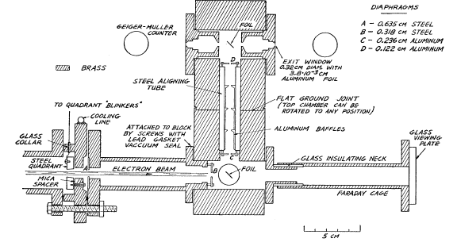
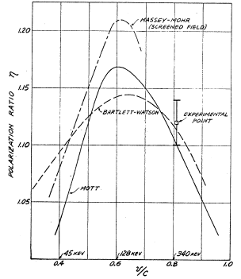
First Mott polarization demonstration

Slide 7
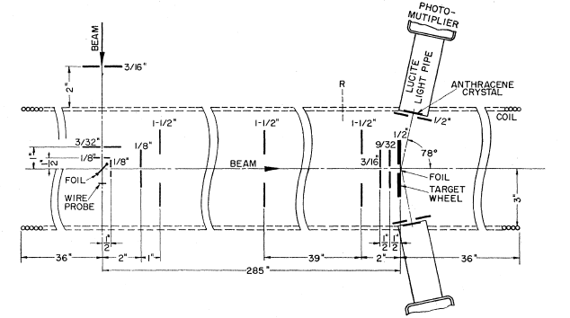
Measurement of free electron g value
420 keV beam energy
from Louisell et al., Phys. Rev. 94, 7 (1954)

Slide 8
First β decay polarization measurement by Mott scattering
Frauenfelder et al., Phys Rev. 106, 386 (‘57)
A very difficult experiment
⁶⁰Co β decay consistent with P = -v/c
Interestingly, they refer to a tensor/scalar interaction, and say their results are consistent with this!
They quickly abandoned Mott in favor of Mφller!

Slide 9
Drawbacks with Mott measurements
Only a single electron is detected
Only transverse polarization can be measured, requiring a polarization rotation for beta decay studies
Plural and multiple scattering in even the thinnest target foils degrade the measured asymmetry, and are not easily calculated
Mott doesn’t work with positrons
These problems led to the introduction of Μφller scattering for beta decay polarimetry

Slide 10
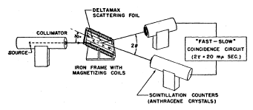
First Mφller polarization measurement
³²P, ¹⁴⁴Pr
From Frauenfelder et al., Phys. Rev. 106, 643 (1957)

Slide 11
Early Mφller PV measurement on ³²P, ⁶⁸Ga, ¹⁹⁸Au, and RaE
The “monochromater” (a solenoid) was employed
to reduce the impact of associated gammas
From Ullman et al., Phys. Rev. 122, 536 (1961)

Slide 12
First “high quality” Mott measurement (on ⁶⁰Co)
Greenberg et al., Phys. Rev. 120, 1393 (‘60)
Carefully assessed the many instrumental asymmetries and depolarizing effects, planned a good apparatus to do the experiment, and did a thorough analysis
Ultimately, Mott scattering became the most widely used tool for studying electron polarization in β decay.

Slide 13
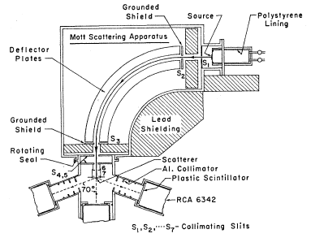
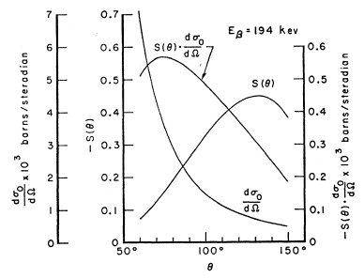
Apparatus and Operating Point
Note the forward scattering
angle used

Slide 14
And there things sat….. until 1974
No need to develop polarimetry at higher energies, as there were no high energy polarized electrons to be had – awaiting the development of a polarized electron source for an accelerator
Mott polarimetry underwent slow but continuous development, with increased understanding of the importance of inelasticity, multiple/plural scattering, etc.
Mφller polarimetry was static – easily magnetized foils at 20º to the beam and coincidence detection

Slide 15
1974 was a big year for polarized electrons
A source based on photoionization of ⁶Li, developed at Yale, delivering ~ 10⁹ electrons per pulse with ~ 80% polarization (180 Hz) was installed on the SLAC linac
Polarization from GaAs photocathodes was demonstrated at ETH Zurich
A single arm Mφller polarization measurement of the beam from the Yale source, accelerated to 19.4 GeV, was done

Slide 16
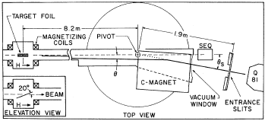
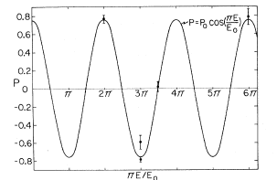
The 1974 Mφller Experiment at SLAC
Coincidence
Mφller polarimeters
were developed
for subsequent
SLAC experiments
on DIS and parity
violation

Slide 17
Transverse polarization in e⁺ - e⁻ storage rings
First observed at Orsay (‘69) and Novosibirsk (‘71) by Touschek (intrabunch Mφller) scattering
Polarization buildup results from synchrotron radiation – strongly energy dependent
Compton is the ONLY choice for rapid storage ring polarization measurements
The potential importance of polarization for e⁺- e⁻ physics, and the possible use of longitudinal polarization in the future, led us to build a Compton polarimeter for SPEAR

Slide 18
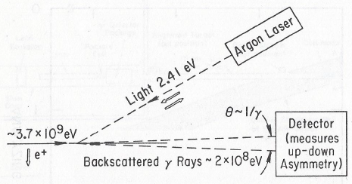
The SPEAR Compton polarimeter

Slide 19
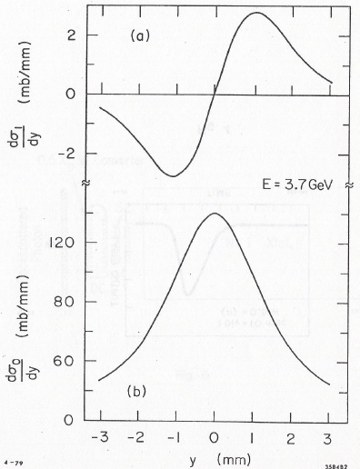
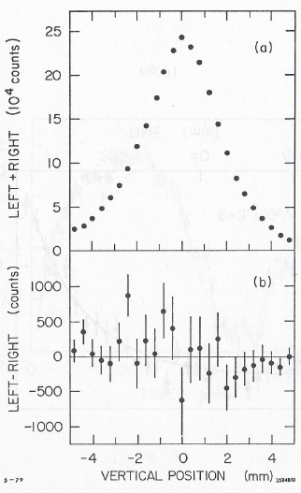
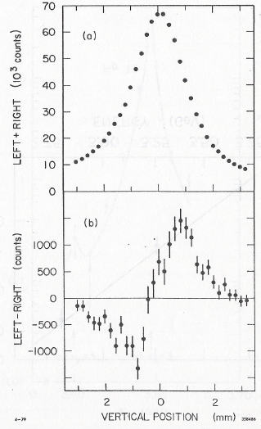
Asymmetry Measurements
2.05 GeV unpol.
measurement
3.7 GeV pol
measurement.
3.7 GeV Theory

Slide 20
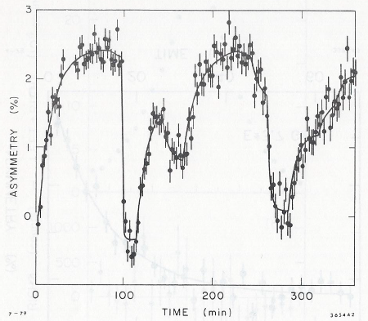
Polarization with energy changes
P_{max} = 92.4%
P(t) = ((8√3)/15)(1 – e^{-t/Tpol})
1/T_{pol} = (5√3)/8(e²hγ⁵/2πm²c²ρ³)

Slide 21
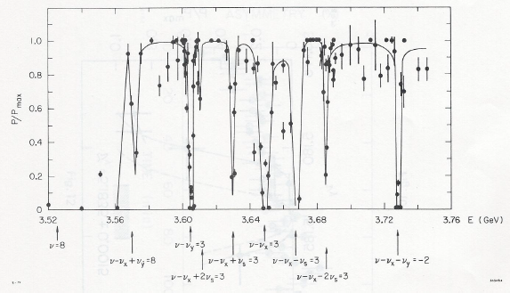
Polarization scan vs.energy shows complex depolarizing phenomena

Slide 22
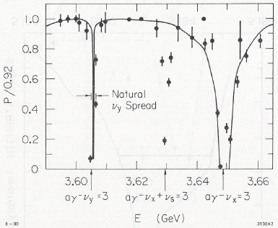
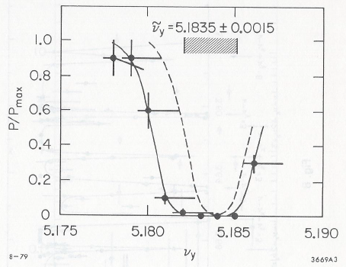
Use knowledge of depolarizing resonances for precision energy measurement
Gives E = 3.6061 +/- 0.0007 GeV

Slide 23
e⁺ - e⁻ storage ring polarization
Ultimately, Compton polarimeters were built at many storage rings after SPEAR
Transverse polarization was observed in all rings where it was looked for – even in LEP at 60.6 GeV
The sole application of polarimetry in e⁺ - e⁻ storage rings has been for precision energy measurement – no use of transverse polarization has been made in physics measurements

Slide 24
Another long dry spell, into the mid-90s
GaAs polarized sources were added to almost all research electron accelerators
All experiments used Mφller polarimeters of conventional design – i.e. supermendur foils at 20º and primarily coincidence electron detection. Some measured transverse polarization as well as longitudinal.
The advent of Jlab, with polarization in all three halls and mutiple polarimeters, led to a renaissance in the development of all three polarimeters

Slide 25
JLab Polarimetry Advances
Mott polarimeter extended to MeV beam energies
Μφller polarimeter adopted pure iron target, perpendicular to the beam (hard magnetization)
Optical storage cavity at 1.06 μm makes a Compton polarimeter practical at Jlab’s low beam currents

Slide 26
Advantages of MeV Mott
RF structure of the beam current allows rapid, high precision position and current measurement
Precision beam profile measurements on the target foil possible with OTR
High energy allows a large range of target thickness
High current makes use of different Z’s OK
TOF greatly aids background reduction

Slide 27
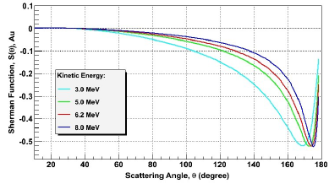
Sherman function at Mev energies
172.6º

Slide 28
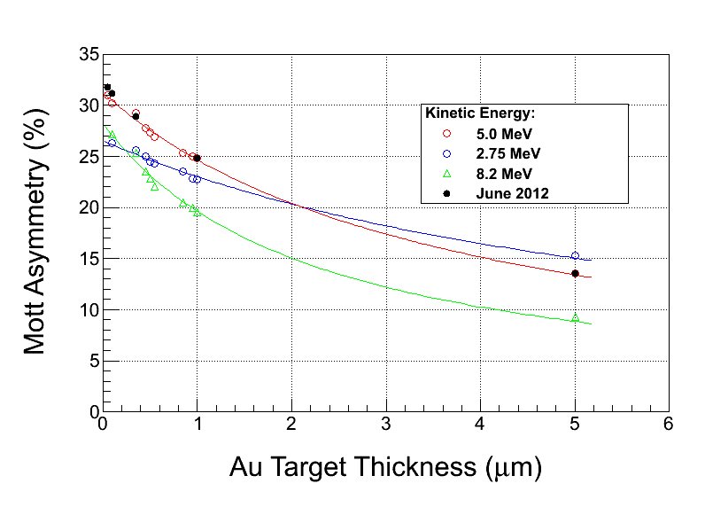
Mott measurements in 2001, 2012

Slide 29
Current MeV Mott status
GEANT4 simulations of full polarimeter underway
TOF improvements make it highly likely that we can assure that any detected electron originated from the target foil
Detailed experiments planned for late 2013
Experimental status justifies a concerted effort to understand and bound the theoretical uncertainties in the calculated Sherman function

Slide 30
Mφller polarimeter characteristics
Energy independent analyzing power for 90º scattering of ~ 8% for alloy foils at 20º to beam
Large cross section permits rapid measurement
Coincidence detection is natural, and greatly reduces Mott background
Levchuk effect broadens scattered distributions, requiring expanded acceptance
Separating incident beam and scattered e⁻ becomes difficult at higher energies

Slide 31
Mφller situation in mid-1990s
Recognition of the Levchuk effect in 1994 cast doubt on previous Mφller measurements, and affected the design of future polarimeters
Uncertain polarization in Supermendur (alloy of Fe-Co-V) foils was the dominant systematic uncertainty
Beam heating effects in the target added to the polarization uncertainty or limited the maximum beam current

Slide 32
Improved precision Mφller
Change target to pure iron foil at normal incidence to the beam
Requires moderate field (~ 4 T) to saturate, where electron polarization is known with good (~ 0.25%) precision
Expand acceptance to reduce Levchuk effect
Reduce uncertainty from heating effects by Kerr effect measurements, or by artificially limiting the duty factor with pulsed or rastered beam

Slide 33
Improved precision Mφller, cont’d.
Proposal to use ~ 100% polarized atomic hydrogen to provide a near perfect and non-intercepting Mφller target
Many potential advantages, but requires development and tests of major equipment
?? Can optically pumped He 2³S metastables be used instead of atomic hydrogen?
?? Can optical chopper at injector replace raster or pulsed beam? (easily verified with injector Mott measurement)

Slide 34
Compton polarimeter characteristics
Analyzing power depends on beam and scattered electron energy, better at higher energy
Low cross section results in long measurement times
Systematic studies difficult due to long measurement times
Electron beam setup, halo have been problematic
Coincidence detection is natural
532 nm is shortest practical wavelength?

Slide 35
“Best” polarimeter performance at present time
5 MeV Mott, ~ 1%, completely dominated by Sherman function uncertainty
Hall C Mφller with saturated iron target and low current, < 0.5%, dominated by Levchuk effect and target polarization uncertainties
Hall A Compton achieved 1% in Happex I, better with 532 nm

Slide 36
“Spin Dance” polarimeter comparison
There is essentially NO beam depolarization from the photocathode source to the end of the full five-pass CEBAF accelerator at 6 GeV
Spin can be rotated through +/- 110º with the injector Wien filter, allowing more than a full 180º cycle of polarization to each polarimeter
These measurements provide an excellent comparison of expected systematic effects for each polarimeter, and could be repeated with the now improved 12 GeV polarimeters

Slide 37
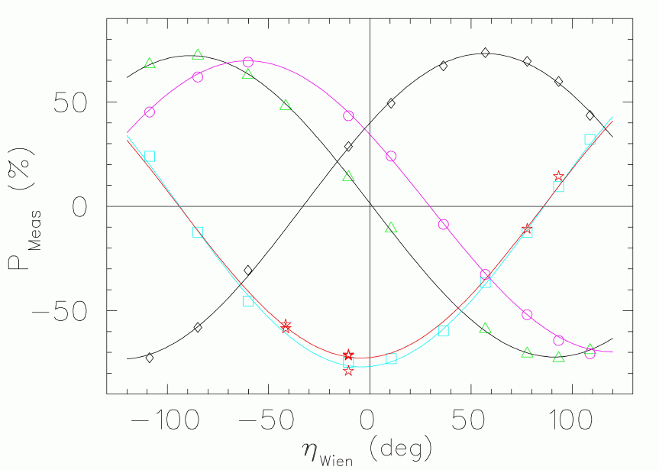
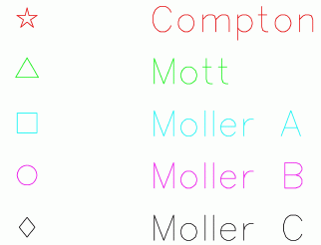
Spin Dance results

Slide 38
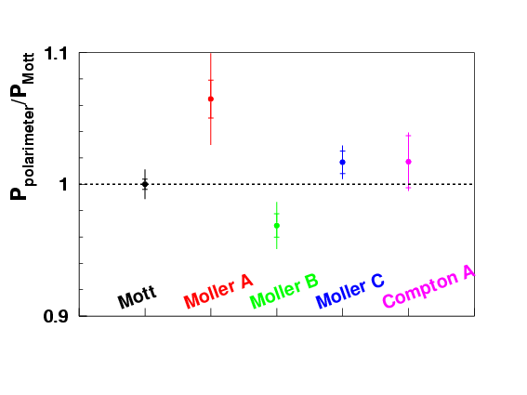
First polarimeter intercomparison

Slide 39
Summary of an “Overview”???
All three types of polarimeters are poised for significant advances in the 12 GeV era
A new spin dance should be conducted when all polarimeters are ready
Reduced theoretical uncertainty of the Sherman function in the MeV range should be pursued
Are there other improvements lurking out there?? e.g. optical chopping at injector, possible use of He metastables for Mφller, etc.

