Slide 1


Long term performance of the COSY/Jülich polarized ion source
September 13, 2013 | Ralf Gebel
Institute for Nuclear Physics (IKP-4/COSY)
Jülich Centre for Hadron Physics (JCHP)

Slide 2
Outline
Introduction
Status
Performance milestones
Details and current investigations
Outlook

Slide 3
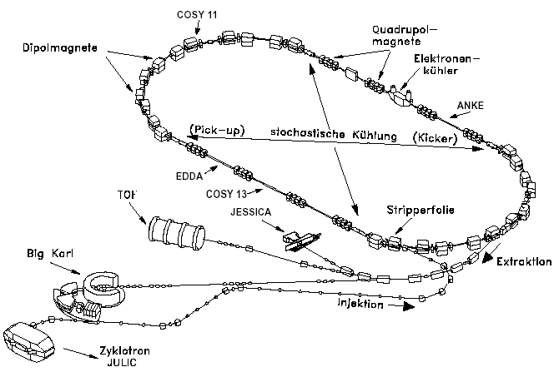
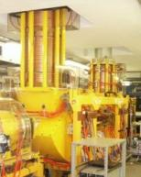
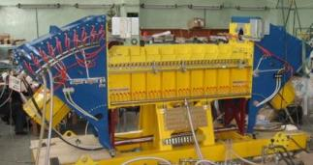
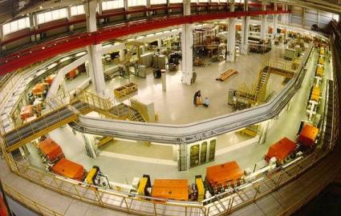
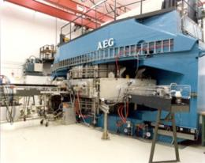
Introduction: COSY
Cooler and storage ring for (polarized) protons and deuterons
p = 0.3 – 3.7 GeV/c
Phase space
cooled internal &
extracted beams
COSY
e-Cooler(s*)
Injector
cyclotron
(*) The 2 MeV e-cooler has been installed in 2013
… and soon a superconducting snake: 1m, 5 T, full ramp in 30 s

Slide 4

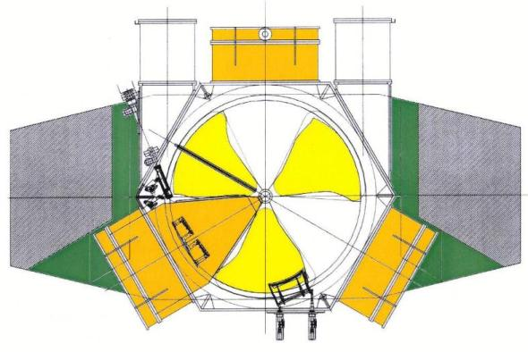
Introduction: COSY‘s Injector
AEG design
Request for quote: 1961
First internal beam: 1968
Upgrade for COSY: 1990
Pole diameter 3.3 m / 700 t iron
<B>_{max} =1.35 T B_{hill} = 1.97 T
20 – 30 MHz (h=3)
22.5-45 MeV/A
2-4.5 keV/A injection
3 ion sources (2 multicusp +pol. CBS)
routinely 45 MeV H⁻ and 75 MeV D⁻ for COSY
with 20 ms stripping injection/cycle
AEG cyclotron

Slide 5
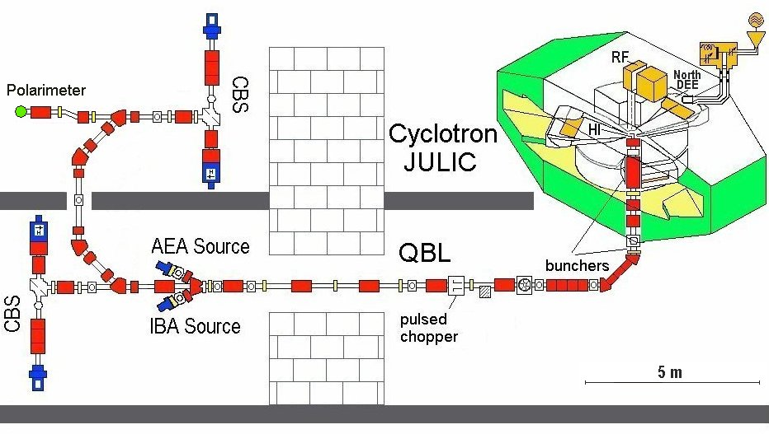
Ion Sources at the Injector Cyclotron
Injection energy: 4.5 +/- 0.02 keV/u
Acceptance: 150 µm rad
Transmission: <0.1
Lamb shift
Wien filter

Slide 6
Status: COSY and Cyclotron Operation
accumulated hours
Availability (Up time) of the injector cyclotron
Distribution of beam species

Slide 7
Status: Statistics 2000 –2012
 | Protons | Deuterons | pol. Protons | pol. Deuterons
beam hours
since 2000 | 52800 | 6600 | 23000 | 11700
 | 56% | 7% | 24% | 12%
sum | ~59400 h |  | ~34700 h
average/ year | 4570 hours/year |  | 2670 hours/year
Delivered beam species
COSY’s availability: > 92% (average)

Slide 8
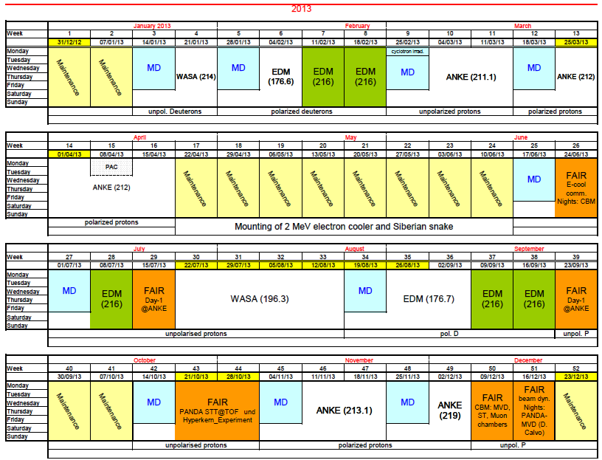

Status: run plan 2013

Slide 9
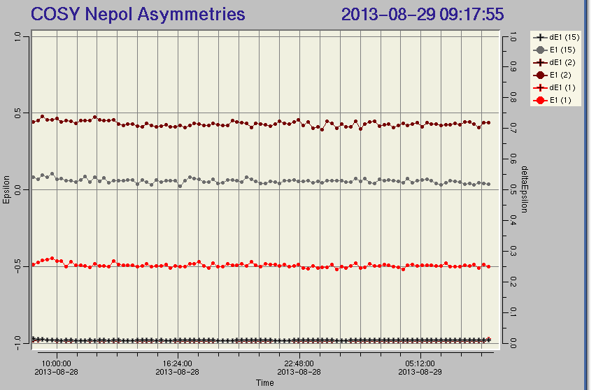
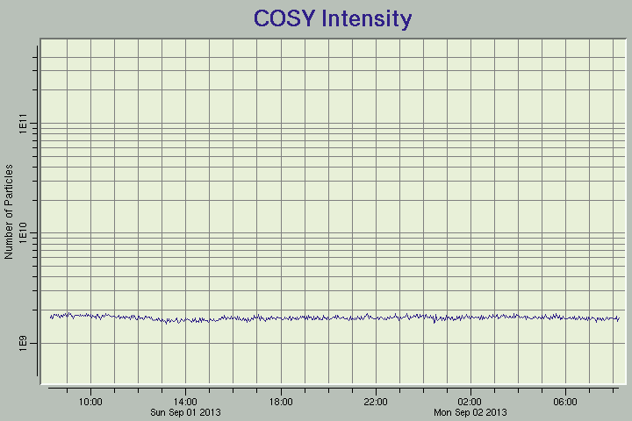
COSY state September 2013:
0.97 GeV/c electron cooled polarized deuterons
left/right asymmetries
number of particles
Polarized sources delivers P_{z}=(+/-/0)

Slide 10
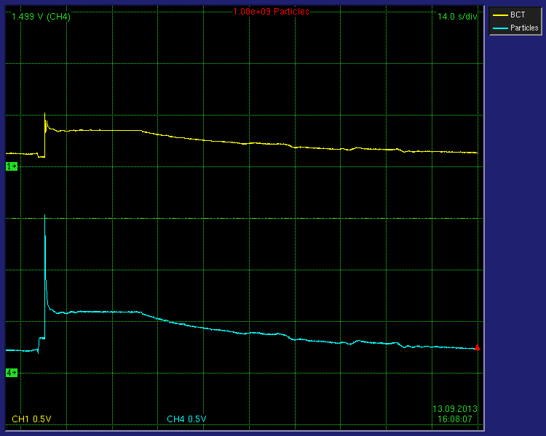
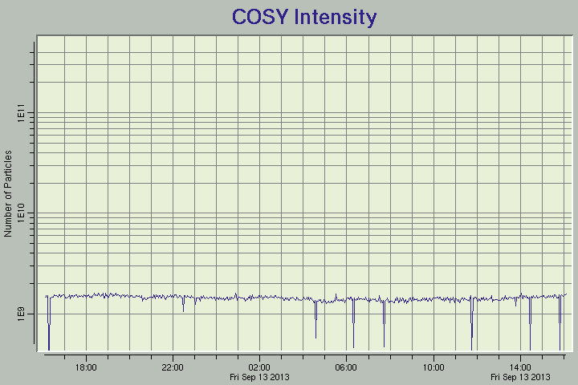
„Current“ COSY state:
0.97 GeV/c electron cooled polarized deuterons
beam current
number of particles
particle number

Slide 11
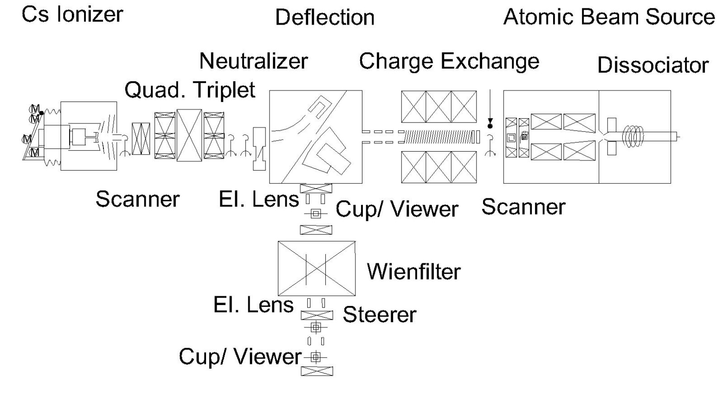
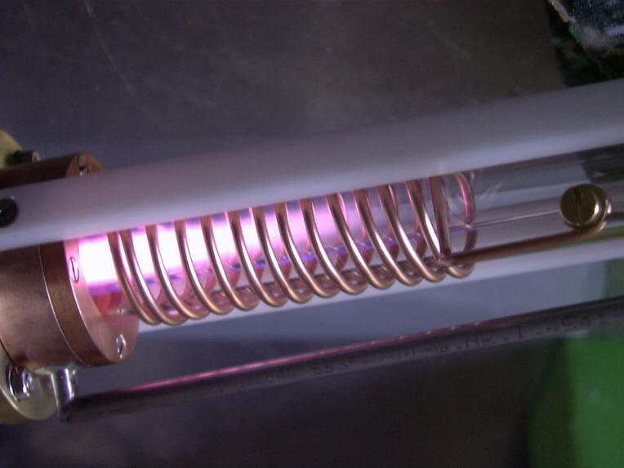
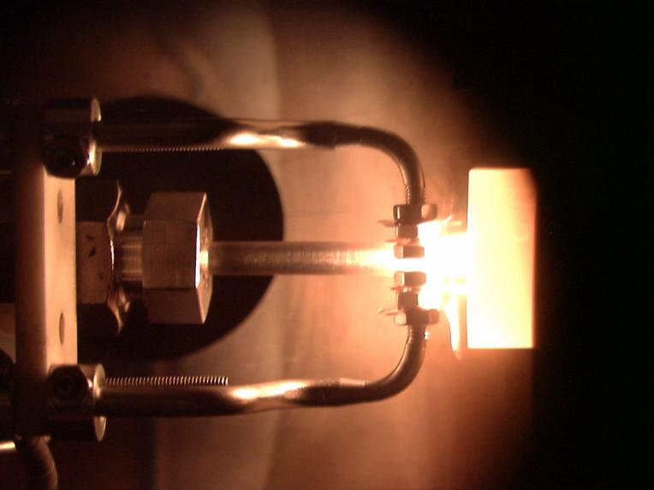
COSY‘s Polarized Ion Source
1150 K
38 K
550 K
Thermal ionizer
RF discharge
Charge exchange reaction
H⁰(D⁰) + Cs⁰ → H⁻(D⁻) + Cs⁺
Ref.: Haeberli , NIM 62(1968)

Slide 12
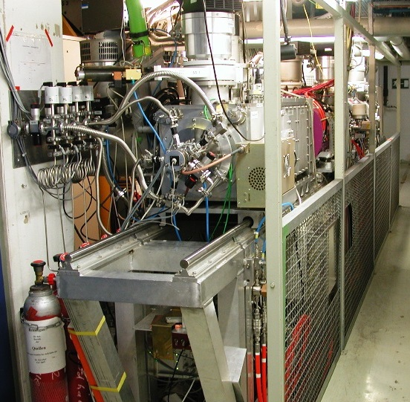
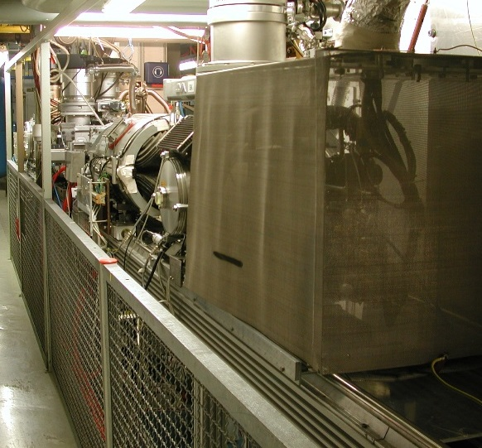
COSY‘s Polarized Ion Source
About 6 m from the pulsed ABS to the Cs ionizer

Slide 13
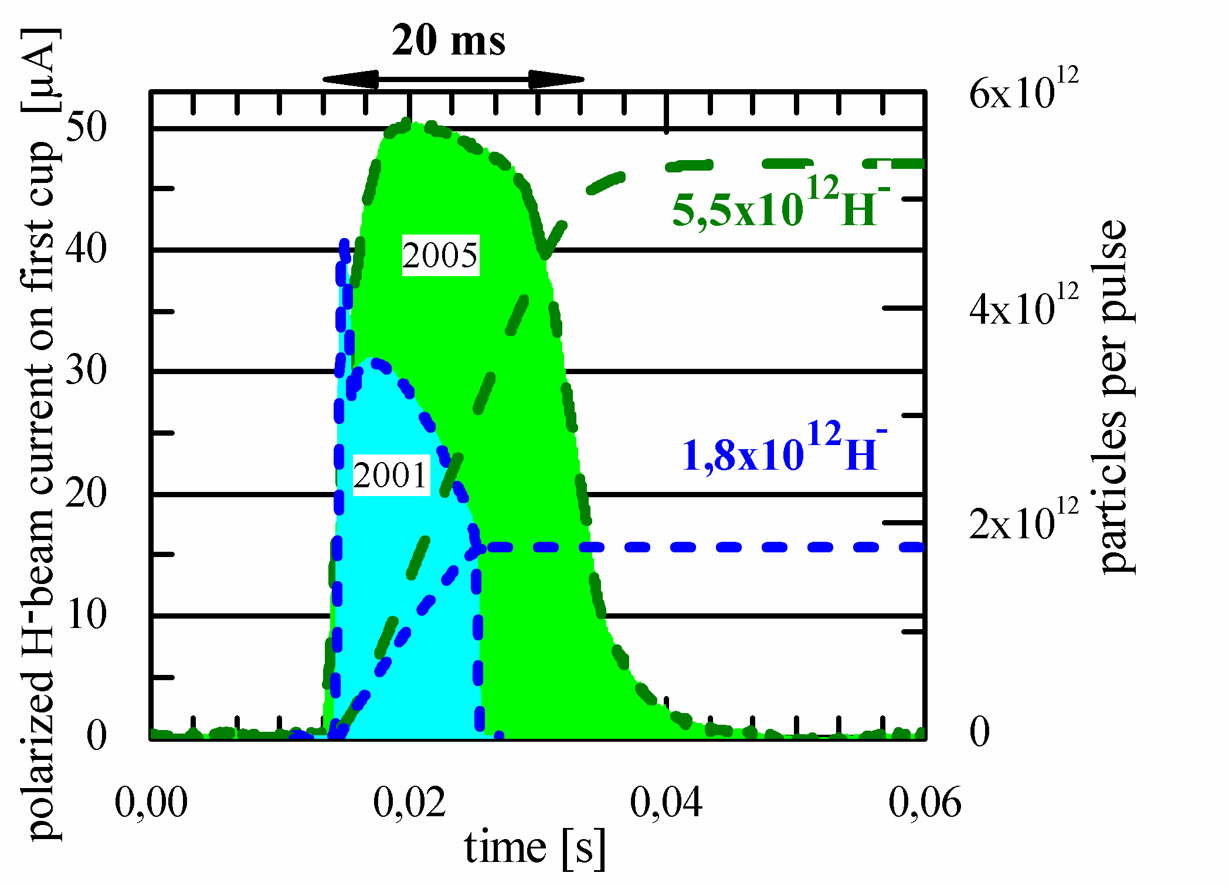
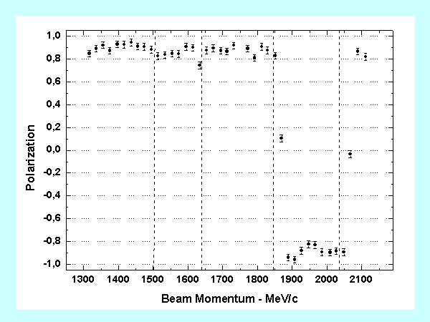
Performance (Reference values 1)
P_{avg} = (91.4 ± 2.2 ) %
Data from Exp. EDDA
(pp – elastic scattering)
Beam current at the source exit*
*compare to routine COSY fill of a few 10¹⁰ protons or deuterons
(space charge limit of about 10¹¹)
Polarization inside COSY

Slide 14
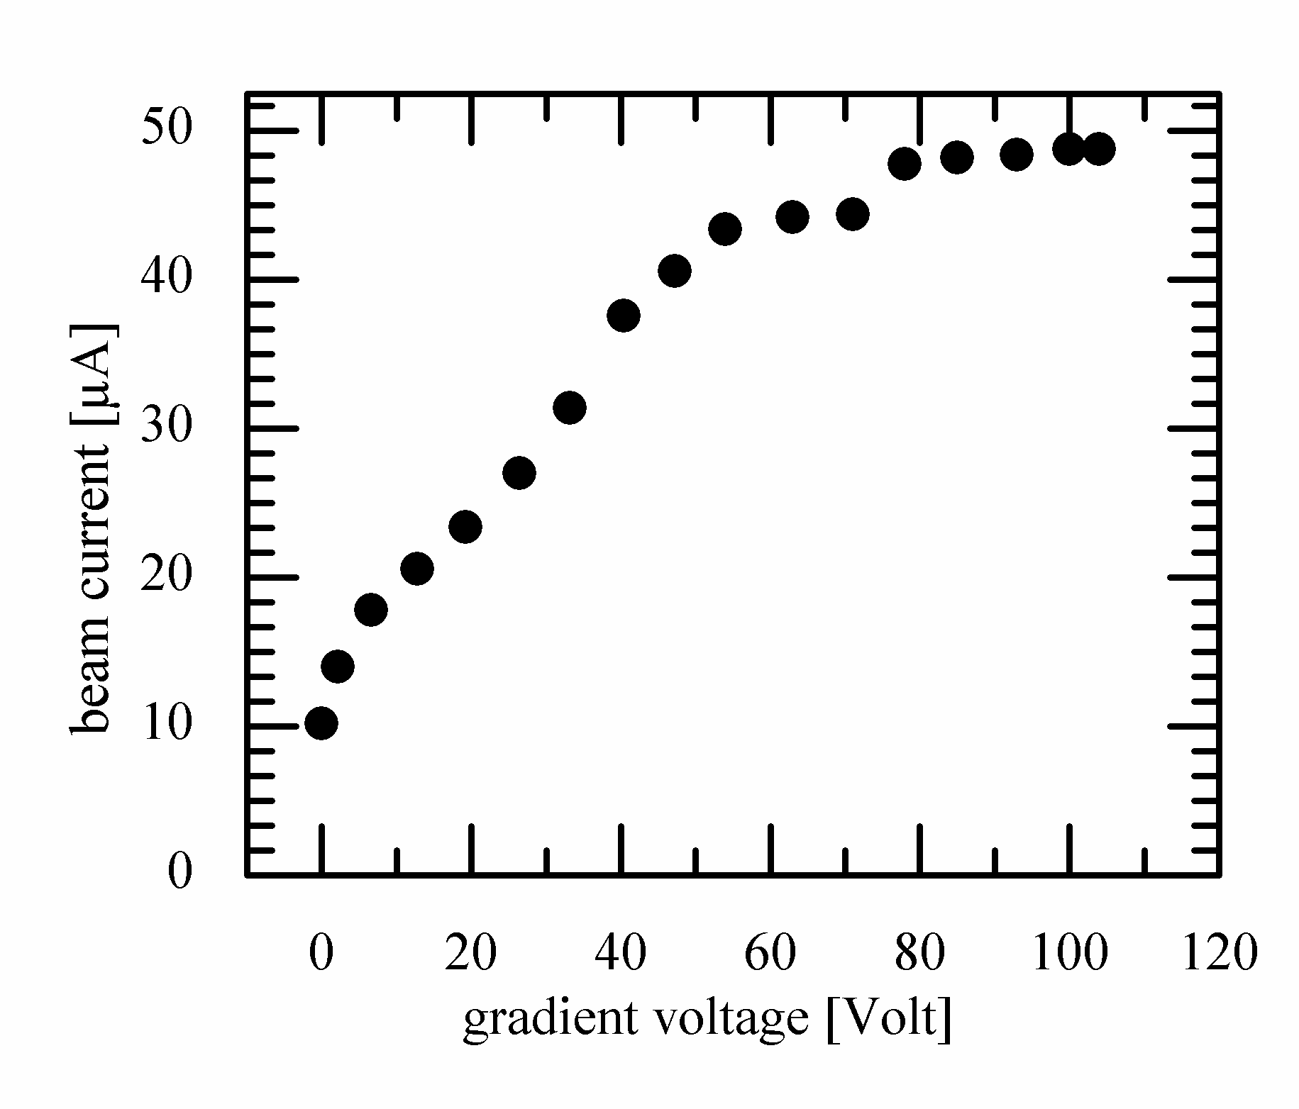
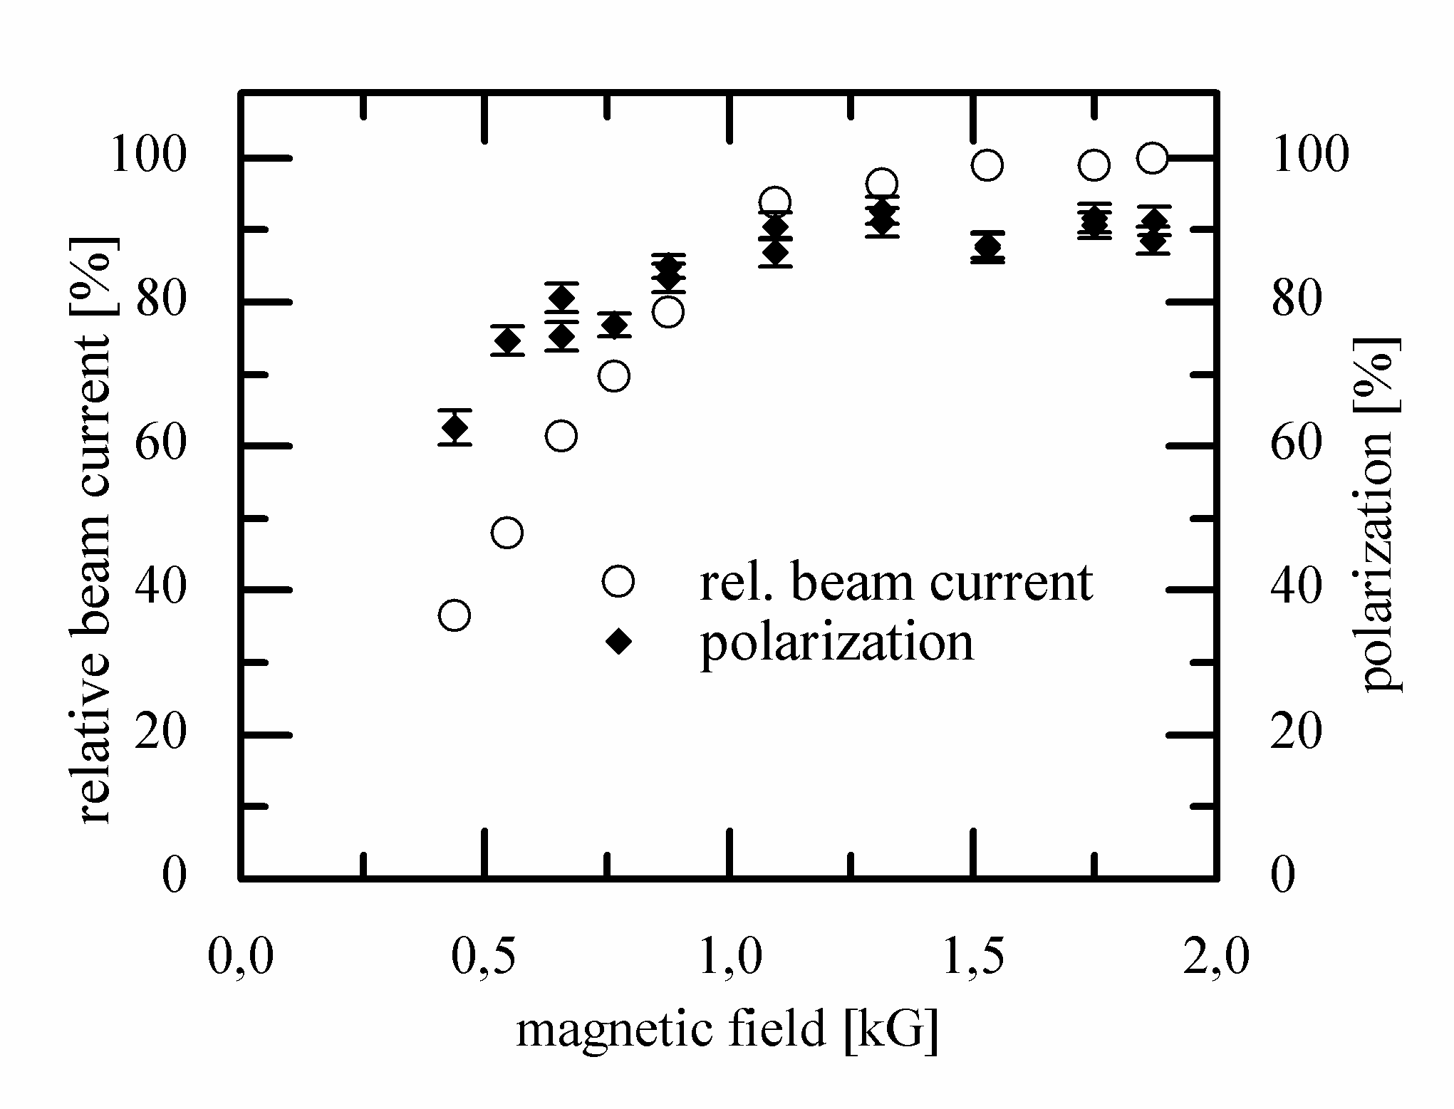
Performance (Reference values 2)
With 6 pmA Cs @ 50 kV
Gradient voltage -> energy spread
High polarization is preferred
Magnetic field -> emittance growth

Slide 15
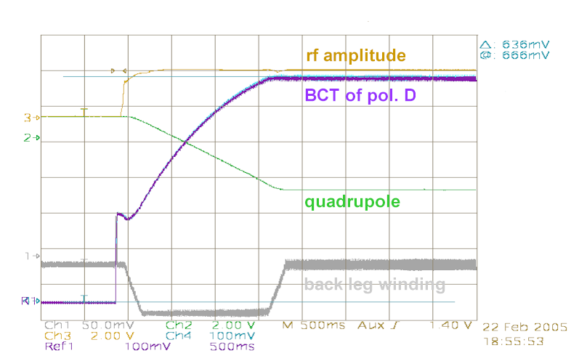
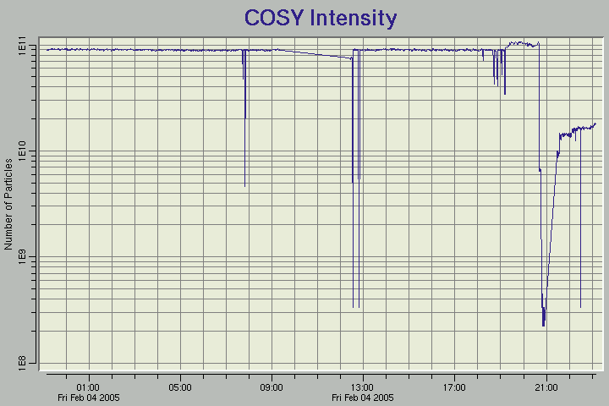
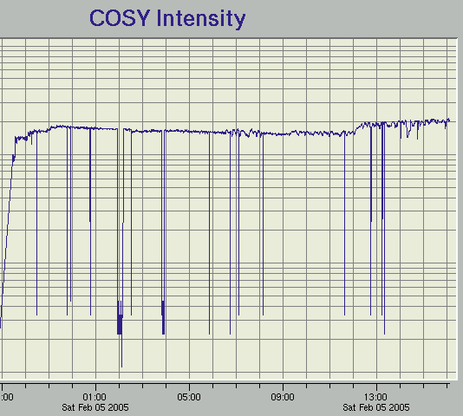
Performance (Reference values 3)
best values for COSY:
35 mA unpol. D and 6 mA pol. D
unpolarized deuterons
switching to polarized deuterons

Slide 16
Performance Milestones
1993 Installation
1994 ABS: Pulsed operation
Cs Ionizer: Prototype replacement
1998 ABS: PM sextupoles
Cs dispenser; electron beam heating
2000 Pulsed Cs Ionizer
first routine operation for COSY experiments
2001 H⁻ extraction with EM-dipole
D⁻ extraction with PM-EM-dipole
2003 routine D⁻ operation for COSY
ABS: Pulsed mode optimization (with A.S.Belov)
2007 Polarimeter improvements
        Breit Rabi
        Lambshift
        45 MeV
2012 New Cs dispenser generation for ionizer
Laser applications

Slide 17
Keep Performance
Identify and replace weak components
Get spares (build or inherit (EDDA ABT))
  Dissociators (> 4 + prototypes)
  Transition units (9 + spare cavities)
  Cs ionizers (3 + 6 ovens + N W-ionizer)
  Neutralizers (3 cells, > 3 oven units, …)
  …
Improved diagnostics (Viewer,Polarimeter,…)
Test facilities
New cleaning methods

Slide 18
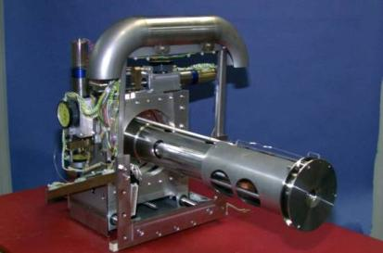
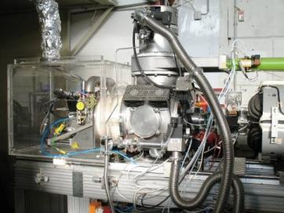
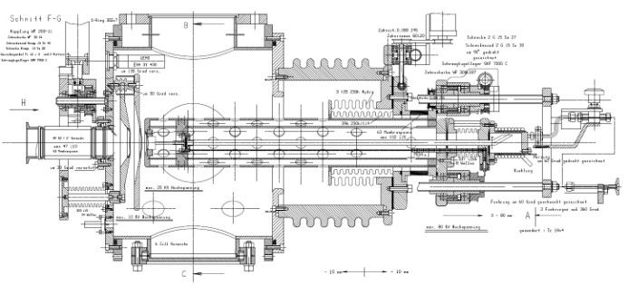
Cs Ionizer development
DC version (2 prototypes)
Version 2 features
Reservoir under vacuum
Short transfer line
Improved positioning
Pulsed version (3 identical inserts)
with separation
of heater and reservoir
FZJ made tungsten ionizer
Electron beam heating
Prototype 1
1 of 3 Cs ionizers, and within the external test facility

Slide 19
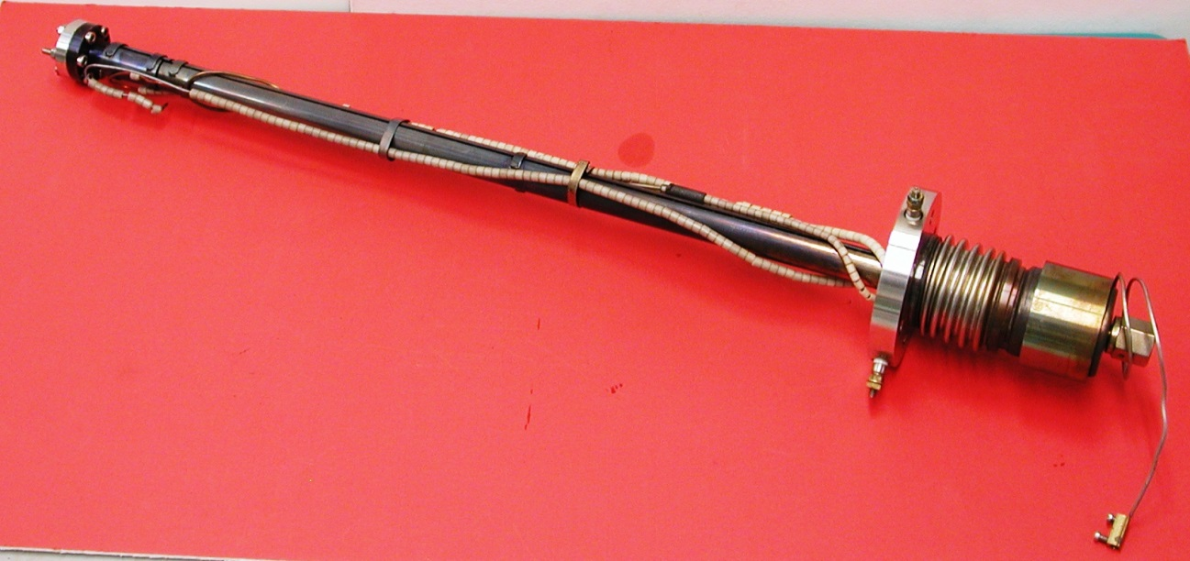

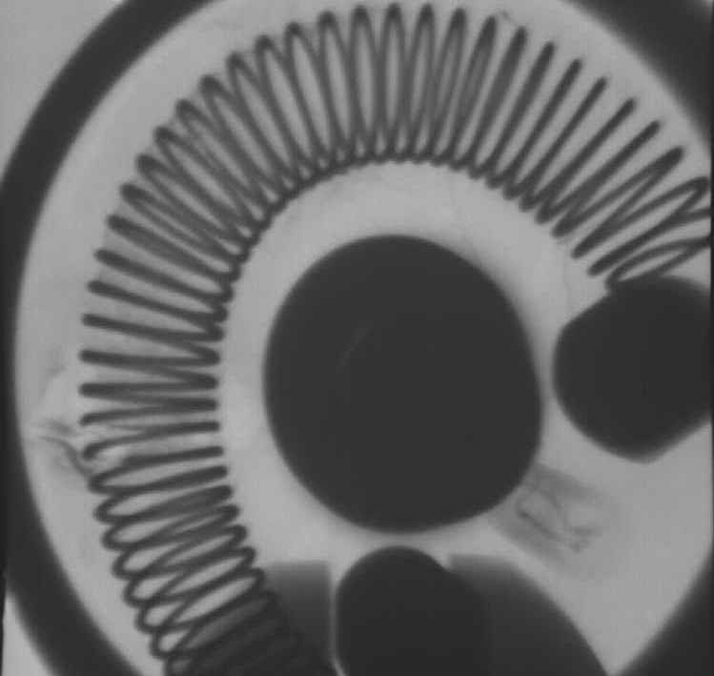
Prototype replacement (cw)
External oven
Resistively heated dispenser
Long heated transfer tube
Heater failure
S. Lemaitre’s and R. Reckenfelderbäumer’s Ph.D. theses
NIM A 408, 345 (1998)

Slide 20
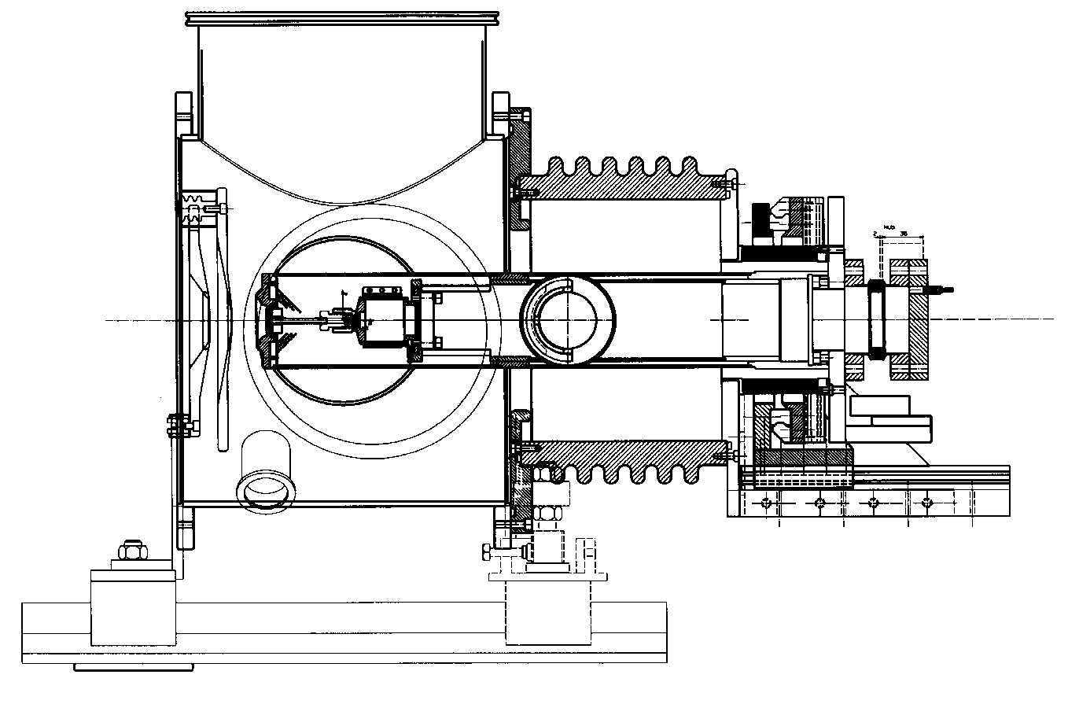
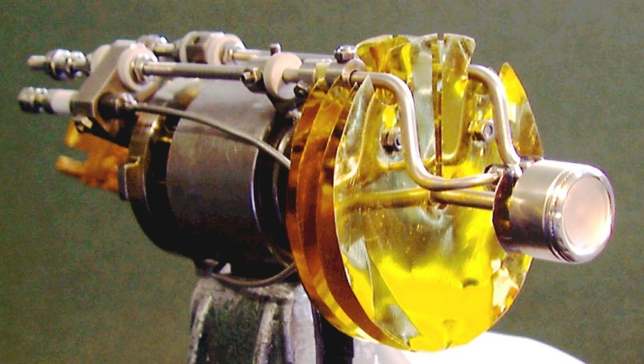
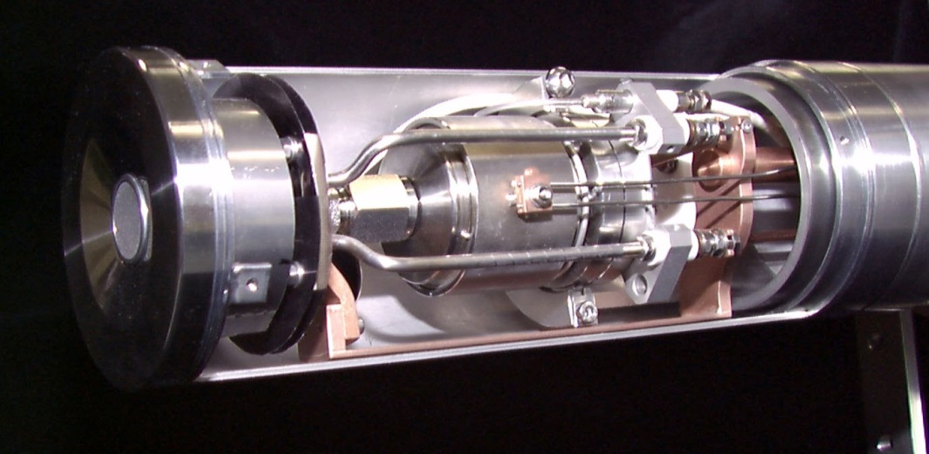
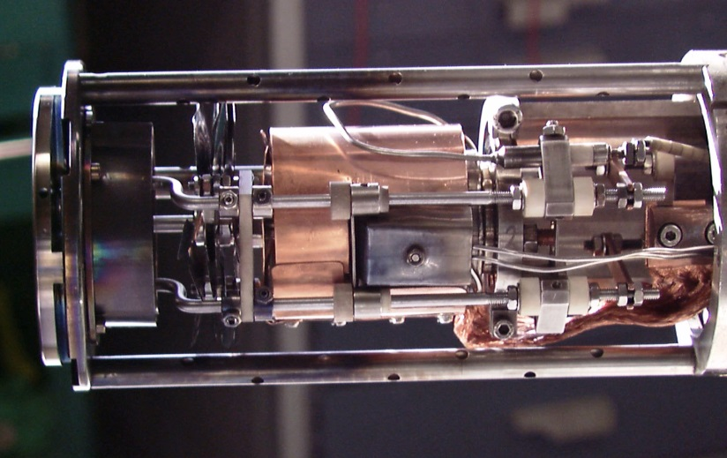
Intermediate Cs Ionizers
Electron beam heated, improved thermal design

Slide 21
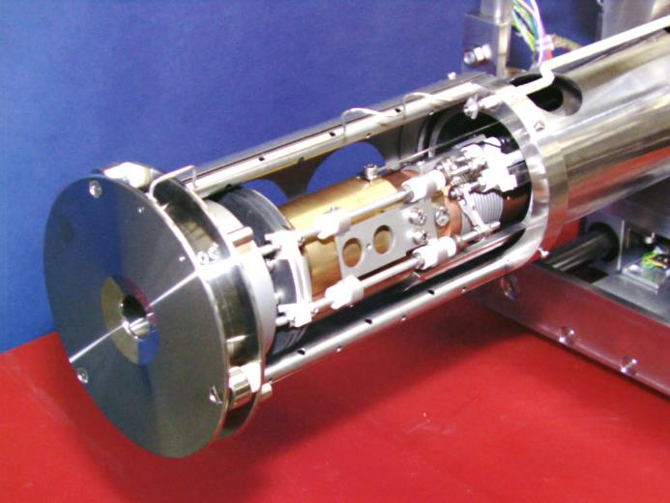
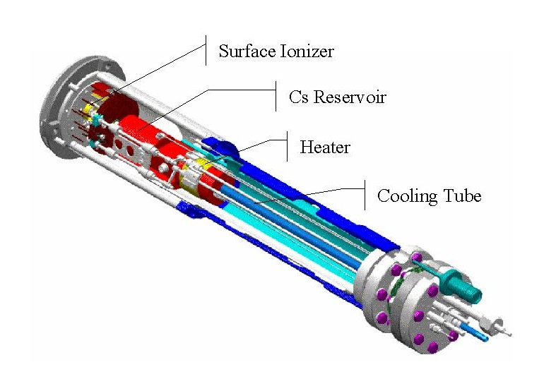
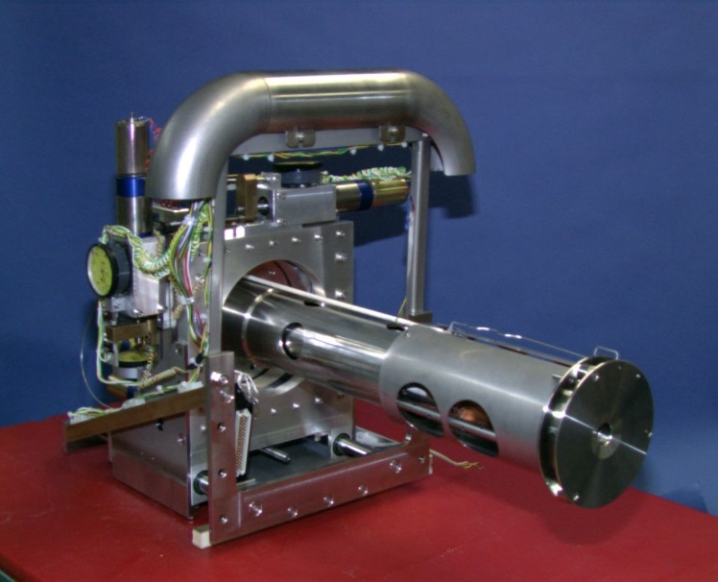
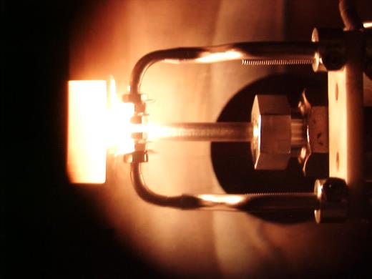
Current: pulsed Ionizer

Slide 22
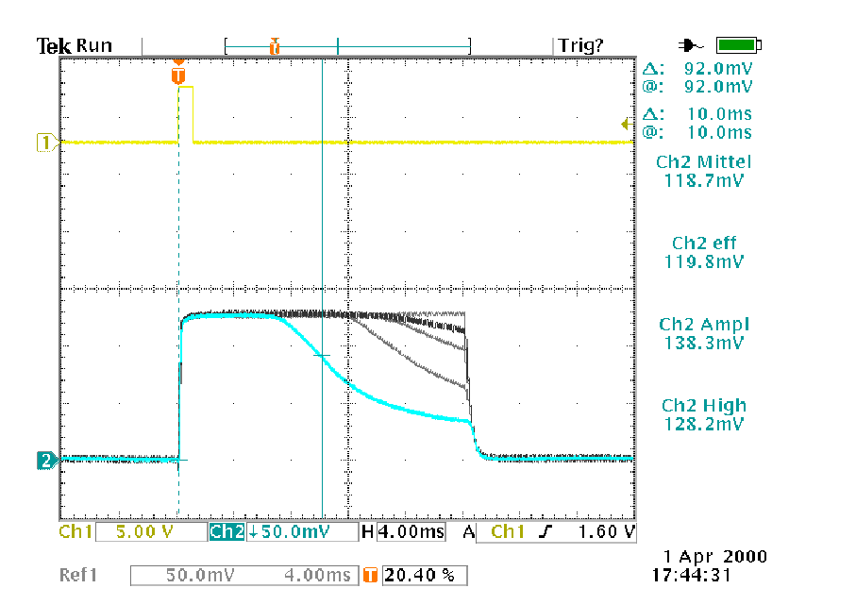
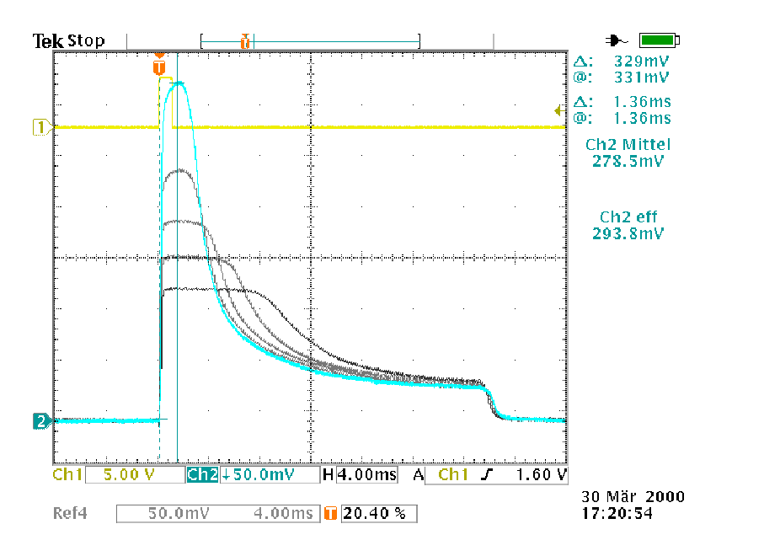
Examples for Cs⁺ pulses
12
-7.5 kV
-7 kV
8
-6 kV
mA
-5 kV
65°C
4
-4 kV
5.5 mA
60°C
55°C
20 ms
0

Slide 23
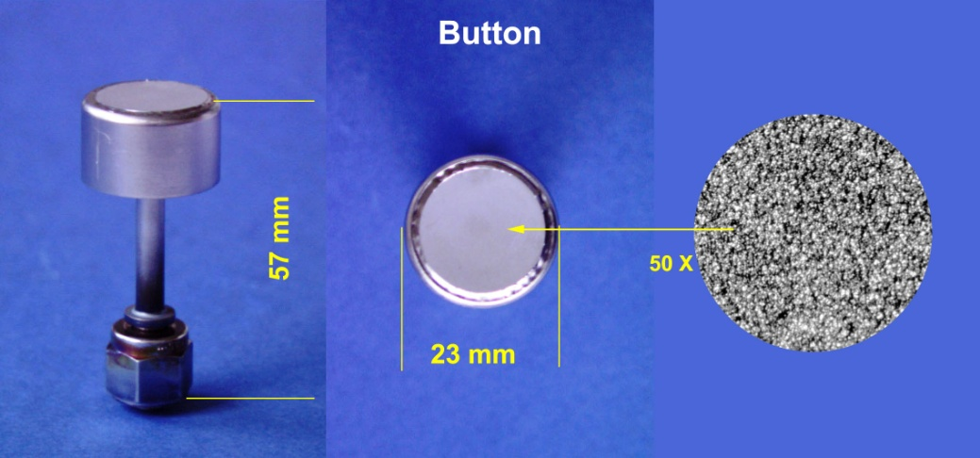
FZJ made Tungsten Ionizer
Similar to dispenser cathode for electron guns, but with:
Electron beam welded permeable tungsten - molybdenum (TZM) connection
Capability to allow >200 W heating to over 1100°C (e.g. for conditioning)
Optional special shaping of the emitter surface by spark erosion
Quality control and assurance of all production steps
Experienced Issues, with consequences for reproducibility and performance:
Porosity variation, contamination, surface quality, cracks, welding quality….
> 100 samples tested
New, improved samples available!

Slide 24
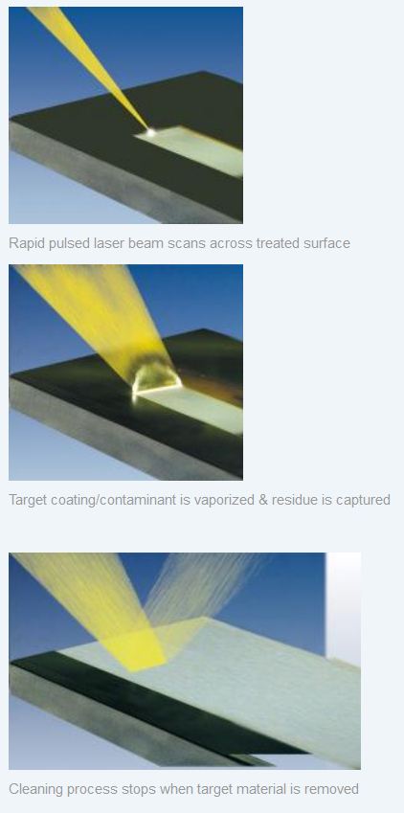

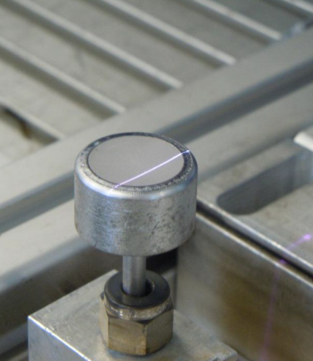
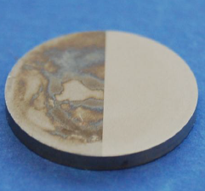
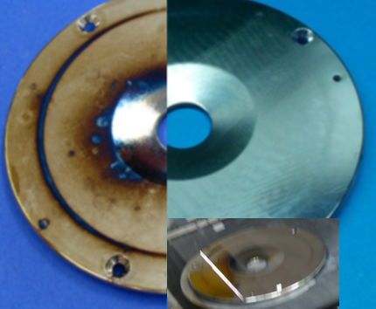
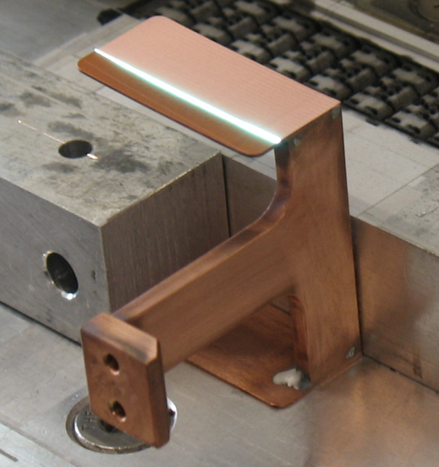
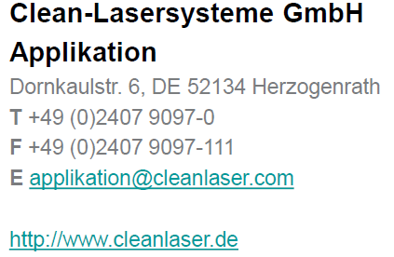
Successful Recovery with IR Laser
Application samples:
Tungsten, Mo, Ti, Steel …
Speed: up to several cm²/s
Cs Ionizer
Treated dispensers behave unused!
Cs Extraction
20 mm
From RF Transition

Slide 25
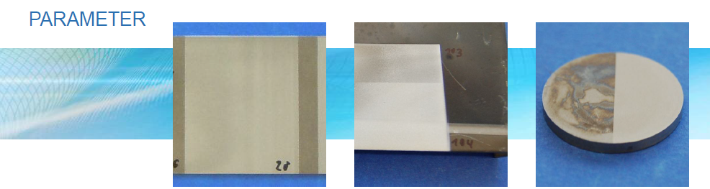

Micro second laser cleaning
Parameter studies
Parameter | P20 (Titan) | P103 / P104 (SS) | Probe 3 (W)
Puls frequency / kHz | 200 | 110 200 (2x) | 110
velocity area rate / cm²/s | 6,4 | 1,9 (1x) 1,0 (2x) | 2,5

Slide 26
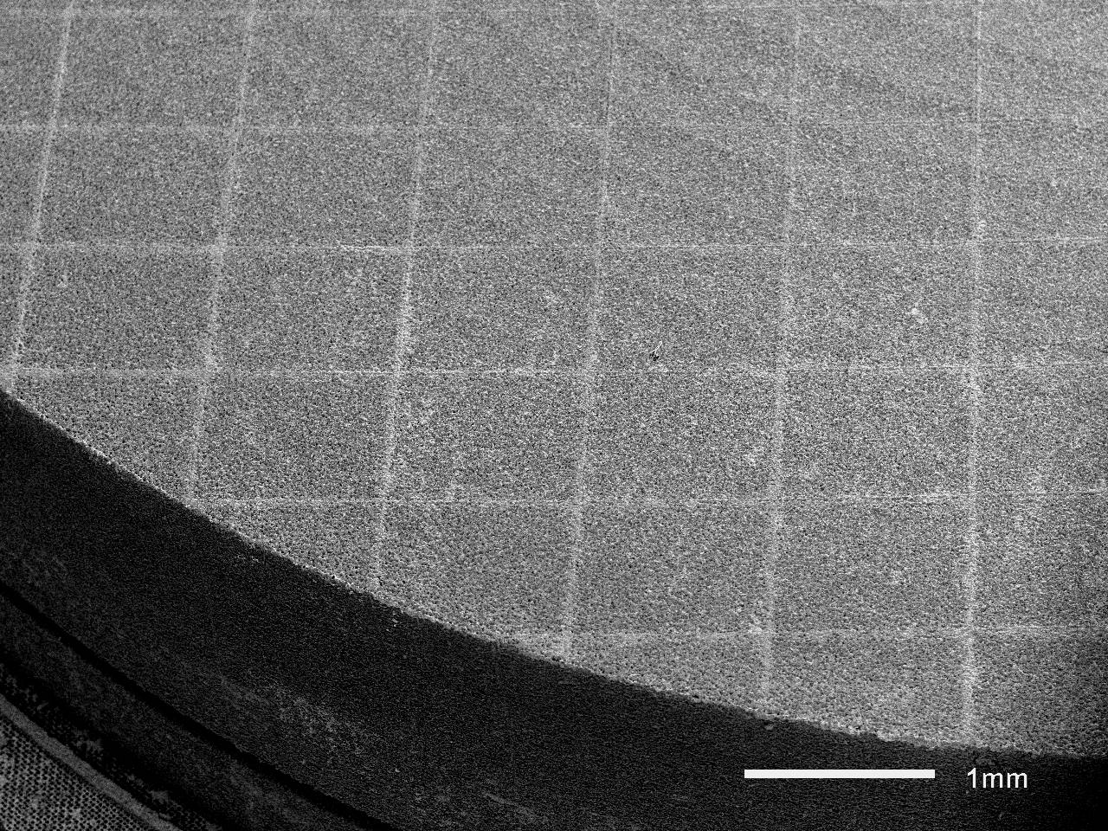
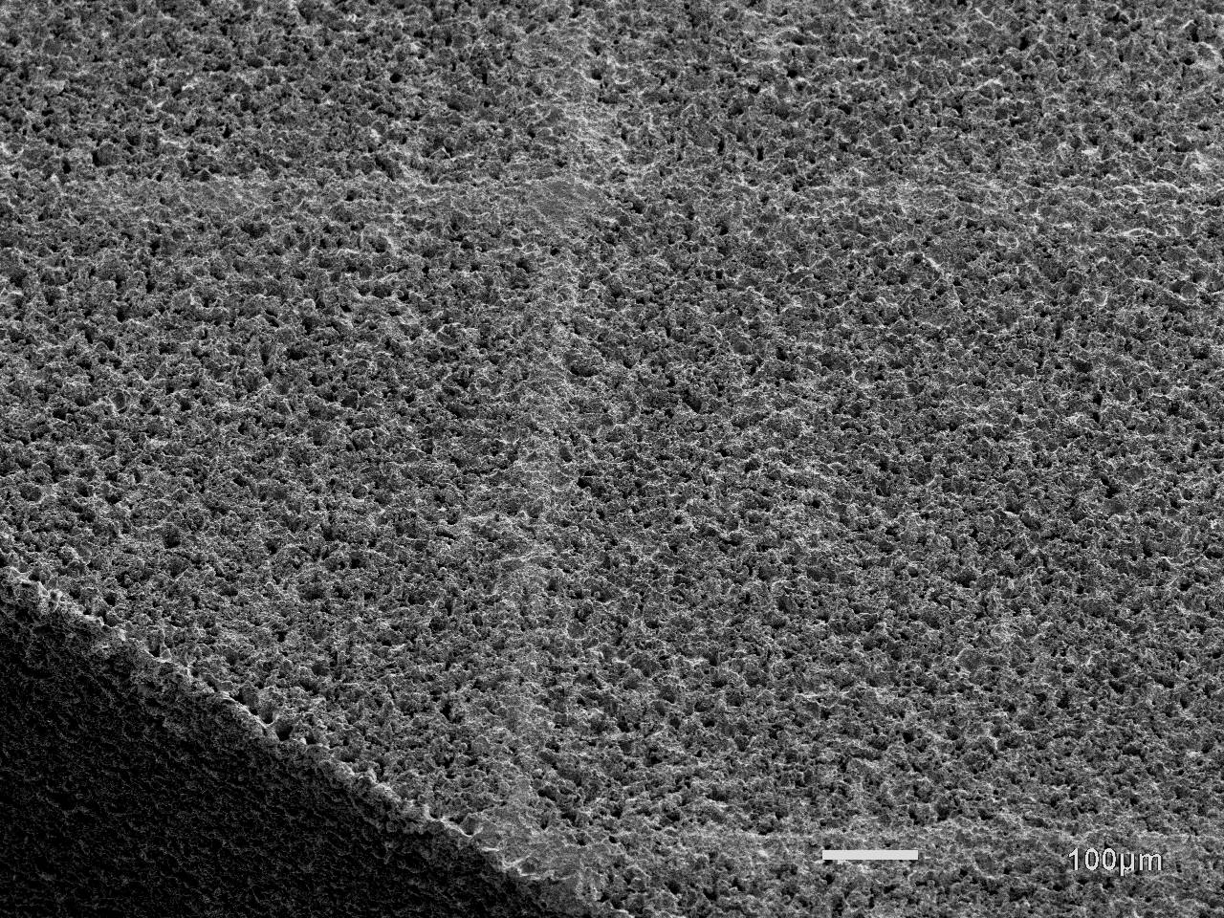
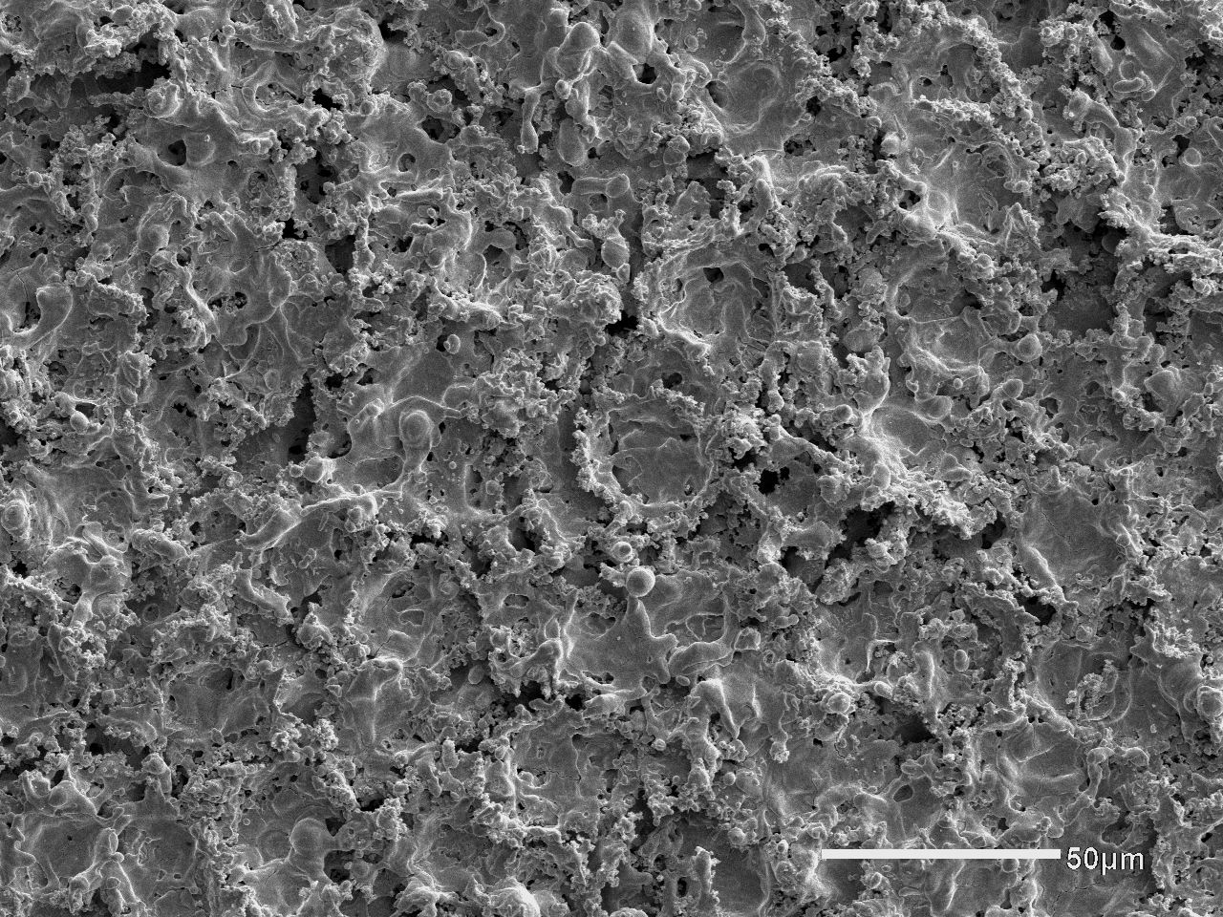
Femtosecond laser micro sintering
Tungsten dispenser disks:
sintered to desired shape and and density
sample disks arrived at FZJ: promising …
R. Ebert et al., University of Applied Science, Laser Institute, 17 Technikumplatz, 09648 Mittweida, Germany;
Laser Processing of Tungsten Powder with Femtosecond Laser Radiation
Proceedings of LPM2010 - the 11th International Symposium on Laser Precision Microfabrication 1

Slide 27






Cs beam diagnostic tools
A set of computer controlled wire scanners
for Cs^{+/o} diagnosis
to judge the beam and the ionizer quality
to optimize Cs^{+/o} transmission
space charge compensation by adding Argon

Slide 28




Source watching

Slide 29
Cs
Cs beam
(deflected on purpose)
Graphite collimator (15 mm)

Slide 30




Neutral Cs beam in the ABS

Slide 31



Neutral Cs beam in the ABS
Cs beam off
(Button glows)
Cs beam on
(check for focusing)
A moveable viewer plate (45 degree) allows quick Cs beam alignment.

Slide 32


Neutralizer
50 mm
Improved geometry
Modular design with
exchangeable flapper unit
Cs reservoir: 45 - 60 g
Exchange interval:
> 2 years (> 5000 hours beam)
Neutralization > 90%
Vapor cell (32° C)
(water, double wall)
Magnetic flapper valve
Shielded Cs oven (278° C)

Slide 33



Replacement of Deflectors
New chamber with
  E-deflector for Cs⁺
  Water cooled EM-PM-Hybrid for H⁻/D⁻
Improved cooling (to trap Cs)

Slide 34

PM sextupoles
EM diameter 220 mm
PM diameter 80 mm
M. Altmeier’s and O. Felden’s Ph.D. theses
NIM A 626, 117 (1997)

Slide 35





ABS: RF Transitions
For Protons:
λ/2 – 1.43 GHz
Q: 800 - 1200
For Deuterons: tuneable!
λ/4 – 0.3 – 0.45 GHz
Q: 800 - 1100

Slide 36




Breit Rabi-Polarimeter
RFT 3 @ 5.65 MHz (H)
RFT 3 @ 5.65 MHz (D)
RFT 2 @ 328 MHz (D)
intensity
intensity
intensity
Magnetic field
Magnetic field
Magnetic field

Slide 37



Lambshift-Polarimeter
Usable for tuning
Double stripping of H⁻/D⁻
Neutralization of p/d
Spin filter

Slide 38




45 MeV Polarimeters
Calibration

Slide 39





45 MeV-Polarimeter (Upgrade)
12 Plastic scintillators (NE110)
More statistics
Similar resolution
Now C and CH2 targets
With CH₂ kinematic dp coincidences
allow fast electronics / 100 MHz
Cross calibration with NaI and C Target
Pol. H⁻ on C target
Pol. D⁻ on CH₂ target

Slide 40



45 MeV Polarimeter
pC elastic
NaI scintillator @ 52.5° (Lab)
Amplifier & TSCA for MHz Counter
Pulse height analysis
Several Carbon targets (C)
Chromox viewer

Slide 41


Monitoring Beam Asymmetries
11 days of deuteron beam
Solenoid reversal
Transition unit retuned

Slide 42

Testbench for Atomic beam parts
Used for offline tests of e.g. transition units
Equipment for neutral beams:
Quadrupole mass spectrometer,
TOF spectrometer,
Compression tubes,
Diaphragms, Chopper, Scanner etc.
For:
Intensity
Density, profiles
Velocity distribution
  cw operation: 4x10¹⁶ (initial CBS)
  Pulsed: 7.5x10¹⁶ (COSY operation)
  Improved: 11x10¹⁶ with spare PM hexapoles (EDDA)

Slide 43



Pulsed ABS development
Optimized design for pulsed operation
Improved performance:
doubles density for free atomic beam
better beam cooling
higher gas flux
up to 3 kW RF power

Slide 44


Outlook
R&D for Hadron Storage Rings
Topics (with FZJ as leading lab)
(polarized) Ion sources for hadron storage rings
  Assure high intensity beams for COSY/JEDI
  Enable experiments at e.g. FAIR with polarized beams
Combined electrostatic and magnetic deflectors
  Search for an electric dipole moment in p, d and He3
High energy beam cooling and broad band stochastic cooling
  Electron cooling up to COSY’s maximum momentum
  Electron cooling for HESR
  Fast stochastic cooling at different energies

Slide 45
Thank you for your attention

