Slide 1
The Dudnikov born in 1943 The man & his deals

Slide 2
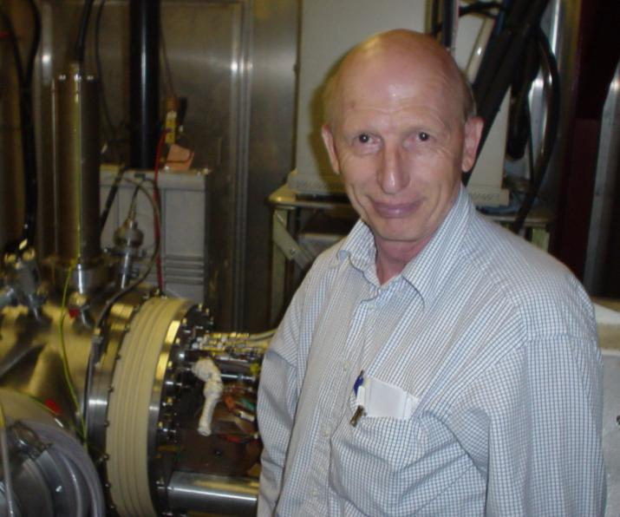
There was the Source at the Beginning
of the Days... Psalm 1 of Bible for believers in Beam
The Man
Notes:
The Man

Slide 3
...And The Deals
--Development of charge-exchange injection for accelerators and storage rings (with G. Budker and G. Dimov), 1966.
--Experimental discovery and explanation of the Cesiation effect of negative ion production in gas discharge ion sources (Russian Patent,1972), and development of Surface Plasma Sources
--Development of Surface Plasma Sources of multi-Amp current and ultra-bright beams of negative ions.
--Proposed using cesiated surface plasma converter for negative ion generation and resonance charge exchange nuclear-polarized atoms in negative hydrogen ions source(1993-95). Realized with A. Belov with record polarized H- ions intensity of 4 mA
--Achieved significant enhancing of positive and negative ions production in RF ion sources by using a saddle type antenna in a divergent magnetic field.
--Discovery of the electron cloud effect and proposal of a damping method.
-Invention of the residual gas ionization and luminescent beam profile monitors (1965),
---Invention of geometrical focusing and charge exchange cooling of negative ions in SPS (1974
-Developed many ion sources and systems for nanolithigraphy and patterned ion implantation, negative ion projection lithography system
-Diagnostics development for fusion plasma. Plasma production experiments in cooperation with Livermore LNL.
-Developed electrohydrodynamic ion emitters of melted metals, alloys and dielectrics. Fabrication of fine focused ion beam for submicron lithography.
-The first in Russia to manufacture and investigate Yttrium HTS.
-Proposal and development of ion beam formation-transportation with neutralization of space charge by negative ions. It improves significantly the intensity of low energy ion beams in implanters and other ion beam technologies(1996-99).
-Developed a new version of ion source for implantation.
-Proposed Beam Brightness Booster with charge exchange injection, space charge compensation and ionization cooling for production of ion beams with brightness above space charge limit (2006).

Slide 4
The Man as a Source and Resource
200 papers published...
EMISSION OF INTENSIVE FLOWS OF NEGATIVE-IONS FROM SURFACES BOMBARDED BY FAST DISCHARGE PARTICLES ,BELCHENK.YI, DIMOV GI, DUDNIKOV VG,: IZVESTIYA AKADEMII NAUK SSSR SERIYA FIZICHESKAYA 37, 12 ,2573-2577, 1973
FORMATION OF NEGATIVE-IONS IN GAS-DISCHARGE Author(s): BELCHENK.YI, DIMOV GI, DUDNIKOV VG, et al. Source: DOKLADY AKADEMII NAUK SSSR Volume: 213 Issue: 6 Pages: 1283-1285 Published: 1973;
PRODUCTION OF AN INTENSIVE BEAM OF H- IONS FROM DISCHARGE IN CROSSED FIELDS Author(s): BELCHENK.YI, DIMOV GI, DUDNIKOV VG Source: ZHURNAL TEKHNICHESKOI FIZIKI Volume: 43 Issue: 8 Pages: 1720-1725 Published: 1973;
SURFACE-PLASMA SOURCE OF NEGATIVE-IONS , BELCHENKO YI, DIMOV GI, DUDNIKOV VG , ZHURNAL TEKHNICHESKOI FIZIKI, 45, 1, 68-73, 1975;
Y. Belchenko and V. Dudnikov, “Surface negative ion production in ion sources,” in Production and Application of Light Negative Ions, 4thEuropean Workshop, edited by W. Graham (Belfast University, Belfast, 1991), pp. 47–66;
V. Dudnikov, Proc. Second Symp. Production and Neutralization of Negative Hydrogen Ions and Beams, Brookhaven, 1980 (BNL, Upton, NY, 1980), BNL- 51304, p. 137;
NEGATIVE-ION SURFACE-PLASMA SOURCE DEVELOPMENT FOR FUSION IN NOVOSIBIRSK BELCHENKO YI, DIMOV GI, DUDNIKOV VG, et al. Source: REVUE DE PHYSIQUE APPLIQUEE Volume: 23 Issue: 11 Pages: 1847-1857 Published: NOV 1988
ELECTROMAGNETIC SHUTTER FOR A PULSED GAS INLET INTO VACUUM UNITS, DEREVYANKIN GE, DUDNIKOV VG, ZHURAVLEV PA, PRIBORY I TEKHNIKA EKSPERIMENTA, 5, 168-169, 1975; (now used in many pulsed devices including BNL magnetron SPS during 20 yeas continuously).
100-MA NEGATIVE HYDROGEN-ION SOURCE FOR ACCELERATORS ,DIMOV GI, DEREVIANKIN GY, DUDNIKOV VG ,IEEE TRANSACTIONS ON NUCLEAR SCIENCE ,V. 24, 3 , 1545-1547, 1977; High brightness of Dudnikov Source.
NEGATIVE-ION PRODUCTION IN SURFACE-PLASMA SOURCES WITH UNCLOSED ELECTRON-DRIFT DISCHARGES , BELCHENKO YI, DUDNIKOV VG , JOURNAL DE PHYSIQUE, 40,501-502, 7, 1979; Semiplanotron SPS with highest efficiency of negative ion generation ~ 100 mA/kW).
Notes:
200 papers published...

Slide 5
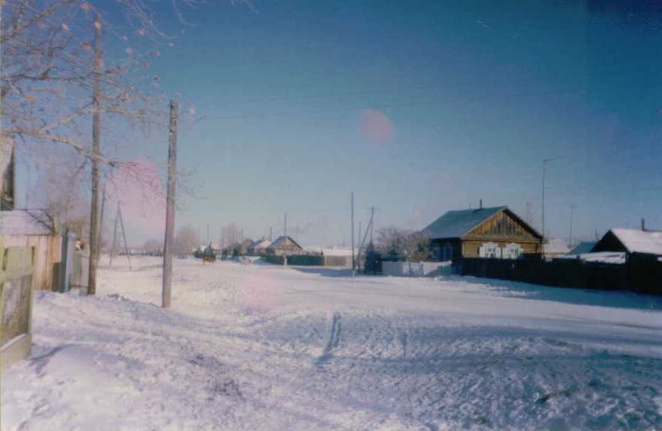
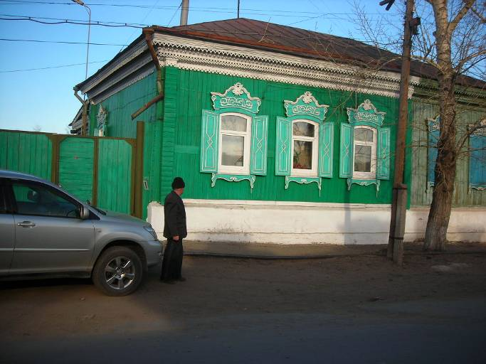
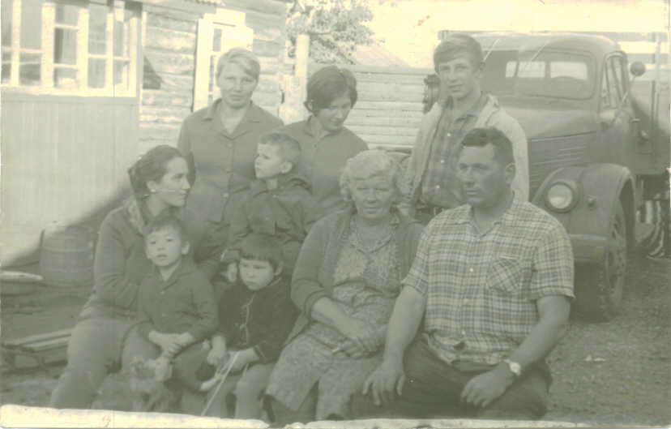
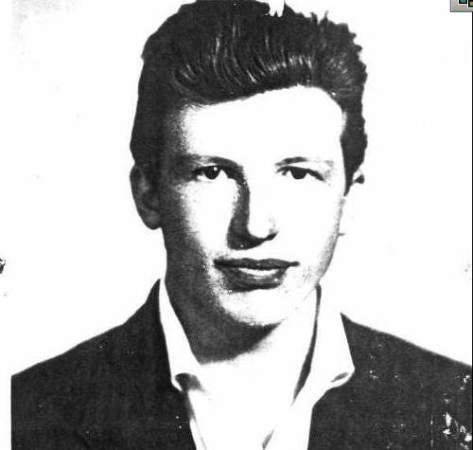
But Even THE Source has the origin
The Grandpa
Somewhere not far away
of the Baikal lake...
The concur of Siberia...
...or a voluntary exile?...
Dudnikovs’ Greenhouse
in Siberia
the kasak...
The harvest...
+
+...
Notes:
+

Slide 6
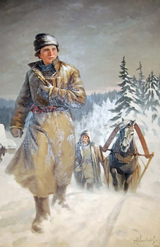
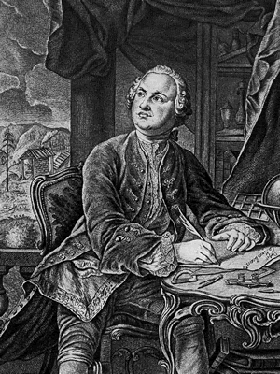
our snowy treks as proof of the Theory of relativity
By the way, the little snoopy boy has read about the Einstein’s relativity
principle and realized that, indeed, time goes very slowly when you stay with
relatives...
So he decided went to the Novosibirsk State University, just like his famous predecessor Mikhail Lomonosov went to Moscow about two centuries before him walking from the White Sea coast by the snowy road...

Slide 7
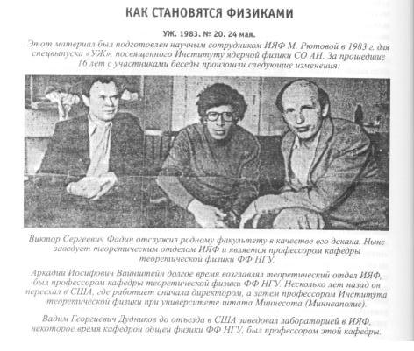
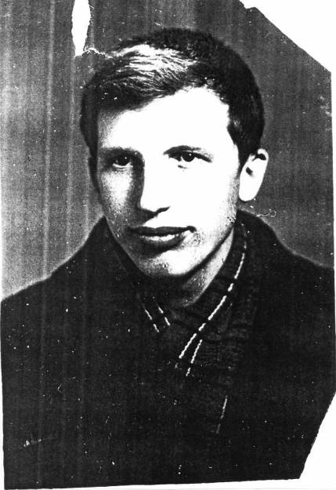
how to become the physicist /Russian secret /
A Boy
A Young Man
A Real Man
The rules as the exclusions
You better born in Siberia
You better to be graduated from NSU
Your wife should be a physicist too
She should be born in Siberia too
You better marry Galina Dudnikov, the Superwife
You better start your career at Budker’s Institute in Siberia
You better work hard...
You better think hard...
You better do not think about your career...
The Superman
Notes:
The rules as the exclusions
You better marry Galina Dudnikov, the Superwife
You better start your career at Budker Institute

Slide 8
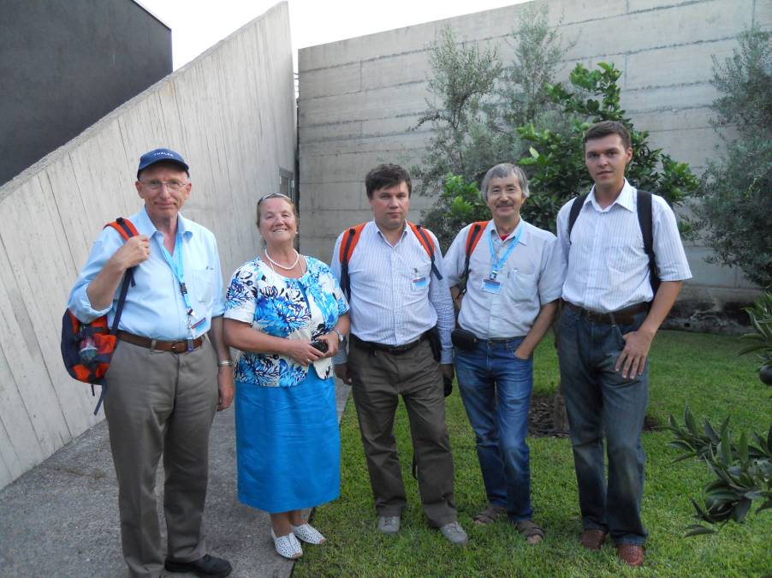
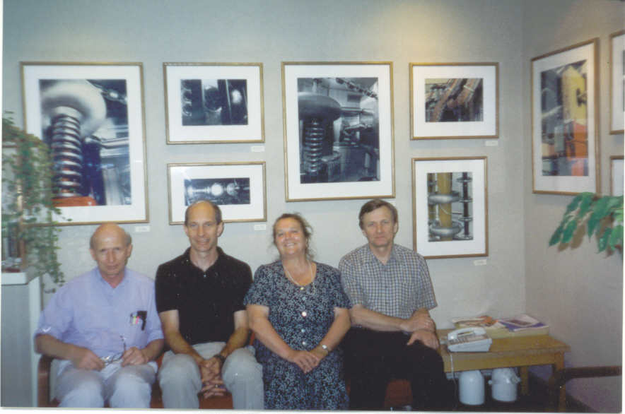
The Superwife
The Superwife:
Galina Dudnikov,
Soviet Doctor in Science
Notes:
The Superwife

Slide 9
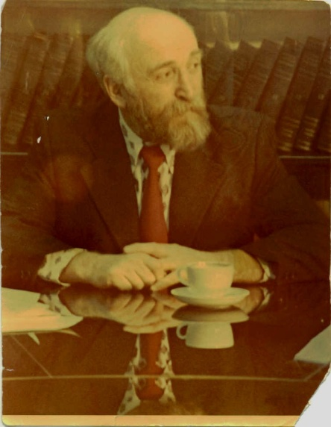
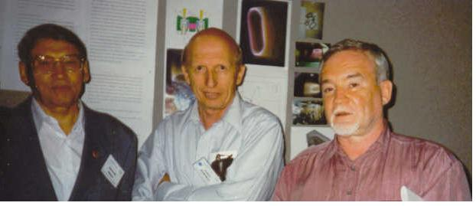
To reach the true understanding of the Liouville theorem, you have to brake it...
Phase I: How to violate the law
M.Sc., Physics Department, 1965, Novosibirsk State University, Novosibirsk, Russia. Diploma with distinguishes “Measurement of Stripping Cross Sections of H- with Energy 0.5-1.3 MeV in Gas Targets”. High efficiency of neutral beam production.
CROSS SECTIONS FOR STRIPPING OF -1-MEV NEGATIVE HYDROGEN IONS IN CERTAIN GASES DIMOV GI, DUDNIKOV VG , SOVIET PHYSICS TECHNICAL PHYSICS-USSR , 11: 7, 919- 1967. Was determined an optimal efficiency of neutral beam production from negative ions. Now is basis for neutral beam production for Fusion.
Notes:
Phase I

Slide 10
Phase II: how to run the broken theorem to work
Ph.D. in Beam Physics and Accelerators Technology, BINP, Novosibirsk, 1967. Thesis: "High-intensity Proton Beam Production in a Storage Ring by the Charge-Exchange Injection Method." (Development of Charge Exchange Injection, now routinely used around the word. First proton beam accumulation up to space charge limit, First experimental observation, correct interpretation and damping of e-p instability. Electron cloud effect),
Although the electron-cloud effect (ECE) for lepton beams was first reported in 1995 [1], the ECE was apparently first discovered 30 years earlier at the Budker Institute (Novosibisrk) as a form of a two-stream instability for coasting proton bunches [2] and later, in resonant form, at the CERN ISR in the mid 70’s [3] (a recent historical overview has been presented by F. Zimmermann [4]).
Димов Г.И., Дудников В.Г. «Перезарядный метод управления потоками частиц» Физика плазмы 4, 692-701 ,1978; G. Dimov, V. Dudnikov, Charge Exchange method of particles beams controlling; Plasma Physics 4, 692-701 ,1978.
Space charge compensation of low energy ion beam for implantation, Dudnikov V and Dudnikov A , Rev. Sci. Instrum., v.73 995 (2002). Development of ion implanter with high intense low energy B+ ion beam.

Slide 11
Not every idea lies on the surface...
Soviet Doctor of Science in Experimental Physics, BINP, Novosibirsk,1978. Thesis :
"Surface-Plasma Method of Negative Ions Production." (Discovery of Cesiation effect of negative ion formation in gas discharges, development of Surface Plasma Negative ion Sources (SPS), now routinely used around the world, known as Dudnikov sources).
Invention: V. Dudnikov, Method for Negative Ion Production, Russian Patent, No. 411542, 1973;Discovery of cesiation. SPS development.
Y. I. Belchenko, G. I. Dimov, and V. G. Dudnikov, A powerful injector of neutrals with a surface-plasma source of negative ions, Nucl. Fusion 14(1), 113 (1974);
«Physical principles of the efficient negative ion production”, Symposium on the Production and Neutralization of Negative Hydrogen Ions and Beams, Brookhaven, 1977 (Brookhaven National Laboratory (BNL), BNL-50727, Upton, NY, 1977), pp. 79–96;
Power of three
Sharing the fame
Notes:
Power of three

Slide 12
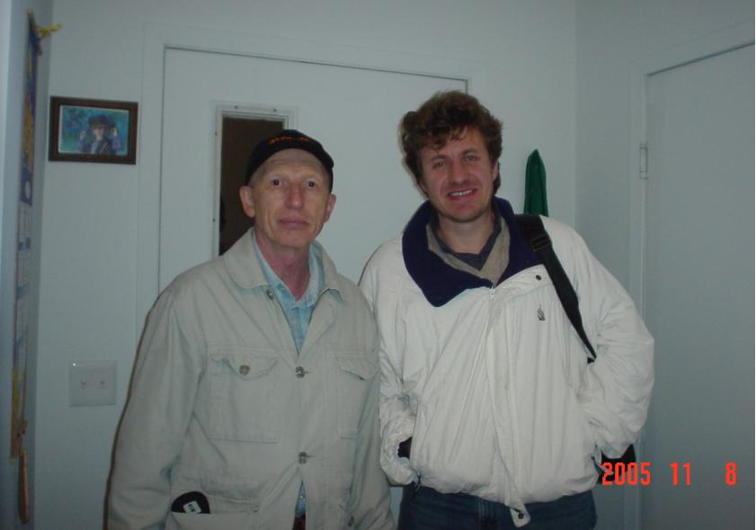
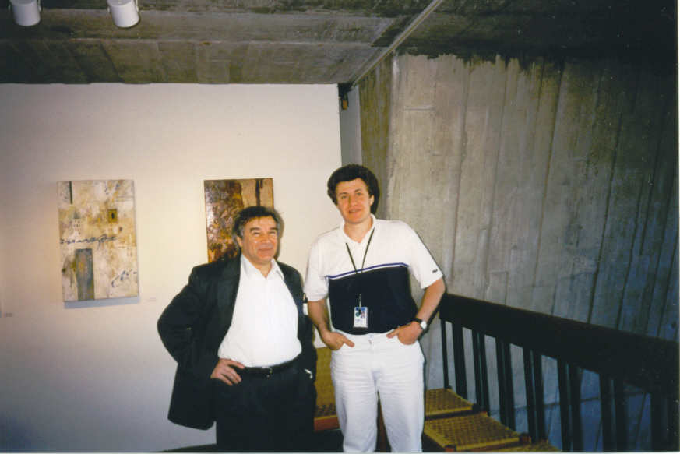
Former students
With V. Shiltsev
V. Balakin and V. Shiltsev
Notes:
With V. Balakin

Slide 13
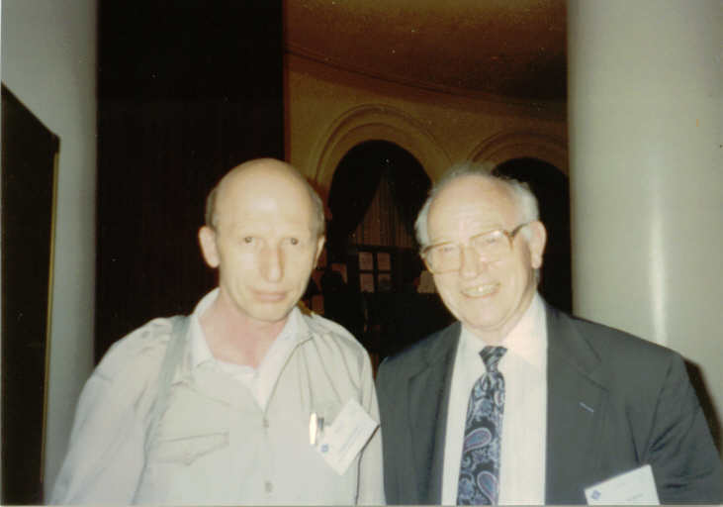
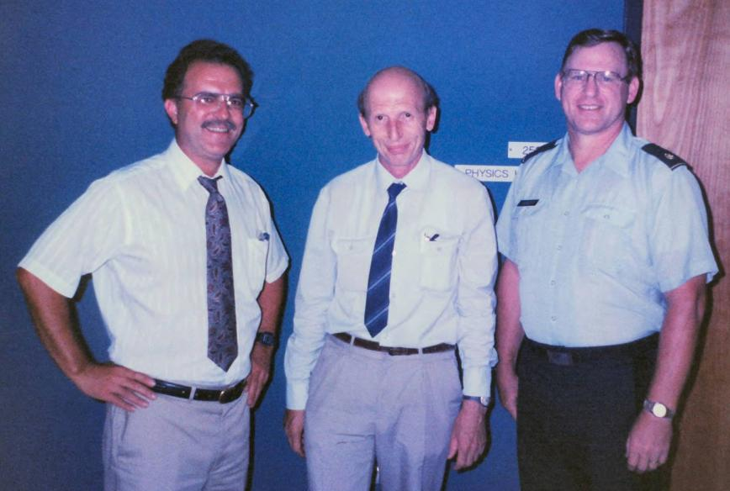
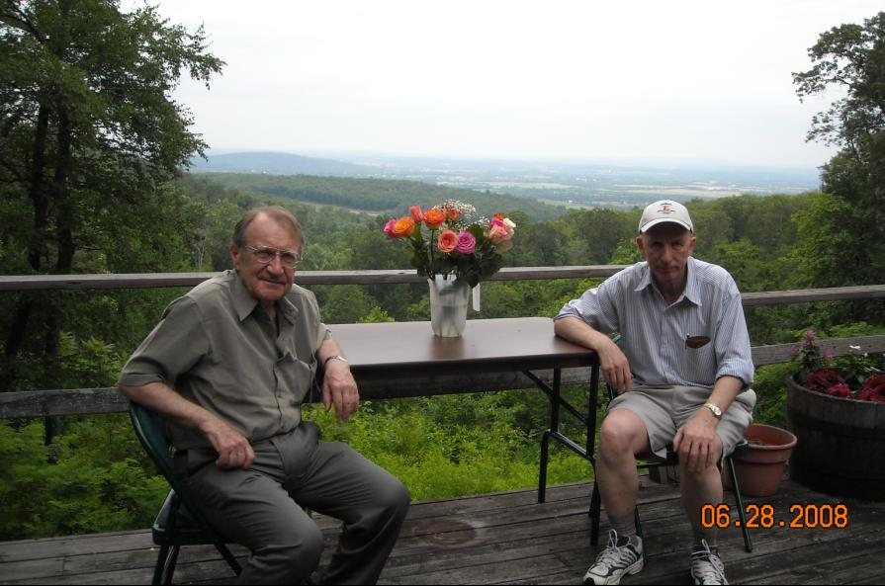
The sky anxiety: SDI i.e. SOI
Friendly exchange
Let us build the sky defense together...
With Ron Martin
Space, Beams and Star wars
veterans...
With Roald Sagdeev
Penstate, 20…

Slide 14
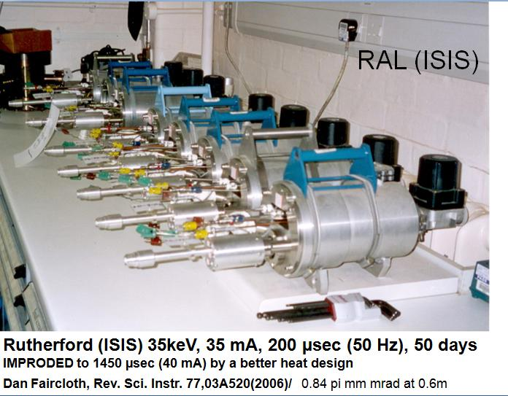
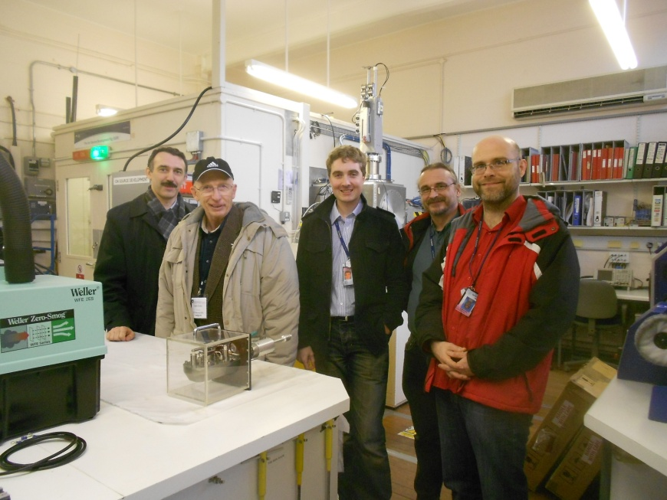
The new era
Dudnikov Source at ISIS
Notes:
The new era

Slide 15
The polarized Source
A SOURCE OF POLARIZED NEGATIVE HYDROGEN-IONS WITH DEUTERIUM PLASMA IONIZER, BELOV AS, DUDNIKOV VG, KUZIK VE, et al., NUCLEAR INSTRUMENTS & METHODS IN PHYSICS RESEARCH SECTION A-ACCELERATORS SPECTROMETERS DETECTORS AND ASSOCIATED EQUIPMENT , 333, 2-3, 256-259, 1993;
High-intensity source of polarized negative hydrogen ions with a resonant charge-exchange plasma ionizer , Belov AS, Dudnikov V.G. Esin SK, Netchaeva LP, et al. REVIEW OF SCIENTIFIC INSTRUMENTS, 67, 3, 1293-1295, Part 2, 1996;

Slide 16
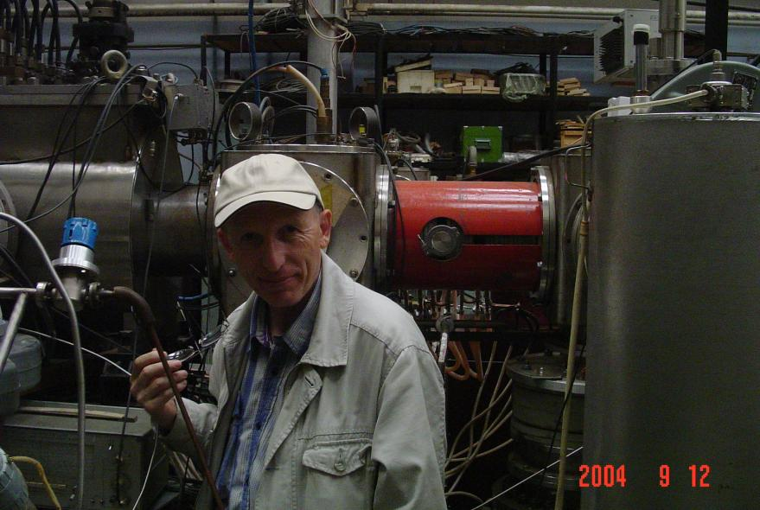
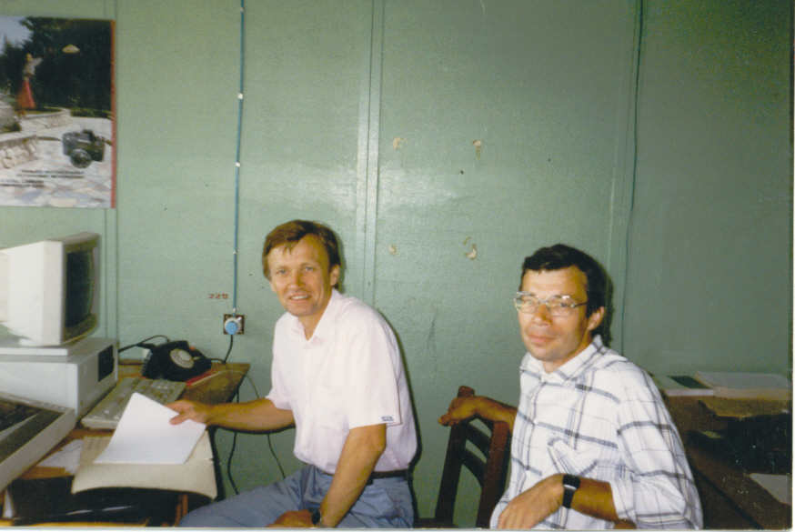
For INR
INR Polarized ABS
Indiana Polarized ABS

Slide 17
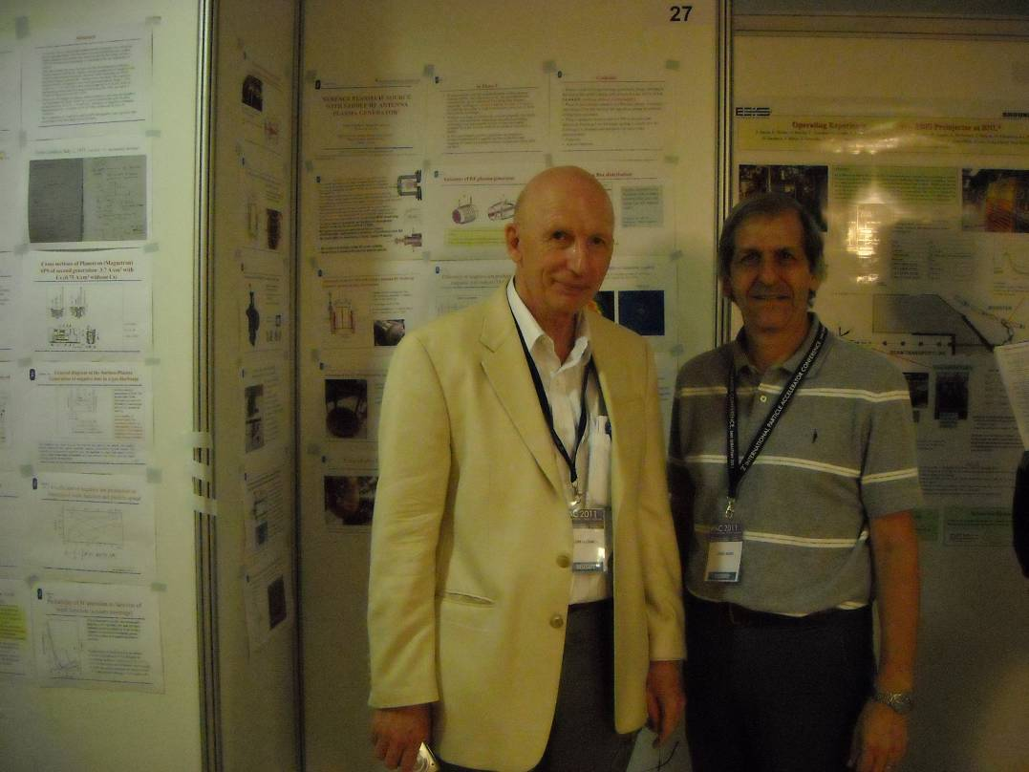
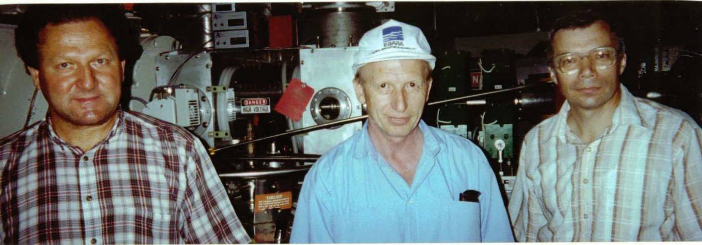
For BNL
BNL. With J. Alessi
BNL. With A. Zelenski and V. Klenov
Notes:
BNL. With A. Zelenski and V. Klenov

Slide 18
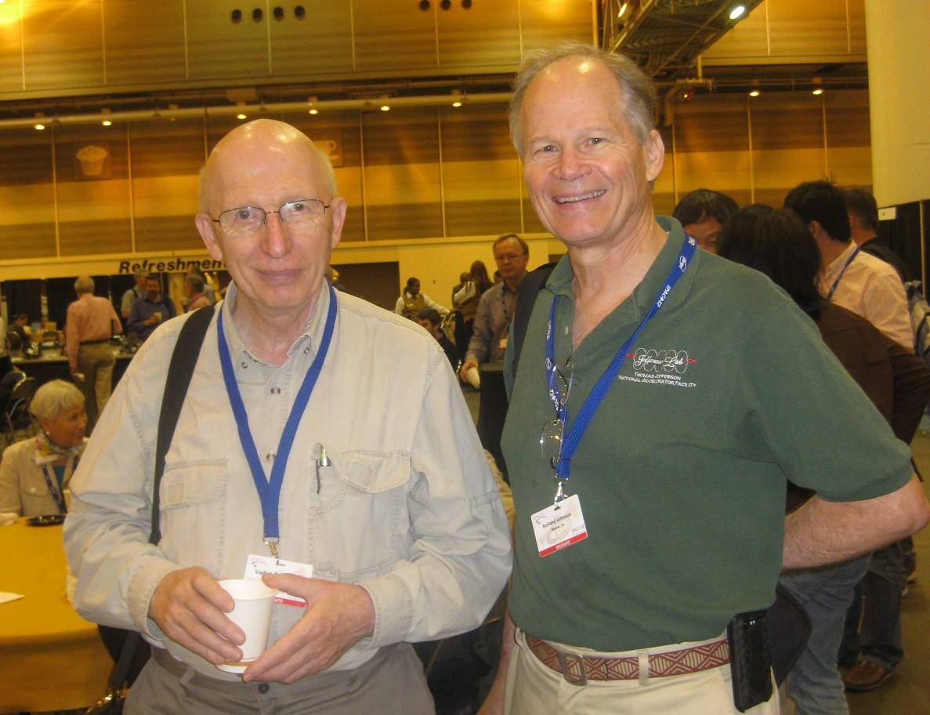
For SNS
Muons, Inc era
Improving efficiency of negative ion production in ion source with saddle antenna
V. Dudnikov^{1,b)}, R. Johnson¹, S. Murrey ², T. Pinnisi ², C. Piller ², M. Santana ²,. M.Stockli ², R. Welton ², C. Johnson³, M. Turvey⁴
A specific efficiency of H⁻ production was increased up to ~ 20 mA/ cm² kW from previous ~2.5 mA/ cm² kW.
SNS cooperation. With R. Welton
Notes:
Muons, Inc era

Slide 19
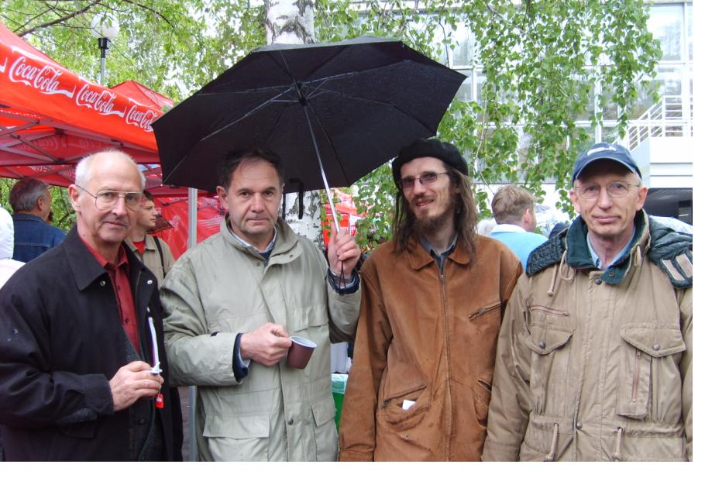
For EIC
Muons, Inc era
Prospects for polarized ${}_{}^{3}{He}$
Notes:
Prospects for polarized ${}_{}^{3}{He}$

Slide 20
A little more recently, we had the even greater experience of having Vadim work with our ion source group at Brookhaven for 1-2 months as a Visiting Scientist. It was fantastically stimulating, for me as well as for our engineers and technicians, to be working alongside Vadim – as he contributed to our work on polarized H-minus, surface H-minus, and volume H-minus sources. Ideas just flow from him, and it is quite challenging to try and keep up. I still have a folder several inches thick, containing all sorts of references that he gave me related to all the ideas he was coming up with during that brief time. It was then that I came to appreciate the breadth of his knowledge – physics, chemistry, materials science, electronics, industrial applications, etc. – all showing why he is such a great ion source physicist.
Jim Alessi
Preinjector Group Leader
Collider-Accelerator Department
...because of difficulties with Russian scientists visiting the US in the old days, I had probably been working in H-minus ions sources for more than 10 years before I first got to meet Vadim. That was really something that I had looked forward to, because he was truly a pioneer in the field, and his discovery of cesium catalysis was revolutionary - both for accelerator laboratories and for fusion applications of H-minus sources. Of course, upon meeting Vadim I was definitely not disappointed – his experience and knowledge of the entire field of ion sources (including polarized ion sources!) was amazing. Fortunately, I was able to interact with Vadim much more frequently in the 1990's and beyond, and his participation at our regularly held International Symposium on the Production and Neutralization of Negative Ions and Beams was great for the program.
Notes:
With Jim Alessi

Slide 21
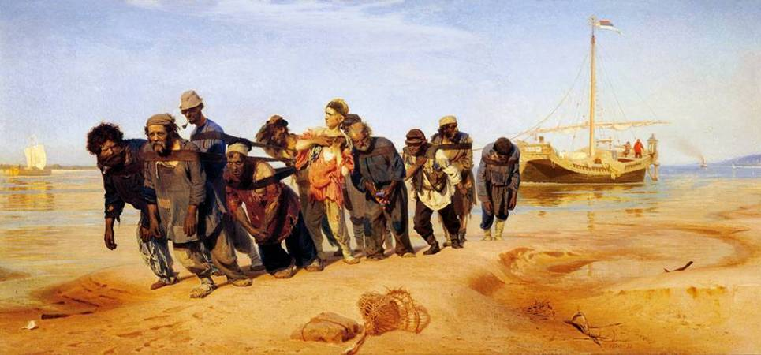
How to execute a hard work
Testimony 1 from apostoles (Y. Eidelman and S. Derbenev)
You dress a rough robe
Take a strong rope
Then go to find a big heavy barge to pull it against the stream
Do not try do it alone
Notes:
Testimony 1 from apostoles (Y. Eidelman and S. Derbenev)

Slide 22
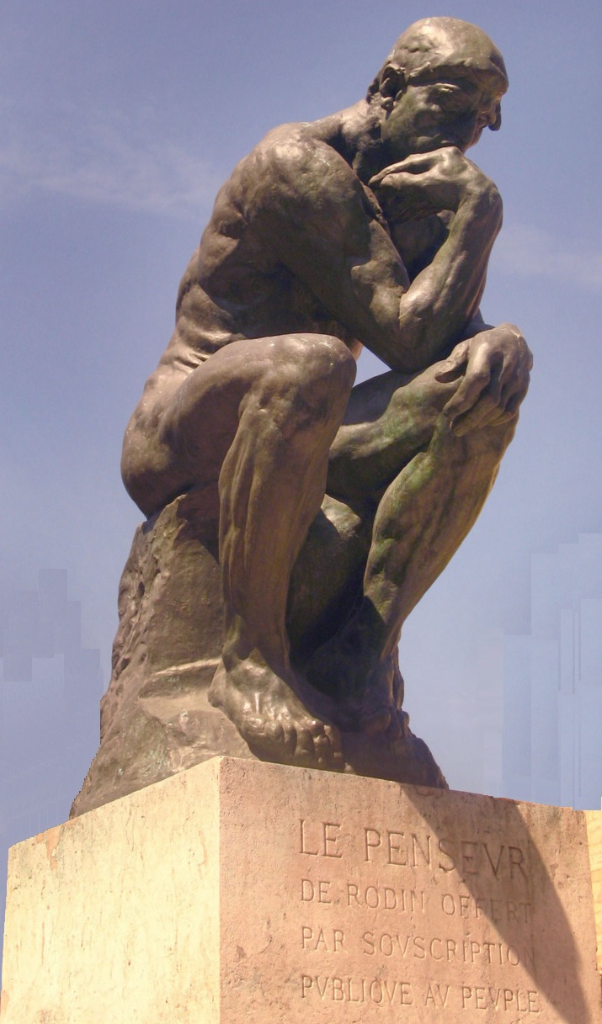
How to think hard
Testimony 2
Take your clothes off
Find a firm stone to sit down
Take an appropriate pose
You do not need anything else. Do not pay attention to girls and rigorous ladies wandering around you but
CONCENTRATE. TIME WILL GO FAST...
Notes:
Testimony 2

Slide 23
Happy 70th Birthday,
Dear Vadim!

