Slide 1
The polarized hydrogen jet target measurements at RHIC
Andrei Poblaguev
Brookhaven National Laboratory
The RHIC/AGS Polarimetry Group:
I. Alekseev, E. Aschenauer, G. Atoian, A. Bazilevsky, A.Dion, K.O. Eyser, H. Huang, D.Kalinkin,
Y. Makdisi, A.Poblaguev, W. Schmidke, D. Smirnov, D. Svirida, K. Yip, A. Zelenski

Slide 2
Polarized Proton Beams at RHIC
Absolute Polarimeter (H jet)
Siberian Snakes
RHIC pC Polarimeters
PHENIX (p)
Spin flipper
STAR (p)
Spin Rotators
(longitudinal polarization)
Spin Rotators
(longitudinal polarization)
Solenoid Partial Siberian Snake
LINAC
BOOSTER
Pol. H⁻ Source
Helical Partial
Siberian Snake
200 MeV Polarimeter
AGS
AGS pC Polarimeter
Strong AGS Snake
H-Jet polarimeter: (96 channels)
- measure average (absolute) polarization of RHIC beams

Slide 3
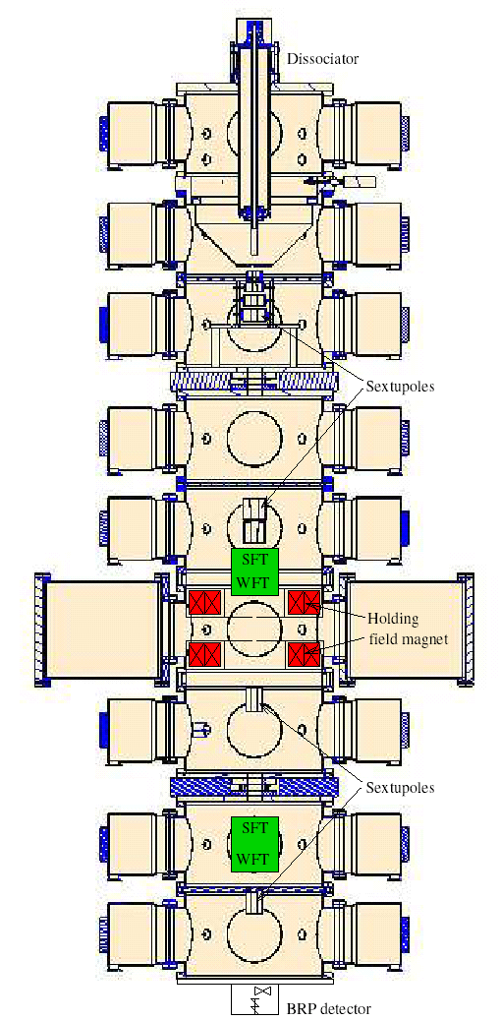
The Polarized H-Jet Target
H₂ dissociator
RF cavity
H = p⁺ + e⁻
separation
magnets
(sextupoles)
Atomic Beam Source
focusing
magnets
(sextupoles)
OR
RF transitions
Scattering chamber
Holding field
magnet
P⁺ OR P⁻
record beam intensity
100% eff. RF transitions
focusing high intensity
B-R polarimeter
P_{jet} ~ 0.92
recoil detectors
ToF, E_{REC}; Θ_{REC}
Breit-Rabi Polarimeter
Ion Gage

Slide 4
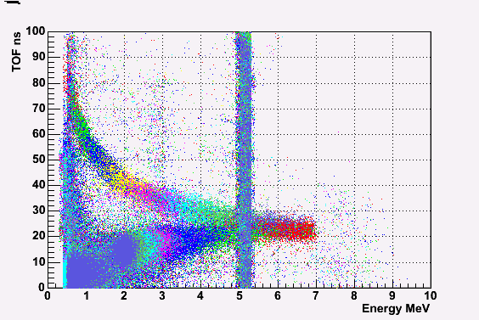
Recoil Spectrometer Measurement
(Run 2004 Configuration)
Forward scattered
proton
Ch#1- 16
proton beam
proton target
recoil proton
Array of Si detectors measures T_{R} & tof
of recoil particles.
Channel # corresponds to recoil angle θ_{R}.
2 correlations , (T_{R} & tof ) and (T_{R} & θ_{R} ),
to isolate the elastic process
θ_{R}
#16
Ch#1

Slide 5
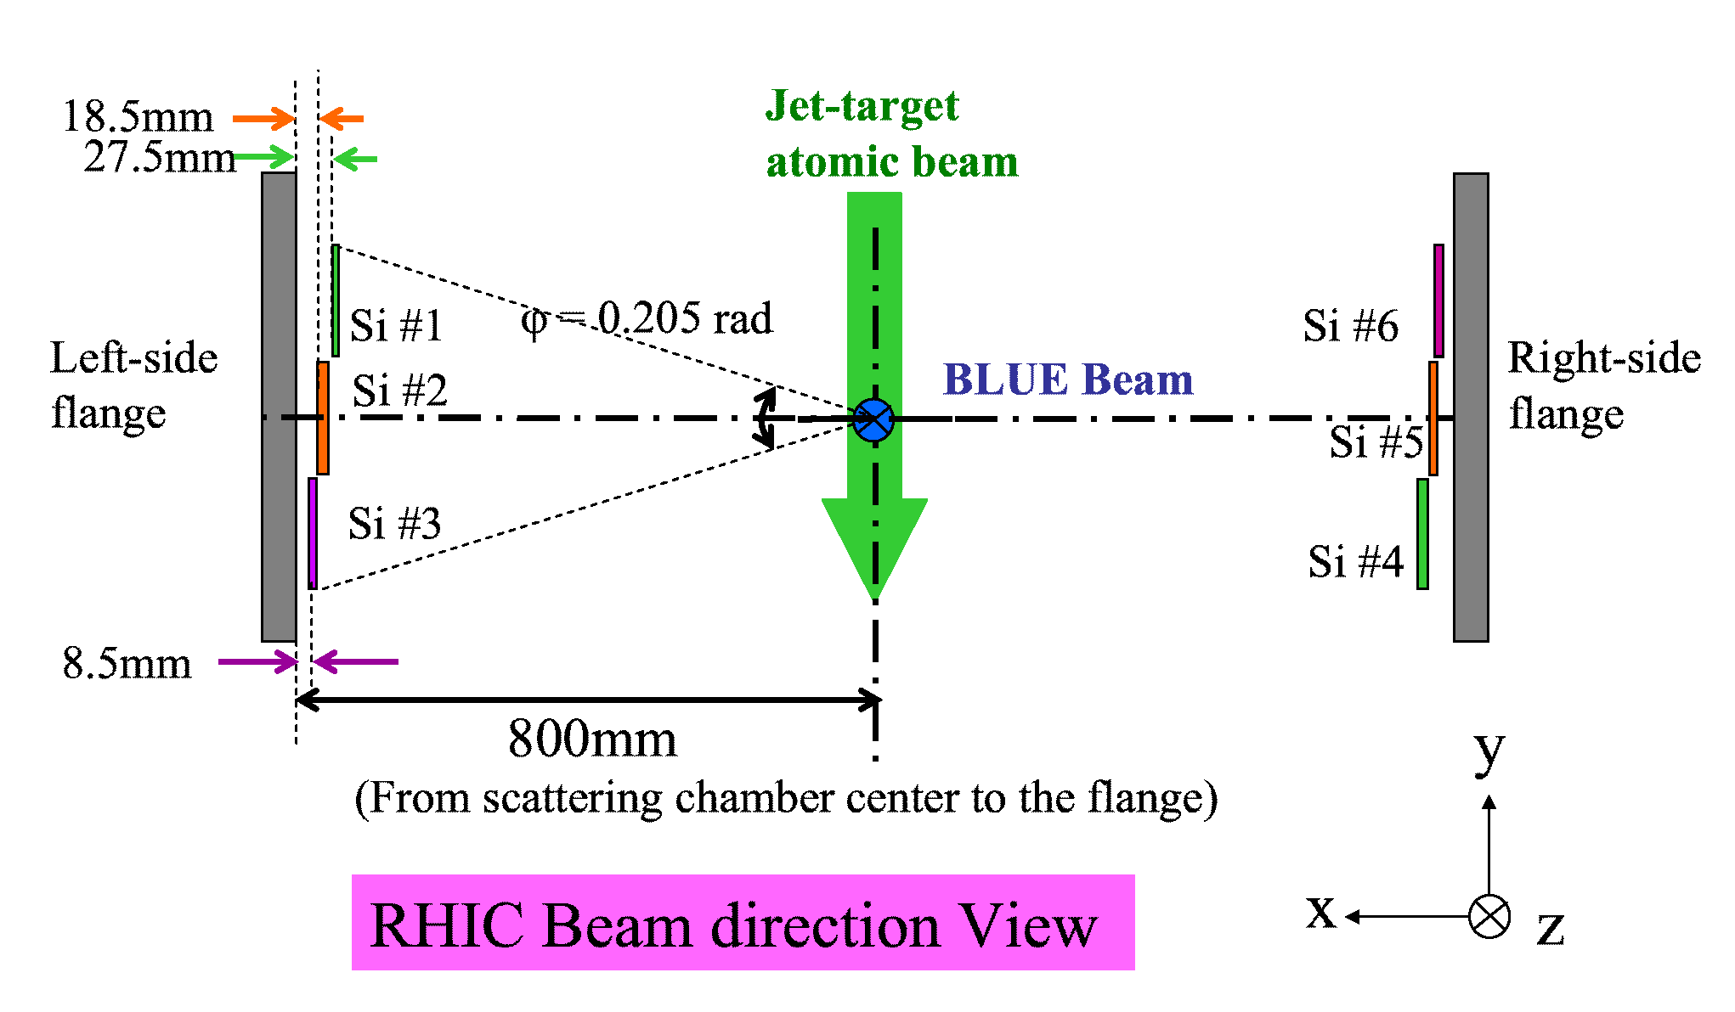
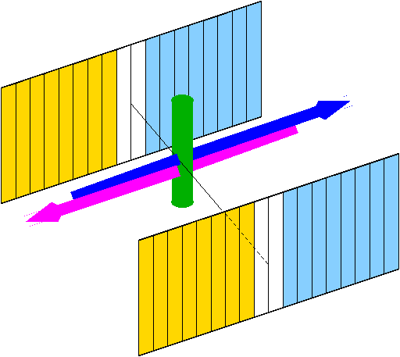
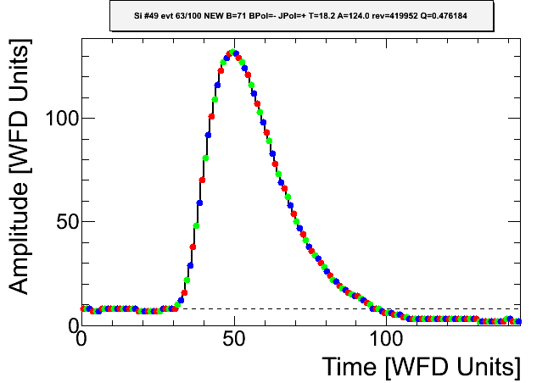
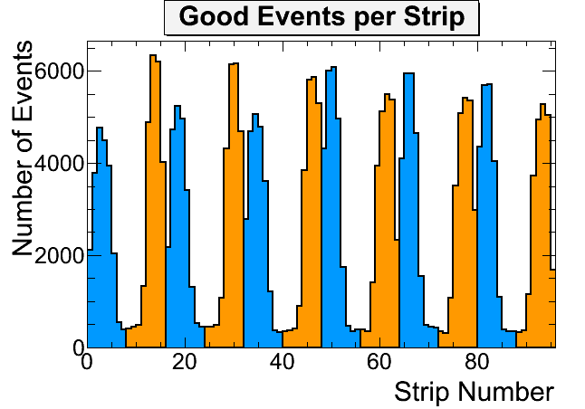
Running conditions (2013)
255 GeV/c proton beams.
6 detectors (98 channels)
Ran with two beam simultaneously separated vertically
by 3-4 mm dictated by the machine beam-beam
requirements.
Alpha-source runs were taken separately from physics runs.
Full waveform was recorded for every triggered event
Recoil protons were selected within energy range 1 – 5 MeV
Recoil proton asymmetry relative to the beam and jet
polarization was mesured simultaneously
a_{Beam} = A_{N}(t) P_{Beam} & a_{Jet} = A_{N}(t) P_{Jet}
P_{Beam} = (a_{Beam} /a_{Jet} ) × P_{Jet}

Slide 6
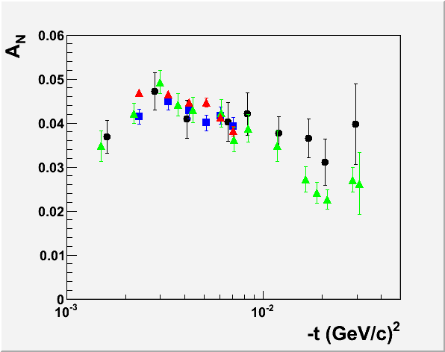
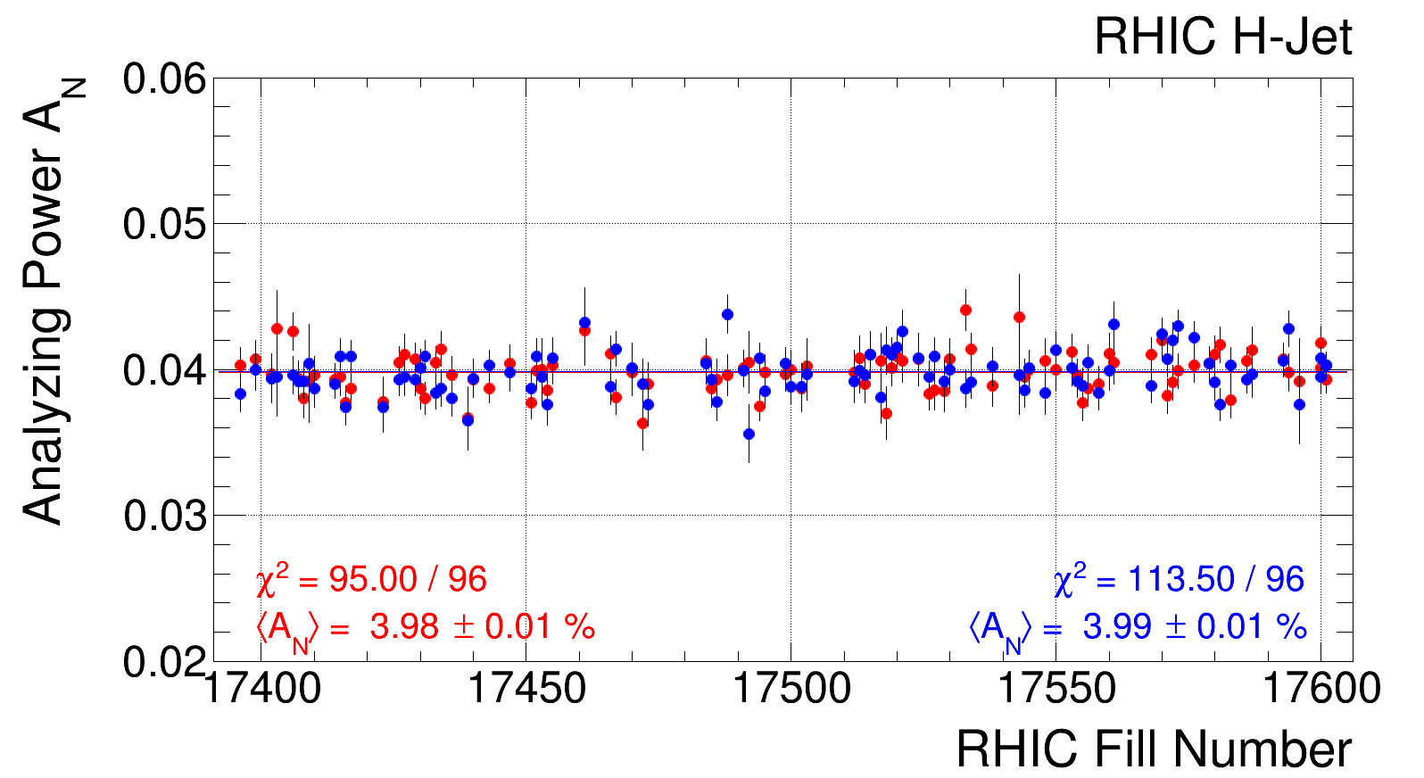
Analyzing Power
Used for polarization measurements
pp-CNI
24 GeV: PRD 79, 094014(2009)
31 GeV: Preliminary
100 GeV: PLB 638 (2006) 450
250 GeV: Preliminary
255 GeV
Average Analyzing Power in Run 13:
Variations of the measured value of A_{N} are less than 1%

Slide 7
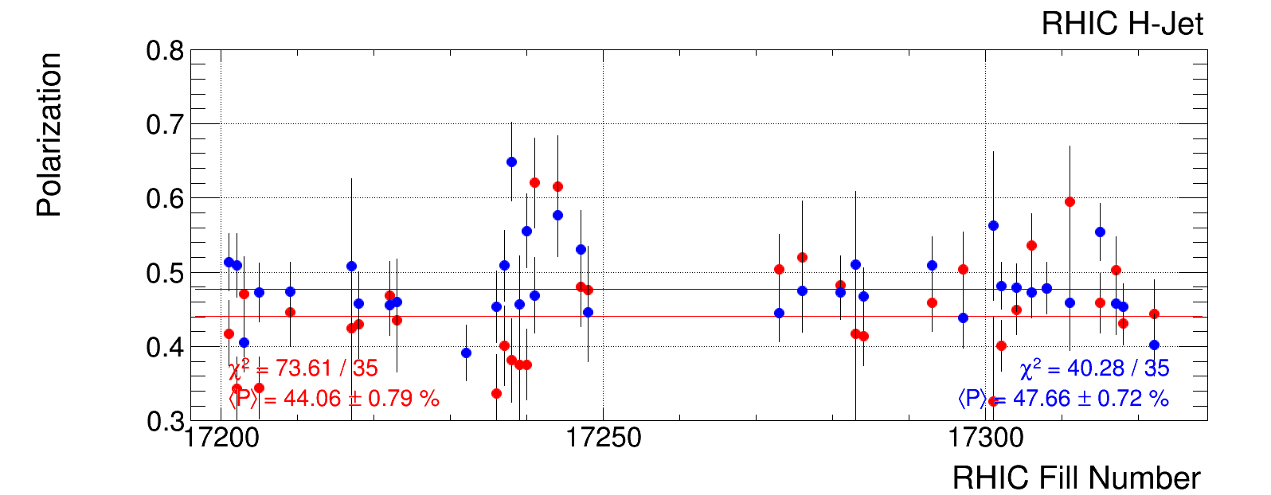
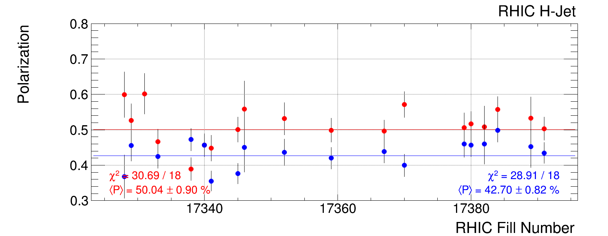
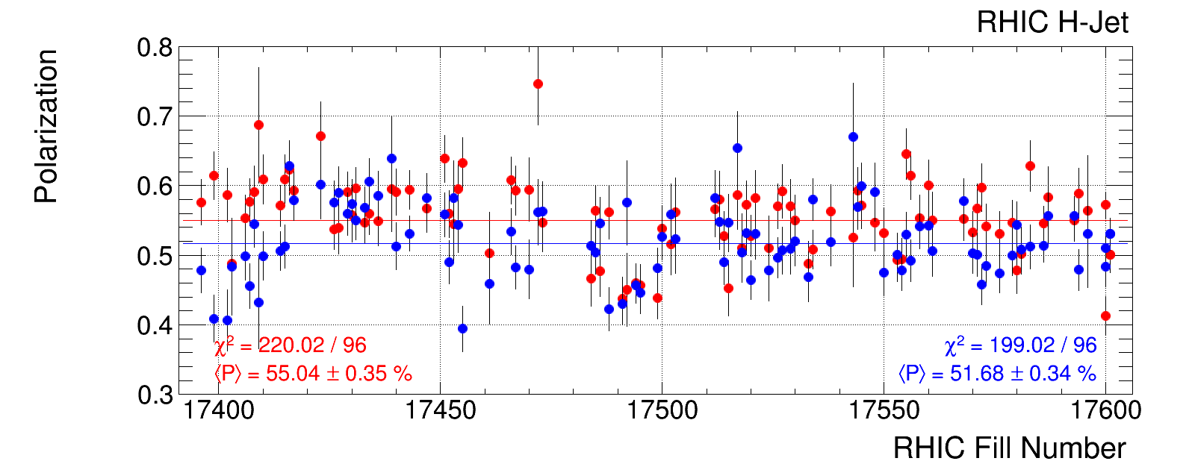
Polarization measurement in the H-Jet in Run 13
Preliminary Analysis:
Fills 17201 – 17324 (Run13 Lattice)
Fills 17328 – 17601 (Run12 Lattice)
Fills 17328 – 17601 (Run12 Lattice)

Slide 8
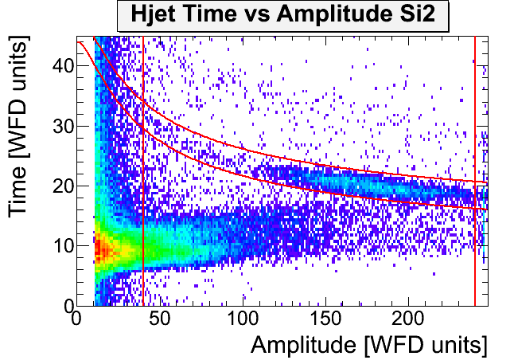
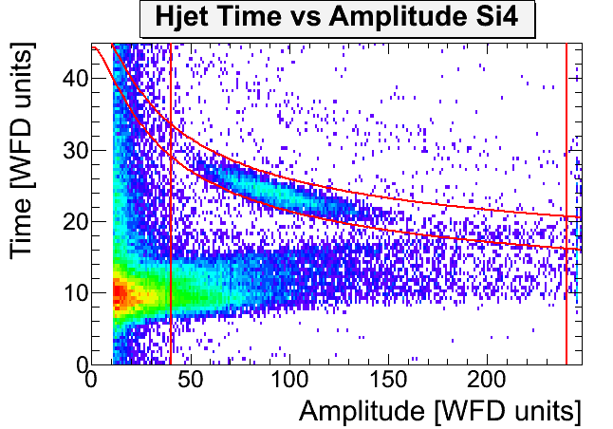
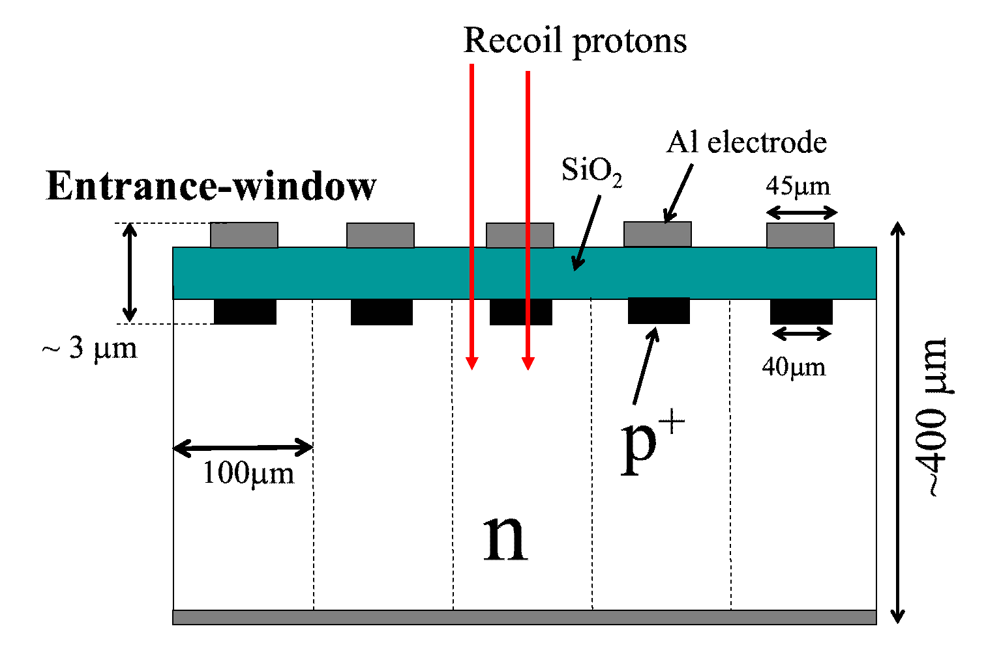
Event Selection
To measure polarization we have to isolate elastic recoil proton:
Detected particle is proton (from the E_{kin} = M_{p}v²/2)
Missing mass cut: M_{X}(E,θ) = M_{p} (p+p → p+X)
Actual cuts:
Time cut depending on the amplitude (energy)
Amplitude cut depending on the strip number
Waveform → Signal amplitude (A) and time (t)
Parameters α, t₀, and x_{DL} are determined in the calibration
At first approximation, calibration is not needed for the polarization measurement with H-Jet. Since effective Analyzing Power is internally measured, we may just select events from the Amplitude-Time plot.
Background may affect polarization measurement. Precise calibration is important for proper background suppression.

Slide 9
Calibration methods used in HJet
α-particles from ²⁴¹Am and ¹⁴⁸Gd (α, x_{DL})
high energy (low amplitude) prompt particles (t₀)
geometry based calibration (t₀ and α* )
All three methods use essentially different experimental data
Neither method allows to determine all calibration parameters α, t₀, x_{DL}
Every method combined with experimentally measured dependence
t = t(A) allows us to determine all calibration parameters α, t₀, x_{DL}.

Slide 10
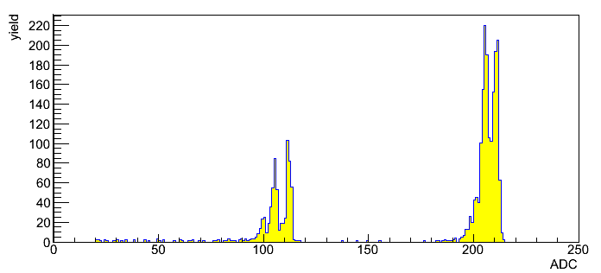
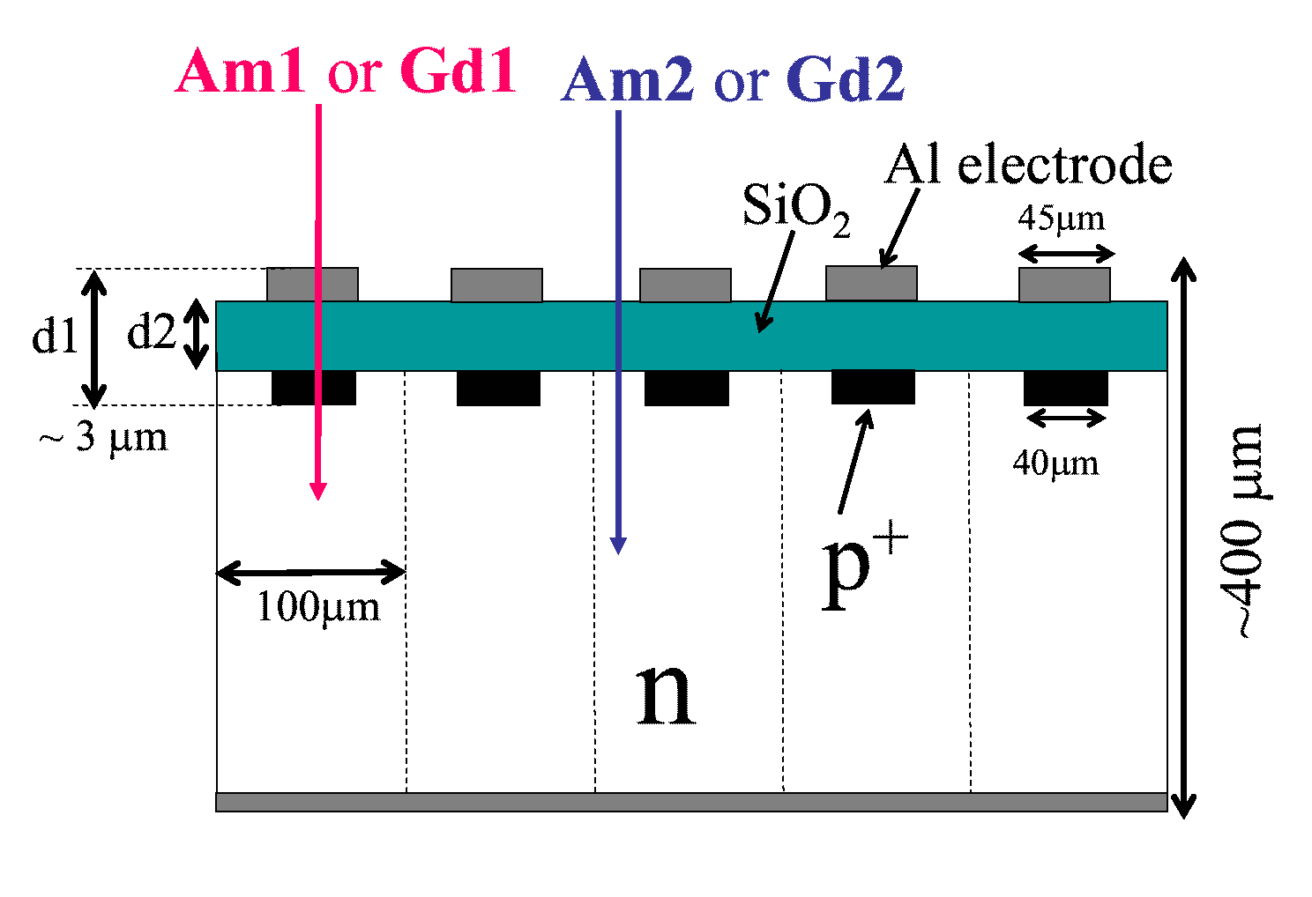
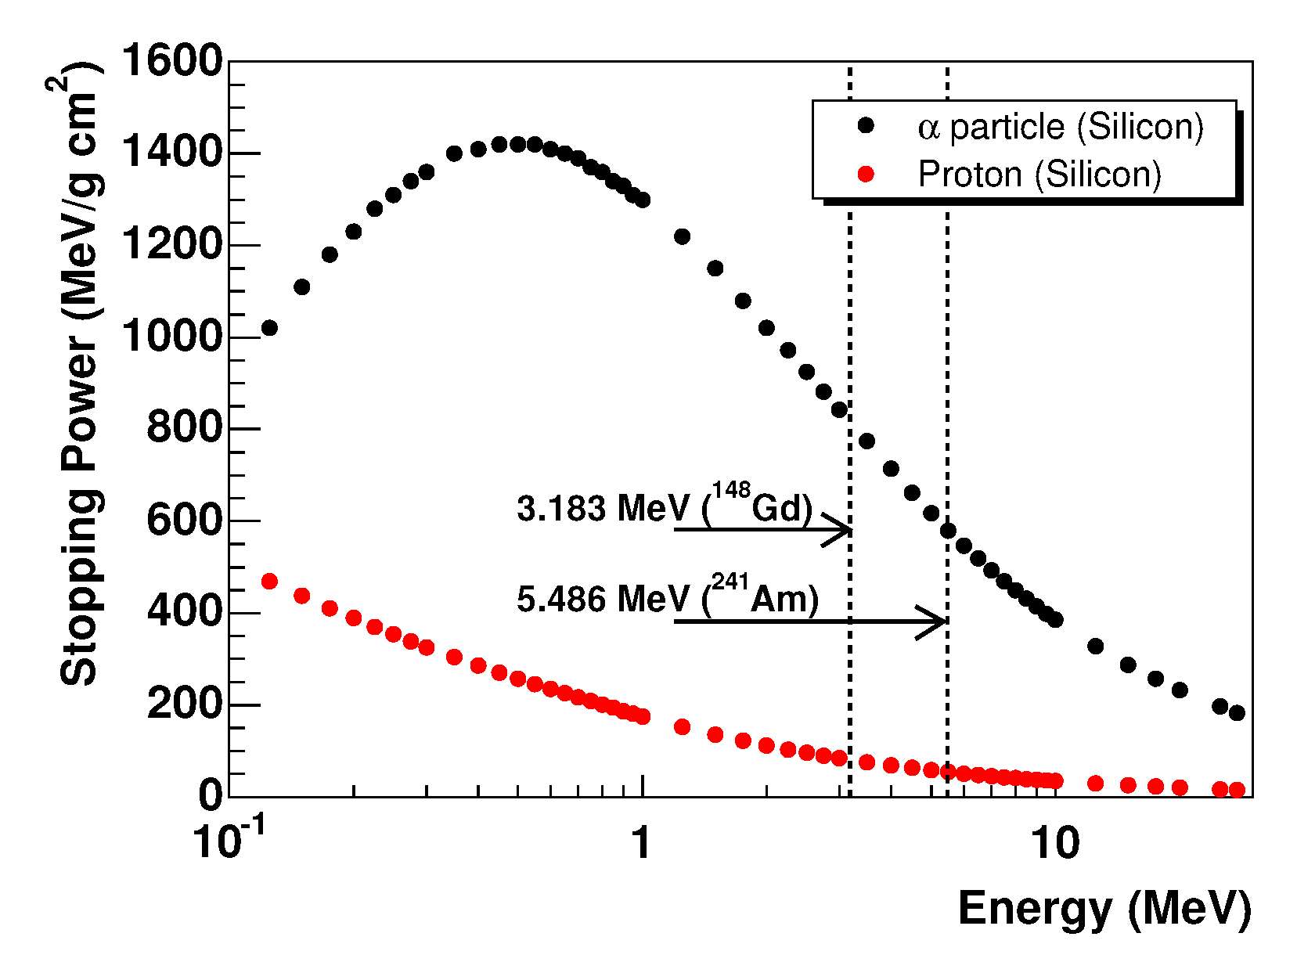
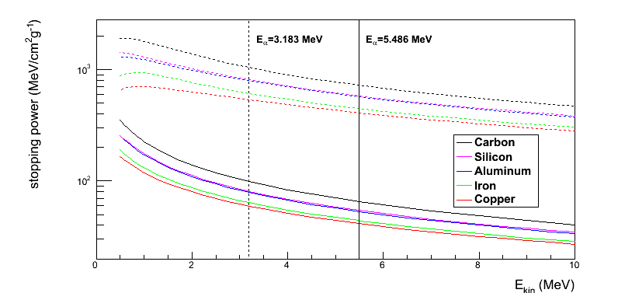
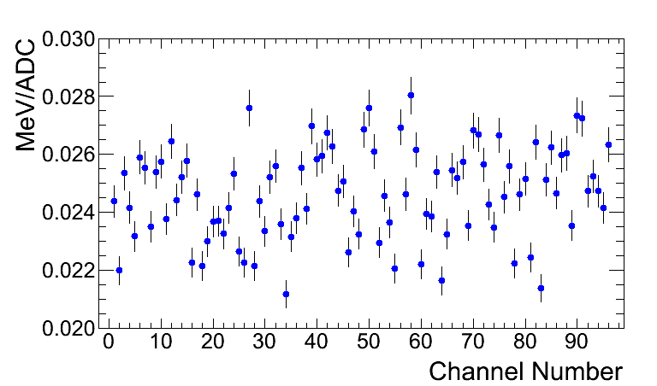
Calibration using a-source
$$E_{∝}\left(Gd\right)=3.183 \text{MeV}$$
$$E_{∝}\left(Am\right)=\text{5.486 }\text{MeV}$$
Pair of α-signals (Gd and Am) and known stopping power allows us to measure both α and x_{DL}
Only half of detectors have Gd signal
An average dead-layer same for all Si strips is used after calibration.
Possible variation of dead-layer as well as different materials in the dead-layer are included to the estimated error of gains and dead-layer.

Slide 11
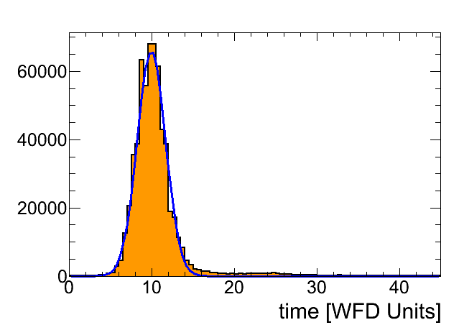
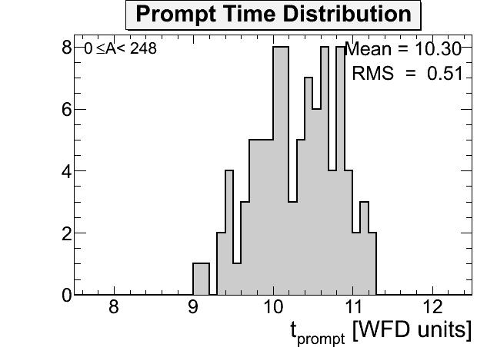
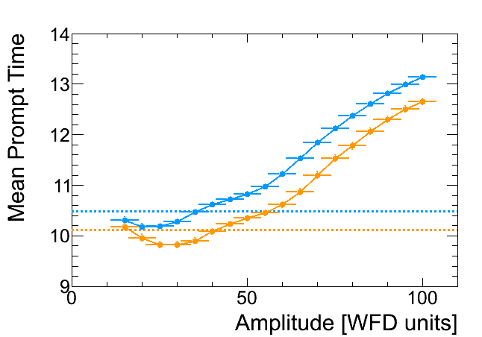
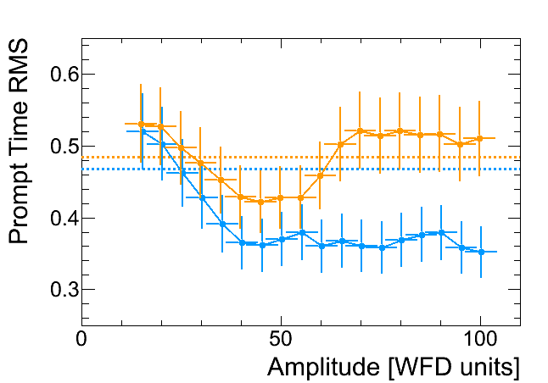
Determination of t₀ from the prompt events
Si4 all events
Amplitude selection for the prompt t₀ determination.
Prompt RMS includes variation of delays in the strips
Prompt Time should be measured with
40<A<50 cut.
A naive estimate t_{prompt} = t₀ + L/c = t₀ + 2.7 ns does not work well
( a correction may be found in comparison with other methods)

Slide 12
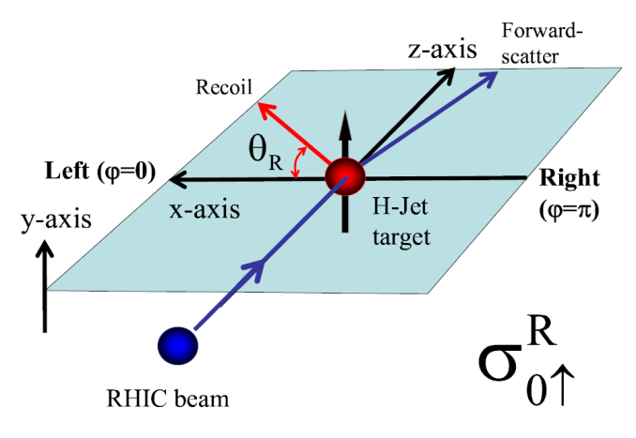
Proton energy spectrum in elastic pp interaction
Acceptance
Jet Density
For a narrow Si strip:
For a 4.44 mm strip:
For elastic pp-interactions , the function
where A is signal amplitude, gives the image of the jet concentration along z-axis. The value of A at the maximum may be associated with a well defined (from the detector geometry) energy.
A beam gas background is expected to be the same for all strips. This background may be amplitude (energy) dependent.

Slide 13
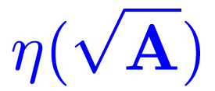
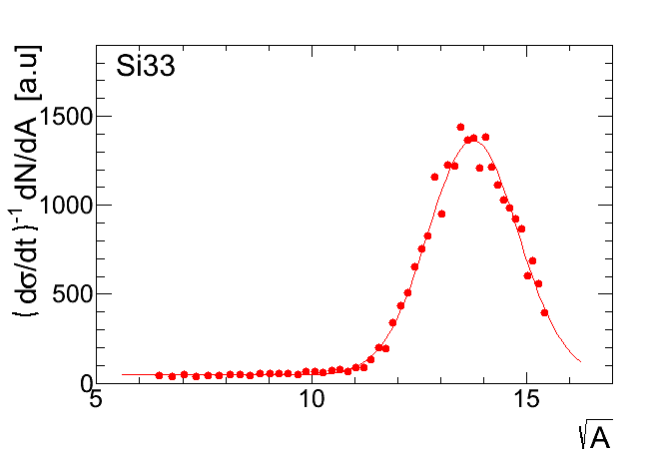
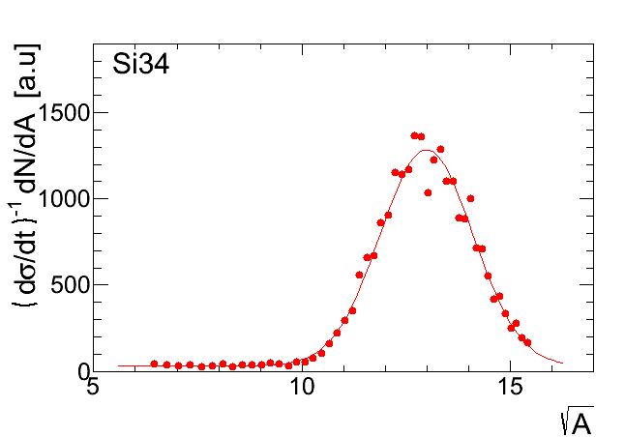
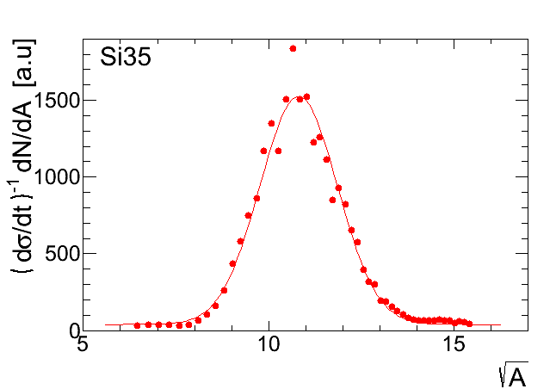
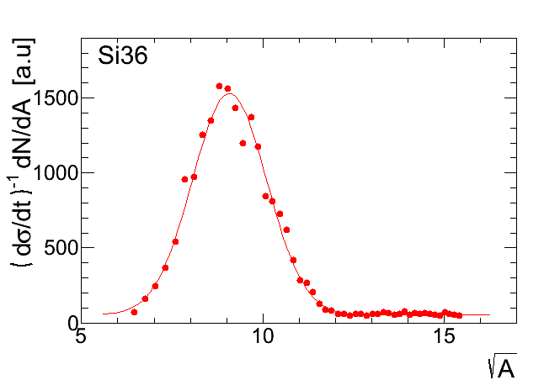
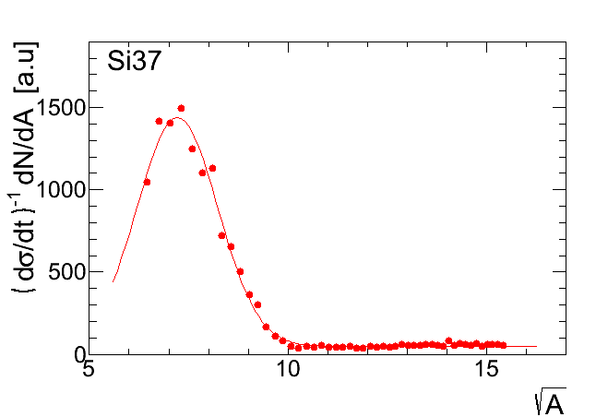
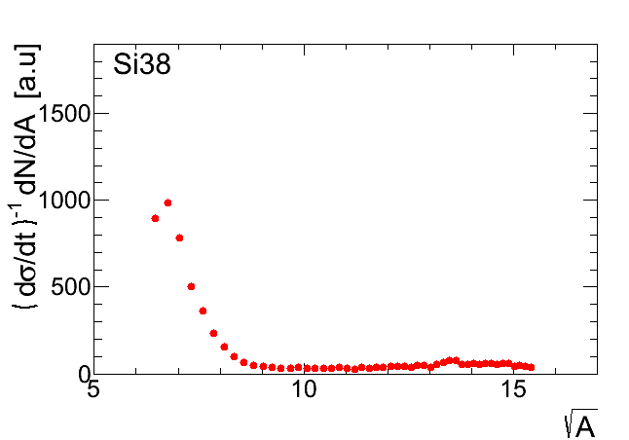
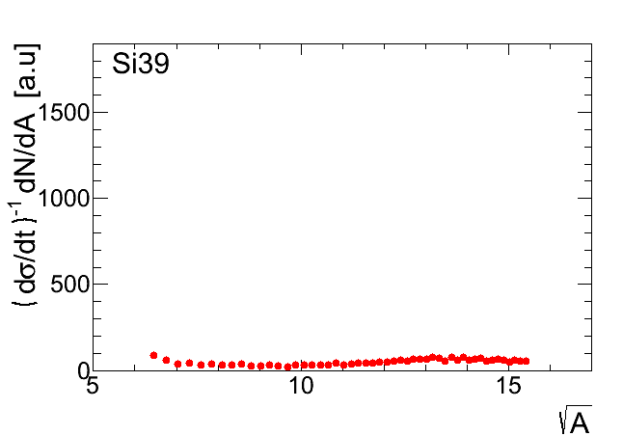
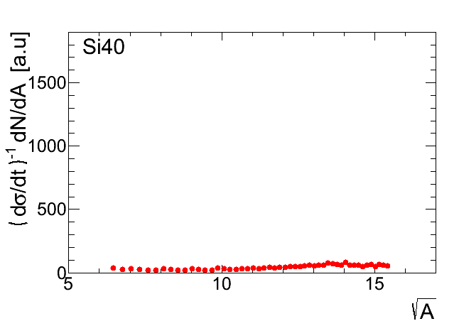
for eight (yellow) strips of the detector 3 (Fill 17600)
pp peaks (jet profile)
“flat” background
background from prompts
pp signals and backgrounds are approximately the same in all strips.
5 pp signals may be used for calibration. Other – to evaluate background

Slide 14
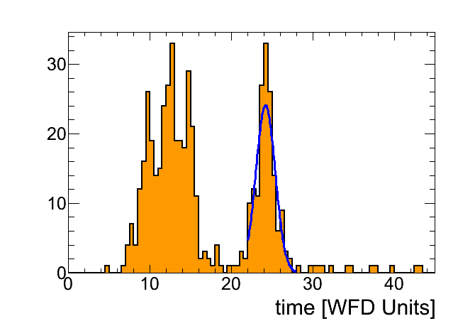
The calibration schema
Si4
t₀ is measured in a model independent (almost) way, without any knowledge about gain and dead-layer.
If we measure the dependence t=t(A) , then for every amplitude we may calculate the energy:
Gain α and dead-layer d are only one of the possible parameterizations of t=t(A)
Accuracy of the t₀ determination is crucial for the energy calibration.

Slide 15
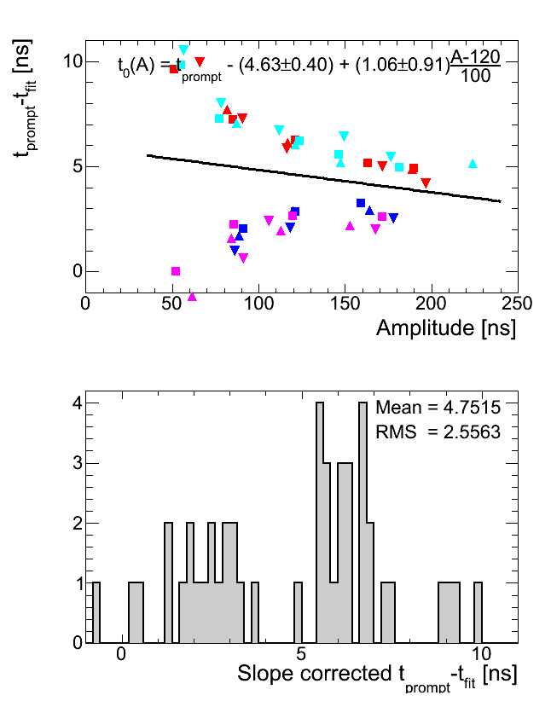
First Results (Run 17600)
Very poor consistency between two method of determination of t₀.
Results for different beam/side strips are shown by different colors.
A geometrical alignment (in software) is needed !

Slide 16
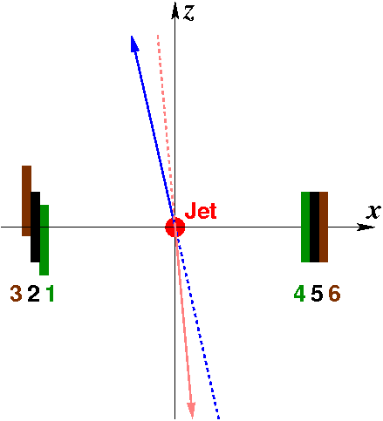
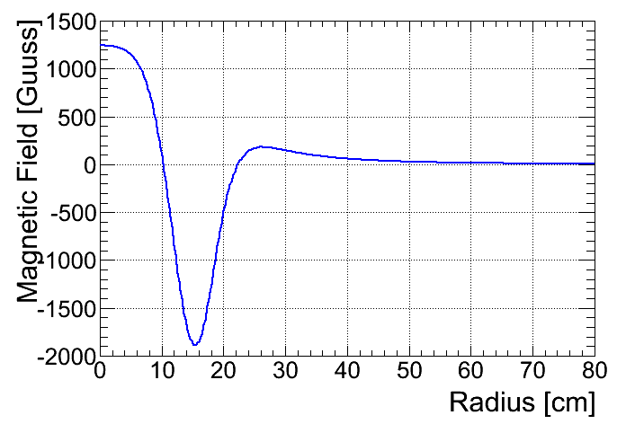
Geometrical Alignment
Coordinate selection: x-axis goes through centers of detectos 2 and 5
z-axis perpendicular to x (and horizontal)
Alignment parameters: z1, z3, z4, z6, zJet
θ = (θ_{B}+θ_{Y})/2
δθ = θ_{B}-θ_{Y}
Holding Field Correction:
Calculation:
Calculation may be inaccurate. We should determine b from the fit. b is strongly correlated with θ .

Slide 17
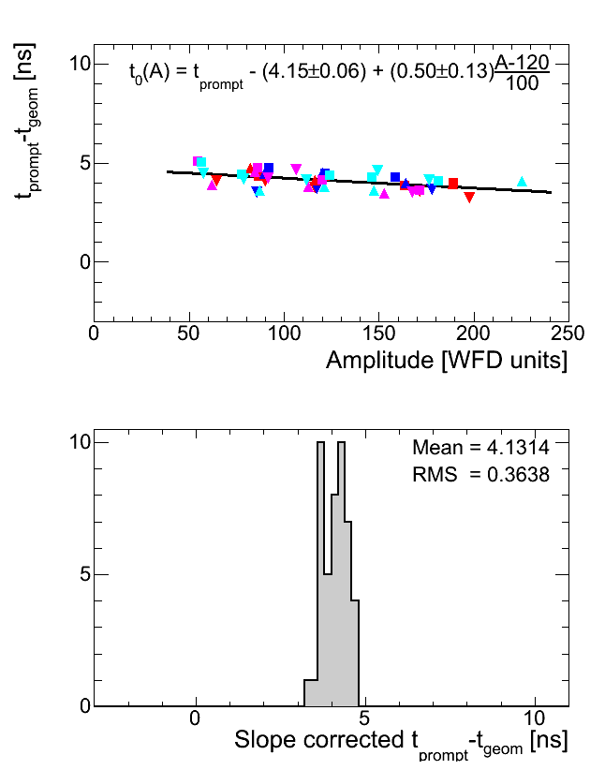
Results After Alignment
Accuracy of the t0 determination:
Contribution to the energy calibration:
 |  | Fill 17247 | Fill 17600
z1 | (mm) | 0.17 ± 0.24 | 0.33 ± 0.16
z3 | (mm) | -0.09 ± 0.27 | 0.07 ± 0.17
z4 | (mm) | -0.38 ± 0.22 | -0.36 ± 0.14
z6 | (mm) | -0.64 ± 0.22 | -0.54 ± 0.24
zJet | (mm) | 0.13 ± 0.11 | -0.05 ± 0.07
θ | (mrad) | 0.35 ± 0.60 | -0.10 ± 0.39
δθ | (mrad) | 0.07 ± 0.18 | -0.04 ± 0.12
b | (MeV cm) | 9.7 ± 2.8 | 12.4 ± 1.9
Alignment results
for March 25 and June 8 are consistent

Slide 18
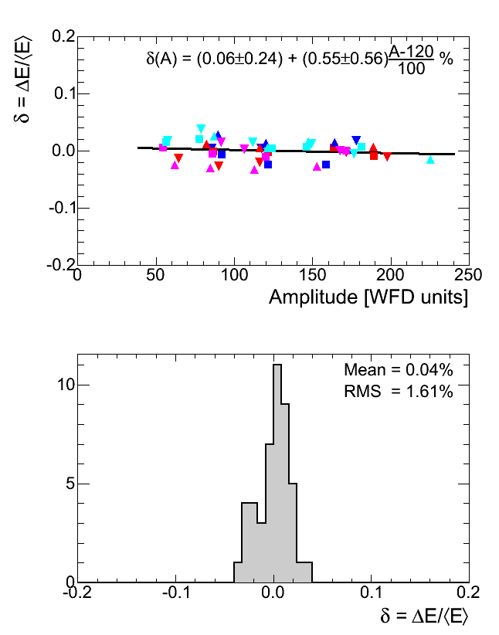
Comparison α- and geometry based calibration
If A_{geom} is mean proton amplitude, E_{geom} is energy corresponding to it, and E_{α}(A_{geom}) is energy calculated using α-caliration then the value of
allows us to compare two calibrations directly
No dependence on signal amplitude is observed.
The consistency of the calibrations may be improved if the dead-layer will be treated separetely for each detector.
Energy calibration is controlled at ~ 1% level.

Slide 19
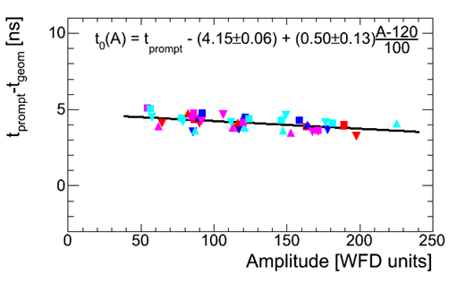
t₀ dependence on amplitude
Time-of-Flight
No indication that δt is associated with it.
Measured time
Signal waveform depends on amplitude.
This dependence may be parameterized:
δt (A) ≈ 0.005 A

Slide 20
Systematic Errors in the H-Jet Measurements
Processes detected by the polarimeter
Elastic scattering
Inelastic scattering
Molecular hydrogen in jet
Beam gas background
The formula
Is applicable only to first two processes

Slide 21
The Jet Polarization
There are 2 hydrogen components in the jet:
- atomic with (measured) polarization P_{BR}≈96%
- molecular (unpolarized)
The admixture of molecular hydrogen atomic equivale
ε≈ 3%
was measured in 2004 and 2005 with an error of about 2 %.
The average polarization
P_{jet} = (1- ε) ×P_{BR}
should be used in analysis
In ONLINE analysis the value of P_{jet} = 92% was used.

Slide 22
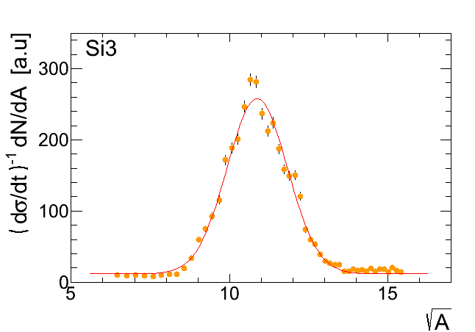
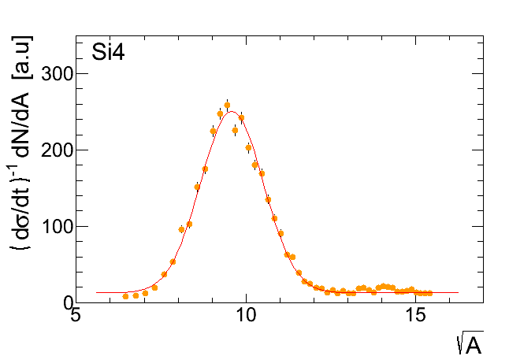
Beam gas background
Background level : r ~ 5%
For the Jet asymmetry measurements α=0 (no dependence on Jet polarization)
For the Beam asymmetry measurements α is unknow.
For beam gas protons only background α=1
Some previous experimental estimates gave α≈0.

Slide 23
Estimation of background effect. Method I
Yellow side
Blue side
+
+
+
+
+
-
All strips
-
+
+
-
+
-
+
+
+
Rate per bunch
+
-
-
Abort gaps
-
-
+
-
-
-
Background events in “blue strips”
+
-
+
-
Background events in “yellow strips”
-
+
+
-
+
-
+
+
Bunches with a single beam (abort gaps) may be employed to understand background
Single beam stores (blue and yellow) at the end of Run 13
The method is under development.
+
-
-
+
+
-
-
-

Slide 24
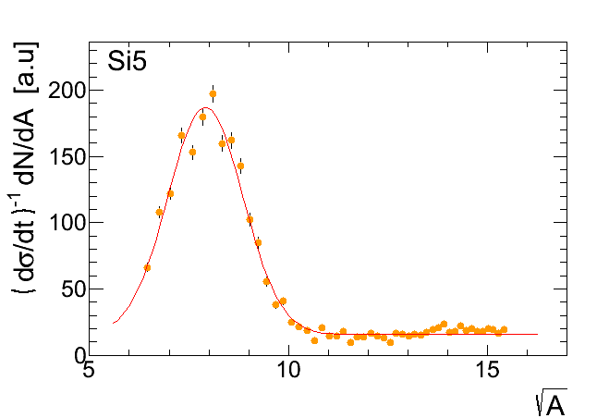
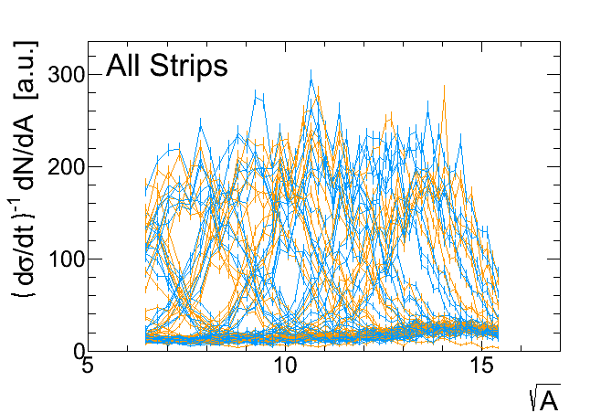
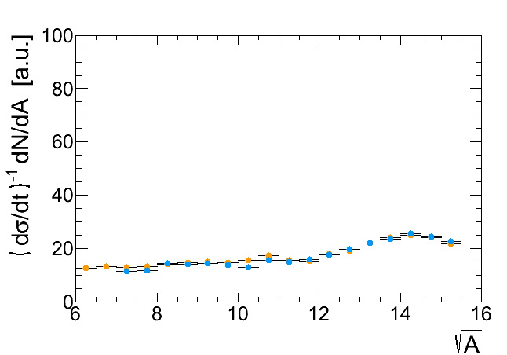
Estimation of background effect. Method II
Two methods for background subtraction
- from the fit
- average background
The method is not verified yet

Slide 25
Summary
H-Jet polarimeter provide reliable measurements of the average beam polarizations at RHIC.
Several calibration methods were developed which allow us to monitor energy calibration with a percent accuracy as well as to make a precise alignment of the detectors.
Study of background due to the beam gas is underway
Molecular hydrogen in the Jet gives the largest uncertainty in the polarization measurements.
For future we are considering replacing of the WFD system from the old 8-bit CAMAC based to the recently developed JLab’s 250 MHz VME-based.
We are developing new Si detectors to increase acceptance and energy range.

Slide 26
Backup

Slide 27
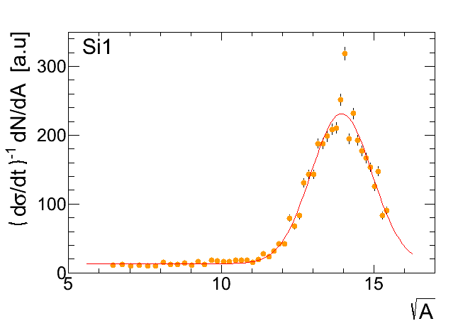
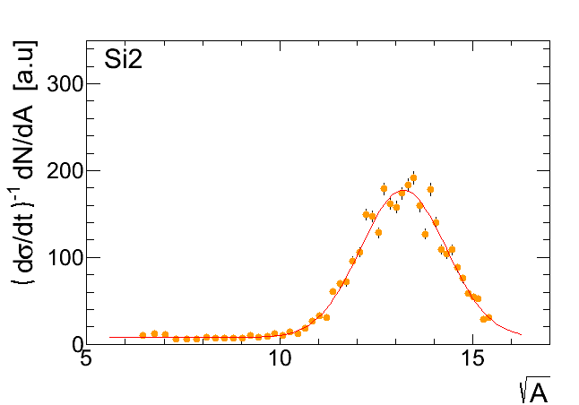
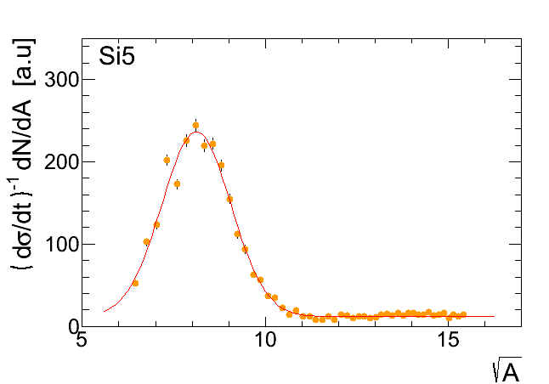
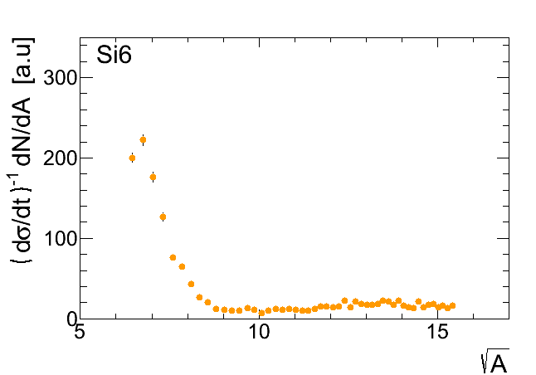
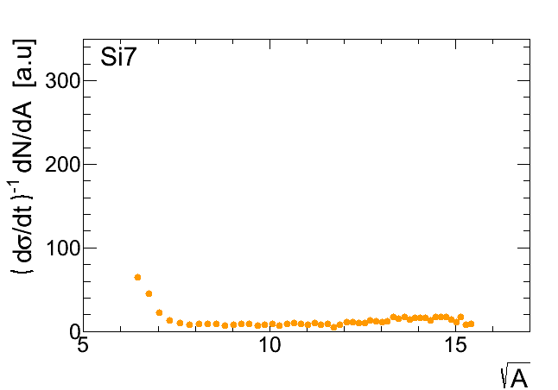
for eight (yellow) strips of the detector 1 (Fill 17273)
pp peaks (jet profile)
“flat” background
background from prompts
pp signals and backgrounds are approximately the same in all strips.
5 pp signals may be used for calibration. Other – to evaluate background

Slide 28
for eight (yellow) strips of the detector 1 (Fill 17600)
pp peaks (jet profile)
“flat” background
background from prompts
pp signals and backgrounds are approximately the same in all strips.
5 pp signals may be used for calibration. Other – to evaluate background

Slide 29
Background Evaluation
The algorithm is satisfactory for the calibration purposes.
To study background asymmetry, an improvement is needed.

Slide 30
Systematic Errors in the H-Jet Measurements
Jet Polarization: there are 2 hydrogen components in the jet:
- atomic with (measured) polarization P_{BR}≈96%
- molecular (unpolarized)
The admixture of molecular hydrogen was measured to be ε≈ 3% but, but systematic errors of this measurement is not well known. The average polarization
P_{jet} = (1- ε) ×P_{BR} should be used in analysis
Background:
r ~ 5% is background level
For Jet asymmetry α=0. For beam asymmetry α is unknown and may be as large as 1 (e.g for beam gas protons).
(some previous experimental estimates gave α≈0)
In ONLINE analysis the value of P_{jet} = 92% was used.

Slide 31
Detector 1 after background subtraction
Inelastic pp ?
Background subtraction works !
All n(z) profiles must be the same (if gain and cuts are the same)

Slide 32
Analyzing Power
Used for polarization measurements
pp-CNI
24 GeV/c
100 GeV/c
24 GeV: PRD 79, 094014(2009)
31 GeV: Preliminary
100 GeV: PLB 638 (2006) 450
250 GeV: Preliminary
● 2004
● 2011
● 2012
● 2011
● 2009 (blue)
● 2009 (yellow)
255 GeV
Average Analyzing Power in Run 13:
Variations of the measured value of AN are less than 1%

Slide 33
Systematic Errors in the H-Jet Measurements
Jet Polarization: there are 2 hydrogen components in the jet:
- atomic with (measured) polarization P_{BR}≈96%
- molecular (unpolarized)
The admixture of molecular hydrogen was measured to be ε≈ 3% but, but systematic errors of this measurement is not well known. The average polarization
P_{jet} = (1- ε) ×P_{BR} should be used in analysis
Background:
r ~ 5% is background level
For Jet asymmetry α=0. For beam asymmetry α is unknown and may be as large as 1 (e.g for beam gas protons).
(some previous experimental estimates gave α≈0)
In ONLINE analysis the value of P_{jet} = 92% was used.

Slide 34
Estimation of background effect. Method I
Oleg Eyser:
4.4 mm
Bunches with a single beam (abort gaps) may be employed to understand background
Single beam stores (blue and yellow) at the end of Run 13
The method is under development.

Slide 35
Summary
.

