Slide 1
Polarimetry at the AGS
Andrei Poblaguev
Brookhaven National Laboratory
The RHIC/AGS Polarimetry Group:
I. Alekseev, E. Aschenauer, G. Atoian, A. Bazilevsky, K.O. Eyser, H. Huang,
Y. Makdisi, A.Poblaguev, W. Schmidke, D. Smirnov, D. Svirida, K. Yip, A. Zelenski

Slide 2
Polarized Proton Beams at RHIC
Absolute Polarimeter (H jet)
RHIC pC Polarimeters
Siberian Snakes
PHENIX (p)
Spin flipper
STAR (p)
Spin Rotators
(longitudinal polarization)
Spin Rotators
(longitudinal polarization)
Solenoid Partial Siberian Snake
LINAC
BOOSTER
Pol. H⁻ Source
Helical Partial
Siberian Snake
200 MeV Polarimeter
AGS
AGS pC Polarimeter
Strong AGS Snake
AGS CNI pCarbon polarimeter (96 channels)
- is used for beam development at AGS
- monitors polarization delivered to RHIC

Slide 3
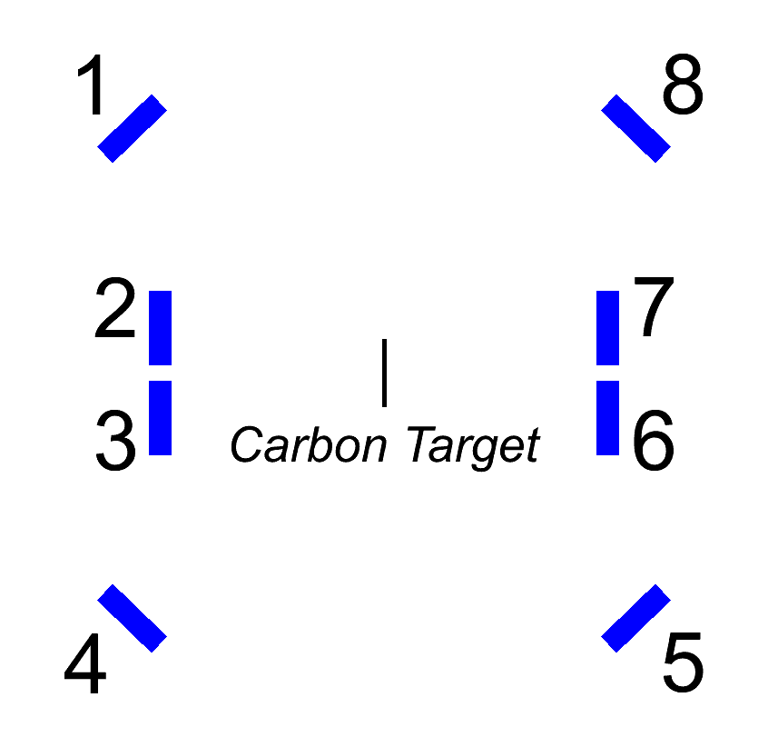
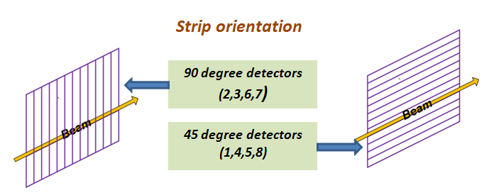
AGS CNI Polarimeter 2013
3 different detector types:
1,8 - Hamamatsu, slow preamplifiers, L = 51 cm
2,7 - BNL 2mm, slow preamplifiers, L = 30 cm
Right
Left
3,6 - BNL 1 mm, slow preamplifiers, L = 30 cm
4,5 - Hamamatsu, slow preamplifiers, L = 51 cm
outer
inner
Every detector consists of 12 Si strips.
Carbon target foils:
Thickness: 27 nm
Width: 50 and 125 μm (Vertical)
75 and 125 μm (Horizontal)

Slide 4
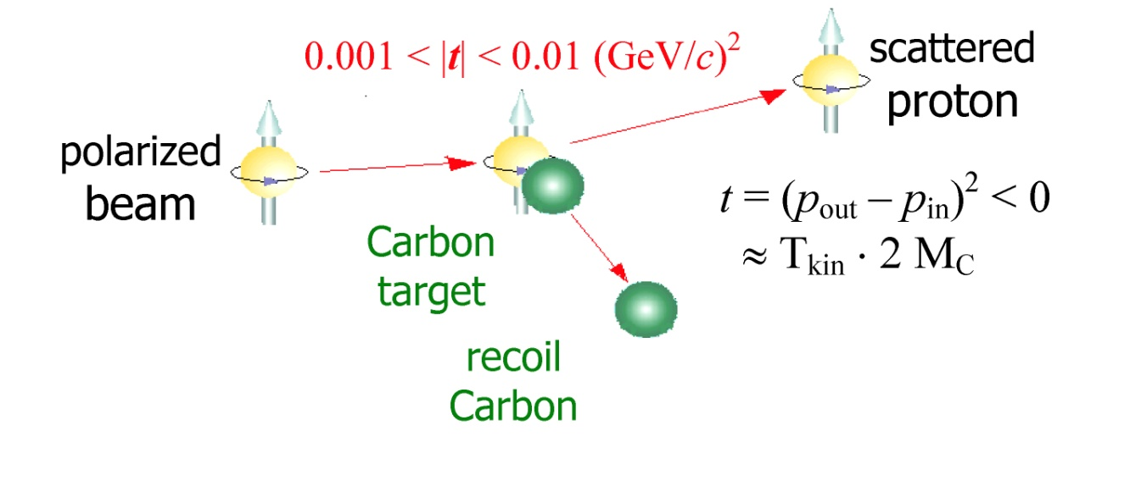
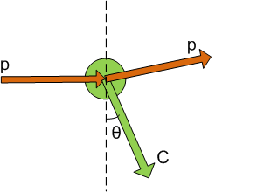
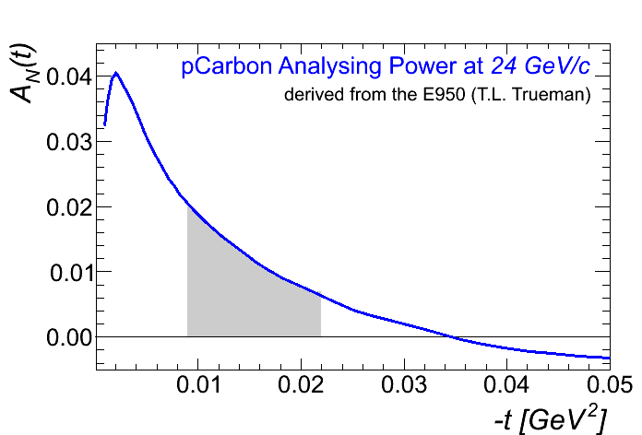
Proton-Carbon Polarimeter kinematics
Plan view
Beam polarization P may be derived from the left-right asymmetry of the low energy (Coulom-Nuclear Interference region) recoil Carbon production:
a_{LR} = A_{N}(t) P
Multiple scattering θ_{mult} in the target is essential for the AGS polarimeter
Event selection in RHIC/AGS pC polarimeters:

Slide 5
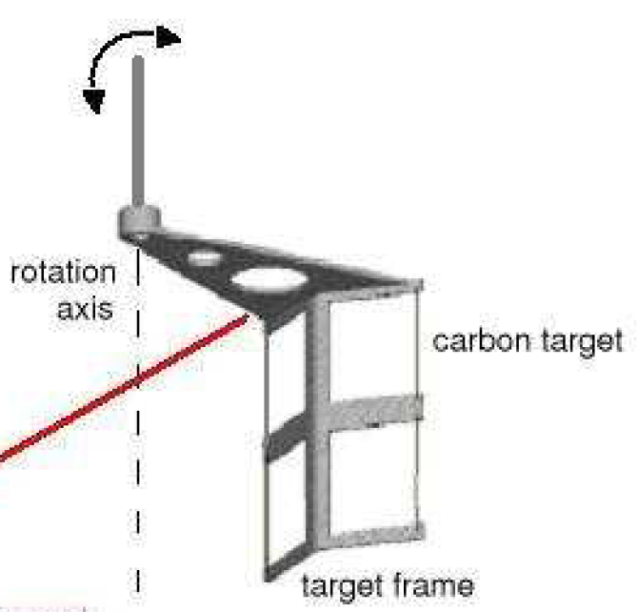
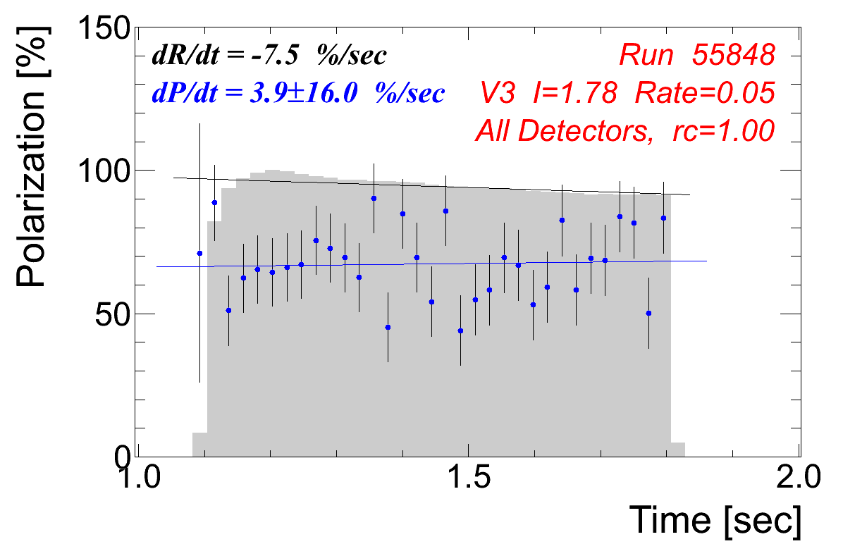
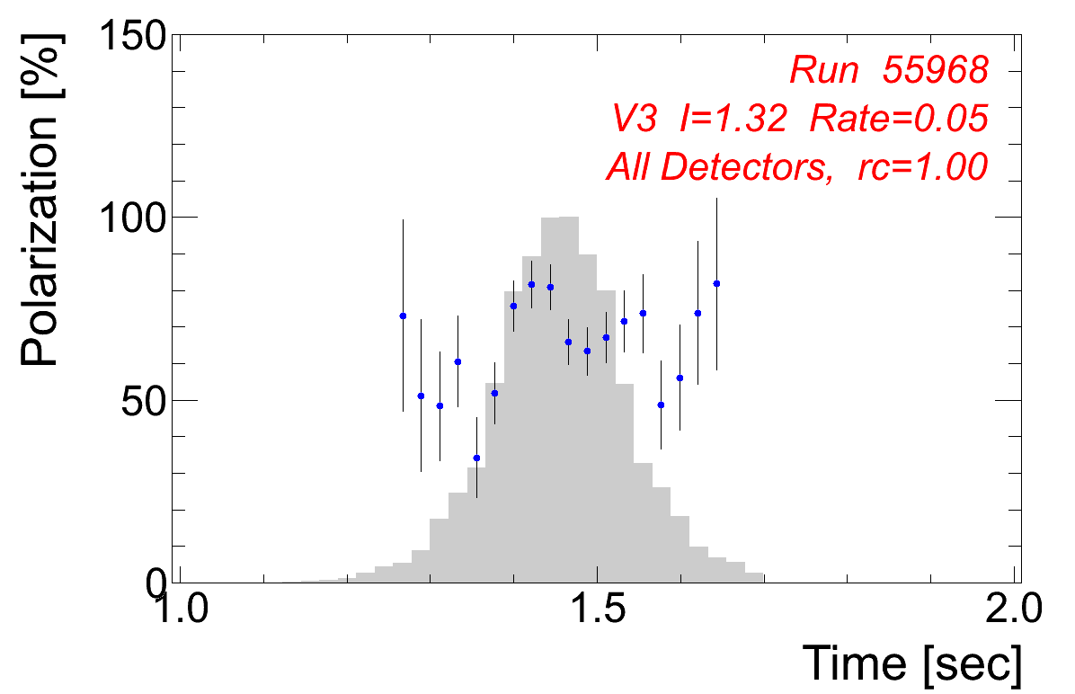
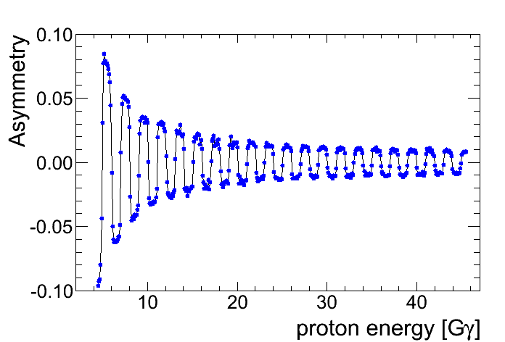
Measurement Types
The target is being moved in/out the beam every AGS cycle (4 sec)
Fixed Target measurement: target is putt to the center of beam, polarization is measured at flattop. Constant rate in the detectors.
Profile (moving target) measurement: target is uniformly moving during the measurements. Rate in the detectors follows the beam profile.
Ramp measurement: the fixed target measurement during the acceleration. Polarization flips at integer values of Gγ.
beam
Fixed Target:
Mooving Target:
Ramp Measurement:

Slide 6
Polarization Measurement
L
R
Spin dependent amplitude:
Rate in the detector:
Two methods to measure polarisation:
Beam intensity has to be controlled with 10⁻⁴ accuracy.
1. Spin Flip (one detector):
2. Left-right asymmetry
(two detectors)
Detector acceptamces has to be controlled with 10⁻⁴ accuracy.
Square-root formula:
Combining “spin flip” and “left/right asymmetry” methods allows us to suppress systematic errors

Slide 7
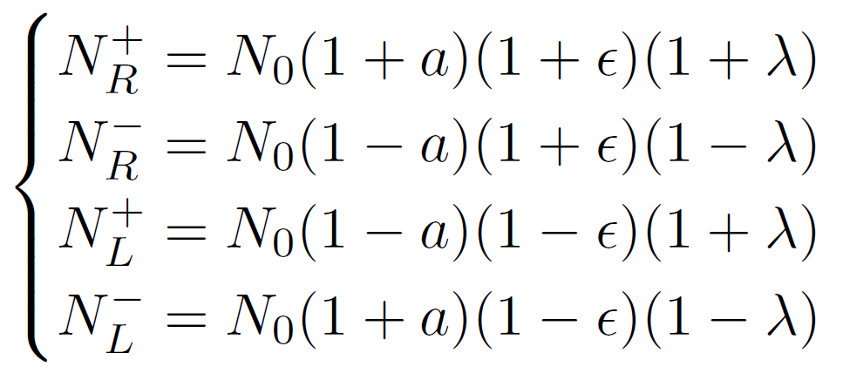
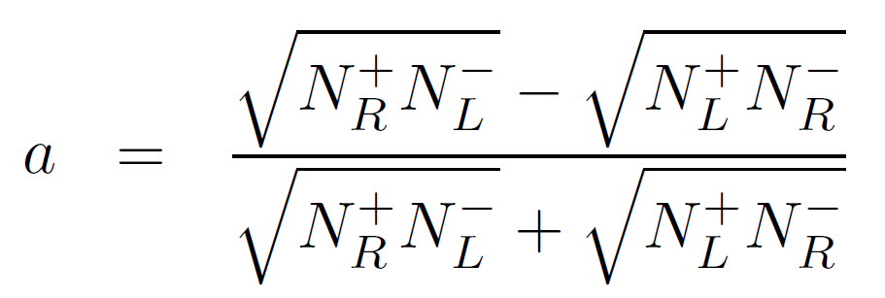
Square Root Formula in details
+
L
R
-
Number of events in a detector:
Exact solution
(Plus similar equations for the ε and λ)
a – polarization asymmetry
ε – acceptance asymmetry
λ – intensity asymmetry
Square root formula is absolutely valid as long as there is
no correlation between a, ε, and λ.
(and if we neglect statistical errors in measured number of events)

Slide 8
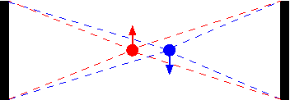
Possible correlation between asymmetries
Actually δ_{ε}, δ±, δ_{LR} are systematic errors in measurements of the a, ε, and λ, respectively
δ_{ε} - acceptance asymmetry dependence on beam polarity.
Possible source: a shift between averaged beam/target positions for
positive and negative polarities.
Was experimentally estimated to be negligible.
δ_{LR} – left right asymmetry of the calculated analyzing power due to inaccurate calibration etc.
May be experimentally evaluated by studying of λ in different groups of detectors.
δ± - physics asymmetry (analyzing power) dependence on beam polarity.
Was experimentally estimated to be negligible.
Systematic errors of the measurements of physics asymmetry a are negligible.
Systematic errors of the measured polarization are dominated by the accuracy of calculation of analyzing power due to the calibration, backgrounds and knowledge of A_{N}(t).

Slide 9
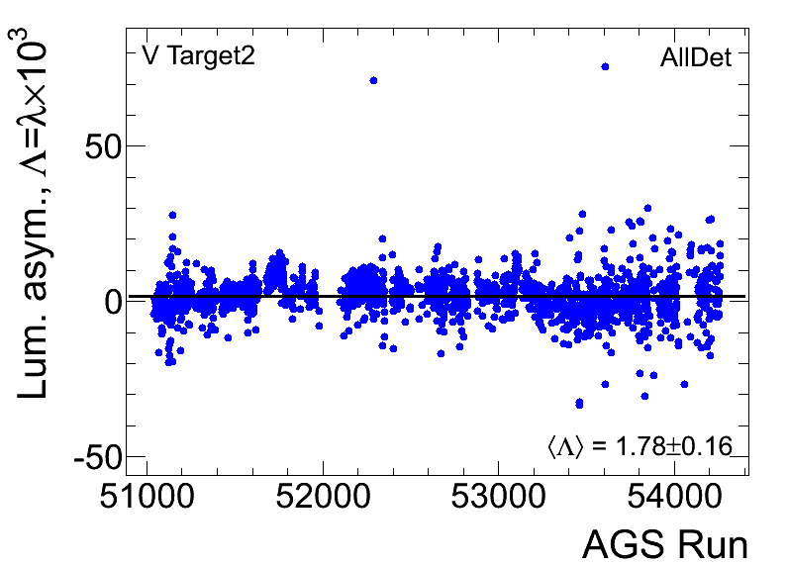
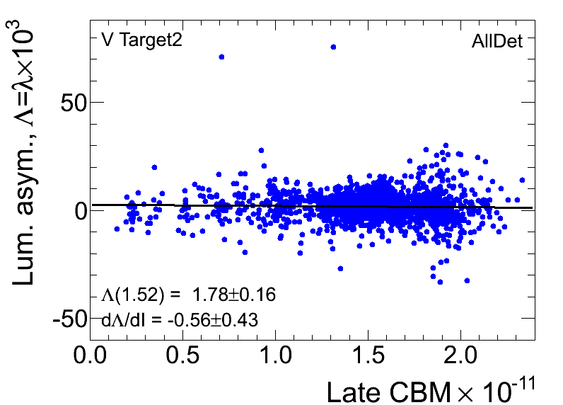
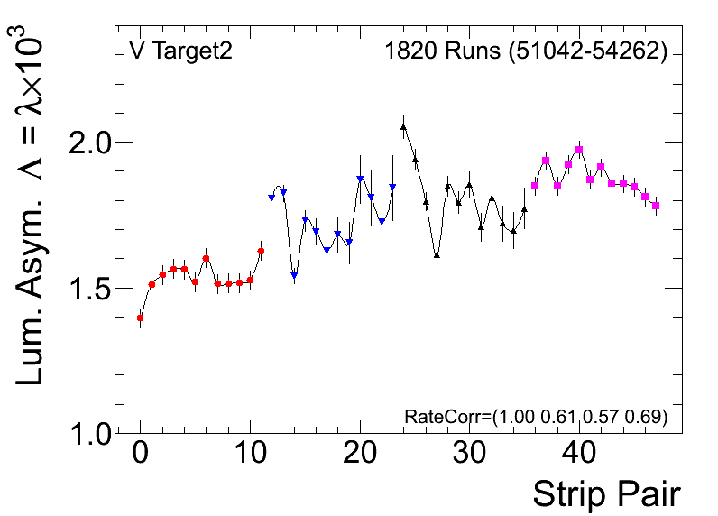
δ_{LR} – left right asymmetry of the analyzing power
λ is the same for any strip pair.
We can evaluate δ_{LR .}
δ_{LR} should be compared with a≈ 10⁻²
Possible contribution to the polarization accuracy:

Slide 10
Substitution of the square root formula for a
general (non-symmetric) detector configuration
For n detectors, there are 2n equations and n+2 unknown values. To find P, λ, G_{i} we should minimize the
Iteration method:
0. P=0, λ=0
1.
2. Minimize χ² with fixed G_{i}. (Find P and λ)
3. Goto 1.
The method works well in the case of asymmetric detectors. For example, 90 degree detectors in one side and 45 degree in other side
For the standard (left-right symmetric) detectors configuration, the method does not give significant improvement compared to the square root formula.
The method is helpful if some detectors are broken.
Also, the method may be used to study single detectors.

Slide 11
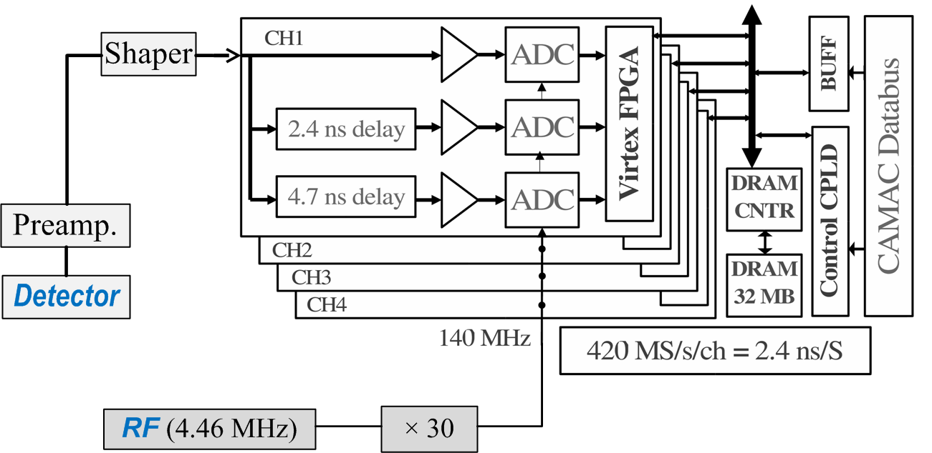
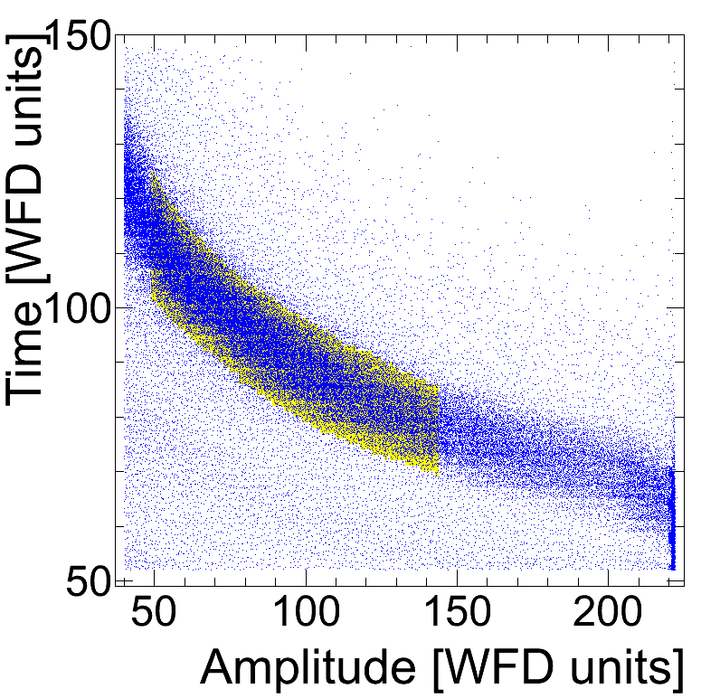
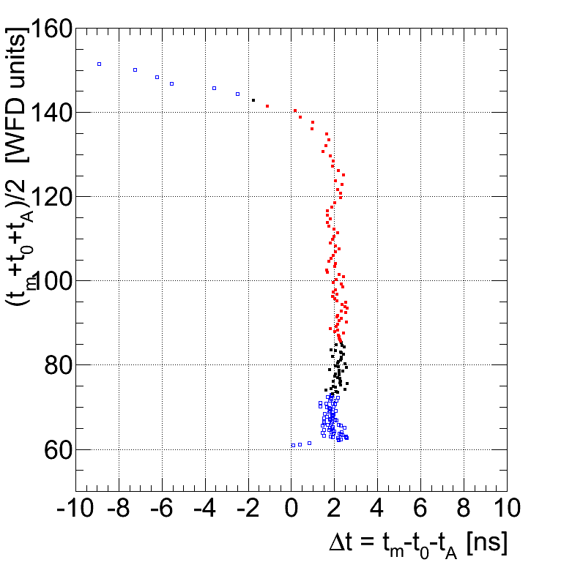
Schema of Mesurements
WFD
α-source measurements (²⁴¹Am , 5.486 MeV)
“Banana fit”
t-t₀ = t_{A}(x_{DL},αA)
Parameters α, x_{DL} , and t₀ have to be determined in a calibration.
Standard measurement (run):
40 M events (20M good events)
Data is acquired from few to few tens minutes depending on beam intensity and emittance, target thickness, etc.
Data analysis takes about 5 sec.
Polarization is measured with statistical accuracy δP≈2%

Slide 12
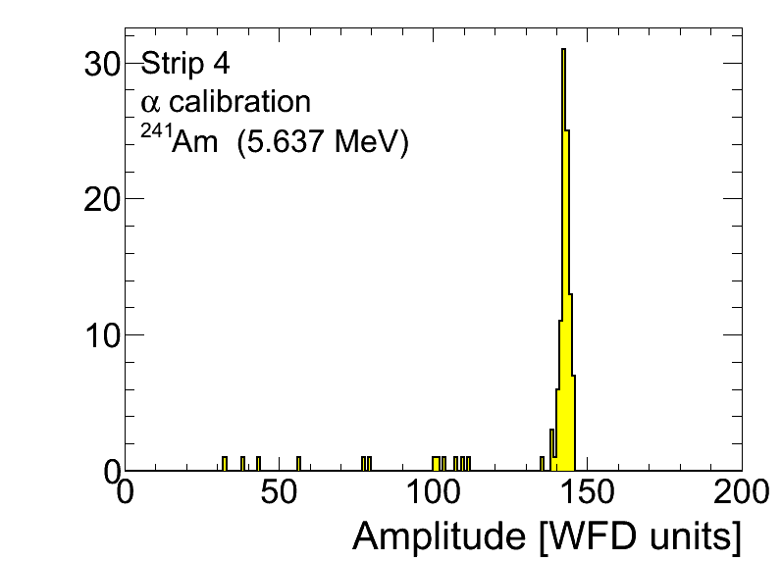
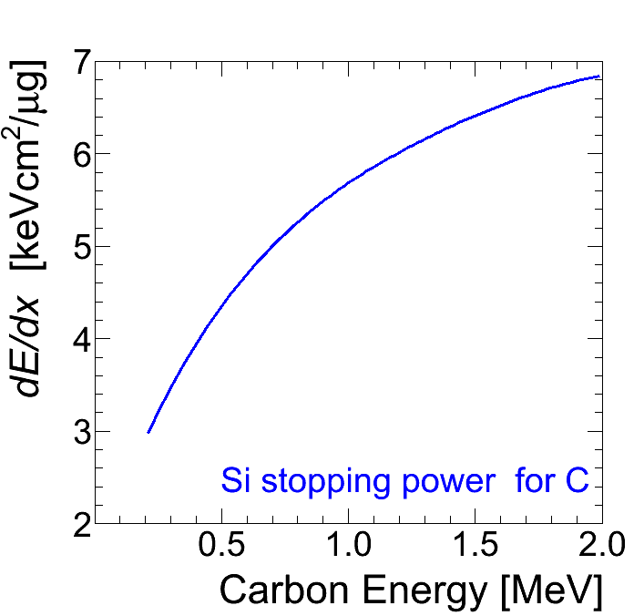
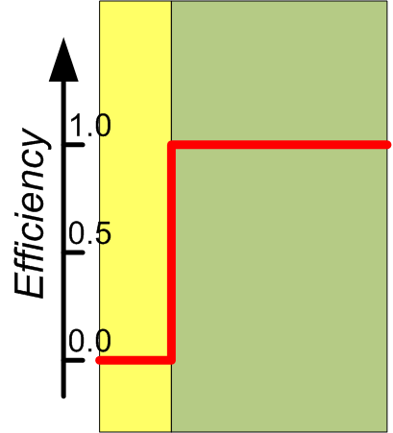
Calibration
Since A_{N}=A_{N}(E), energy calibration is crucial for the polarization measurement δP/P≈δE/E
From experimental data, can find the dependence between measured time and amplitude:
If t₀ is known, we can calibrate detector in a model independent way:
ADC gain is calibrated using α-source ²⁴¹Am : E_{dep} = αA
A dead-layer approximation:
Stopping range:
A dead-layer condition:
Using MSTAR parameterization for the dE/dx,
we can determine t₀ and x_{DL} from the data fit
Dead Layer

Slide 13
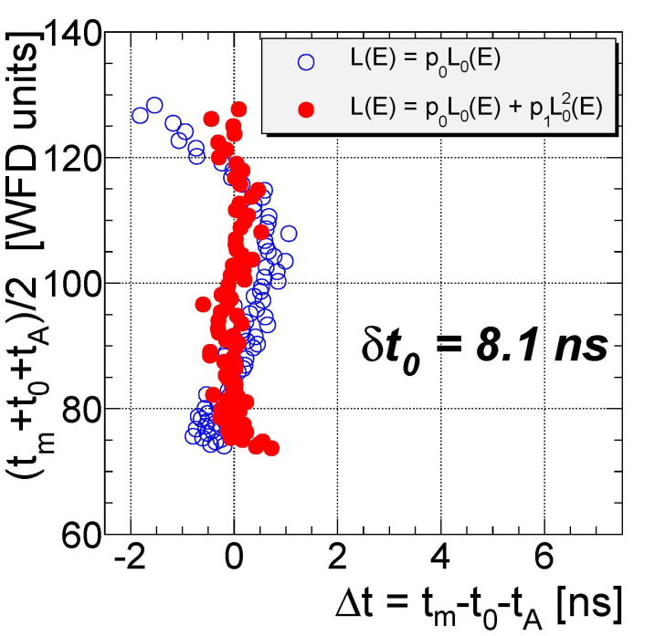
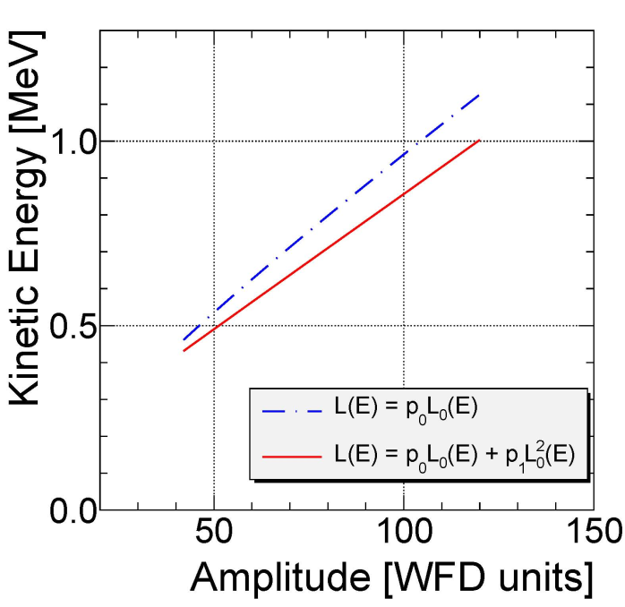
Comments about Dead-Layer based calibraion
This calibration is very sensitive to small variations of the stopping power and dead-layer model.
Comparison of the “standard” and “modified” calibrations
t_{m} is measured time
t_{A} is time derived from the
measured amplitude
Normalized stopping range
L₀ (E) = L_{MSTAR}(E) / x_{DL}
Fit function:
L(E_{t}) – L(αA) = 1
The modified stopping range L(E) = p₀L₀(E) + p₁L₀²(E) fits data much better.
Energy calibrations are significantly different. Better fit does not garantee better calibration.
More study is still needed.

Slide 14
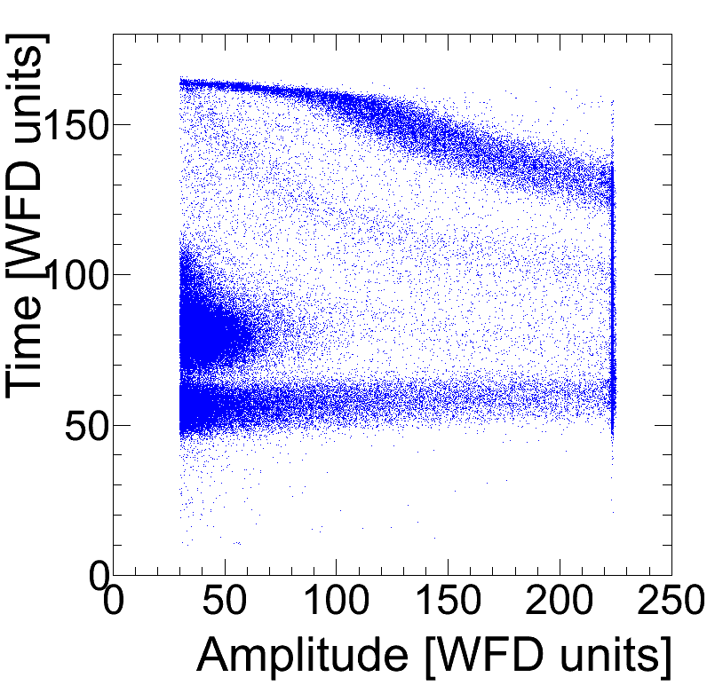
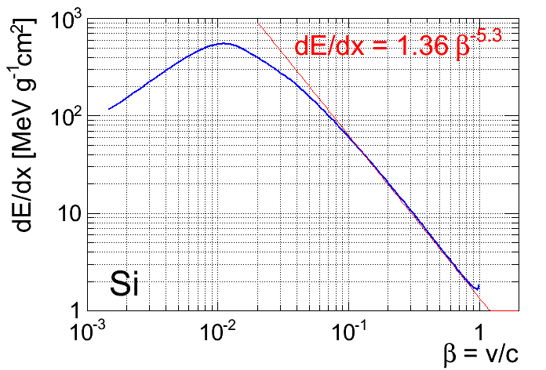
Calibration using fast (punch through) protons
Low Energy Carbons
Bethe-Bloch formula:
Alpha (?)
Low energy protons (?)
Fast π and p
“Induced” pulse
Measured amplitude:
For d=300 μm and α=6.6 keV:
Time of flight:

Slide 15
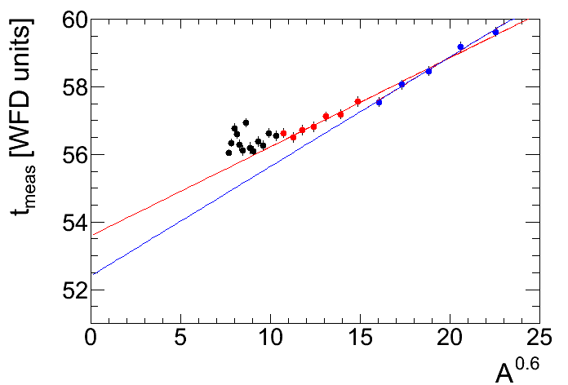
Fast protons data fit
Low energy data is disturbed by “induced pulse”!
t = t₀ + kA^{0.6}
A > 50
t₀ = 53.6±0.2
k = 0.26±0.01
χ² = 10.5 / 10
A > 100
t₀ = 52.4±0.5
k = 0.32±0.03
χ² = 1.3 / 3
In agreement with expectations k=0.34 !
Potentially, fast protons allows us to measure t0 in a simple fit.
The results of the fit are controllable.
Knowledge of t0 allows us to calibrate detector in a model independent way.
The measurements are affected by the “induced pulse”
The method is not verified yet

Slide 16
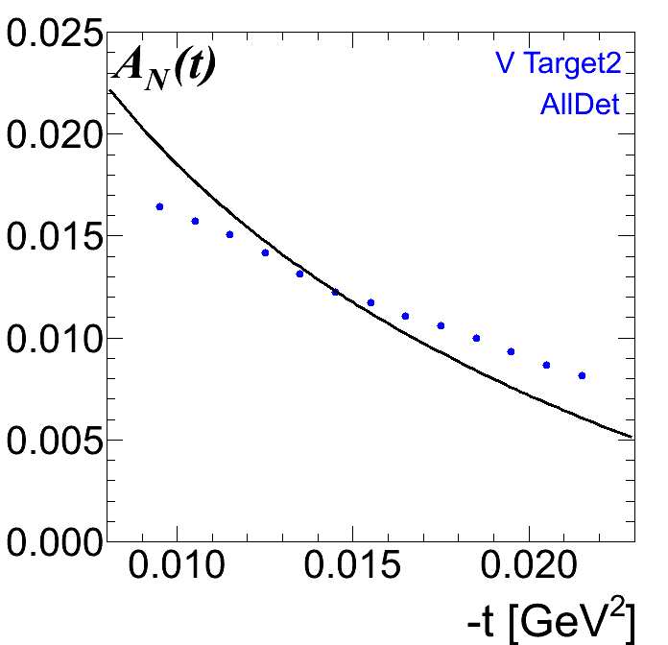
Analysing Power
We can measure the asymmetry of proton productions for different energy intervals, and, thus, we can measure analysing power (up to a normalization factor unless the beam polarization is known)
There is a poor consistency between measured (blue dots) and theoretical A_{N}(t).
Possible explanations:
Theory is not good
Energy losses in the target
(effect must be much smaller)
Wrong energy calibration
We will continue to use the theoretical A_{N}(t) and “standard” calibration until the “calibration problem” will be exhaustively resolved.

Slide 17
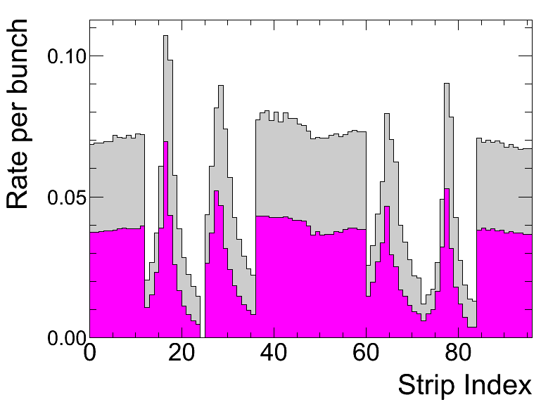
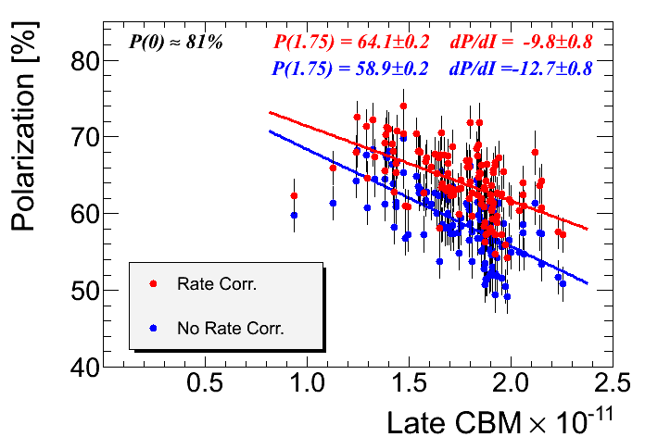
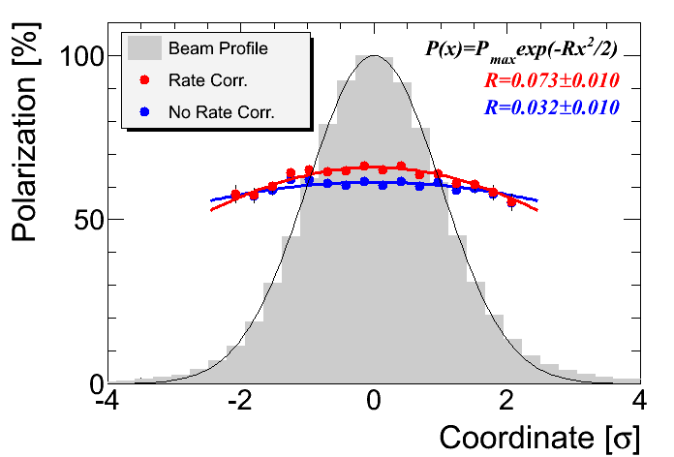
Rate Corrections
Run 58731
In a single Si strip, rate per bunch is
r ≈ 0.05-0.10 (Run2013)
(depends on intensity, emittance, target, …)
The Data Acquisition may take only one events per bunch.
No good event may be detected even if both coincide
signals are good.
Good event detection efficiency is rate dependent
ε_{good} = 1 – kr
The factor k may be very roughly evaluated as:
k = 1-ρ/2 ≈0.75 (ρ = r_{good}/r≈0.5)
Polarization in RHIC reference runs
The measured Polarization is underestimated:
Rate correction should be implemented
The factor k should be experimentally estimated.
2012
Horizontal Polarization Profile
Several methods to estimate k were tested.
Even though neither method was proved as reliable,
we can estimate the accuracy of rate corrections:
δk ≈ 0.1-0.2 → δP ≤ 1 %
2012

Slide 18
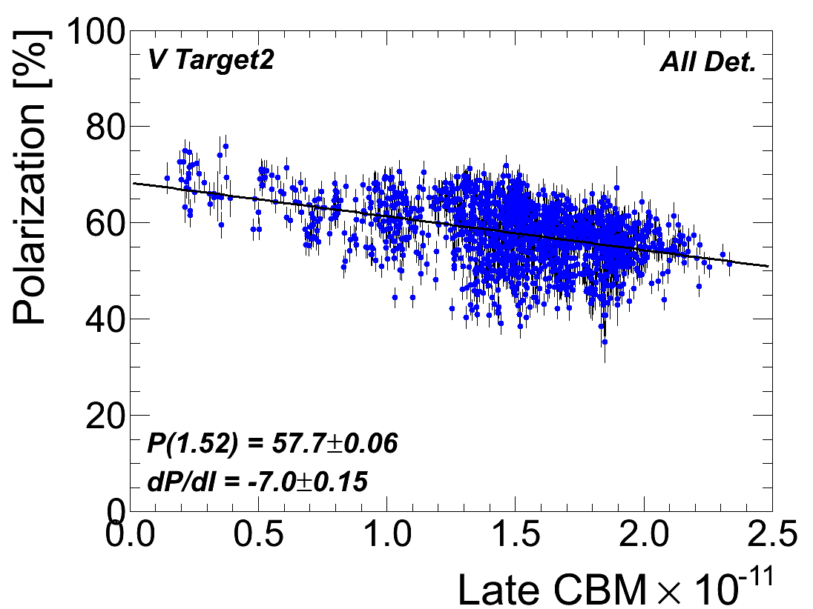
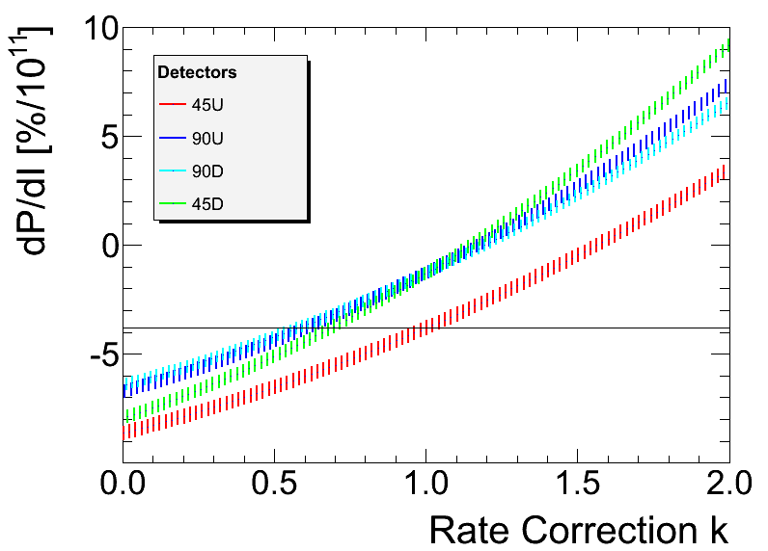
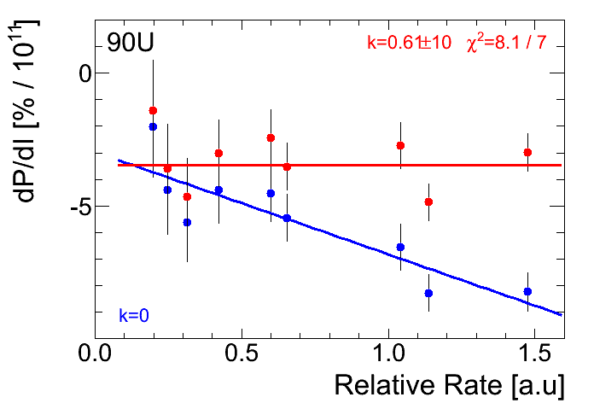
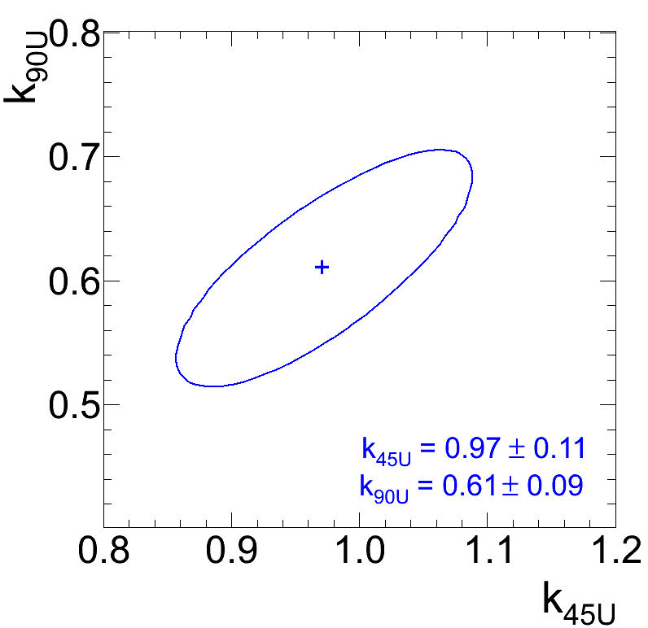
Rate Correction Factor. Method I.
All detectors measure the same polarization.
The average slope, dP/dI must be measured the same in all detectors
if rate corrections are properly applied.
The rate in vertically oriented strips (90 deg. detectors) are systematically different.
All 2012 runs
dP/dI dependence on rate correction
Vertical strip pairs
No Rate Corrections
The drawbacks of the method:
poor statistical accuracy even for the full year statistics
If the rate correction factor is not the same for all
vertical strips, the result may be unpredictable.

Slide 19
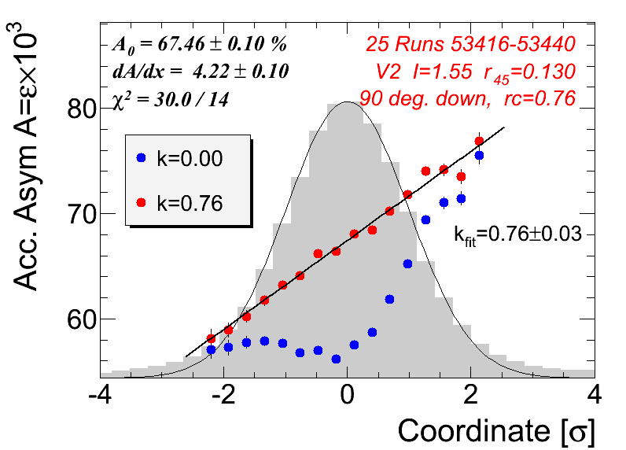
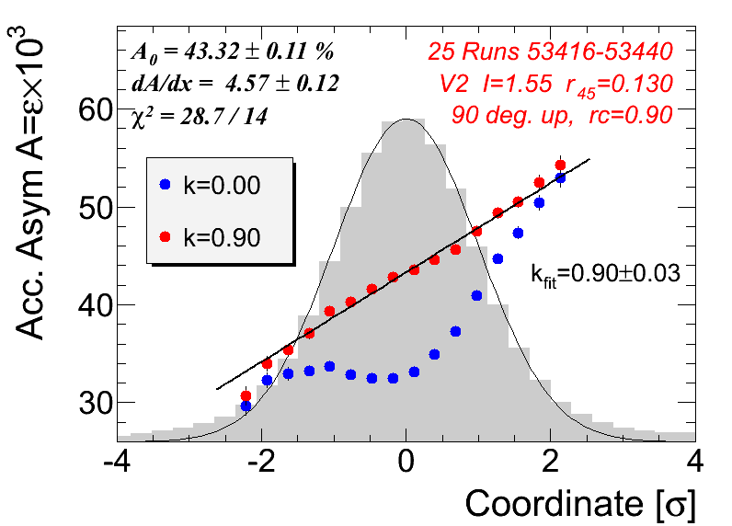
Rate Correction Factor. Method II.
The detector acceptance asymmetry ε is affected by the rate corrections in the same way as polarization is.
In the profile measurements, acceptance asymmetry linearly depends on the target coordinate:
ε = ε₀ + cx
BNL 1 mm
BNL 2 mm
The method works well in the above example, but did not work in some other cases.
There may be some contributions to the acceptance in addition to the solid angle.

Slide 20
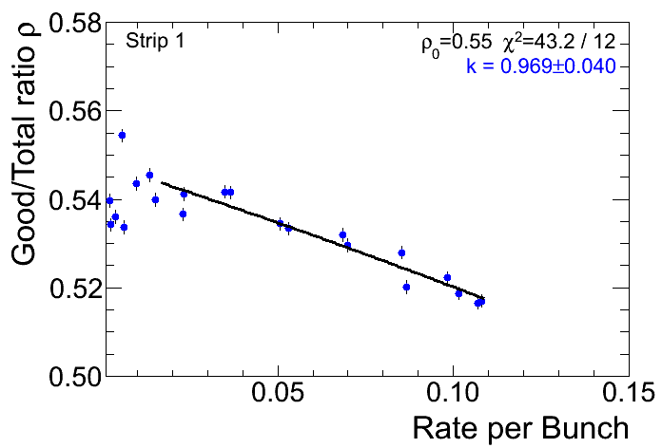
Rate Correction Factor. Method III.
A pileup probability of any event detection
Probability that detected event is “good”
Detection efficiency:
Advantage oh the Method:
A single sweep target run provides acceptable
statistical accuracy.
Rate correction parameter may be measured for each strip separately.
Single Run Measurement (sweep)
Possible problems:
Wrong results at low intensities
Superimposing of 2 low amplitude signals (below DAQ threshold) may result into detected signal. This is not accounted by the method.

Slide 21
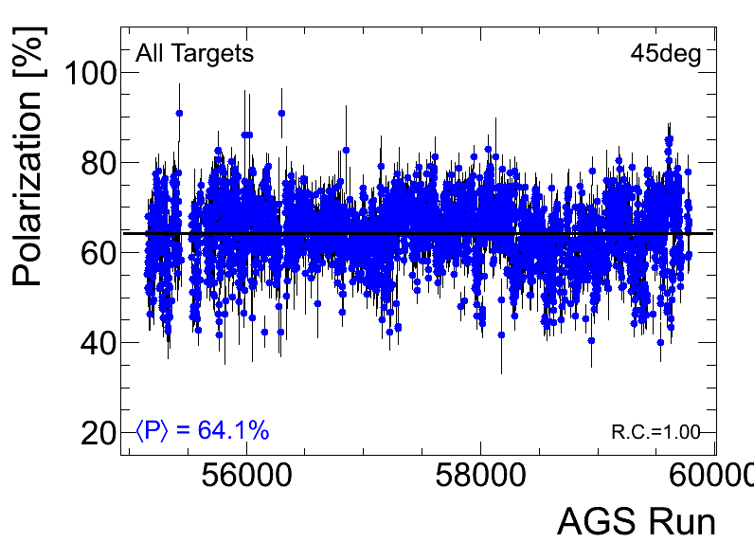
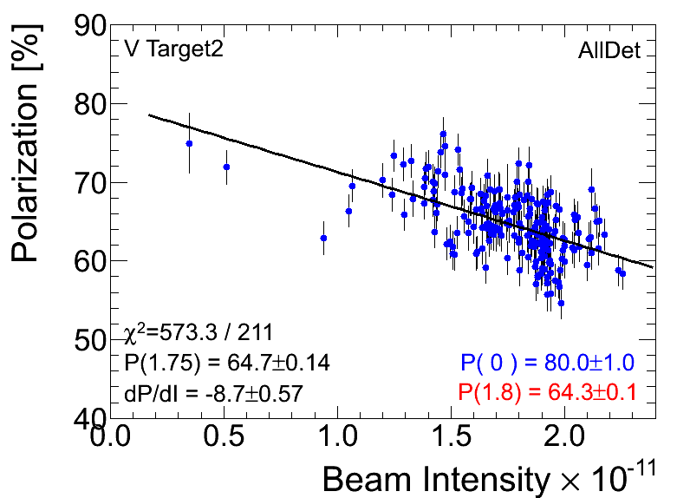
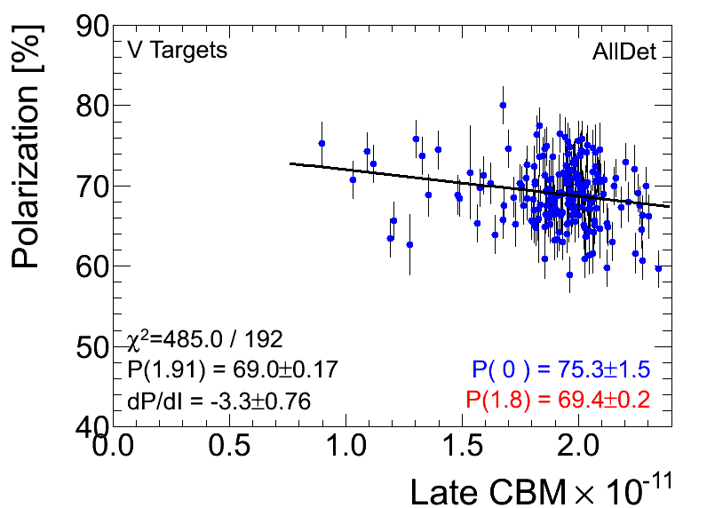
Run 13: Polarization at Flattop (24 GeV)
3800 Polarization measurements at flattop in Run 2013
200 Measurements for RHIC Fill monitoring
Polarization results are consistent with Run 12 with a possible few percent improvement.
Run12 RHIC ref measurements
Run13 RHIC ref measurements

Slide 22
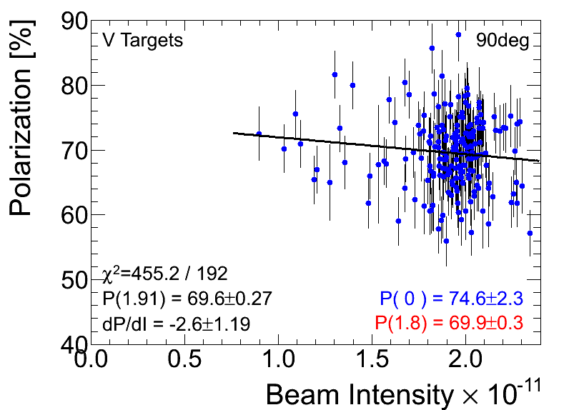
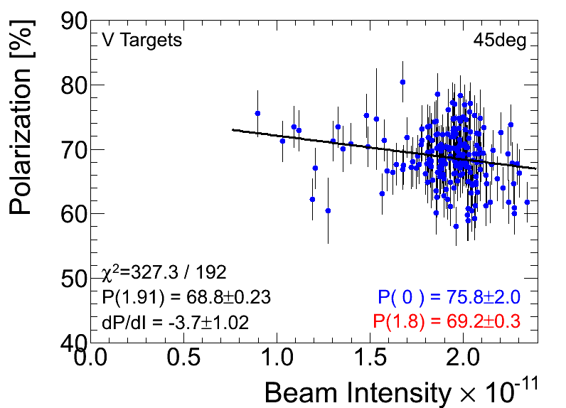
AGS p-Carbon Detectors: 90 degree vs. 45 Degree
The 90-degree and 45-degree detectors are essentially different:
different manufacturers
different strip orientations
different size
different distance to the target
Results are consistent within 1% accuracy.

Slide 23
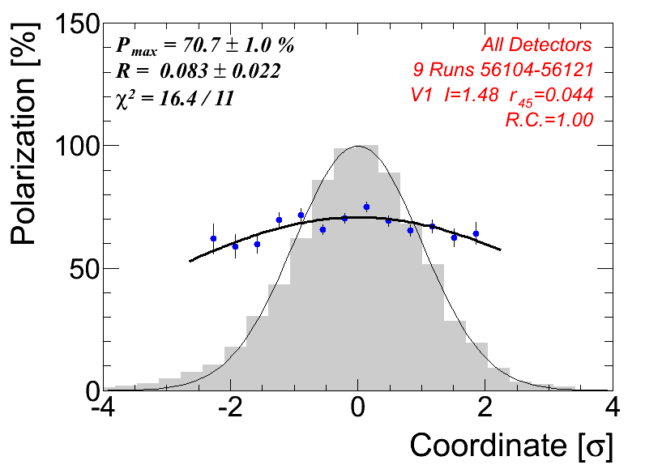
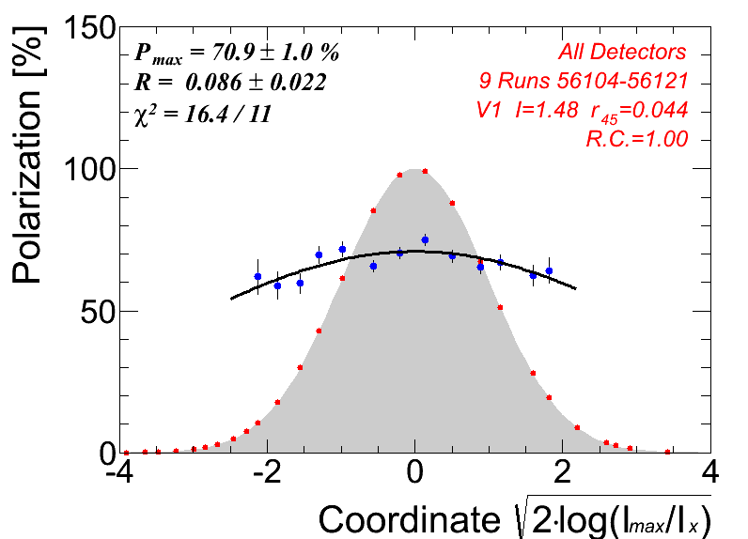
Polarization Profile
The x- and y- polarization profiles may be mesured using moving target (vertical and horizontal, respectively). In a fixed target run, the Pmax is measured.
Intensity and Polarizations profiles, I(x,y) and P(x,y),
are needed for the RHIC experiments
Gaussian Approximation:
(similar for y coordinate).
Average Beam Polarization (measured by polarimeter):
In Run13, in many measurements beam was moving in the beginning of measurements. As result coordinate was calculated incorrectly. Corrections may be applied.

Slide 24
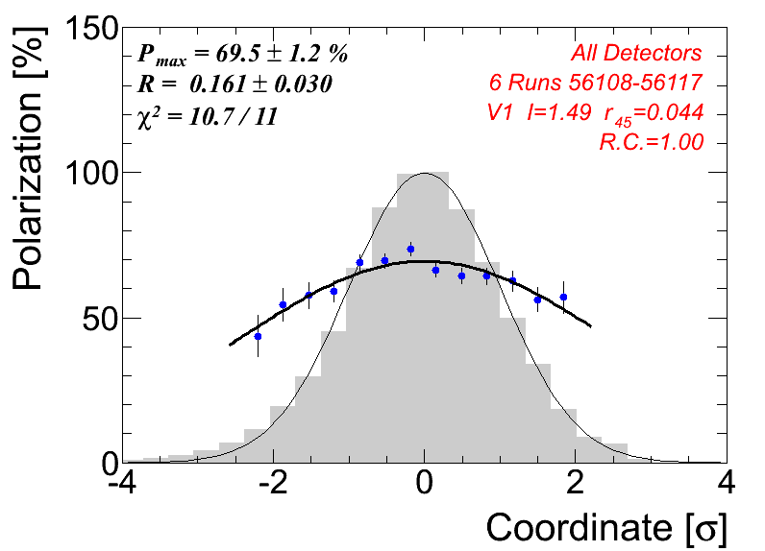
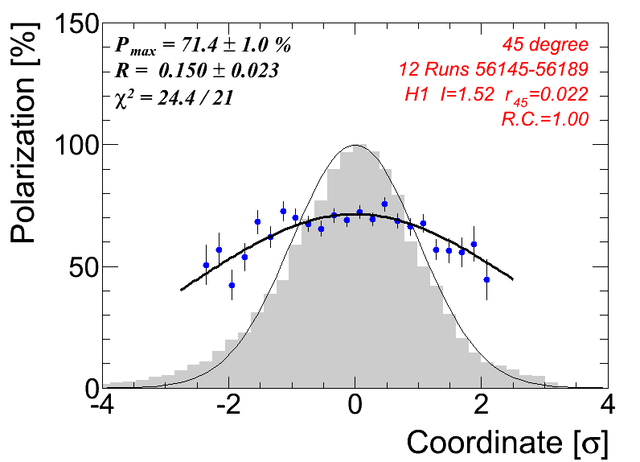
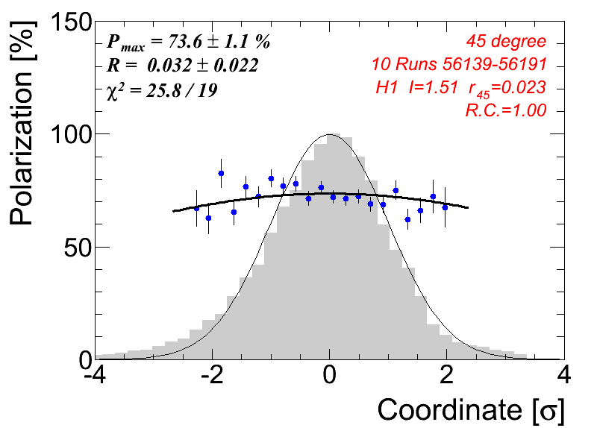
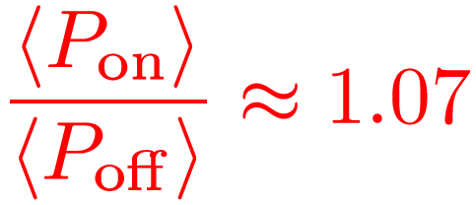
Jump Quads
Horizontal Profile
Vertical Profile
JQ OFF
JQ ON

Slide 25
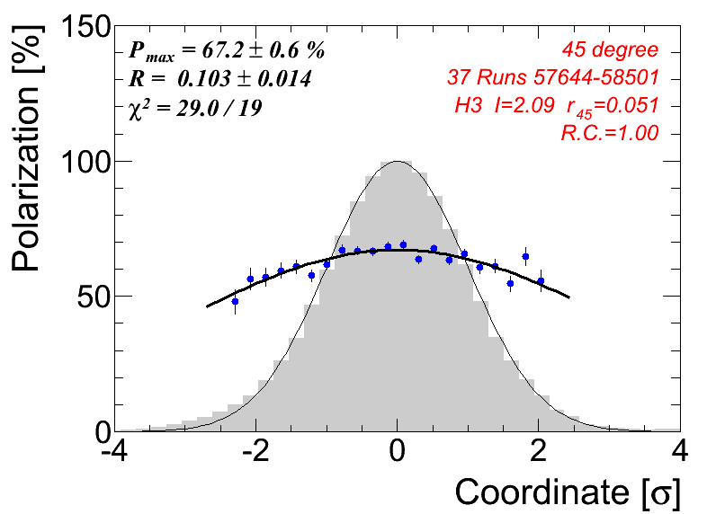
“Zero Emittance Polarization”
A model dependence between <P> and R:
(W. Fischer and A. Bazilevsky, Phys.Rev.ST Accel.Beams 15 (2012) 041001)
If the development of polarization profiles it the primary reason for the reduction of the average polarization :
P₀ = P_{source} is “zero-emittance polarization”.
In AGS polarimeter we can measure both (horizontal and vertical) polarization profiles:
Corrections:
c_{angle} – correction due to the polarization angle at injection
c_{target} – correction due to the energy losses in the target
systematic error of the source polarization measurement is included

Slide 26
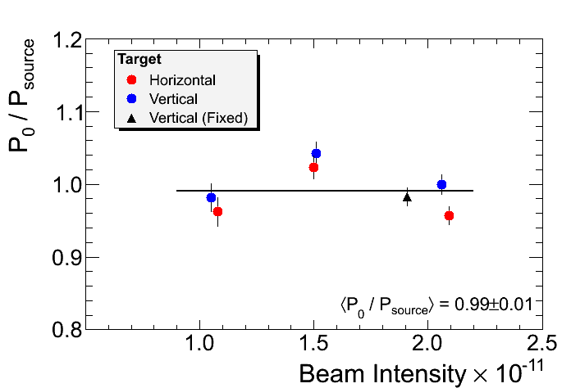
Measurement of P₀ at AGS
Target | Intesity | P_{max} | R | P₀ | P_{source}
V3 | 2.06 | 70.9 ± 0.5 | 0.098 ± 0.010 | 81.2 ± 1.1 | 81.2 ± 0.1
V3 | 1.51 | 74.2 ± 0.5 | 0.113 ± 0.010 | 85.5 ± 1.3 | 82.0 ± 0.1
V3 | 1.05 | 74.7 ± 0.8 | 0.049 ± 0.015 | 80.1 ± 1.6 | 81.6 ± 0.1
H3 | 2.09 | 67.2 ± 0.6 | 0.103 ± 0.014 | 77.5 ± 1.0 | 81.0 ± 0.1
H3 | 1.50 | 72.3 ± 0.8 | 0.093 ± 0.017 | 84.1 ± 1.3 | 82.2 ± 0.1
H3 | 1.08 | 73.2 ± 0.9 | 0.047 ± 0.016 | 78.6 ± 1.6 | 81.7 ± 0.1
V3 | 1.91 | 69.0 ± 0.2 | Fixed target | 79.7 ± 1.0 | 81.1 ± 0.1
If the model is valid:
The polarization scale of the AGS polarimeter is correct with a few percent accuracy.
The average beam polarization delivered to RHIC is <P>≈66% ( I ~ 2×10¹¹)

Slide 27
AGS p-Carbon: Polarization at Injection (2.4 GeV)
P_{source} = 75.9%
P_{source} = 77.8%
Arbitrary units for Polarization !
In AGS, polarization profile at injection was measured for the first time:
No polarization profile was observed at low intensity.
R≈ 0.02 at higher intensity
Analyzing power was not calibrated for the injection energy ( 24 GeV A_{N} was used instead)
P_{source} = 82.4%

Slide 28
Summary
The AGS pCarbon polarimeter provide fast and reliable relative polarization measurements
It is employed for monitoring polarization delivered to the RHIC as well as for numerous developments of polarized beam at AGS.
The statistical accuracy of the polarization measurement in a single run is about δP ~ 2%
The systematic accuracy of the relative measurement of polarization is about δP<2%
We may expect that the polarimeter measures absolute polarization with a few percent accuracy
The AGS pCarbon polarimeter may be used as absolute polarimeter if
- the conserving of “zero-emittance polarization” will be proved
- the energy calibration of the polarimeter detectors will be verified.

