Slide 1


HIGS Frozen Spin Target System (HIFROST)
Pil-Neyo Seo
University of Virginia
Triangle Universities Nuclear Laboratory (TUNL)
PSTP International Workshop, 9/10/13

Slide 2
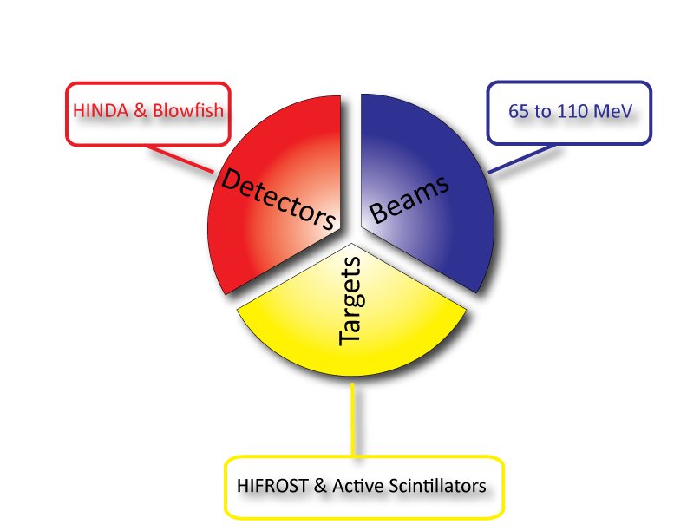
What is needed to execute experiments
~100 MeV
Ying Wu’s talk
17:40-18:10
Overview of the High Intensity
Gammra-ray Source at TUNL:
Capabilities and future upgrades

Slide 3
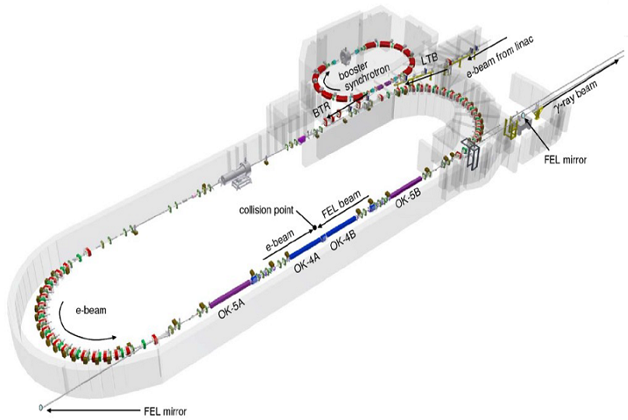
High Intensive γamma Source (HIγS)
Free electron laser from 192 to 780 nm
Compton backscattering to produce
γ-ray beam up to 100 MeV
Intracavity scattering leads to a very
intense beam (~10⁷ γ/s)
Monoenergetic beam (ΔE/E=0.7~4.0% with collimators)
Beam can be linearly or circularly polarized

Slide 4
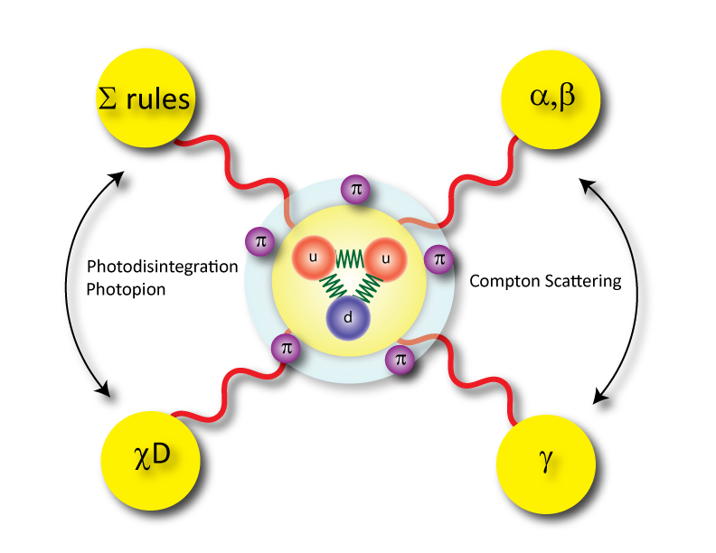
Motivation: HIFROST @ HIGS/TUNL

Slide 5
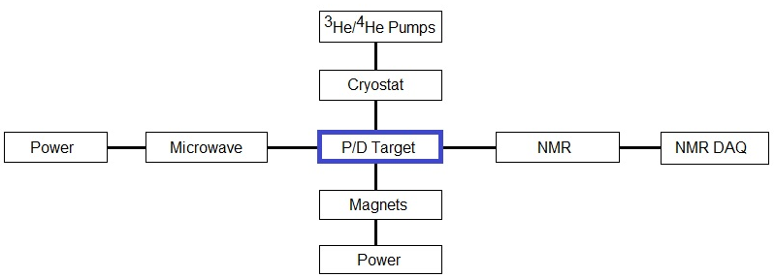
HIγS Frozen Spin Target (HIFROST) System

Slide 6
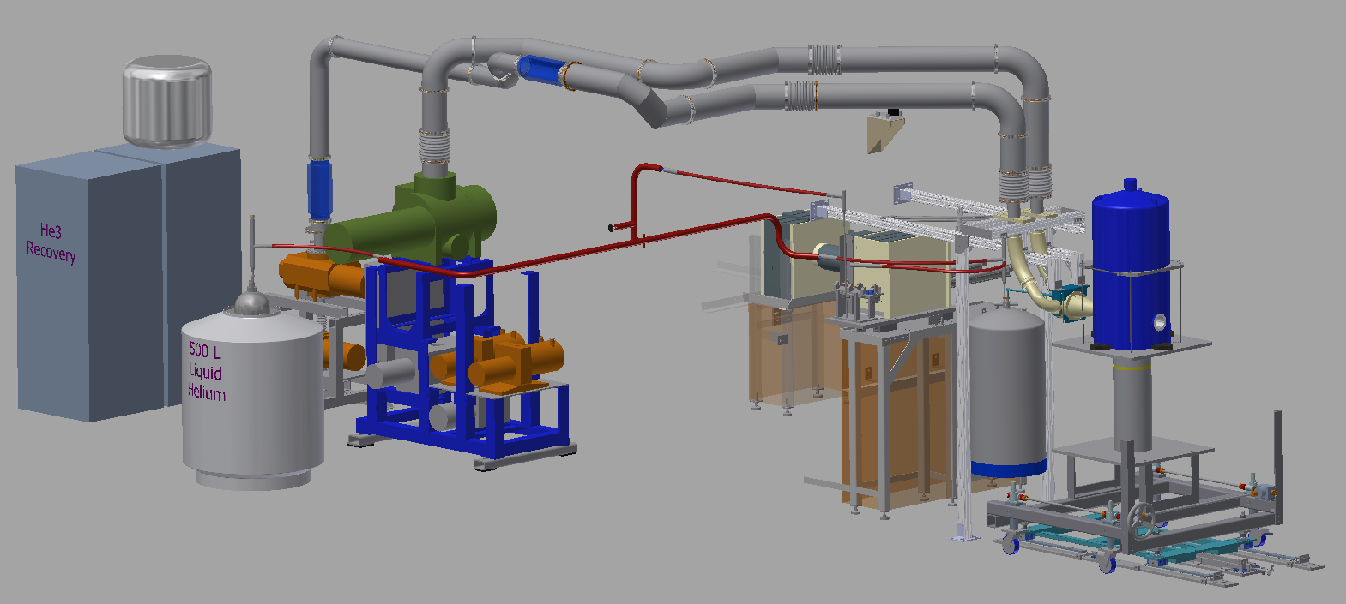
Conceptual Design of HIFROST
Polarization mode with 2.5 T SC magnet

Slide 7
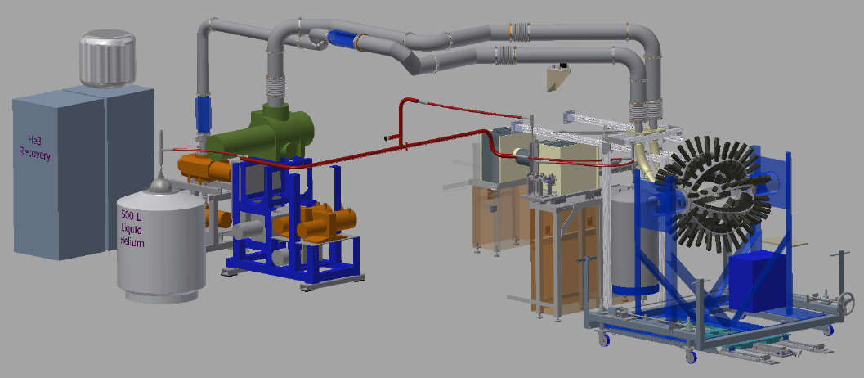
Conceptual Design of HIFROST
Data-production mode with a detector array

Slide 8
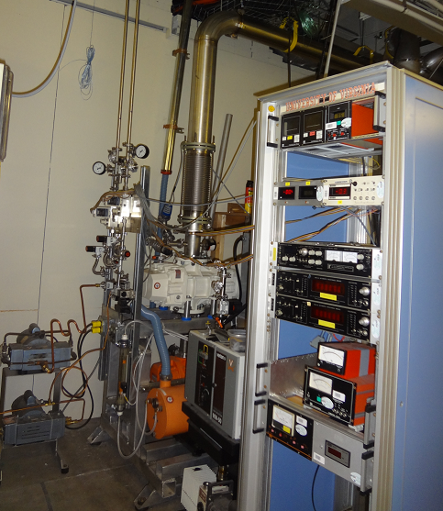
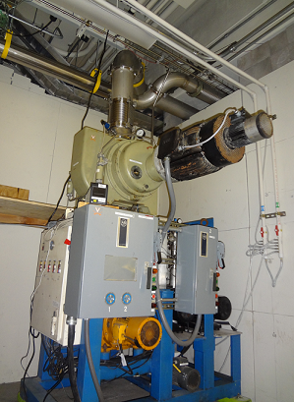
HIFROST System
³He (3 roots+2 mech pump) sys
⁴He (2 roots + 1 mech pump) sys

Slide 9

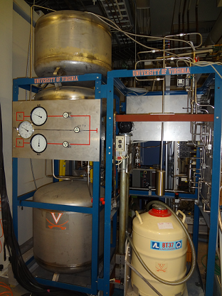
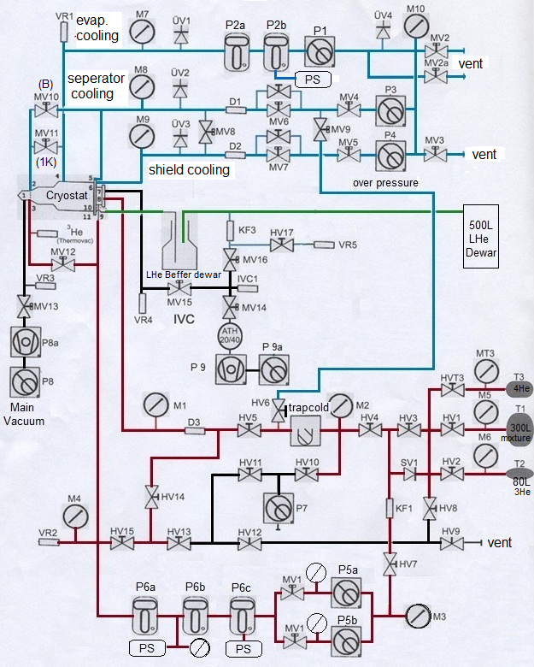
Gas Control System

Slide 10
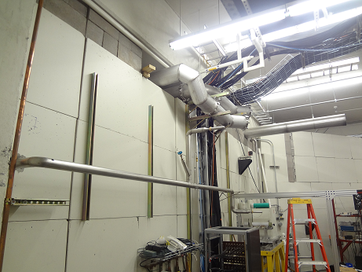
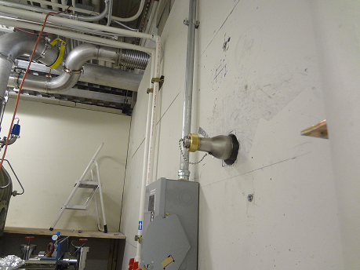
Gas Control System-LHe transfer line
inside gamma vault
Outside gamma vault

Slide 11
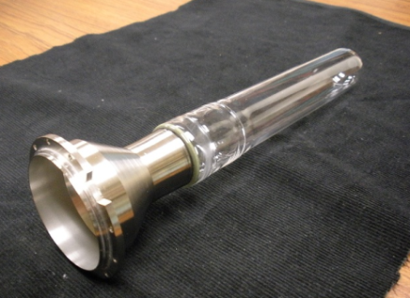
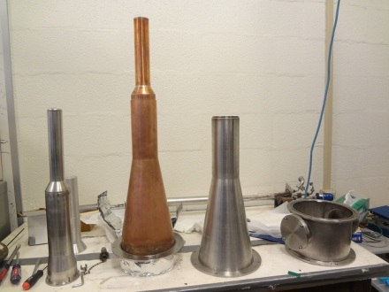
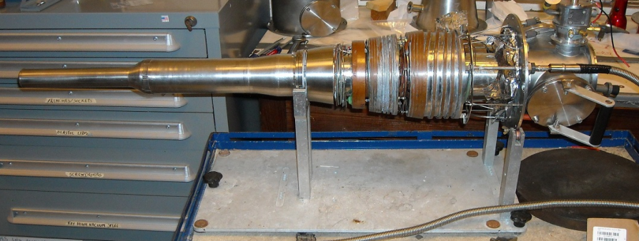
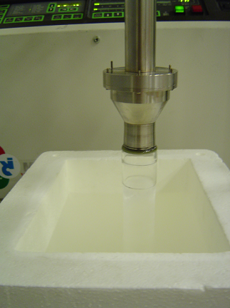
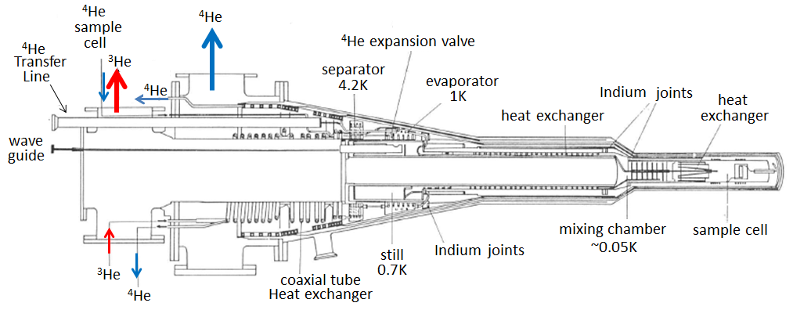
HIFROST System
Originally designed by T. Niinikoski
Used at CERN and GKSS in Germany
Modified by Uva
Ready for HIFROST
new mixing chamber
Horizontal dilution refrigerator

Slide 12
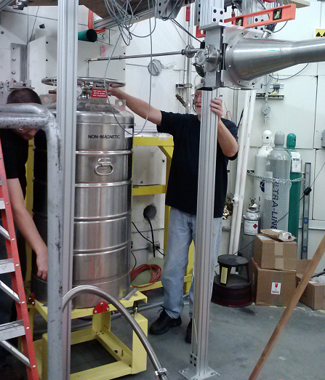
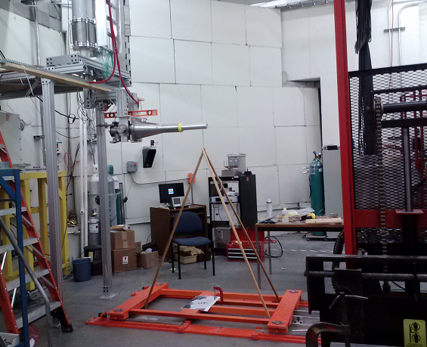

Slide 13
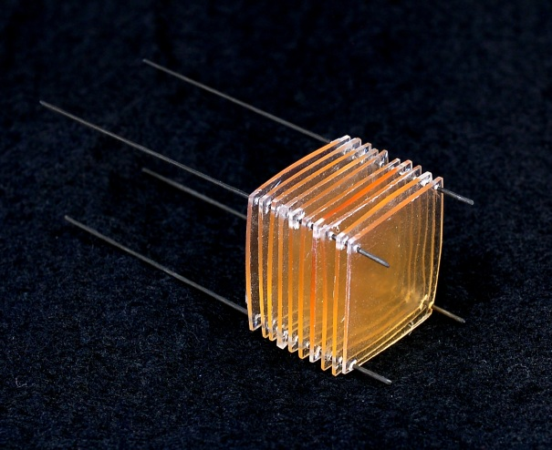
HIFROST System
Butanol target
as deuteron
source is at UVa
Scintillating target
Developed as proton source at UMass

Slide 14
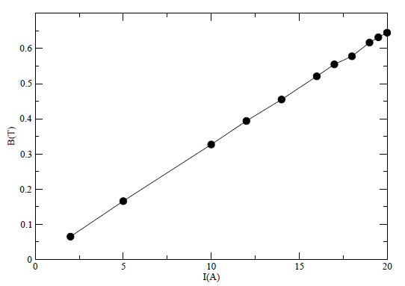
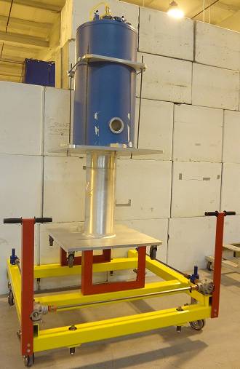
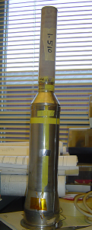
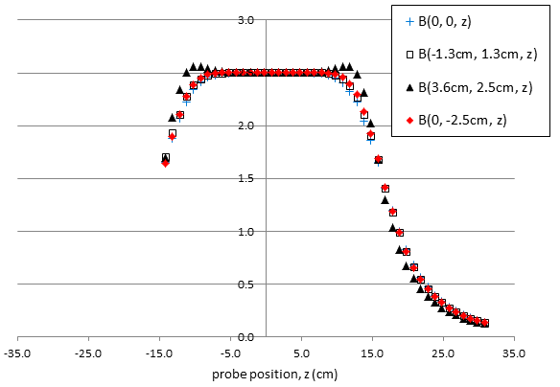
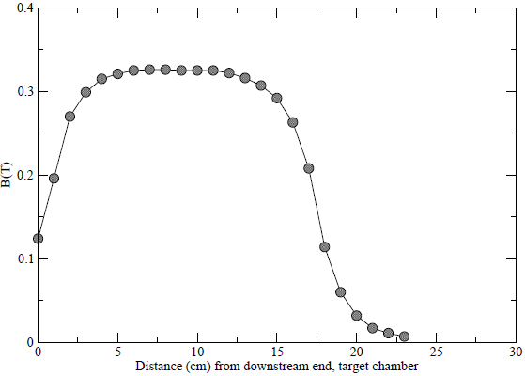
HIFROST System
0.5 T solenoid from CERN
AMI 2.5 T Polarizing SC magnet

Slide 15
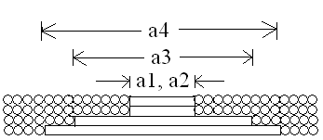
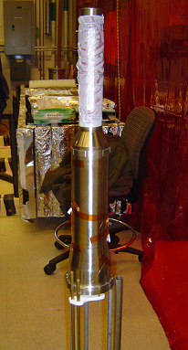
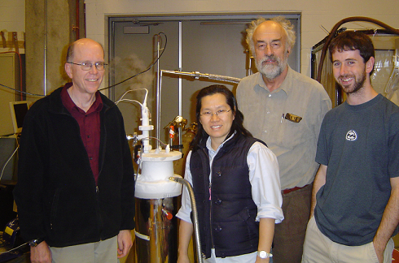
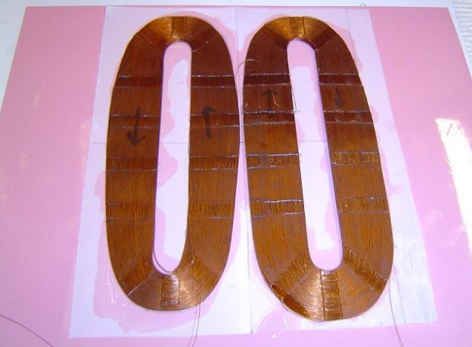
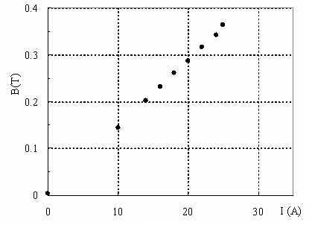
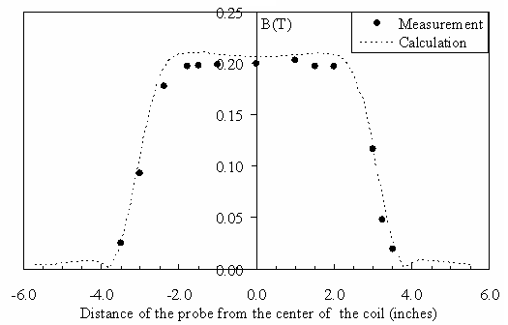
Transverse Holding Field Magnet
Designed and constructed in 2009
NbTi:Cu=1.13:1
4 layers in 136,136,122,48 turns
Measured 0.36T at 25 A
Expected 0.5T at 35 A
Seo et al.,
NIM A618,
43-47 (2010)

Slide 16
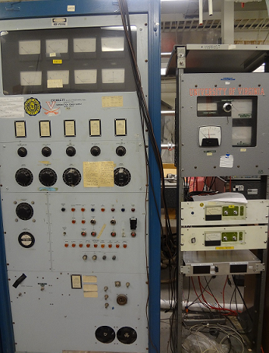
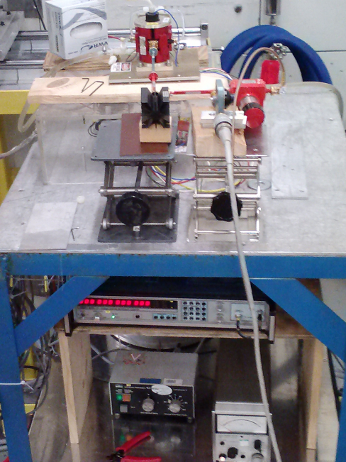
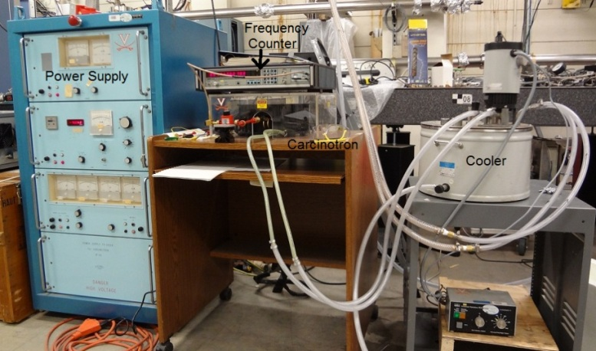
HIFROST System
- two sets of “microwave generator + power supply”
EIO + Cober power supply
Carcinotron + power supply
(from HZG, use as a backup)
70 GHz Microwave system w/ Carcinotron

Slide 17
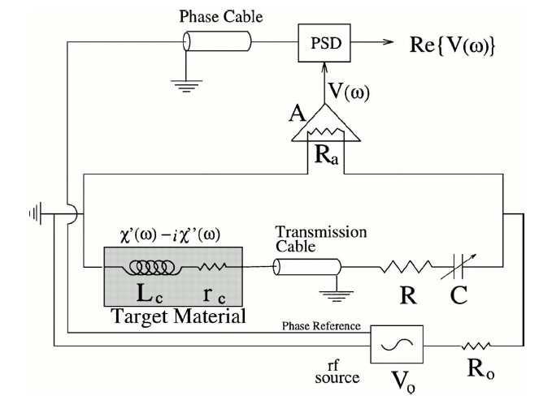
HIFROST System
Liverpool Q meter
2 Deuteron box, 2 Proton box are available
Setup at HIgS is in progress

Slide 18
GDH Sum Rule for the Deuteron
Hosoda and Yamamoto showed that the same relation
holds for spin S=1 nuclei such as the deuteron
HIγS/TUNL
LEGS,JLab,Bonn
Sum of GDH for neutron
plus proton
PRL 93 (2004) 202303

Slide 19
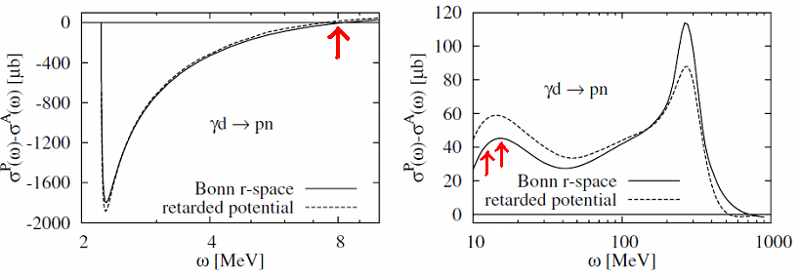
GDH Sum Rule for the Deuteron
Hosoda and Yamamoto showed that the same relation
holds for spin S=1 nuclei such as the deuteron
HIγS
LEGS,JLab,Bonn
Sum of GDH for neutron
plus proton
8 MeV
16 MeV
12 MeV
PRL 93 (2004) 202303

Slide 20
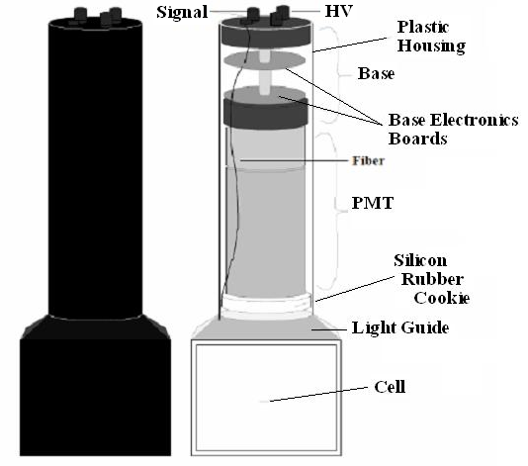
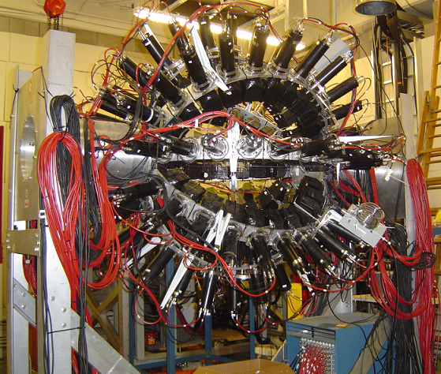
The Neutron Detector Array (Blowfish)
from Ward Wurtz’s Ph.D. Thesis (2010)
88 BC-505 liquid scintillators covering ¼ 4π
Active volume: 7.6 x 7.6 x 6.4cm³
Optically coupled to 12 staged PMT through a light guide
8 evenly spaced arm in φ
11 evenly spaced ring in θ from 22.5º to 157.5º

Slide 21
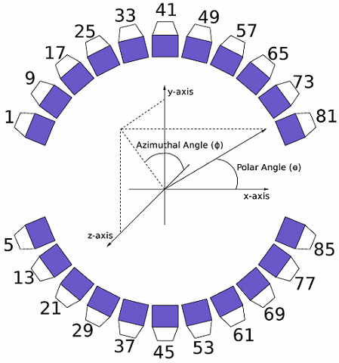
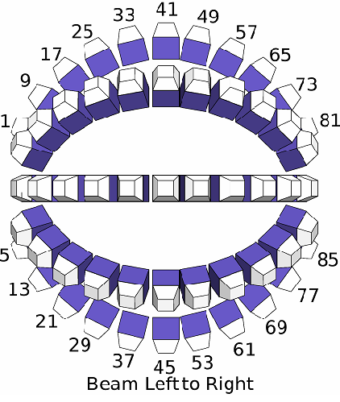
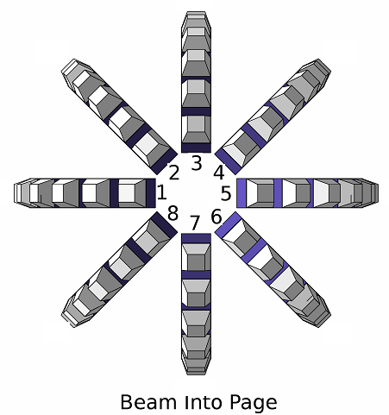
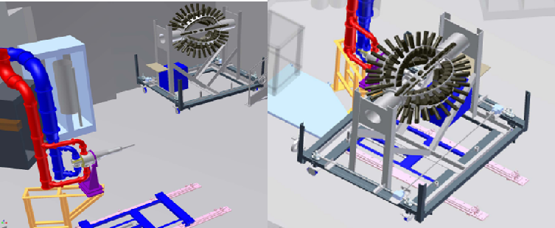
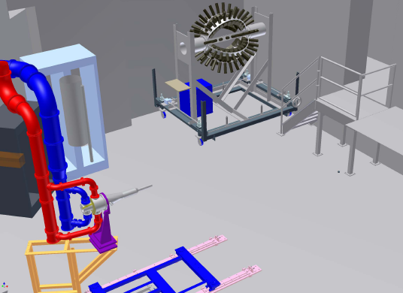
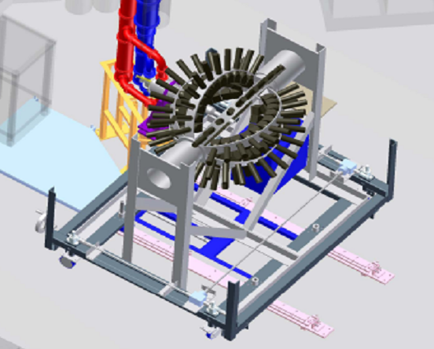
from Ward Wurtz’s Ph.D. Thesis (2010)

Slide 22
Summary
HIFROST is currently in commissioning at TUNL
Fridge is going to be cooled down within two weeks
First experiment , GDH sumrule test on deuteron
is scheduled in late October 2012

