Slide 1
Physics of Polarized Targets
Presented in PSTP2013, Charlottesville, USA with tributes to the work of Michel Borghini and Franz Lehar
Introduction to spins in solids at low temperature
  tributes to the work of Michel Borghini and Franz Lehar
  quantum statistics and spin temperature
  saturation and relaxation in magnetic resonance
Equal spin temperature model for DNP
Magnetic resonance and relaxation at low temperatures
Radiolytic paramagnetic impurities usable for DNP
Weak saturation during NMR polarization measurement
Refrigeration using quantum fluids

Slide 2
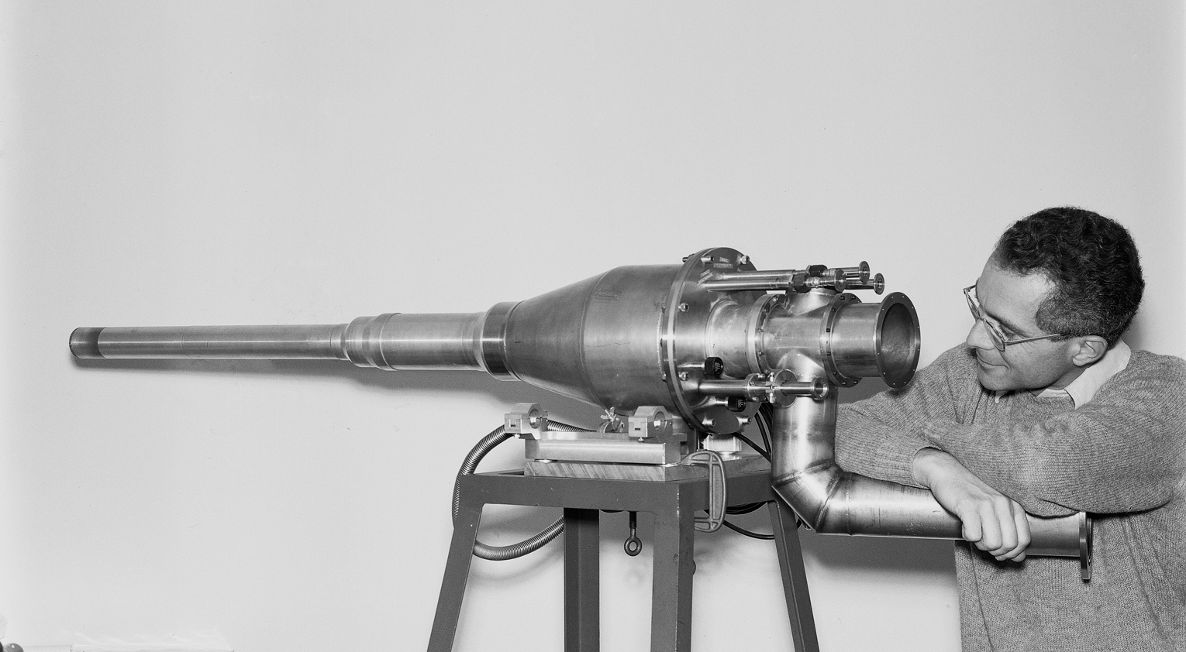
Michel Borghini
† 15 December 2012, at age of 78 years
Michel Borghini and WA6 Polarized Target cryostat in 1976

Slide 3
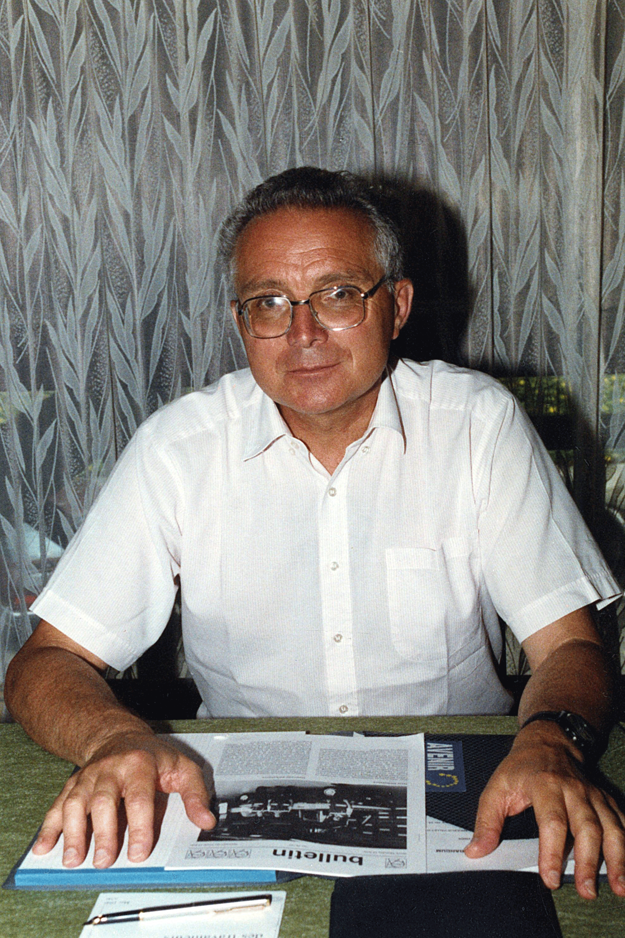
Michel Borghini
Obituary was published in CERN Courier of 28 March 2013, with biographic information including references to his work on polarized targets and spin physics
“Spin temperature model of DNP” remains one of his best recalled contributions for this community (Phys. Rev. Lett. 20 419, 1968)
This model extended the general QS treatment of magnetic resonance saturation to electron spin systems at low temperatures where the polarization is high
Borghini and his team at CERN proved also experimentally the validity of his hypothesis that all nuclear spin species cool towards a common temperature, that of the dipolar energy reservoir of the electronic spin system under saturating microwave field

Slide 4
František (Franz) Lehar
† 23 November 2011, at age of 77 years
Franz Lehar delivering his Honorary Doctor’s speech in Prague in 1996

Slide 5
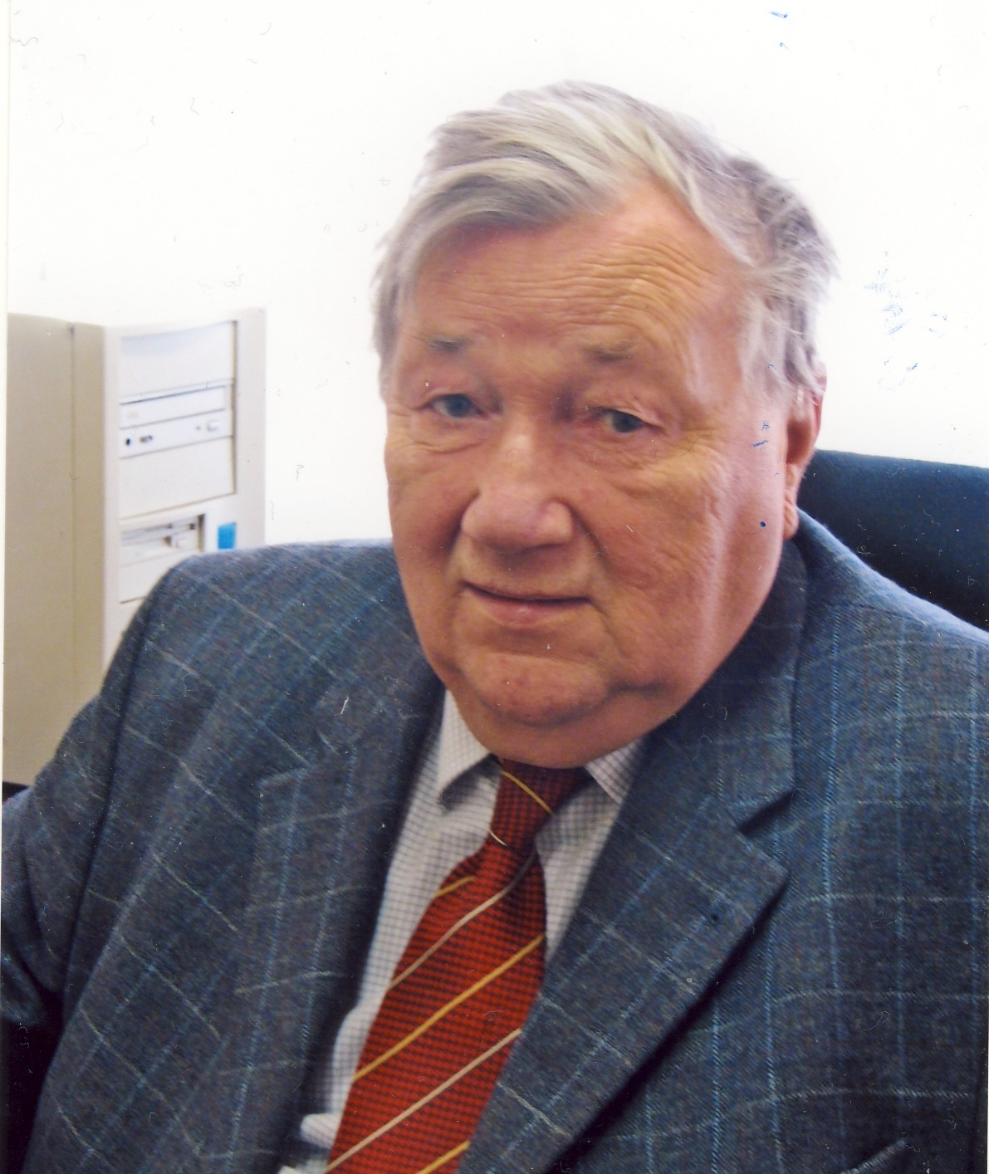
Franz Lehar
Obituary was published by CTU in http://www.utef.cvut.cz/en/index.php?Ns=406&id=1000028
One of the examples of the perfection of Franz’s work is his publication “Proton-proton Data Measured by the Saclay Nucleon-nucleon Collaboration at Saturne II”, CTU Reports 1/2000, Volume 4 (247 pages)
Known for his experimental work on nucleon-nucleon interaction: 3000 points for p-p and 1800 points for n-n interaction with 2 or 3 spins measured
Complete reconstruction of the scattering amplitudes based on this experimental data
Promoted Frozen Spin target techniques required for his experimental work

Slide 6
Spin in solid matter
We speak of (intrinsic) spin when the particle is very weakly connected with the dynamics of the solid matter; example: nuclear spin in solids
The term orbital angular momentum is used when the angular motion is strongly linked with the dynamics of the solid matter; example: orbital momentum of electrons
The term effective spin refers to an electron bound in a solid, when only the lowest magnetic states of its ground-state multiplet are populated; in this case the term "spin" must be understood as a shorthand notation

Slide 7
Spin operator
The commutation rules of the 3 components of the spin vector are obtained by performing small rotations about x- and y- axes, and by then comparing with the same rotations in reverse order:
The same can be done for the two other pairs.
It is remarkable that these commutation rules only require that space is isotropic, and that all physics of spin can be derived from these rules
Gravity curves the space-time; thus in quantum gravity the physics of spin is different
C.N. Yang suggested that the 3 families of particles could possibly be explained in quantum gravity (BNL Symposium 1982; PRL 33, 445 (1974))

Slide 8
Consequences of the commutation rules for I_{j} =>
The difference between the largest eigenvalue I and the smallest eigenvalue –I must be an integer => I can then only take half integer values 0, ±1/2, ±1, etc.
The eigenvalue of I² is I(I + 1)
Speaking of spin I then means a vector of length [I(I + 1)]^{1/2} and maximum projection of I on any axis
Only one component of the spin vector can be determined; the 2 other components oscillate with unknown phase factor
Orbital angular moment operator has only integer eigenvalues, because of the form of the wave function that represents orbital motion

Slide 9
Spin in magnetic field
Magnetic energy operator
The Schrödinger equation
has 2I + 1 eigenvalues
with –I ≤ m ≤ I .
Time dependent Schrödinger equation:
integrate with wave function representing spin
initially along x–coordinate:
=> Larmor precession with
Recall: this only requires that space is isotropic, which fixes the commutation rules of the rotation operator

Slide 10
Polarization and spin temperature
- quantum statistics (QS) -
Need quantum statistics to describe large arrays of spins I and their polarization and spin temperature (more generally: to obtain equilibrium and transient behaviour of the spin array)
QS provides sound framework to describe interactions among the spins I and their all other interactions; these yield shapes to the resonant lines and determine the spin-lattice and spin-spin relaxation times
QS also provides framework to describe the interaction of the spins with static and resonant fields, including saturation (Provotorov 1961)
Most importantly, QS allows to describe correctly the dynamic nuclear polarization by cooling of electron spin-spin interactions (Borghini 1968)
Results are obtained in closed form by perturbation theory (in high field and at high temperature)
At very low spin temperatures (= very high polarization) we cannot get results in closed form easily, because the spin density matrix cannot then be expanded into Taylor series (which would converge very slowly)

Slide 11
Where is QS less useful?
Low-density spin systems (weak interactions)
Very narrow line widths and slow spin-spin relaxation
Dominance of first-order forbidden transitions with low (but leading) second-order probability
These lead to (thermal) non-equilibrium states and unfavourable situations for DNP
Exception: solid-effect in single crystals (LMN + Nd)
Polarized targets users wish high densities of spins, fast polarization (synonym with fast relaxation), and high polarization (synonym of low spin temperature)

Slide 12
Spin density matrix
- also called polarization matrix -

Slide 13
Boltzmann distribution

Slide 14
Provotorov equations

Slide 15
QS description of DNP
Solve in rotating frame
Only dipolar broadening of ESR, high- temperature approximation (Provotorov):

Slide 16
Outline
Introduction to spins in solids at low temperature
Equal spin temperature model for DNP
Magnetic resonance and relaxation at low temperatures
Radiolytic paramagnetic impurities usable for DNP
Weak saturation during NMR polarization measurement
Refrigeration using quantum fluids

Slide 17
Dynamic nuclear polarization (DNP)
Two main categories of DNP:
Property or item | Solid effect | Cooling of spin interactions
Main spin transitions | Weak two-spin transitions | Strong single-spin transitions
Rotating field orientation | Parallel to B_{z} | Perpendicular to B_{z}
Theory of transitions | Second-order perturbation | First-order perturbation theory
DNP modeling | Rate equations | Density matrix
Microwave field | Strong | Weak
ESR line | Narrower than | Broader than
Solid effect in LMN + Nd (Jeffries and Schmugge 1965, Abragam and coworkers 1965)
Cooling of spin-spin interactions (Redfield 1955, Provotorov 1962, Borghini 1968)

Slide 18
Spin-temperature model for DNP
M. Borghini, PRL 20, 419 (1968)
Borghini extended the QS treatment of saturation to the case of spectral distribution of the electron spin system due to hyperfine interactions with nearby nuclei and to the anisotropy of the g-factors
The treatment assumes that Provotorov’s result for cross-relaxation at high temperature is valid also at low temperature, when cross-relaxation is faster that spin-lattice relaxation
The resulting equations yield the equilibrium spin temperature shared by the Zeeman and dipolar reservoirs of the electrons
All nuclear spins in the solid are also cooled to this temperature.

Slide 19
Spin-temperature model for DNP (cont.)

Slide 20
Spin-temperature model for DNP (cont.)

Slide 21
DNP with ESR line broadenening by anisotropic g-factor
Solve in rotating frame
Low-temperature formula obtained by Borghini (1968), Niinikoski (1976) and by de Koker and Niinikoski (1988):
valid for all inhomogeneous lineshapes (but caution with sub-lines due to hyperfine nuclei)
Dipolar interactions neglected (but important for internal equilibrium and for the transfer of polarization to nuclei)

Slide 22
Numeric results for DNP in deuterated PD at LT
R. de Koker and T. Niinikoski (1988)

Slide 23
Conclusions based on the DNP at LT
Little gain in 1/T_{S} for T_{L} < 0.4 K
Small linewidth can lead to very low T_{S}
Kink in the curves depends on ∆g but not on B
Higher P_{D} by lower ∆g/g or by higher B
B is optimum when power absorption (≈ B⁵) and higher T_{L} beats benefits from increasing
Requirement of field homogeneity becomes more severe at higher field and for narrow EPR line
New paramagnetic compounds should be developed for use in higher B (5 T for example), such that
optimum T₁ ≈ 10 ms ; optimum ∆g < 0.002

Slide 24
Outline
Introduction to spins in solids at low temperature
Equal spin temperature model for DNP
Magnetic resonance and relaxation at low temperatures
  in glassy and crystalline solids
Radiolytic paramagnetic impurities usable for DNP
Weak saturation during NMR polarization measurement
Refrigeration using quantum fluids

Slide 25
Magnetic resonance and relaxation at low temperatures
Provotorov’s equations have two relaxation times in the rotating frame T_{1Z} and T_{D}, which describe the rate at which the Zeeman and dipolar systems reach internal thermal equilibrium (≠ T₁ in fixed frame)
These have never been measured at low temperatures; direct measurement is difficult; T_{1Z}/T_{D} ≈ 3
Values can be determined, for nuclear spins, indirectly by measuring accurately the absorption (and dispersion) lineshapes at high RF current => fit with lineshapes of Provotorov
For electron spins, the relevant T_{1Z} and T_{D} can be estimated from the transient behaviour of different nuclear spins approaching common spin temperature
See results of W. de Boer et al., JLTP 15, 249 (1974); better data can be produced using the much improved instrumentation available today
T_{D} can be best measured by looking at the transient behaviour of the NMR lineshape when turning microwaves rapidly off and on.

Slide 26
Electron spin relaxation at low temperatures (cont.)

Slide 27
Experimental electron spin-lattice relaxation at LT
Few direct results exist at T < 1 K, B = 2.5 T or B = 5 T
Indirect T – dependence can be inferred from nuclear spin-lattice relaxation
Zhou et al., J. Mag. Res. 139, 165 (1999), report X-band results for 3 organic radicals and 14 transition metal complexes in glassy solids in the temperature range 10 K to 300 K; the data was fit with the temperature dependences of the direct process, Raman process, local mode (vibration) process, Orbach process and a thermally activated process.
The fits yield the Debye temperatures for the solvents, and the coefficients for the listed processes, with the exception of the Orbach process that could not be resolved
The following results are relevant for the polarized targets:
  The direct process could not be resolved for the Nycomed Trityl and Tempone radicals (probably no or low g-anisotropy)
  The direct process was resolved for all metal complexes; these have larger g-anisotropies
  Both the Debye temperature (50 K – 120 K) and the coefficients for the processes depend on the glassy solid matrix; these disagree with the range of the calorimetric data of C. Talón et al., PR B 58, 745 (1998)
  To resolve the direct process well, we should use a V-band spectrometer and extend the measurements down to 1 K

Slide 28
Experimental electron spin resonance line parameters
Accurate in-situ lineshape measurements in PT materials require a Fabry-Perot interferometer resonator, because the V-band wavelength is in the order of the sample dimensions
The Bochum group of W. Meyer have constructed such and apparatus, and report in PR B 74, 134418 (2006) highly relevant results for the radicals used in deuterated materials
Such an apparatus could also be modified for relaxation time measurements
While resolved hyperfine lines can be approximately measured in diluted liquid samples, the anisotropies of these and the g-tensor can only be seen in-situ; lines of radiolytic centres cannot be measured in liquid phase at all
One of the questions to be answered is, whether the hyperfine coupling of the electron can contribute to its spin-lattice relaxation, when the direct and Orbach processes are weak due to the smallness of the g-shift and/or g-anisotropy

Slide 29
Outline
Introduction to spins in solids at low temperature
Equal spin temperature model for DNP
Magnetic resonance and relaxation at low temperatures
Radiolytic paramagnetic impurities usable for DNP
  irradiated ammonia
  lithium hydrides
  Irradiated BuOD
Weak saturation during NMR polarization measurement
Refrigeration using quantum fluids

Slide 30
Radiolytic paramagnetic impurities usable for DNP

Slide 31
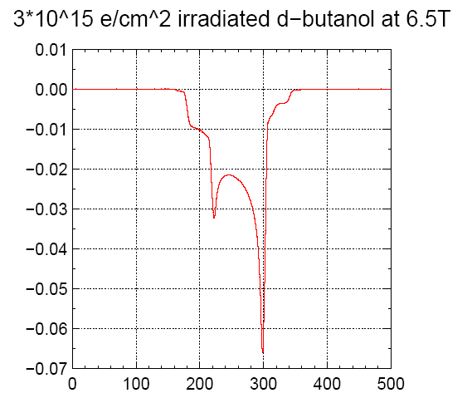
Deuteron Polarization of 63% at 6.5T and 1 K
Courtesy of D.G. Crabb, U. Virginia
- Rad damage: Characteristic flux > 10¹⁶ e⁻ /cm² , i.e. close to chemical destruction

Slide 32
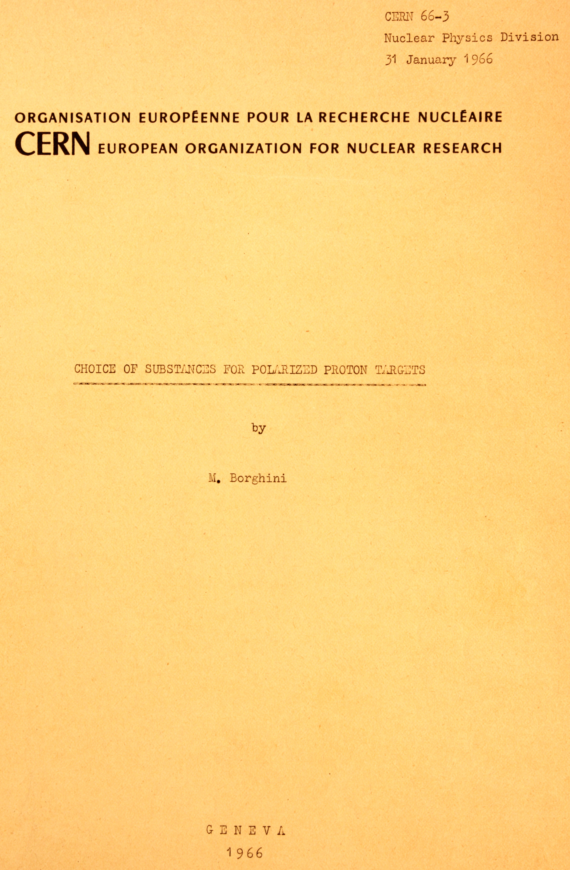
This yellow report of Michel Borghini was highly useful for the PT community, and it might still offer useful ideas for new developments.
It contains a broad compilation of potential PT materials and data on radicals, both stable paramagnetic molecules and radiolytic centres.

Slide 33
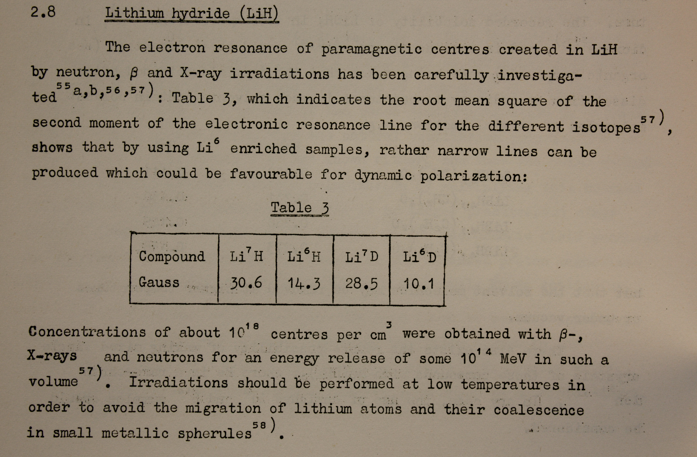
Extract from Borhini’s yellow report

Slide 34
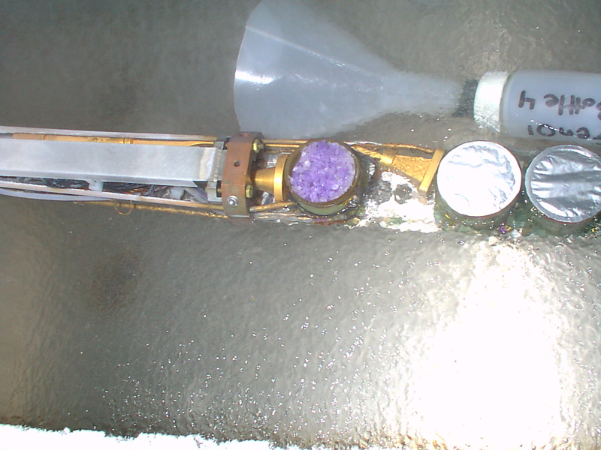
UVA/SLAC/JLAB Target

Slide 35
Outline
Introduction to spins in solids at low temperature
Equal spin temperature model for DNP
Magnetic resonance and relaxation at low temperatures
Radiolytic paramagnetic impurities usable for DNP
Weak saturation during NMR polarization measurement
  Lineshape distortion due to resonance circuit
  Lineshape distortion due to saturation
Refrigeration using quantum fluids

Slide 36
Series-tuned NMR circuit (SMC)

Slide 37
NMR lineshape distortion due to RF circuit
The signal at the input of the preamplifier (with high impedance) can be expanded in power series of the real and imaginary parts of the NMR signal:

Slide 38
NMR lineshape distortion due to RF circuit
The coefficients A_{n}(x) now depend on the offset of the angular frequency x and on circuit components in the following way:

Slide 39
NMR lineshape distortion due to RF circuit
After amplification, phase sensitive detection, and subtraction of A₀(x), the real part of the experimental DMR signal is now
If the cable and capacitor are tuned exactly to the center frequency, the baseline is a skew parabola
All parameters are now known or easily measurable
A₀(x) is the parabolic baseline, fit yields the circuit components (true + parasitic)
A₁(x) has a small skew parabolic contribution
A’₁(x) is small and has skew and parabolic components
A₂(x) and A’₂(x) are small but cannot be made negligible
=>
The experimental absorption signal is distorted with left-right asymmetry (≈ 5%)
The integral of the signal has a non-linear error (few % at P = 0.5) coming mainly from the large asymmetry of the signal itself, amplified by the skewness of the terms above

Slide 40
NMR lineshape distortion: possible remedy
Knowing that the skew and parabolic distortions cannot be simultaneously corrected by tuning, we can propose to detect also the imaginary part of the experimental signal, which will permit to determine the true absorption and dispersion parts of the complex susceptibility directly from the original equation

Slide 41
NMR lineshape distortion due to saturation
Provotorov’s original work yielded (in high-temperature approximation) the distortions of the susceptibility itself due to the saturation of the resonance signal.
Abragam and Goldman (1982) derived, using the density matrix techniques, low-temperature expressions for the moments of the dipolar lineshapes, valid at any spin density and polarization, and for any nuclear spin species with no quadrupole moment.

Slide 42
Outline
Introduction to spins in solids at low temperature
Equal spin temperature model for DNP
Magnetic resonance and relaxation at low temperatures
Radiolytic paramagnetic impurities usable for DNP
Weak saturation during NMR polarization measurement
Refrigeration using quantum fluids
  Cooling by evaporating ⁴He superfluid
  Refrigeration by superfluid mixtures of ³He and ⁴He (Dilution refrigeration)

Slide 43
Refrigeration using quantum fluids
Low lattice temperature T_{L} ≤ 1 K requires particular care in heat transfer and
cooling power
Boiling bath of ⁴He solves both:
  Kapitza conductance ≈ T⁴ , excellent heat transport by two-fluid convection
  Nucleate boiling limit is quite high; boiling heat transfer is also good
  High burnout heat flux
  Large latent heat = 80 J/mol, => very powerful refrigerators
  Important developments were made by Roubeau (1968)
Boiling bath of ³He enabled to get even higher polarizations in glassy hydrocarbons
  Hydrogen content larger than that of LMN
  Lower cooling power and large boiling heat resistance, but dynamic cooling required less microwave power; cooling is mainly by boiling in 2-phase flow
  Early development was made by Roubeau and Masaike (1970)
Dilution refrigeration yielded even better DNP
  Kapitza conductance ≈ T⁴ , excellent heat transport by convection of the dilute solution
  Large cooling power proportional to T⁴
  Breakthrough in design by Niinikoski (1974)

Slide 44
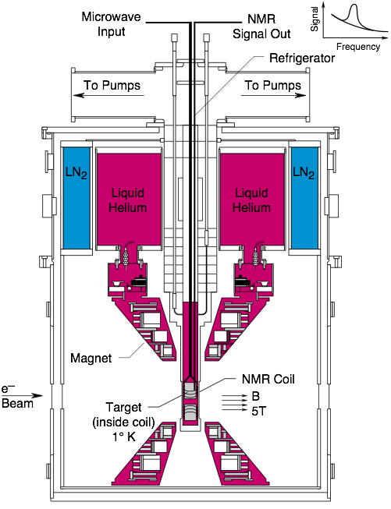
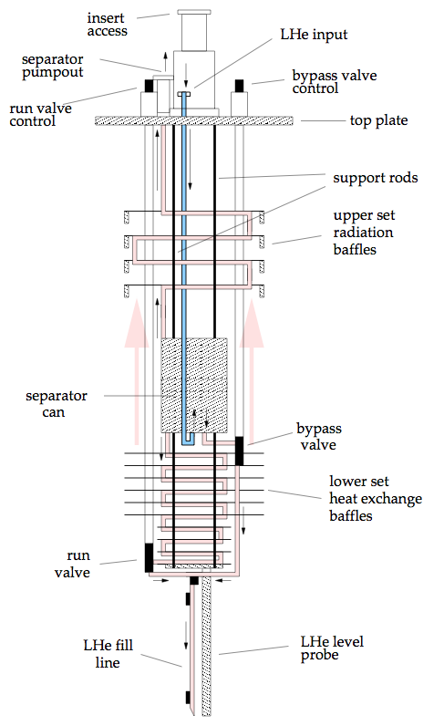
UVA/SLAC/JLAB Target

Slide 45
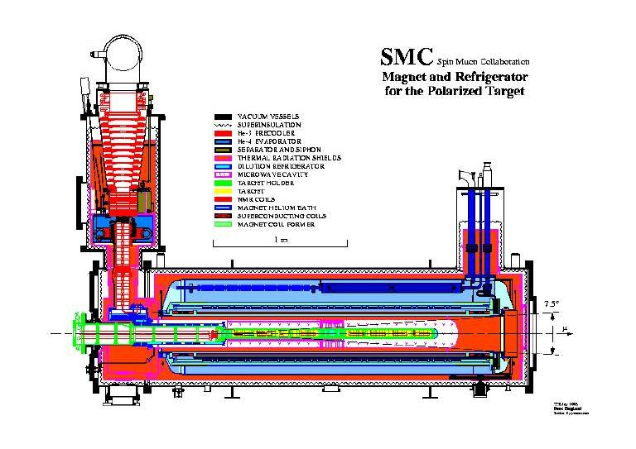

Slide 46
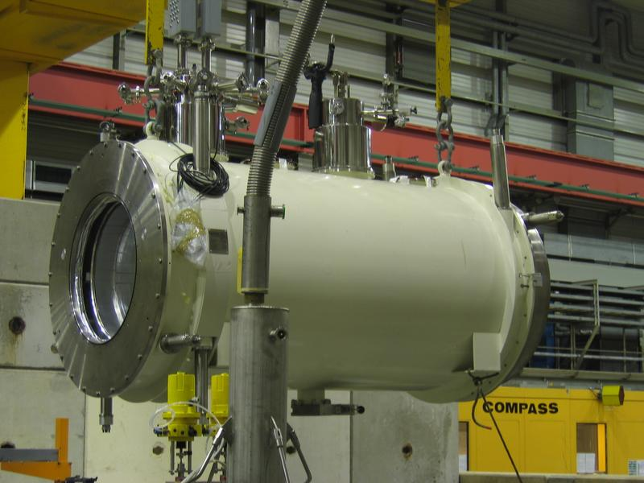
COMPASS PT magnet

Slide 47
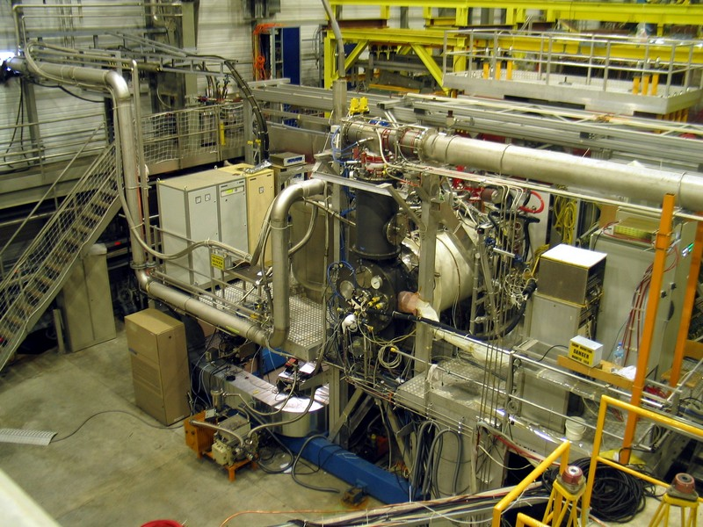
SMC DR in COMPASS magnet

Slide 48
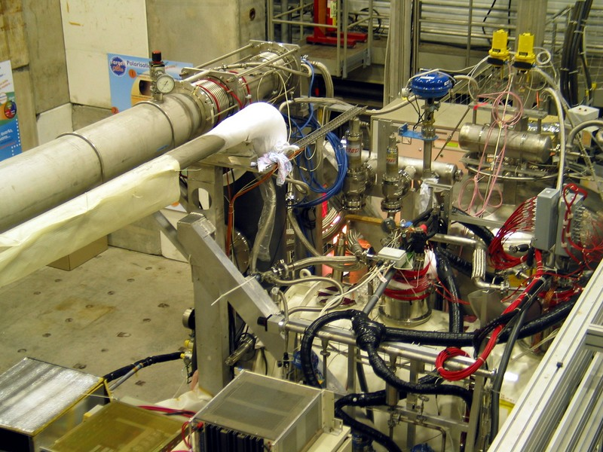
COMPASS PT in operation

Slide 49
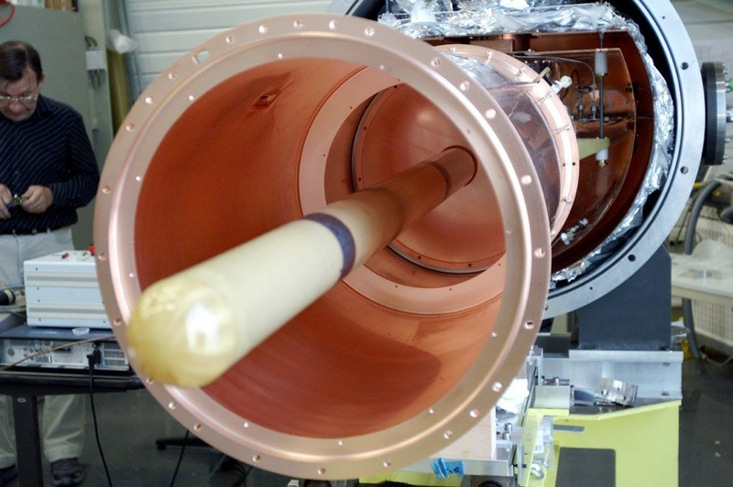
COMPASS triple-cell cavity

Slide 50
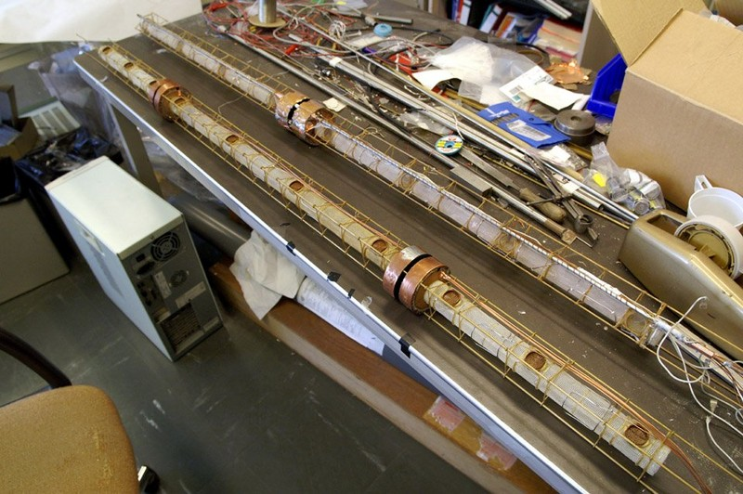
COMPASS double- and triple-cell target holders

Slide 51
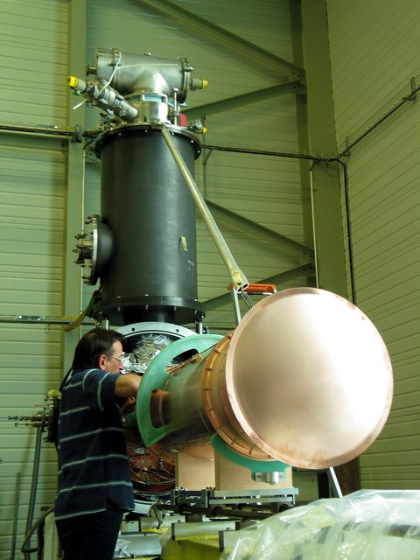
Triple-cell cavity mounted

Slide 52
Warm thanks to the organizers!
More details will be included in the paper, if editors and publisher permit

Slide 53
Double-target techniques for small A
The target is split in two cells with opposite polarizations and aligned in the beam so that
both target halves see the same beam flux. The polarizations of the halves are reversed
at least once. Notations:
This is exact if the acceptance
ratio K is constant in time:
If not, acceptance drift can be
eliminated by frequent pol.
reversals.

