Slide 1
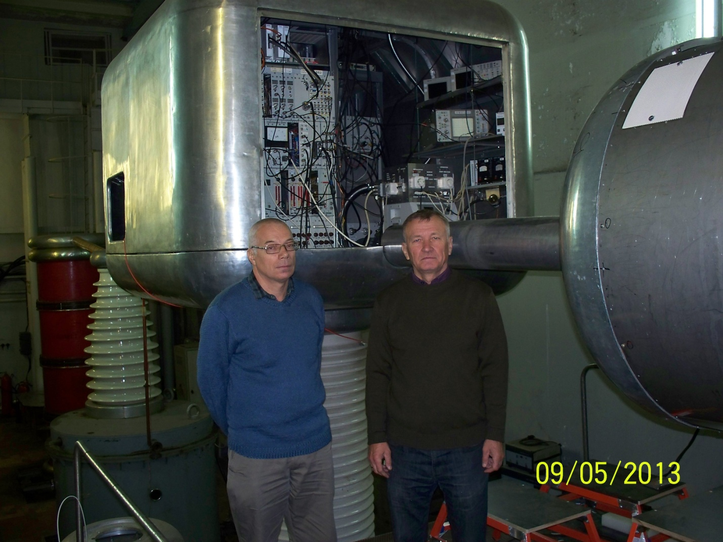
High-brightness Dudnikov – type H⁻ ion source at INR RAS
Development of the high-intensity H- ion sources with peak current ~ 100 mA and small emittance by V. G. Dudnikov made significant influence on design of INR RAS linear accelerator and experimental facility.
Dudnikov – type H- ion source (Penning discharge) had been built at Novosibirsk and delivered to INR RAS in beginning of 80th. The ion source produced 100 mA H- ion beam with small emittance and with rep. rate 50Hz.
Viktor Klenov started to work with the H- ion source at INR RAS. He was V. G. Dudnikov student at Novosibirsk and contributed to development of the H- ion source with high-brightness ion beam.
The INR RAS linear accelerator has H- ion beam injector equipped with Dudnikov –type H-ion source.
Viktor Klenov (left) and Alexander Belov (right) at H- ion injector at INR RAS

Slide 2
μ
Muons, Inc.
Vadim dudnikov at muons, inc.*
For the past 4 years, Vadim has been a Senior Accelerator Physicist at Muons
Our main contact with ORNL and John Adams Institute
participating in H-minus source development
See presentation at http://vimeo.com/62864876
Principal Investigator on 3 Phase I and 1 Phase II projects
H-minus Source using a Saddle Antenna (ORNL)
Proton/ion beam profile monitor using a ribbon electron beam (ORNL)
High efficiency Dudnikov-Type Penning Surface Plasma Source (FNAL)
The author of many clever proposals that are in progress

Slide 3
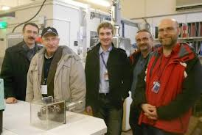
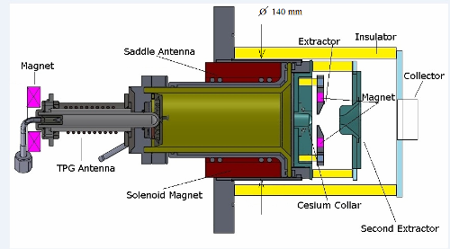
μ
Muons, Inc.

Slide 4
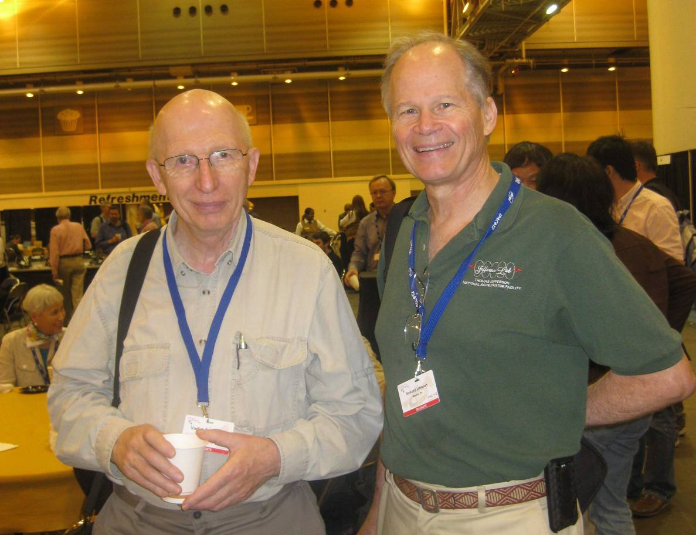
μ
Muons, Inc.
Although I am unable to attend this workshop, I send my best wishes to Vadim, my friend and co-worker, with congratulations on his ongoing and inspiring life of enthusiastic productivity and creativity.
Rolland Johnson, President Muons, Inc.

Slide 5
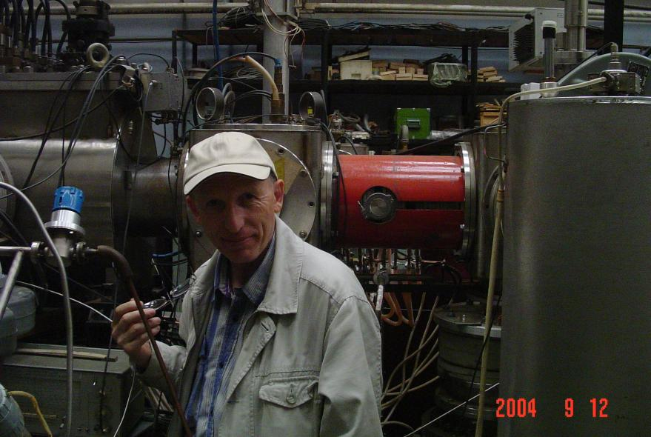
Foundation of EIC at JLab
“Ion sources are the sources of life of accelerator facilities”
- V.G. Dudnikov
Dudnikov Universal Highly-Polarized Ion Source (DUHPIS):
- high polarization,
- high intensity,
- different ion species (p, d, He, Li),
together with
- charge-exchange injection
12 GeV CEBAF

Slide 6
Best wishes From MEIC Study Group
Congratulations on your past and best wishes for the future!
We wish you many more years of science and success!
A. Accardi, S. Ahmed, A. Bogacz, P. Chevtsov, Ya. Derbenev, D. Douglas, R. Ent, V. Guzey, T. Horn, A. Hutton, C. Hyde, G. Krafft, R. Li, F. Lin, F. Marhauser, R. McKeown ,V. Morozov, P. Nadel-Turonski, E. Nissen, F. Pilat, A. Prokudin, R. Rimmer, T. Satogata, M. Spata, C. Tennat, B. Terzić, H. Wang, C. Weiss, B. Yunn, Y. Zhang --- Thomas Jefferson National Accelerator Facility
J. Delayen, S. DeSilva, H. Sayed -- Old Dominion University
M. Sullivan -- Stanford Linear Accelerator Laboratory
S. Manikonda, P. Ostroumov -- Argonne National Laboratory
S. Abeyratne, B. Erdelyi -- Northern Illinois University
R. Johnson -- Muons, Inc
A. Kondratenko -- STL “Zaryad”, Novosibirsk, Russian Federation
Y. Kim -- Idaho State University

