Slide 1
Two Novel Approaches for Electron Beam Polarization from Unstrained GaAs J L McCarter^{1,2}, N B Clayburn³, A Afanasev⁴, J M Dreiling³, T J Gay³, J Hansknecht⁵, A Kechiantz^{4,6}, M Poelker⁵, D M Ryan³
13 September 2013
Charlottesville, VA
¹ Department of Physics, University of Virginia, Charlottesville, VA 22901
² Currently Laser and Plasma Technologies, Hampton, VA 23666
³ Department of Physics, University of Nebraska, Lincoln, NE, 68588
⁴ Department of Physics, The George Washington University, Washington, DC 20052
⁵ Thomas Jefferson National Accelerator Facility, Newport News, VA 23606
⁶ On leave from Institute of Radiophysics and Electronics, NAS of Armenia, Ashtarak 0203, Armenia

Slide 2
Outline
Motivation: Improve polarization capabilities of the CEBAF photoinjector at Jefferson Lab
Motivation for higher polarization electron beam
Brief description of new style micro-Mott polarimeter
Photoemission from GaAs using two photons
Theoretical and experimental background
Current experimental set up
Electron polarization results and discussion
Photoemission from GaAs using light with orbital angular momentum
Theoretical background
Current experimental set up
Electron polarization results and discussion
Future work and questions

Slide 3
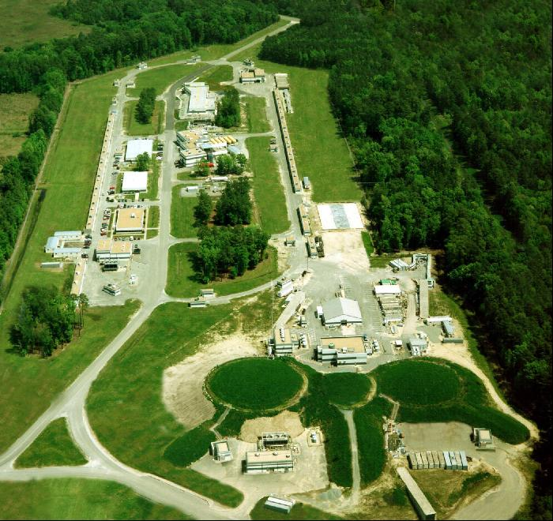
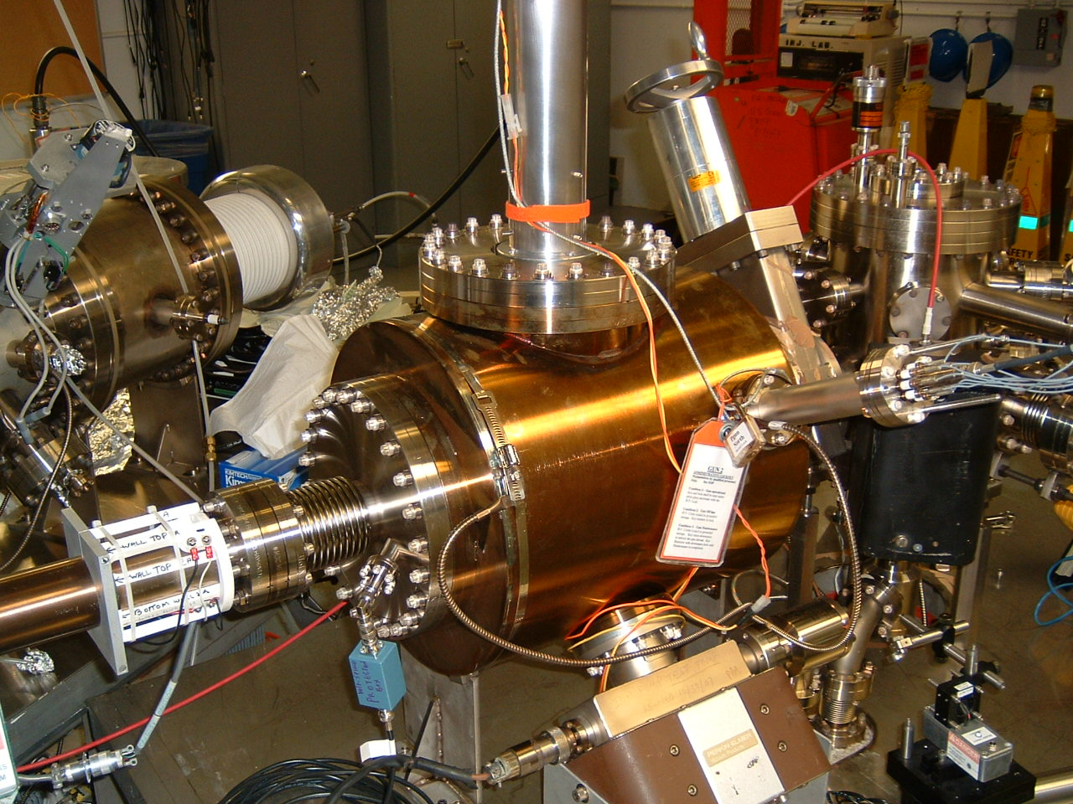
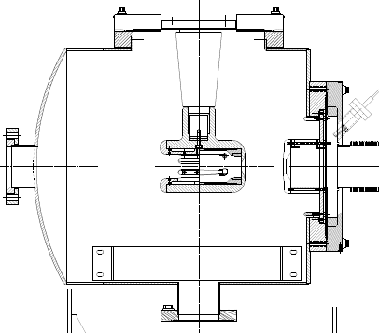
JLab's Electron Beam Needs
Polarized beam currently supplied to 3 experimental halls doing nuclear physics
Interaction statistics go like current*polarization²
Beamtime currently oversubscribed – need to increase polarization
Current 100 keV DC photogun
GaAs photocathode

Slide 4
Micro Mott for Lab Room Photocathode Experiments
Accelerator-based Mott polarimeters are ~100 keV and require electromagnets: Complicated!
Advantages to operating ~ 20 keV
Radiation is not an effective problem
Smaller potentials allow for smaller designs
Smaller designs usually have increased efficiency, and thus increased figures of merit
No electromagnets
Sherman function determined by cross calibrating against the 5 MeV Mott @ CEBAF
New design was chosen to have increased efficiency and ease of construction
Improved efficiency : no
Ease of construction: YES!

Slide 5
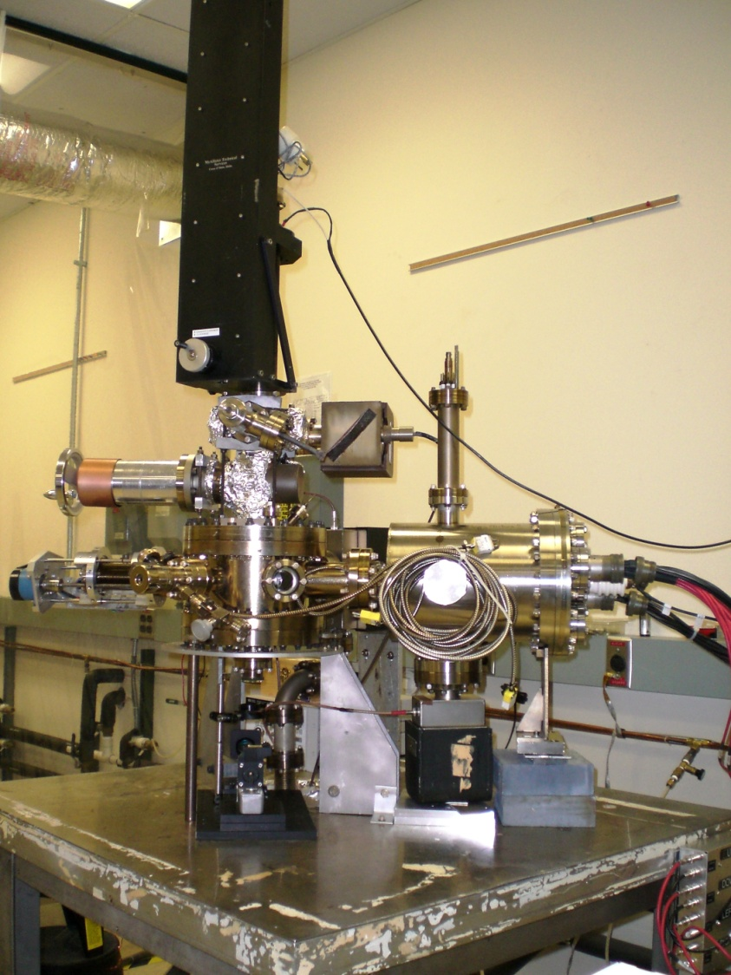
Electron Source and Polarimeter Apparatus
Three main parts
Electron Beam Source – Load Locked
Beam Steering
Bent 90º, preserving polarization transverse to polarimeter plane
Simple deflector and polarization rotator
(Al-Khateeb, H.M. et al., Rev. Sci. Instrum. 1999. 70. 3882)
Electron Trajectory
Incident Laser

Slide 6
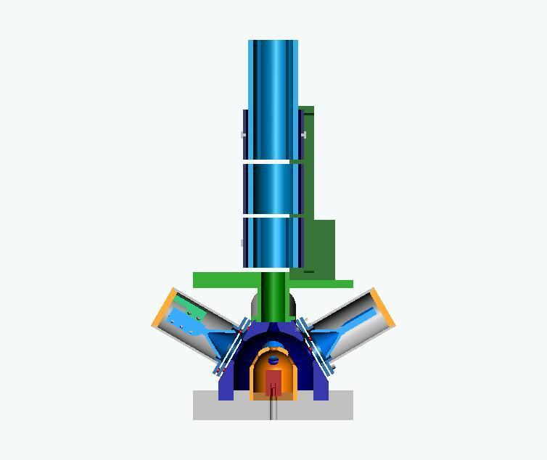
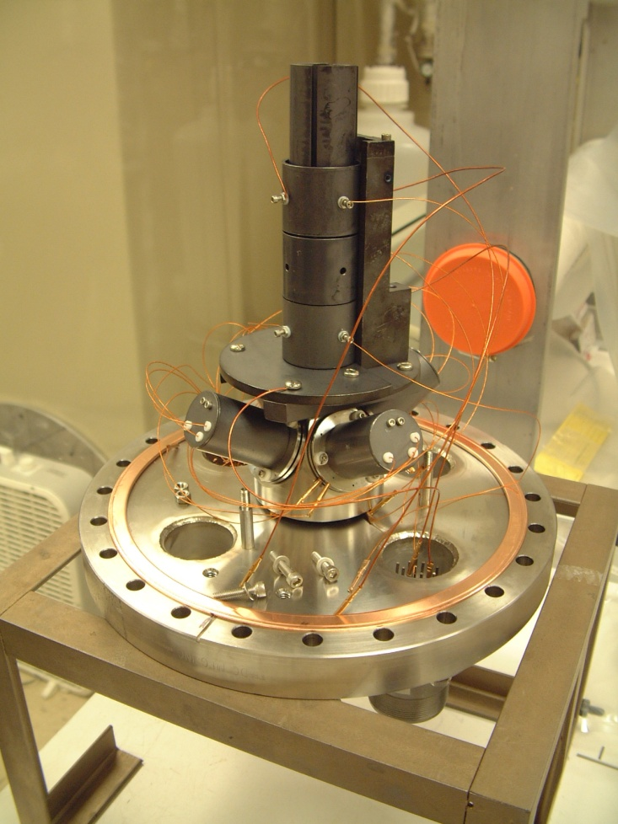
Electron Source and Polarimeter Apparatus
Three main parts
Electron Beam Source
Beam Steering
Mott Polarimeter ( 10” Chamber)
Retarding Field style micro Mott polarimeter
Determined Sherman function by using the same photocathode wafers (bulk and superlattice GaAs) used @ CEBAF and characterized with 5 MeV Mott
Effective Sherman function of 0.201(4) at 20 keV scattering energy

Slide 7
Photoemission using Two Photons
Nonlinear optical process
Intensity matters! (Power/Area)
QE proportional to light intensity for two - photon
QE constant for one - photon
Requires:
Bulk GaAs
Light at half the band gap energy of 1.42eV
Use light at 1560nm instead of 780nm
Two photons are absorbed simultaneously to excite electrons from valance band to conduction band.
QE_{1560nm} very small – need to ensure no photoemission from low wavelengths, where QE is much higher!
Will vary intensity to verify effects

Slide 8
Two-Photon Absorption – High Polarization?
Does two photon absorption lead to high (>50%) polarization?
Optical transitions in bulk GaAs
a) one-photon absorption, normal 780nm absorption, ~50% pol
b) one-photon absorption, strained GaAs, up to 92% pol
c) two-photon absorption as suggested by Matsuyama et al. Jpn. J. Appl. Phys., 2001, Part 2 40, L555. ~100% pol

Slide 9
Other Previous Two-Photon Polarization Results
Previous experimental polarizations disagree
Pump/probe differential transmission yields
Pol = 49.5% (Miah, M.I. J. Phys. Chem B. 2009, 113, 6800-6802)
Pol = 49% (Bhat, R.D.R et al, Phys. Rev. B. 2005, 71, 035209)
Photoluminescence yields
Pol = 92% (Suziki, C. et al, Spin 2002 proceedings)
Pol = 95(3)% (Matsuyama, T. et al, Jpn. J. Appl. Phys. 2001, 40, 555-557)
First to measure polarization via photoemission
Results coming up…

Slide 10
QE Characterization of Two-Photon Emission
Equipment
Polarimeter apparatus previously described
Bulk GaAs
Gain switched diode laser at 780nm
Gain switched diode and fiber amplifier at 1560nm
Laser has constant average power output regardless of repetition rate of pulses
Maximum pulse energy was 7 nJ over ~50ps
Measure QE response at 780nm and 1560nm, varying peak intensity: Intensity = Power/Area
Average power of laser
In-line optical attenuator
Repetition rate of pulses
Repetition rate of laser seed amplifier, pulse width (~50ps)
Spot size on cathode
Focusing lenses

Slide 11
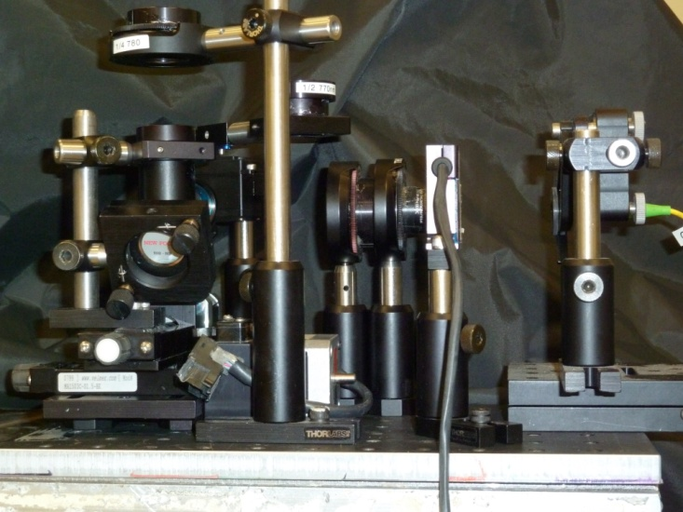
Two-Photon Optical Set Up
LPF 850nm
λ/4
Insertable λ/2
L
LP
LP
L
LPFs 1350nm
λ/2
Translation stages and mirrors
Shutter
DFB
G
RF
ISO
Fiber Amp
G
SRD
Bias Network
DC Current

Slide 12
GaAs Response to Laser Power
For 780nm, QE ~ Slight variations seen due to surface charge and space charge effects.
For 1560nm, QE proportional to power, and intensity
Two photon process!

Slide 13
Bulk Polarization Results
No dependence of measured polarization on extracted photocurrent.
At high 1560nm power: start heating wafer – QE falls and lifetime greatly decreases, limiting available photocurrent.
1560nm polarization much lower than predictions/experiments…but why?

Slide 14
Investigating Two-Photon Photoemission Polarization Results
Why is the polarization of the extracted beam so much lower than photoluminescence (93%) and differential transmission (49%) experiments?
Unlike previous experiments, photoemitted beam studied.
Absorption coefficient (α) @780nm ~ 1.03x10⁴ cm⁻¹
Effective absorption coefficient (β*I_{max}) @1560nm ~ 2.5x10⁻⁴ cm⁻¹
Electrons must diffuse through more material at 1560nm.
Diffusion introduces depolarization effects.
Used samples of bulk GaAs, with varying active layers, to test the effects these deeper electrons have on polarization.

Slide 15
GaAs Depolarization Results
 | Photoelectron Polarization %
Active Thickness | One-photon (778 nm) | Two-photon (1560 nm)
0.18 mm | 42.6±1.0 | 40.3±1.0
0.32 mm | 44.0±1.1 | 36.0±0.9
Bulk Material | 33.4±0.8 | 16.8±0.4
Polarization decreases with GaAs thickness, with both two and one photon emission.
Max value for two photon polarization (like one photon) seems to be no greater than 50%, making two-photon emission unsuitable for use as a high polarization source.

Slide 16
Photoemission from OAM Light
Light beams with azimuthal phase dependence can carry orbital angular momentum (OAM).
OAM light can have arbitrarily large values of angular momentum (±mħ)
Conventional circularly-polarized light has only one unit (±ħ) of spin angular momentum (SAM) per photon.
Requires:
Bulk GaAs
Light at the band gap energy of 1.42eV
Use linearly polarized light with Laguerre-Gaussian spatial modes to create OAM conditions
QE_{OAM} experimentally approximately the same as QE_{SAM}

Slide 17
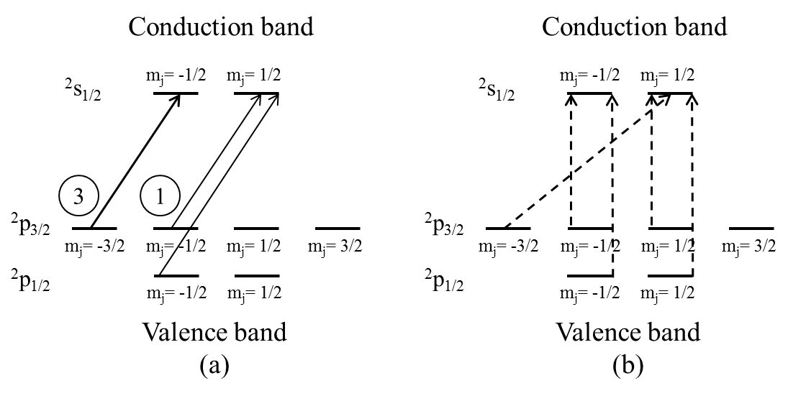
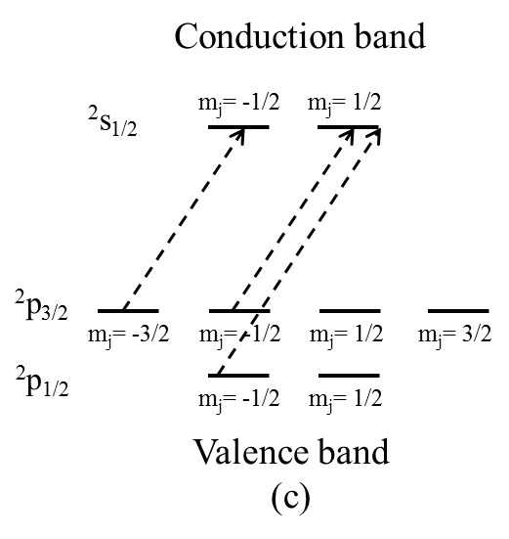
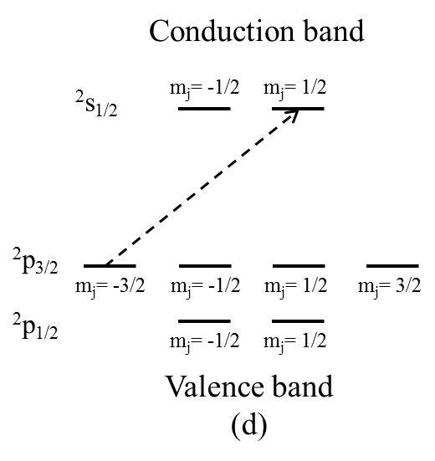
OAM Absorption – High Polarization?
Does absorption of OAM light lead to high (>50%) polarization?
Optical transitions in bulk GaAs
SAM of +1ħ; the circled numbers indicate relative transition strengths
linearly-polarized light with OAM = +1ħ
linearly-polarized light with OAM = +2ħ
linearly-polarized light with OAM = +3ħ
The dashed arrows correspond to vector addition of SAM of both +1ħ or -1ħ and OAM, as linearly polarized light is composed of photons of both spin states.

Slide 18
OAM Light Optical Set Up
Diode
laser
Beam
splitter
L
L
The diffraction grating can be replaced with gratings of different topological charge to change amount of OAM.
Steering mirrors M1, M2, and M3, and the beam splitter aligned companion OAM beams - verified via the CCD camera.
Mechanical shutters allowed one OAM beam at a time.
Systematic error in polarization associated with beam misalignment, determined by displacing one linearly-polarized beam with a Gaussian profile relative to the other by a distance comparable to the spatial extent of the OAM beams, was 1.8%.
M1
Spatial
filter
LP
LP
Translation stages and mirrors
Mechanical
shutters
Rotatable
λ/2
Y
Diffraction
grating
-mħ
M2
X
+mħ
M3
Z
Vacuum
window
L
CCD
camera
Insertable mirror
Z
Translation stages and mirrors
Laser
X

Slide 19
OAM Light Production
m = +1
m = -1
|m|=1
Interference
m = +2
m = -2
|m|=2
Interference
Computer-generated m = 1 interference pattern comprising alternating dark and light fringes. The order-1 fringe defect is in the center of the figure.
m = +3
m = -3
|m|=3
Interference
Topological | Width | Height
Charge | (μm) | (μm)
+1 | 273 | 215
-1 | 313 | 315
+2 | 377 | 436
-2 | 378 | 382
+3 | 488 | 443
-3 | 536 | 495
+5 | 719 | 745
-5 | 842 | 680
m = +5
m = -5
|m|=5
Interference
Intensity patterns of various OAM beams. The integer number m is the topological charge of the vortex. The right most column is the interference pattern obtained by superimposing the positive and negative |m| beams. The interference pattern reveals the order m of the OAM beam.
FWHM measurements of the focused OAM beams from CCD camera images taken at the same distance from the grating (as measured along the appropriate optical path) as the photocathode.

Slide 20
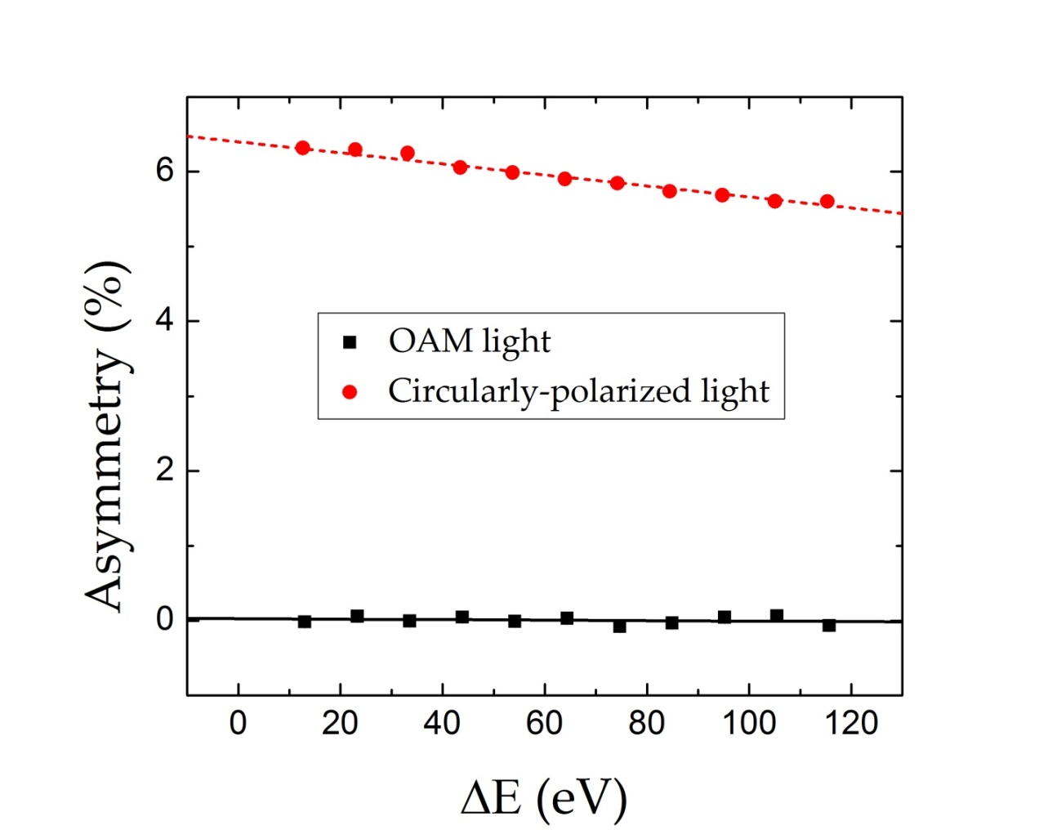
Measured OAM Electron Asymmetry
Asymmetry as a function of Δ$E$for OAM light and circularly polarized light. Solid and dashed lines indicate the weighted linear fit for extrapolation to ΔE = 0 eV for OAM and circularly polarized light respectively. Statistical error bars are smaller than the data points.

Slide 21
Measured Polarization and Systematic Error
m = +2
m = -2
For beams with opposite degrees of OAM, the locations of maximum intensity shifted ~ 90º.
Electron transmission between the photocathode to the polarimeter was highly dependent on the incident laser location.
Complementary OAM states had slightly different transmission rates and beam trajectories to the polarimeter, introducing the dominant systematic error.
m = +5
m = -5
$$A=\frac{N^{+}−N^{−}}{N^{+}+N^{−}}$$
$N^{+}=\sqrt{L_{+}R_{−}}$
The systematic error associated with beam misalignment, determined by displacing one linearly-polarized beam with a Gaussian profile relative to the other by a distance comparable to the spatial extent of the OAM beams, was 1.8%.
$$N^{−}=\sqrt{L_{−}R_{+}}$$
Standard asymmetry calculation does not normalize for different detection rates on the same detector over different polarization states.

Slide 22
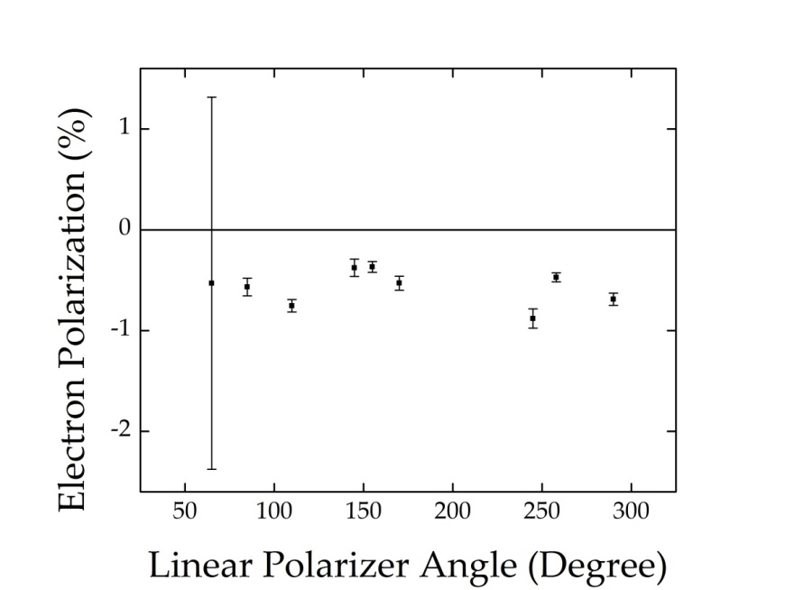
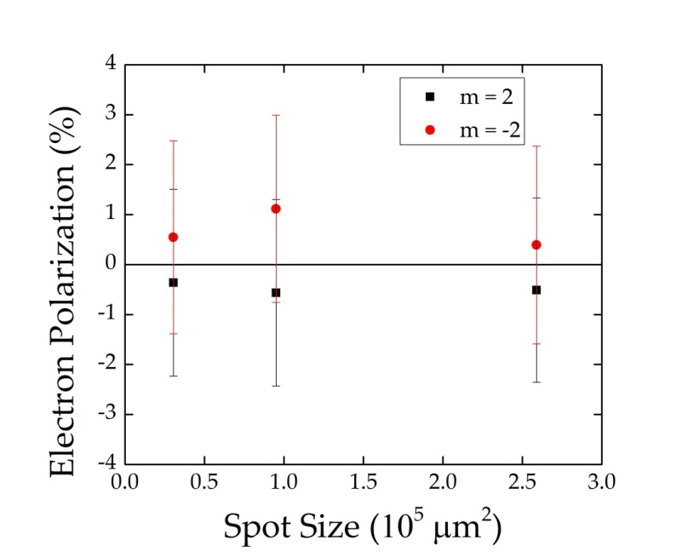
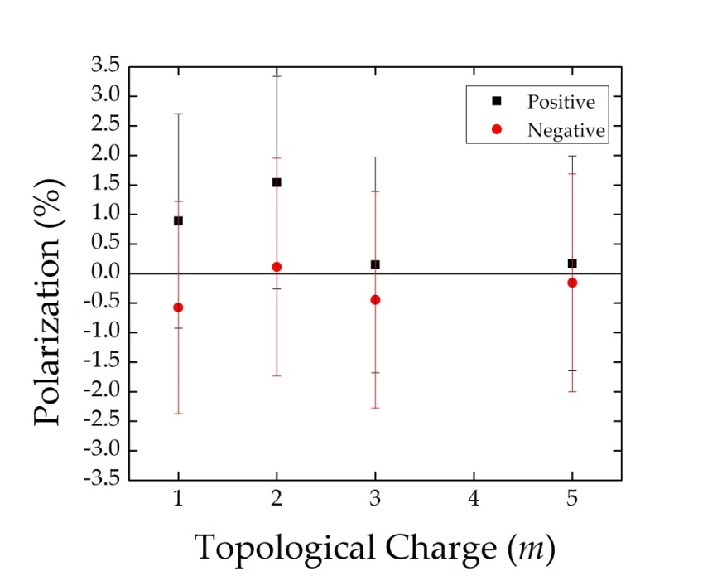
OAM Polarization Results
Dependence of electron polarization on the angle of linear light polarization incident on the photocathode. The large error bar includes the composite (systematic and random) error of the asymmetry measurement as well as the error in S_{eff}. Subsequent error bars exclude systematic error.
Dependence of electron polarization on laser spot size incident on the photocathode for OAM light. Composite errors are shown.
Sadly, the polarization of electrons created via OAM light is lower than 2.5%, compared to 35% polarization with circularly polarized light. Given the systematic spatial displacement, these results are consistent with zero, suggesting no coupling of OAM to the extended (delocalized) electron states in GaAs, at least with beams of diameter >250 μm.
Electron polarization produced by light with varying degree of OAM. Composite errors are shown.

Slide 23
The End
Any questions?
Comments?

Slide 24
Comparison to other Mott designs
Paper | Institution | Year | Target | Voltage (keV) | Max. Efficiency (x 0.001) | Max. Sherman (%) | Max. FOM (x 0.0001)
Neufeld | Rice | 2007 | Th | 25 | 6 | 25 | 1.2
Snell | Rice/ALS | 2000 | Au | 25 |  |  | ~1
Tang | Rice | 1988 | Au | 20 | 2 | 10.5
Iori | Hiroshima | 2006 | Au | 20 | 9.9 | 13 | 1.7
Iori | Hiroshima | 2006 | Au | 25 | 13 | 12 | 1.8
Iori | Hiroshima | 2006 | Au | 30 | 8.3 | 15 | 1.9
Uhrig | Muenster | 1989 | Au | 20 | 0.01 | 25 | 0.006
Petrov | St. Petersburg | 1997 | Au | 60 |  | 33 | 2.5
Petrov | St. Petersburg | 2003 | Au | 40 |  | 32 | 5.6
McCarter | Jlab/UVA | 2009 | Au | 20 | 0.6 | 20.1 ± .4 | 0.011

Slide 25
Surface Uniformity of GaAs
QE of GaAs surface not uniform, due to positioning of Cs and NF₃ sources
Transmission to microMott is very dependent on initial laser positioning on the cathode.
Care must be taken during experiments to ensure continuity of QE and transmission states during taking of data.
Transmission %
Mott current/photocurrent

Slide 26
Polarimeter Characteristics
Determined Sherman function by using same piece materials (bulk and superlattice GaAs) used @ CEBAF and characterized with 5 MeV Mott
Value of 0.201(4) at 20 keV scattering energy
Efficiency of 0.6x10⁻³ and a FOM of 0.011x10⁻⁴ at 20keV scattering energy.
Efficiency is ~order of magnitude lower than comparable designs
Still useful, only need ~100 pA to target

