Slide 1
Electrons on the HDice Target
Results and Analysis of Test Runs at JLab in 2012
M. M. Lowry
PSTP2013
Sep 2013
Notes:
Blue Title Page

Slide 2
HDice Collaboration
Jefferson Laboratory
Universita’ di Roma
A. D’Angelo
M. M. Lowry
A. M. Sandorfi
X. Wei
A. Deur
T. Kageya
C. Bass
C. Hanretty¹
D. Ho²
V. Laine³
P. Peng¹
James Madison University
C. S. Whisnant
University of Virginia
Carnegie-Mellon University
Blaise Pascal University
Notes:
Blue Interior Page Design 1

Slide 3
HDice Overview
Brute force polarization of solid HD
at 15 Tesla and 15-10 mK in DF
T1 switch with small (~10⁻⁴)
impurity of o-H₂ and p-D₂
– see talk by Whisnant
Initially polarize o-H₂ and p-D₂, they
spin exchange and polarize HD
Wait for o-H₂ (6.3 days) and
p-D₂ (18.6 days) to decay
Frozen spin, remove from DF,
load into in-beam cryostat
Option to do RF transitions
to rotate and transfer spin
– see talk by Wei
15T/10mK
P_{H}=91%
P_{D}=30%
A_{D}=7%
Notes:
Blue Interior Page Design 1

Slide 4
HDice In-Beam Cryostat
Notes:
Blue Interior Page Design 1

Slide 5
HDice Target
Notes:
Blue Interior Page Design 1

Slide 6
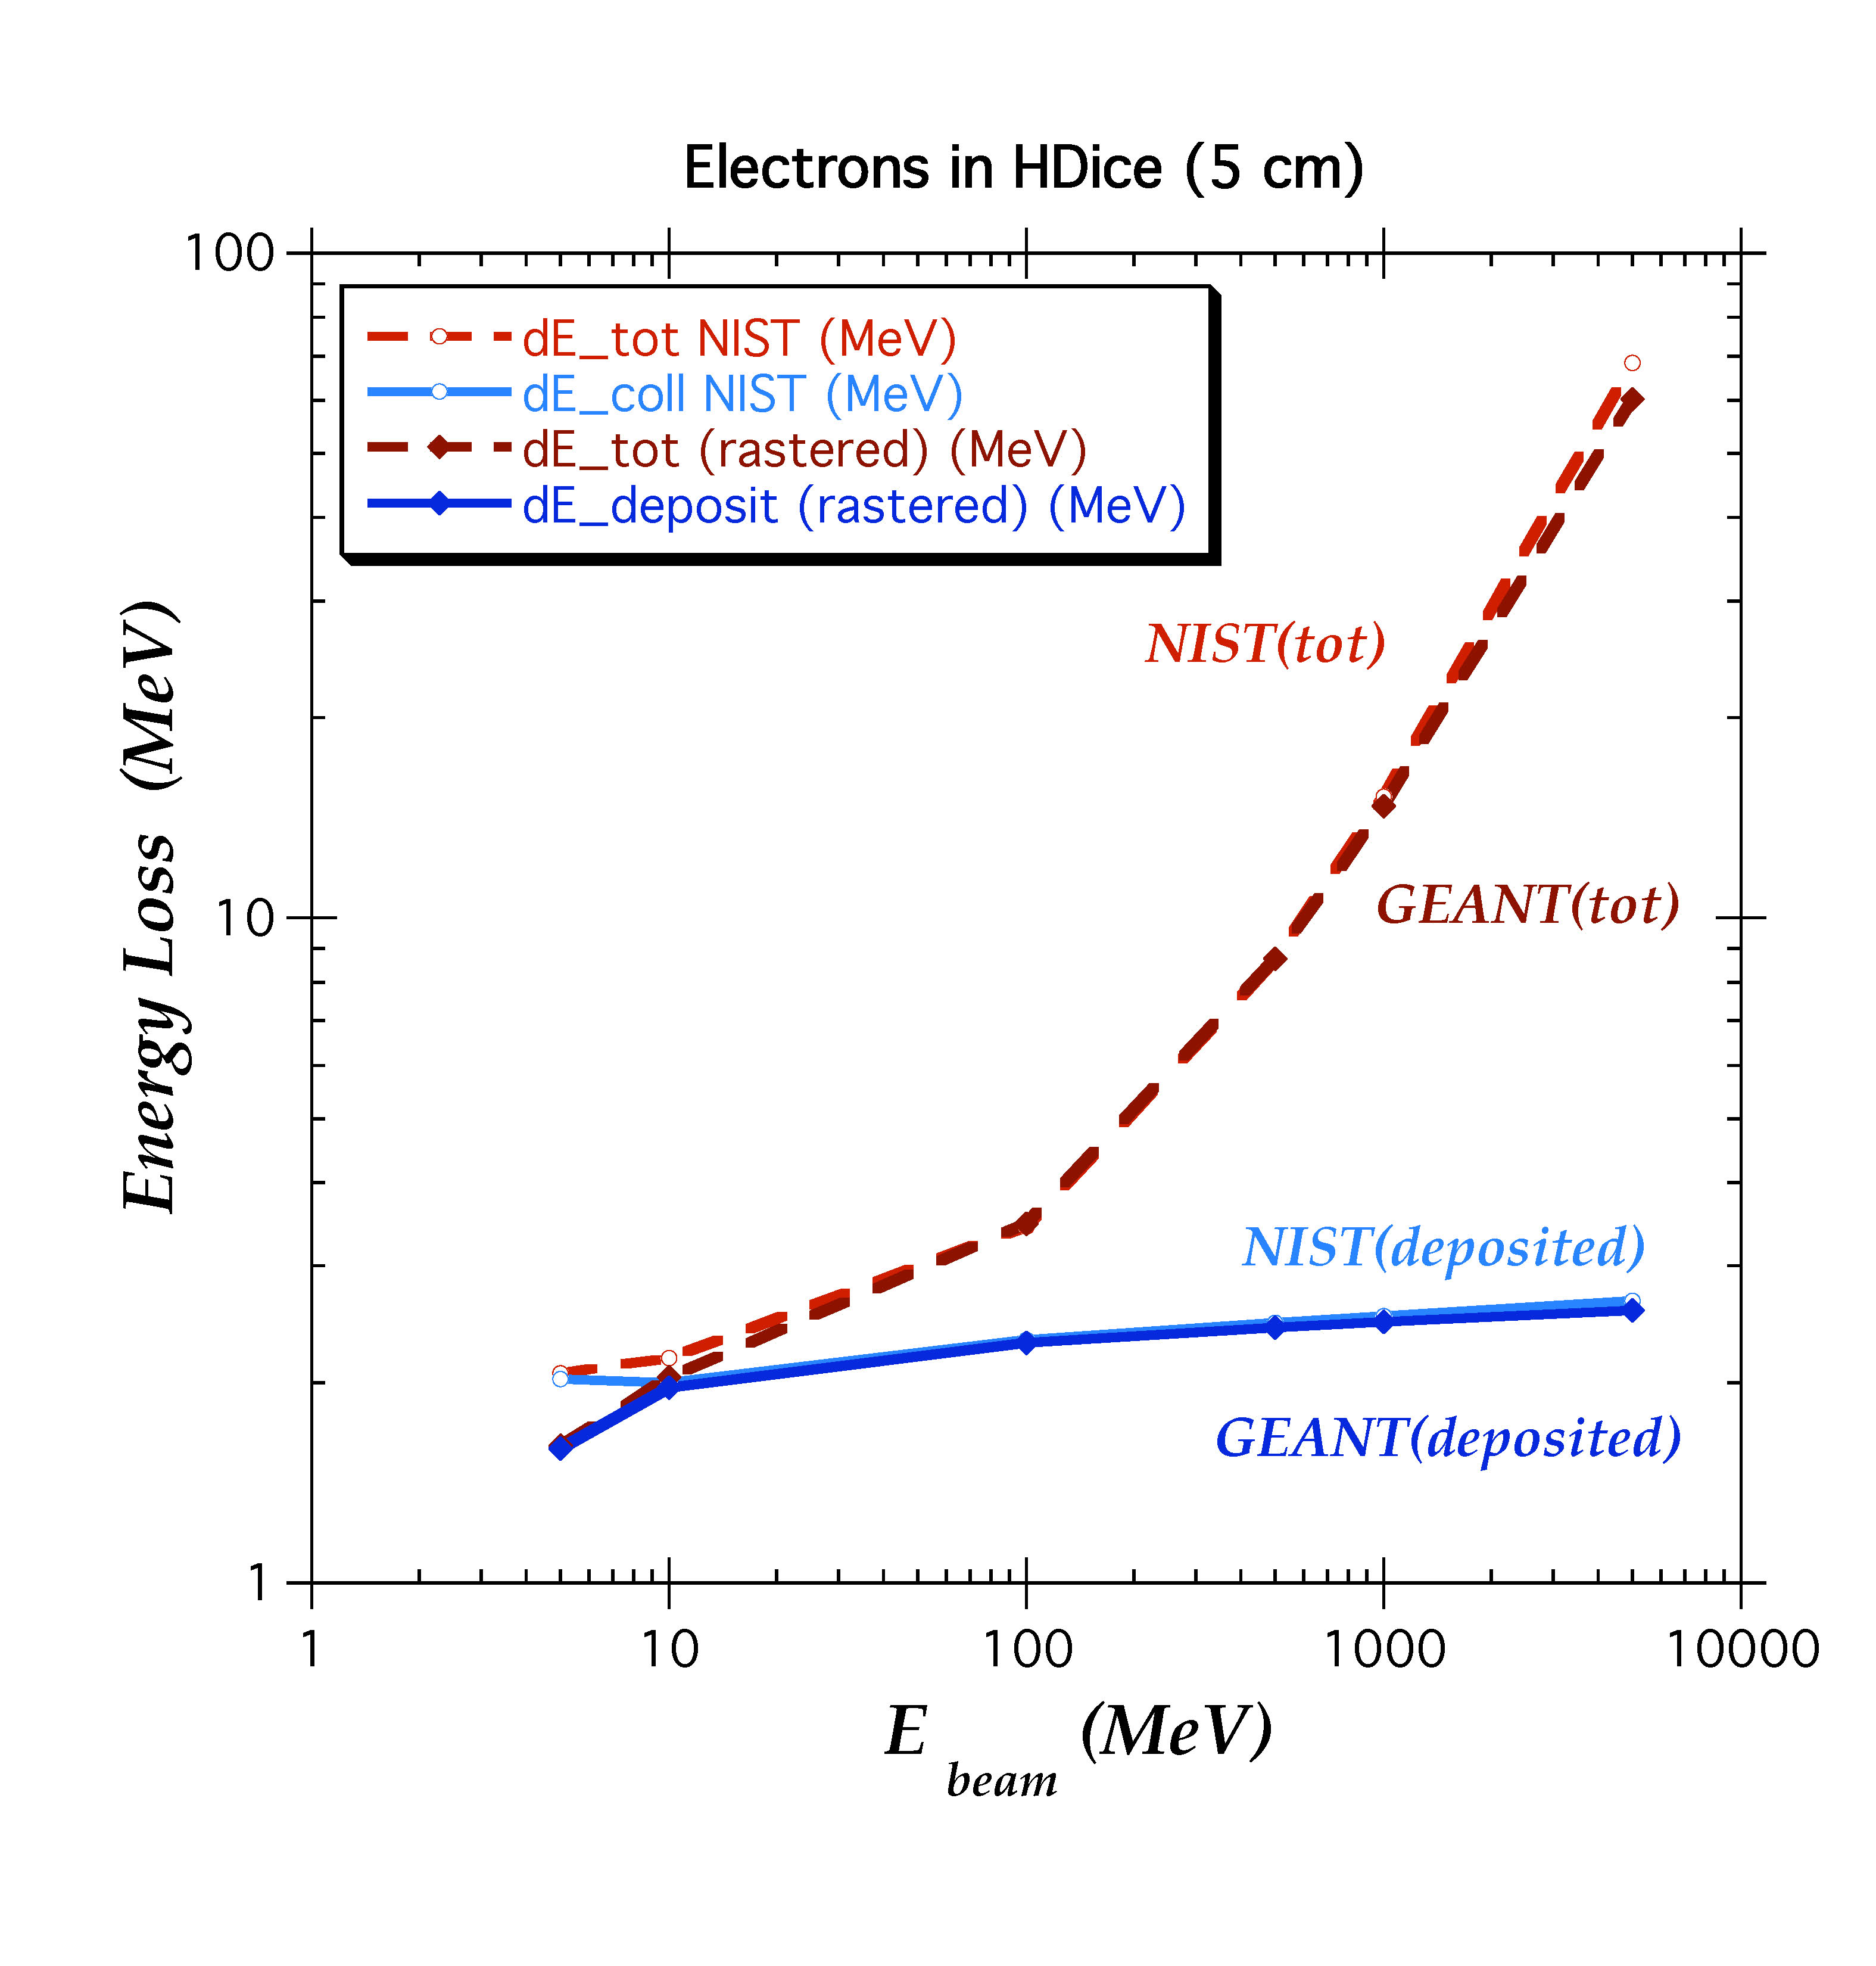
Ebeam Energy Deposit
Note: 1 MeV/e- = 1 mW/nA
Notes:
Blue Interior Page Design 1

Slide 7
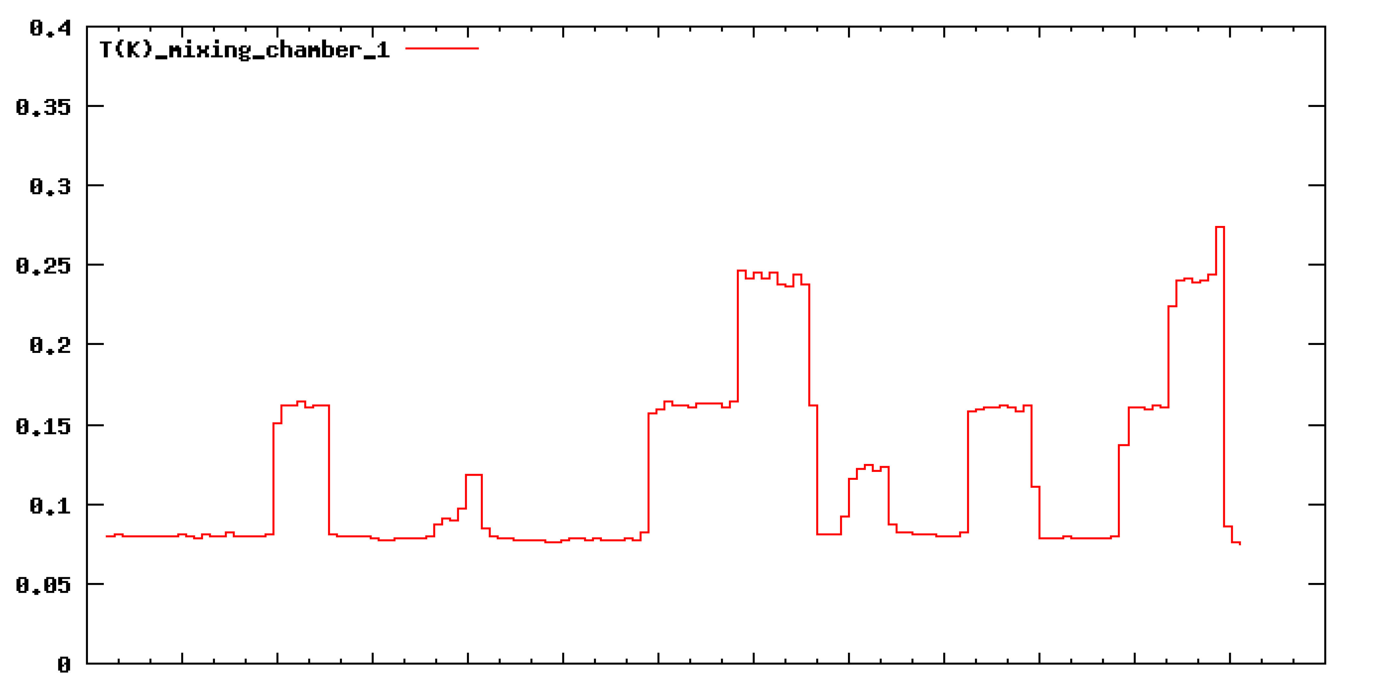
Mixing Chamber Temperature
3.9 mW
2.0 mW
0.5 nA
(not real)
Notes:
Blue Interior Page Design 1

Slide 8
Thermal Conduction
Thermal Resistivities
Temperature [K] | Al [m‐K/W] | HD [m‐K/W] | Kapitza [m²‐K/W]
0.800 | 0.00208 | 1.14 | 0.00095
0.200 | 0.00833 | 71.3 | 0.0608
0.020 | 0.0833 | 71250 | 60.8
Characteristic Geometry – 960 38-micron wires in 15mm dia. x 50mm long cell
 | Al | HD | Kapitza
Area [m²] | 1.1x10⁻⁶ | 5.7x10⁻³ | 5.7x10⁻³
Length [m] | 0.05 | 2.2x10⁻⁴ | --
Thermal Resistances
Temperature [K] | Al [K/W] | HD [K/W] | Kapitza [K/W]
0.800 | 95.2 | 0.044 | 0.165
0.200 | 381 | 2.77 | 10.57
0.020 | 3810 | 2770 | 10570
Al: Woodcraft, Cryogenics 45(2005)626
HD: Constable & Gaines, Phys Rev B8(1973)3966
Notes:
Blue Interior Page Design 1

Slide 9
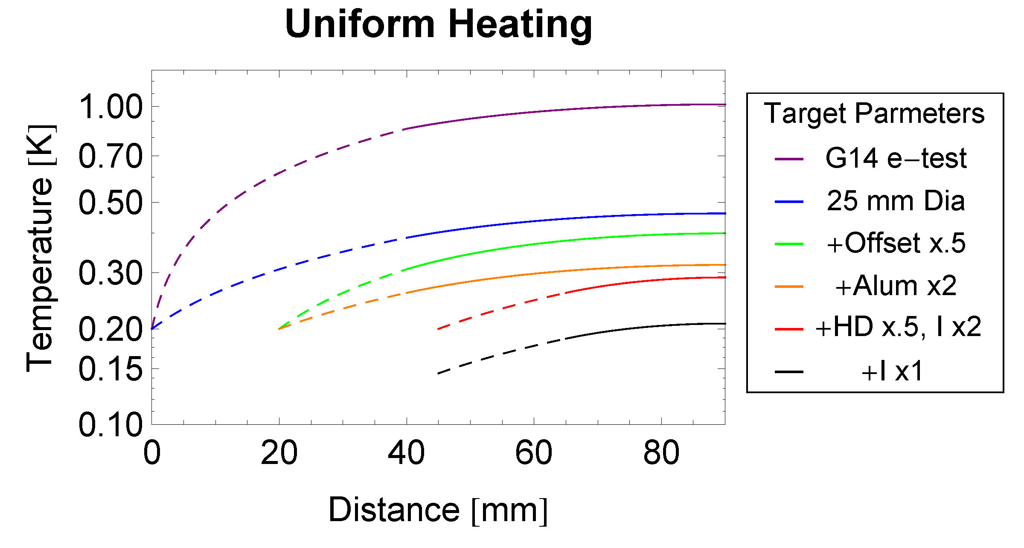
Target Temperature
Notes:
Blue Interior Page Design 1

Slide 10
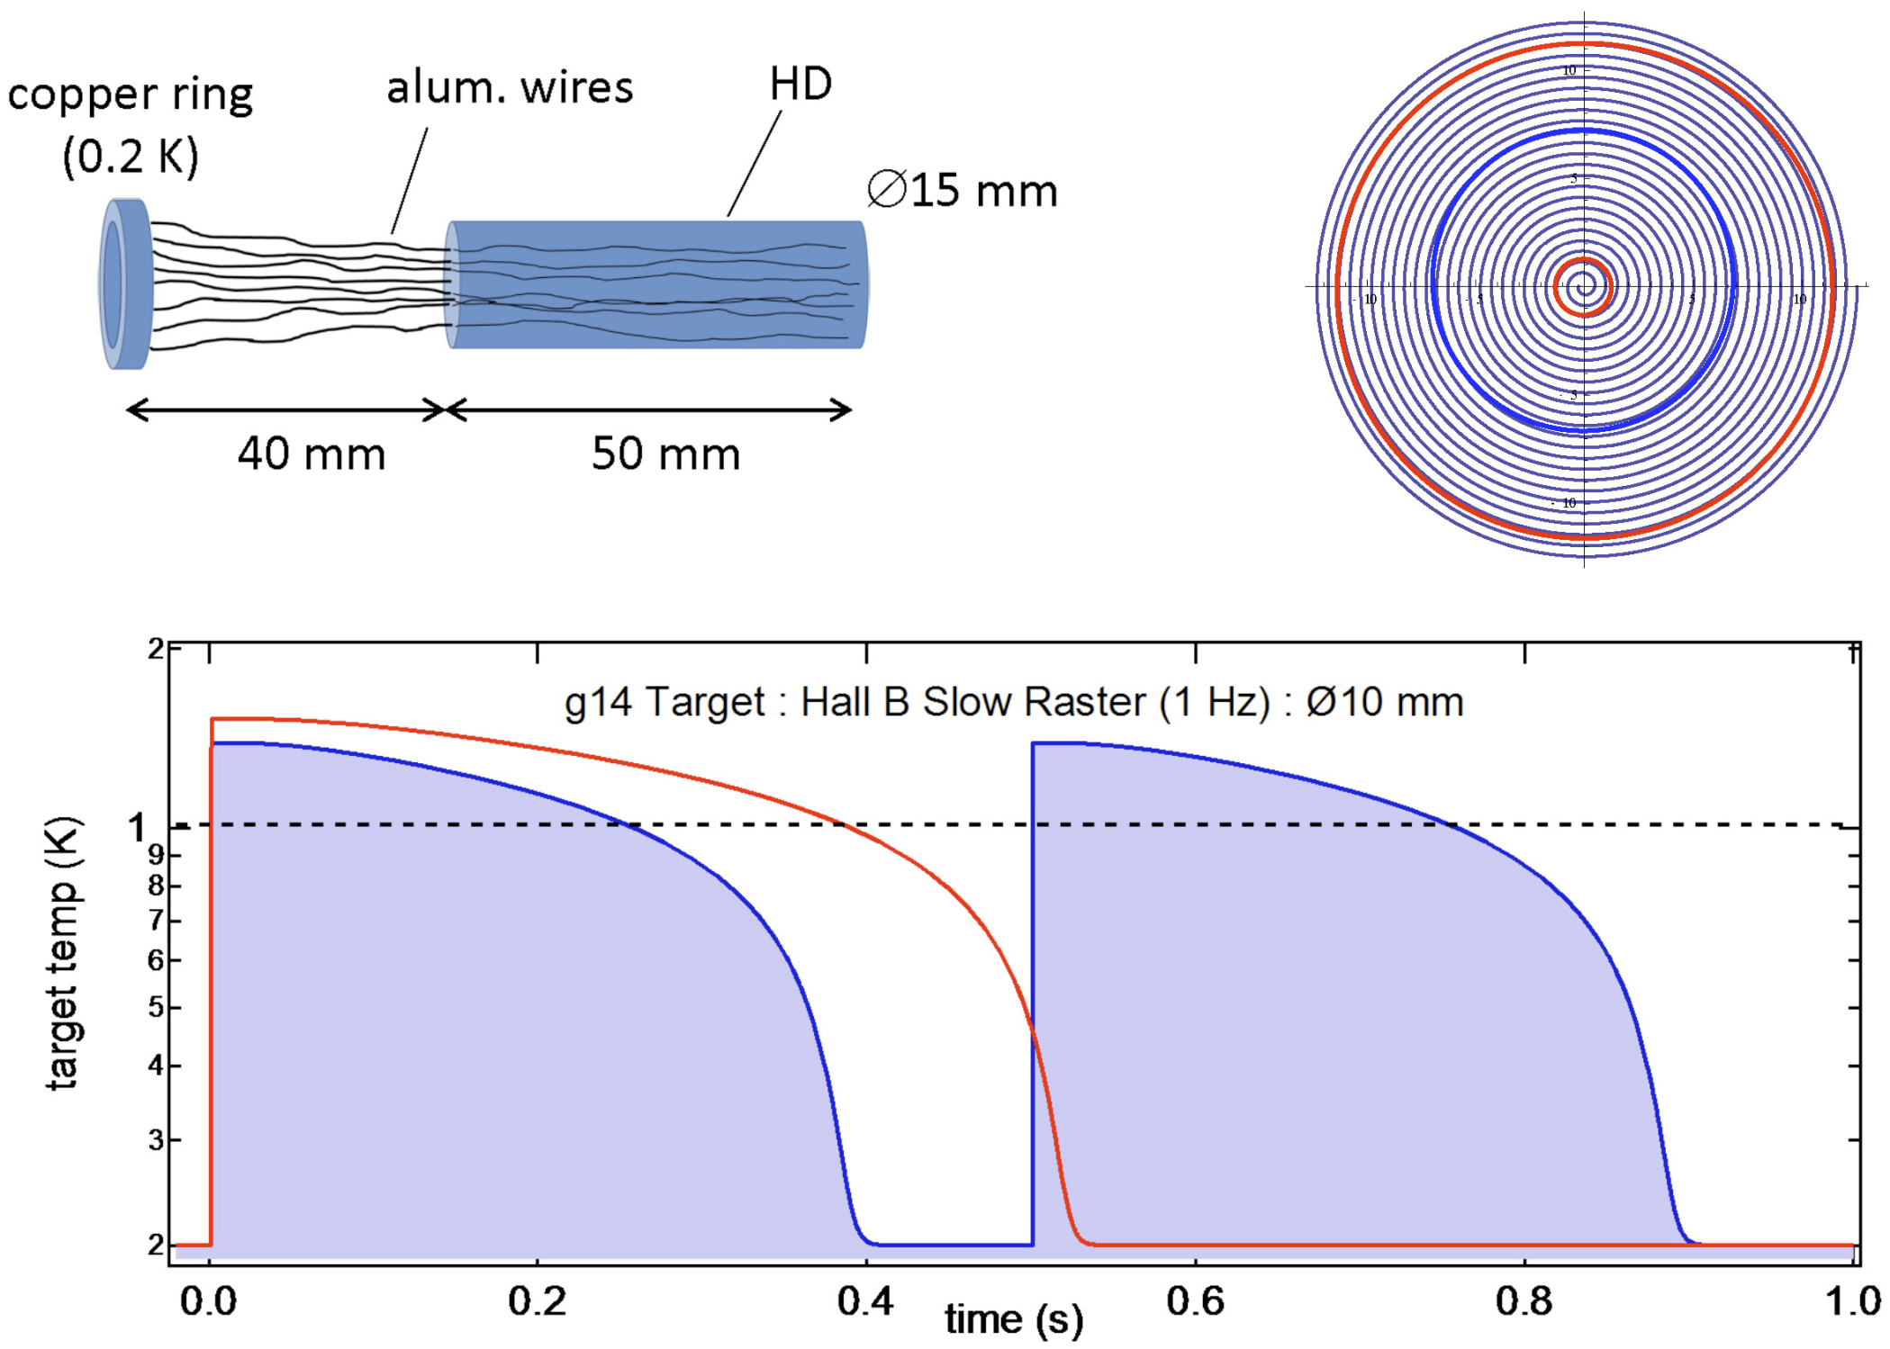
Rastered Temperature for Test
Notes:
Blue Interior Page Design 1

Slide 11
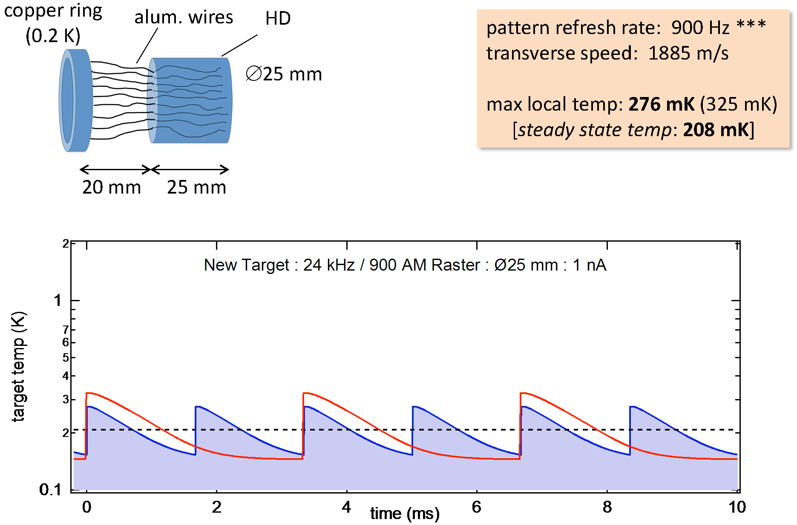
Future Rastered Temperature
Notes:
Blue Interior Page Design 1

Slide 12
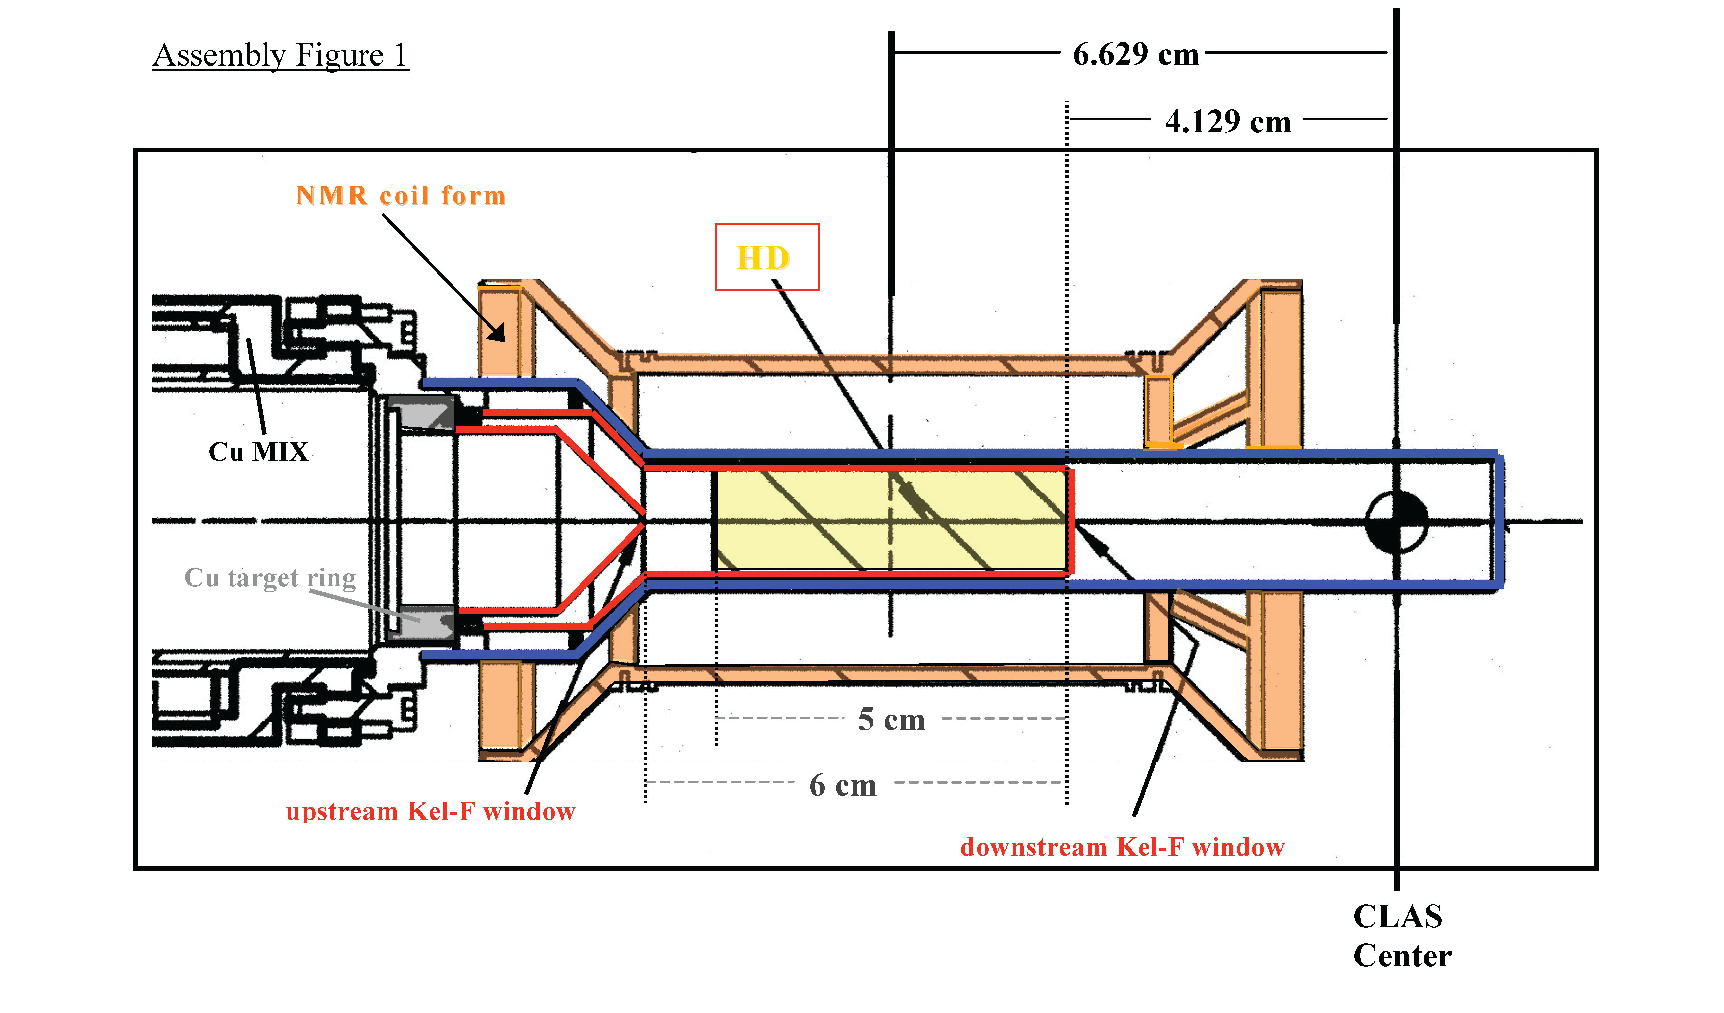
NMR Measurements
Target surrounded by NMR coils for monitoring of H and D polarizations
Notes:
Blue Interior Page Design 1

Slide 13
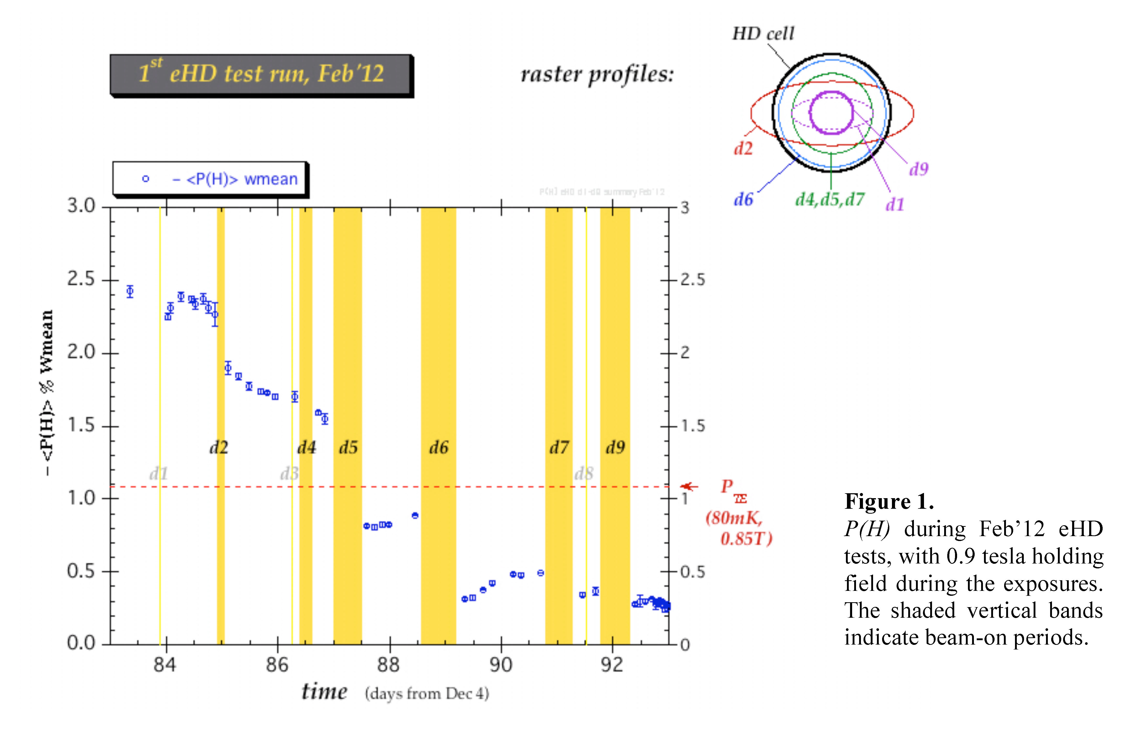
NMR Measurements
Directed at post-Irradiation effects
Confused by too many changes and too low polarization
Evidence for screening of NMR RF by free electrons
Most polarization lost during irradiation
Notes:
Blue Interior Page Design 1

Slide 14
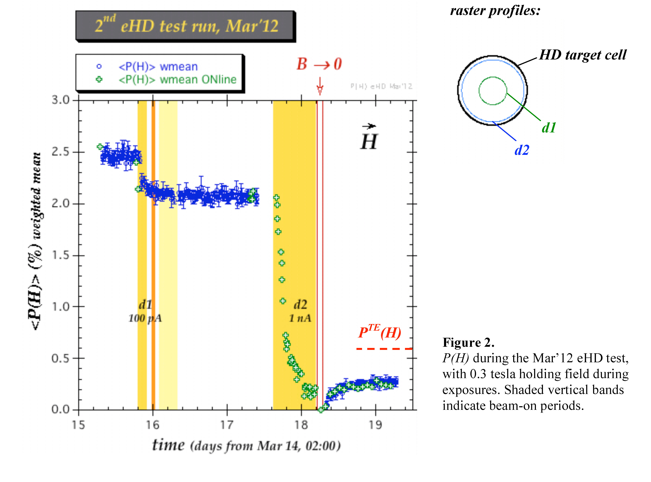
NMR Measurements
Directed at during-Irradiation effects
Confirm NMR RF screening
Polarization decay T1 ~ 3-6 hr
Re-growth after B zero’ing shows
mechanism still active after beam
gone but freeze out after 6-12 hr
@ 50 mK,
0.29T
Notes:
Blue Interior Page Design 1

Slide 15
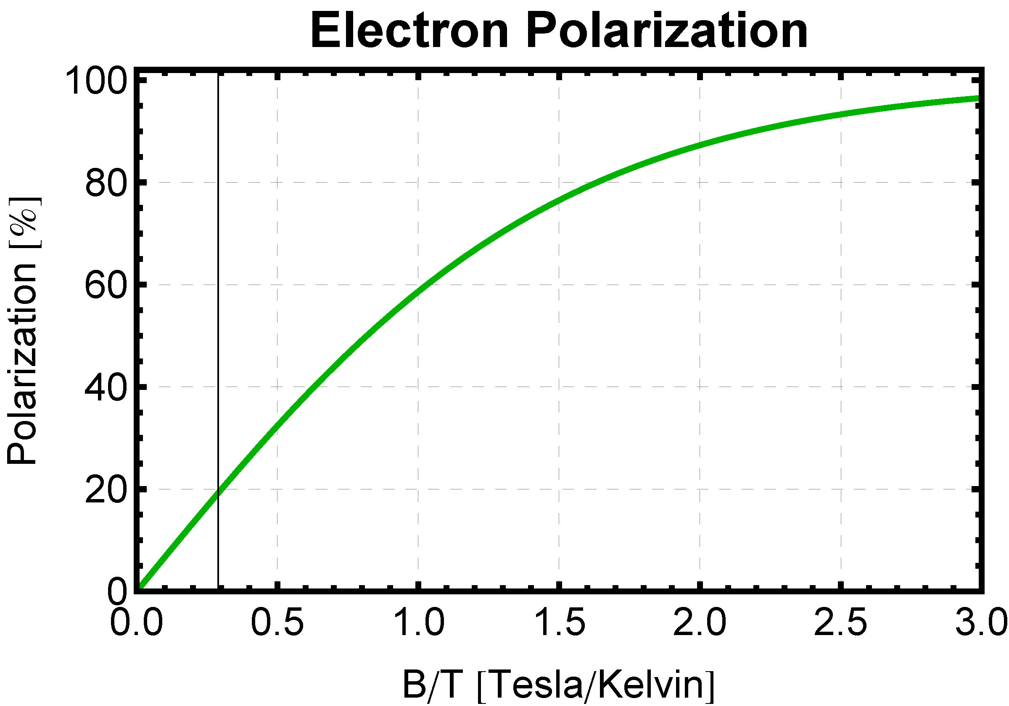
Depolarization Mechanisms
Paramagnetic Impurity – un-paired, bound,
electron spin
Lattice flips intermittently to bring into equilibrium with B / T
Flip rate has Fourier component at
nuclear resonance frequency of binding nucleus or nearby one, flipping it
Depolarized spin diffuses to rest of target
Rorschach, Physica 30(1964)38
Solutions
Suppress flips by higher electron polarization
Impede diffusion with higher electron polarization
Raise nuclear resonance frequency with higher B
20% for e-test
0.29 T/ 1.0 K
Notes:
Blue Interior Page Design 1

Slide 16
Depolarization Mechanisms
Hyperfine Interaction – un-paired, bound, electron spin mixes with nuclear spin
Mixing independent of T, amplitude admixture inversely proportional to B-field in Paschen-Back regime
Opposite direction nuclear spin diffuses to rest of target
Solutions
Suppress mixing with higher B
Impede diffusion with higher electron polarization
Eliminate hyperfine mixing with “stretched” angular momentum state by rotating nuclear polarization
Notes:
Blue Interior Page Design 1

Slide 17
Irradiation Chemistry
What happens to the molecules when solid HD is irradiated?
Subject dates back to the 50’s, with tritium decay studies in gas proportional counters.
³H → ³He⁺ + e‐ + ν +18.6 keV, t_{1/2}= 12.3 yr
Average energy deposited per decay = 5.65 keV
156 ion pairs, 36.2 eV per pair
(15 eV required to ionize)
5.1 atoms per ion pair, 7.2 eV per atom
(4.5 eV required to disassociate,
11 eV threshold)
This is in gas. Could be different in solid.
Notes:
Blue Interior Page Design 1

Slide 18
Irradiation Chemistry
Note that energetics only work because H₂⁺ is very reactive.
H₂⁺ + H₂ → H₃⁺ + H (note use of H for all isotopic analogs)
Thus we have three species produced:
free e⁻ - polaron, some localize on lattice defects (low mobility)
H₃⁺ ion - 2 paired electrons, not depolarizing, small triangle (high mobility)
atomic H - single unpaired electron – the problem (intermediate mobility)
In time, the free electrons are captured
H₃⁺ + e⁻ → H₂ + H or → 3 H but first dominates
H + e⁻ → H⁻ + γ
 H⁻ + H → H₂ + e⁻ Recombination= Self-Healing!
Notes:
Blue Interior Page Design 1

Slide 19
Irradiation Chemistry
Recombination is a function of concentration and mobility. The energy release raises local temperature, increases mobility and can provide feedback that generates a chain reaction
– Recombination Flash!
Indications are that several hours after bombardment there is little free e⁻ or atomic H left.
Explains why inertial fusion community unable to make polarized T₂ pellets and, at least partially, why dynamic polarization efforts have been unsuccessful.
Do we see evidence of recombination? Yes!
Notes:
Blue Interior Page Design 1

Slide 20
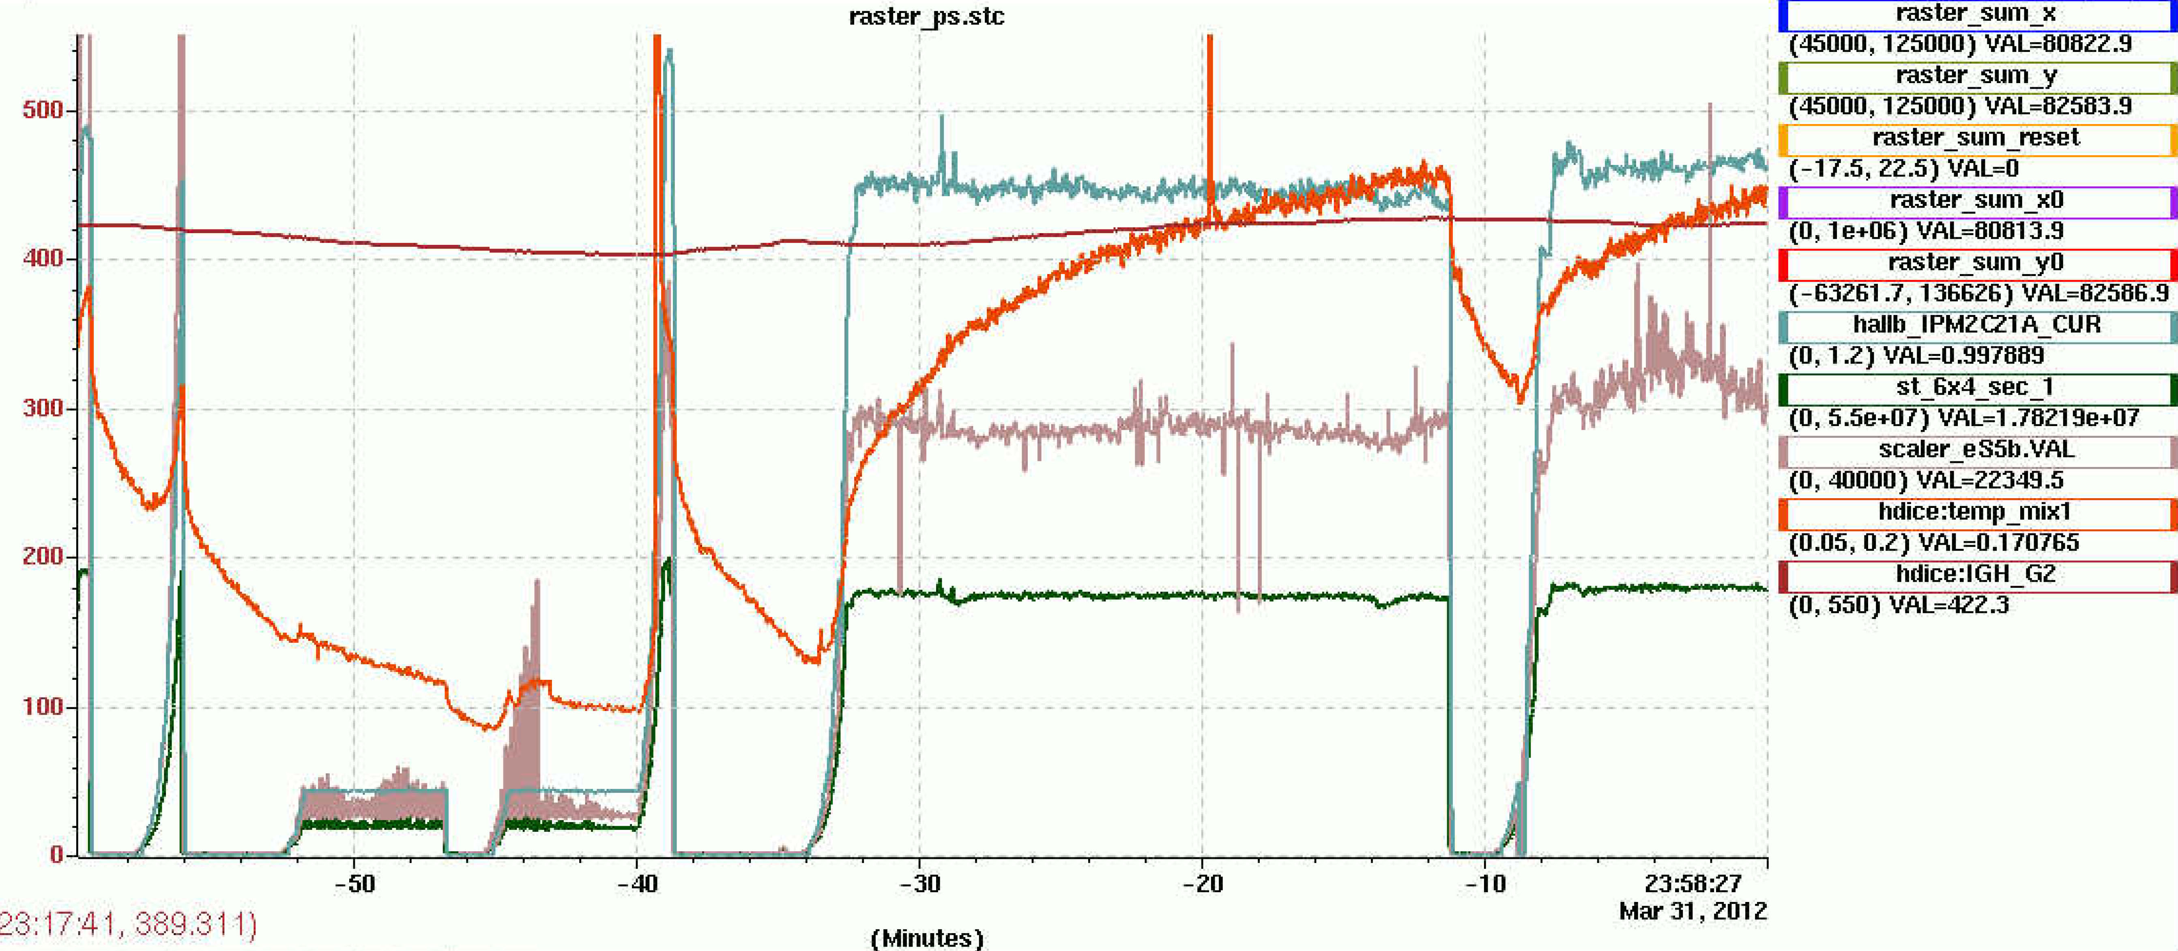
Ebeam Energy Deposit
1 nA current
temperature rises as atomic
concentration builds up
Notes:
Blue Interior Page Design 1

Slide 21
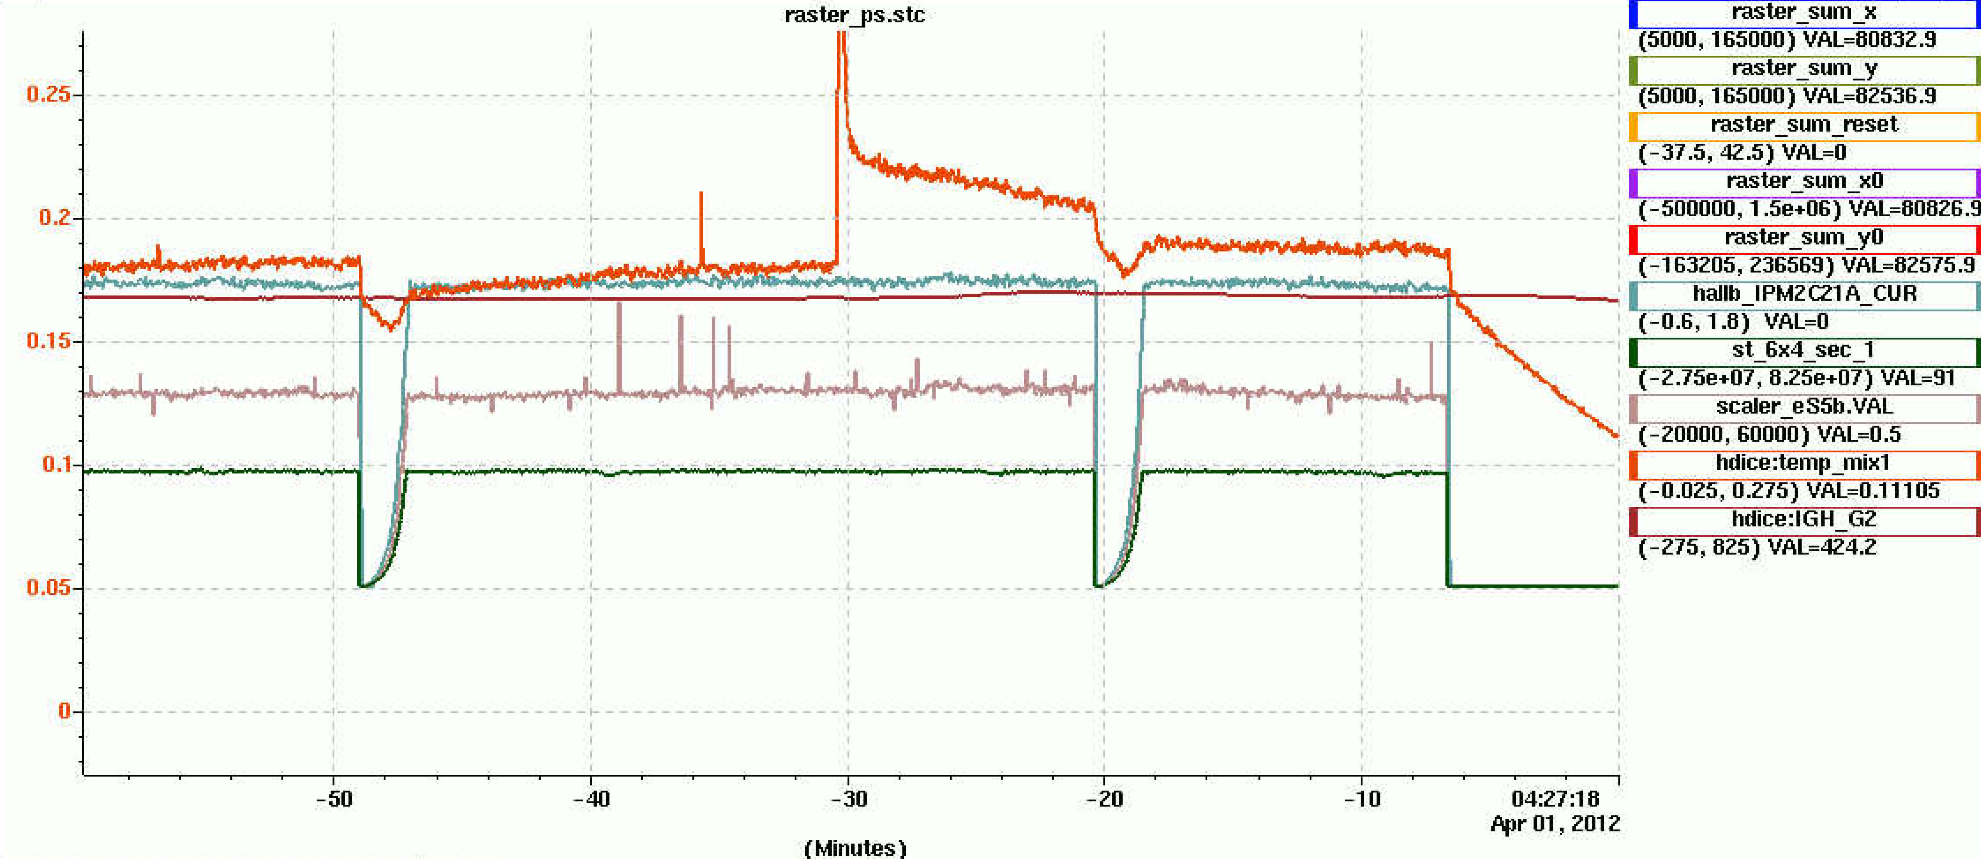
Ebeam Energy Deposit
Recombination Flash!
15 mK drop out of 100 mK => ~85% of energy is recombination,
implies ~14 (not 5) atoms per ion pair,
agrees with ESR measurements on solid tritium (x3)
Notes:
Blue Interior Page Design 1

Slide 22
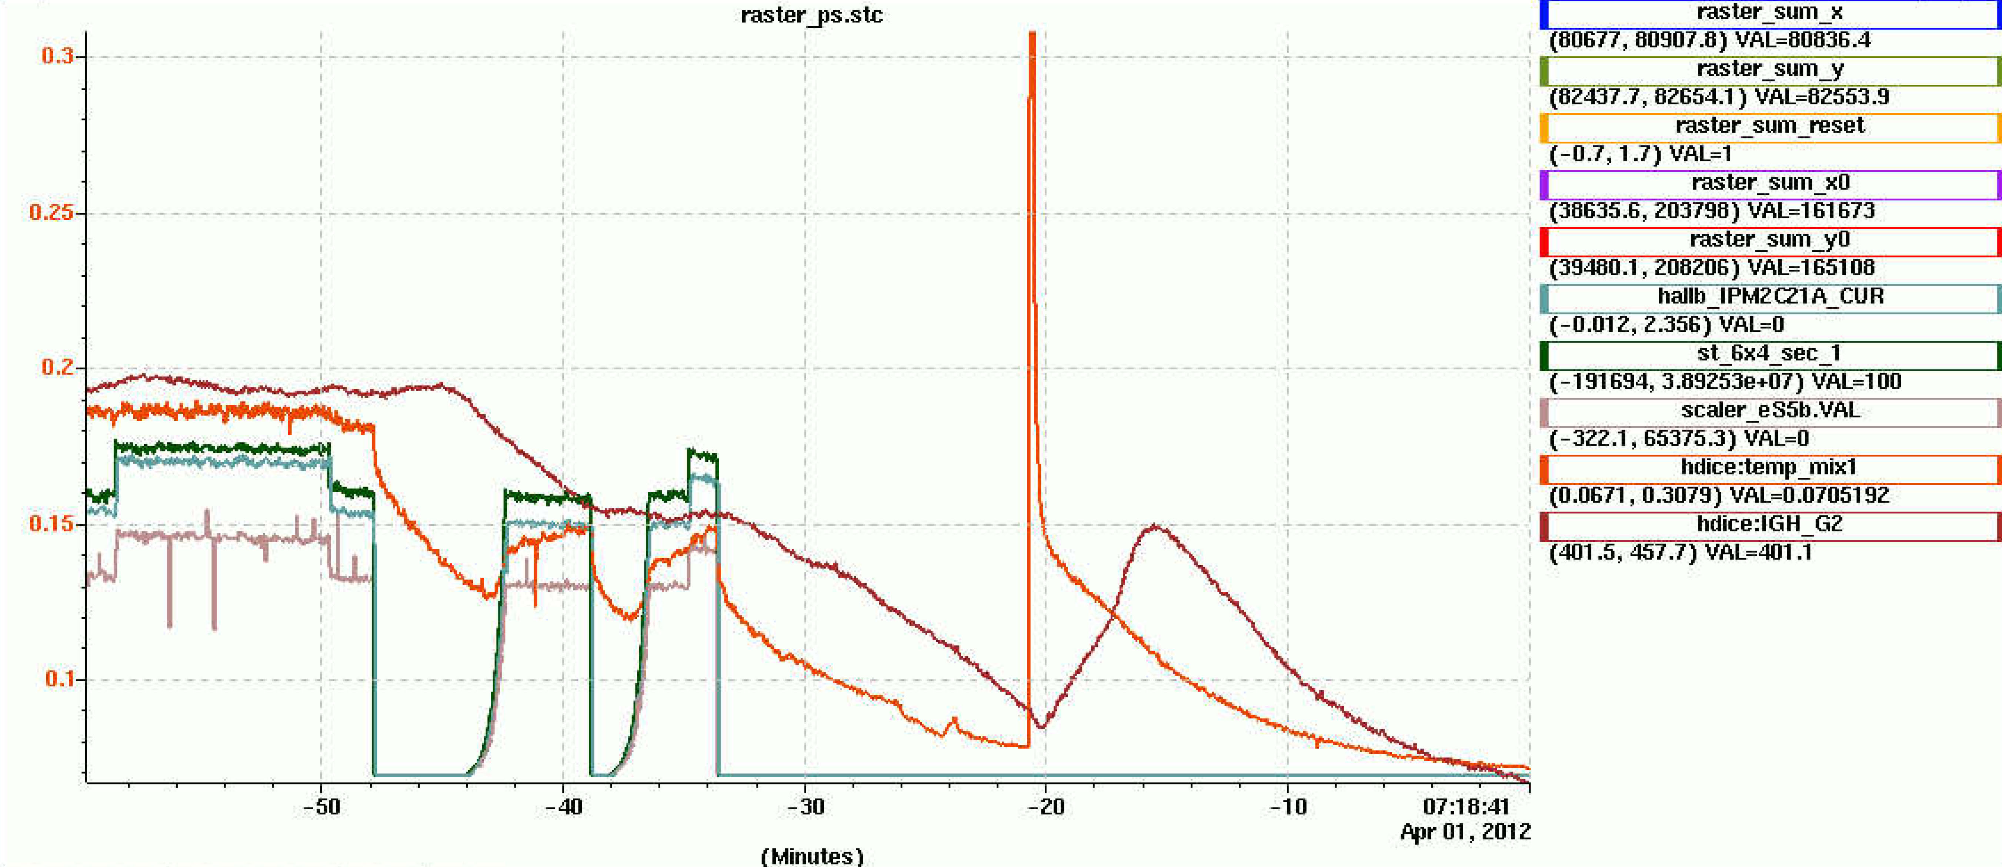
Ebeam Energy Deposit
Recombination Flash!
some mixture out of IBC
(note zero suppression)
Notes:
Blue Interior Page Design 1

Slide 23
Summary
Permanent radiation damage does not appear to be a major limitation, yet.
85% of energy in recombination
=> 3x10¹⁵ molecules/s =>1. 3x10²⁰ /12 hr
1/3 mole HD target => 6x10⁻⁴ new/old
naïve estimate: 3/16 ortho-H₂ , 1/12 para-D₂
Target geometry and Raster parameters need to be optimized for cooling in this temperature regime.
Need to have a higher holding field, hopefully 1.25 T.
Need to test eliminating hyper fine interaction with stretched angular momentum state.
Plan is to continue development and testing at a new accelerator test facility that will provide 5-10 MeV electron beams to our targets.
Notes:
Blue Interior Page Design 1

Slide 24
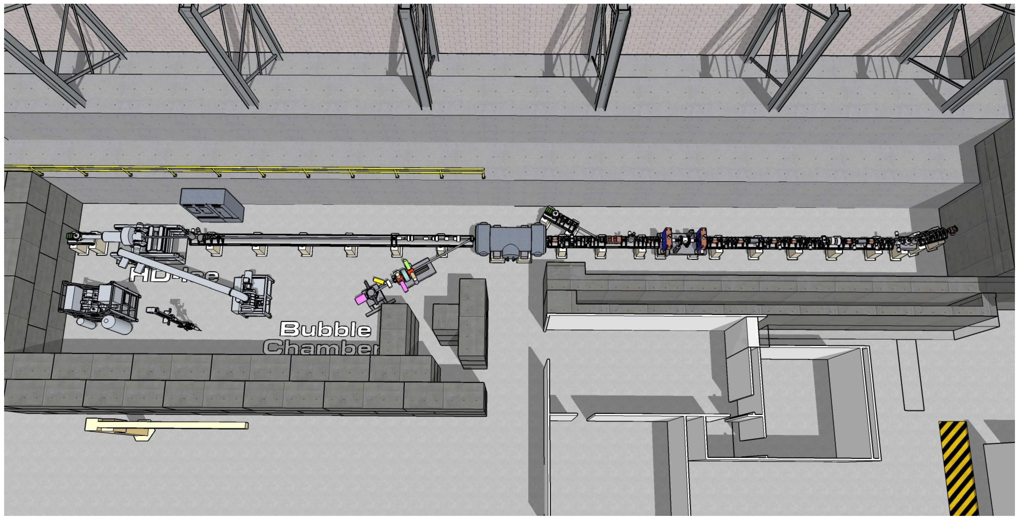
Planned Test Facility
Notes:
Blue Interior Page Design 1

