Slide 1



Polarized Protons in the Fermilab
Main Injector
Wolfgang Lorenzon
(12-September-2013)
PSTP 2013
Sivers Function in Polarized Drell-Yan
  fundamental QCD prediction:
Polarized Drell-Yan at Fermilab
  polarized Beam (E-1027) or Target (E-1039)
Main Injector Polarization Scheme
  present status & plans
This work is supported by
Notes:
Polarized Drell-Yan scattering has become a major milestone in the hadronic physics community, motivated by a fundamental prediction of QCD that postulates that a time-reversal-odd distribution function (e.g. the Sivers function) measured in Drell-Yan must have the opposite sign when measured with semi-inclusive deep inelastic scattering (DIS).
I want to start with a discussion of the Sivers function and how it is accessed through SSA in DIS, and then discuss the tremendous opportunity at Fermilab, for a relatively modest cost to set up the arguably best polarized Drell-Yan experiment to perform this fundamental test of the gauge structure of QCD (which could be the beginning of a world-class polarized proton program at Fermilab that is complementary to the spin physics programs at RHIC and Jefferson Lab.)
I will then focus on a discussion of the work that is needed to polarize the MI and how far we have moved towards that goal.

Slide 2
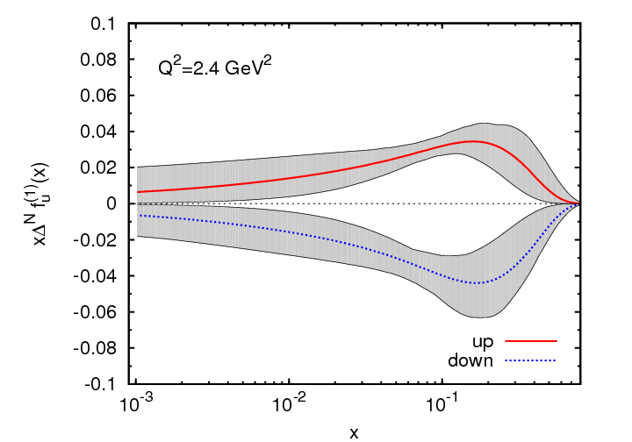
Sivers Function
describes transverse-momentum
distribution of unpolarized quarks inside transversely polarized proton
captures non-perturbative spin-orbit
coupling effects inside a polarized proton
Sivers function is naïve time-reversal odd
leads to
  sin(φ – φ_{S}) asymmetry in SIDIS
  sinφ_{b} asymmetry in Drell-Yan
measured in SIDIS (HERMES, COMPASS)
future measurements at Jlab@12 GeV planned
Anselmino et al. (arXiv:1107.4446 [hep-ph])
x
First moment of Sivers functions:
  u- and d- Sivers have opposite signs, of roughly equal magnitude
Notes:
This single-spin asymmetry is odd under so-called ``naive time-reversal'', the operation that reverses all vectors and pseudo-vectors but does not exchange initial and final states.

Slide 3
Polarized Drell-Yan Experiment
NOT Yet Done!
Access to transverse-momentum dependent distribution (TMD) functions
    Sivers, Boer-Mulders, etc
Transversely Polarized Beam or Target
    Sivers function in single-transverse spin asymmetries (sea quarks or valence quarks)
      − valence quarks constrain SIDIS data much more than sea quarks
      − global fits indicate that sea quark Sivers function is small
    transversity Boer-Mulders function
    baryon production, incl. pseudoscalar and vector meson production,
    elastic scattering, two-particle correlations, J/ψ and charm production
Beam and Target Transversely Polarized
    flavor asymmetry of sea-quark polarization
    transversity (quark anti-quark for pp collisions)
      − anti-quark transversity might be very small

Slide 4
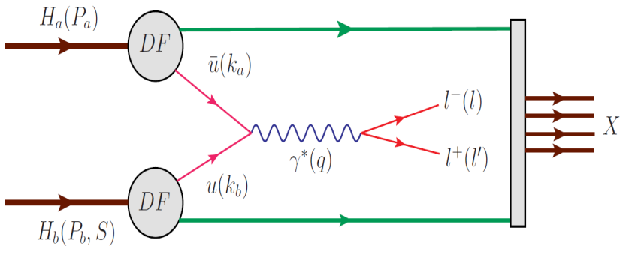
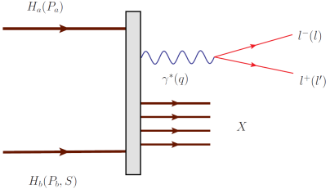
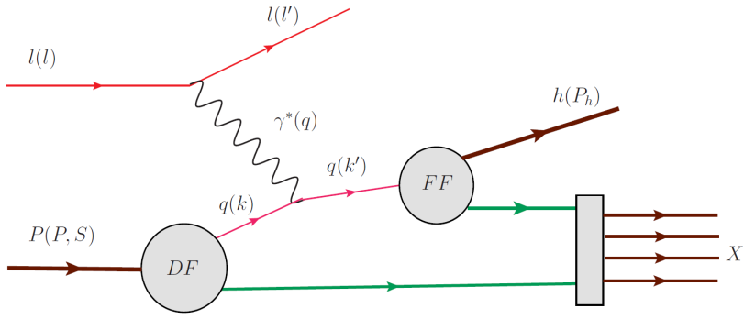
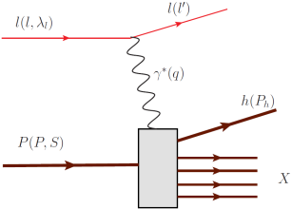
Drell Yan Process
Similar Physics Goals as SIDIS:
  parton level understanding of nucleon
  electromagnetic probe
timelike (Drell-Yan) vs. spacelike (SIDIS) virtual photon
Drell-Yan
SIDIS
A. Kotzinian, DY workshop, CERN, 4/10
Cleanest probe to study hadron structure:
  hadron beam and convolution of parton distributions
  no QCD final state effects
  no fragmentation process
  ability to select sea quark distribution
  allows direct sensitivity of transverse momentum-dependent distribution (TMD)
  functions (Sivers, Boer-Mulders, etc)
Notes:
Assuming factorization is valid in QCD, Drell-Yan can be written as a hard scattering process, and the direct production of two transverse momentum-dependent distribution (TMD) functions (Sivers, Boer-Mulders, etc); and SIDIS allows to measure convolution of DF with FF.
If universality is valid in QCD, DF in D-Y and SIDIS are identical.

Slide 5
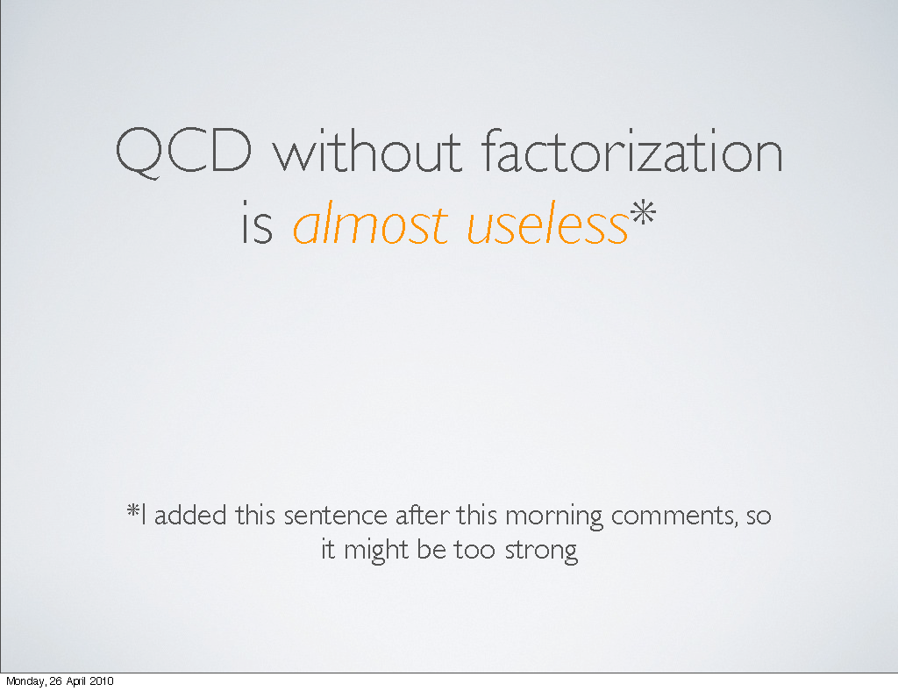
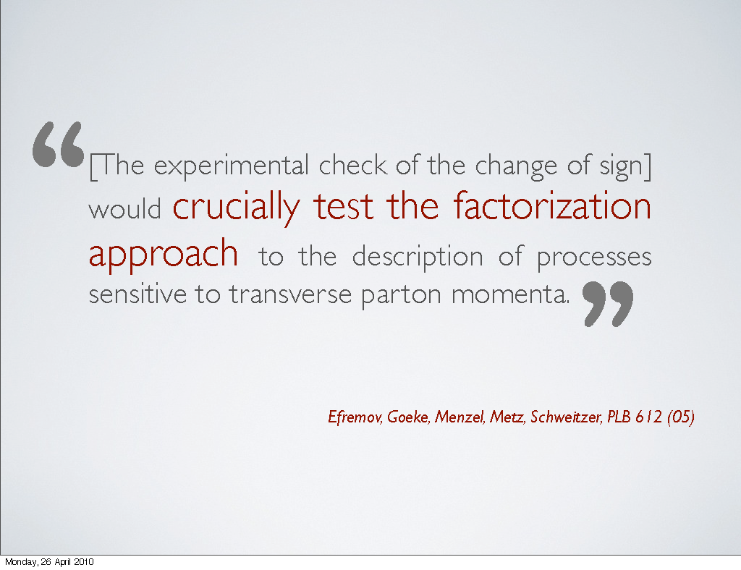
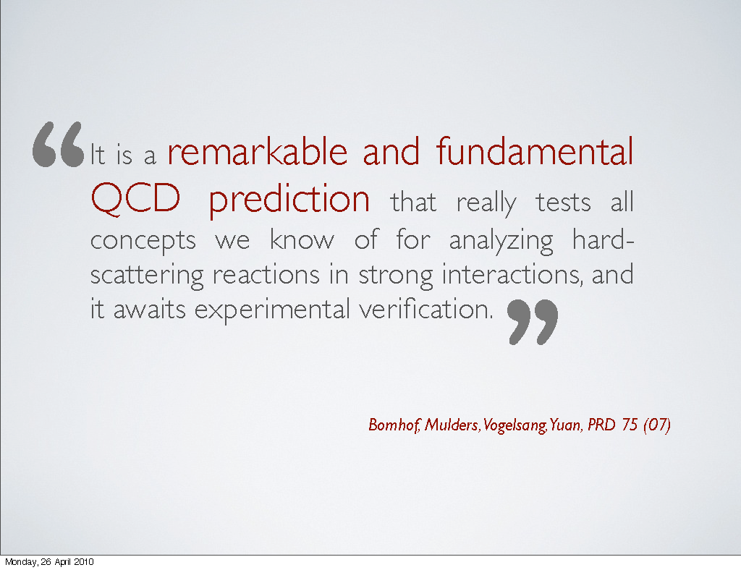
Sivers in Drell-Yan vs SIDIS: The Sign Change
fundamental prediction of QCD (in non-perturbative regime)
  goes to heart of gauge formulation of field theory
Polarized Drell-Yan:
  major milestone in hadronic physics
  (HP13)
Importance of factorization in QCD:
A. Bacchetta , DY workshop, CERN, 4/10

Slide 6
Planned Polarized Drell-Yan Experiments
experiment | particles | energy | x_{b} or x_{t} | Luminosity | timeline
COMPASS (CERN) | π± + p↑ | 160 GeV √s = 17.4 GeV | x_{t} = 0.2 – 0.3 | 2 x 10³³ cm⁻² s⁻¹ | 2014, 2018
PAX (GSI) | p↑ + p_{bar} | collider √s = 14 GeV | x_{b} = 0.1 – 0.9 | 2 x 10³⁰ cm⁻² s⁻¹ | >2017
PANDA (GSI) | p_{bar} + p↑ | 15 GeV √s = 5.5 GeV | x_{t} = 0.2 – 0.4 | 2 x 10³² cm⁻² s⁻¹ | >2016
NICA (JINR) | p↑ + p | collider √s = 20 GeV | x_{b} = 0.1 – 0.8 | 1 x 10³⁰ cm⁻² s⁻¹ | >2014
PHENIX (RHIC) | p↑ + p | collider √s = 500 GeV | x_{b} = 0.05 – 0.1 | 2 x 10³² cm⁻² s⁻¹ | >2018
RHIC internal target phase-1 | p↑ + p | 250 GeV √s = 22 GeV | x_{b} = 0.25 – 0.4 | 2 x 10³³ cm⁻² s⁻¹
RHIC internal target phase-1 | p↑ + p | 250 GeV √s = 22 GeV | x_{b} = 0.25 – 0.4 | 6 x 10³⁴ cm⁻² s⁻¹
SeaQuest (unpol.) (FNAL) | p + p | 120 GeV √s = 15 GeV | x_{b} = 0.35 – 0.85 x_{t} = 0.1 – 0.45 | 3.4 x 10³⁵ cm⁻² s⁻¹ | 2012 - 2015
polDY§ (FNAL) | p↑ + p | 120 GeV √s = 15 GeV | x_{b} = 0.35 – 0.85 | 2 x 10³⁵ cm⁻² s⁻¹ | >2016
 | § L= 1 x 10³⁶ cm⁻² s⁻¹ (LH₂ tgt limited) / L= 2 x 10³⁵ cm⁻² s⁻¹ (10% of MI beam limited)

Slide 7
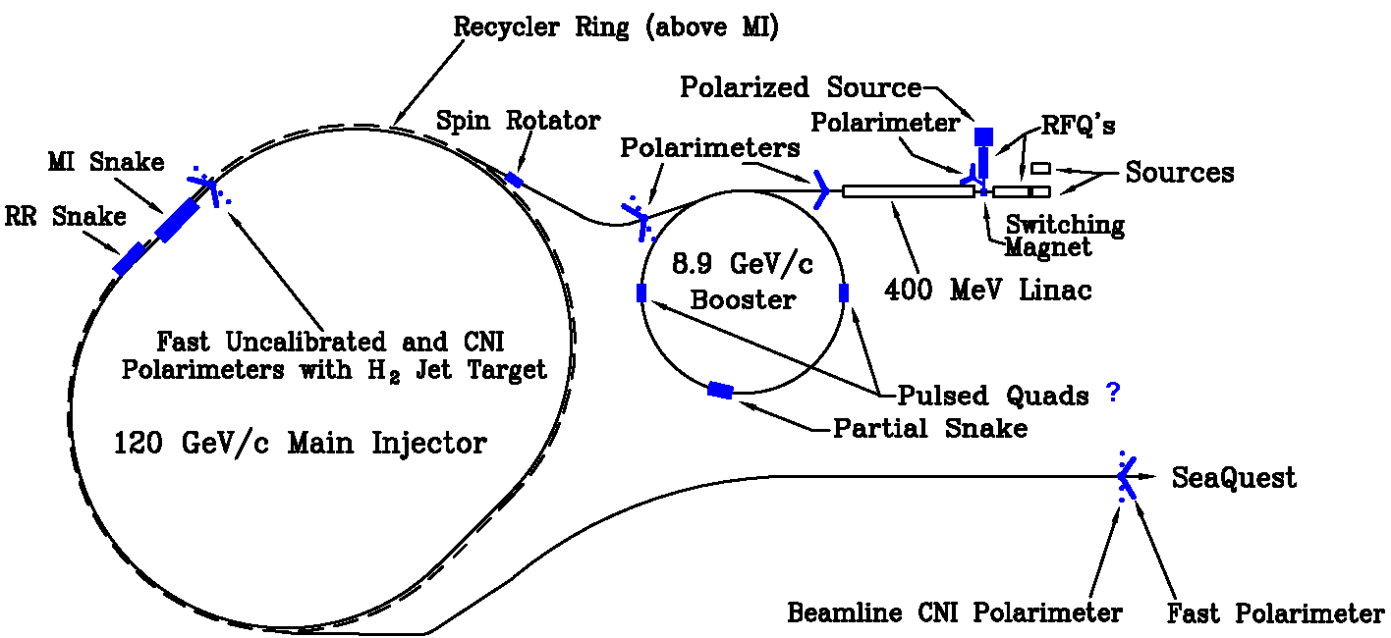
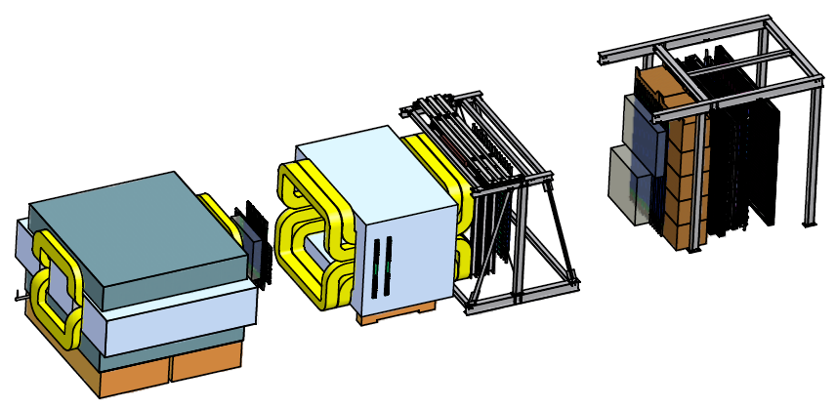
Polarized Drell-Yan at Fermilab Main Injector
Polarize Beam in Main Injector & use SeaQuest di-muon spectrometer
  measure Sivers asymmetry
SeaQuest di-muon Spectrometer
  fixed target experiment, optimized for Drell-Yan
  luminosity: L_{av} = 3.4 x 10³⁵ /cm²/s
    I_{av} = 1.6 x 10¹¹ p/s (=26 nA) / N_{p}= 2.1 x 10²⁴ /cm²
  approved for 2-3 years of running: 3.4 x 10¹⁸ pot
  by 2015: fully understood, ready to take pol. beam

Slide 8
Polarized Drell-Yan at Fermilab Main Injector - II
Polarized Beam in Main Injector
  use SeaQuest target
    liquid H₂ target can take about I_{av} = 5 x 10¹¹ p/s (=80 nA)
  1 mA at polarized source can deliver about I_{av} = 1 x 10¹² p/s (=150 nA)
  for 100% of available beam time (A. Krisch: Spin@Fermi report in (Aug 2011): arXiv:1110.3042 [physics.acc-ph])
    26 μs linac pulses, 15 Hz rep rate, 12 turn injection into booster, 6 booster pulses into Recycler Ring, followed by 6 more pulses using slip stacking in MI
    1 MI pulse = 1.9 x 10¹² p
    using three 2-sec cycles/min (~10% of beam time):
    → 2.8 x 10¹² p/s (=450 nA) instantaneous beam current , and I_{av} = 0.95 x 10¹¹ p/s (=15 nA)
  Luminosity considerations:
    L_{av} = 2.0 x 10³⁵ /cm²/s (beam-time limited)
    L_{av} = 1 x 10³⁶ /cm²/s (target heating limited)

Slide 9
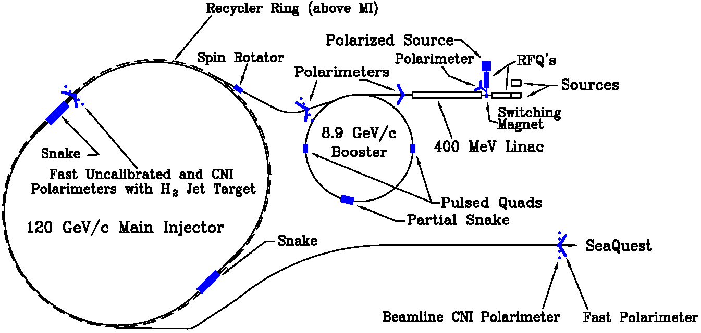
From 2 Siberian Snakes to 1 Snake
2 Siberian Snakes in MI
(not enough space)
1 Siberian Snake in MI
(fits well)
plus 1 solenoid snake in RR
Notes:
We can polarize the beam - how are we going to keep it polarized and deliver it to the experiment?

Slide 10
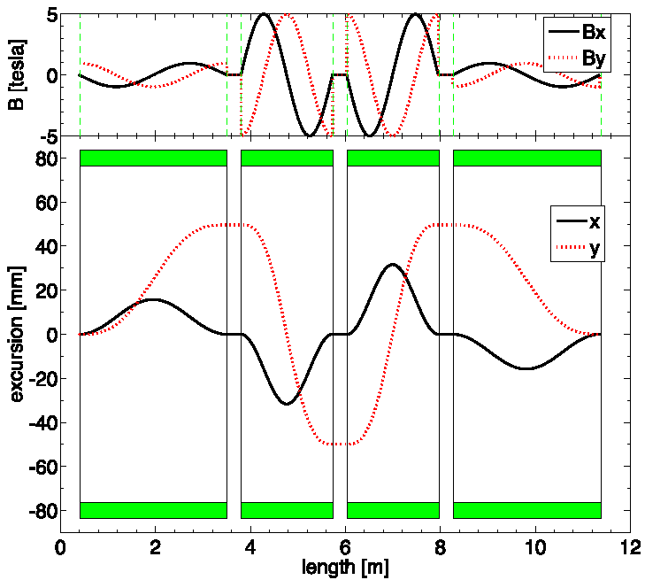
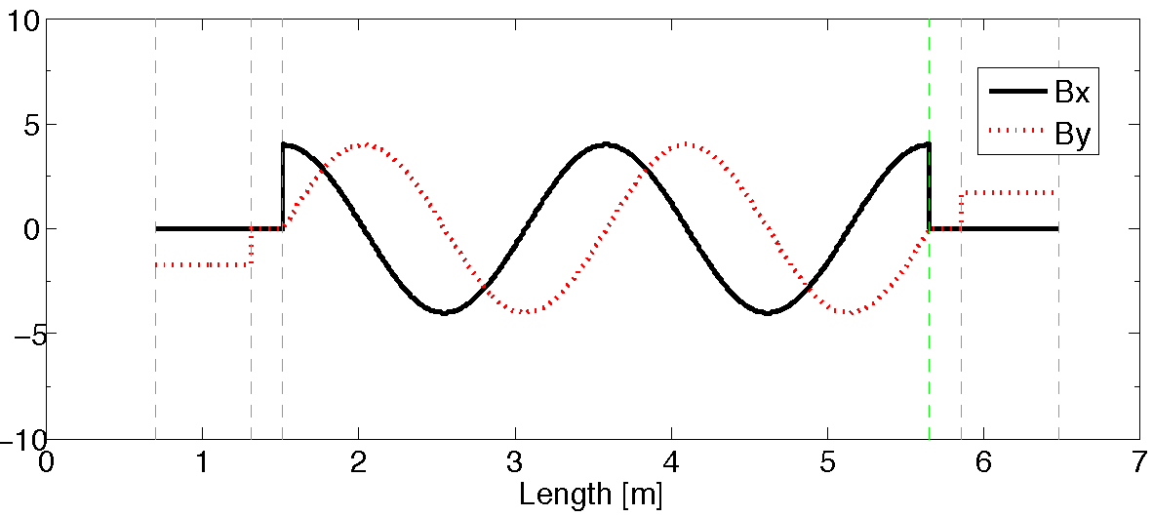
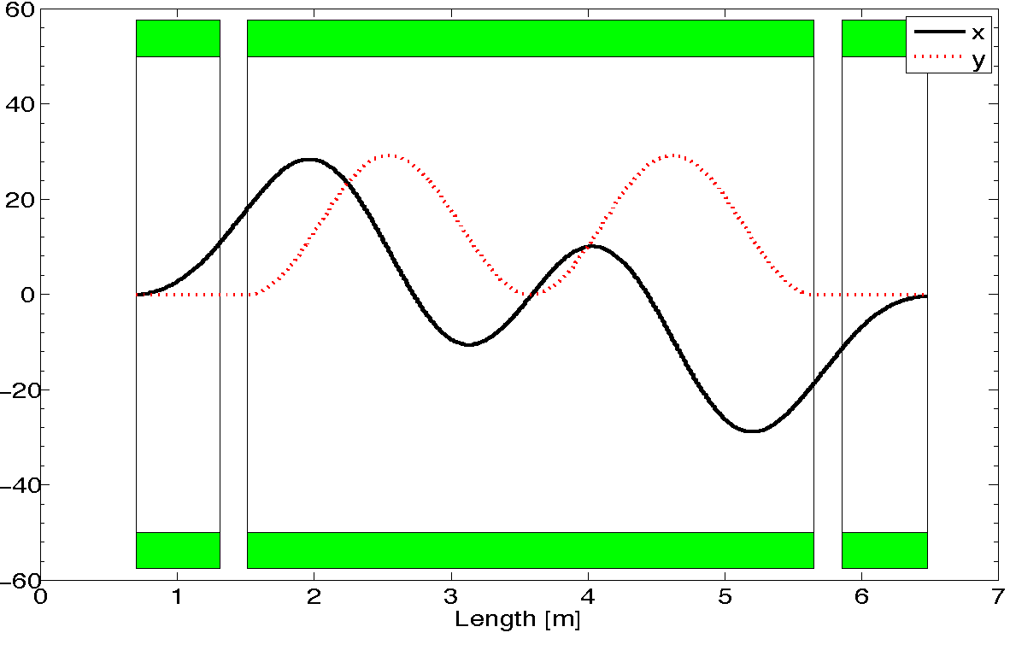
From 2 Siberian Snakes to 1 Snake - II
2-snake design (11m long):
4 helical dipoles / snake
  2 helices: 5T / 3.1m / 6” ID
  2 helices : 5T / 2.1m / 6” ID (cold)
1-snake design (5.8m long):
1 helical dipole + 2 conv. dipoles
  helix: 4T / 4.2 m / 4” ID
  dipoles: 4T / 0.62 m / 4” ID (warm)
does not fit
fits well
T. Roser (BNL): - test snakes/rotators up to 5.4T
- operation not above 4T
Notes:
4 single twist helixes / snake vs 1 2-twist helix snake

Slide 11
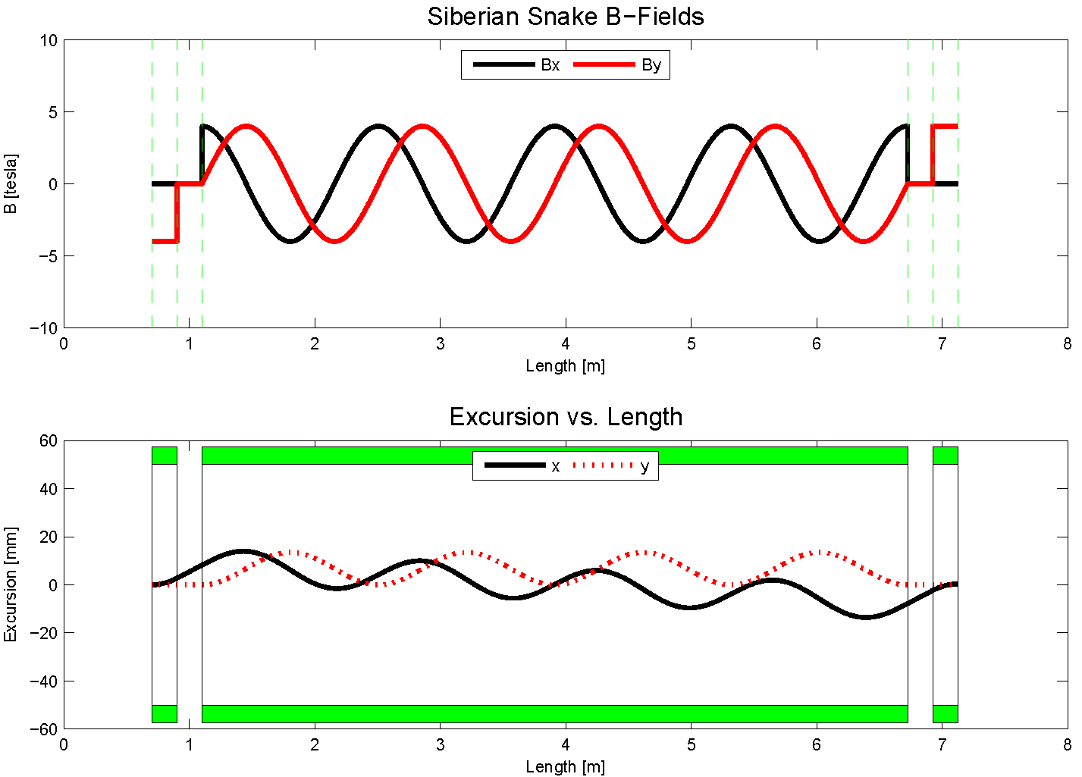
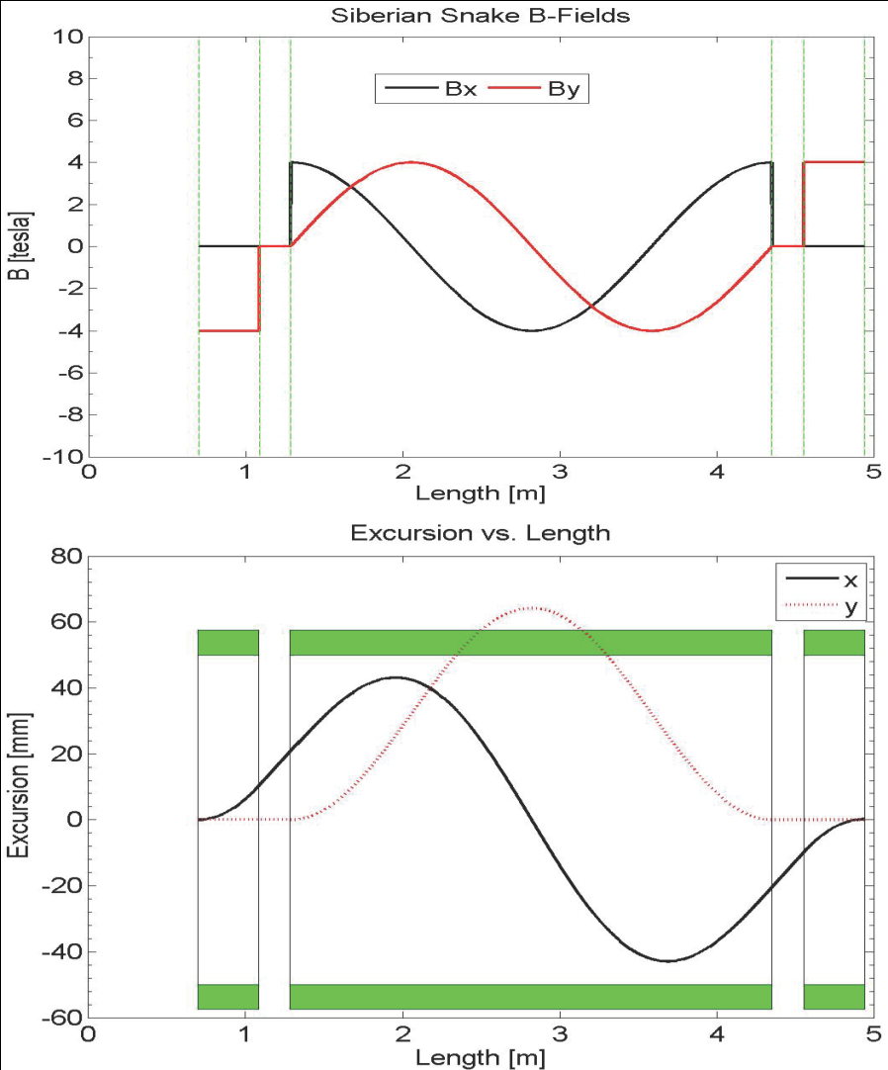
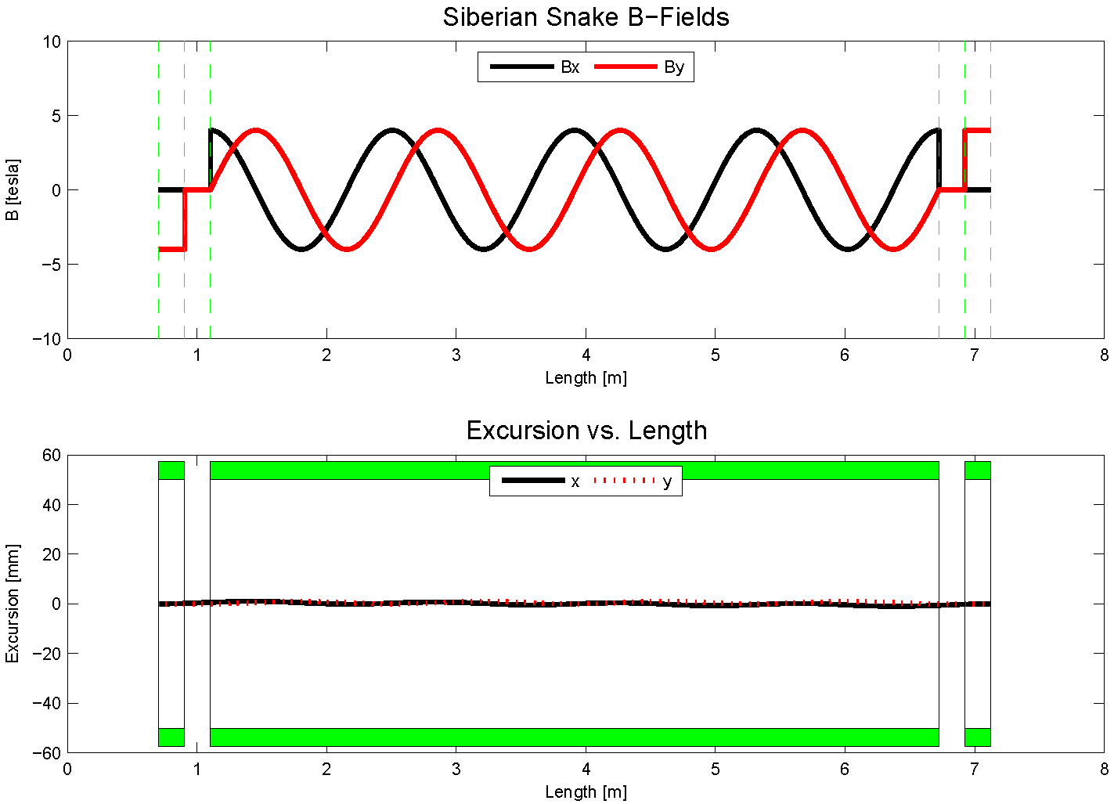
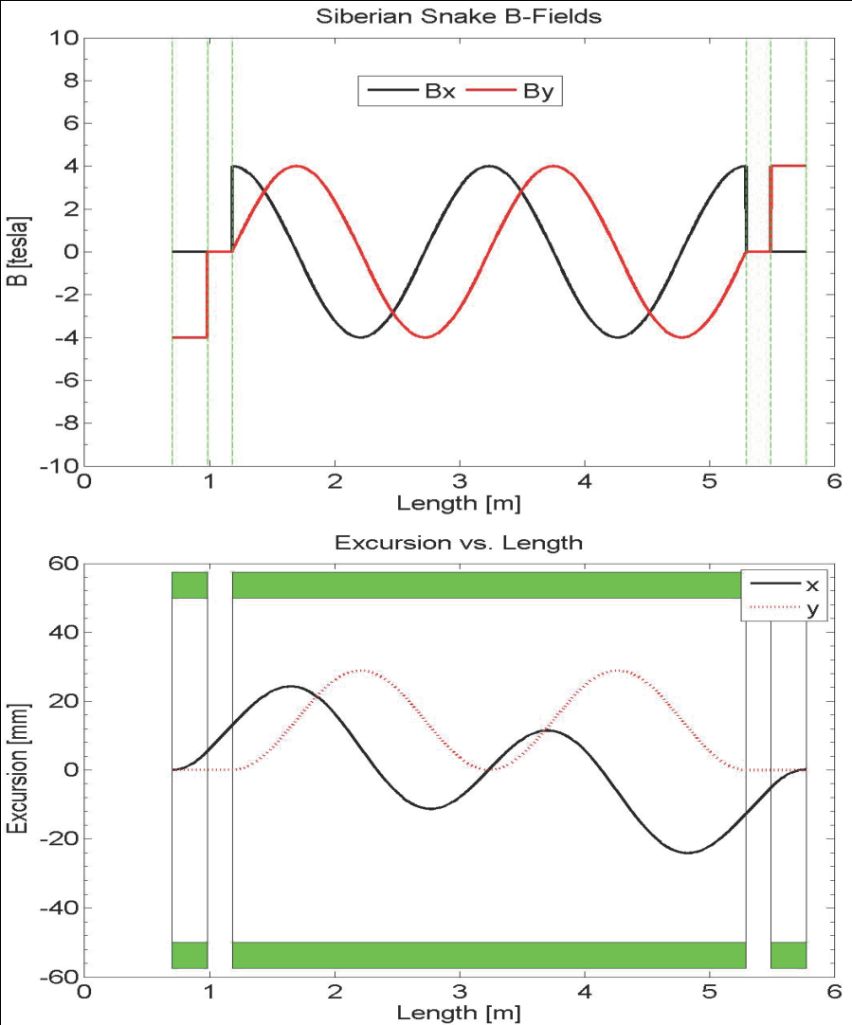
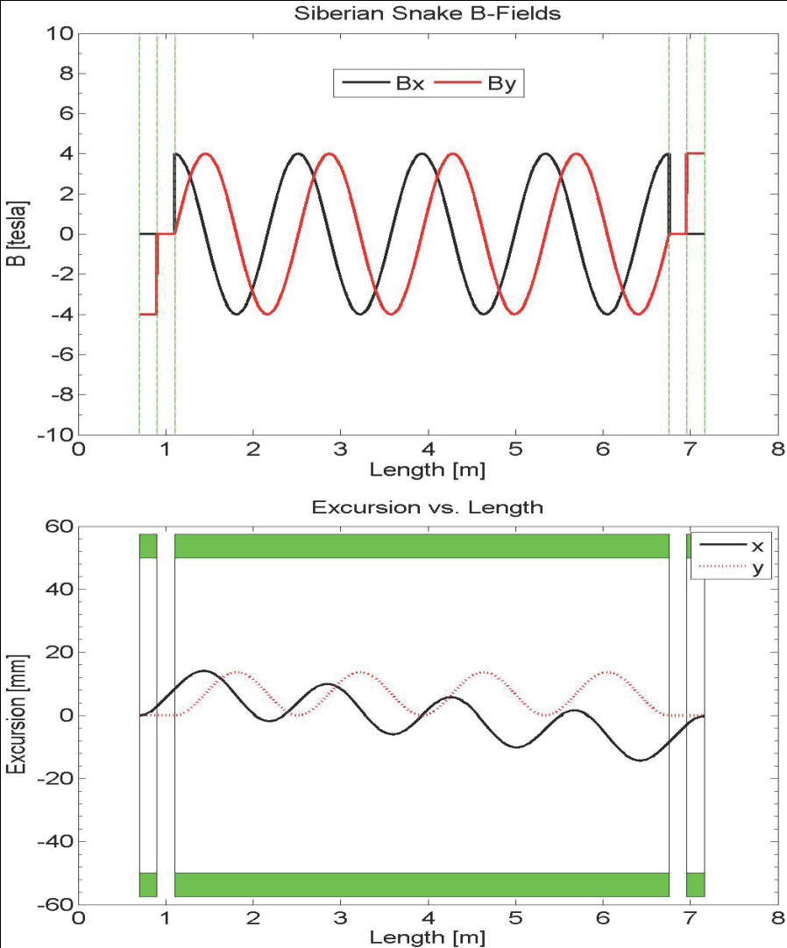
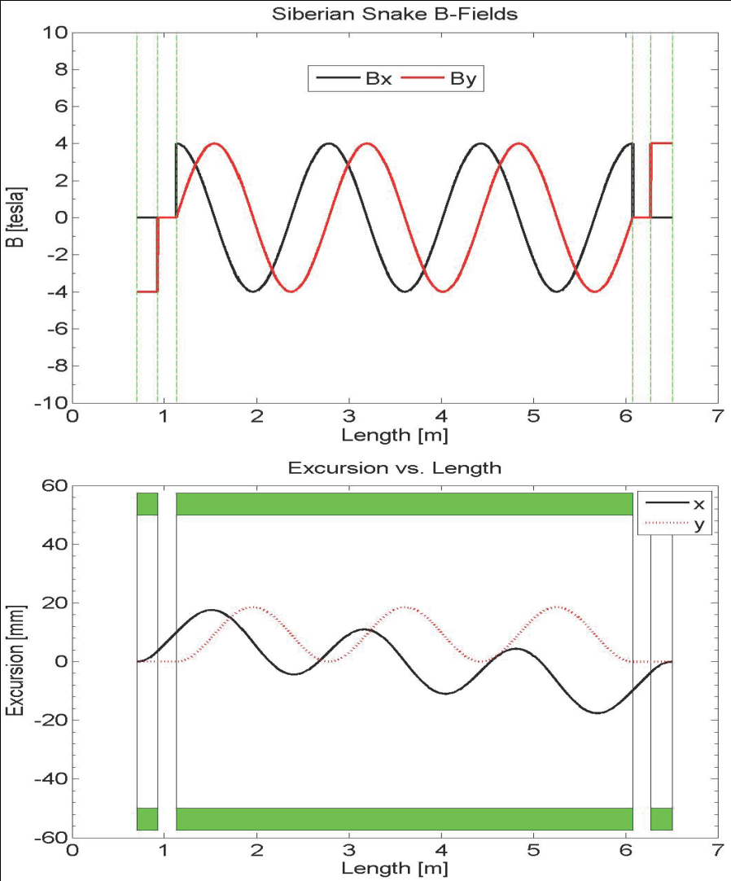
Steady Improvements to 1 Snakes solution - I
8.9 GeV 4T
4-twist 4T
8.9 GeV
120 GeV
beam excursions shrink w/ number of twists
beam excursions shrink w/ beam energy

Slide 12
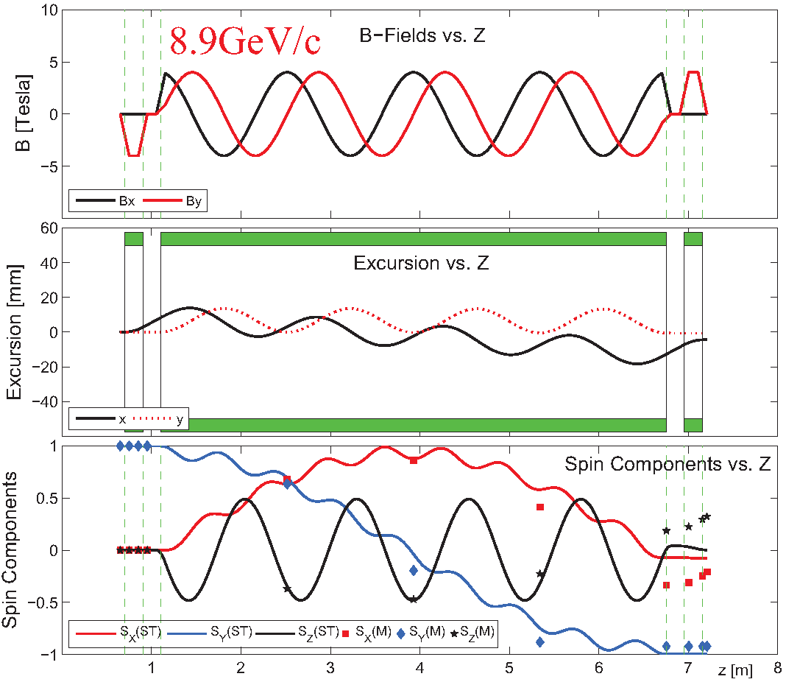
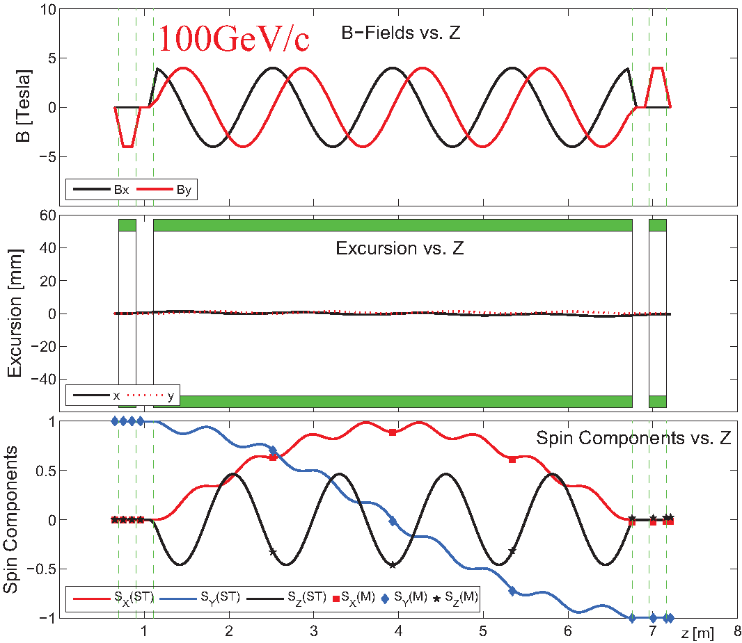
Steady Improvements to 1 Snakes solution - II
Including fringe fields
x, y, z spin components vs distance
transport matrix formalism (E.D. Courant): fringe field not included, β = 1 (fixed)
spin tracking formalism (Thomas-BMT): fringe field included, β varibale
fringe fields have <0.5% effect at 8.9 GeV and <<0.1% effect at 100 GeV [arXiv: 1309.1063]

Slide 13
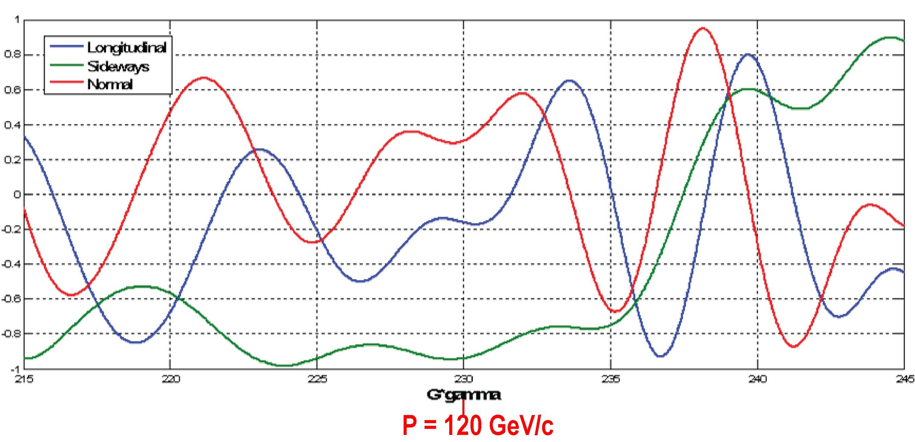
Spin direction control for extracted beam
Spin rotators used to control spin direction at BNL
Spin@Fermi collaboration recent studies (to save $$)
  rotate beam at experiment by changing proton beam energy around nominal 120 GeV
  radial (“sideways”) / vertical (“normal”)
Spin component magnitudes
112 GeV/c
128 GeV/c
124.5 GeV/c
Notes:
Beam direction can be rotated w/in the horizontal plane or into the vertical direction as required by the experiments. This is at the end of a 2.4 km long beam line with 140 bending magnets, some w/ horizontal fields, some w/ vertical and some w/ skew fields.

Slide 14
The Path to a polarized Main Injector
Stage 1 approval from Fermilab: 14-November-2012
Collaboration with A.S. Belov at INR and Dubna to develop polarized source
Detailed machine design and costing using 1 snake in MI
  Spin@Fermi collaboration provide design
    get latest lattice for NOVA:
      translate “mad8” optics file to spin tracking code (“zgoubi”)
    determine intrinsic resonance strength from depolarization calculations
    do single particle tracking with “zgoubi” with novel single-snake
    set up mechanism for adding errors into the lattice:
      orbit errors, quadrupole mis-alignments/rolls, etc.
    perform systematic spin tracking
      explore tolerances on beam emittance
      explore tolerances on various imperfections: orbit / snake / etc
  Fermilab (AD) does verification & costing

Slide 15
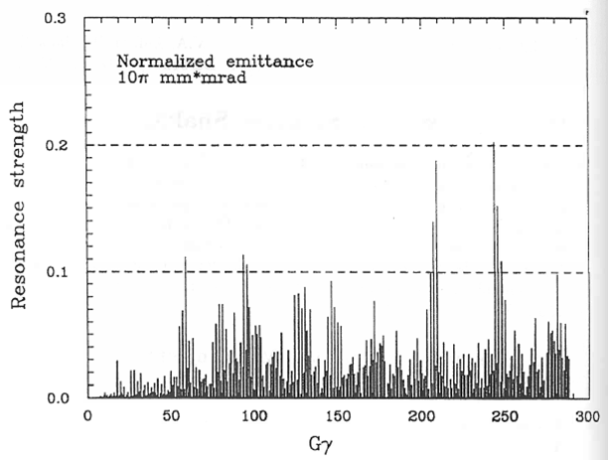
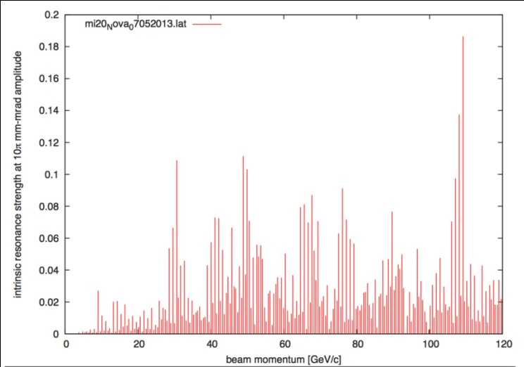
Intrinsic Resonance Strength in Main Injector
Depol calculations: single particle at 10π mm-mrad betatron amplitude
1995 Spin@Fermi report
  before MI was built
using NOVA lattice (July 2013)
very similar: largest resonance strength just below 0.2
  one snake sufficient (E. Courant rule of.thumb)

Slide 16
Polarized Target at Fermilab (E-1039)
Probe Sea-quark Sivers Asymmetry
with a polarized proton target at SeaQuest
sea-quark Sivers function poorly known
significant Sivers asymmetry expected
from meson-cloud model
KMAG
FMAG
Polarized Target
use current SeaQuest setup
a polarized proton target, unpolarized beam
Proton Beam 120 GeV/c
Ref: Andi Klein (ANL)

Slide 17
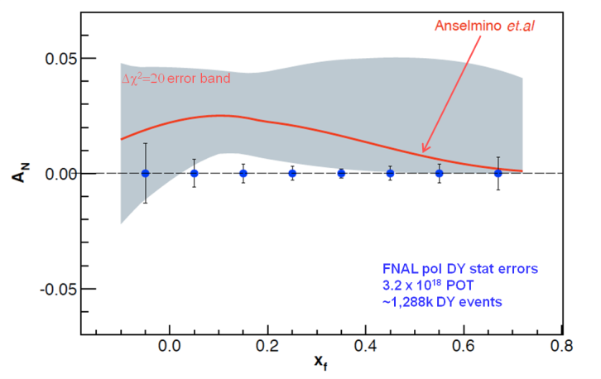
Summary
QCD (and factorization) require sign change
Fermilab is arguably best place to do this measurement
    high luminosity, large x-coverage
    spectrometer already setup and running
Run alongside neutrino program (10% of beam needed)
Measure DY with both Beam or/and Target polarized
    broad spin physics program possible
Path to polarized proton beam at Main Injector
    perform detailed machine design and costing studies
      proof that single-snake concept works
      applications for JPARC, NICA, ….
    Secure funding
Fermilab

Slide 18
The END
Notes:
Provide polarized beam in slow extraction mode (assumed 70% in stat. analysis)

Slide 19
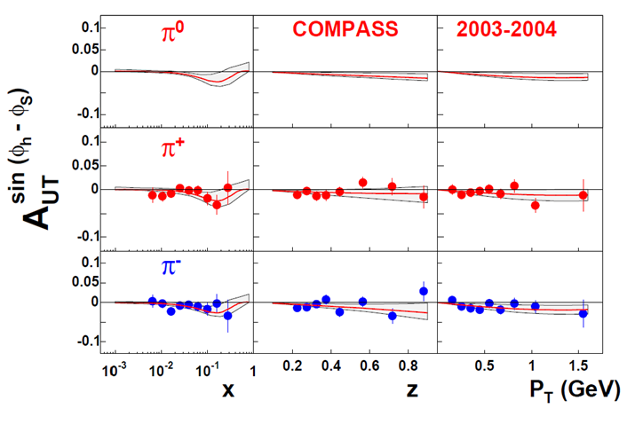
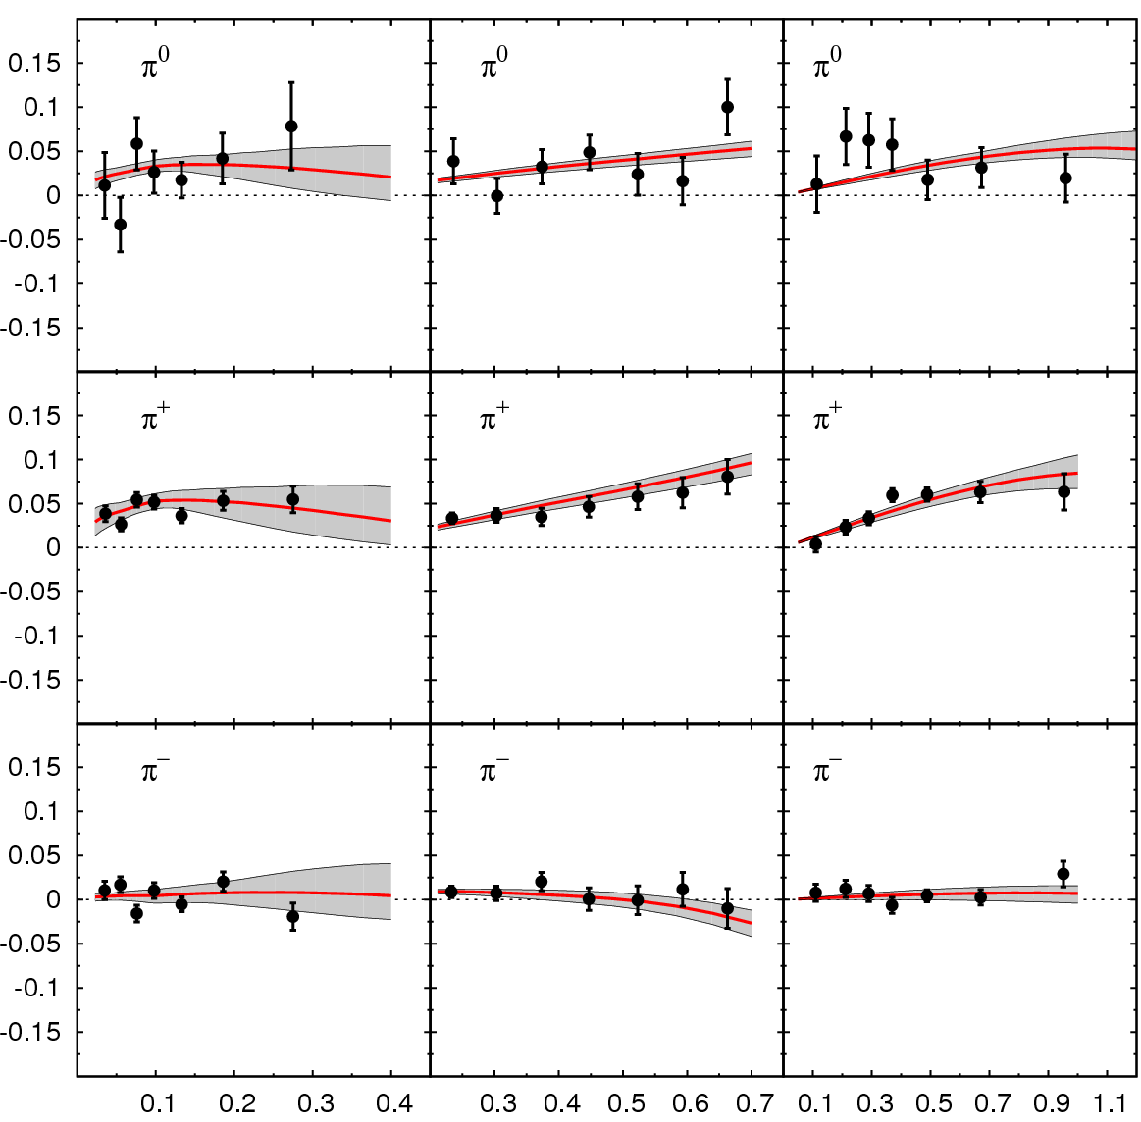
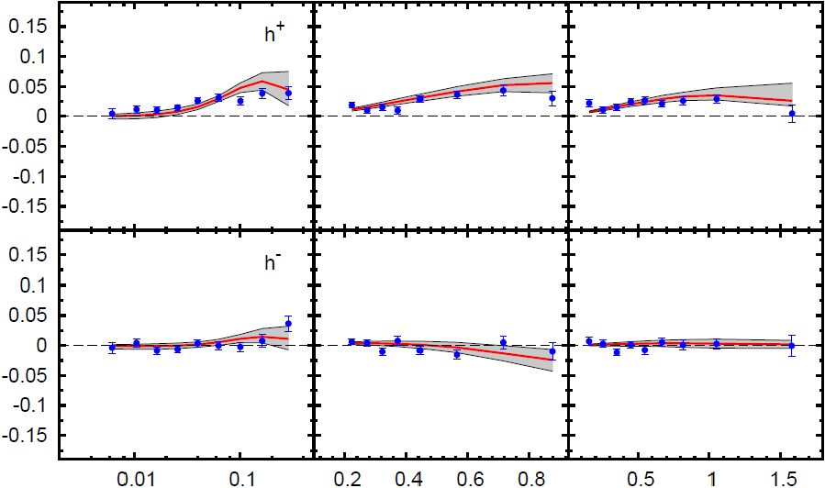
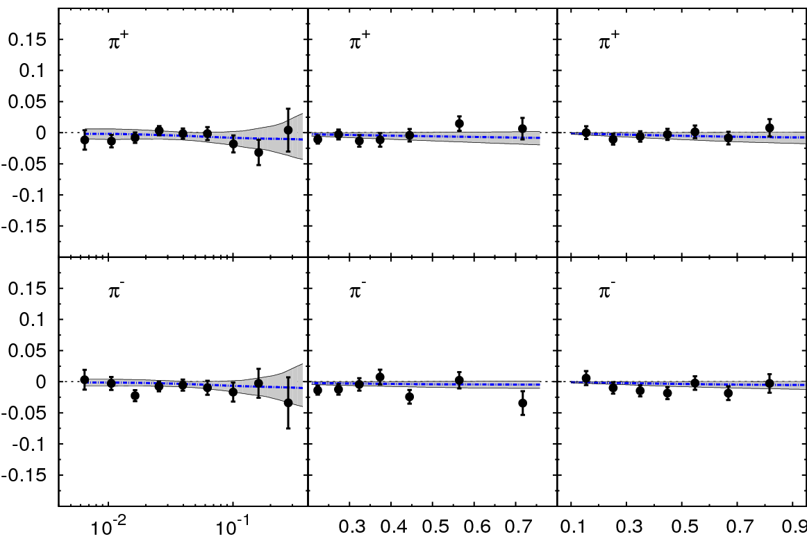
Sivers Asymmetry in SIDIS
HERMES (p)
COMPASS (p)
π⁰
h⁺
π⁺
h⁻
π⁻
x z P_{T} (GeV)
COMPASS (d)
π⁺
Global fit to sin (φ_{h} – φ_{S}) asymmetry in SIDIS (HERMES (p), COMPASS (p), COMPASS (d))
π⁻
x z P_{T} (GeV)
Comparable measurements needed in Drell-Yan process

Slide 20
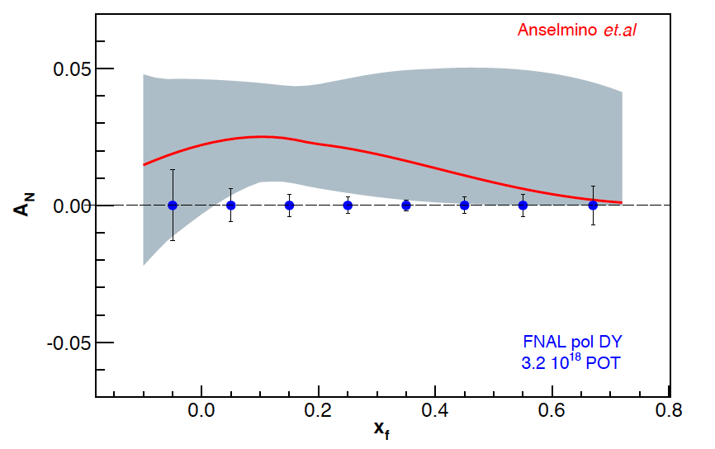
Sivers Asymmetry at Fermilab Main Injector
Experimental Sensitivity
  luminosity: L_{av} = 2 x 10³⁵ (10% of available beam time: I_{av} = 15 nA)
  3.2 x 10¹⁸ total protons for 5 x 10⁵ min: (= 2 yrs at 50% efficiency) with P_{b} = 70%
  Can measure not only sign, but also the size & maybe shape of the Sivers function !
Δχ²=20 error band
Note:
~650k DY events
FNAL pol DY stat errors
3.2 x 10¹⁸ POT
~1,288k DY events
330k DY events
Notes:
Note that SSA A_N^sin(phi-phi_s) is scaled by 2/pi

Slide 21
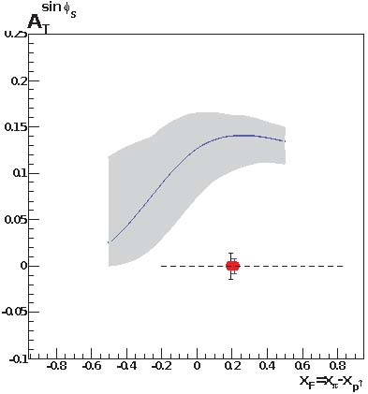
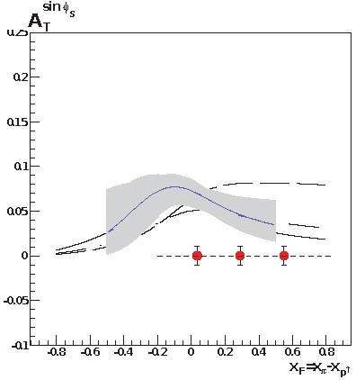
Main Competition: COMPASS
COMPASS statistical significance after two years of running for M_{γ} > M_{J/Ψ}
approved for one year run at LHC restart
  2nd year after 2 years of Primakoff measurements
for comparison of Sivers function need to measure entire function
  must evolve to same Q²
  cannot do QCD evolution on a point
for M_{γ} < M_{J/Ψ} significant contamination from many sources
  charm decays that appear to reconstruct to low mass
  combinatorial background
2.0 GeV < M_{γ} < 2.5 GeV
Notes:
Note that SSA A_N^sin(phi-phi_s) is scaled by 2/pi

Slide 22
Hadronic Physics Milestone #13
Report to NSAC, 11-Aug-2008 (by subcommittee on performance measures):
  Table 11: New, Updated and Continuing Milestones for Hadronic Physics
New Milestone HP13 reflects the intense activity and theoretical breakthroughs of recent years in understanding the parton distribution functions accessed in spin asymmetries for hard-scattering reactions involving a transversely polarized proton. This leads to new experimental opportunities to test all our concepts for analyzing hard scattering with perturbative QCD.
2015 | HP13 (new) | Test unique QCD predictions for relations between single-transverse spin phenomena in p-p scattering and those observed in deep-inelastic lepton scattering
Notes:
Since it is milestone, DOE pays attention to these miles stones, and directs funding to meeting the milestones

