Slide 1
Polarized Electron Beams In The MEIC Collider Ring At JLab
Fanglei Lin
Center for Advanced Studies of Accelerators (CASA), Jefferson Lab
2013 International Workshop on Polarized Sources, Targets & Polarimetry
University of Virginia, Charlottesville, Virginia
September 9th – 13th, 2013
Notes:
Title Page

Slide 2
Outline
Medium-energy Electron Ion Collider (MEIC) at JLab
Introduction to electron spin and polarization, SLIM algorithm and spin matching
Electron polarization design for MEIC: spin rotator, polarization configurations
Example of polarization (lifetime) calculation for MEIC electron collider ring
Summary and perspective

Slide 3
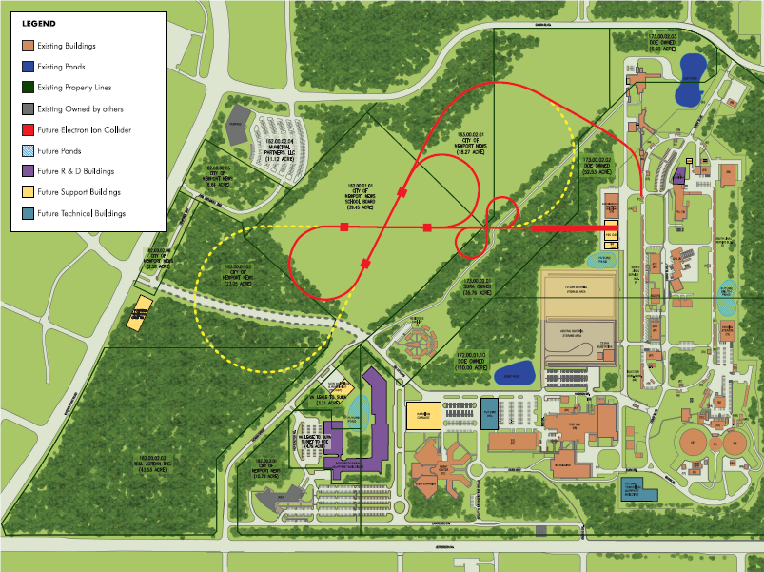
Future Nuclear Science at Jlab: MEIC
MEIC
IP
Ion linac
IP
Pre-booster
CEBAF
Full Energy EIC

Slide 4
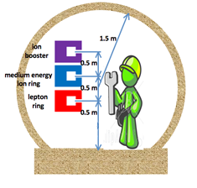
MEIC Layout
Prebooster
Ion
source
Warm large booster
(up to 20 GeV/c)
Three Figure-8 rings
stacked vertically
SRF linac
Cold 20-100 GeV/c
proton collider ring
Warm 3-12 GeV
electron collider ring
Medium-energy IPs with
horizontal beam crossing
Injector
Hall A
12 GeV CEBAF
Hall B
Hall C
Cross sections of tunnels for MEIC

Slide 5
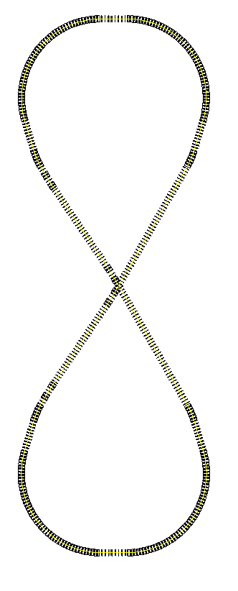
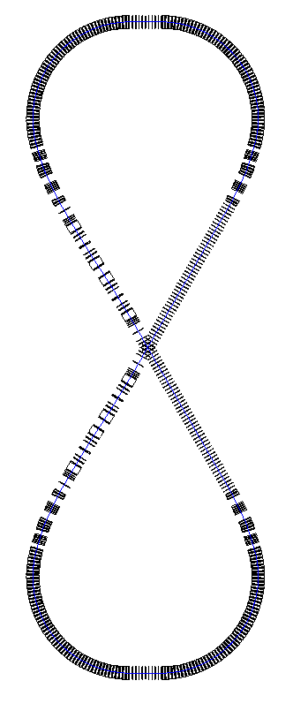
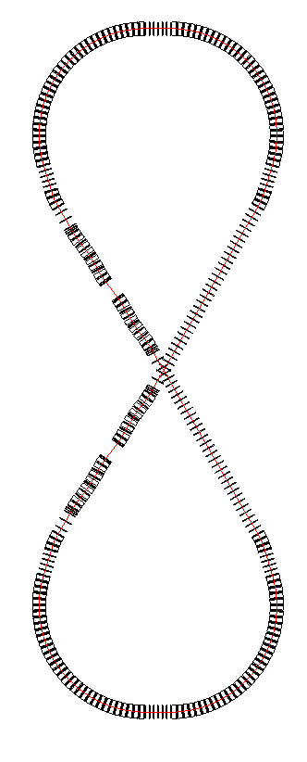
Stacked Figure-8 Rings
Interaction point locations:
Downstream ends of the electron straight sections to reduce synchrotron radiation background
Upstream ends of the ion straight sections to reduce residual gas scattering background
Ion path
Interaction Regions
Electron path
Large Ion Booster
Electron Collider
Ion Collider
Vertical stacking for identical ring circumferences
Ion beams execute vertical excursion to the plane of the electron orbit for enabling a horizontal crossing, avoiding electron synchrotron radiation and emittance degradation
Ring circumference: 1400 m
Figure-8 crossing angle: 60 deg.

Slide 6
MEIC Design Parameters
Energy (bridging the gap of 12 GeV CEBAF and HERA/LHeC)
Full coverage of s from a few 100 to a few 1000 GeV²
Electrons 3-12 GeV, protons 20-100 GeV, ions 12-40 GeV/u
Ion species
Polarized light ions: p, d, ³He, and possibly Li
Un-polarized light to heavy ions up to A above 200 (Au, Pb)
Up to 2 detectors
Two at medium energy ions: one optimized for full acceptance, another for high luminosity
Luminosity
Greater than 10³⁴ cm⁻²s⁻¹ per interaction point
Maximum luminosity should optimally be around √s=45 GeV
Polarization
At IP: longitudinal for both beams, transverse for ions only
All polarizations >70% desirable
Upgradeable to higher energies and luminosity
20 GeV electron, 250 GeV proton, and 100 GeV/u ion
arXiv:1209.0757

Slide 7
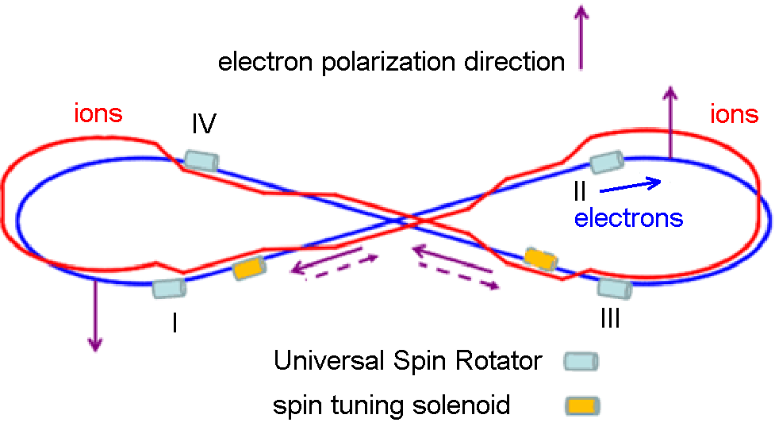
MEIC Electron Polarization
Requirements:
polarization of 70% or above
Strategies:
highly longitudinally polarized electron beams are injected from the CEBAF (~15s)
polarization is designed to be vertical in the arc to avoid spin diffusion and longitudinal at collision points using spin rotators
new developed universal spin rotator rotates polarization in the whole energy range (3-12GeV)
desired spin flipping can be implemented by changing the polarization of the photo-injector driver laser at required frequencies
rapid and high precision Mott and Compton polarimeters can be used to measure the electron polarization at different stages
figure 8 shape facilitates stabilizing the polarization by using small fields
longitudinal polarization at IPs
spin flipping
Illustration of polarization orientation
Alternating polarization of electron beam bunches
spin
spin
spin
spin

Slide 8
Electron Spin And Polarization Equations
Thomas-Bargmann-Michel-Telegdi (Thomas-BMT) equation
$$\frac{d\vec{S}}{dt}=−\frac{Ze}{mγ}\left[\left(1+Gγ\right){\vec{B}}_{⊥}+\left(1+G\right){\vec{B}}_{∥}+\left(Gγ+\frac{γ}{γ+1}\right)\frac{\vec{E}×\vec{v}}{c^{2}}\right]×\vec{S}$$
Derbenev –Kondratenko Formula (Sokolov-Ternov self-polarization + spin-orbit coupling depolarization)
$$P_{dk}=−\frac{8}{5\sqrt{3}}\frac{\oint{ds{\left\langle \frac{1}{{\left|ρ\left(s\right)\right|}^{3}}\hat{b.}(\hat{n}−\frac{∂\hat{n}}{∂δ})\right\rangle }_{s}}}{\oint{ds{\left\langle \frac{1}{{\left|ρ\left(s\right)\right|}^{3}}(1−\frac{2}{9}{\left(\hat{n}.\hat{s}\right)}^{2}+\frac{11}{18}{(\frac{∂\hat{n}}{∂δ})}^{2})\right\rangle }_{s}}}$$
Polarization build-up rate (the inverse polarization lifetime constant)
$${τ_{dk}^{}}^{−1}=\frac{5\sqrt{3}}{8}\frac{r_{e}γ^{5}h/2π}{m_{e}}\frac{1}{C}\oint{ds{\left\langle \frac{1−\frac{2}{9}{\left(\hat{n}.\hat{s}\right)}^{2}+\frac{11}{18}{(\frac{∂\hat{n}}{∂δ})}^{2}}{{\left|ρ\left(s\right)\right|}^{3}}\right\rangle }_{s}}$$
$\hat{n}$ is a 1-turn periodic unit 3-vector field over the phase space satisfying the Thomas-BMT equation along particle
trajectories ($\hat{n}$ is not ${\hat{n}}_{0}$). Depolarization occurs in general if the spin-orbit coupling function ${\left|\frac{∂\hat{n}}{∂δ}\right|}^{2}$no longer vanishes
in the dipoles (where $1/{{\left|ρ(s)\right|}^{3}}$ is large).
Time-dependent polarization
$$P\left(t\right)=P_{dk}{\left\langle \hat{n}\right\rangle }_{s}(1−e^{−t/τ_{dk}})+P_{0}e^{−t/τ_{dk}}$$

Slide 9
SLIM Algorithm And Spin Matching
Obtaining expression for ${∂\hat{n}}/{∂δ}$ in a linear approximation of orbit and spin motion. Therefore, $\hat{n}\left(\overset{⃑}{u};s\right)={\hat{n}}_{0}\left(s\right)+α\left(\overset{⃑}{u};s\right)\hat{m}\left(s\right)+β\left(\overset{⃑}{u};s\right)\hat{l}\left(s\right)$.
The combined linear orbit and spin motion is propagated by an 8x8 transport matrix of
$\left(\begin{aligned}\begin{matrix}x \\ x^{′} \\ y\end{matrix} \\ y^{′} \\ σ \\ δ \\ α \\ β\end{aligned}\right)(s_{1})=\left(\begin{matrix}M_{6×6} & 0_{6×2} \\ G_{2×6} & D_{2×2}\end{matrix}\right)$($s_{1}$, $s_{0}$) $\left(\begin{aligned}\begin{matrix}x \\ x^{′} \\ y\end{matrix} \\ y^{′} \\ σ \\ δ \\ α \\ β\end{aligned}\right)$($s_{0}$)
$M_{6×6}$ is a symplectic matrix describing orbital motion; $0_{6×2}$ represents no spin effect to the orbital motion;
$G_{2×6}$ describes the coupling of the spin variables ($α$, $β$) to the orbit motion. $G$ matrix is the target of so-called
“spin matching”, involving adjustment of the optical state of the ring to make some crucial regions
spin transparent.
$D_{2×2}$ is a rotation matrix associated with describing the spin motion in the periodic reference frame.
The code SLICK, created and developed by Prof. A.W. Chao and Prof. D.P. Barber, calculates the equilibrium polarization and depolarization time using SLIM algorithm.

Slide 10
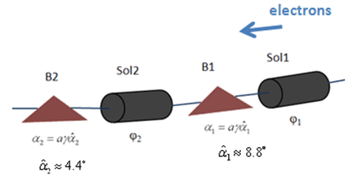
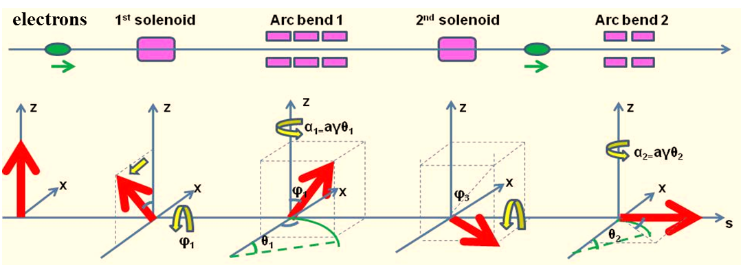
Universal Spin Rotator (USR)
Schematic drawing of USR
Parameters of USR for MEIC
Illustration of step-by-step spin rotation by a USR
Arc
IP
$$\vec{S}$$
$$\vec{S}$$
P. Chevtsov et al., Jlab-TN-10-026
E | Solenoid 1 |  | Arc Dipole 1 | Solenoid 2 |  | Arc Dipole 2
 | Spin Rotation | BDL | Spin Rotation | Spin Rotation | BDL | Spin Rotation
GeV | rad | T·m | rad | rad | T·m | rad
3 | π/2 | 15.7 | π/3 | 0 | 0 | π/6
4.5 | π/4 | 11.8 | π/2 | π/2 | 23.6 | π/4
6 | 0.62 | 12.3 | 2π/3 | 1.91 | 38.2 | π/3
9 | π/6 | 15.7 | π | 2π/3 | 62.8 | π/2
12 | 0.62 | 24.6 | 4π/3 | 1.91 | 76.4 | 2π/3

Slide 11
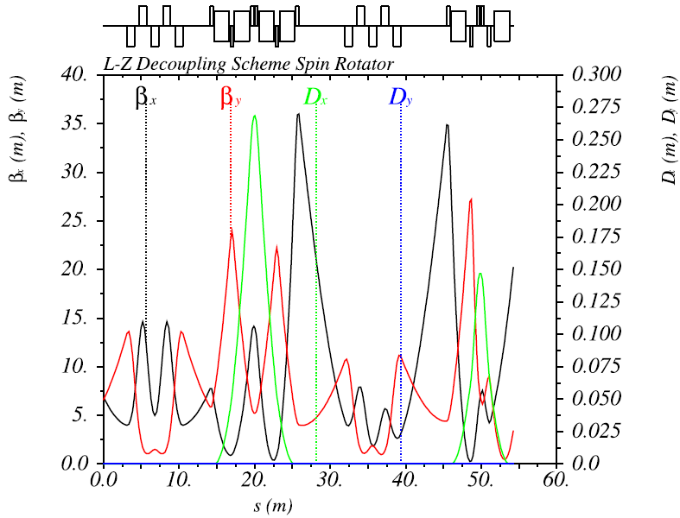
Solenoid Decoupling Schemes --- LZ Scheme
Litvinenko-Zholents (LZ) Scheme*
A solenoid is divided into two equal parts
Normal quadrupoles are placed between them
Quad strengths are independent of solenoid strength
1st Sol. + Decoupling Quads
2nd Sol. + Decoupling Quads
Dipole Set
Dipole Set
Half
Solenoid
Quad. Decoupling Insert
Half
Solenoid
Half Sol.
Half Sol.
5 Quads. (3 families)
* V. Litvinenko, A. Zholents, BINP (Novosibirsk) Prepring 81-80 (1981). English translation: DESY Report L-Trans 289 (1984)

Slide 12
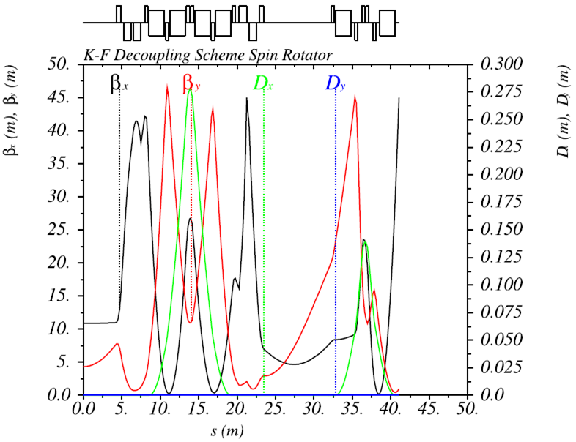
Solenoid Decoupling Schemes --- KF Scheme
Kondratenko-Filatov (KF) Scheme*
Mixture of different strength and length solenoids
Skew quadrupoles are interleaved among solenoids
Skew quad strengths are dependent of solenoid strengths
Decoupling Skew Quads
1st Sol.
Dipole Set
2nd Sol.
Dipole Set
1st
Solenoid
2nd
Solenoid
Skew Quad.
..………..
1st
Solenoid
2nd
Solenoid
^{3rd}
Solenoid
Skew Quad.
* Yu. N. Filatov, A. M. Kondratenko, et al. Proc. of 20th Int. Symp. On Spin Physics (DSPIN2012), Dubna.

Slide 13
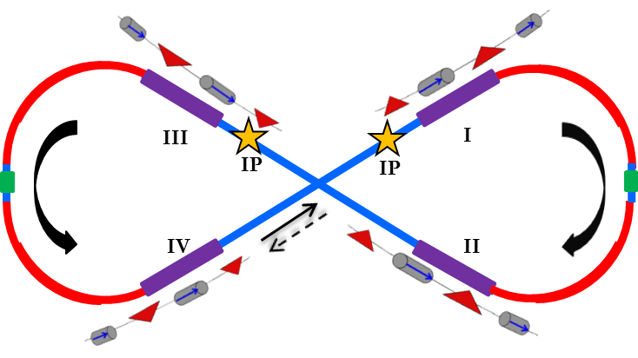
Polarization Configuration I
Same solenoid field directions in two spin rotators in the same IR (flipped spin in two half arcs )
Magnetic field $\vec{B}$
Spin vector $\vec{S}$
FOSP : First Order Spin Perturbation from non-zero δ in the solenoid through G matrix.
S-T : Sokolov-Ternov self-Polarization effect
spin orientation
Arc
Solenoid field
IP
Solenoid field
Arc
S-T
FOSP
Notes:
Interior Page

Slide 14
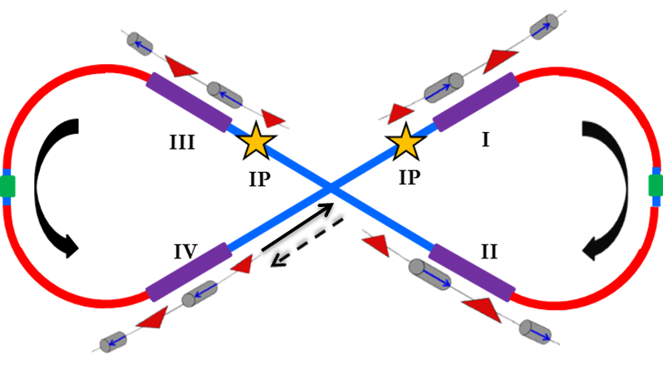
Polarization Configuration II
Opposite solenoid field directions in two spin rotators in the same IR (same spin in two half arcs)
Magnetic field $\vec{B}$
Spin vector $\vec{S}$
FOSP : First Order Spin Perturbation from non-zero δ in the solenoid through G matrix.
S-T : Sokolov-Ternov self-Polarization effect
spin orientation
Arc
Solenoid field
IP
Solenoid field
Arc
S-T
FOSP
Notes:
Interior Page

Slide 15
Example Calculation (Polarization Lifetime)¹
Polarization configuration I --- (same solenoid field directions)
Energy (GeV) | Equi. Pol.² (%) | Total Pol. Time² (s) | Spin-Orbit Depolarization Time (s) |  |  |  | Sokolov-Ternov Polarization Effect |  | Spin Tune⁴
 |  |  | Mode I³ | Mode II³ | Mode III³ | Subtotal | Pol. (%) | Time (s)
5 | 12.4 | 2950 | 86492 | 9E17 | 3954 | 3470 | 87.2 | 19673 | 0.389892
9 | 24.2 | 313 | 1340 | 2E15 | 535 | 449 | 87.6 | 1035 | 0.234249
Polarization configuration II --- (opposite solenoid field directions)
Energy (GeV) | Equi. Pol.² (%) | Total Pol Time² (s) | Spin-Orbit Depolarization Time (s) |  |  |  | Sokolov-Ternov Depolarization Effect |  | Spin Tune⁴
 |  |  | Mode I³ | Mode II³ | Mode III³ | Subtotal | Pol. (%) | Time (s)
5 | 0 | 10178 | 25911 | 6E18 | 84434 | 21086 | 0 | 19673 | 0
9 | 0 | 584 | 1383 | 1E15 | 5123 | 1340 | 0 | 1035 | 0
Thick-lens code SLICK was used for those calculations without any further spin matching.
Equilibrium polarization and total polarization time are determined by the spin-orbit coupling depolarization effect and Sokolov-Ternov effect.
Mode I, II, III are the horizontal, vertical and longitudinal motion, respectively, for an orbit-decoupled ring lattice.
Non-zero spin tune in the configuration I is only because of the non-zero integral of the solenoid fields in the spin rotators; non-zero spin tune in the configuration II can be produced by very weak solenoid fields in the region having longitudinal polarization.

Slide 16
Comparison Of Two Pol. Configurations
Polarization Configuration I same solenoid field directions in the same IR | Polarization Configuration II opposite solenoid field directions in the same IR
Sokolov-Ternov effect may help to preserve one polarization state with spin matching. Spin matching is demanding to maintain the polarization due to the non-zero integral of longitudinal solenoid fields in the two spin rotators in the same IR. The total depolarization time is determined by the spin-orbit coupling depolarization time. Design-orbit spin tune ($ν_{0}$) is not zero, only because of the non-zero integral of longitudinal fields. | Sokolov-Ternov effect does not contribute to preserve the polarization. Spin matching is much less demanding due to the zero integral of longitudinal solenoid fields in the two spin rotators in the same IR. The total polarization time is mainly determined by the Sokolov-Ternov depolarization time. Design-orbit spin tune ($ν_{0}$) is zero, but can be adjusted easily using weak fields because of figure-8 shape.

Slide 17
Summary And Perspective
Highly longitudinally polarized electron beam is desired in the MEIC collider ring to meet the physics program requirements.
Polarization schemes have been developed, including solenoid spin rotator, solenoid decoupling schemes, polarization configurations.
Polarization lifetimes at 5 and 9GeV are sufficiently long for MEIC experiments.
Future plans:
Study alternate helical-dipole spin rotator considering its impacts (synchrotron radiation and orbit excursion) to both beam and polarization
Study spin matching (linear motion) schemes and Monte-Carlo spin-obit tracking with radiation (nonlinear motion)
Consider the possibility of polarized positron beam

Slide 18
Thank You For Your Attention !
Acknowledgement
I would like to thank all members of JLab EIC design study group and our external collaborators, especially:
Yaroslav S. Derbenev, Vasiliy S. Morozov, Yuhong Zhang, Jefferson Lab, USA
Desmond P. Barber, DESY/Liverpool/Cockcroft, Germany
Anatoliy M. Kondratenko, Scientific and Technical Laboratory Zaryad, Novosibirsk, Russia
Yury N. Filatov, Moscow Institute of Physics and Technology, Dolgoprudny Russia
This wok has been done under U.S. DOE Contract No. DE-AC05-06OR23177 and DE-AC02-06CH11357.
Notes:
Title Page

Slide 19
Back Up
Notes:
Interior Page

Slide 20
SLIM Algorithm And Spin Matching
Obtaining expressions for ${∂\hat{n}}/{∂δ}$ in an linear approximation of orbit and spin motion. For spin, the linearization assumes small angle between $\hat{n}$ and ${\hat{n}}_{0}$ at all positions in phase space so that the approximately $\hat{n}\left(\overset{⃑}{u};s\right)={\hat{n}}_{0}\left(s\right)+α\left(\overset{⃑}{u};s\right)\hat{m}(s)+β(\overset{⃑}{u};s)\hat{l}(s)$with an assumption that $\sqrt{α^{2}+β^{2}}≪1$. ($\hat{m}$ and $\hat{l}$ are 1-turn periodic and is orthonormal.) This approximation reveals just the 1st order spin-orbit resonances and it breaks down when $\sqrt{α^{2}+β^{2}}$ becomes large very close to resonances. The code SLICK (created and developed by Prof. A.W. Chao and Prof. D.P. Barber) calculates the equilibrium polarization and depolarization time under these approximations.
The combined linear orbit and spin motion is described by 8x8 transport matrices of
$\left(\begin{aligned}\begin{matrix}x \\ x^{′} \\ y\end{matrix} \\ y^{′} \\ σ \\ δ \\ α \\ β\end{aligned}\right)(s_{1})=\left(\begin{matrix}M_{6×6} & 0_{6×2} \\ G_{2×6} & D_{2×2}\end{matrix}\right)$($s_{1}$, $s_{0}$) $\left(\begin{aligned}\begin{matrix}x \\ x^{′} \\ y\end{matrix} \\ y^{′} \\ σ \\ δ \\ α \\ β\end{aligned}\right)$($s_{0}$)
$M_{6×6}$ is a symplectic matrix describing orbital motion;
$G_{2×6}$ describes the coupling of the spin variables ($α$, $β$) to the orbit and depend on $\hat{m}(s)$ and $\hat{l}(s)$. $G$
matrix is the target of spin matching mechanism and can be adjusted only within linear approximation
for spin motion in the lattice design (successfully used at HERA electron ring (DESY, Germany)).
$D_{2×2}$ is a rotation matrix associated with describing the spin motion in the periodic reference frame.

Slide 21
SLIM Algorithm (cont.)
The eigenvectors for one turn matrix can be written as
${\overset{⃑}{q}}_{k}\left(s_{0}\right)=\left(\begin{matrix}{\overset{⃑}{v}}_{k}(s_{0}) \\ {\overset{⃑}{w}}_{k}(s_{0})\end{matrix}\right), {\overset{⃑}{q}}_{−k}\left(s_{0}\right)={\left[{\overset{⃑}{q}}_{k}\left(s_{0}\right)\right]}^{∗}, for k=I,II, III$
${\overset{⃑}{q}}_{k}\left(s_{0}\right)=\left(\begin{matrix}{\overset{⃑}{0}}_{6}(s_{0}) \\ {\overset{⃑}{w}}_{k}(s_{0})\end{matrix}\right), {\overset{⃑}{q}}_{−k}\left(s_{0}\right)={\left[{\overset{⃑}{q}}_{k}\left(s_{0}\right)\right]}^{∗}, for k=IV$
${\overset{⃑}{v}}_{k}$ are the eigenvectors for orbital motion with eigenvalues $λ_{k}=e^{−i2πν_{k}} \left(k=I,II,III\right)$
${\overset{⃑}{w}}_{k}$ are the spin components of the orbit eigenvectors $\left(k=I,II,III\right)$.
Finally, the spin-orbit coupling term can be expressed as
$\frac{∂\hat{n}}{∂δ}≡i \sum_{k=I,II,III}{\left\{{v_{k5}}^{∗}{\overset{⃑}{w}}_{k}−v_{k5}{{\overset{⃑}{w}}_{k}}^{∗}\right\}}=−2 Im\sum_{k=I,II,III}{{v_{k5}}^{∗}{\overset{⃑}{w}}_{k}}$
${(\frac{∂\hat{n}}{∂δ})}^{2}=4\sum_{μ=1}^{2}{{(Im\sum_{k=I,II,III}{{v_{k5}}^{∗}w_{kμ}})}^{2}}$
This is the spin-orbit coupling function used in the code SLICK (created and developed by Prof. A.W. Chao and Prof. D.P. Barber) to calculate the equilibrium polarization and depolarization time under the linear orbit and spin approximation.

Slide 22
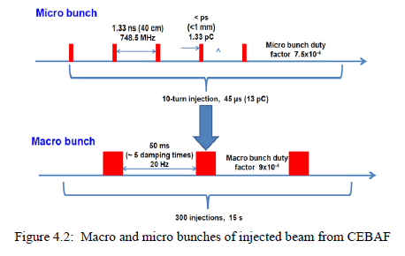
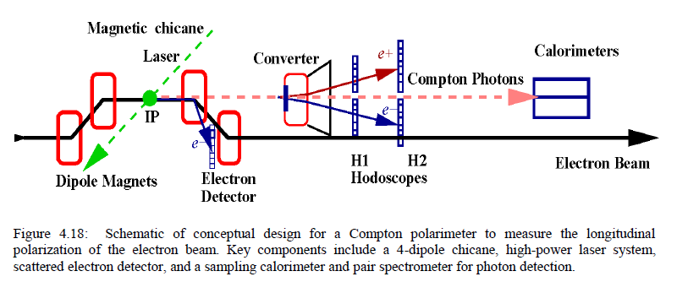
Electron Injection And Polarimetry

Slide 23
General Information Of Helical Dipole
The trajectories in the helical magnet is determined by the equations
, , .
The solutions of orbits are
, , ,
where is the amplitude of the particle orbit in a helical magnet.
The curvatures of the orbits in the horizontal, vertical and longitudinal direction are
, , .
The 3D curvature can be calculated through
The integral of helical field:
from Dr. Kondratenko’s thesis for protons
we can obtain for electrons
where M is the integer number of field periods, ϕ is the spin rotation angle, G_{e}=0.001159652.

Slide 24
Effects Of Helical Dipoles
Synchrotron radiation power is calculated using the following two formulas
$P_{r}=\frac{cC_{r}}{2π}.\frac{E^{4}}{ρ^{2}}=14.085\frac{I\left(A\right)E^{4}\left(GeV\right)}{ρ^{2}\left(m\right)}\left(kW/m\right)$
$P_{r}=\frac{cC_{r}}{2π}.\frac{E^{4}}{ρ^{2}}=1.26694\frac{I\left(A\right)E^{2}\left(GeV\right)B^{2}\left(T\right)}{1}(kW/m)$
where $C_{r}=8.85×{10}^{−5}m/{GeV}^{3}$, I is the beam current, B is the magnetic field, $ρ=1/κ$ is the local radius of curvature, E is the beam energy.
Orbit excursion is calculated as the amplitude of the particle orbit in the helical magnet
$$r=\frac{B_{h}}{Bρk^{2}}=\frac{B_{h}}{Bρ}.{(\frac{L}{2πM})}^{2}$$
where wave number $k={2π}/λ$, $λ=L/M$ is helical magnet period, $M$ is the integer number of field period in the $L$ long helical magnet.
$B_{h}L≈\frac{Bρ}{G_{e}γ}\sqrt{φ^{2}+4πMφ}$ ===> $P_{r}∝\frac{M}{L^{2}}$
$r=\frac{B_{h}}{Bρk^{2}}=\frac{B_{h}}{Bρ}.{(\frac{L}{2πM})}^{2}$ ===> $r∝\frac{L^{2}}{M^{2}}$

Slide 25
Impact Of Solenoid & Helical Dipole
Helical-dipole spin rotator ?
Comparison
 | Solenoid | Helical Dipole
Synchrotron Radiation | No | Yes³
Orbit Excursion | No | Yes⁴
Coupling | Yes¹ | No
Polarity Change Needed | Yes² | No
Quadrupole decoupling scheme is applied in the current USR design, which occupies ~8.6m long space for each solenoid.
The solenoids have the opposite field directions in the two adjacent USRs in the same interaction region. Such an arrangement cancels the first order spin perturbation due to the non-zero integral of solenoid fields, but the polarization time may be restricted by the Sokolov-Ternov depolarization effect, in particular at higher energies.
Synchrotron radiation power should be controlled lower than 20kW/m at all energies.
Orbit excursion should be as small as possible (< a few centimeters).

Slide 26
Effects Of Helical Dipoles
Synchrotron radiation power is calculated using the following two formulas
$P_{r}=\frac{cC_{r}}{2π}.\frac{E^{4}}{ρ^{2}}=1.26694\frac{I\left(A\right)E^{2}\left(GeV\right)B^{2}\left(T\right)}{1}(kW/m)$
where $C_{r}=8.85×{10}^{−5}m/{GeV}^{3}$, I is the beam current, B is the magnetic field, $ρ=1/κ$ is the local radius of curvature, E is the beam energy.
Orbit excursion is calculated as the amplitude of the particle orbit in the helical magnet
$$r=\frac{B_{h}}{Bρk^{2}}=\frac{B_{h}}{Bρ}.{(\frac{L}{2πM})}^{2}$$
where wave number $k={2π}/λ$, $λ=L/M$ is helical magnet period, $M$ is the integer number of field
period in the $L$ long helical magnet.
$B_{h}L≈\frac{Bρ}{G_{e}γ}\sqrt{φ^{2}+4πMφ}$ ===> $P_{r}∝\frac{M}{L^{2}}$
$r=\frac{B_{h}}{Bρk^{2}}=\frac{B_{h}}{Bρ}.{(\frac{L}{2πM})}^{2}$ ===> $r∝\frac{L^{2}}{M^{2}}$

Slide 27
Estimation Of Helical Dipole Effects
E | Beam Current | 1st Helical Dipole (L=20m, M=4)
 |  | Spin Rot. | BDL | B | Amp_x,y | Syn. Rad. Power
GeV | A | rad | T·m | T | cm | kW/m
3 | 3 | π/2 | 13.26 | 0.66 | 4.2 | 15.1
4.5 | 3 | π/4 | 9.31 | 0.47 | 2.0 | 16.7
6 | 2.0 | 0.62 | 8.26 | 0.41 | 1.3 | 15.5
9 | 0.4 | π/6 | 7.58 | 0.38 | 0.8 | 5.9
12 | 0.18 | 0.62 | 8.26 | 0.41 | 0.7 | 5.6
E | Beam Current | 2nd Helical Dipole (L=20m, M=4)
 |  | Spin Rot. | BDL | B | Amp_x,y | Syn. Rad. Power
GeV | A | rad | T·m | T | cm | kW/m
3 | 3 | 0 | 0 | 0 | 0 | 0
4.5 | 3 | π/2 | 13.26 | 0.66 | 2.8 | 33.8
6 | 2.0 | 1.91 | 14.67 | 0.73 | 2.3 | 49.0
9 | 0.4 | 2π/3 | 15.39 | 0.77 | 1.6 | 24.3
12 | 0.18 | 1.91 | 14.67 | 0.73 | 1.2 | 17.7

