Slide 1


Polarizing ¹²⁹Xe for medical applications
Bill Hersman
Professor of Physics, University of New Hampshire
Founder and CEO, Xemed LLC
Prof. Hersman has a financial interest in Xemed LLC

Slide 2

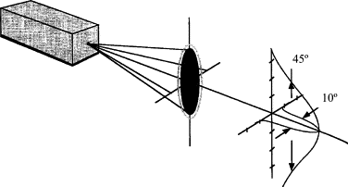
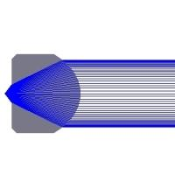
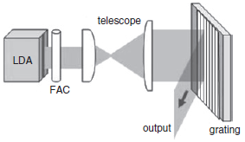
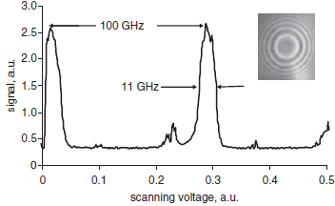
Wavelength-locked diode laser
Diode facet has dimensions 1 µm × 100 µm
Output is diffraction limited along “fast-axis”
Fast-axis collimating micro-lens achieves parallel output in one dimension
Slow-axis is multimode and diverging
External elements can feed back power, selected for wavelength and/or transverse mode
A single element can lock the wavelength of 50 emitters
Grating inclined at Littrow angle selects wavelength
Univ of New Hampshire/Xemed Bill Hersman 13 Sept, 2013
Xenon Polarization

Slide 3
Challenge: narrowing a stack
  Diode bar has ~25 emitters; stack of diode bars has ~300 emitters
  Fast axis is parallel-to-parallel from FAC to grating
  Slow axis is point-to-point from facet to grating
  Multiple beams from diode array bars side-by side cannot all focus on a grating at the Littrow angle
  Only the central bar will be properly focused on the grating
Top view
Perspective view
Top view
Note: fast axis in green, slow axis in red
Univ of New Hampshire/Xemed Bill Hersman 13 Sept, 2013
Xenon Polarization

Slide 4
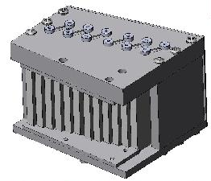
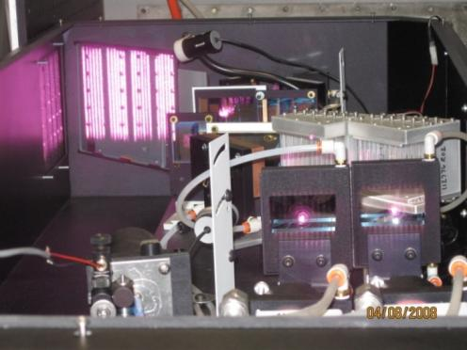
Solution: narrowing a stack
  A stepped-mirror corrects path-lengths, equalizing object to image distances from FAC to a grating at the Littrow angle
  Also compresses dark spaces between bars
Stepped mirror
Telescope lens
Note: fast axis in green, slow axis in red
Stepped mirror
Hersman, Distelbrink, Zhu, US patent #7769068
Pump laser system incorporates 24 x100 W bars, with wavelength locked output of over 1.5 kW
Univ of New Hampshire/Xemed Bill Hersman 13 Sept, 2013
Xenon Polarization

Slide 5
Polarizer cell design
Long polarizing cell and high rubidium density aid in efficient diode laser photon utilization
Counter-flow high-velocity operation allows higher-polarization xenon to be subjected to higher-polarization rubidium
Mixture is saturated in rubidium saturator helix before entering polarizing cell
Rubidium is extracted from gas in presence of laser before leaving polarizing cell
Published Phys. Rev. Lett. 96 053002 (2006)
Univ of New Hampshire/Xemed Bill Hersman 13 Sept, 2013
Xenon Polarization

Slide 6
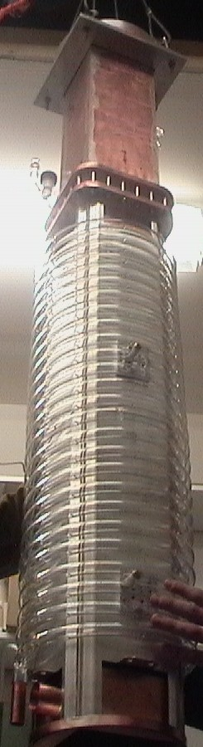
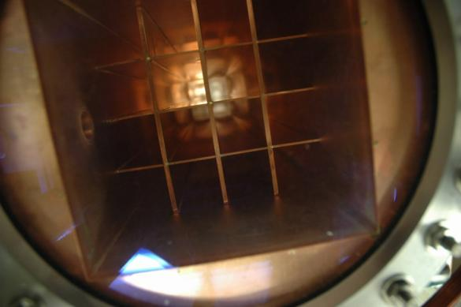
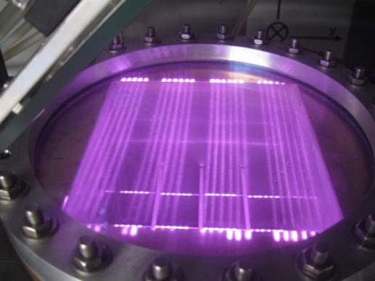
Polarization chamber
Laser deposits ~1.2kW into the gas
Polarization in multiple heat-exchanger channels
Immersion of copper column in flowing hot oil allows us to efficiently utilize and dissipate kilowatt laser power
Produces 2.5 L/hr at 54% polarization
Univ of New Hampshire/Xemed Bill Hersman 13 Sept, 2013
Xenon Polarization

Slide 7
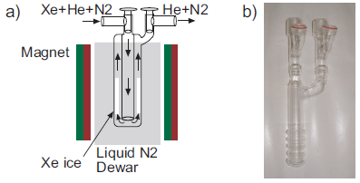
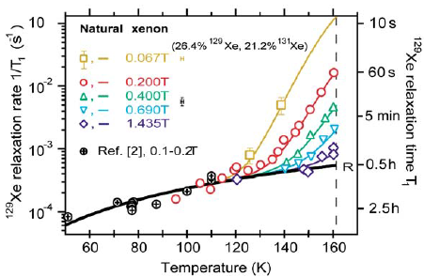
Challenge: Cryogenic accumulation
Pure xenon can be isolated from the flowing mixed gases by separating cryogenically
Solid xenon nuclear polarization relaxes rapidly at temperature near the phase transition
Fast-freezing and quick cooling to LN2 temperature in strong magnetic field preserves polarization
Fast-thawing of large accumulated quantities proved more challenging
N. Kuzma, et al, PRL 88:147602 (2002)
Univ of New Hampshire/Xemed Bill Hersman 13 Sept, 2013
Xenon Polarization

Slide 8
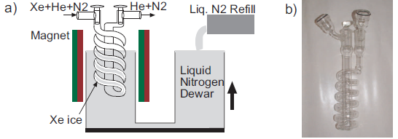
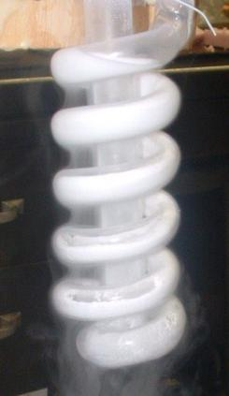
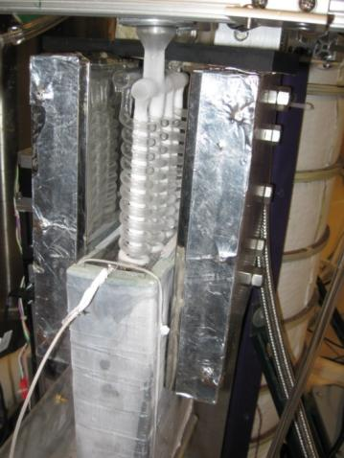
Solution: Rising-dewar freeze-out
Mixed gases enter cryogenic accumulator, spiraling downward
Beginning at the lowest quarter of the glassware, the dewar slowly rises throughout the accumulation
Hyperpolarized xenon is frozen to the glass surface beginning near the bottom, and finishing near the top
Removing the dewar and replacing with warm water immersion quickly thaws the xenon into the breathing bags
Univ of New Hampshire/Xemed Bill Hersman 13 Sept, 2013
Xenon Polarization

Slide 9
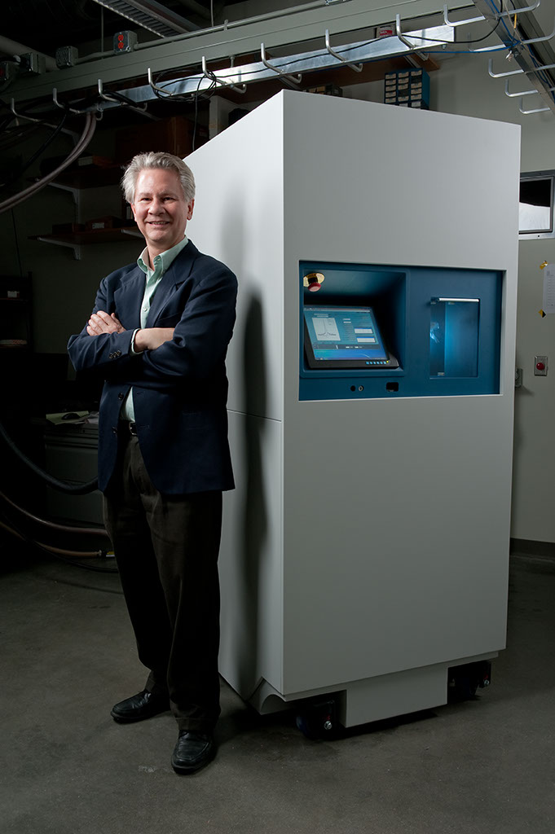
XeBox-E10 circa 2011
Launched in April 2011
Delivered MagniXene® at three sites
  University of Virginia
  Washington University, St. Louis
  Robarts Research Institute
Spectrally narrowed laser exceeds 1 kW
Copper polarization column dissipates heat
Polarization typically 40%-60%
Production typically 2 liters in 20 minutes
Over one year without a production failure
Univ of New Hampshire/Xemed Bill Hersman 13 Sept, 2013
Xenon Polarization

Slide 10
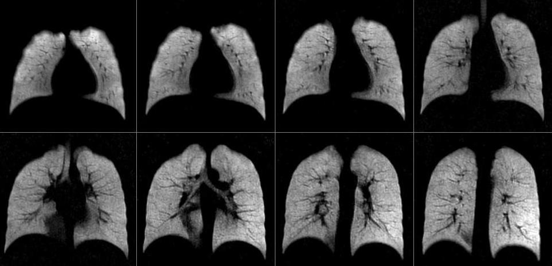
Spin Density – Healthy Subject
FLASH spin density acquisition, 2.1 x 2.1 x 10 mm³, acceleration factor 2
Univ of New Hampshire/Xemed Bill Hersman 13 Sept, 2013
Xenon Polarization

Slide 11
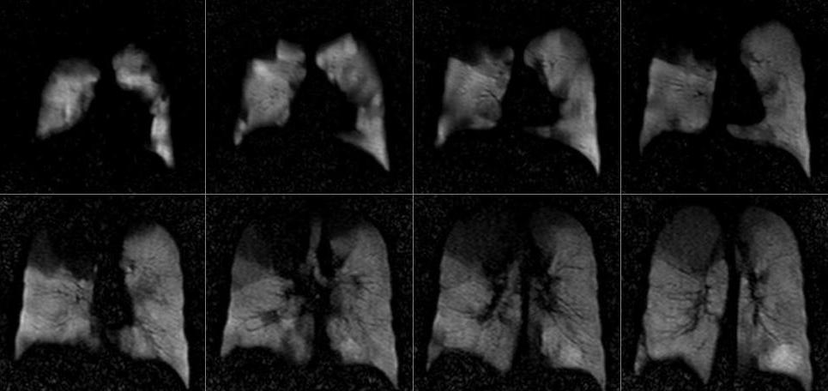
Spin Density – COPD Subject
FLASH spin density acquisition, 3.1 x 3.1 x 15 mm³, acceleration factor 3
Univ of New Hampshire/Xemed Bill Hersman 13 Sept, 2013
Xenon Polarization

Slide 12
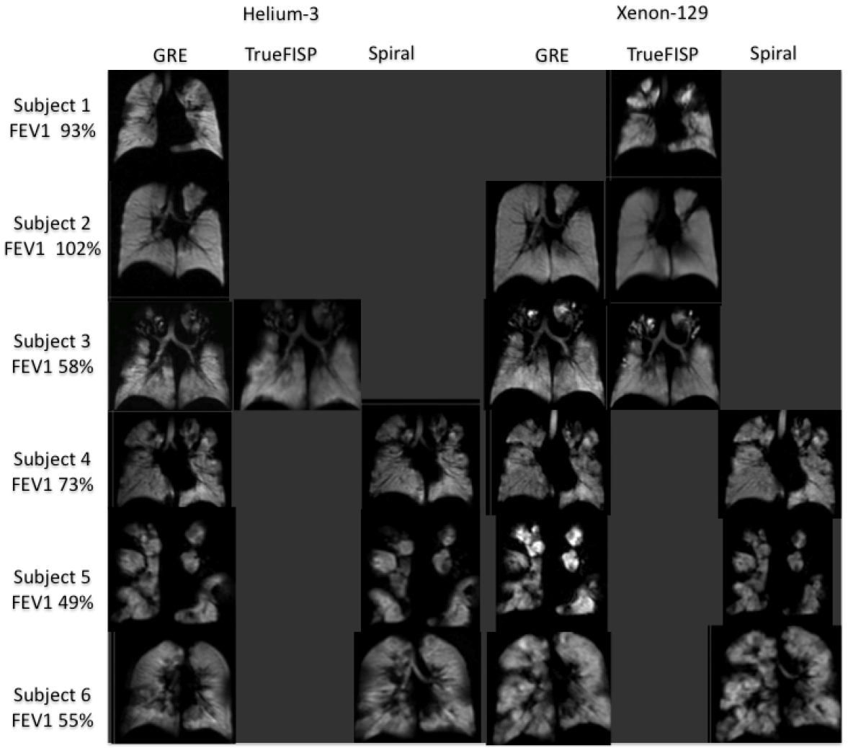
HXe MRI - Spin Density - Comparison with HHe
Altes TA, Mugler 3rd JP, Meyer C, et.al. A Comparison of Hyperpolarized Helium-3 and Xenon-129 MR Ventilation Imaging in Cystic Fibrosis. Proc.Intl.Soc.Mag.Reson.Med.20 (2012) p1354.

Slide 13
HXe MRI - Spin Density - Comparison with HHe
HXe and HHe MRI in two subjects with cystic fibrosis
HXe shows better contrast in ventilation defect delineation in Subject B
Mugler J.P. 3rd, Altes T.A. Hyperpolarized 129Xe MRI of the Human Lung. J.Magn.Reson.Imaging 37: 313-331 (2013)

Slide 14
HXe MRI – Apparent Diffusion Coefficient
Mugler J.P. 3rd, Altes T.A. Hyperpolarized 129Xe MRI of the Human Lung. J.Magn.Reson.Imaging 37: 313-331 (2013)

Slide 15
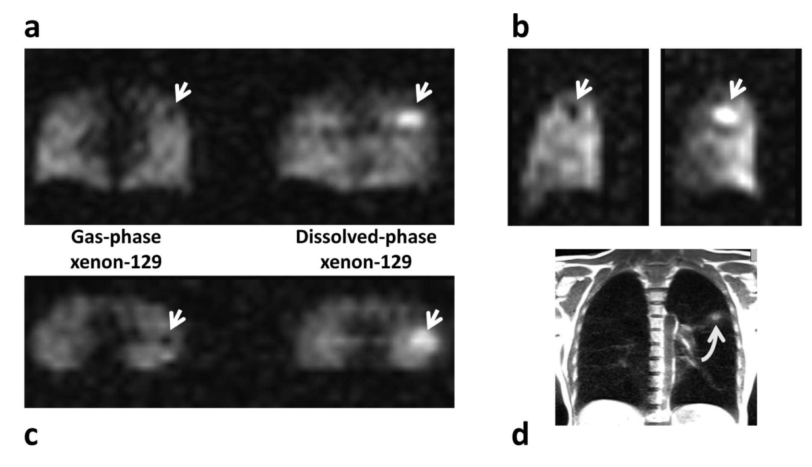
HXe MRI – Direct Dissolved Phase Imaging
Tissue inflammation detected in healthy subject imaged using HXe
Mugler 3rd JP, Altes TA, Ruset IC, et.al. “Simultaneous magnetic resonance imaging of ventilation distribution and gas uptake in the human lung using hyperpolarized xenon-129.” Proc Natl Acad Sci U S A 2010;PNAS

Slide 16
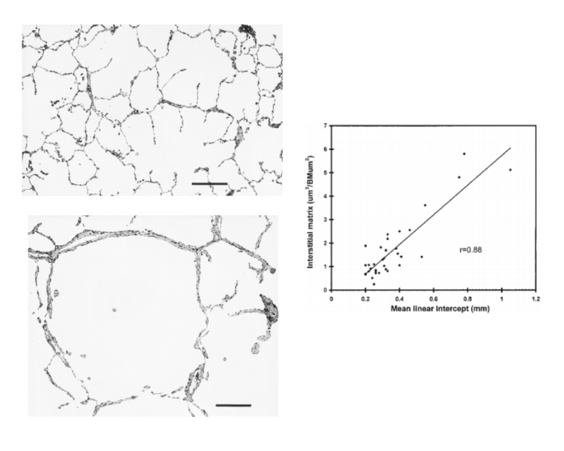
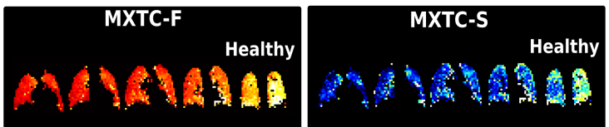
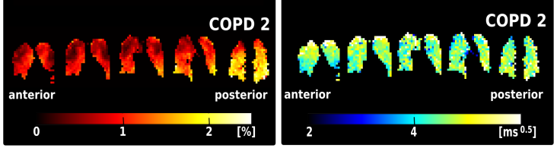
HXe MRI – Xenon Polarization Transfer Contrast Imaging
tissue thickness
vs. alveolar size
Healthy
Vlahovic et al (1999)
ACCM ,160:2086-2092
COPD
COPD:
Regions of decreased tissue density
Elevated septal wall thickness
Dregely I., Ruset I.C., Mata J.F., et.al. Multiple-Exchange-Time Xenon Polarization Trasfer Contrast (MXTC) MRI: Initial Results in Animals and Healthy Volunteers. Magn.Reson.Med. 67:943-953 (2012).

Slide 17
Production data from XeBox-E10
Measured in tedlar bags at University of Virginia
Univ of New Hampshire/Xemed Bill Hersman 13 Sept, 2013
Xenon Polarization

Slide 18
Safety and Tolerability
“In 3.5 weeks, we evaluated 33 subjects in 54 visits with 142 doses administered. There were no adverse events except in a single COPD subject who reported mild headache 3 hours after scanning, that was judged possibly related to the contrast agent and resolved without treatment within 3 hours. Most subjects inhaled four 500 mL ¹²⁹Xe doses consecutively after completing four previous inhalation breath-holds for ³He MRI. A 1L mixture of ¹²⁹Xe (500mL) and ⁴He (500mL) was readily inhaled by all subjects.”
David G. McCormack et al, “Hyperpolarized ¹²⁹Xe MRI Feasibility, Subject Safety, and Tolerability: At the Doorstep of Clinical Translation?” ATS meeting (2012)
Univ of New Hampshire/Xemed Bill Hersman 13 Sept, 2013
Xenon Polarization

Slide 19
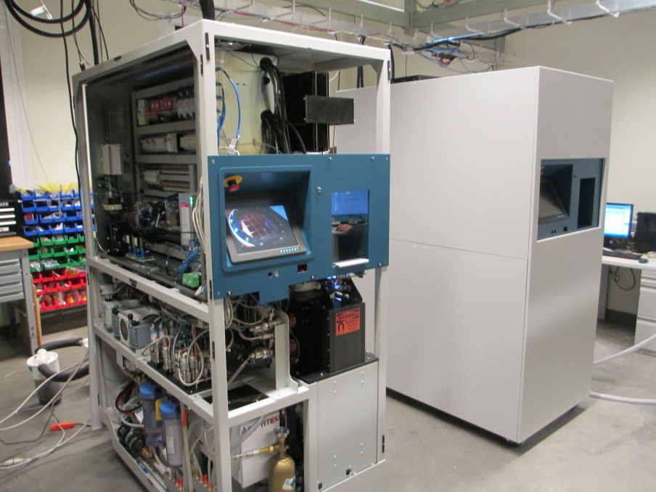
XeBox-B10 circa 2013
Refinements over XeBox-E10 include:
  zero dead volume
  dual cryostat
  improved laser
  automation
Univ of New Hampshire/Xemed Bill Hersman 13 Sept, 2013
Xenon Polarization

Slide 20
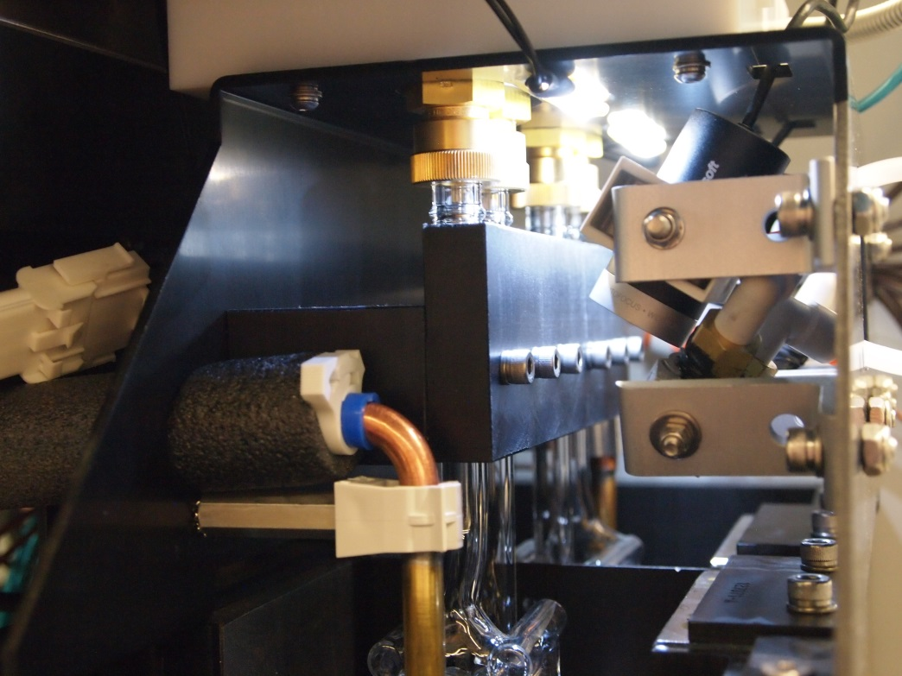
Extraction of polarized gas from freeze-out
Eliminates the need to polarize an extra half-liter
Reduces down time
Saves cost of 129Xe raw material
Increases service life of polarizer
Univ of New Hampshire/Xemed Bill Hersman 13 Sept, 2013
Xenon Polarization

Slide 21
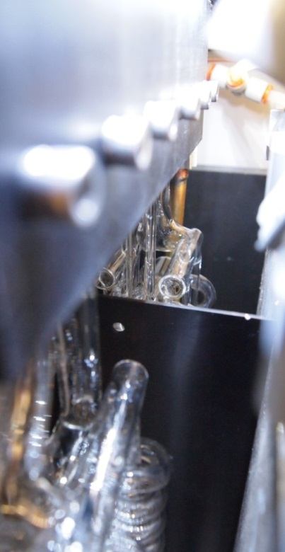
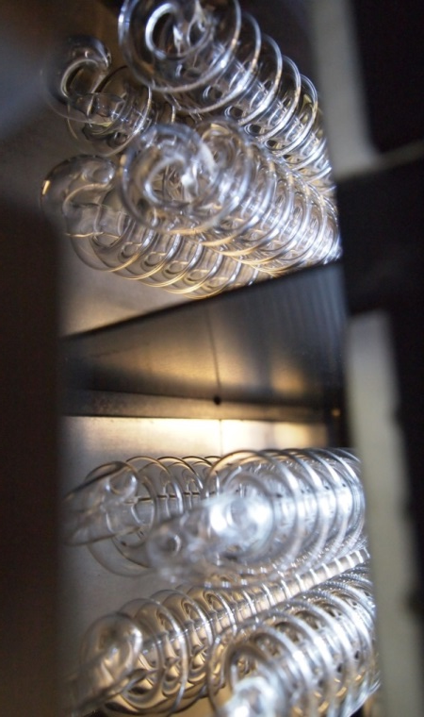
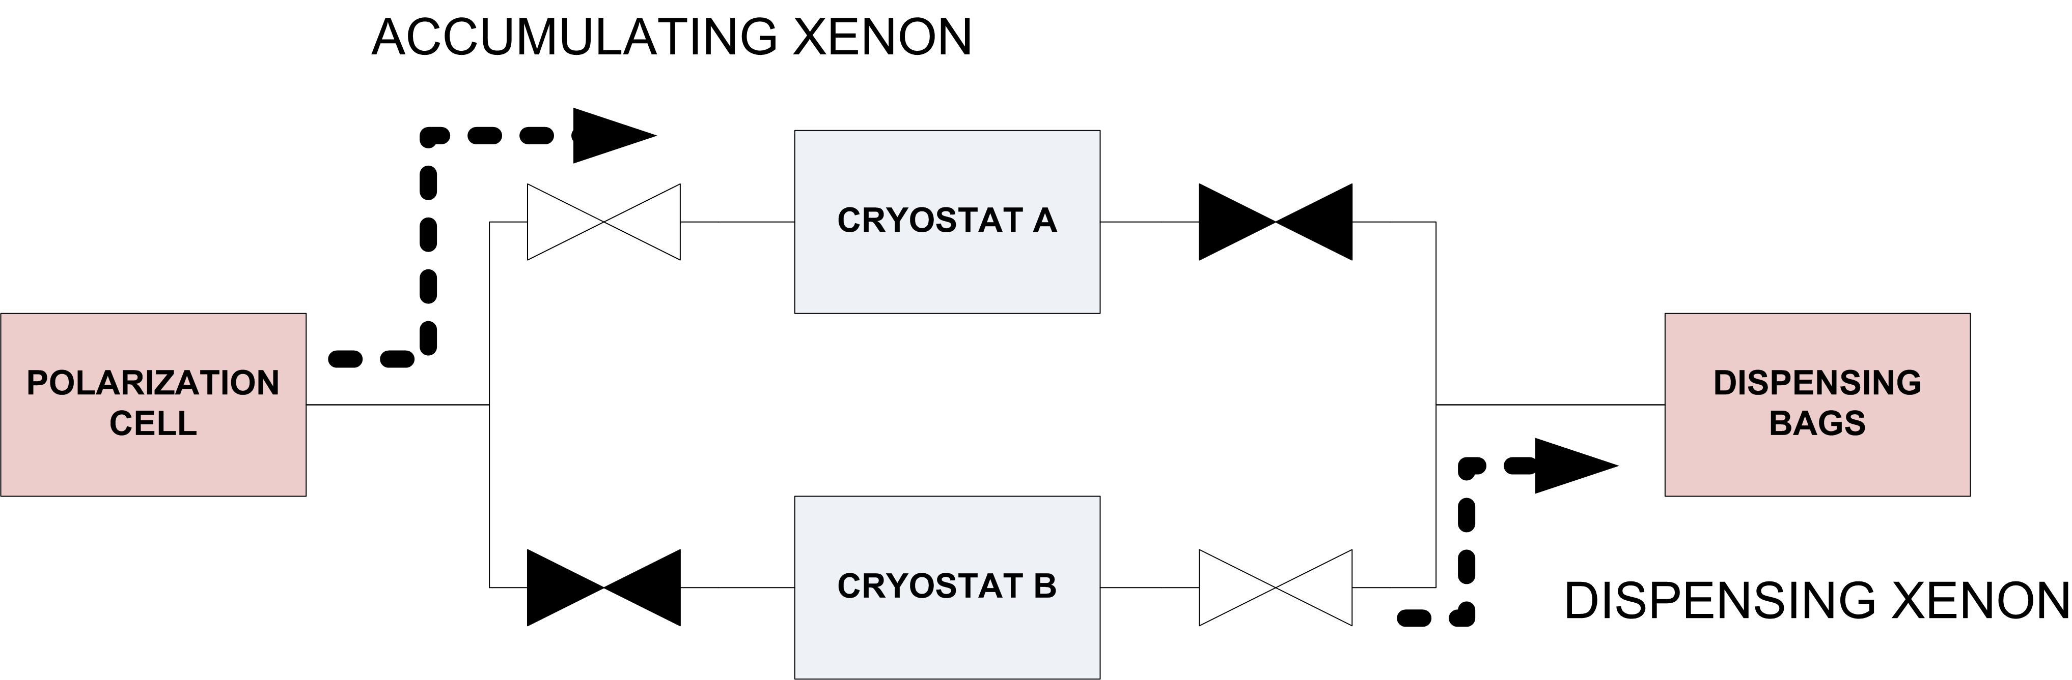
Dual cryostat
Xemed has built a xenon dual cryostat into XeBox-10
The dual cryostat will eliminate the down time between polarization runs by allowing the polarizer to continue accumulating polarized xenon ice even as a batch is being dispensed
Univ of New Hampshire/Xemed Bill Hersman 13 Sept, 2013
Xenon Polarization

Slide 22
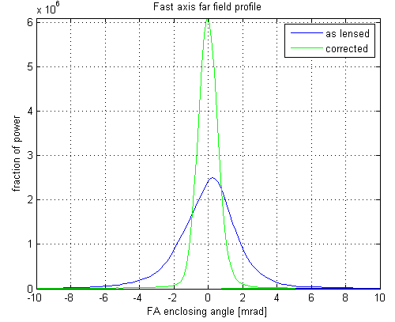
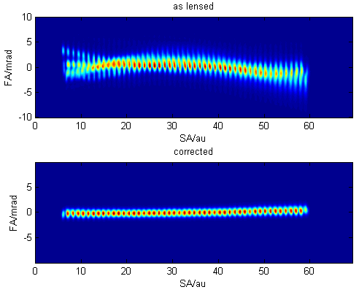
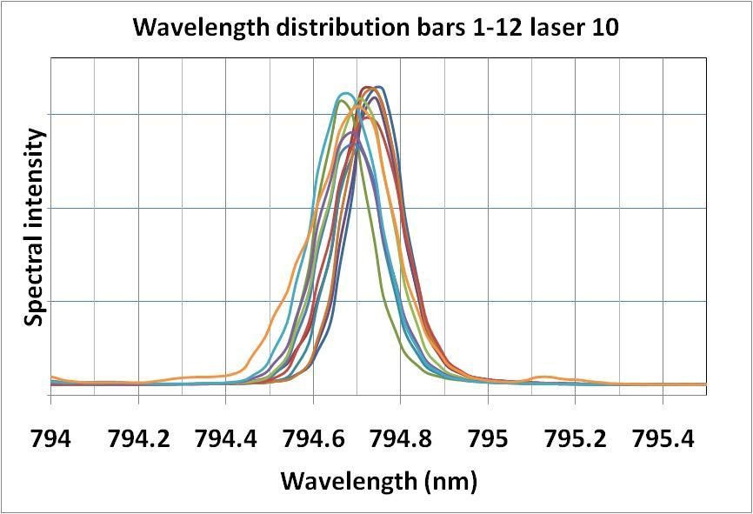
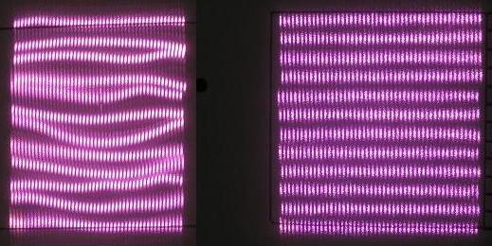
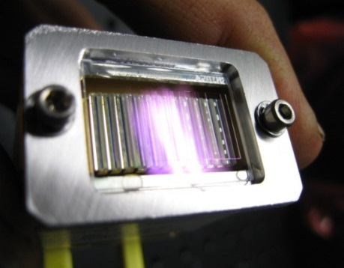
Even more 795nm photons…
Correction of individual emitters improves laser spectrum by factor 2.5
PowerPhotonic Ltd., Fife, UK
Univ of New Hampshire/Xemed Bill Hersman 13 Sept, 2013
Xenon Polarization

Slide 23
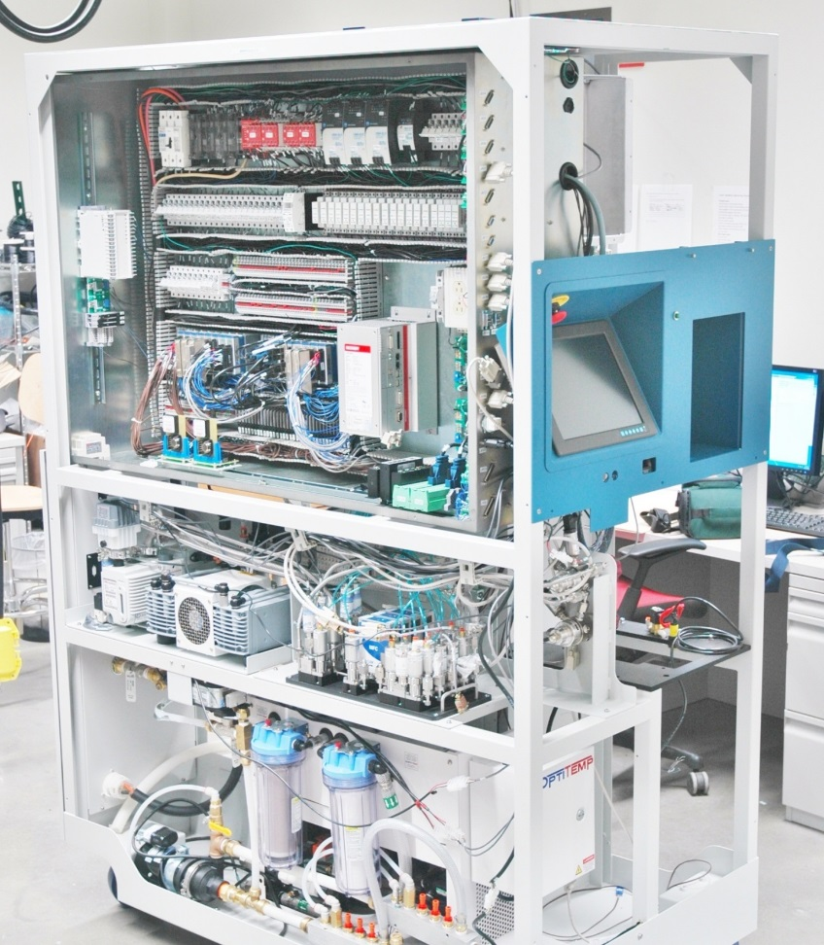
Automation System
On-site initiation of production runs can select accumulation volumes for one, two, three, or four bags
Remote monitoring identifies and solves problems before they can impact xenon production
Advances operational consistency, Good Manufacturing Practices (GMP/GCP)
Univ of New Hampshire/Xemed Bill Hersman 13 Sept, 2013
Xenon Polarization

Slide 24
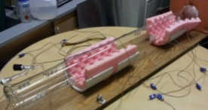
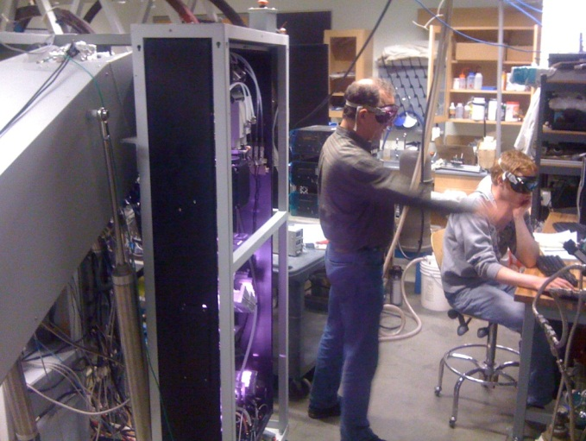
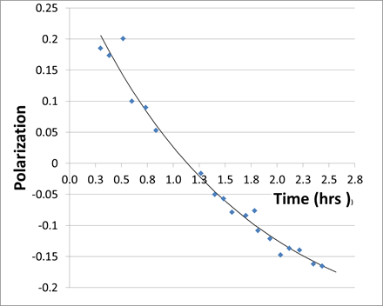
Large-scale 3He polarizer
Polarizes up to 50 L of 3He in 8.5 L cell at 6 amagat
A thermally-induced gas connection failure limited highest polarization to <50%
Slope at zero gives spin up rate of 17% per hour
Univ of New Hampshire/Xemed Bill Hersman 13 Sept, 2013
Polarized 3He

Slide 25
Summary
    Xenon polarizer apparatus has reached commercial status.
    Imaging technology improvements and clinical trials seek ways to address medical needs.
    Laser advancements are being applied to scale up production of polarized 3He
    All projects are collaborations between University of New Hampshire academics and the spin-out company Xemed
Univ of New Hampshire/Xemed Bill Hersman 13 Sept, 2013
Xenon Polarization

Slide 26
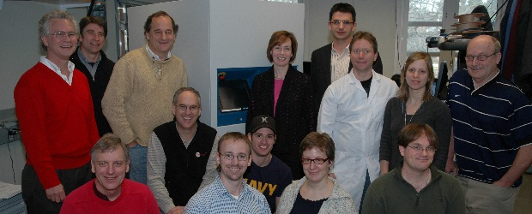
Acknowledgements
XemedLLC
Steve Bryn
Jan Distelbrink, PhD
Aaron Hope
Christina Johnson
Steve Ketel
Jeff Ketel
Walt Porter
Iulian Ruset, PhD
Daniel Sargent
Igor Tsentalovich NIH active grant: HL87550; past: HL83545;
Dave Watt, PhD DOE grant for polarized 3He: SC0006534
Univ New Hampshire
Bill Hersman, PhD
Steven Anderson
Joe Jarvis
Minh Ly
Jared Van Cor
Jonathan Wurtz
Univ Virginia
Talissa Altes, MD
Kai Ruppert, PhD
Jaime Mata, PhD
Wilson Miller, PhD
Chengbo Wang, PhD
John P Mugler, III PhD
Visit http://www.xemed.com
Univ of New Hampshire/Xemed Bill Hersman 13 Sept, 2013
Summary

Slide 28
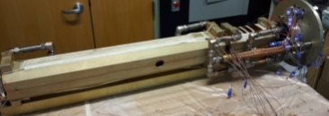
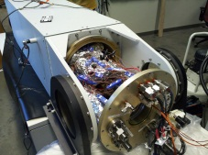
Glass cell encased in pressure vessel
Installation with
Conductive Grease
8.5 liter glass cell
Two thermal zones
Hot section below
Cool section above
Laser enters from above
Rb density depleted in upper region
Hot section
Cooler section
Cartridge insulated and
ready for installation
Univ of New Hampshire/Xemed Bill Hersman 13 Sept, 2013
Polarized 3He

Slide 29
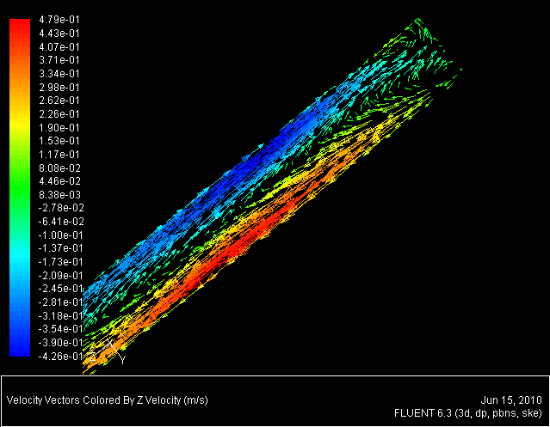
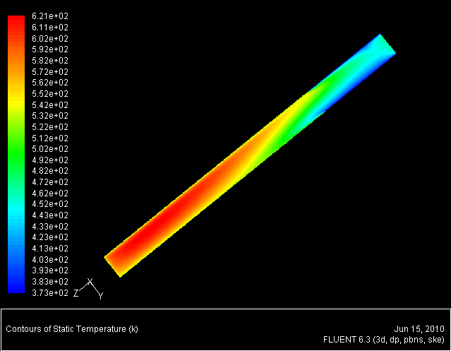
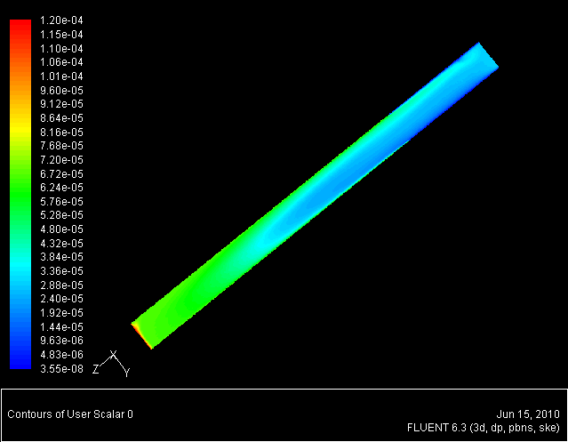
Gas circulation
In vertical orientation, buoyancy causes alkali to accumulate at the top of the cell, leading to an unstable thermal runaway.
Tilting the cell creates steady asymmetric temperature, velocity, and alkali distributions.
Shear layer promotes heat and mass transfer between upward and downward streams.
Circulating flow creates an alkali-depleted region near the top window.
FLUENT simulation of cell tilted at 45º (1200 W, 5.8 amagat) velocity ~.45 m/s
Velocity Field
near top window
Temperature
Distribution
Potassium Vapor
Distribution
Univ of New Hampshire/Xemed Bill Hersman 13 Sept, 2013
Polarized 3He

Slide 30
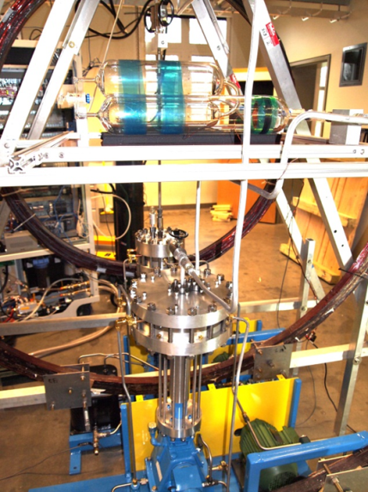
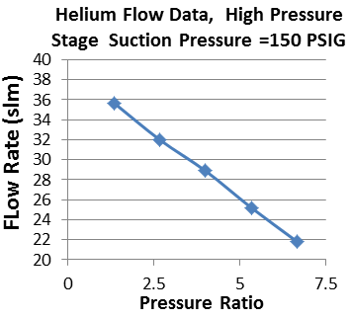
Titanium Diaphragm Pump
Intermediate goal is to characterize polarization losses during compression, evacuation, circulation of polarized 3He
Allows automated filling, emptying, and repolarizing 3He of neutron analyzers
Univ of New Hampshire/Xemed Bill Hersman 13 Sept, 2013
Polarized 3He

