Slide 1
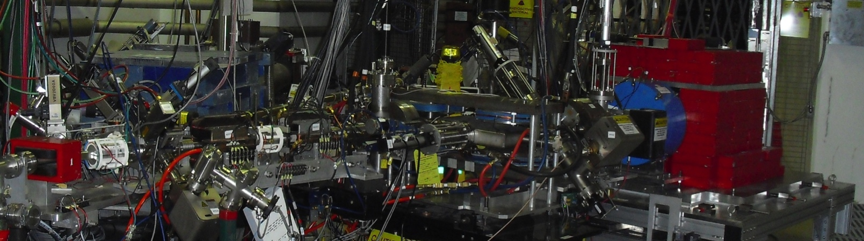
Polarized Electrons for Polarized Positrons
A Proof-of-Principle Experiment
Joe Grames on behalf of the PEPPo Collaboration
Jefferson Lab
PSTP-2013 @ U. Va., Charlottesville, Sept 9-13, 2013
Generating Polarized Positrons
Experimental Apparatus
Preliminary Results

Slide 2

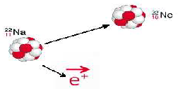



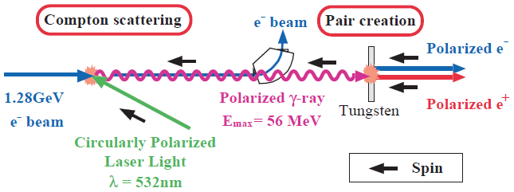
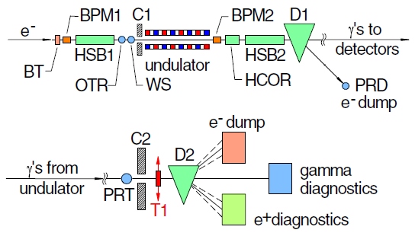
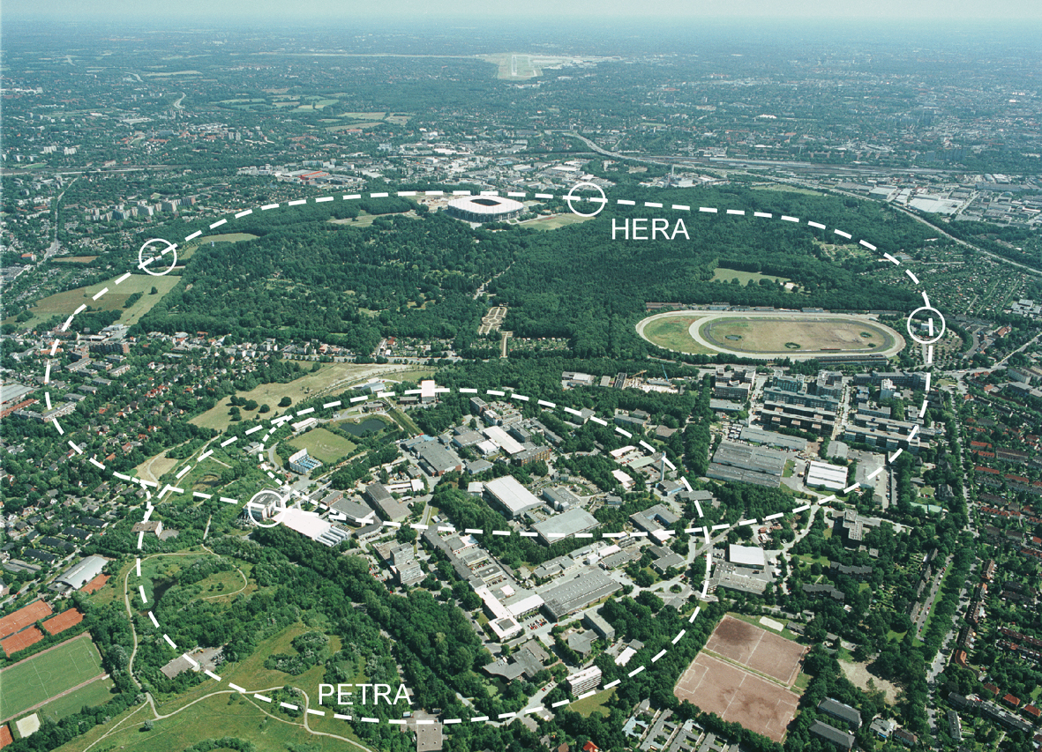
Proven Methods to Produce Polarized Positrons
Sokolov-Ternov Effect
D. Barber , AIP Conf. Proc. 588, 338 (2001)
Polarized β⁺ Decay
L.A. Page & M. Heinberg. Phys. Rev.
106(6):1220-1224 (1957)
HERA 27.5 GeV e+/e-
Polarized due to parity non-conservation in the weak interaction
P(e⁺) ~ 70 %
P(e⁺) ~ 40 %
Compton Backscattering (KEK)
T. Omori et al, PRL 96 (2006) 114801
Helical Undulator (SLAC E166)
G. Alexander et al, PRL 100 (2008) 210801
47.7GeV
P(e⁺) = 73 ± 15_{(stat)} ± 19_{(syst)} %
P(e⁺) = 80 ± 7_{(stat)} ± 9_{(syst)} %

Slide 3
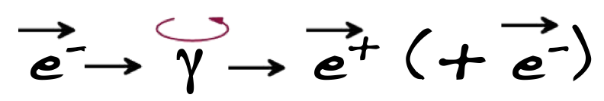
Alternate Approach Starting with a Highly Polarized Electron Beam
E.G. Bessonov, A.A. Mikhailichenko, EPAC (1996)
A.P. Potylitsin, NIM A398 (1997) 395
CEBAF OPERATIONS
Bulk GaAs Strained GaAs Superlattice GaAs
P_{e-}
I_{e-}
35% 35% 75% 75% 85% 89%
30μA 100μA 50μA 100μA 150μA 200μA
1995 1998 1999 2000 2004 2012
Sustainable polarized electron intensities up to 4 mA have been demonstrated from a superlattice photocathode.
R. Suleiman et al., PAC’11, New York (NJ, USA), March 28 – April 1, 2011

Slide 4
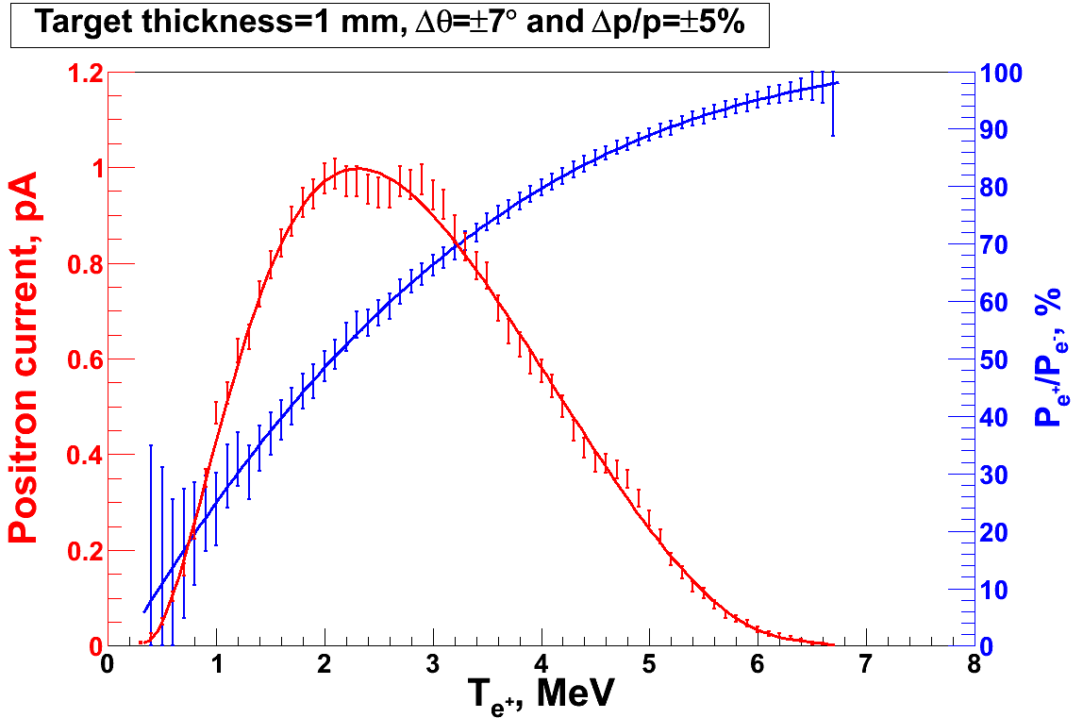
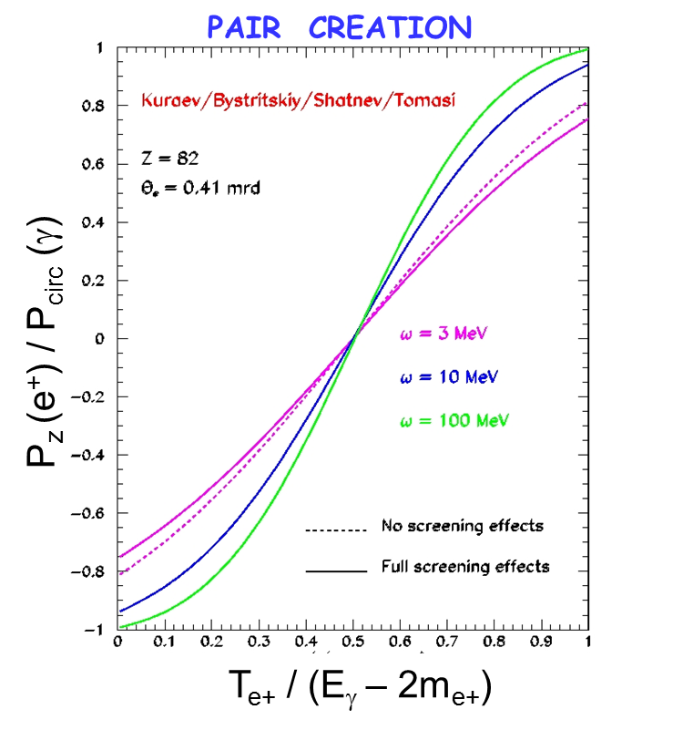
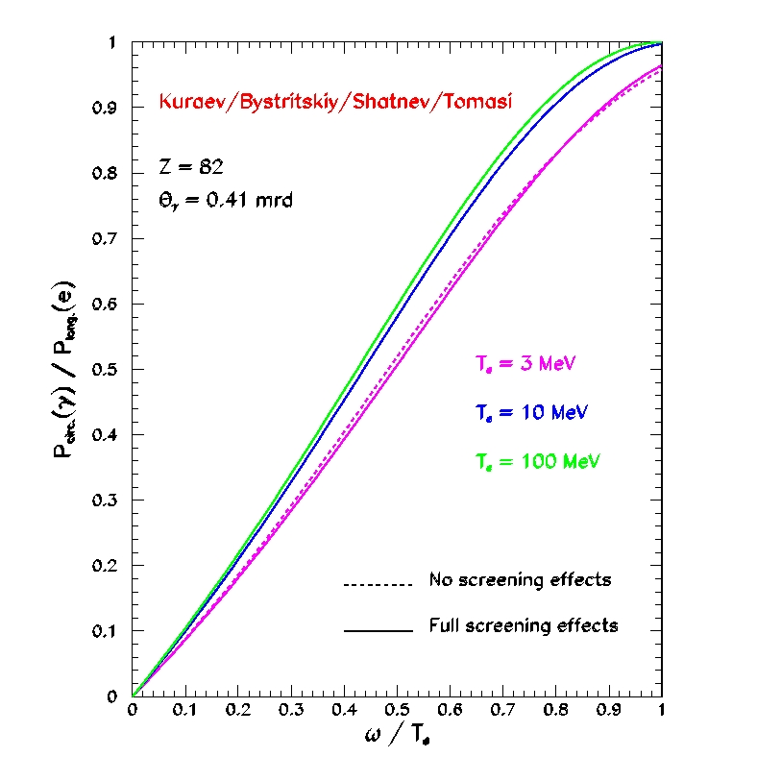
Introducing the PEPPo Concept
Simulation
BREMSSTRAHLUNG
Polarized Electrons
(<10 MeV) strike production target
Positron Transverse and Momentum Phase Space Selection
E_{e} = 6.3 MeV
I_{e} = 1 µA
T₁ = 1 mm W
P_{e-}
S₁
e⁻
PEPPo
D
J. Dumas, PhD Thesis (2011)
P_{circ}(γ) / P_{z} (e⁻)
T₁
Longitudinal e⁻ (P_{e-}) produce elliptical γ whose circular (P_{γ}) component is proportional to P_{e-}.
S₂
P_{e+}
γ produces pairs; P_{γ} transfers to e⁺ into longitudinal (P_{e+}) and transverse polarization averages to zero.
e⁺
D
P_{T}
Calorimeter
T₂
E_{γ} / T_{e-}
Compton Transmission Polarimeter
PEPPo measured the polarization transfer from 8.2 MeV/c longitudinal electrons to longitudinal positrons in the 3.1-6.2 MeV/c momentum range.

Slide 5
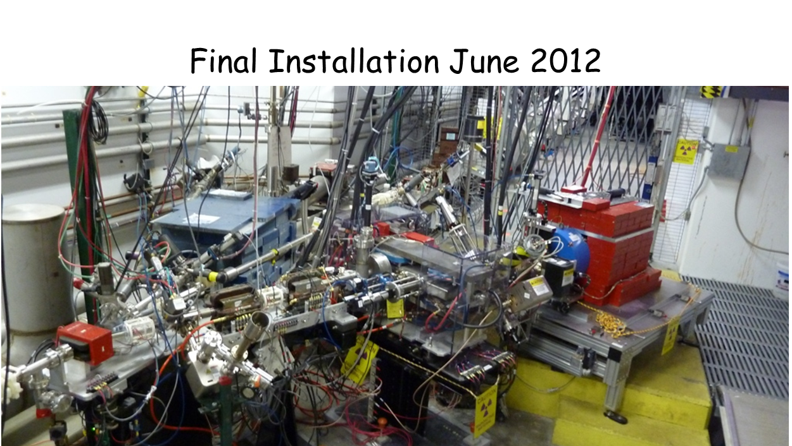
Experiment Layout
Viewers
Beam position monitors
Collection
Solenoid
Viewers
Momentum Aperture
Polarized Analyzing Target
(7.5 cm Fe)
Transport
Solenoid
Corrector magnets
Dipoles
Quadrupoles
Insertable
Faraday Cup
Pair Production Target
T₁ (0.1-1 mm W, < 1 r.l.)
Annihilation detector
Positron Selection Device
Viewer
Pair
Creation
Target
Collection
Magnets
(Princeton/SLAC)
Compton
Polarimeter
(DESY)
Corrector magnets
Reconversion Target
T₂ (2 mm Densimet)
Compton Transmission Polarimeter

Slide 6
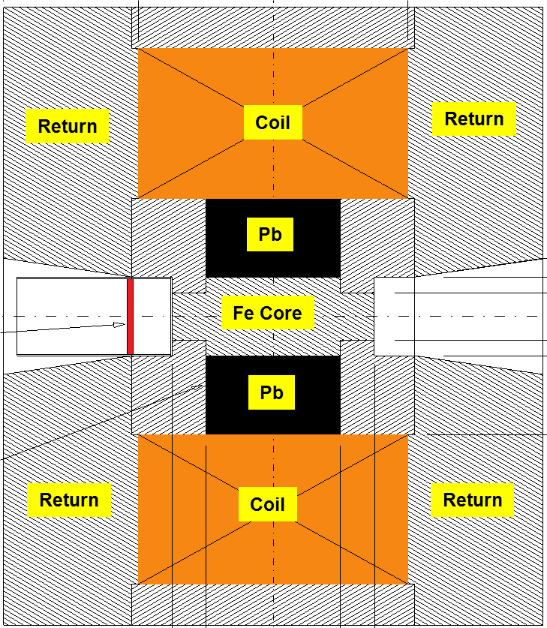
Compton Transmission Polarimeter
Electrons or Positrons radiate polarized photons by Bremmstrahlung in reconversion target
Energy dependent Compton scattering of photons transmitted through polarized target correspond to polarization of incoming Electrons or Positrons (aligned or anti-aligned).
μ1 - Compton absorption coefficient
L - target length
P₃ - photon polarization (long.)
P_{e-}
e⁻
γ
P_{e+}
e⁺
Reconversion
Target
(Densimet D17K)
90.5% W
7% Ni
2.5% Cu
P_{e} - electron/positron polarization
P_{T} - target polarization
A_{e} - analyzing power
Bremmstrahlung photon spectrum requires energy-dependent analyses
  Energy binning
  Energy integration

Slide 7
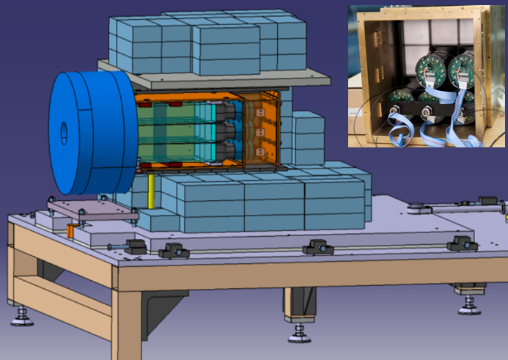
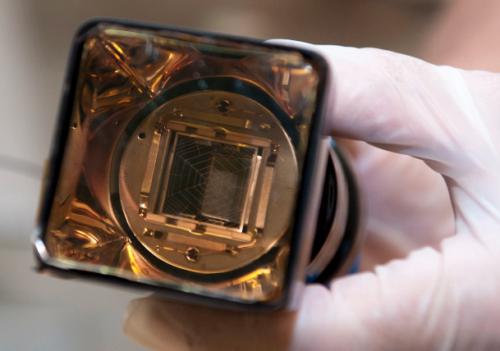
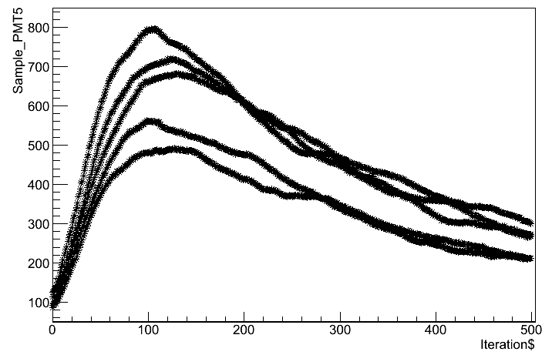
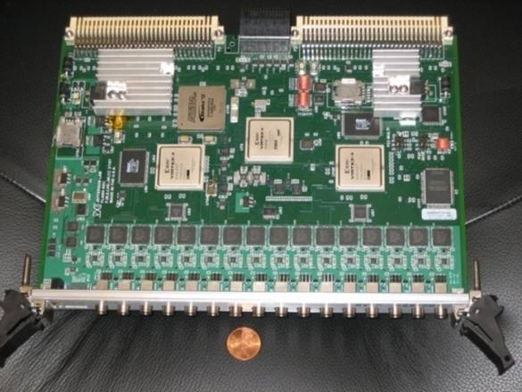
Photon Calorimeter and DAQ
CsI(Tl) crystals (28cm) are coupled to PMTs equipped with LPSC custom amplified basis to extend the PMT life-time in the high rate environment of PEPPo.
The ~2 µs long and 2 V optimized signal is fed into the JLab custom FADC250 that sampled the signal at 250 MHz.
CsI events
Hamamatsu R6236-100
2 microsec
FADC250 allows for 3 data taking modes :
Sample (500 samples /2 micro-sec)
Semi-integrated (1 integral / 2 micro-sec)
Integrated (1 integral /33 milli-sec)

Slide 8
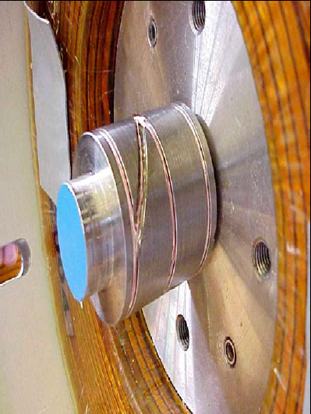
Determine Polarization of the Iron Core
The model of the analyzing magnet developed within OPERA-2D is controlled by the measured magnetic map of the fringe field of the solenoid at ±60 A current.
The 75mm long iron core of a solenoid magnet functioned as the polarimeter target.
Coil
2.6T
Return
Coil
Return
Return
Pb
Pb
Fe Core
Fe Core
Pb
0T
Return
Coil
Return

Slide 9
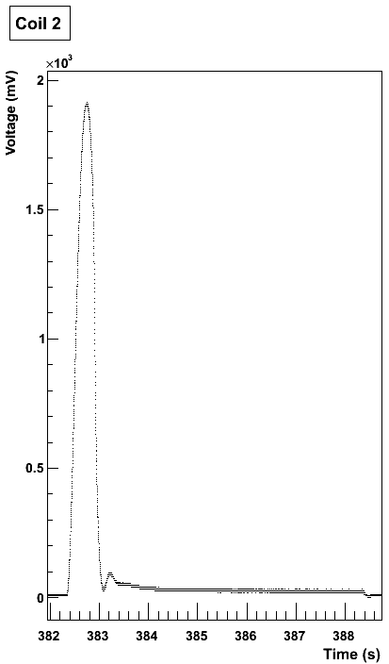
Magnetic Flux Measurement
The iron core target is equipped with 3 pick-up coils measuring the magnetic flux generated by the magnet current variation (ramping-up, polarity reversal).
Specific cycling procedures are used during the experiment to monitor the target polarization.
<P_{T}> = (7.53%) ± (0.06%) _{Opera} ± (0.04%) _{Coil}

Slide 10
Measurement Strategy
Calibration of PEPPo Apparatus Using Highly-Polarized Electron Beam
Calibrate PEPPo spectrometer using measured electron beam energy
Measure Compton asymmetries for known e⁻ beam polarization
Benchmark GEANT4 model of Compton polarimeter analyzing power
Electron and Positron Collection
Define collection from production target with momenta-degraded electrons
Reverse spectrometer polarity to collect positrons and verify flux
Positron Polarization
Measure Compton positrons asymmetries
Calculate positron polarization with a positron analyzing power

Slide 11
CEBAF Polarized Electron “Drive Beam”
PEPPo used the CEBAF pre-injector, taking advantage of existing electron beam diagnostics to determine with precision properties of the polarized electron beam.
Low Beam Intensities
1 μA down to 10’s pA
(See M. McHugh’s S12 talk)
Mott Electron
Polarization Measurement
dP/P<3%
Energy Measurement
dE/E<0.5%
Laser
PEPPo
Beam Energy
Up to 8.25 MeV/c
Beam Polarization
30 Hz fast helicity reversal (delayed)
Slow laser helicity reversal (waveplate)
4π Spin Rotator

Slide 12
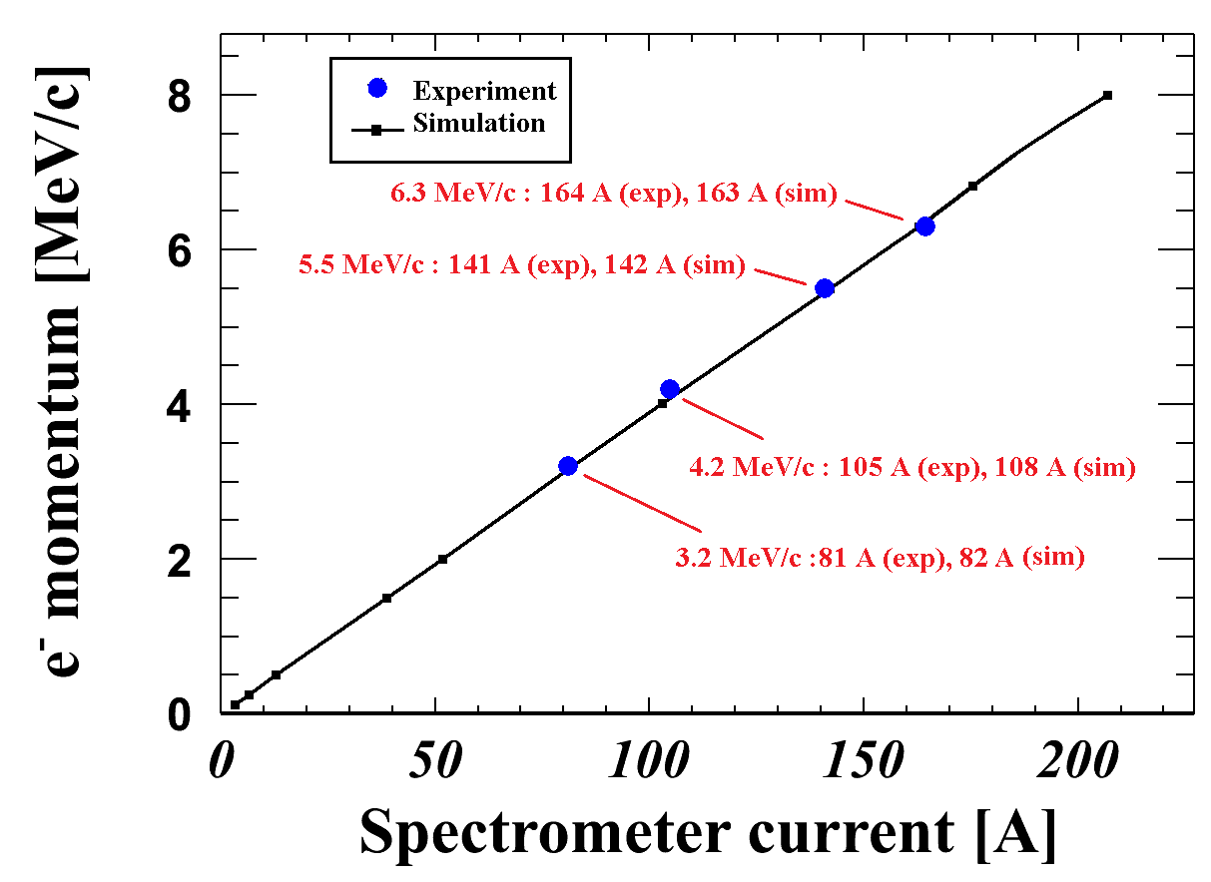
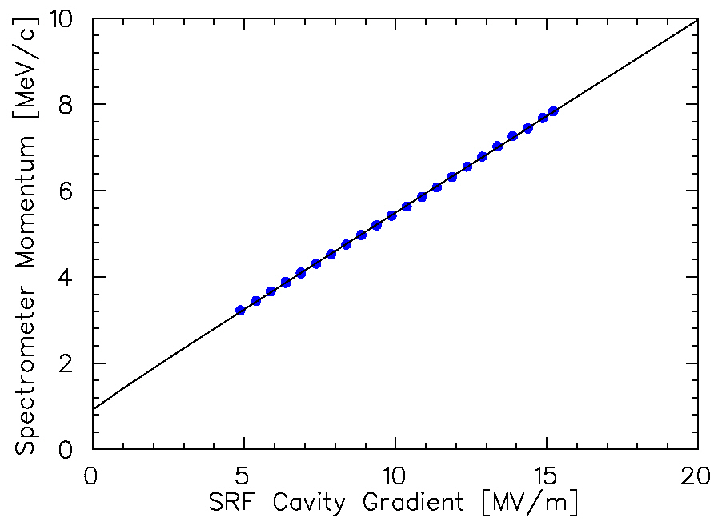
Electron Momentum and Spectrometer Calibration
Spectrometer Calibration
S₁=0
e⁻
D
Spectrometer current (A)
Momentum Calibration
S₂=0
D
e⁻
P_{T}
Calorimeter
Electron beam momentum (MeV/c)
T₂
Compton Transmission Polarimeter
SRF cavity gradient (MV/m)

Slide 13
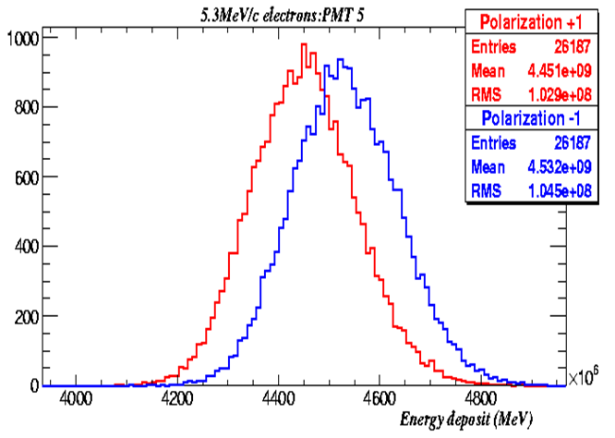
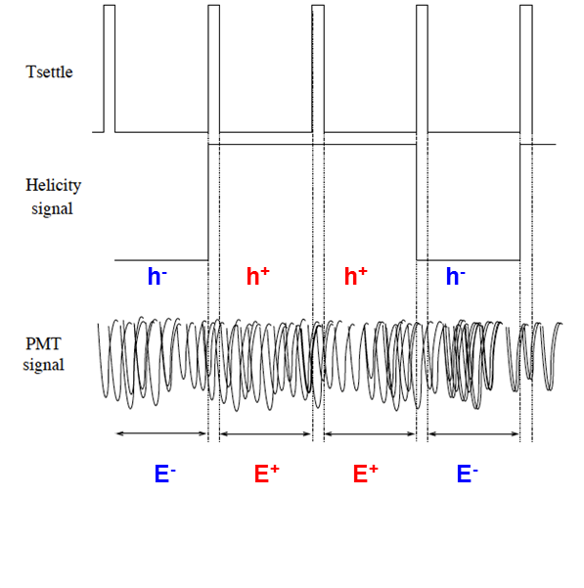
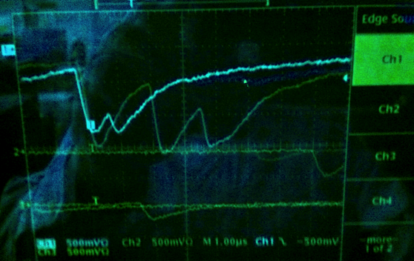
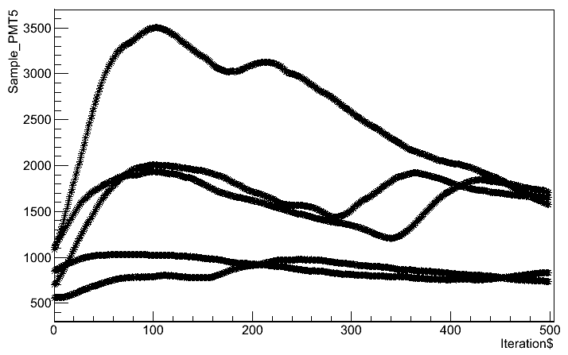

Compton Polarimeter Electron Calibration
  Compton transmission polarimeter was tested against a known electron beam polarization as measured by injector Mott polarimeter: P_{e-} = 83.7% ± 0.6% _{(stat)} ± 2.8% _{(sys)}
At lowest achievable current ~10’s pA photon rates >100kHz
Thus, electron asymmetries computed by integrating the photon energies
P_{e-} (MeV/c) | Electron Current | Rate (kHz)
3.2 | 60 pA | 112
4.2 | 23 pA | 184
5.5 | 25 pA | 202
6.3 | 10 pA | 471
7.3 | 10 pA | 164
Helicity +1
Helicity +1
Fast Pockels Cell Helicity Reversal
  Frequency = 30 Hz
  Delay = 8 windows
  Pattern = quartet (+--+,-++-)
Slow Systematic Helicity Reversal
  insertable half-waveplate
  polarized target reversal
Pile up
Analysis:
Cuts on beam trips
Pedestal subtraction for beam energy and PMT HV
Asymmetry calculations (global, false)

Slide 14
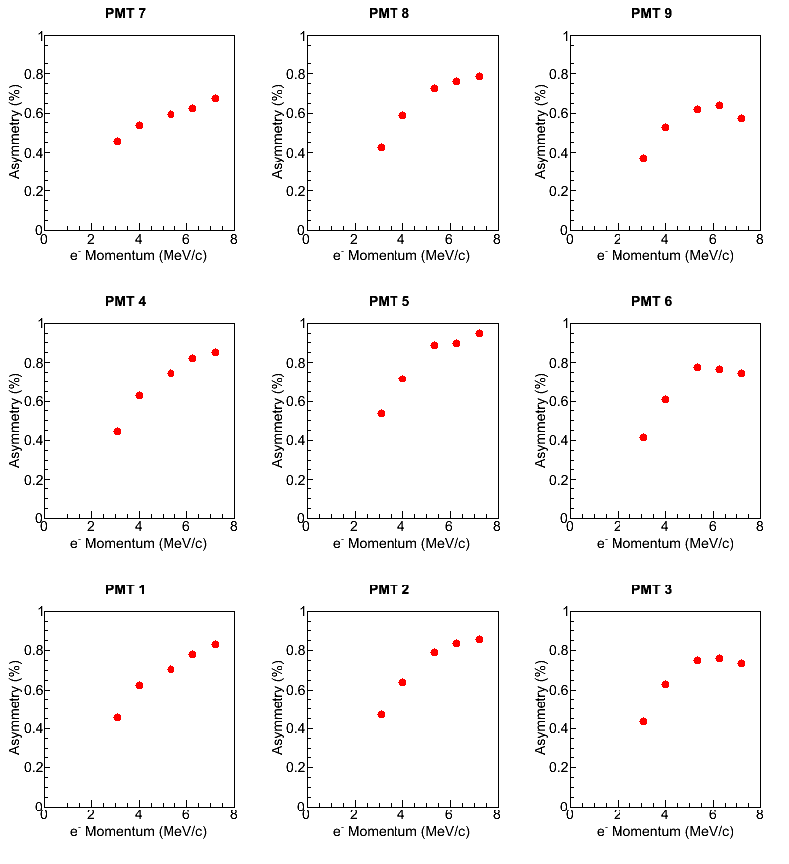
Electron Asymmetries (3x3 CsI Array)
Measured false asymmetries associated with systematic slow reversal are small
  Wavplate (~500ppm) - associated with generating low e- current (pA’s)
  Polarimeter target (~300ppm) - associated with photon background

Slide 15
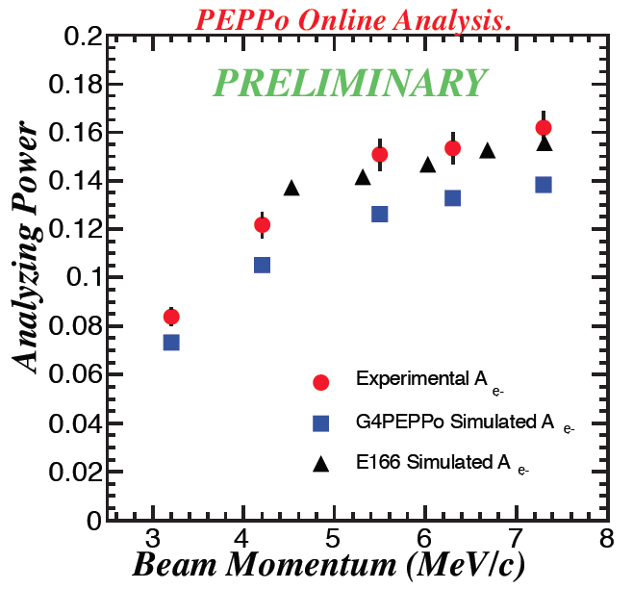
Electron Analyzing Power
Goal: Use measured electron analyzing power to benchmark our GEANT4 model of the polarimeter.
Electron beam polarization
  P_{e-} = 83.7% ± 0.6% _{(stat)} ± 2.8% _{(sys)}
Target polarization
  P_{T} = 7.53% ± 0.06% _{(Opera)} ± 0.04% _{(Coil)}
We have just begun refining our GEANT4 simulation for the experiment conditions
Preliminary and reported simulations are coming close to agreement, but more work needed here

Slide 16
Measurement Strategy
Calibration of PEPPo Apparatus Using Highly-Polarized Electron Beam
Calibrate PEPPo spectrometer using measured electron beam energy
Measure Compton asymmetries for known e⁻ beam polarization
Benchmark GEANT4 model of Compton polarimeter analyzing power
Electron and Positron Collection
Define collection from production target with momenta-degraded electrons
Reverse spectrometer polarity to collect positrons and verify flux
Positron Polarization
Measure Compton positrons asymmetries
Calculate positron polarization with a positron analyzing power

Slide 17
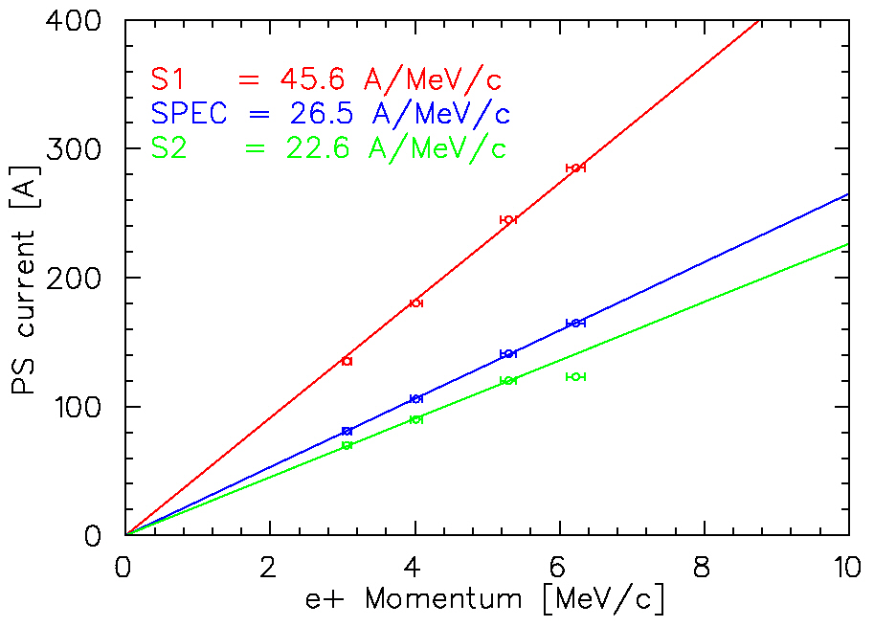
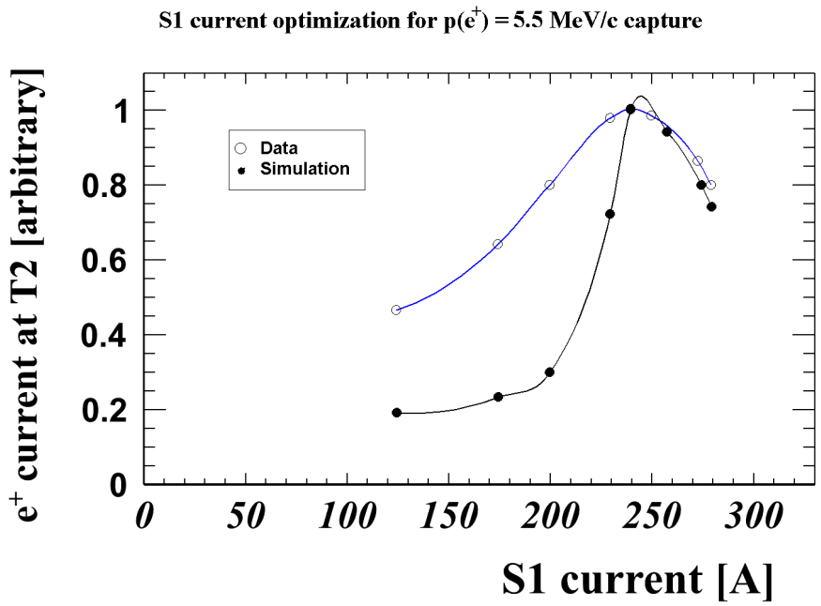
Optimize Transmission with Energy-Degraded Electrons
Degraded Electron Collection
S₁
e⁻
p_{e-}= 8.2 MeV/c
D
T₁
e⁻ Momentum [MeV/c]
S₁ current optimization at 5.5 MeV/c
S₂
D
e⁻
T₂
Current @ T₂ (arbitrary)
S1 current (A)

Slide 18
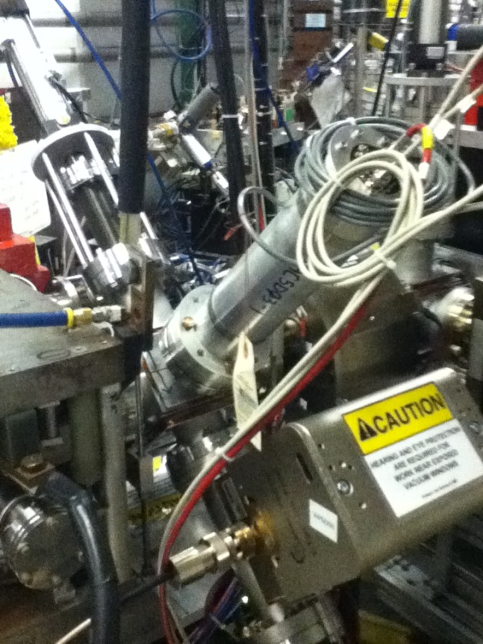
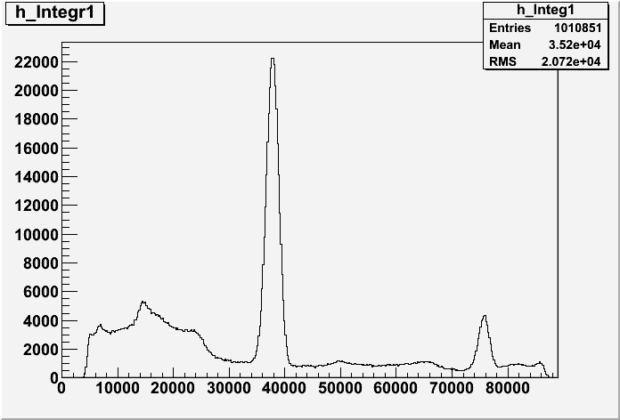
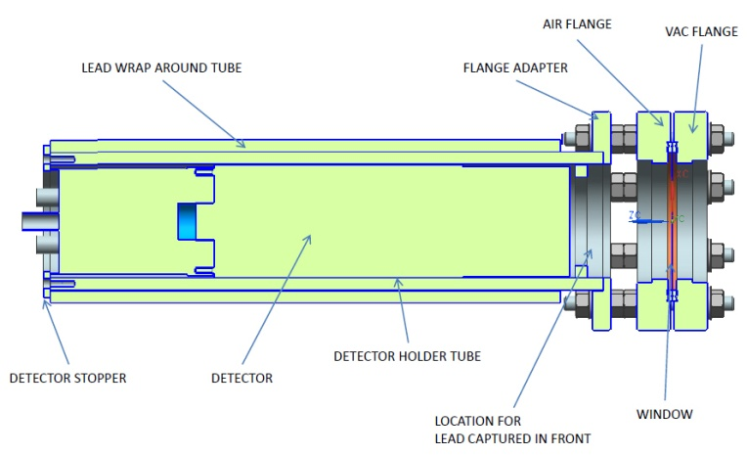
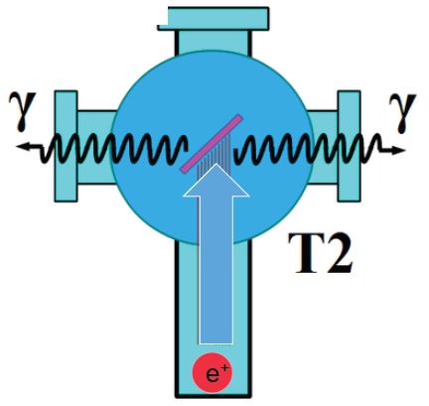
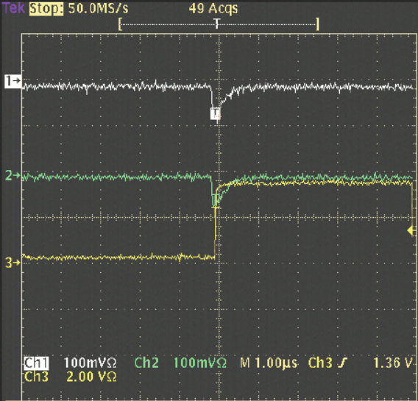
Reverse Spectrometer Polarity for Positrons
Two NaI detectors measured coincidence of back-to-back photons emitted by annihilation of positrons in a viewscreen.
Positron Collection
S₁
e⁻
p_{e-}= 8.2 MeV/c
D
T₁
Na²²
S₂
e⁺
Test @ proposal e- beam energy
4 MeV/c e⁺ collected from 0.5 nA 7 MeV/c e⁻ on 1 mm W target
D
T₂
Viewscreen
0.011 thick @ 45 deg to beam line
99.5% aluminum oxide Al₂O₃
0.5% chromium doped Al₂O₃/Al₂O₃Cr₂O₃

Slide 19
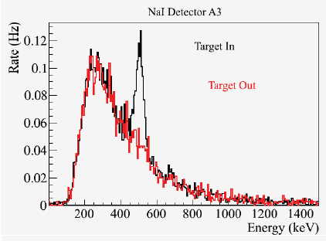
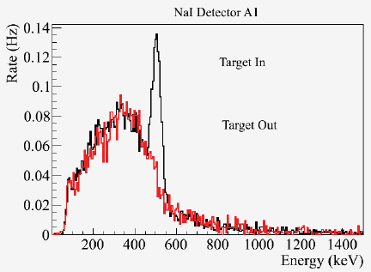
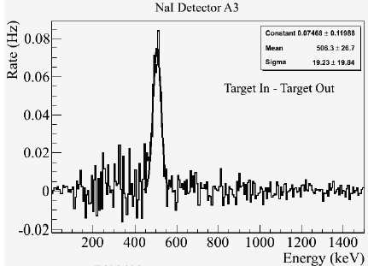
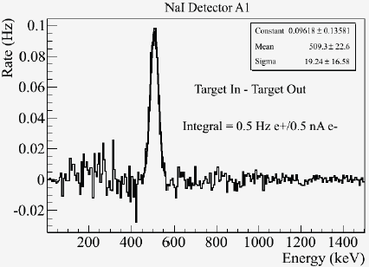
Coincidence Signal and Positron “Beam” Yield
Detected e+ rate (1 e⁺ per 10¹⁰ e⁻)
Solid Angle (0.1 sr)
GEANT annihilation probability (1/400)
Coincidence detector efficiency (0.49 @ 511keV)
1 e⁺ per 10⁶ e⁻
(consistent with proposal)

Slide 20
Measurement Strategy
Calibration of PEPPo Apparatus Using Highly-Polarized Electron Beam
Calibrate PEPPo spectrometer using measured electron beam energy
Measure Compton asymmetries for known e⁻ beam polarization
Benchmark GEANT4 model of Compton polarimeter analyzing power
Electron and Positron Collection
Define collection from production target with momenta-degraded electrons
Reverse spectrometer polarity to collect positrons and verify flux
Positron Polarization
Measure Compton positrons asymmetries
Calculate positron polarization with a positron analyzing power

Slide 21
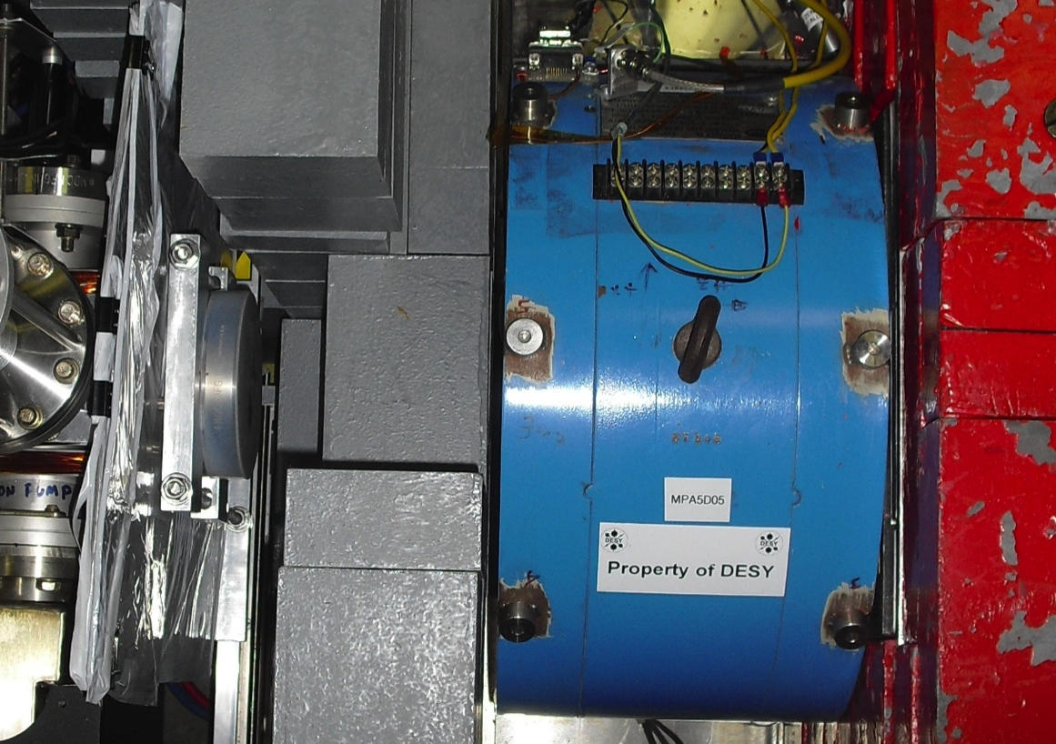
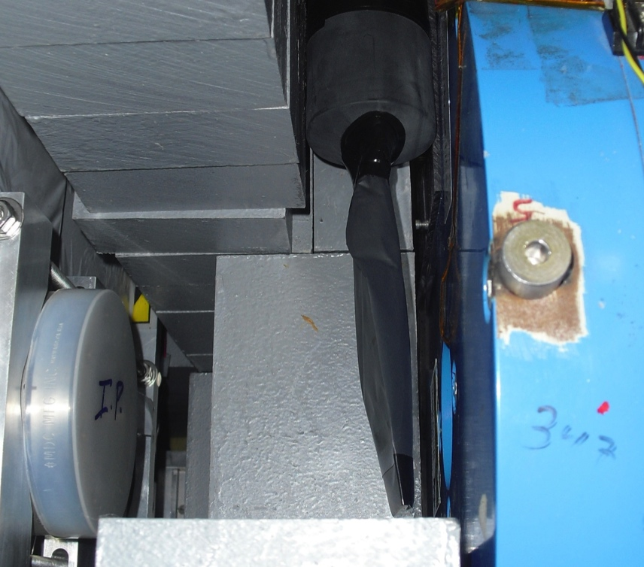
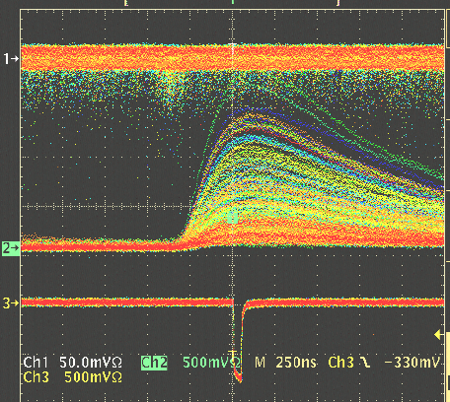
Measurement of Positron Asymmetry
Positrons asymmetry measurements are complicated by backgrounds associated with their production and collection.
Positrons are detected in coincidence between a thin trigger scintillator placed prior to the reconversion target and the central crystal (PMT5) and tagged by e- helicity.
C
A
L
O
R
I
M
E
T
E
R
Scintillator
e+
γ
PMT5
Reconversion
Target
Coincidence trigger
10mil Al window
Trigger Scintillator
Mom (MeV/c) | Mode | Set | I_{e-} @ T1 | Rate (kHz) | Target (mm)
3.2 | Sem. | 1 | 380 nA | 9 | 1
4.2 | Sem. | 1 | 25 nA | 7 | 1
5.5 | Sem. | 1 | 95 nA | 2 | 1
6.3 | Sem. | 1 | 380 nA | 8 | 1
3.2 | Sem. | 2 | 120 nA | 2 | 1
4.2 | Sem. | 2 | 130 nA | 2 | 1
5.5 | Sem. | 2 | 200 nA | 3 | 1
6.3 | Sem. | 2 | 620 nA | 6 | 1
3.2 | Sem. | 2 | 380 nA | 3 | 0.1
e⁺ Data @ 6.3 MeV/c
Bremsstrahlung
end-point
(beam energy – m_{e+})
Fast Pockels Cell Helicity Reversal
  Frequency = 30 Hz
  Delay = 0,8 windows
  Pattern = quartet (+--+,-++-)
Slow Systematic Helicity Reversal
  insertable half-waveplate
  polarized target reversal
511 keV production
from e+ annihilation

Slide 22
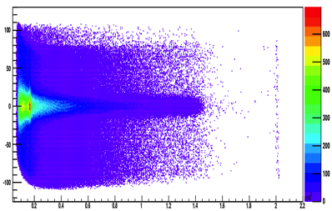
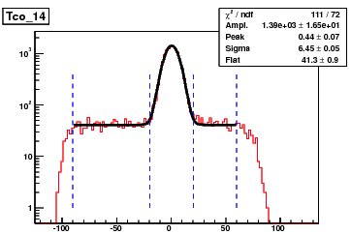
Subtraction of Accidental Events
TDC v. Energy (CFD corrected)
200ns
E_{γ}
Energy Bin Accidental Subtraction
Positrons per energy bin
Background subtraction

Slide 23
Positron Asymmetry: 6.3MeV/c
Positron asymmetry is determined for each energy bin following cut on 511keV annihilation signal and with accidental background subtraction. This is a recent step in the analysis & yielding our first precision energy dependent asymmetry for positrons.
Set 1 (Initial Run)
Set 2 (Improved Shielding)
Set1 + Set2
Positron polarization will be computed by this method using a simulated analyzing power, but only once the GEANT4 model is benchmarked to the electron calibration.
Until our GEANT4 simulation is more developed a less precise preliminary estimate of the positron polarization be made by directly using the measured electron analyzing power

Slide 24
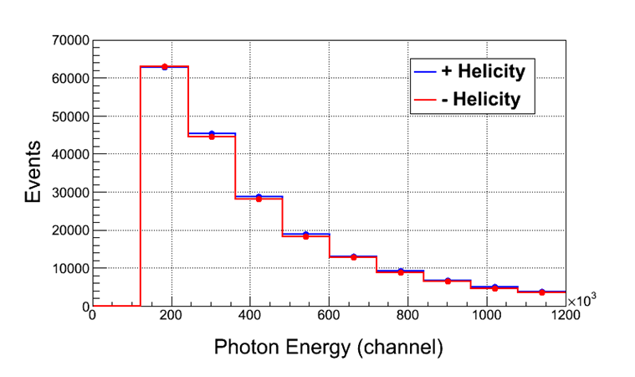
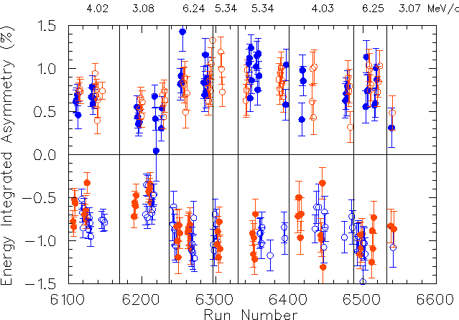
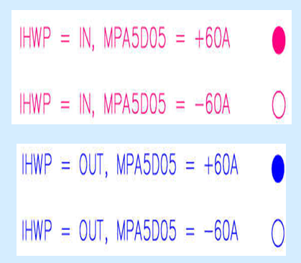
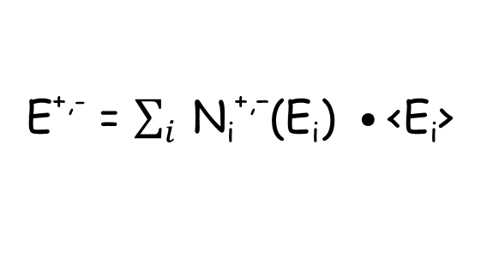
Positron Asymmetry – Energy Integrated
In this way, asymmetries may be formed for e⁺ asymmetries: 3.1-6.2 MeV/c
E^{+,-} = $\sum_{i}{ \text{N}\text{i}\text{+,−}\text{(}\text{Ei}\text{) }•\text{<}\text{Ei}\text{> }}$

Slide 25
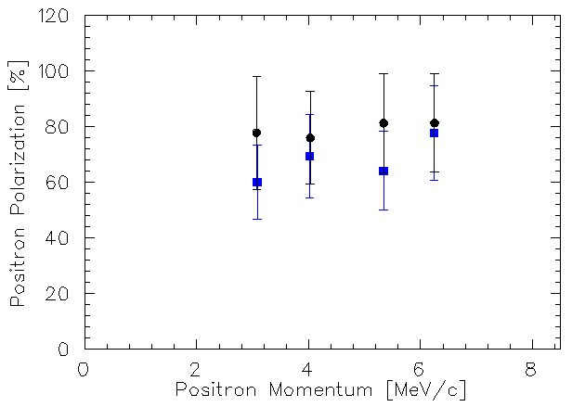
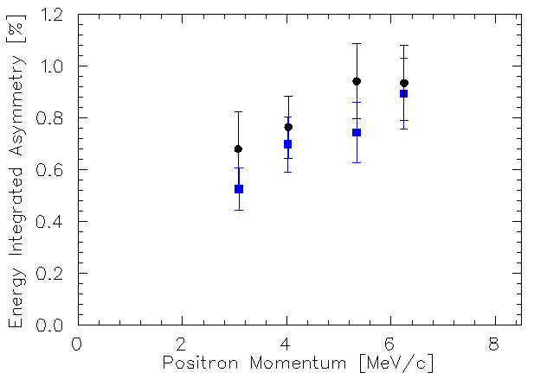
Positron Polarization – Energy Integrated
Using the measured electron analyzing power (A_{e-}), the target polarization (P_{T}) and « estimating » for e+ to e- analyzing power ratio C(E) ~ 1.1-1.4 (*)
Positron asymmetry significantly non-zero, increases with momentum and reduction of background (which may have analyzing power itself).
P_{e+} = A_{T}^{e+} / [ A_{e-} ⋅ C(E) ⋅ P_{T} ]
Set 1 (Initial Run)
Set 2 (Improved Shielding)
Set 1 (Initial Run)
Set 2 (Improved Shielding)
(Preliminary)
Electron
Beam
Polarization
(*) G. Alexander et al., NIMA 610 (2009) 451-487

Slide 26
Summary & Plans
PEPPo experiment completed successfully in Summer 2012
Data analysis and calibration results progressing well
electron beam energy and polarization
analyzing magnet target polarization
electron calibration asymmetries nearly complete
positron asymmetries recently started
Much to do on the modeling and simulation front
GEANT4 model polarimeter, integrating collection system
Benchmarking simulations to experiment
Preliminary results promising for new polarized positron source option
transfer of polarization from e- to e+ demonstrated
polarization >50% appears reasonable to expect
Aiming to finish analyses and publish results by Summer 2014

Slide 27
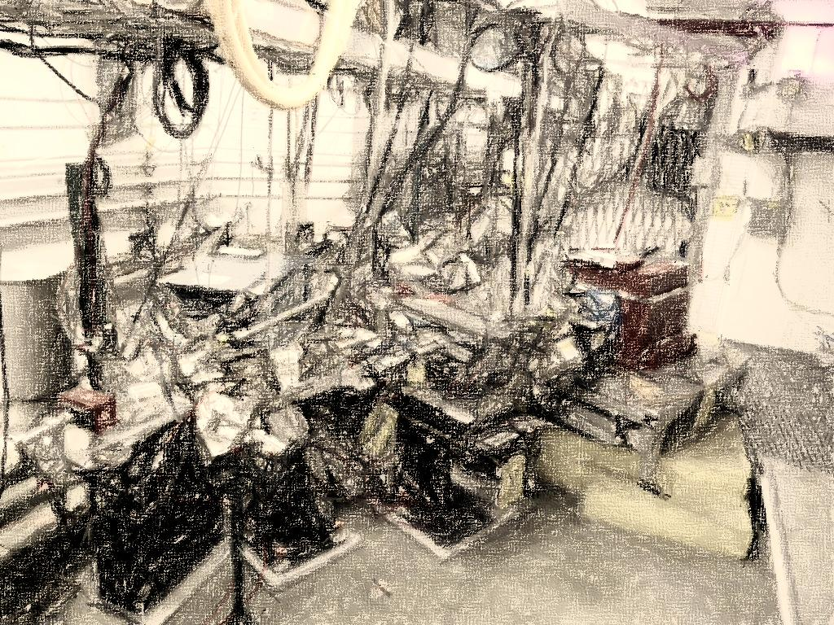
PEPPo Collaboration
P. Aderley¹, A. Adeyemi⁴, P. Aguilera¹, M. Ali, H. Areti¹, M. Baylac², J. Benesch¹,
G. Bosson², B. Cade¹, A. Camsonne¹, L. Cardman¹, J. Clark¹, P. Cole⁵, S. Covert¹,
C. Cuevas¹, O. Dadoun³, D. Dale⁵, J. Dumas^{1,2}, E. Fanchini², T. Forest⁵, E. Forman¹,
Freyberger¹, E. Froidefond², S. Golge⁶, J. Grames¹, P. Guèye⁴, J. Hansknecht¹,
P. Harrell¹, J. Hoskins⁸, C. Hyde⁷, R. Kazimi¹, Y. Kim^{1,5}, D. Machie¹, K. Mahoney¹,
R. Mammei¹, M. Marton², J. McCarter⁹, M. McCaughan¹, M. McHugh¹⁰, D. McNulty⁵, T. Michaelides¹, R. Michaels¹, C. Muñoz Camacho¹¹, J.-F. Muraz², K. Myers¹²,
Opper¹⁰, M. Poelker¹, J.-S. Réal², L. Richardson¹, S. Setiniyazi⁵, M. Stutzman¹,
R. Suleiman¹, C. Tennant¹, C.-Y. Tsai¹³, D. Turner¹, A. Variola³, E. Voutier², Y. Wang¹, Y. Zhang¹²
¹ Jefferson Lab, Newport News, VA, US ² LPSC, Grenoble, France ³ LAL, Orsay, France
⁴ Hampton University, Hampton, VA, USA ⁵ Idaho State University & IAC, Pocatello, ID, USA
⁶ North Carolina University, Durham, NC, USA ⁷ Old Dominion University, Norfolk, VA, US
⁸ The College of William & Mary, Williamsburg, VA, USA ⁹ University of Virginia, Charlottesville, VA, USA ¹⁰ George Washington University, Washington, DC, USA ¹¹ IPN, Orsay, France
¹² Rutgers University, Piscataway, NJ, USA ¹³ Virginia Tech, Blacksburg, VA, USA
Many thanks for advice, equipment loan, and funding to
SLAC E-166 Collaboration
International Linear Collider Project
Jefferson Science Association Initiatives Award

Slide 28
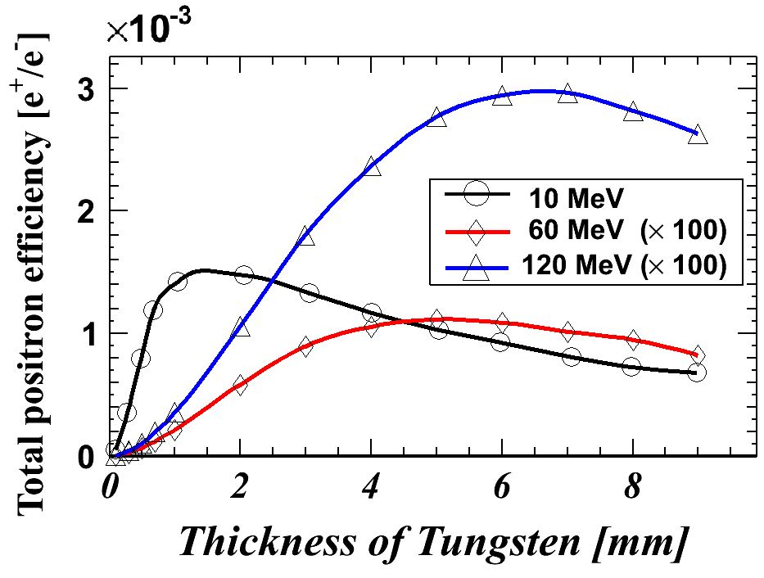
CEBAF Energy Compatibilities
CEBAF Pre-Injector
(/100)
(/100)
CEBAF 6 GeV Injector
CEBAF 12 GeV Injector
Conversion efficiencies are low, but 100nA – 10μA sufficient for user requirements
Corresponding milliamp electron beams are challenging, yet possible (more later).

Slide 29
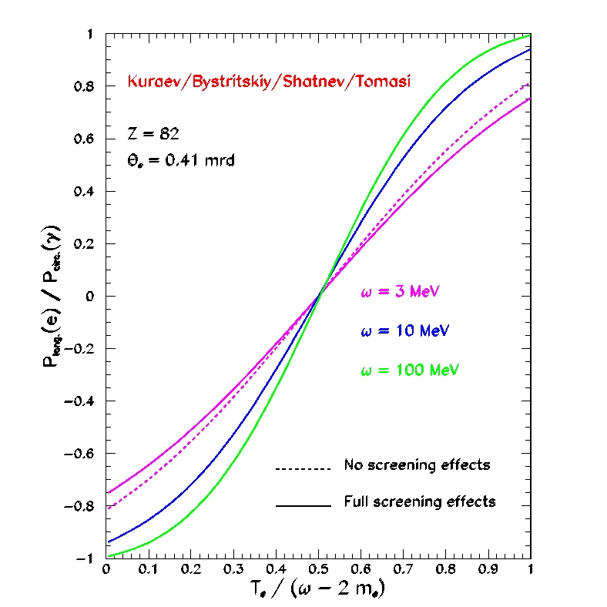
Polarization Transfer in Bremsstrahlung and Pair Creation
New PEPPo Motivated Calculations
  E.A. Kuraev, Y.M. Bystritskiy, M. Shatnev, E. Tomasi-Gustafsson, PRC 81 (2010) 055208
  Address atomic screening and electron mass
Polarization Transfer in Bremsstrahlung and Pair Creation (like that in Geant4)
  H. Olsen, L. Maximon, PR 114 (1959) 887
  Results for low energies (<10MeV) produce unphysical results, particularly in pair creation
BREMSSTRAHLUNG
PAIR CREATION
P_{circ}(γ) / P_{z} (e⁻)
P_{z} (e⁺) / P_{circ} (γ)
E_{γ} / T_{e-}
T_{e+} / (E_{γ} – 2m_{e+})

Slide 30

Positron Source Concept at CEBAF
A. Freyberger at the Town Hall Meeting, JLab, 2011
I = 300 nA
P_{e+} = 75%
δp/p = 10⁻²
ε_{x} = 1.6 mm.mrad
ε_{y} = 1.7 mm.mrad
S. Golge, PhD Thesis, 2010 (ODU/JLab)
1mA

Slide 31


Systematic Study of Compton Asymmetry (raw)
R_{y}
4π spin rotator determines
e⁻ polarization orientation
R_{z}
R_{x}
(0, 0, P)
(P, 0, 0)
(0, P, 0)
Fast reversal of electron beam polarization at 30 Hz through experiment.
Slow systematic reversal of electron polarization with optical wave-plate (source) and target polarization (Compton).
Orient polarization in x,y,z direction using 4π spin rotator.
Reverse beam helicity
Reverse magnet polarity
P ~ 85%

Slide 32

Comparison of Geant4 e-/e+ energy dependent A.P.
positron
electron

Slide 33



Final Installation June 2012
The PEPPo production targets are mounted in a ladder with 3 different thicknesses of tungsten and a viewer. It is water cooled to allow for maximum beam currents.

