Slide 1
Ion Sources with Muons, Inc
ICIS 2013.
Improving efficiency of negative ion production in ion source with saddle antenna
V. Dudnikov^{1,b)}, R. Johnson¹, S. Murrey ², T. Pinnisi ², C. Piller ², M. Santana ²,. M.Stockli ², R. Welton ², C. Johnson³, M. Turvey⁴
Extraction of negative ions from a saddle antenna radio-frequency surface plasma source (SA RF SPS) is considered. The efficiency of positive ion generation in plasma has been improved up to ~0.2 A/cm² per 1 kW (~40 times). For cesiation was used a heating of the cesium chromate cartridges. A small oven for cesium compounds and alloys decomposition by heating was developed and tested. After cesiation a current of negative ions to the collector was increased from ~1 mA to 10 mA with RF power ~ 1.5 kW in the plasma and longitudinal magnetic field B_{l}~250 Gauss. A specific efficiency of H⁻ production was increased up to ~ 20 mA/ cm² kW from previous ~2.5 mA/ cm² kW.

Slide 2
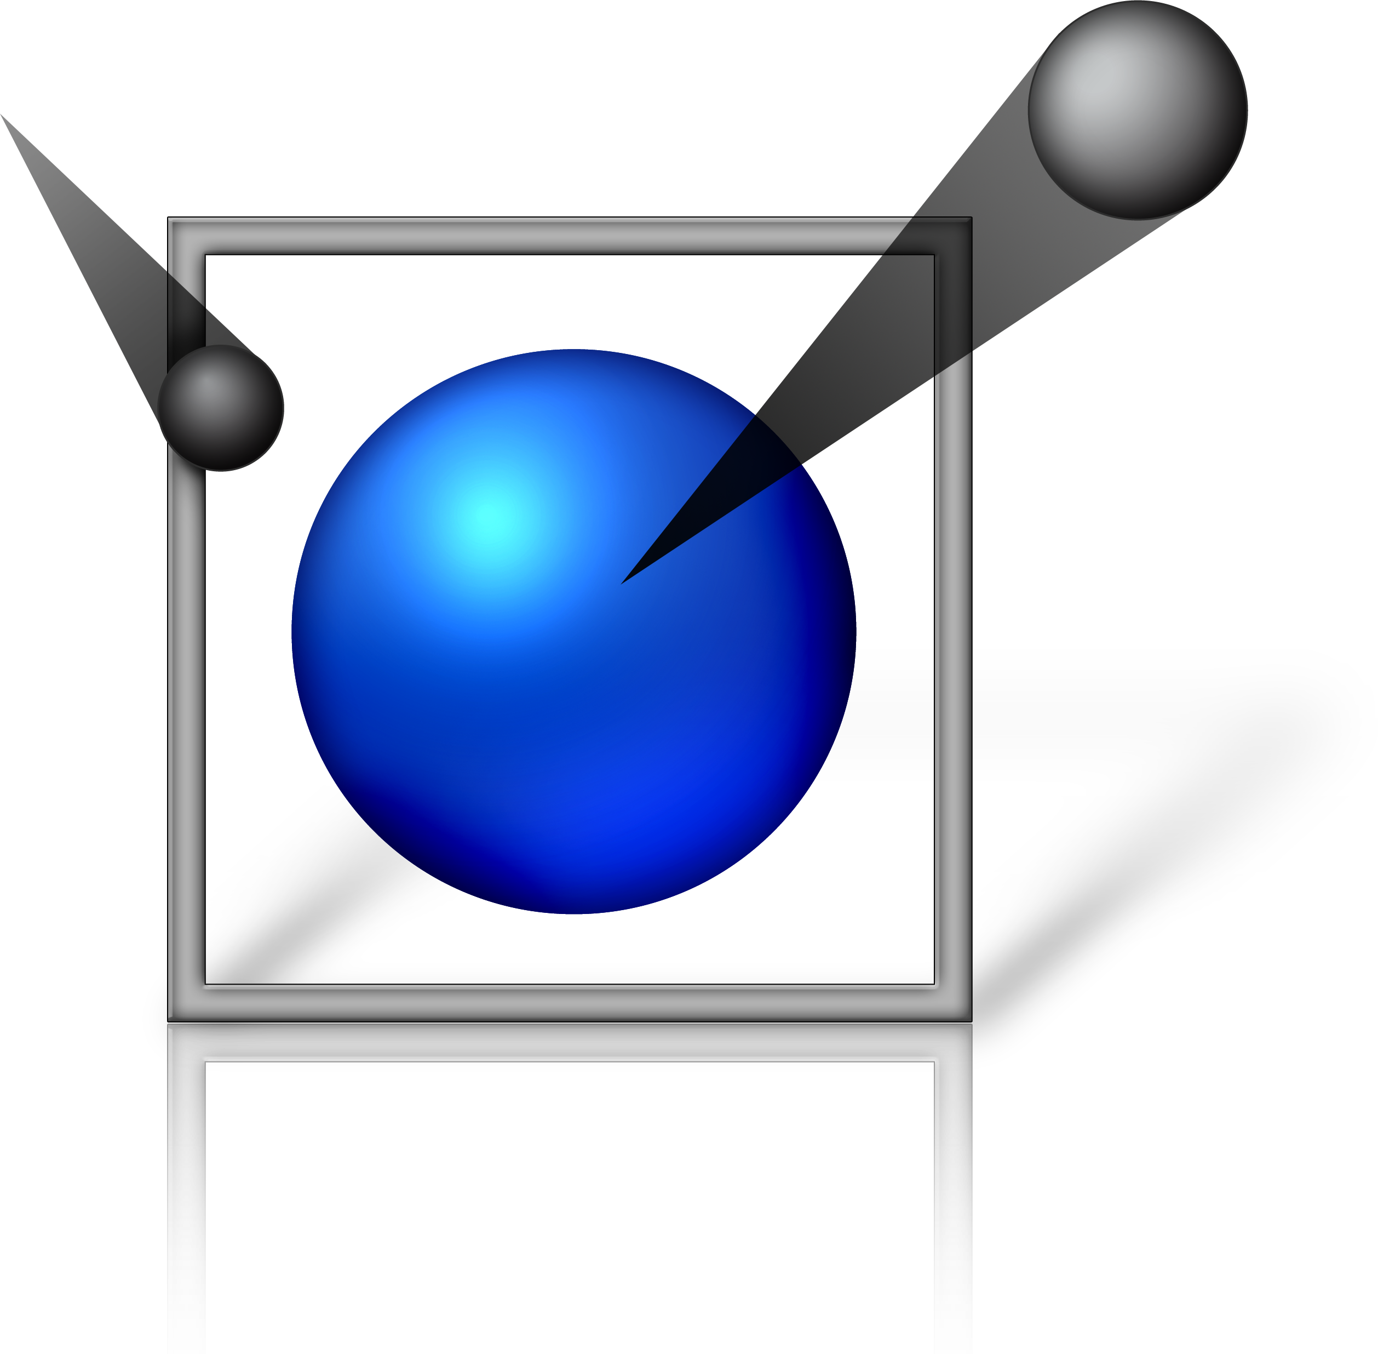
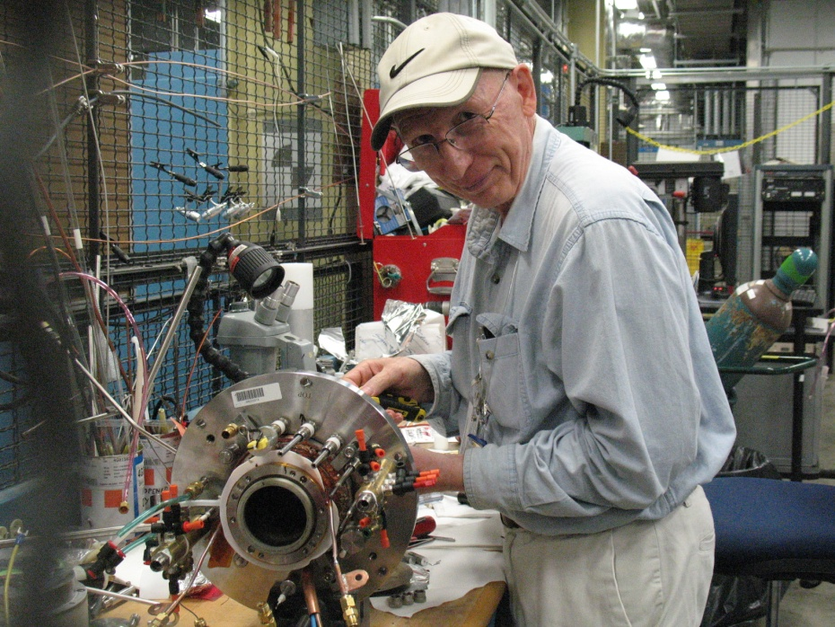
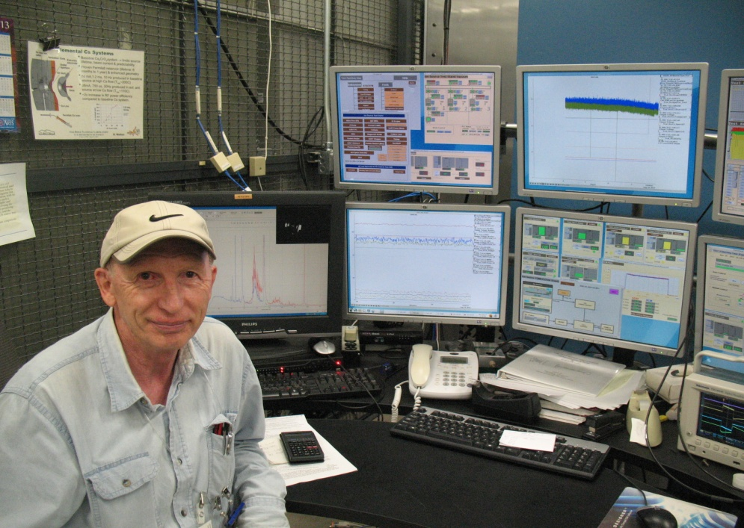
SNS congratulates Vadim Dudnikov!!! Happy Anniversary!!!
Saddle type antenna proposal.
Source efficiency improves 10 time or more.
External antenna proposal of 2002 finally
is operational and shows great results.
Vadim Georgievich, thanks a lot for your great contributions to the SNS success, and for your seminal contributions to the accelerator field as well!
We wish you good luck in your future work (you only 70☺)!!!
Sasha Aleksandrov, Slava Danilov, and the SNS team
Saddle type antenna proposal. Source efficiency improves 10 time or more!

Slide 3
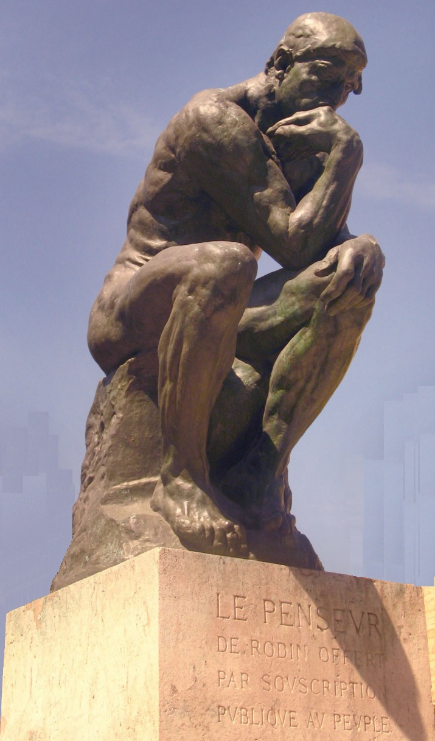
Дорогой Вадим!
Твои друзья и коллеги из Фермилаба сердечно поздравляют тебя с юбилеем! Мы уверены, что еще много лет ты будешь радовать нас своими достижениями в области создания источников отрицательных ионов и других разделов ускорительной физики!
V.G. Dudnikov
Г.Казакевич, В. Лебедев, С.Нагайцев, А.Шемякин, В.Шильцев, Ю.Эйдельман

Slide 4
From Dmitrii Toporkov, Novosibirsk
Дорогой Вадим Георгиевич!
Сердечно поздравляю с наступающим славным юбилеем,
70-летием со дня рождения.
Ваши с коллегами работы по созданию источников отрицательных ионов с плазменно-поверхностной ионизацией позволили в короткий срок повысить ток таких источников более чем в 10 тысяч раз. Практически во всех ускорительных центрах мира работают источники, в основе работы которых лежит Ваше открытие по применению цезия для увеличения выхода отрицательных ионов. Вы полны сил и готовитесь к новым штурмам.
Успеха! Желаю Вам крепкого здоровья, бодрого настроения, удачи в исследованиях.
Дмитрий Топорков.
Notes:
From Dmitrii Toporkov

Slide 5
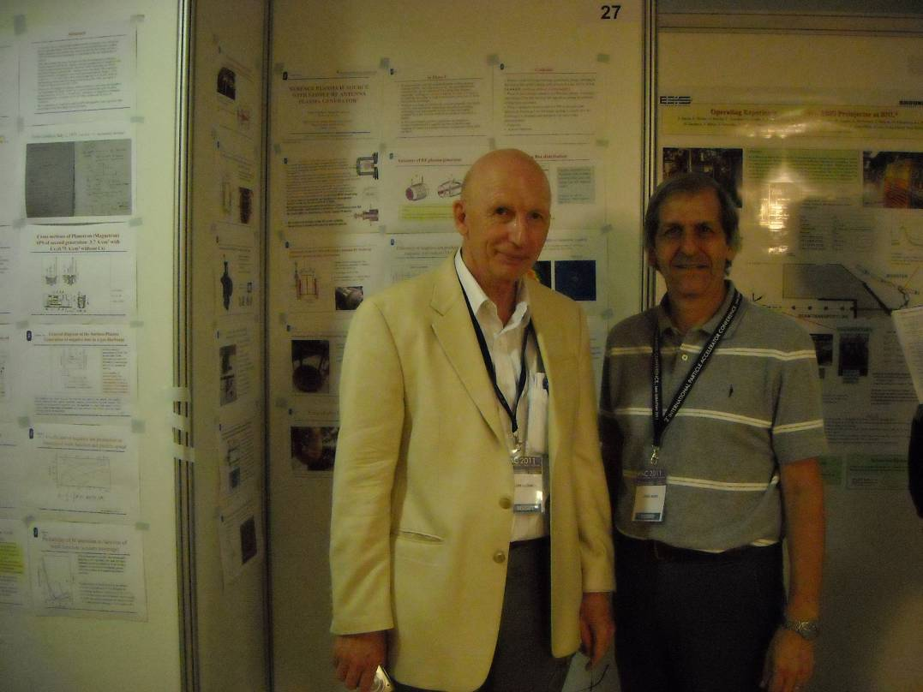
Vadim I was definitely not disappointed – his experience and knowledge of the entire field of ion sources (including polarized ion sources!) was amazing.
Fortunately, I was able to interact with Vadim much more frequently in the 1990's and beyond, and his participation at our regularly held International Symposium on the Production and Neutralization of Negative Ions and Beams was great for the program. A little more recently, we had the even greater experience of having Vadim work with our ion source group at Brookhaven for 1-2 months as a Visiting Scientist. It was fantastically stimulating, for me as well as for our engineers and technicians, to be working alongside Vadim – as he contributed to our work on polarized H-minus, surface H-minus, and volume H-minus sources. Ideas just flow from him, and it is quite challenging to try and keep up. I still have a folder several inches thick, containing all sorts of references that he gave me related to all the ideas he was coming up with during that brief time. It was then that I came to appreciate the breadth of his knowledge – physics, chemistry, materials science, electronics, industrial applications, etc. – all showing why he is such a great ion source physicist.
Jim Alessi
Preinjector Group Leader
Collider-Accelerator Department
Dear Slava,
It is very exciting that you will be honoring Vadim on his 70th anniversary. I had hoped to find some old pictures of Vadim to share with you, but after coming up empty, I now appreciate more the value of digital photos. Although I couldn't find it, I can remember having a picture of Vadim at my house, with my young little kids smiling as they stood next to a famous Russian scientist!
Unfortunately, because of difficulties with Russian scientists visiting the US in the old days, I had probably been working in H-minus ions sources for more than 10 years before I first got to meet Vadim. That was really something that I had looked forward to, because he was truly a pioneer in the field, and his discovery of cesium catalysis was revolutionary - both for accelerator laboratories and for fusion applications of H-minus sources. Of course, upon meeting
With Jim Alessi
Notes:
With Jim Alessi

