Slide 1

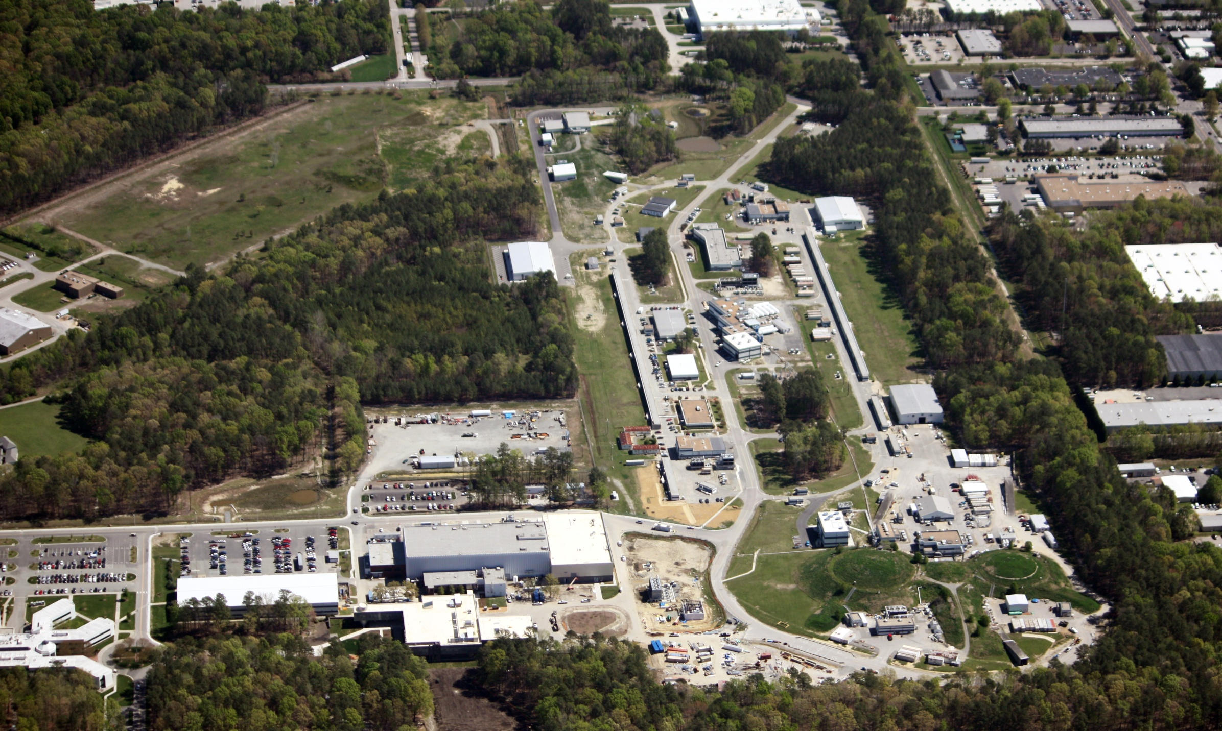
The 12 GeV Physics Program
at Jefferson Lab
R. D. McKeown
Jefferson Lab
College of William and Mary
PTSP 2013 – Charlottesville, VA
September 9, 2013

Slide 2
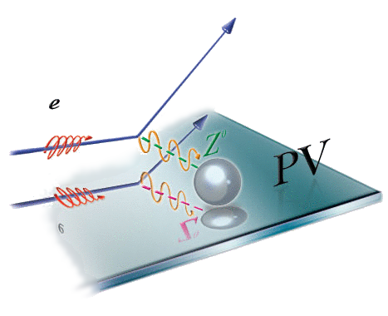
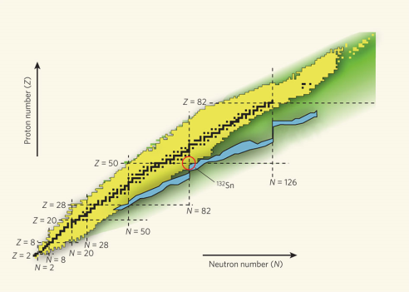
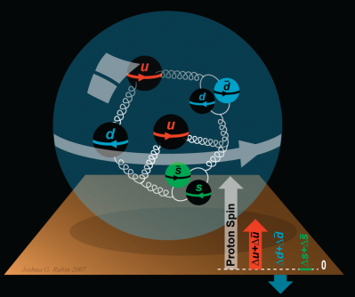
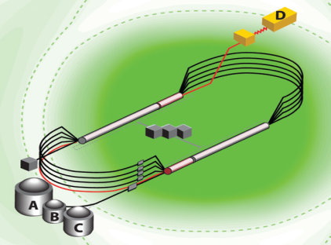

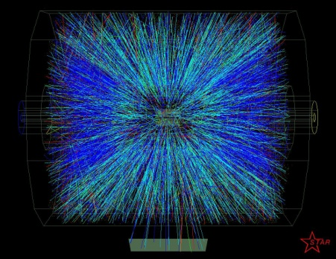
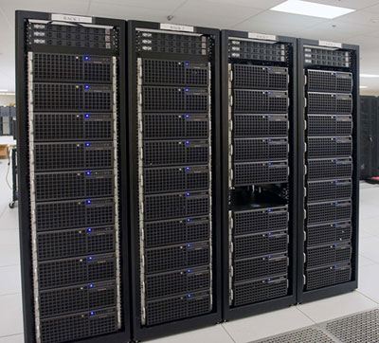
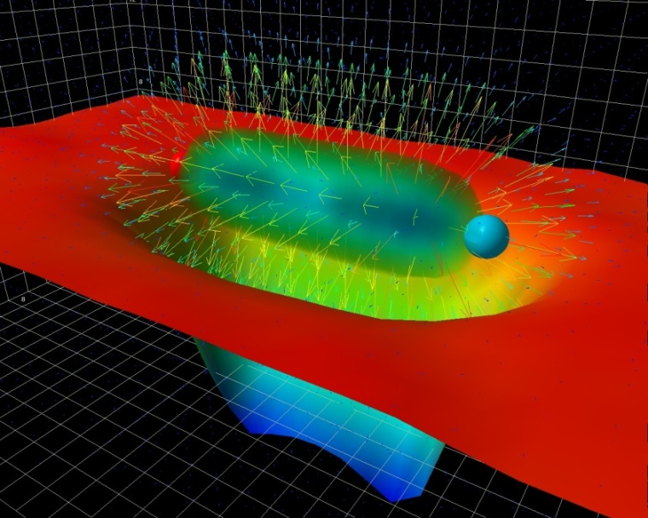
A Laboratory for Nuclear Science
Nuclear Structure
Structure of Hadrons
Fundamental
Forces & Symmetries
Accelerator S&T
Medical Imaging
Quark Confinement
Hadrons from Quarks
Theory and Computation

Slide 3
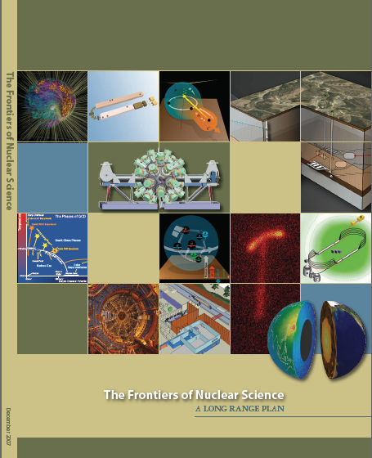
12 GeV Upgrade Project
Upgrade is designed to build on existing facility: vast majority of accelerator and experimental equipment have continued use
New Hall
Upgrade arc magnets
and supplies
Add 5 cryomodules
20 cryomodules
CHL upgrade
Maintain capability to deliver lower pass beam energies: 2.2, 4.4, 6.6….
Add arc
20 cryomodules
The completion of the
12 GeV Upgrade of CEBAF was ranked the highest priority in the 2007 NSAC Long Range Plan.
Add 5 cryomodules
Scope of the project includes:
Doubling the accelerator beam energy
New experimental Hall and beamline
Upgrades to existing Experimental Halls
Enhanced capabilities
in existing Halls

Slide 4
12 GeV Science Program
The physical origins of quark confinement (GlueX, meson and baryon spectroscopy)
The spin and flavor structure of the proton and neutron (PDF’s, GPD’s, TMD’s…)
The quark structure of nuclei
Probe potential new physics through high precision tests of the Standard Model
Defining the Science Program:
  Ten Reviews: Program Advisory Committees (PAC) - 2006 through 2013
  Results: 59 experiments approved; 14 conditionally approved
  White paper for NSAC subcommittee (in progress)
Experiments for 4 Halls approved for
more than seven years of operation beginning in FY15.

Slide 5
12 GeV Approved Experiments by Physics Topics
Topic | Hall A | Hall B | Hall C | Hall D | Other | Total
The Hadron spectra as probes of QCD (GluEx and heavy baryon and meson spectroscopy) |  | 1 |  | 2 |  | 3
The transverse structure of the hadrons (Elastic and transition Form Factors) | 4 | 3 | 2 | 1 |  | 10
The longitudinal structure of the hadrons (Unpolarized and polarized parton distribution functions) | 2 | 2 | 6 |  |  | 10
The 3D structure of the hadrons (Generalized Parton Distributions and Transverse Momentum Distributions) | 5 | 10 | 4 |  |  | 19
Hadrons and cold nuclear matter (Medium modification of the nucleons, quark hadronization, N-N correlations, hypernuclear spectroscopy, few-body experiments) | 4 | 2 | 6 |  | 1 | 13
Low-energy tests of the Standard Model and Fundamental Symmetries | 2 |  |  | 1 | 1 | 4
TOTAL | 17 | 18 | 18 | 4 | 2 | 59

Slide 6
12 GeV Approved Experiments by PAC Days
Topic | Hall A | Hall B | Hall C | Hall D | Other | Total
The Hadron spectra as probes of QCD (GluEx and heavy baryon and meson spectroscopy) |  | 119 |  | 320 |  | 439
The transverse structure of the hadrons (Elastic and transition Form Factors) | 144 | 85 | 102 | 25 |  | 356
The longitudinal structure of the hadrons (Unpolarized and polarized parton distribution functions) | 65 | 120 | 165 |  |  | 350
The 3D structure of the hadrons (Generalized Parton Distributions and Transverse Momentum Distributions) | 409 | 982 | 161 |  |  | 1552
Hadrons and cold nuclear matter (Medium modification of the nucleons, quark hadronization, N-N correlations, hypernuclear spectroscopy, few-body experiments) | 159 | 120 | 179 |  | 14 | 472
Low-energy tests of the Standard Model and Fundamental Symmetries | 513 |  |  | 79 | 60 | 652
TOTAL | 1290 | 1426 | 607 | 424 | 74 | 3821
More than 7 years of approved experiments

Slide 7
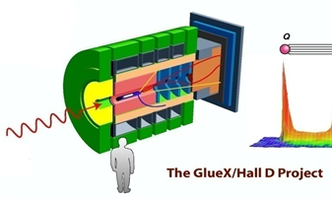
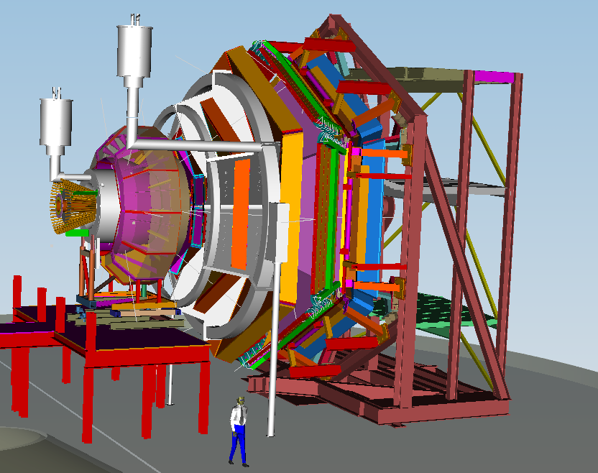
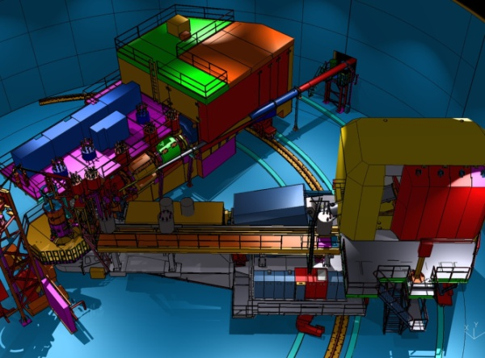
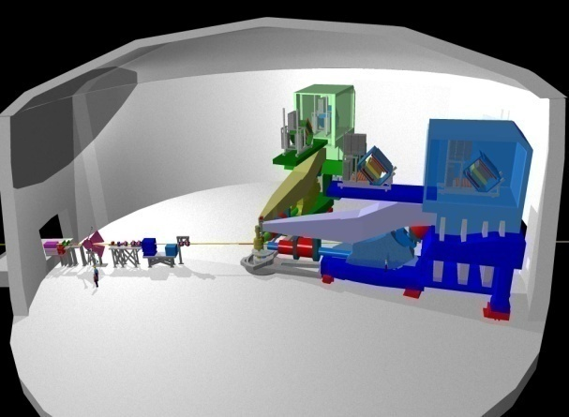
12 GeV Scientific Capabilities
Hall D – exploring origin of confinement by studying exotic mesons
Hall B – understanding nucleon structure via generalized parton distributions
Hall C – precision determination of valence quark properties in nucleons and nuclei
Hall A –form factors, future new experiments (e.g., SoLID and MOLLER)
Notes:
7
Note BSM not included in project

Slide 8
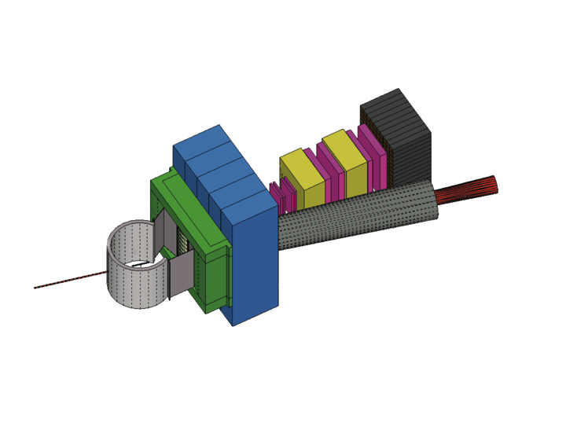
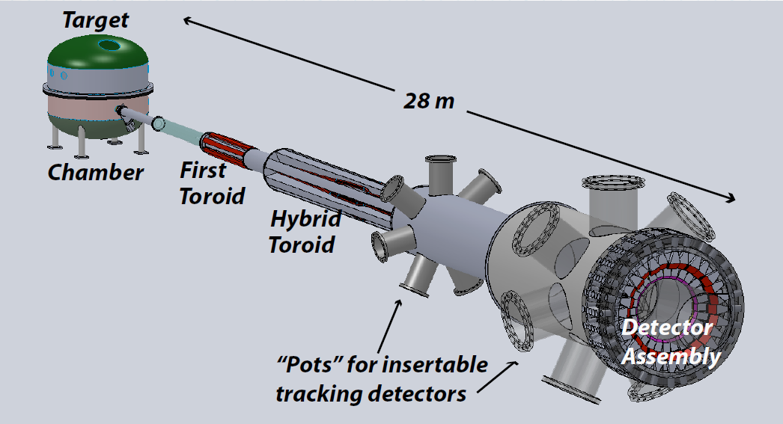
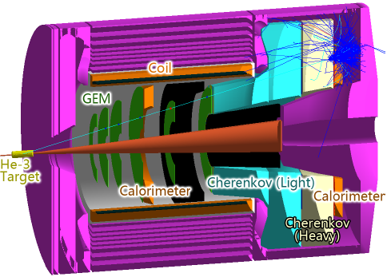
Beyond 12 GeV Upgrade
Super BigBite Spectrometer
(FY13-16 construction)
- high Q² form factors
- SIDIS
MOLLER experiment
(MIE – FY15-18?)
- Standard Model Test
SoLID
Chinese collaboration
CLEO Solenoid 
Enhancements of equipment in B, C, D
(Leverage external investments)

Slide 9
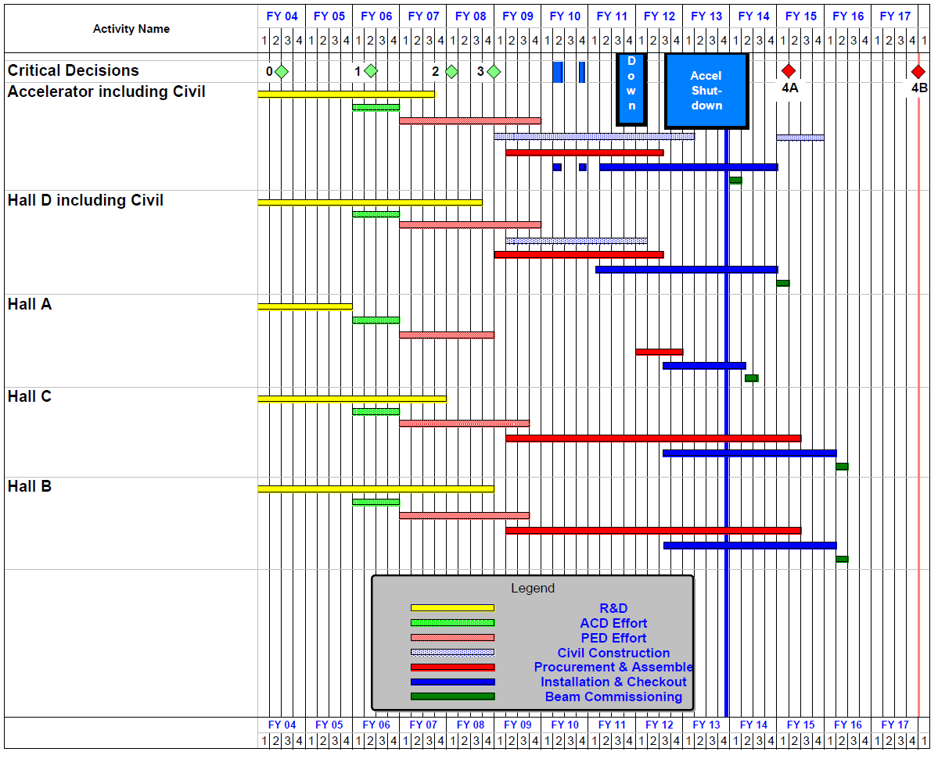
12 GeV Upgrade Project Schedule
FY12: reduction of $16M
FY13: Pres Request – no restoration
    16-month installation
    May 2012 - Sept 2013
    Accelerator commissioning start Oct 2013
    Hall A commissioning start Feb 2014
    Hall D commissioning start
    Oct 2014
    Halls B & C commissioning start Jan/Feb 2016
    Project Completion September 2017
Re-baseline Approved
September 4, 2013

Slide 10
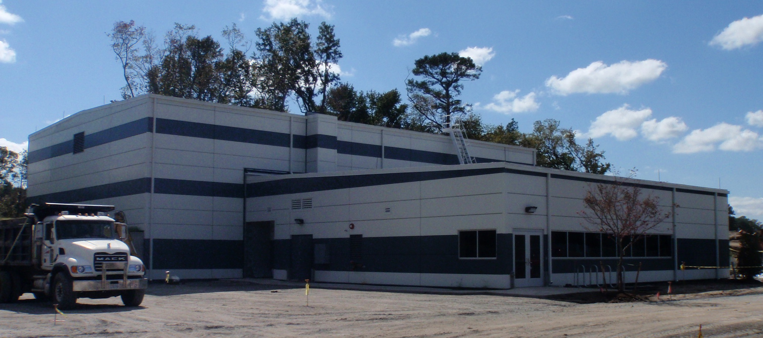
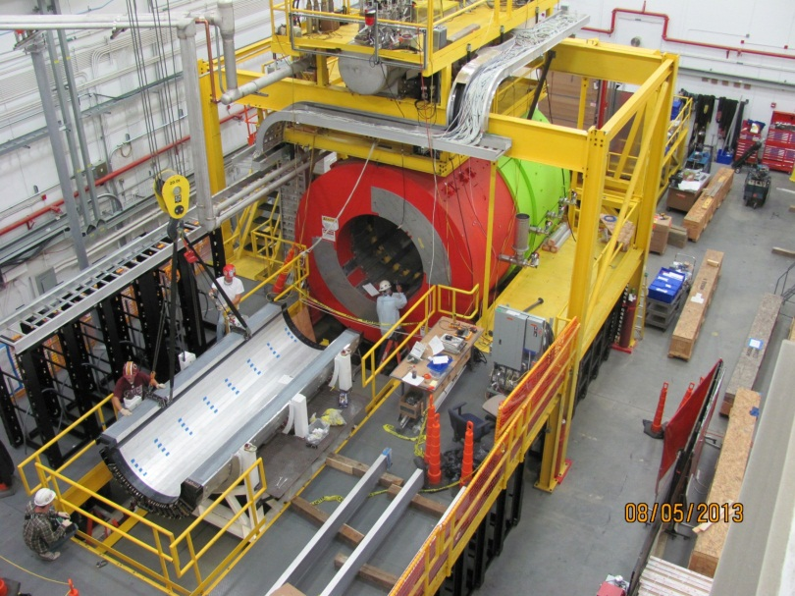
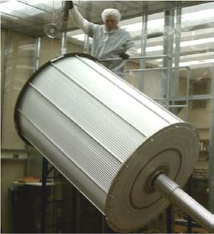
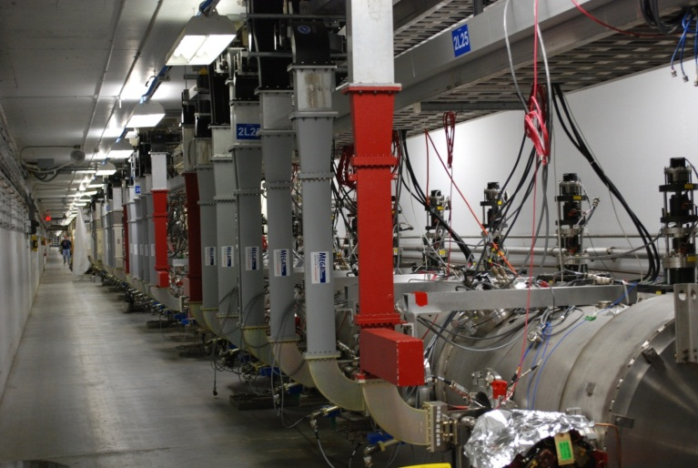
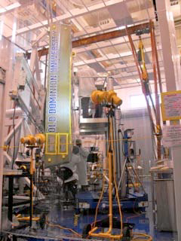
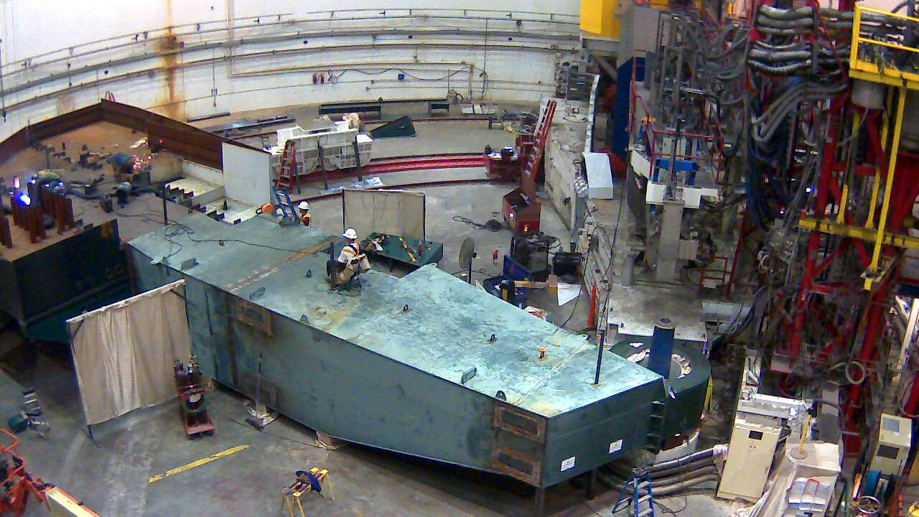
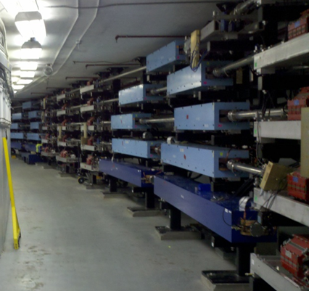
12 GeV Project Highlights
Hall D & Counting House
Hall D
Hall D Central Drift Chamber
12 GeV Cryomodules
Hall C
Arc Magnets
Hall B Drift Chamber

Slide 11
12 GeV JLab – The Potential
Opportunity to discover and study new exotic mesons to elucidate the mechanism of confinement.
Open a new landscape of nucleon tomography, with potential to identify the missing angular momentum.
Establish the quantitative foundation for the short-distance behavior in nuclei, underpinning the development of precision nuclear structure studies.
Provide stringent new tests of the standard model and extensions, complementing the information obtained at LHC.
Establish a firm basis for higher energy studies with a future Electron Ion Collider

Slide 12
Electron Ion Collider
NSAC 2007 Long-Range Plan:
“An Electron-Ion Collider (EIC) with polarized beams has been embraced by the U.S. nuclear science community as embodying the vision for reaching the next QCD frontier. EIC would provide unique capabilities for the study of QCD well beyond those available at existing facilities worldwide and complementary to those planned for the next generation of accelerators in Europe and Asia.”
Jefferson Lab and BNL developing facility designs
Joint community efforts to develop science case ◻ white paper (2013)

Slide 13
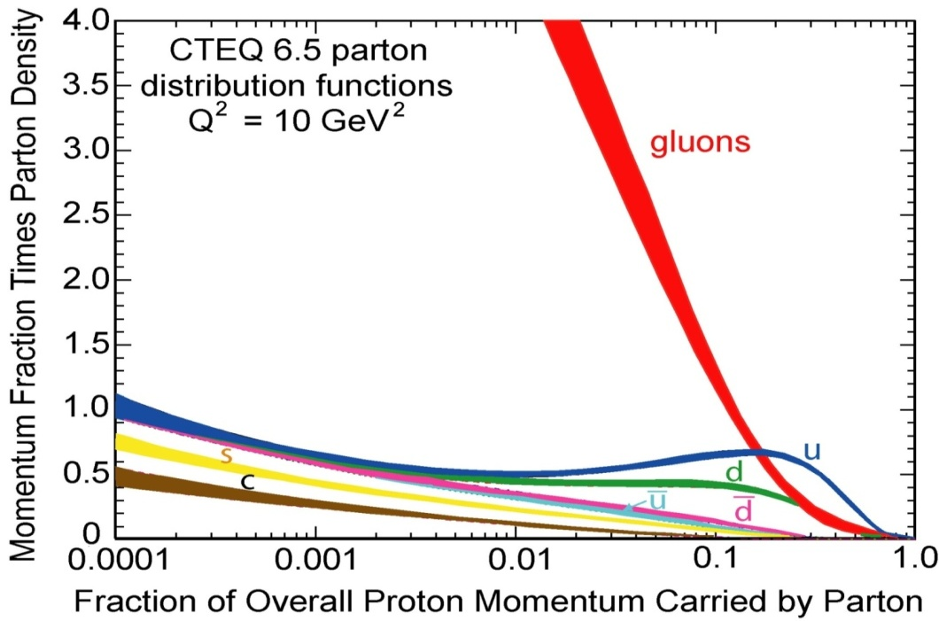
The Reach of EIC
High Luminosity
◻ 10³⁴cm⁻²s⁻¹
Low x regime
x ◻ 0.0001
High Polarization
◻ 70%
JLab
12
EIC
Discovery
Potential!
EMC/E665
HERMES

Slide 14

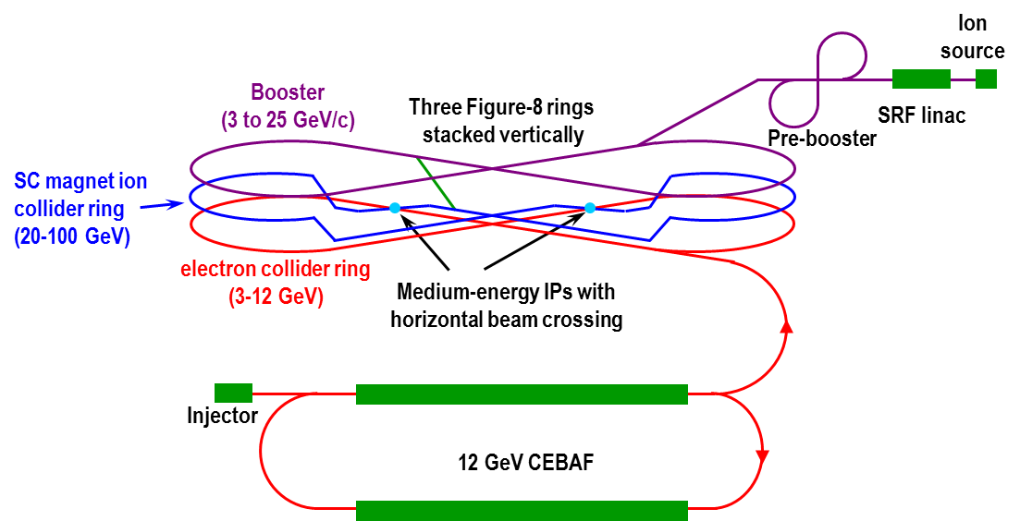
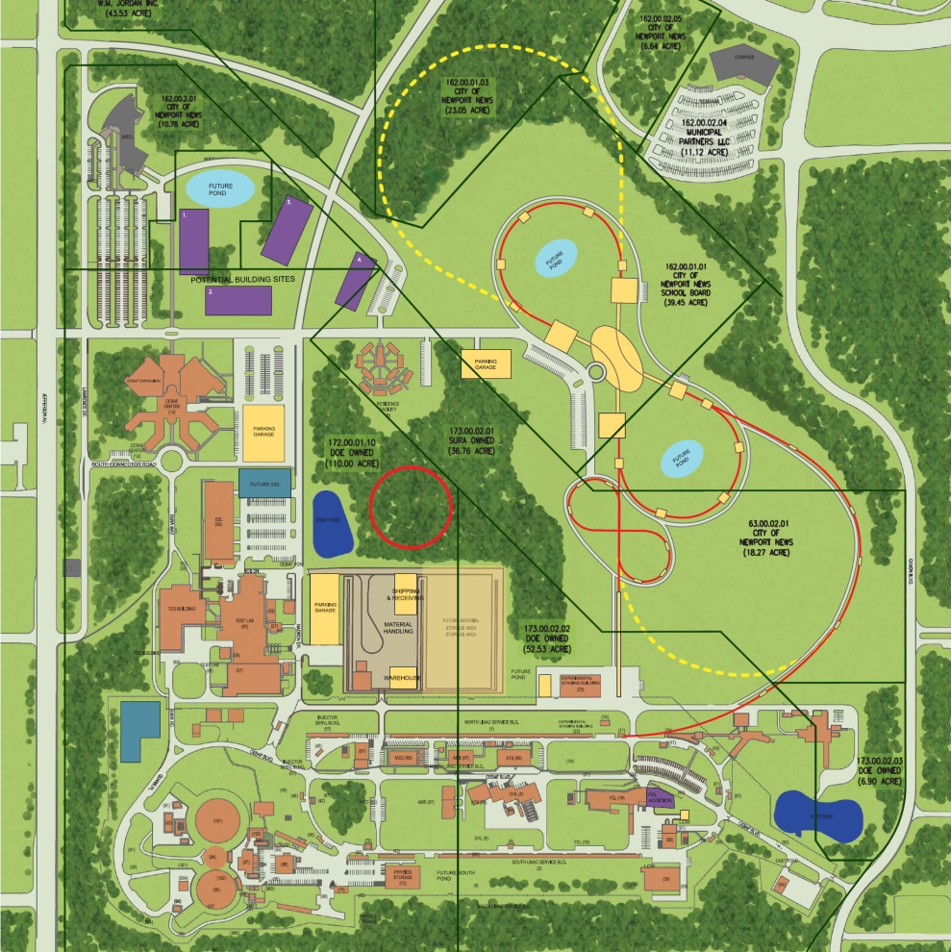
Medium Energy EIC@JLab
JLab Concept
Initial configuration (MEIC):
  3-11 GeV on 20-100 GeV ep/eA collider
  fully-polarized, longitudinal and transverse
  luminosity: up to few x 10³⁴ e-nucleons cm⁻² s⁻¹
    Upgradable to higher energies
    250 GeV protons + 20 GeV electrons

Slide 15
A Laboratory for Nuclear Science
The Jefferson Lab electron accelerator is a unique world-leading facility for nuclear physics research
12 GeV upgrade ensures at least a decade of excellent opportunities for discovery
– New vistas in QCD
– Growing program Beyond the Standard Model
– Additional equipment: SBS, MOLLER, SoLID
EIC moving forward:
– Strong science case, much builds on JLab 12 GeV program
– MEIC design well developed – time scale following 12 GeV program is “natural”

