Slide 1
DSMC simulations of polarized atomic beam sources including magnetic fields
September 13, 2013 | Martin Gaisser, Alexander Nass and Hans Ströher

Slide 2
PAX-Experiment based on Spin Filtering
Polarization build-up of a circulating particle beam
by interaction with a polarized gas target
Unpolarized anti-p beam
Polarized target

Slide 3
PAX-Experiment based on Spin Filtering
Polarization build-up of a circulating particle beam
by interaction with a polarized gas target
Polarized anti-p beam
Unpolarized anti-p beam
Polarized target

Slide 4
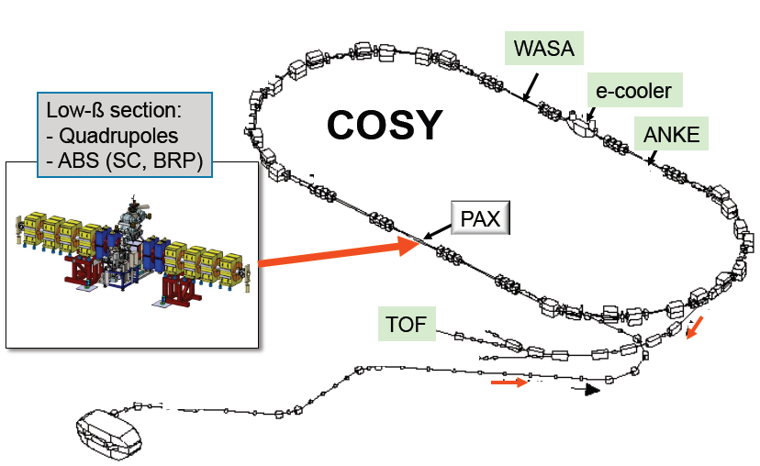
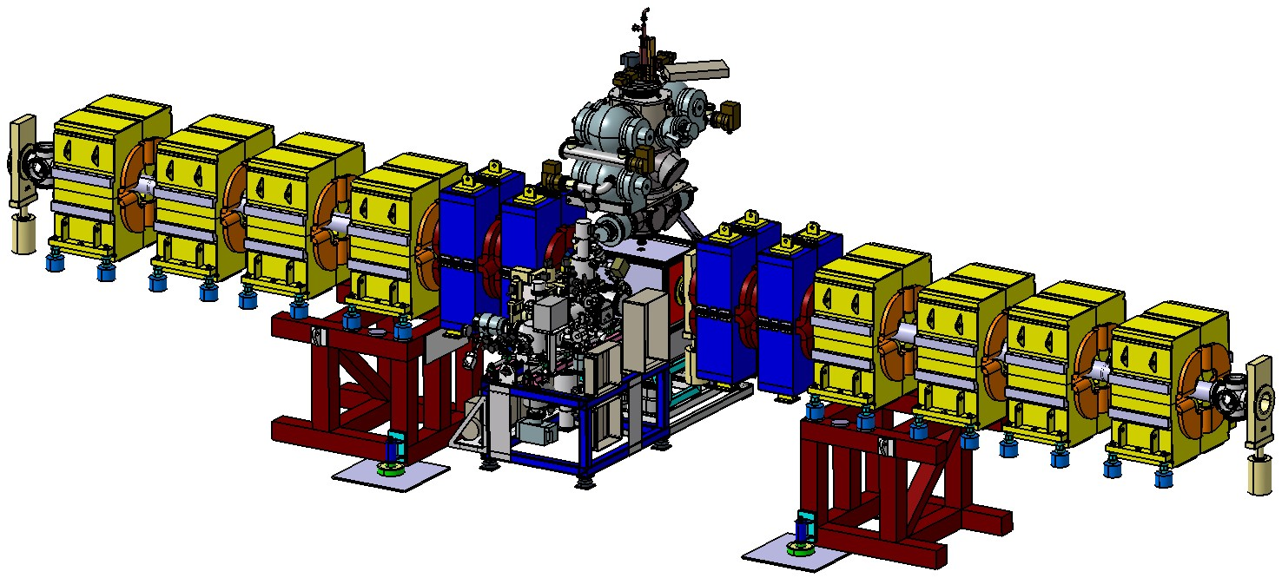
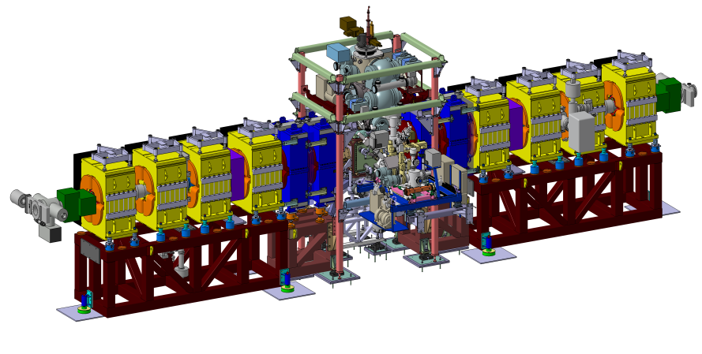
Spin Filtering at COSY
WASA
e-cooler
ANKE
PAX

Slide 5
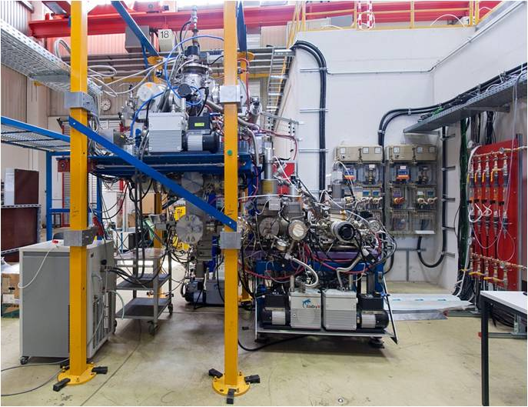
The polarized target
ABS
Breit-Rabi
polarimeter
Atomic beam source (ABS) produces a beam of polarized atoms injected into a storage cell
Breit-Rabi polarimeter analyzes a sample beam from that target cell → measurement of target polarization and molecular content

Slide 6
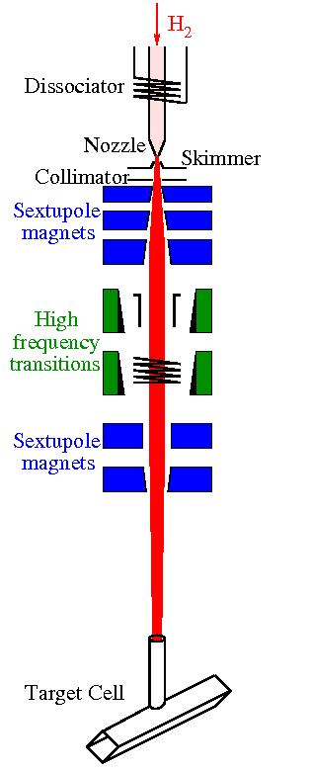
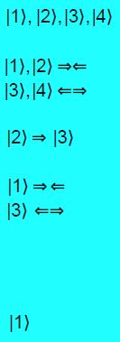
Principle of Atomic Beam Source
Dissociation of hydrogen molecules
Expansion of the atomic gas → supersonic beam
Formation of atomic beam using skimmer and collimator
Removal of atoms with electron spin -1/2 in sextupole system, prefocussing
Exchange of hyperfine state populations
Removal of atoms with electron spin -1/2 in sextupole system, focussing into the target cell

Slide 7
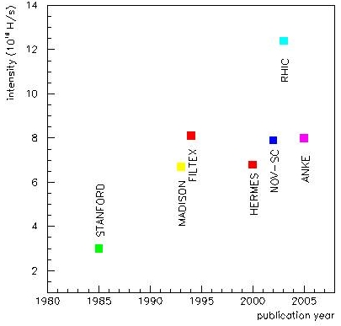
Motivation for Simulations
High intensities / densities and polarization of polarized atomic beams required
Modelling failed in the past because of multitude of processes involved, e.g. collisions in transition region between laminar and molecular flow, magnetic fields, high frequency transitions, recombination, spin exchange, …
Combination of all effects only possible with DSMC calculations
Final goal: Successful modelling of existing sources and
optimization algorithms for new sources

Slide 8
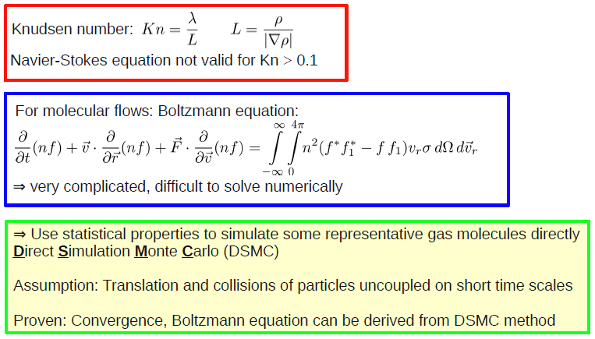
Are DSMC calculations suitable to simulate ABS?
Answer is yes!

Slide 9
DSMC Setup
Use of OpenFoam 1.7.1 and ParaView

Slide 10
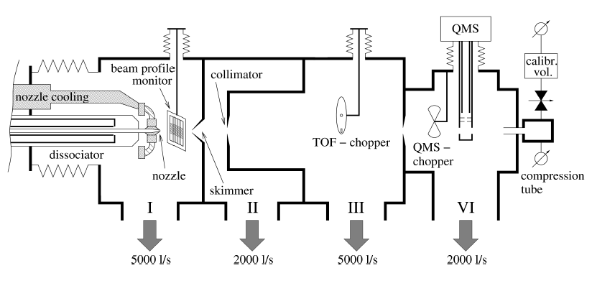
Experimental Setup for Measurements
Atomic beam teststand, equipped with devices to measure the
velocity and density distributions, the intensity of atomic beams,
as well as the atomic and molecular content

Slide 11
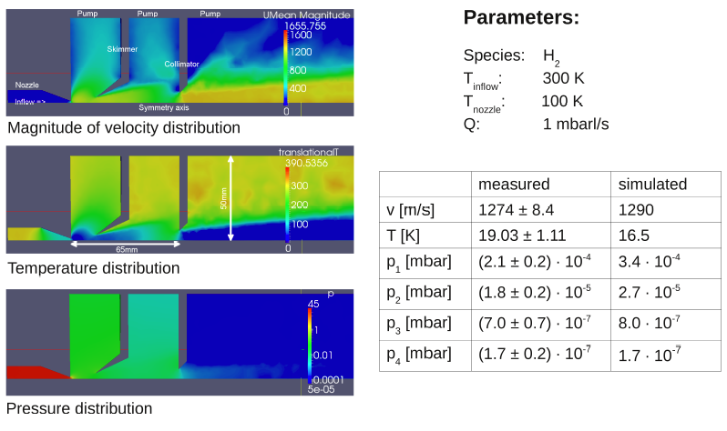
Results: Beam parameters and pressure distibution

Slide 12
Extensions to OpenFOAM 1.7.1
New binary collision model based on a Lennard-Jones potential
Particles are equipped with spin, e.g. creation of an array of hyperfine states
Generic interface for magnetic fields acting on the particles
Introduction of wall recombination of atoms to molecules
Calculation of spin exchange effects
Implementation of high frequency transitions
Calculation of wall collisions
Source development: Optimization algorithm

Slide 13
Binary collision models

Slide 14
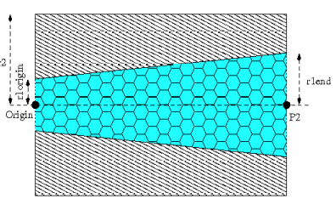
Implementation of magnetic fields

Slide 15
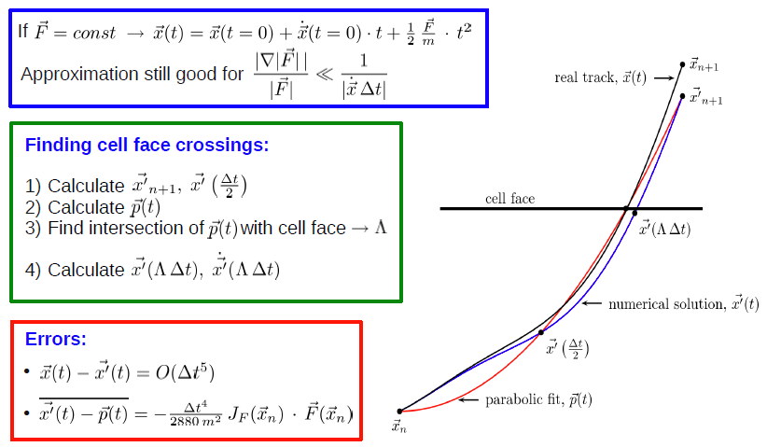
Solution: Parabolic fit
Good approximation if force gradients are small

Slide 16
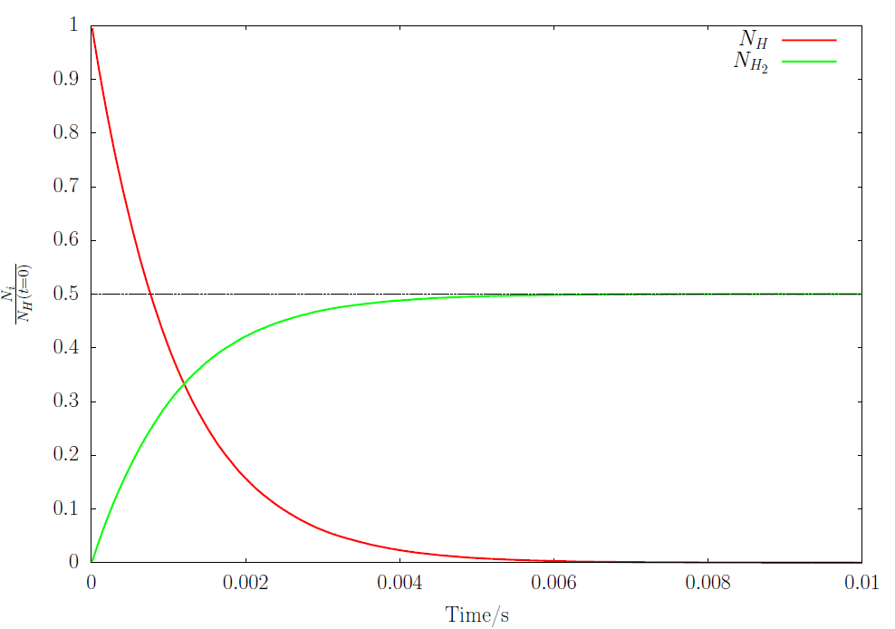
Results: Recombination
Particles in a box: Recombination on the wall with recombination probability of 5x10⁻³
(density: 5x10¹⁷)
$$\frac{Nt}{NH(t=0)}$$

Slide 17
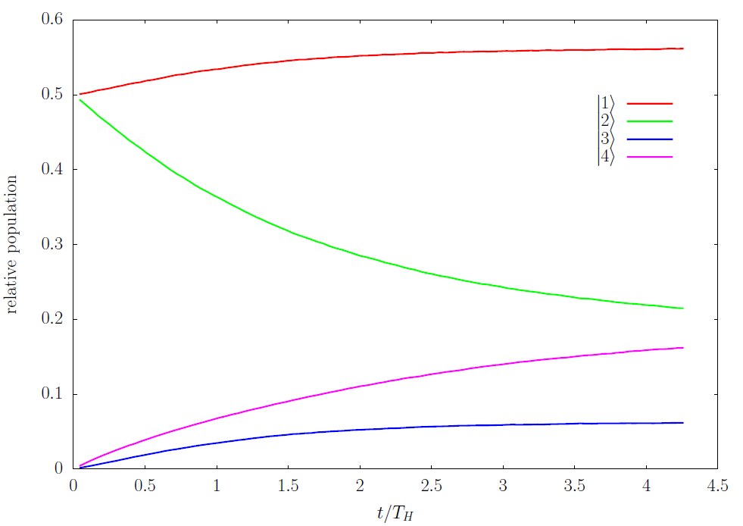
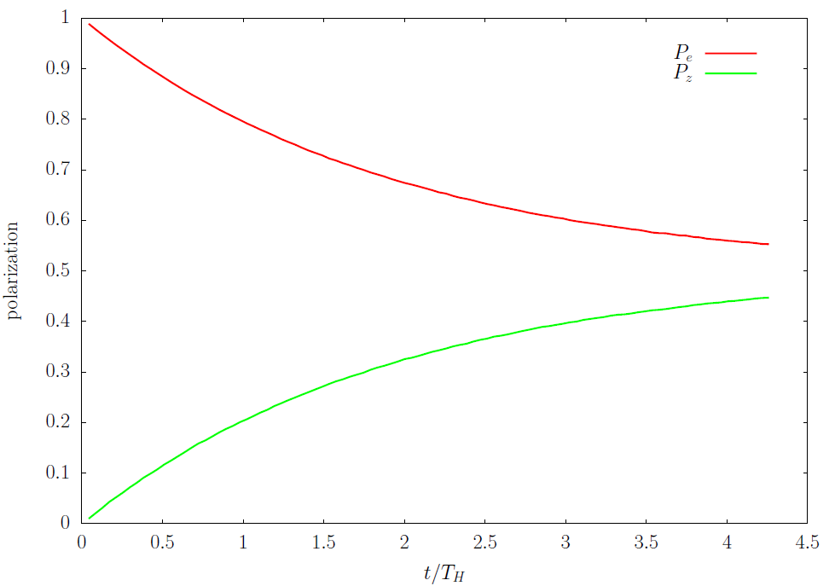
Results: Spin Exchange Collisions
Particles in a box: Spin exchange collisions leading to an equilibrium
of nuclear and electronic polarization
relative population
polarization
t/T_{H}
t/T_{H}
Results are comparable with publications, T_{H} – mean collision time

Slide 18
Results: High frequency transitions
Particles moving through high frequency transitions (left to right):
→ Change of occupation numbers and polarization

Slide 19
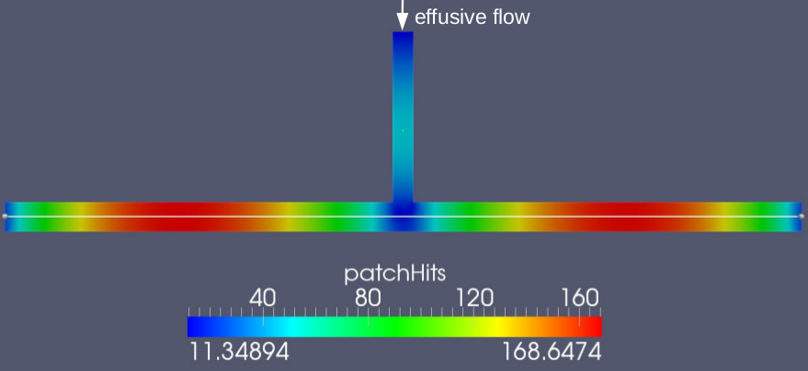
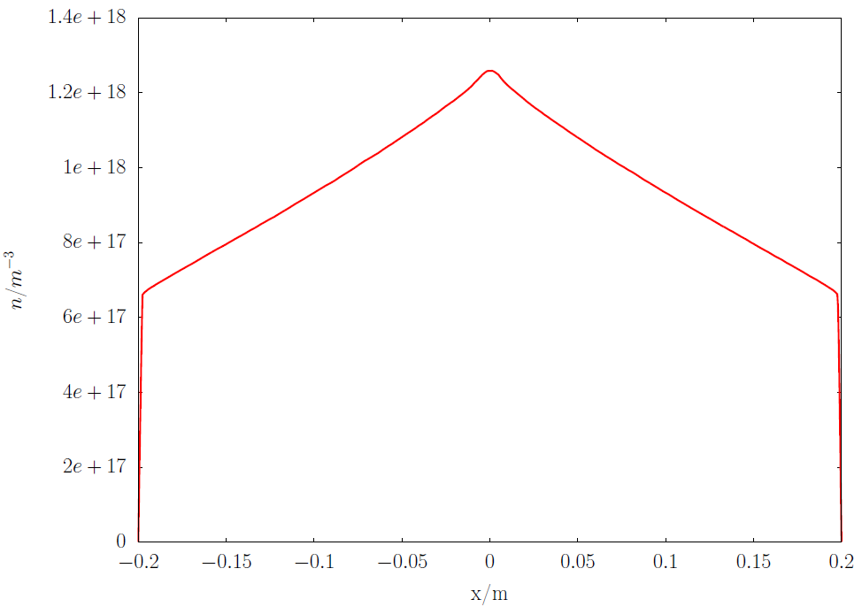
Results: Collision ages
Injected effusive flow : 3.2x10¹⁵ H/s
Maxwellian thermal model: Average collision age:
116.5 wall bounces
n/m⁻³
Collision age depends on wall reflection model, which depends on material
number density
x/m

Slide 20
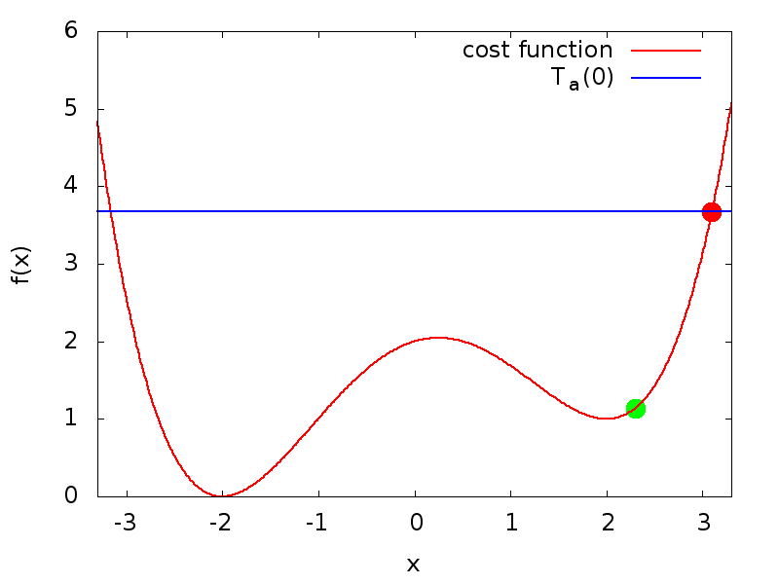
Optimization algorithm:
Adaptive simulated annealing
choose starting point, initial acceptance temperature T_{a}(0)
generate new point with generation temperature T_{g}
calculate cost function f
accept point if: $\frac{1}{1+exp⁡(\frac{∆f}{Ta})}$

Slide 21
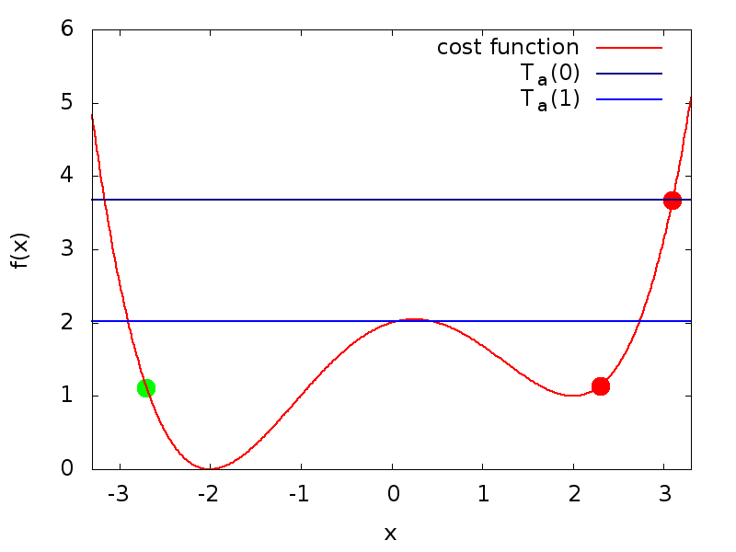
Optimization algorithm:
Adaptive simulated annealing
exponentially decrease T_{a}
exponentially decrease T_{g}
generate new point
calculate cost function f
accept point if: $\frac{1}{1+exp⁡(\frac{∆f}{Ta})}$
repeat

Slide 22
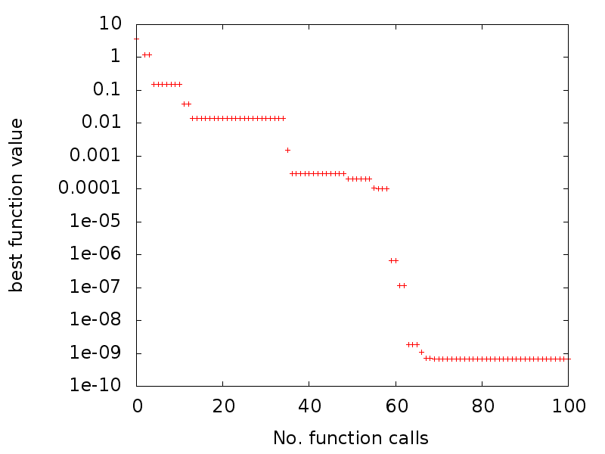
Optimization algorithm - Test
Exponential convergence
Convergence speed depends on parameters of cooling of T_{a} and T_{g}, only slightly on starting point
Cooling parameter tuning
necessary, but difficult

Slide 23
Conclusion
DSMC is viable method to model atomic beam sources
Measured beam parameters could be reproduced with DSMC
New implementations:
Actual task: Modelling of PAX-ABS
Future: Design of a new source with high intensity
Spin
Magnetic fields
Recombination
Spin exchange
High frequency transitions
Collision ages
Optimization algorithm

