Slide 1





Upgrade of the PAX H/D polarized internal target
Ciullo G.
University and INFN of Ferrara - Italy
on behalf of the
collaboration
PSPT 2013
Charlottesville, 2013 September 7-13
1

Slide 2

Outline
HOW TO POLARIZE p_{bar}?
Achievements and
present status
Upgrading in program and
future plans
2

Slide 3
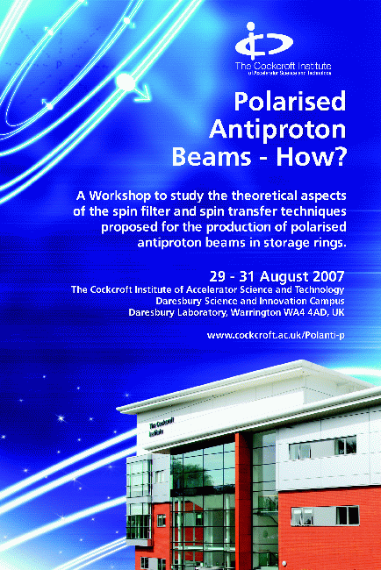
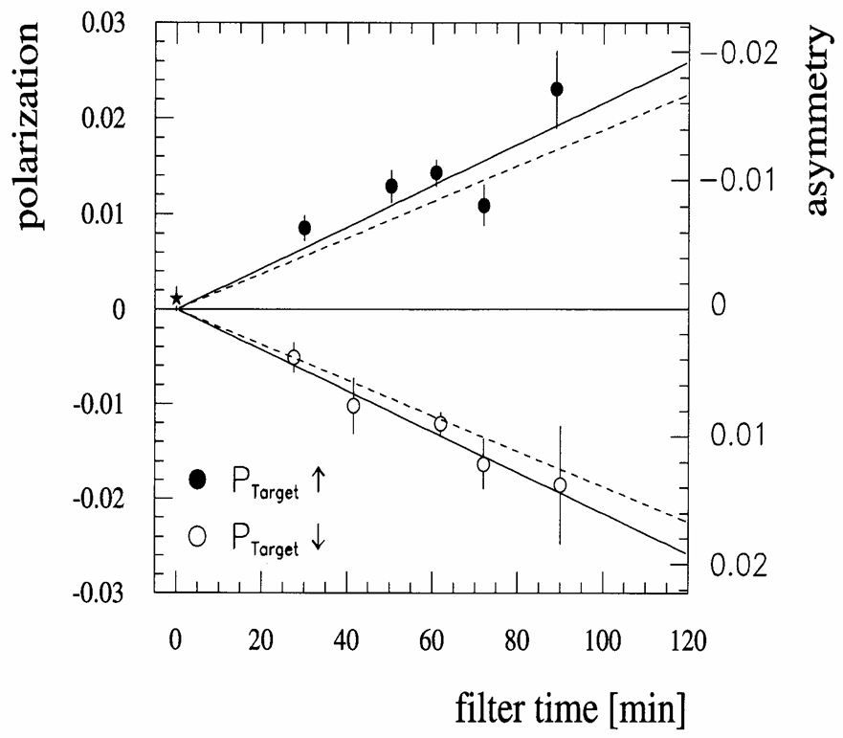
p_{bar↑} enormous physics potential: how to?
Triggered by the storing of antiproton (CERN) 1980
Triggered by PAX for FAIR (2004)
1985 Workshop at Bodega – Bay (CA, USA)
Polarized p_{bar} from decay of anti-Λ.
Spin Filtering
Stochastic tecniques
DNP in flight
Spontaneous Spin flip
Spin flip induced by X-ray
Polarization by scattering
Stern-Gerlach deflection
From anti-H and ABS
In penning Trap
By Channeling
Interaction with X-ray pol from a diamond crystal.
2007 Workshop at Daresb5ury (U.K)
F. Rathmann. et al.,
PRL 71, 1379 (1993)
And on 2008 Bad Honnef
FILTEX @ TSR
Pursuable technique spin-filtering (experimental evidence 1992)
3

Slide 4
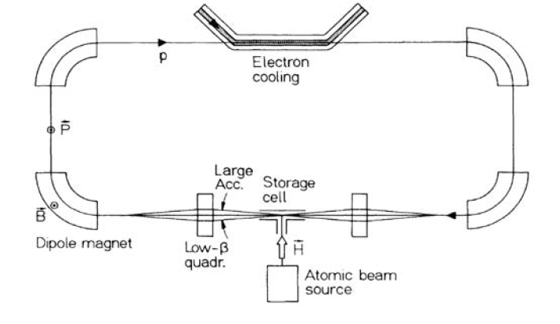
Spin-filtering: a pictorial view
gaseous
polarized target
An un-polarized beam by multiple passage through a polarized target, due to different cross-section for parallel (↑ ↑) and antiparallel (↓↑) spin alignment, becomes polarized, while the intensity decreases.
4

Slide 5
Polarized beams by spin-filtering
Interaction between a polarized beam (P) spin ½ and a polarized target (Q) spin ½
k is the beam direction.
Transverse case
Longitudinal case
+ for (↑ ↑) beam and target spins parallel
- for (↑ ↓) beam and target spins anti-parallel
Intensity of spin-up and spin-down decreases with different time constant.
5

Slide 6
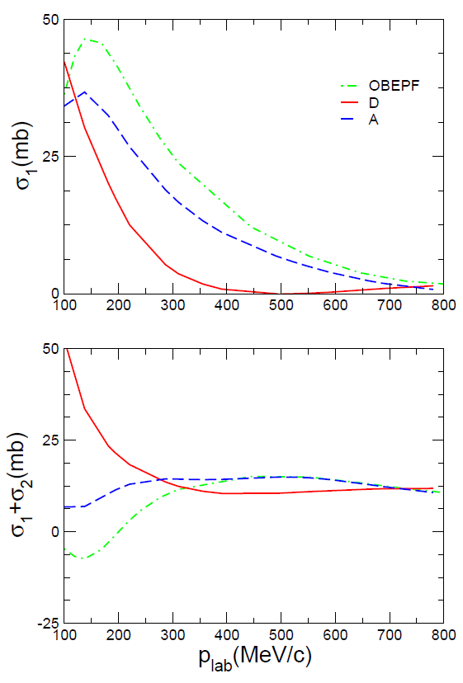
Theoretical prediction of σ₁ & σ₂ for p_{bar}
Measurement of the polarization buildup equivalent to the determination of σ₁ and σ₂
Once a polarized antiproton beam is available, spin-correlation data can be measured at AD (50-500 MeV)
Model A: T. Hippchen et al., Phys. Rev. C 44, 1323 (1991).
Model OBEPF: J. Haidenbauer, K. Holinde, A.W. Thomas, Phys. Rev. C 45, 952 (1992).
Model D: V. Mull, K. Holinde, Phys. Rev. C 51, 2360 (1995).
Measurement of the Spin–Dependence of
the p_{bar}- p Interaction at the AD–Ring
submitted to SPS committee at CERN
arXiv:0904.2325v1 [nucl-ex] 15 Apr 2009
Clarify FILTEX results and verify the feasibility on a proton beams.
6

Slide 7
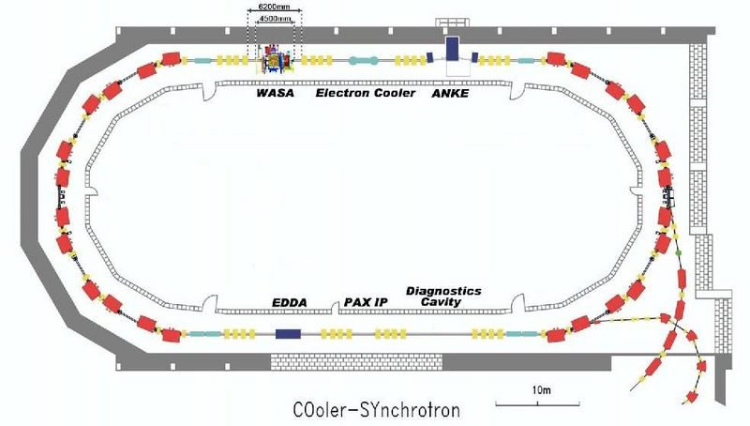
COSY set up for transverse spin filtering on p
D₂ cluster target &
beam polarimeter
Spin flipper RF solenoid
H┴
p beam
7

Slide 8
Requirements for spin-filtering
COSY ring requirements
  long beam lifetime of the beam
  long P lifetime of the beam
  precise measurement of acceptance in the IP
  stable condition of the beam and monitoring.
PAX IP
  FOM of the Target = Q² d_{t}, stable condition,
  Low holding field, unperturbed stored beam optics.
  pump down of feeded gas from the cell and the near ring pipes
Beam Polarimeter
  Measurements of beam polarization (P), by L-R asymmetries.
Spin Flippers
  In order to reduce systematic errors in P measurements.
8

Slide 9
Outline
HOW TO POLARIZE p_{bar}?
Achievements and
present status
Upgrading in program and
future plans
9

Slide 10
COSY upgraded for spin-filtering (┴ )
Beam lifetime of stored beam increased by:
  NEG in the Target chamber just below the Cell.
  Neighbouring NEG coated ring pipes.
  Low β-section at IP τ_{beam} > 8 000 s (from 300 s).
Beam Polarization lifetime
  No depolarizing effects are present (near tunes), polarization loss in a τ_{P} = 2.0 10⁵ s (infinite vs τ_{beam})
10

Slide 11
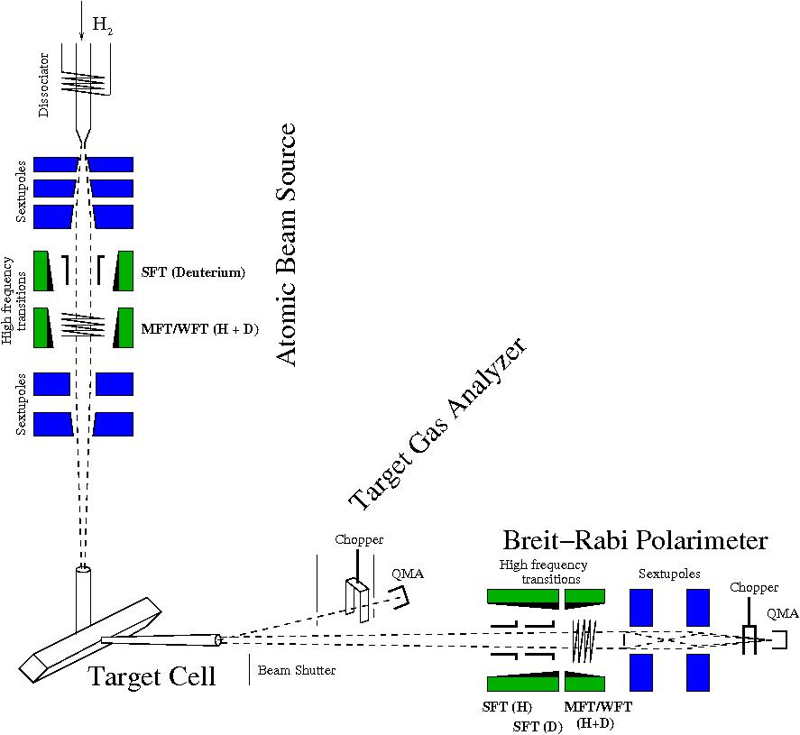
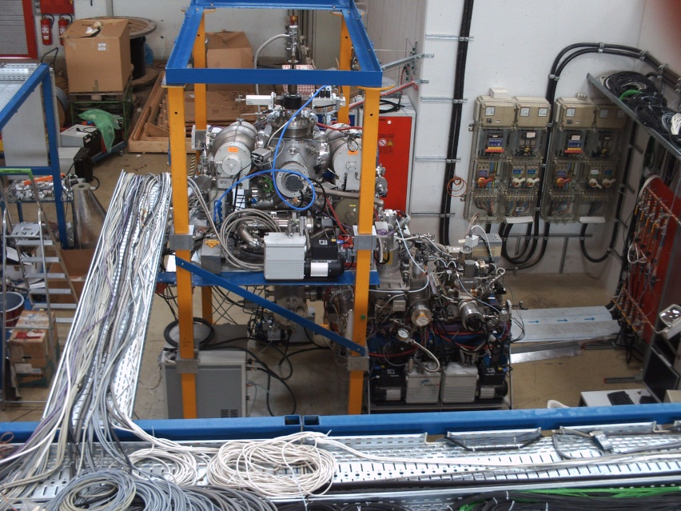
PAX target (the filter)
The polarized target: 1 state injection - low Holding field
Production of a polarized atomic beam by an ABS
Increase of the target areal density by a storage cell
Analysis of Gas Target (TGA) and Polarization (BRP)
MFT for H
SFT for H
MFT for H
11

Slide 12
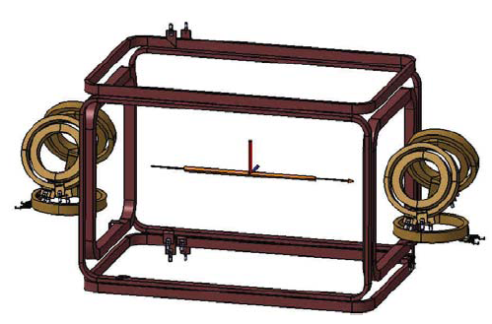
PAX target holding fields (10 G)
Spin filtering
in transverse case,
quantization axis, defined
by the top and bottom
Holding field coils.
HF + (Holding Field pos y )
and
HF – (Holding Field neg y ).
The intensity of the field is 10 G.
Y-axis
Almost perfect compensation coils during the powering of the holding field coils:
no transverse displacement of the beam position could be detected by BPM.
12

Slide 13
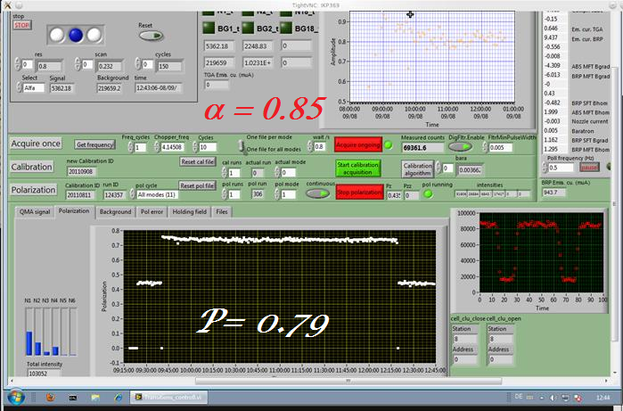
Performance of the target
13

Slide 14
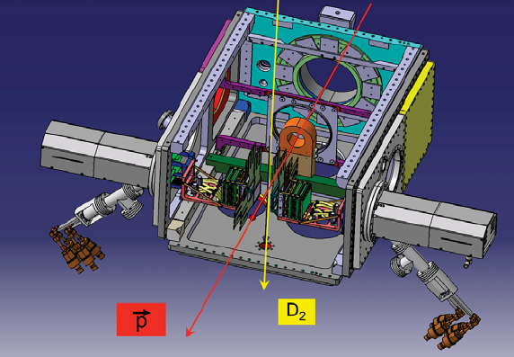
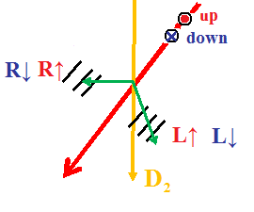
beam polarization measurements
Number of recorded counts (Yeld)
With Beam polarization (spin flippers) pointing up and down we have four Yield :
Defining the ratio:
Cross-ratio method
A_{y} known at 49.3 MeV
14

Slide 15
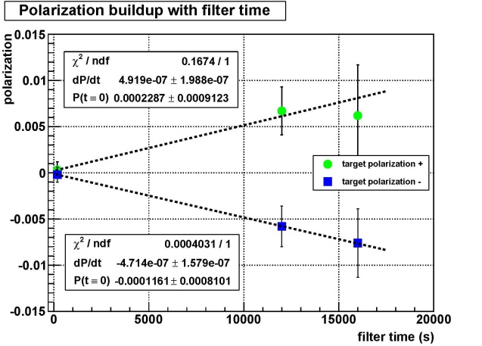
Measured polarization build-up
Beam polarization obtained
From spin-filtering cycles
Of different length and for the two
target spin orientation.
The HF+ (Holding field in up
Direction) induces e positive
polarization build-up in the stored
beam and viceversa (due to the
negative value of effective spin
dipendent cross section.
The linear fit allow to provide for
The build-up:
W. Augustyniak et al. PLB 718 (2012) 64
15

Slide 16
Target Polarization
Q = 0.73 + 0.05
Target areal density:
d_{t} = (5.5 + 0.2) · 10¹³ atoms cm⁻²
Revolution frequency:
f = 510 032 Hz
Acceptance at the IP :
Θ_{acc}= 6.15 + 0.17 mrad
Measured effective spin dependent cross section from P:
16

Slide 17
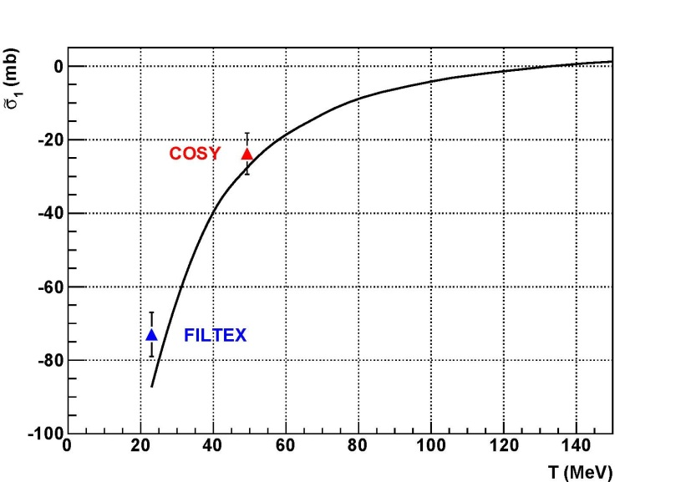
Spin filtering on p well understood
▲
Good agreement confirms that spin-filtering is well described,
contribution from p-p scattering (SAID and Nijmegen databases).
17

Slide 18
Outline
HOW TO POLARIZE p_{bar}?
Achivements and
present status
Upgrading in program and
future plans
18

Slide 19
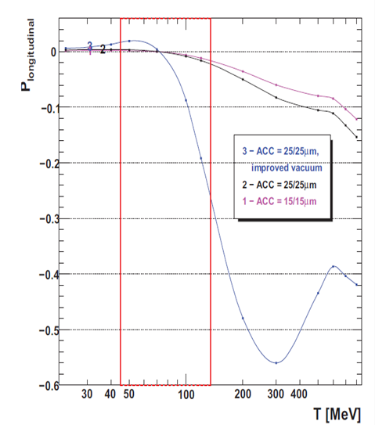
Prediction for longitudinal polarization
Improved vacuum
ecooler
window
19

Slide 20
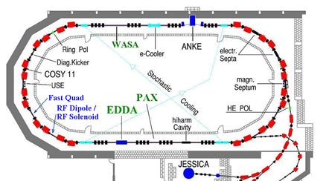
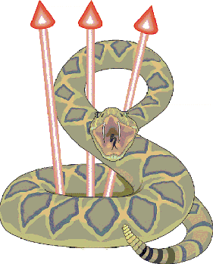
COSY for longitudinal spin filtering
Filter and polarimeter
p beam
H_{II}
20

Slide 21
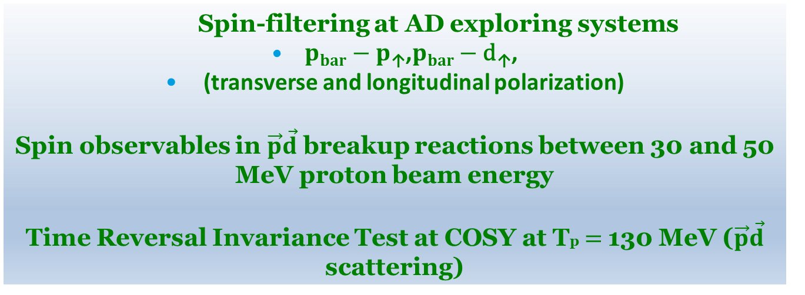
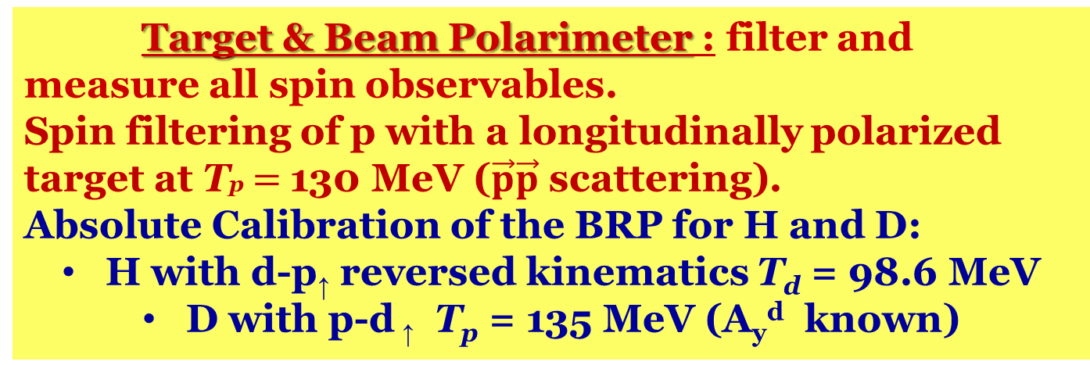
A detector for PAX at PAX IP
Target & Beam Polarimeter : filter and measure all spin observables.
Spin filtering of p with a longitudinally polarized target at Tp$=$130 MeV ($\vec{p}\vec{p}$ scattering).
Absolute Calibration of the BRP for H and D:
H with d-p↑ reversed kinematics T_{d} = 98.6 MeV
D with p-d ↑ T_{p} = 135 MeV (A_{y}^{d} known)
Spin-filtering
Spin-filtering at AD exploring systems
    $pbar−p\text{↑}$,$pbar−\text{d}\text{↑}$,
    (transverse and longitudinal polarization)
Spin observables in $\vec{p}\vec{d}$ breakup reactions between 30 and 50 MeV proton beam energy
Time Reversal Invariance Test at COSY at Tp$=$130 MeV ($\vec{p}\vec{d}$ scattering)
Extension
21

Slide 22
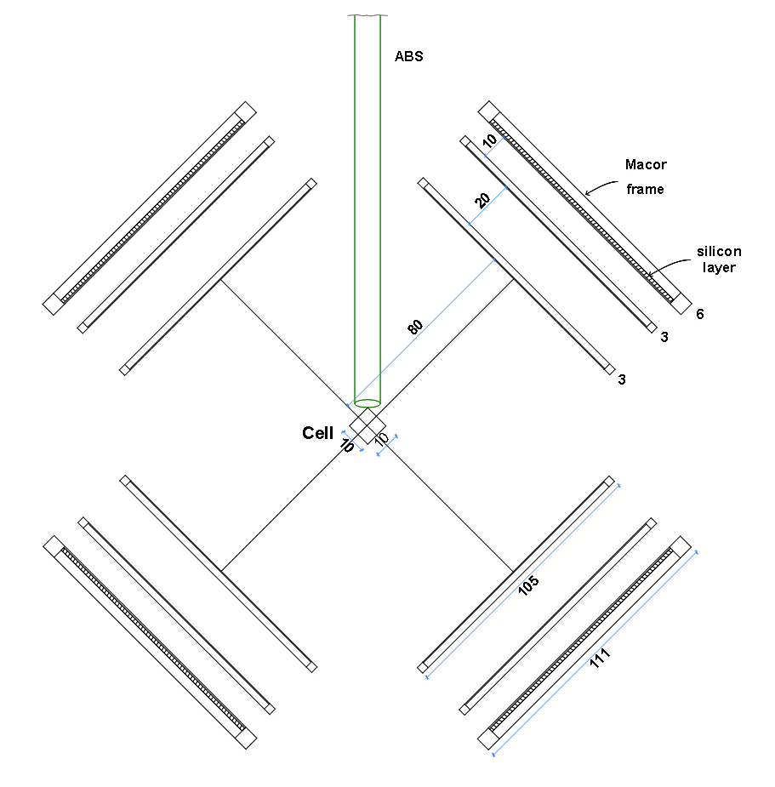
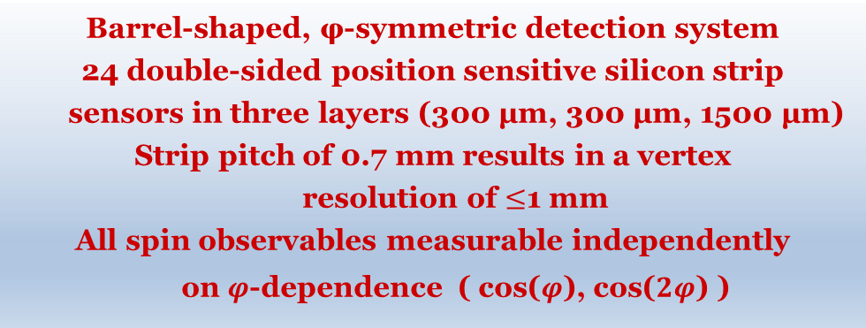
PAX IP: filter and/or polarimeter
Simulations in order to
Optimize the system for spin filtering with antiprotons (acceptance, ...)
Versatility: - feasability of further experiments (pd breakup, TRIC …)
- measurement of all spin observables
Usage of existing equipment (HERMES detectors, readout electronics)
Result
Barrel-shaped, φ-symmetric detection system
24 double-sided position sensitive silicon strip
sensors in three layers (300 μm, 300 μm, 1500 μm)
Strip pitch of 0.7 mm results in a vertex
resolution of $≤$1 mm
All spin observables measurable independently
on $φ$-dependence ( cos($φ$), cos($2φ$) )
22

Slide 23
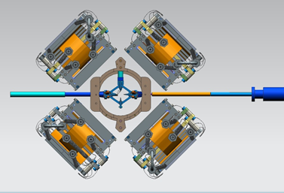
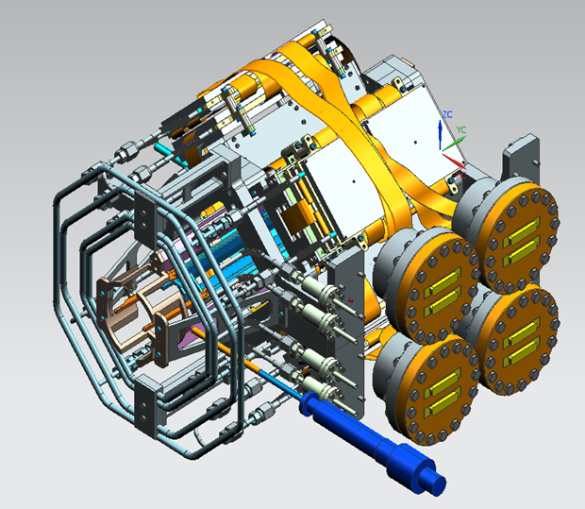
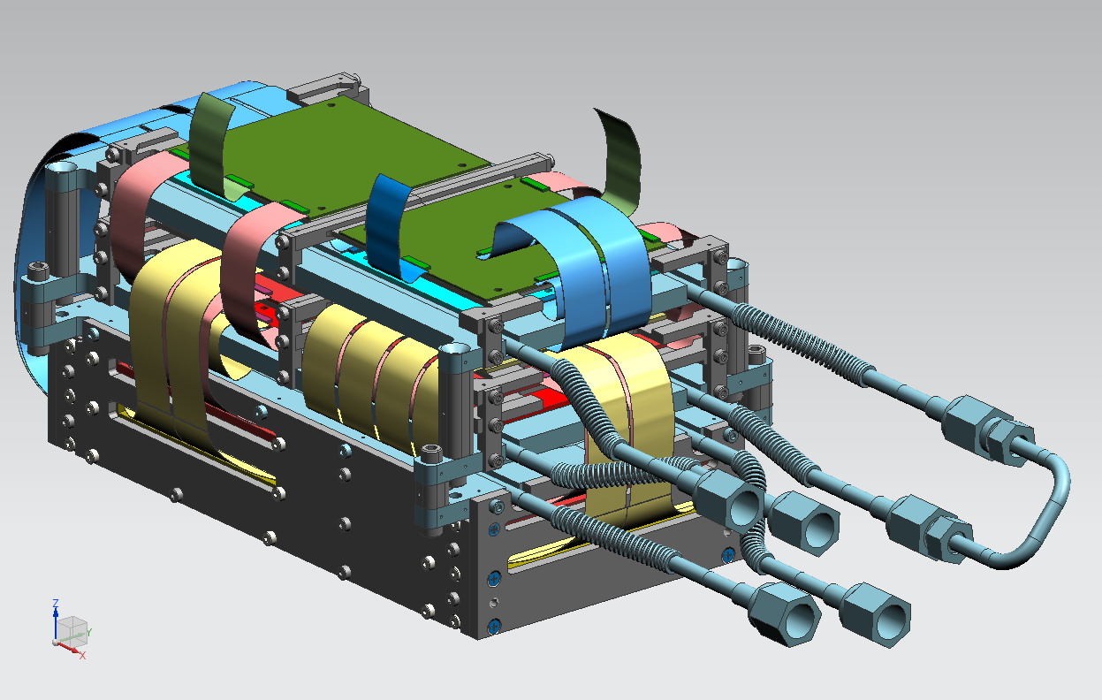
PAX detector designed: in development
23

Slide 24
pABS source and target chamber
The polarized target has to work with H and D:
RF MFT for H is fine also for D HFT
RF SFT for D in the ABS
Air cooled MW diss. installed, skimmer movable.
SFT for D
MFT for H
Intensity
H: 6.7 x 10¹⁶ H/s
D: 5.5 x 10¹⁶ D/s
G. Ciullo
24
24

Slide 25
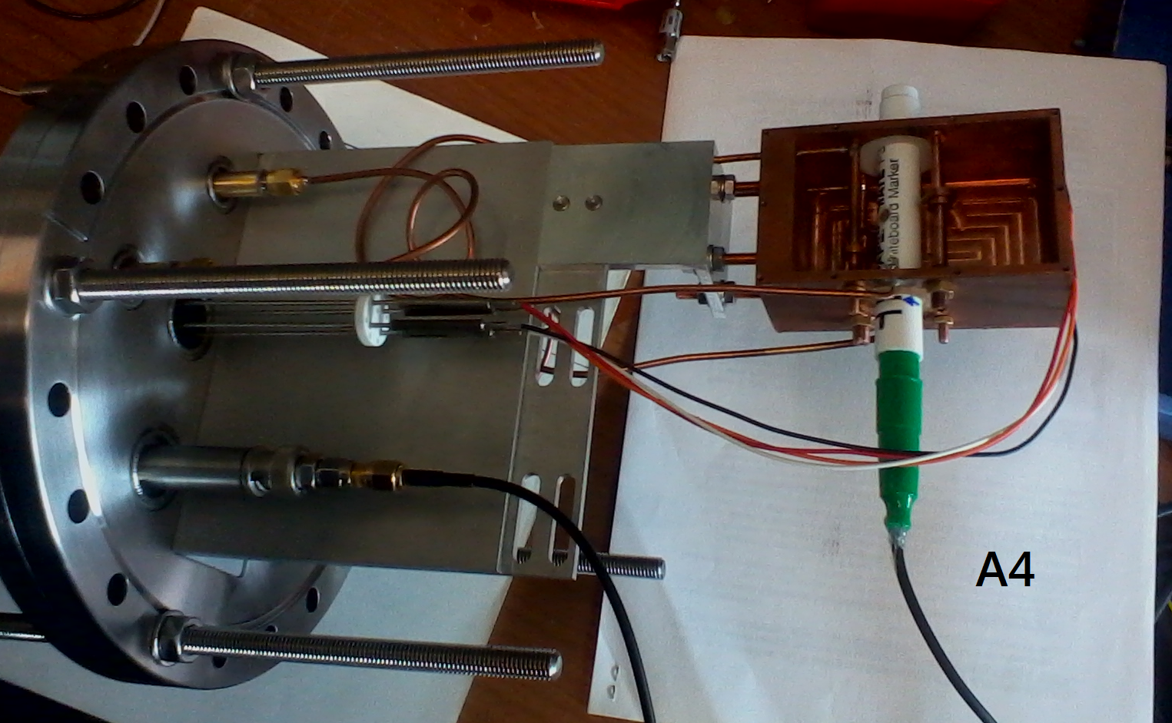
BRP for H/D target
Also the Breit-Rabi polarimeter for H and D:
RF MFT for H fine for D HFT
New dual H/D cavity for BRP
SFT D
MFT H/D
SFT H/D
MFT H/D
G. Ciullo
25
25

Slide 26
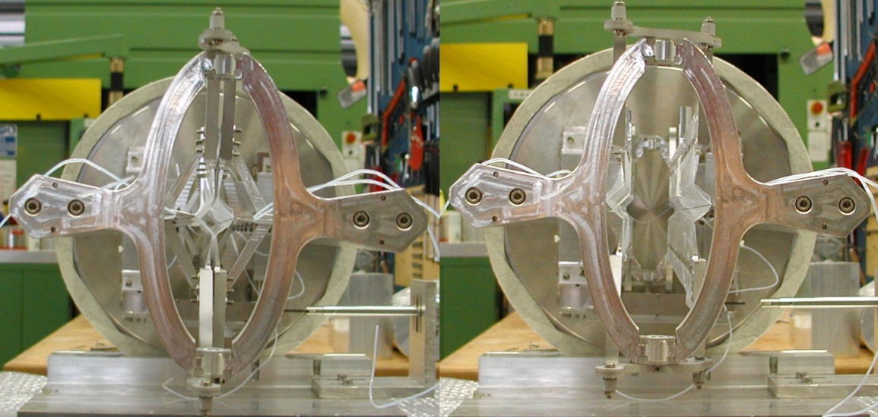
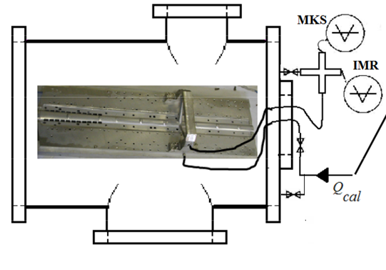
The openable Cell?
High injection at COSY
Constrain for AD
First prototype worked nicely in in the Target commissioning, on COSY
target suffers much stresses.
Construction and test ex situ by He sniffer :
Leaks < 1%.
Absolute monitoring still under study,
BRP already provide a relative monitoring
26

Slide 27
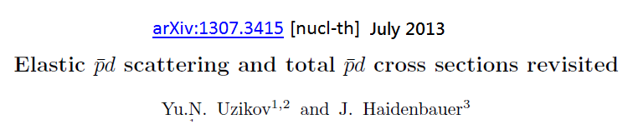
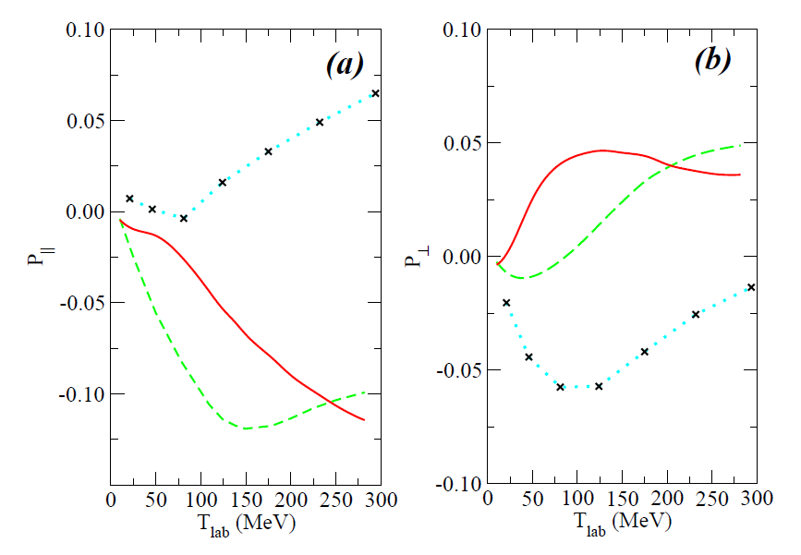
Upgrading include p_{bar} - d↑ spin filtering
Spin parts of the p-p_{bar} elastic and annihilation
σ not well known.
Sizeable difference between
models , Larger (30 %) with
old Nijmegen NN PWA
(S.G. Salnikov
Nucl.Phys.A 874 (2012)98
27

Slide 28
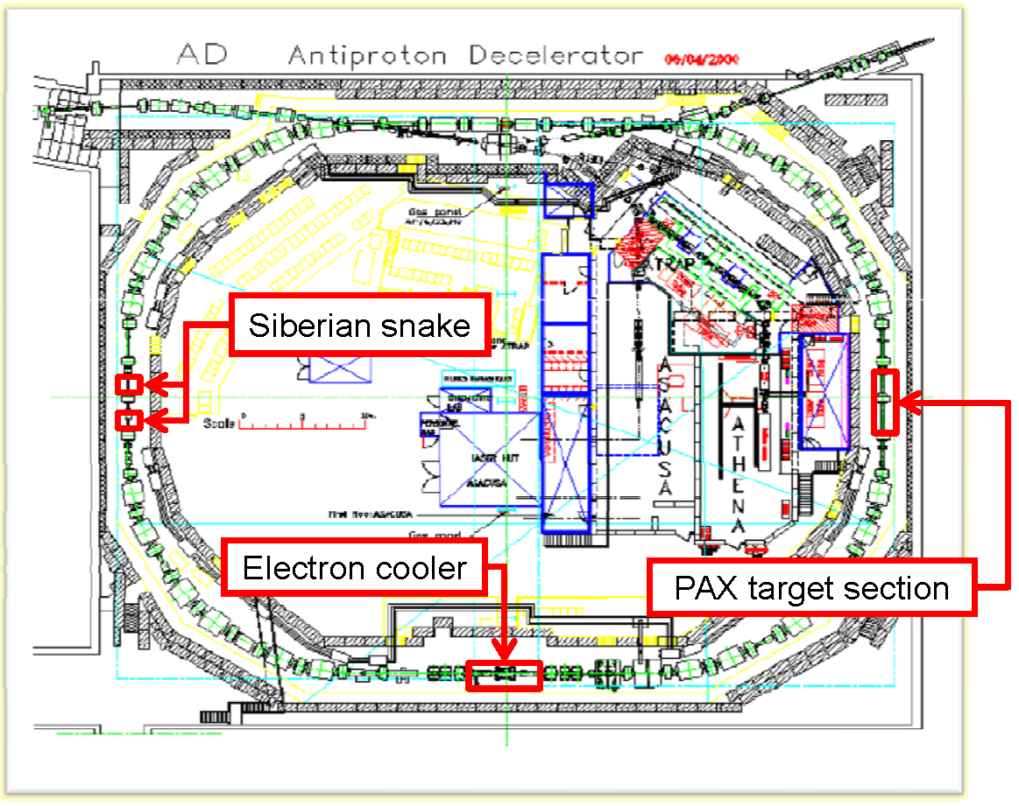
Commissioning of PAX ..toward AD
Moving the PAX
Interaction point with its detector
At AD
Will open this possibility
28

Slide 29
Conclusions
PAX IP and COSY ring are in a very sharp conditions for precise measurements.
  Spin filtering and spin-dependent cross section
  EDM – Lenisa Talk
  new proposal involve PAX training and experience (TRIC).
Results on p-p ↑ interaction are in good agreement with the theory and we hope to give a complete picture of spin dependent cross sections with the longitudinal measurements and with deuterium too for COSY.
Remind:
This result still doesn’t alleviate the lack on spin-dependent cross section on p_{bar} – p interactions.
There are theorethical previsions with consistent differences, which require data constrains.
29

Slide 30
SPARE TRANSPARENCIES
30

Slide 31
Physics motivations for p_{bar} polarized
New key to get clearest insight in structure of the nucleon
Direct measurement of the transversity distribution of the valence quarks in the proton,
test of the predicted opposite sign of the Sivers-function, related
to the quark distribution inside a transversely polarized nucleon in
Drell–Yan as compared to semi-inclusive deep-inelastic scattering,
measurement of the moduli and the relative phase of
the time-like electric and magnetic form factors G_{E,M} of the proton
PAX Collaboration:
Technical proposal for antiproton–proton scattering experiments with polarization, http://arxiv.org/abs/hep-ex/0505054,
an update can be found at the PAX website http://www.fz-juelich.de/ikp/pax
A tool to study p-p spin dependent σ, and p-d (the 3 body system)
A new window p_{bar} p and p_{bar} d polarized cross sections

Slide 32
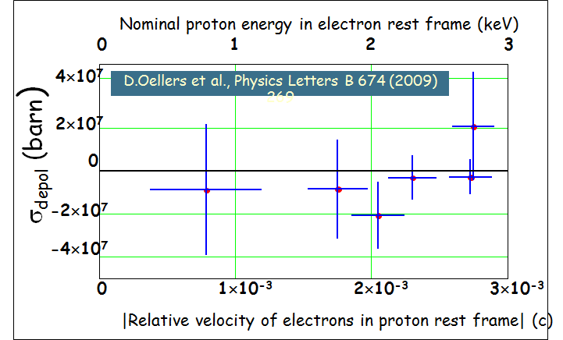
Spin filter against spin-flip
X
F. Rathmann. et al.,
PRL 71, 1379 (1993)

Slide 33
Polarization build-up
The polarization
along the quantization axis
build-up of beam polarization
Transverse case (respect to k)
Longitudinal case (respect to k)
where:
d_{t} is the areal density of the target [atoms cm⁻²]
f is the revolution frequency of the beam [Hz]
33

Slide 34
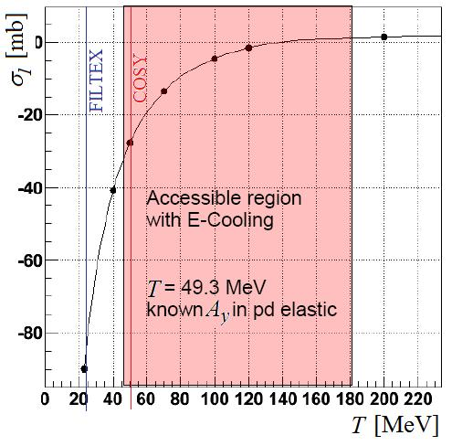
prediction for p at COSY
Analyzing power according to Bystricky
Prediction of spin dependent transverse cross section
at COSY ring (SAID & Nijegen databases).
34

Slide 35
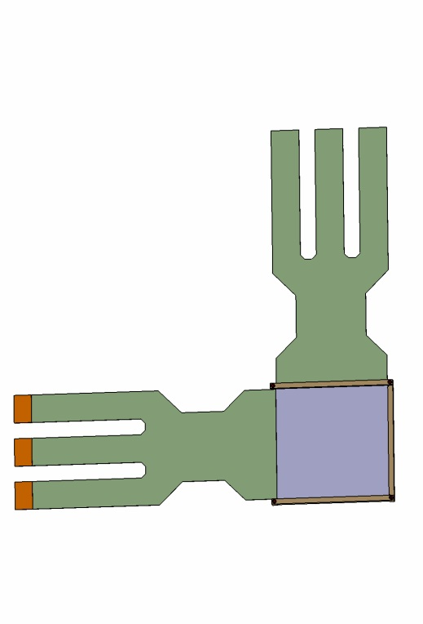
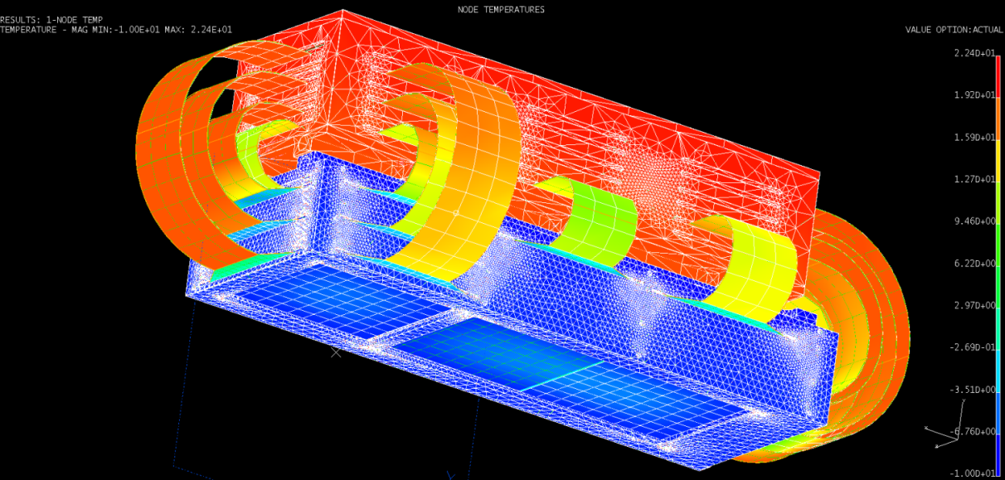
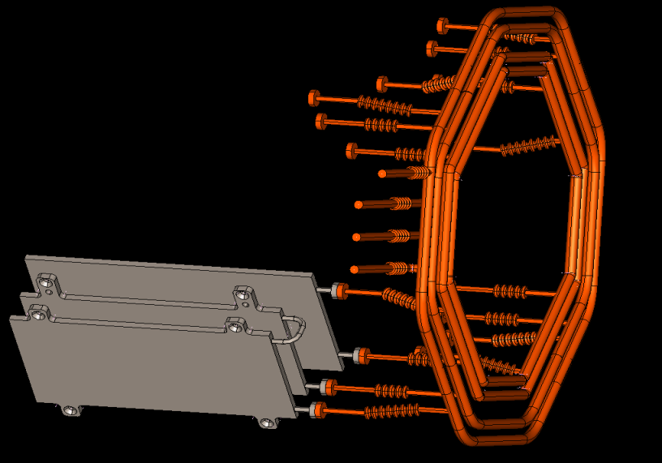
Done
Detector design is fixed
Detectors are ordered and test stations are prepared
Machining of the mechanical support and cooling system started and tested
Specification and ordering of chips
TO BE DONE
Finalizing the electronic readout design
Test (and modifcation) of the mechanical support and cooling system
Test of detectors, chips, and Kapton
Study of a thermoshielding
Available HERMES
detector
Designed PAX
detector
35

Slide 36
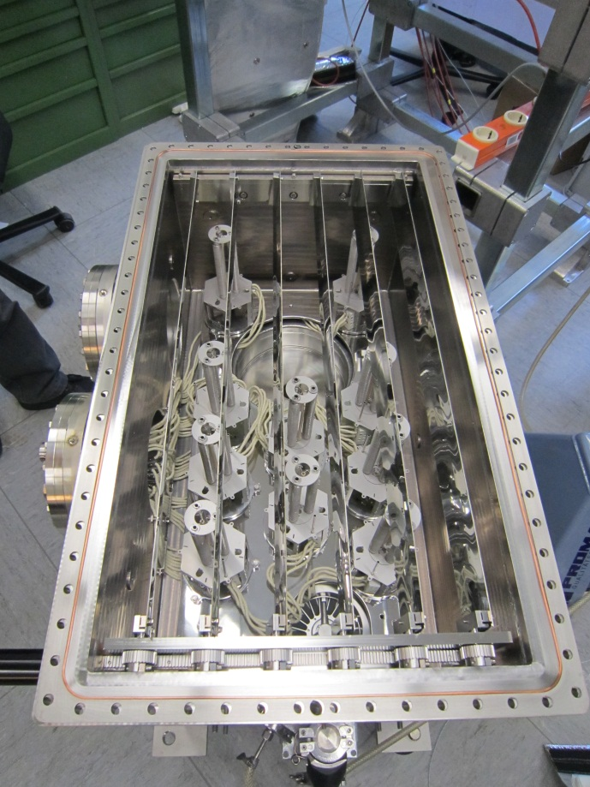
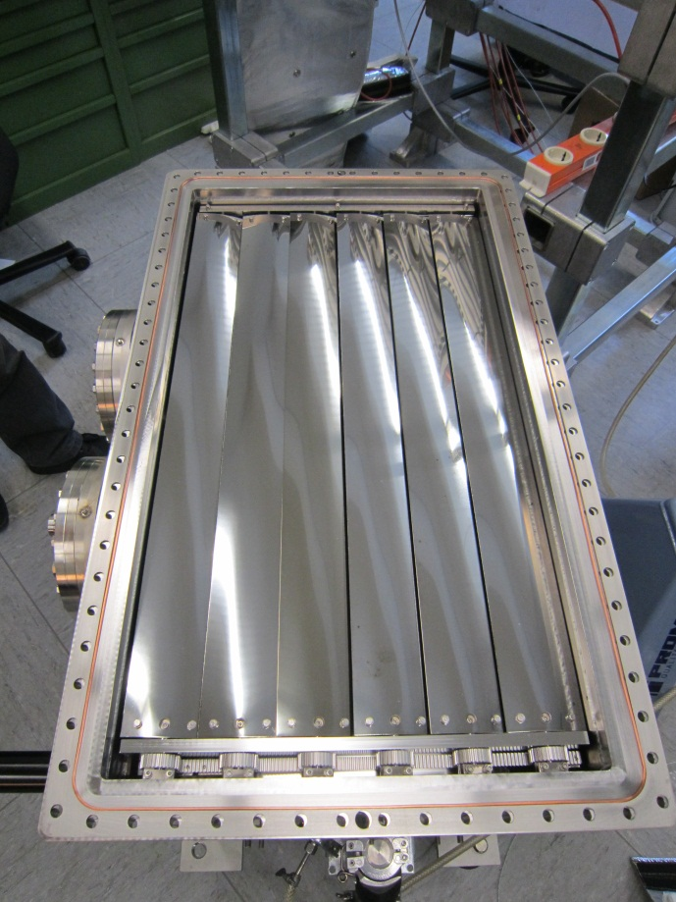
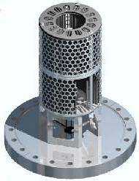
Vacuum improvement: longer τ_{b}
High pumping speed in the target chamber necessary to reduce the pressure of the unpolarized H₂ / D₂ gas in the target chamber and adjacent beam line sections.
Therefore allowing longer beam lifetimes of the COSY proton beam.
Commercially available NEG cartridges mounted into a bakeable stainless steel box
Box is closeable with a jalousie to protect the target cell and detector from the heat when NEG is activated (T=450 °C for 45‘)
Measured pumping speeds of
  12 000 l/s
36

Slide 37
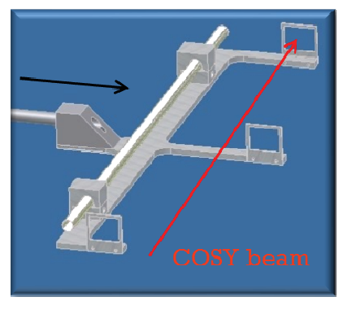
COSY: acceptance measurements
Movable frames installed in the interaction point allow a precise measurements of the acceptance angle Θ_{acc} (target position) fundamental for the determination of the P-build up.
Θ_{acc}= 6.15 + 0.17 mrad
Tube seen like the cell (l = 400 mm and d =10 mm) limits the
injection efficiency 70%, 1.0 10¹⁰ p stored (openable cell).
37

Slide 38
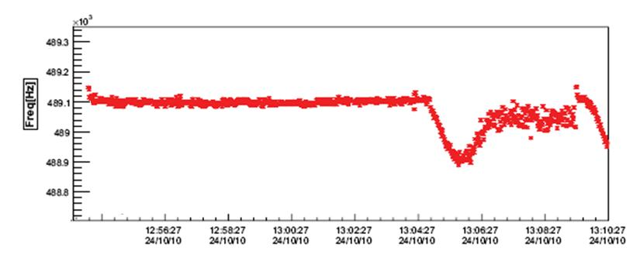
d_{t} measurement by beam loss in COSY
e-cooler ON compensates
energy loss
Small influence on f
OFF
Due to energy loss, e-cooler off,
is possible to measure d_{t} from the slop
of the revolution frequency Δf/Δt
Commissioning of the Openable cell on test bench was fine On COSY d_{t} =(2.52 + 0.09) 10¹³ atoms cm⁻²
expected (4.1 + 0.2) 10¹³ atoms cm⁻²
Installed a fixed Cell for spin-filtering measurements
38

Slide 39
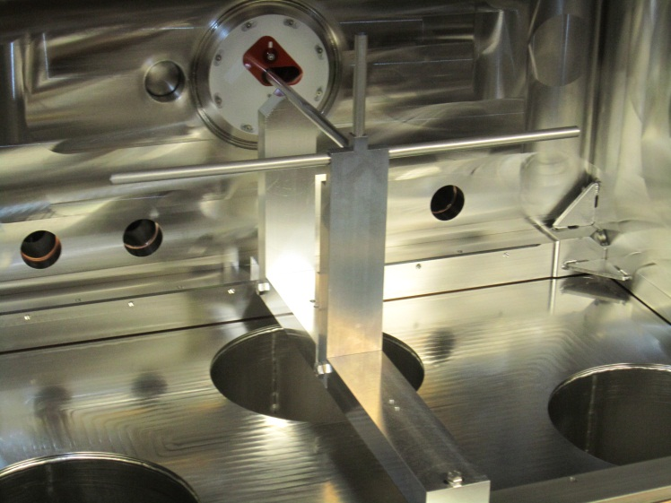
PIT– and apparatus
The (openable) storage cell
Storage cell increases target areal density up to 10¹⁴ atoms/cm²
Storage cell walls should suppress recombination and depolarization
Openable storage cell to allow the uncooled AD beam to pass and (*) for higher intensity at COSY
Teflon foil walls to detect low energy recoils and suppress recombination and depolarization
Fixed cell used in the COSY experiments due to problems with the density in the openable cell
39

Slide 40
Stored beams Polarimetry
Two Silicon Tracking Telescope (SST)
Simmetrically L-R respect to the
Deuterium cluster target at the
ANKE IP.
Each SST : three
position-sensitive detectors,
along the beam direction.
Distance from the beam axis
1st layer of 65 μm at 28 mm,
2nd layer of 300 μm at 48 mm,
3rd layer of 5 mm at 61 mm,
active area of 51 x 61 mm².
Telescope position chosen optimizing the FOM of p-d analyzing power reaction.
Determination of L-R asymmetry in p-d elastic scattering and known Analyzing power
allow us to extract the polarization of the beam.
Particle identification is performed with the ΔE/E technique.
40

Slide 41
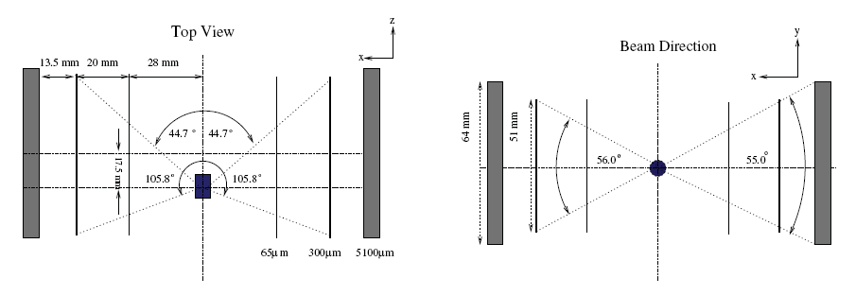
Storage beam Polarimetry
Determination of L-R asymmetry in p-d elastic scattering and known Analyzing power
Allow to extract the polarization of the beam.
Particle identification is performed with the ΔE/E technique.
41

Slide 42
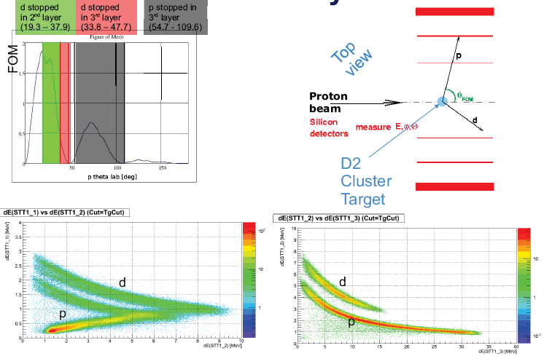
Beam Polarimetry
42

Slide 43
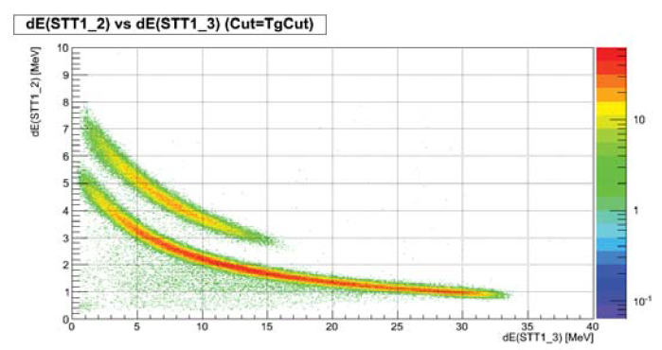
Beam Polarimetry
Task: reconstruction of p d elastic events with low background. Data taken below
the pion production threshold, an identified d ensures that elastic scattering took place.
Energy deposited in the 2 layer vs energy deposited in 3 layer. The top band clear allow
the identification of elastic deuteron.
43

Slide 44
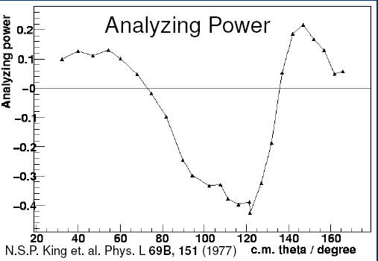
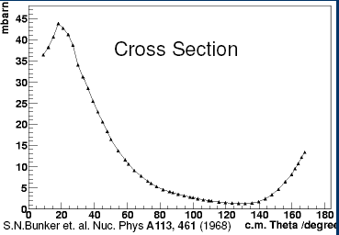
Polarization by the known …
Beam Polarization measured by
p - d elastic scattering.
Precise analyzing Power available at
T_{p}= 49.3 MeV.
Cross section nearby T_{p}= 46.3 MeV.
For transversely polarized p on
unpolarized d
44

Slide 45
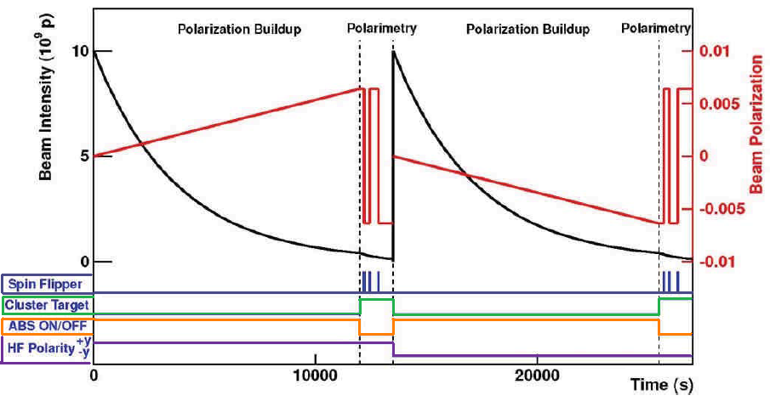
Spin Filtering cycles at COSY
Unpolarized p
Injected at
48 MeV and
Accelerated
To 49.3 MeV
Cluster Target
ABS ON
Holding Field up
ON
OFF
Cluster Target
ABS ON
Holding Field down
ON
OFF
45

Slide 46
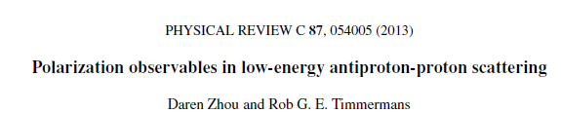
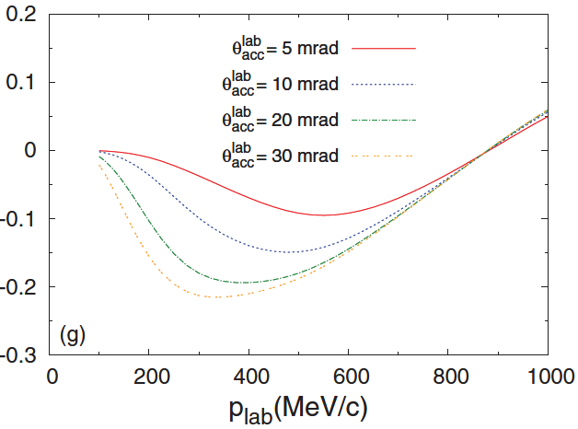
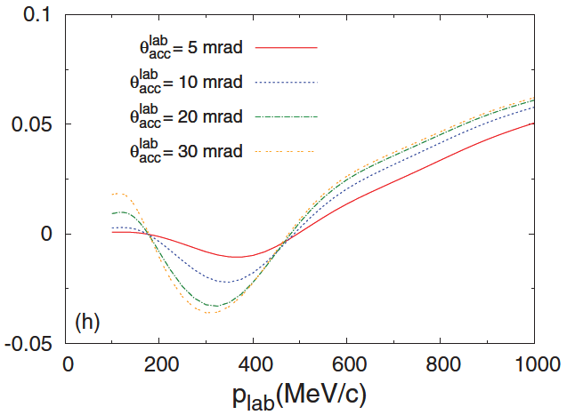
Recent p_{bar} -p↑ interactions (spin-filtering)
P┴
P┴
P||
P||
Based on p_{bar} p ↑ data and matched to the PAX results and COSY parametes.
46

Slide 47
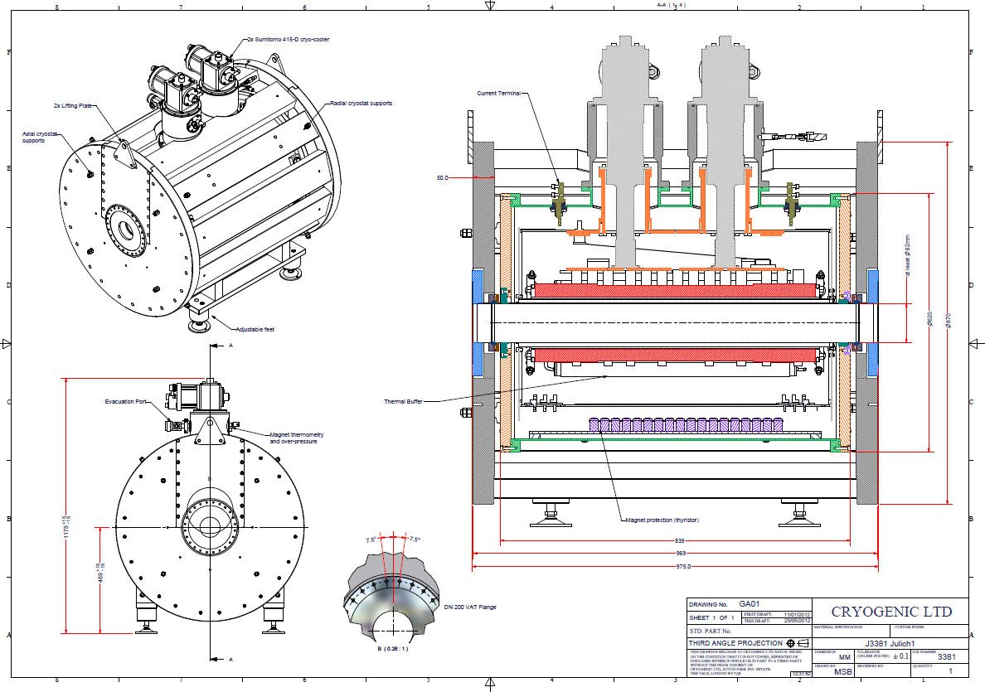
Snake for COSY at ANKE (for || pol )
Superconducting 4.7 Tm solenoid ordered.
Overall length: 1 m
Ramping time 30 s
Spin dynamics and longitudinal polarized beams for experiments
Installation at COSY
postponed > 12/2013
47

Slide 48



Cell Performance test bench
In the test bench no evidence of problem in closing the
cell, degradation after problem in installation in COSY and
after thermal stress test for NEG regeneration in the chamber.
48

Slide 49
COSY longitudinal (commissioning)
p beam
H_{II}
49

Slide 50
Implemeting a test of the cell closing
Measuring (monitoring)
the conductante of
Cell by calibrated flow injected inside it vs pressure in the center.
For N₂:
C_{cal} [l/s] | C_{meas} (MKS) [l/s] | C_{meas} (IMR) [l/s]
3.83 + 0.2 | 3.26 + 0.04 | 3.71 + 0.05
Modified conductance of the cell in order of 10 % to test sensitivity to the closing of cell.
ΔC/C | δ(ΔC/C) | ΔC/C | δ(ΔC/C) | ΔC/C | δ(ΔC/C)
Calculated |  | Baratron Meas. |  | IMR Meas
9.7 % | 0.5 % | 6.0 % | 0.5 % | 10.3 % | 0.5 %
The idea, to measure the pressure in the center of the cell, could work for the design of the openable cell, and its monitoring during running.
50

Slide 51


Measured Target Polarization (Q)
51

Slide 52

Optics and vacuum constrains
Polarization Build-up time,
Stored beam FOM is =P²I (black line).
Spin-filtering @ COSY expected small:
20 000 s to get 1 % of polarization
at 49.3 MeV.
Due to the loose of intensity,
the influence of the ring itself to the lifetime has to be reduced.
52

Slide 53

Details of one sector
DISTRIBUTOR BOARDS
READ-OUT LAYER 1
READ-OUT LAYER 2
SENSORS LAYER 3 : PAX
SENSORS LAYER 2 : PAX
SENSORS LAYER 1 : HERMES
READ-OUT LAYER 3
53

Slide 54

→ longitudinal case: Siberian Snake
Siberian
Snake
Ions: (pol. & unpol.) p and d
Momentum: 300/600 to 3700 MeV/c for p/d, respectively
Circumference of the ring: 184 m
Electron Cooling up to 550 MeV/c
Stochastic Cooling above 1.5 GeV/c
2MV
Electron
Cooler
→ Major Upgrades
54

Slide 55

D option may include TRIC
55

